Slide 1


Slide 2
Models
Input and Output

Slide 3


LangChain
Models Inputs and Outputs
In this section we’ll begin our journey of learning LangChain by understanding how to create basic input prompt requests for models and how to manage their outputs.
At its core Langchain needs to be able to send text to LLMs and also receive and work with their outputs. This section of the course focuses on the basic functionalities and syntax of doing this with Langchain.

Slide 4
LangChain
Models Inputs and Outputs
Using Langchain for Model IO will later allow us to build chains, but also give us more flexibility in switching LLM providers in the future, since the syntax is standardized across LLMs and only the parameters or arguments provided change.
Langchain supports all major LLMs (OpenAI, Azure, Anthropic, Google Cloud, etc.)

Slide 5
LangChain
Models IO Section Overview
LLMs
Prompt Templates
Prompts and Model Exercise
Prompts and Model Exercise - Solution
Few Shot Prompt Templates
Parsing Outputs
Serialization - Saving and Loading Prompts
Models IO Exercise Project
Models IO Exercise Project - Solution

Slide 6
LangChain
Models Inputs and Outputs
You should note that just Model IO is not the main value proposition of Langchain and during the start of this section you may find yourself wondering the use cases for using Langchain for Model IO rather than the original API.
If you do find yourself skeptical, hang on until we reach the “parsing output” examples, and then you’ll begin to see hints of utility.

Slide 7
LangChain
Models Inputs and Outputs
Once we combine the ideas we learn about here with Data Connection and Chains, you’ll have a very clear idea of why a developer may choose to use Langchain rather than building our their own solution.
It will save us a lot of time and give us greater flexibility, but first we need to understand the basics of interacting with Models for input and output with Langchain!

Slide 8
Let’s get started!

Slide 9
LLMs

Slide 10
LangChain
Large Language Models
There are two main types of APIs in Langchain:
LLM
Text Completion Model: Returns the most likely text to continue
Chat
Converses with back and forth messages, can also have a “system” prompt.

Slide 11
LangChain
Large Language Models
LangChain supports many different services:
https://python.langchain.com/docs/modules/model_io/models/llms/
In this course, we will focus on the OpenAI API, since it is the most popular, and due to upcoming changes post GPT-4 wide release, we will also focus on the Chat Completion API.
Note that later when we learn about chains the API calls will look very similar.

Slide 12
LangChain
Large Language Models
Make sure you’ve created an OpenAI API before continuing, or if you’ve decided to use a different model or service, check out the API connection calls in the documentation previously linked (we will also explore this in the lecture).
Let’s get started with some basic LLM calls using LangChain!

Slide 13
LLMs
Chat Models

Slide 14
LangChain
Chat Models
Chat Models have a series of messages, just like a chat text thread, except one side of the conversation is an AI LLM.
Langchain creates 3 schema objects for this:
SystemMessage
General system tone or personality
HumanMessage
Human request or reply
AIMessage: AI’s reply (more on this later!)

Slide 15
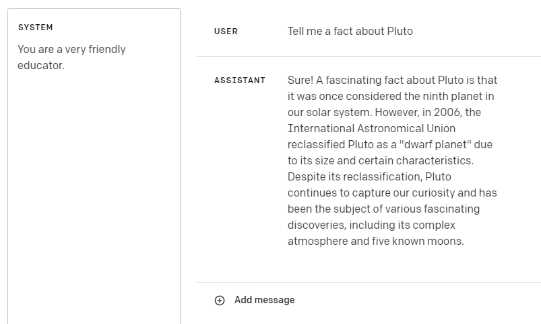
LangChain
Chat Models

Slide 16
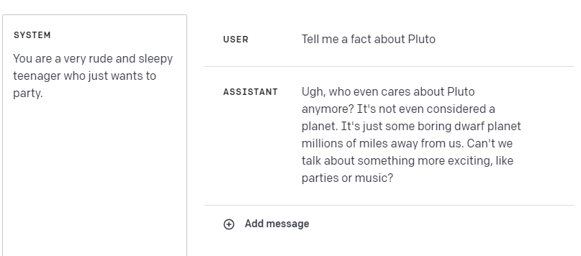
LangChain
Chat Models

Slide 17
LangChain
Chat Models
In this lecture we’ll explore how to expand LLM integrations to chat models with Langchain and how to pass in extra parameters or arguments (for example increasing temperature).
We will also see a great caching feature to save replies in memory for common requests!

Slide 18
Prompt Templates

Slide 19
LangChain
Prompt Templates
Templates allow us to easily configure and modify our input prompts to LLM calls.
Templates offer a more systematic approach to passing in variables to prompts for models, instead of using f-string literals or .format() calls, the PromptTemplate converts these into function parameter names that we can pass in.

Slide 20
LangChain
Prompt Templates
Let’s explore how to build prompt templates for both LLM Text Completion and prompt templates for Chat Models.

Slide 21
Prompts and Models
Exercise

Slide 22
LangChain
Even with just the basics of Model IO and PromptTemplates, you can start to create interesting applications.
Let’s test your understanding of the Langchain syntax with an exercise.
NOTE:
Still feeling a bit too new with Langchain syntax? No worries! Skip to the next lecture and treat the exercise as a code-along example app project.

Slide 23
LangChain
The exercise notebook is:
00-Models-IO
02-Prompts-and-Model-Exercise.ipynb

Slide 24
Prompts and Models
Exercise Solution

Slide 25
Few Shot
Prompt Template

Slide 26
LangChain
Few Shot Prompt Templates
Sometimes it’s easier to give the LLM a few examples of input/output pairs before sending your main request.
This allows the LLM to “learn” the pattern you are looking for and may lead to better results.
It should be noted that there is currently no consensus on best practices, but LangChain recommends building a history of Human and AI message inputs.

Slide 27
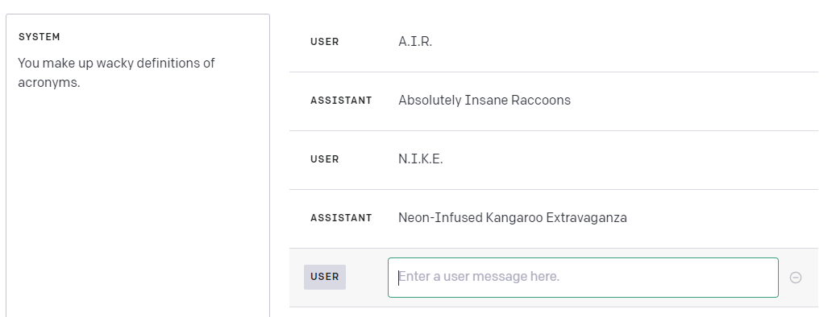
LangChain
Few Shot Prompt Templates
We use the chat history to create example input/output pairs to help the model understand formatting.

Slide 28
Parsing Outputs
Part One

Slide 29
LangChain
Parsing Outputs
Often when connecting LLM output you need it in a particular format, for example, you want a python datetime object, or a JSON object.
LangChain comes with Parse utilities allowing you to easily convert outputs into precise data types or even your own custom class instances with Pydantic.

Slide 30
LangChain
Parsers
Consist of two key elements:
format_instructions
An extra string that Langchain adds to the end of a prompt to assist with formatting.
parse() method:
A method for using eval() internally to parse the string reply to the exact Python object you need.

Slide 31
LangChain
Parsers Example
You need a datetime response from an LLM.
Two Main Issues:
LLM always replies back with a string:
“2020-01-01”
Could be formatted in many ways:
“Jan 1st, 2020”
Parsers use format_instructions to take care of the first issue and eval() to take care of the second issue.

Slide 32
LangChain
Parsers Example
You need a datetime response from an LLM.
Using DatetimeOutputParser:
Replies are actual datetime objects after using parse()
You can also use AutoFix with OutputFixParser to re-attempt the correct parsed output with another LLM call!

Slide 33
LangChain
Let’s explore parsers further!

Slide 34
Parsing Outputs
Part Two

Slide 35
LangChain
We’ve seen the basics on how to use parsers, but what happens when that still isn’t enough to format your output?
There are two ways to solve this:
System Prompt
Have a strong system prompt to combine with your format instructions.
OutputFixingParser
Using a chain, re-send your original reply to an LLM to try to fix it!

Slide 36
LangChain
Important Note:
We are going to try our best to deliberately induce an error in an output.
Models are actually quite good at following instructions, which means you may find yourself not being able to reproduce the error in the future, keep this in mind if you are trying to code along with us, you may get the correct output at the start!

Slide 37
Parsing Outputs
Part Three

Slide 38
LangChain
Using the Pydantic library for type validation, you use Langchain’s PydanticOutputParser to directly attempt to convert LLM replies to your own custom Python objects (as long as you built them with Pydantic).
Note, this requires you to have some Pydantic knowledge and pip install the pydantic library.
Let’s explore a simple example!

Slide 39
Serialization

Slide 40
LangChain
Serialization
You may find yourself wanting to save, share, or load prompt objects.
Langchain allows you to easily save Prompt templates as JSON files to read or share.
Let’s explore this further with some examples!

Slide 41
Models IO Exercise

Slide 42
LangChain
We’ve learned a lot about Model IO with Langchain!
Let’s test your knowledge by having you build out a few methods inside of a class to create a simple historical quiz bot.
Important Note:
Feel free to skip to the next lecture and treat this as a code-along project if you prefer!

Slide 43
Models IO
Exercise Solution

