Slide 1

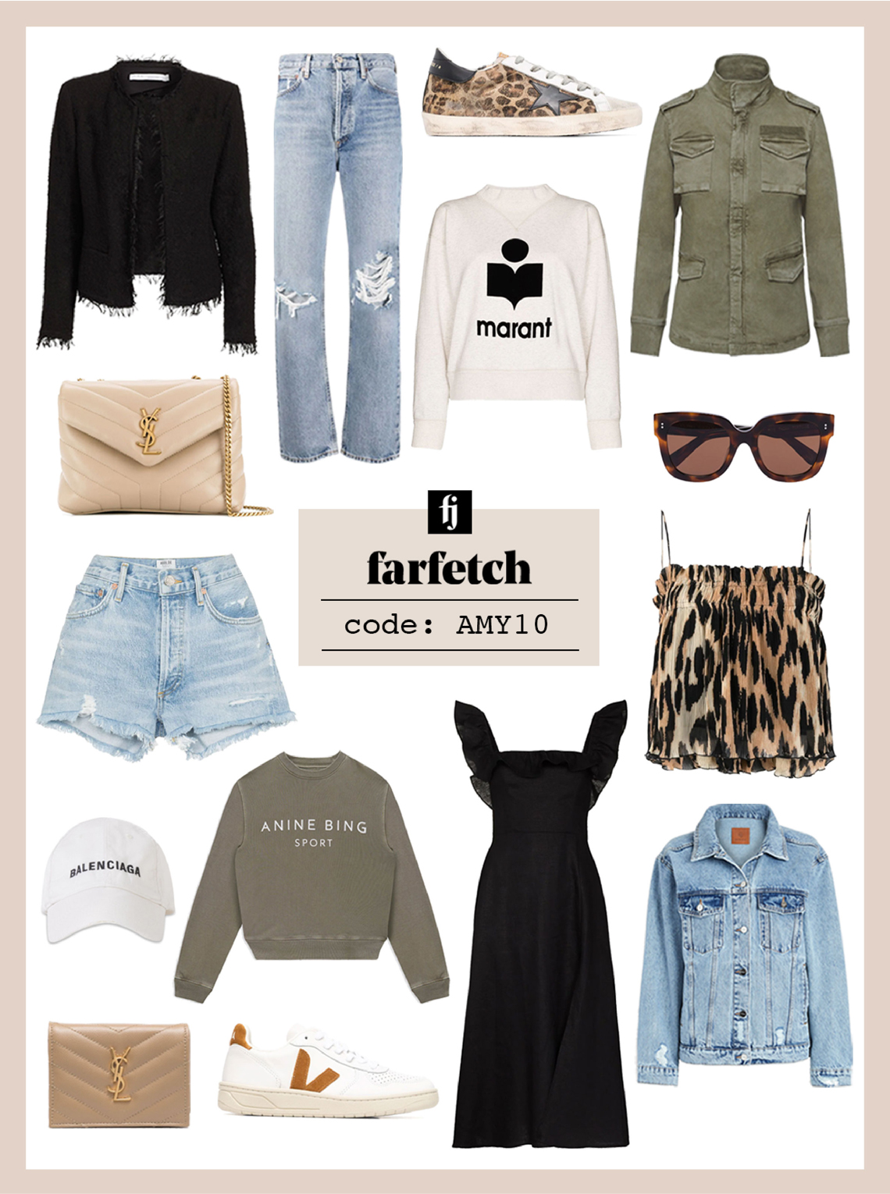
FARFETCH Discount Predictor
Notes:
Online market place for luxuries band.
Where people can buy product on sale

Slide 2
INDEX
INTRODUCTION
PUIRPOSE OF PROJECT
DATA ANALYSIS
PREDICTIVE MODEL
FINAL SOLUTION

Slide 3

The world's leading online platform for designer fashion.
Founded in 2007 by José Neves for the love of fashion in London.
Marketplace for luxury boutiques around the world since 2008.
Customers from over 190 countries can find trendy pieces from partner boutiques in more than 50 countries. over 1300 popular brands .
Notes:
Hose
People from 120 countries
1300 brands from 50 countries are present on farfetch

Slide 4
DATASET OVERVIEW
Current Farfetch Listing
Repeating Fields
Complex Fields
Irrelevant fields
Diversified dataset
Notes:
kaggal

Slide 5
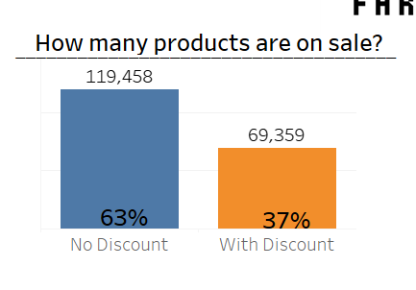
Notes:
Expensive
High quality
1/3 product on sale

Slide 6
CLASSIFICATION PREDICTIVE MODEL
PUIRPOSE OF PROJECT
“Why luxury goods from Farfetch have
Discounts”

Slide 7
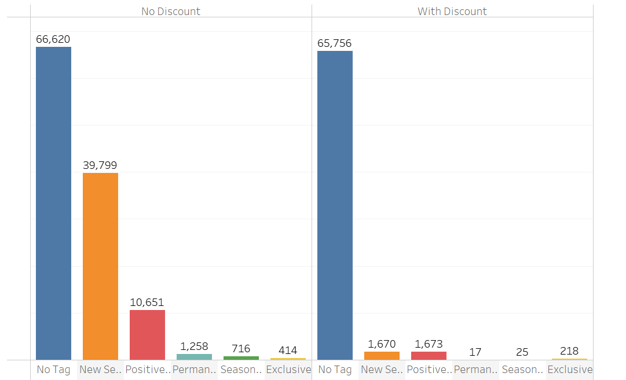
Analysis
Observation:
No Tag,New Season and Positively Conscious Label Tag have a high impact on product discount
Notes:
Product tag -6
3 more impact on prediction
Large in quantity

Slide 8
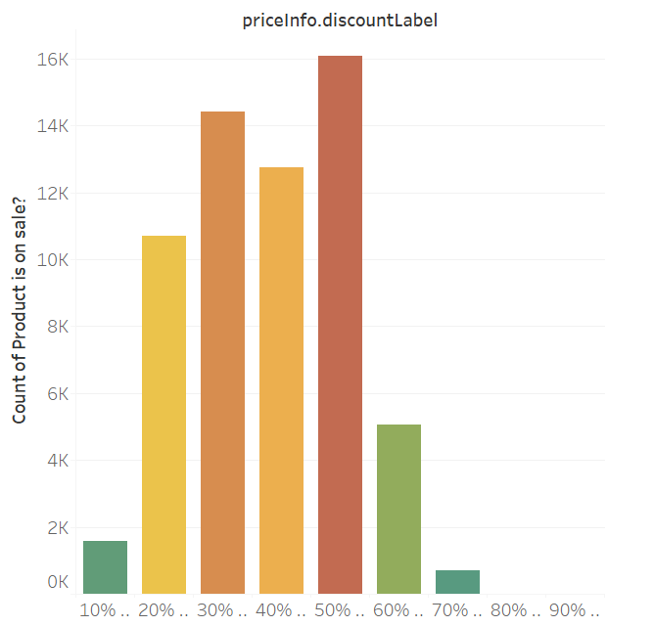
Notes:
Percentage of discount with product on sale
more product in rage of 20-50 percent discount
No heavy discount on many product

Slide 9
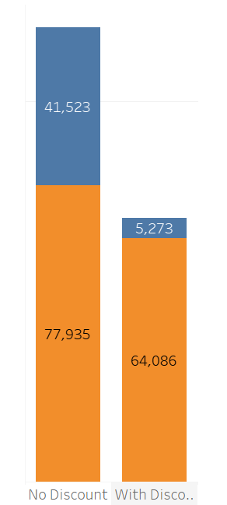
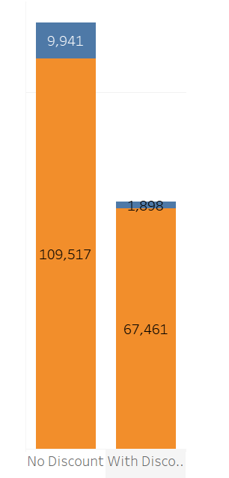

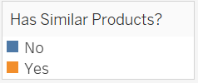
Similar product Vs Discount
Gender Vs Discount

Slide 10
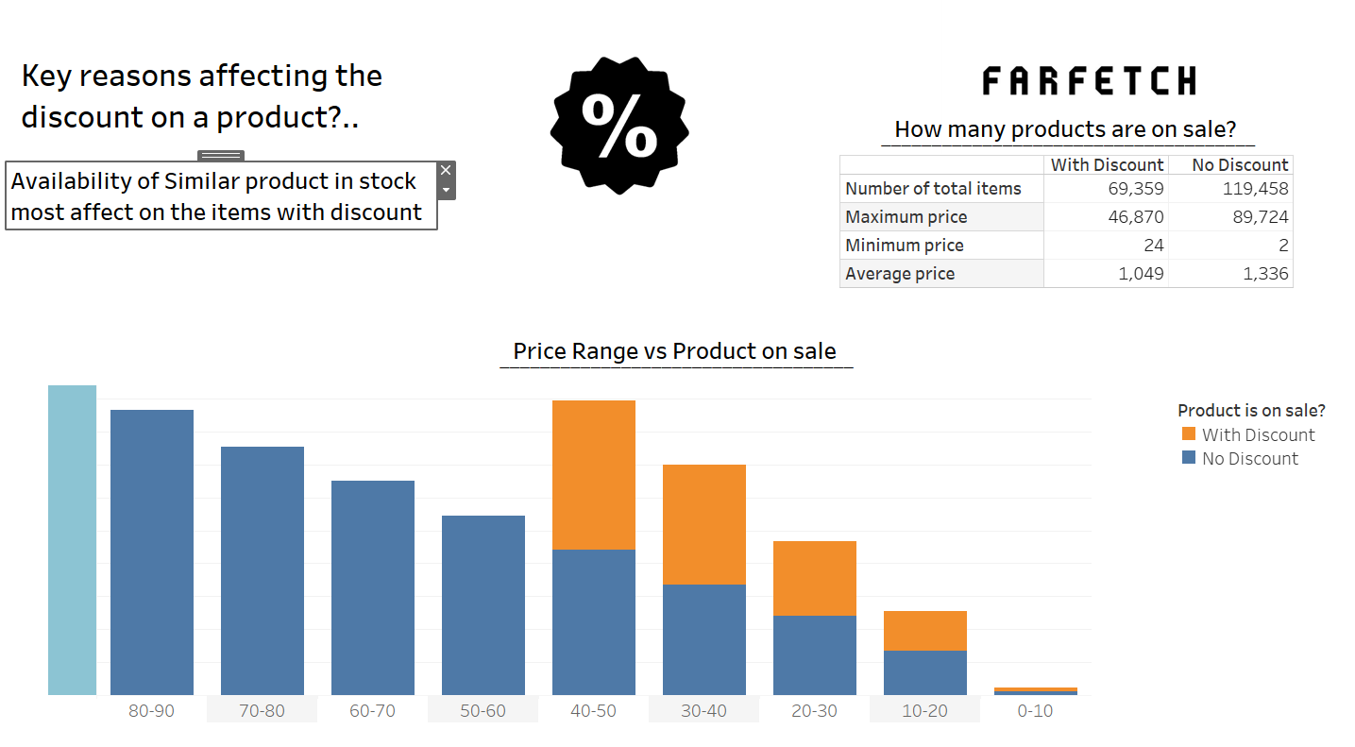
Notes:
Play important role in prediction

Slide 11
Highlighted Points
Out of total products, 37 % products are on discount
No tag products, new season, positively Conscious label tag are more on stock. these are also most discounted product. They also help in prediction for discount
Products which have similar product are more on discount
40% of the total women products are on discount and 15% of total Unisex products are on discount.
The products which are in rage from 50 to 10 are more on discount. so expensive and luxuries products are not on discount

Slide 12
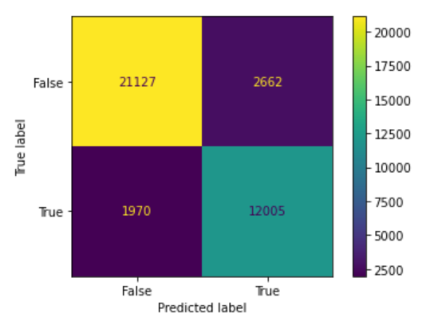
PREDICTION MODELS
Logistics Regression Model
Accuracy %: 0.75
Score : 0.50
SMOTE(oversampling)
Accuracy %: 0.77
Score : 0.53
Decision Tree Classifier
Accuracy %: 0.88
Score : 0.52
Random Forest Classifier
Accuracy %: 0.85
Score :0.74

Slide 13
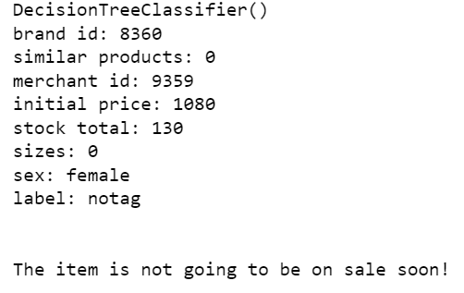
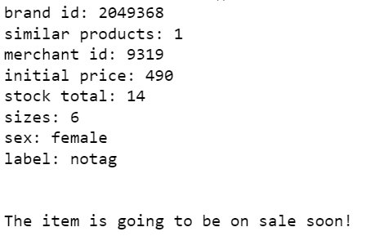
Final Result
If a user enters Brand id of the product , he knows products related to this id will come on sale in future or not .
This Prediction model is for the customers who want to buy Branded products on discount. It will prepare people to buy product at discounted price in Future .

Slide 14
Project Overview
GitHub Repository
Location of the Project with all files used in the creation of the Project
`
Jupyter Notebook
Open-source web application that combines exploratory data analysis and data modelling
Data visualization tool used for data analysis and creation of new dashboard
Tableau

Slide 15
THANK YOU

