Slide 1

Develop a Software Tool To Embed Synthetic Patterns Into Raw Images
Team No.
KLE Tech Mentors
Student Team
8
Dr. Prabha C N, Prof. Sahana Punagin
Karthik, Shaheen Khan, Ananya Khed, Radhika Horti
NVIDIA Mentor
Number of discussions/ reviews held with the mentors
Mr. Animesh Khemka
Mr. Douglas Taylor
6 /Weekly meetings
Context of our work
Embedding synthetic patterns onto images is a versatile technique with various applications in image processing, computer vision, data augmentation, testing, security, and more.
These patterns are valuable tools for improving, evaluating, and extending the capabilities of image-based systems and technologies.
There are several ways to embed synthetic patterns onto images using popular libraries such as Pillow (Python), OpenCV (Python), and MATLAB.
Literature Survey :
Stimulating the Diffusion Model for Image Denoising via Adaptive Embedding and Ensembling (Tong Li, Hansen Feng, Lizhi Wang, Zhiwei Xiong, Hua Huang ) (2023)
Denoising Diffusion Implicit Models (Jiaming Song, Chenlin Meng, Stefano Ermon)(12th Jan 2021)

Slide 2
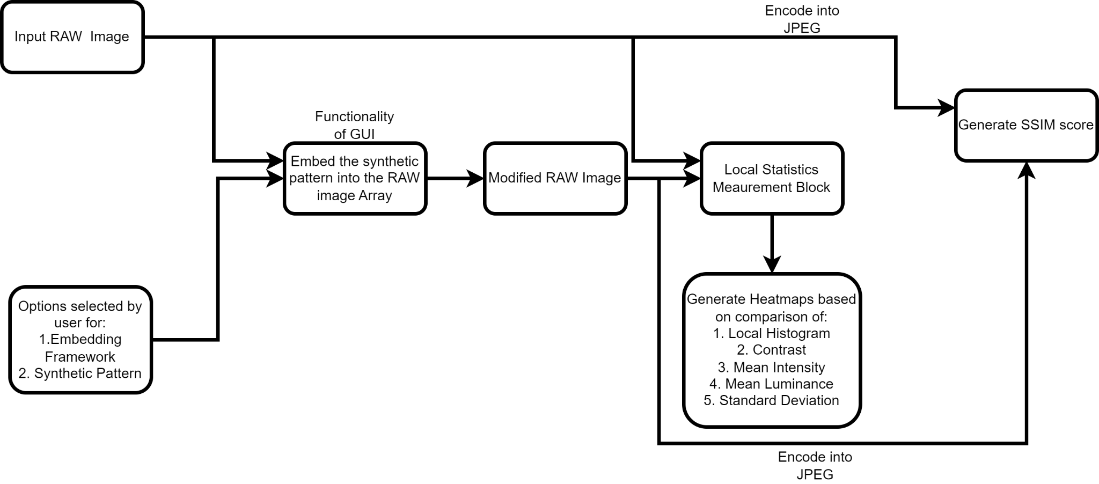
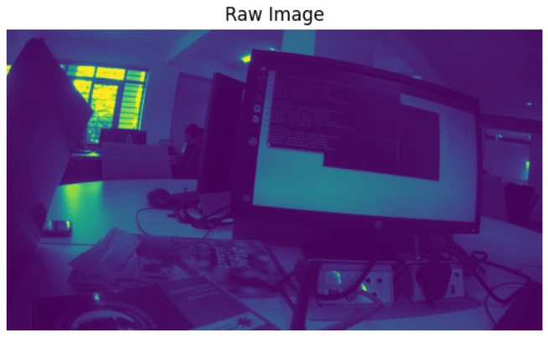
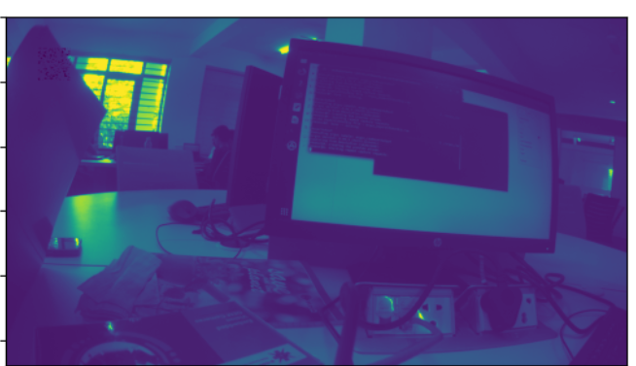
Develop a Software Tool To Embed Synthetic Patterns Into Raw Images
Proposed Framework of the GUI:

Slide 3
Develop a Software Tool To Embed Synthetic Patterns Into Raw Images
Methods for generating synthetic patterns :
1.Dot Pattern
Initialize Generator of GAN
Generate Noise
Generate dot pattern and background
Generator Model
Reshape & concatenate images
Save Image
Check Epoch
Update Parameters
Compute Loss & Gradient
Discriminator model
2.Uniform Color Patch
Initialize Image
Set Parameters
[R,G,B]
Diffusion Loop
[(target color- image)/diffusion steps]
Convert to uint8
Create PIL Image
Save Image

Slide 4
Develop a Software Tool To Embed Synthetic Patterns Into Raw Images
Framework for embedding with mean intensity of block picked by user
(option 4):
Framework for embedding with contrast of block picked by user
(option 3):
Framework for embedding with contrast of synthetic pattern (option 2):
Framework for embedding with user input (option 1):
EMBEDDING THE PATTERN
EMBEDDING THE PATTERN
EMBEDDING THE PATTERN
EMBEDDING THE PATTERN
Capture RAW image
Calculates the standard deviation & determine the contrast of the pattern & Retrieves the dimensions (height and width) .
The function calculates the contrast of the selected pattern and the contrast of the specified block from the image.
The function calculates the mean intensity of the selected pattern and the mean intensity of the specified block from the image.
Check is the position defined by the user is within the image1
Compare the pixel values at the corresponding spots in picture 1 with those in image 2 multiplied by 256
Extract a block of the same size as the pattern from the image data array and then compare the contrast of the block with the pattern.
It adjusts the contrast of the pattern iteratively until it aligns within a threshold (in this case, within 5 units).
Synthetic Pattern
It computes the intensity difference between the block and pattern, then normalizes the pattern array.
Pattern is embedded
Update the value of the pixel in image1 at that position to that the value of image2 multiplied by 256 if the pixel value in image1 is greater than the pixel value in image2 multiplied by 256.
If the contrast of the current block is smaller than the previous one, update the coordinates to embed the pattern .to the current coordinates.
Once the contrast is adjusted, it embeds the modified pattern into the specified block in the image .
The function then adjusts the intensity of the pattern by applying the intensity difference and normalization.
Obtain position and size of the pattern through the user
Obtain size of the pattern through the user
Obtain size of the pattern and location of where it needs to be embedded through the user

Slide 5
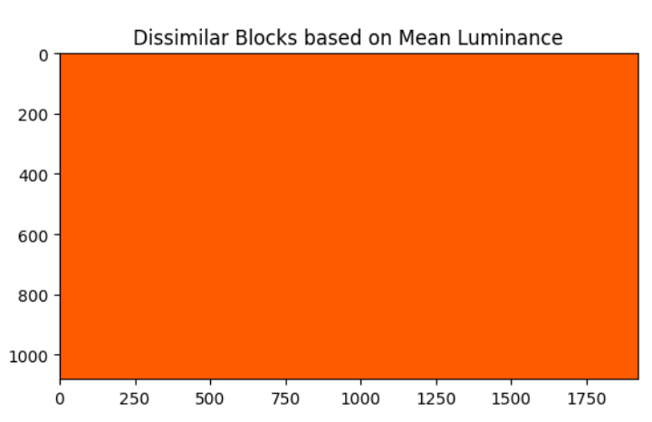
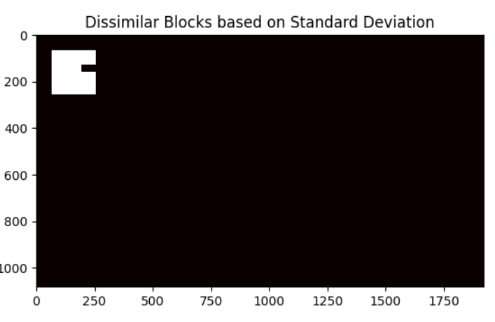
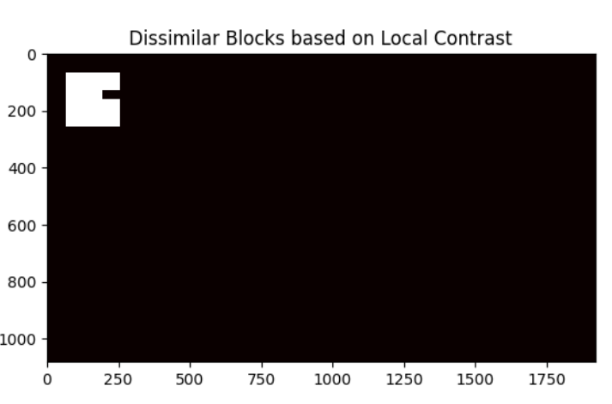
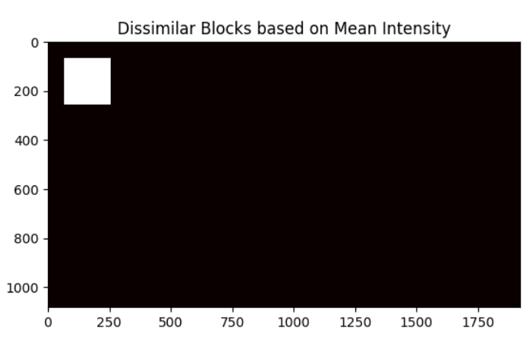
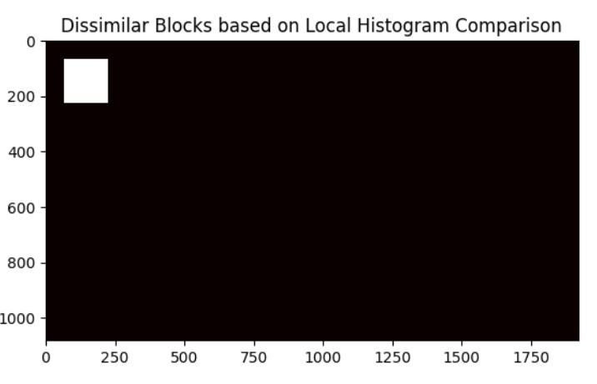
Results
CASE 1: Based on User Input
Measurement of local statistics:
Fig 1. Input RAW image
Fig 2. Output RAW Image
(Embedded user input image with at synthetic pattern at 100,100)
The SSIM score between the images is: 0.9973

Slide 6
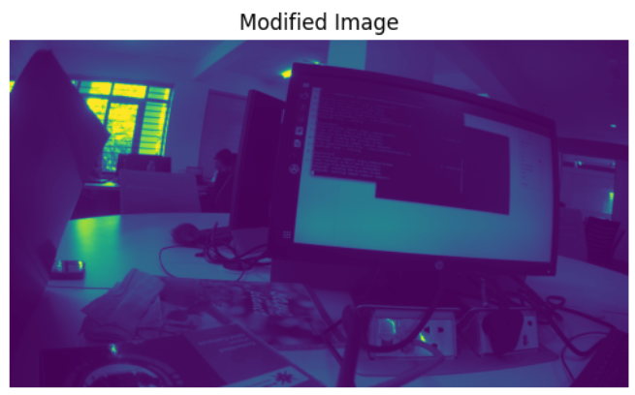
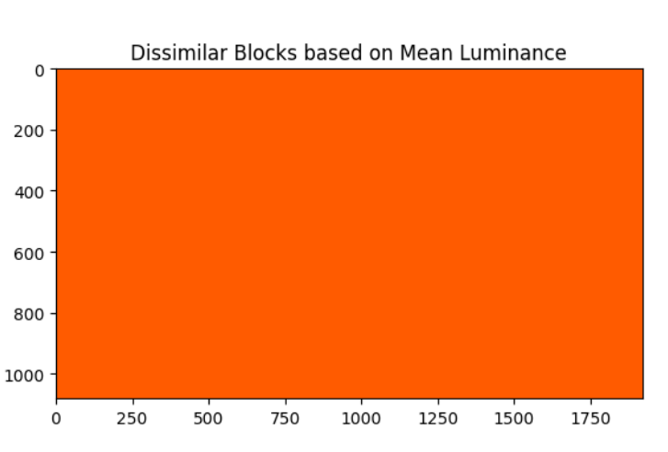
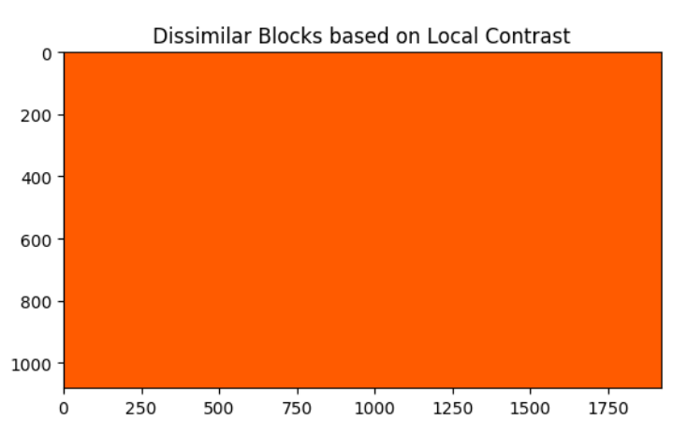
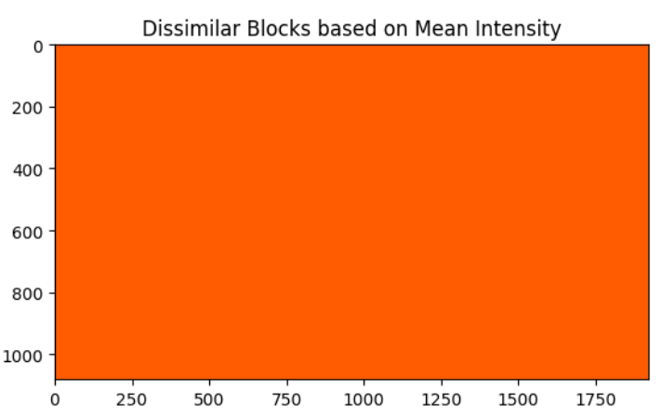
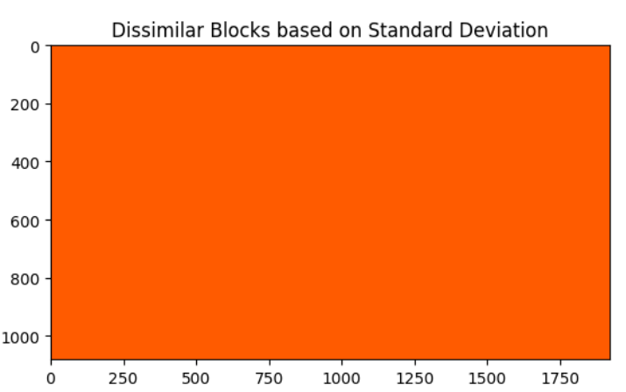
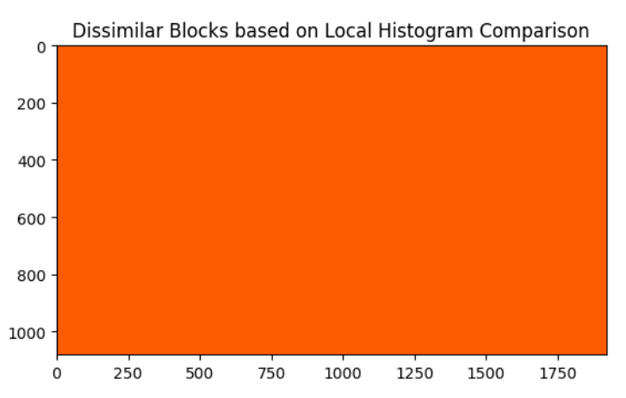
Results
CASE 2: Based on Contrast of the Synthetic Pattern Image
Measurement of local statistics:
Fig 1. Input RAW image
Fig 2. Output RAW Image
(Embedded with Dot Pattern at 1212,707)
The SSIM score between the images is: 1.0

Slide 7
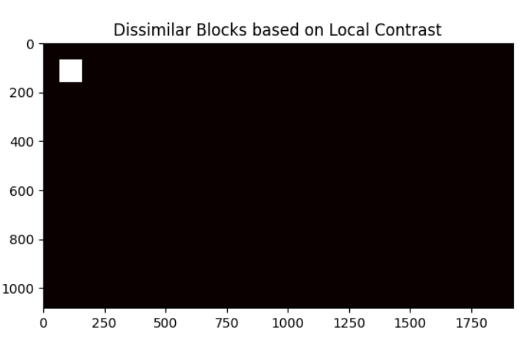
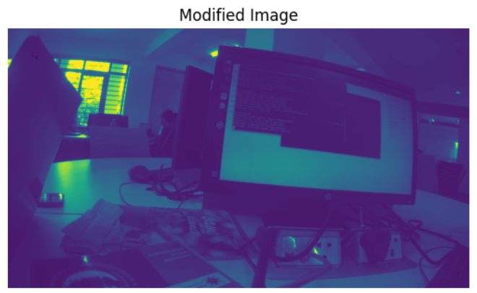
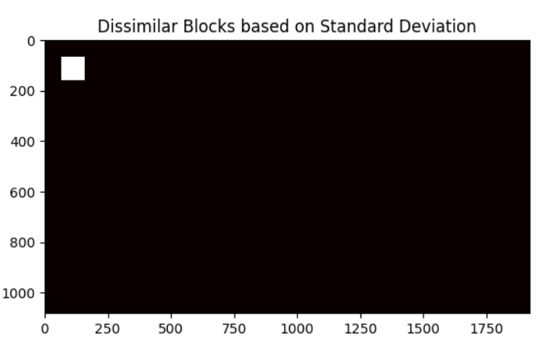
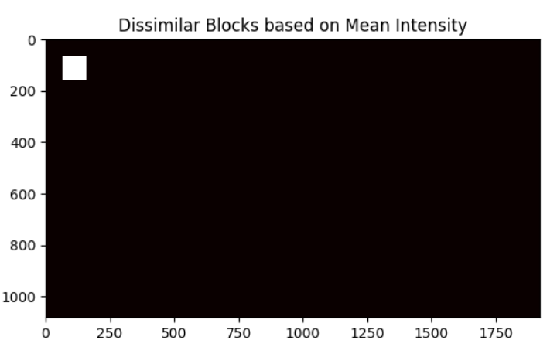
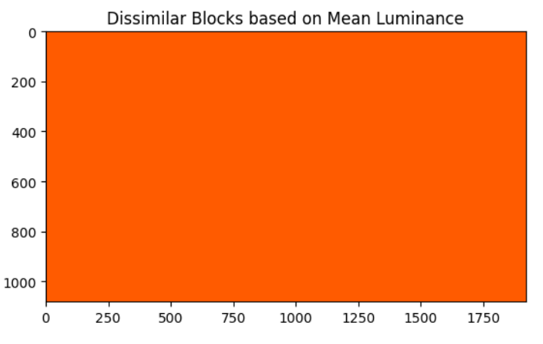
Results
Measurement of local statistics:
CASE 3: Based on Contrast of the Block selected by the User
Fig 1. Input RAW image
Fig 2. Output RAW Image
(Embedded with Dot Pattern at 100,100)
The SSIM score between the images is: 0.99885

Slide 8
Results
Measurement of local statistics:
CASE 4: Based on Mean Intensity of the Block selected by the User
Fig 1. Input RAW image
Fig 2. Output RAW Image
(Embedded with Dot Pattern at 100,100)
The SSIM score between the images is: 0.99907

Slide 9
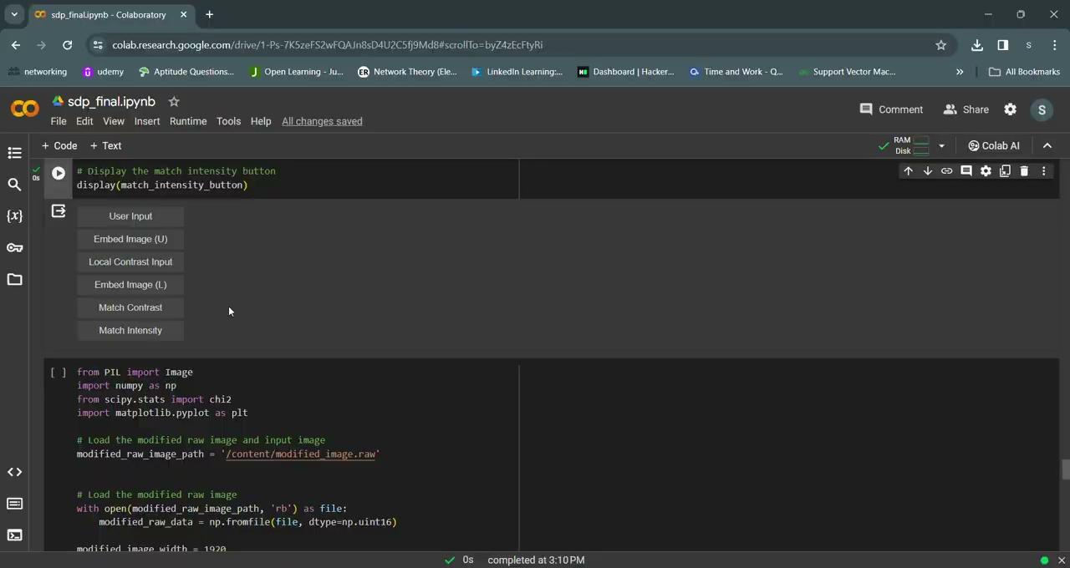
Demo Video

