Slide 1
A SUMMER INTERNSHIP PROJECT | CourierIQ
AI-Powered Courier Delivery Performance Analytics
Python • Streamlit • Pandas • Plotly • Scikit-learn
RADHIKA R (810023104056)
Department of Computer Science and Engineering
University College of Engineering (BIT Campus), Anna University, Tiruchirappalli
Notes:
Vanakkam. Ennoda summer internship project: AI-Powered Courier Delivery Performance Analytics.

Slide 2
Contents
1
Introduction & Objectives
5
Dataset & Methodology
2
Company Profile
6
Sample Output (5 pages)
3
Existing vs Proposed System
7
Analysis, Conclusion & Future Work
4
Block Diagram & Technologies
2
Notes:
Indha presentation-la intha order-la explain panren.

Slide 3
Introduction
Courier firms handle thousands of orders across different distances, traffic and weather
Manual spreadsheet reports are slow, error-prone and only look backwards
CourierIQ is a Streamlit dashboard that monitors, ranks, predicts and alerts
Built on a synthetic dataset of 2,000 orders handled by 25 agents
Five pages: Overview, Agent Performance, Delay Analysis, Predict New Order, Anomaly Alerts
3
Notes:
Courier companies-ku daily ayiram orders. Delay reason theriyanum, agents-a compare pannanum. Adhukku intha Streamlit dashboard.

Slide 4
Objectives
Analytics
Intelligence
Live KPI dashboard
Agent ranking by weighted score
Delay analysis by traffic, weather, hour
Interactive Plotly charts
Predict delay for a new order
Estimate delay in minutes
Flag anomalous deliveries
Easy dark-themed UI, no coding needed
4
Notes:
Main objective: manual work kuraikkanum, proactive-a delay-a handle pannanum.

Slide 5
Company Profile
Astonish Infotech Pvt. Ltd.
My internship
IT services & software development
Tiruchirappalli, Tamil Nadu (since 2010)
Industrial training and internships
Focus: reliable, user-friendly software
Duration: 01.06.2026 – 30.06.2026
Project: Courier Delivery Analytics
Skills: Python, Streamlit, ML integration
Covered the full SDLC
5
Notes:
Astonish Infotech-la 01.06.2026 to 30.06.2026 internship panninen.

Slide 6
Existing vs Proposed System
Existing system
Proposed system
Manual spreadsheet reporting
No unified view of KPIs
Unfair single-measure agent evaluation
Delay causes unknown
Reactive – no prediction
No anomaly detection
Automated interactive dashboard
KPI cards, charts, leaderboard
Weighted performance score
Traffic / weather / hour analysis
Delay prediction before dispatch
Anomaly alerts for review
6
Notes:
Left: ippo irukkura prachanai. Right: namma solution.

Slide 7
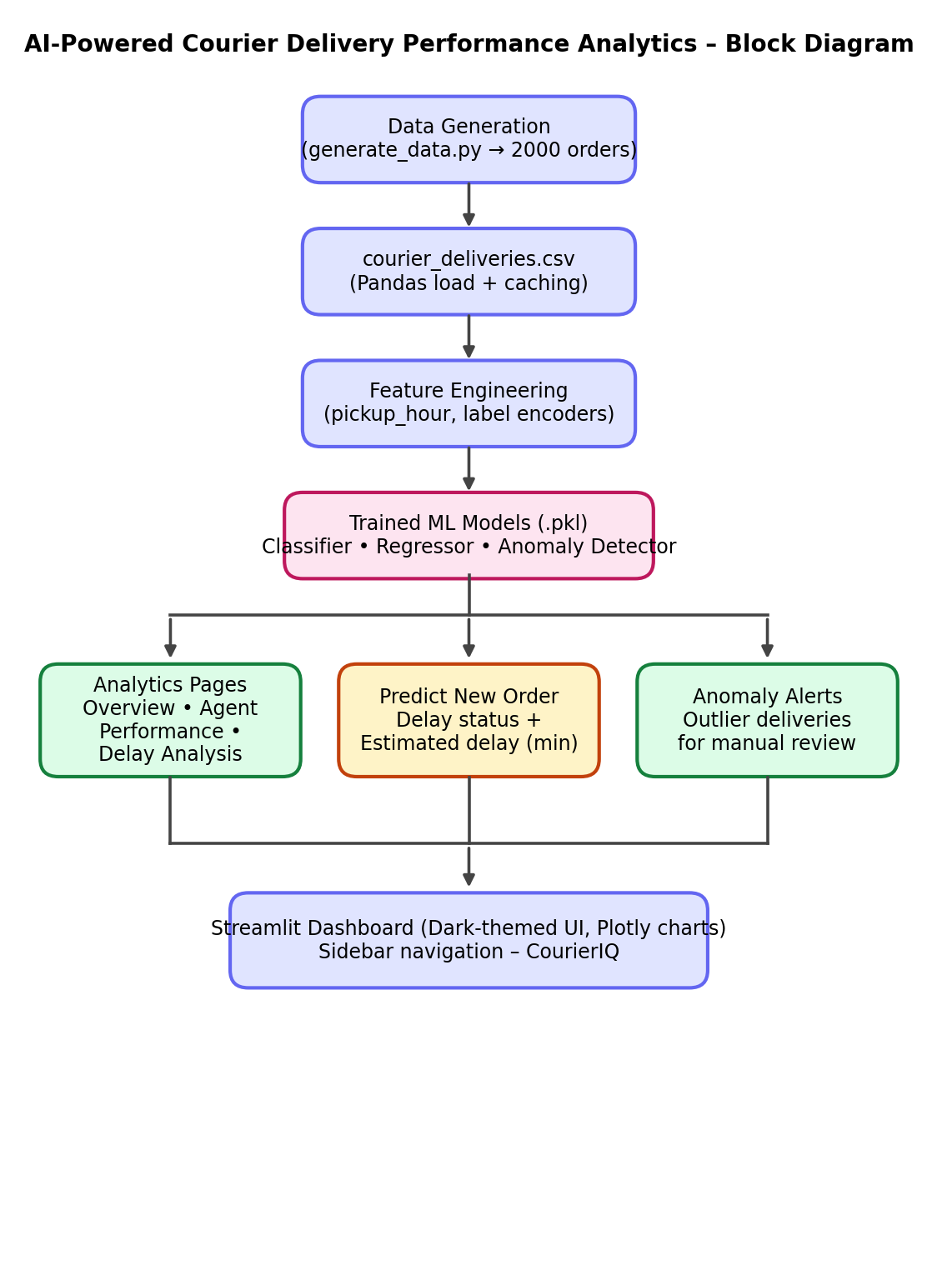
Block Diagram
Fig 4.1 – Block diagram of the system
7
Notes:
Data → feature engineering → ML models → 3 outputs → Streamlit dashboard.

Slide 8
Technologies Used
Python 3.11
Streamlit
Pandas / NumPy
Core language
Web UI + custom dark CSS
Data processing
Plotly Express
Scikit-learn
Joblib
Interactive charts
Classifier, regressor, anomaly model
Save / load trained models
Tools: VS Code • pip / venv • Google Chrome
8
Notes:
Ovvoru technology-um enna kaaranathukku use pannen nu sollunga.

Slide 9
Dataset (generate_data.py)
2000
25
12
0
Orders
Delivery agents
Columns
Missing values
Columns
How it is simulated
order_id, agent_id, agent_name
pickup / expected / actual time
distance_km (1–30 km)
traffic_condition: Low / Medium / High
weather: Clear / Rain / Storm
delivery_status, delay_minutes, rating
Base time = 3 min per km
Traffic and weather multipliers
Agent speed factor + random noise
Late > 10 min = Delayed
About 3% marked Failed
9
Notes:
Real data illa, so Python script-la realistic synthetic data generate pannen.

Slide 10
Methodology & Algorithms
Agent score
Delay prediction
Anomaly detection
On-time rate = on-time ÷ total × 100
Score = 0.5 × on-time rate + 0.3 × (10 × rating) – 0.2 × avg delay
Sorted high → low
Inputs: distance, hour, traffic, weather, agent
Encode categories
Classifier → On-Time / Delayed + confidence
Regressor → delay minutes
Exclude Failed orders
Speed = distance ÷ duration
Model labels outliers (–1)
~3% flagged for review
10
Notes:
3 main logic: score formula, delay prediction, anomaly detection.

Slide 11
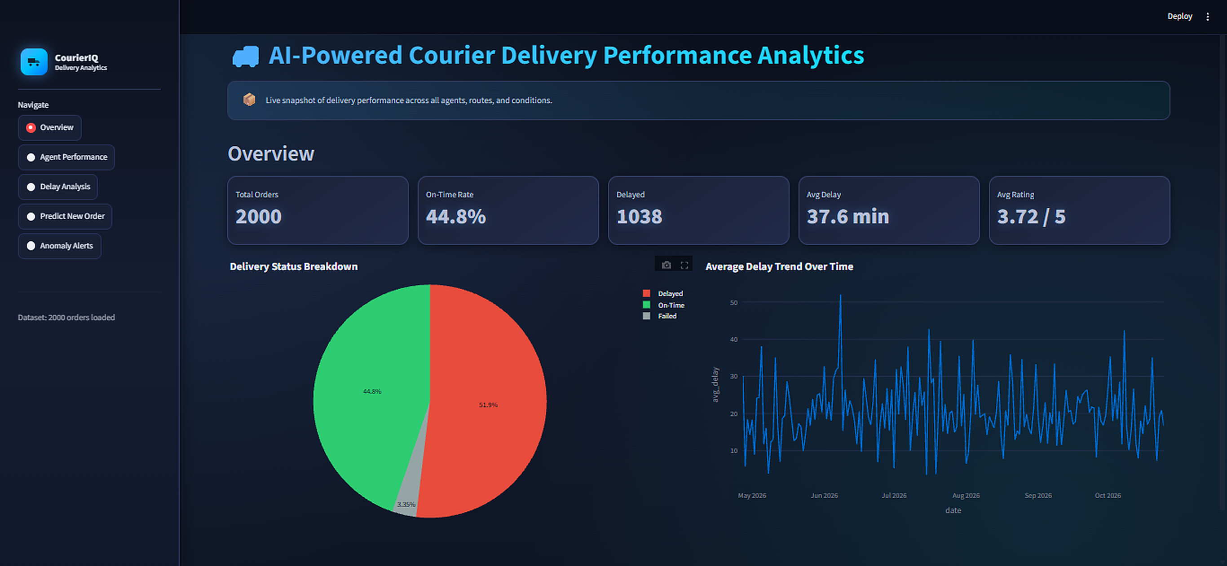
Output 1 – Overview Dashboard
2000
Total orders
44.8%
On-time rate
1038
Delayed
37.6 min
Avg delay
Status split: 44.8% on-time • 51.9% delayed • 3.35% failed
3.72 / 5
Avg rating
11
Notes:
2000 orders, only 44.8% on-time, 1038 delayed, 37.6 min average delay.

Slide 12
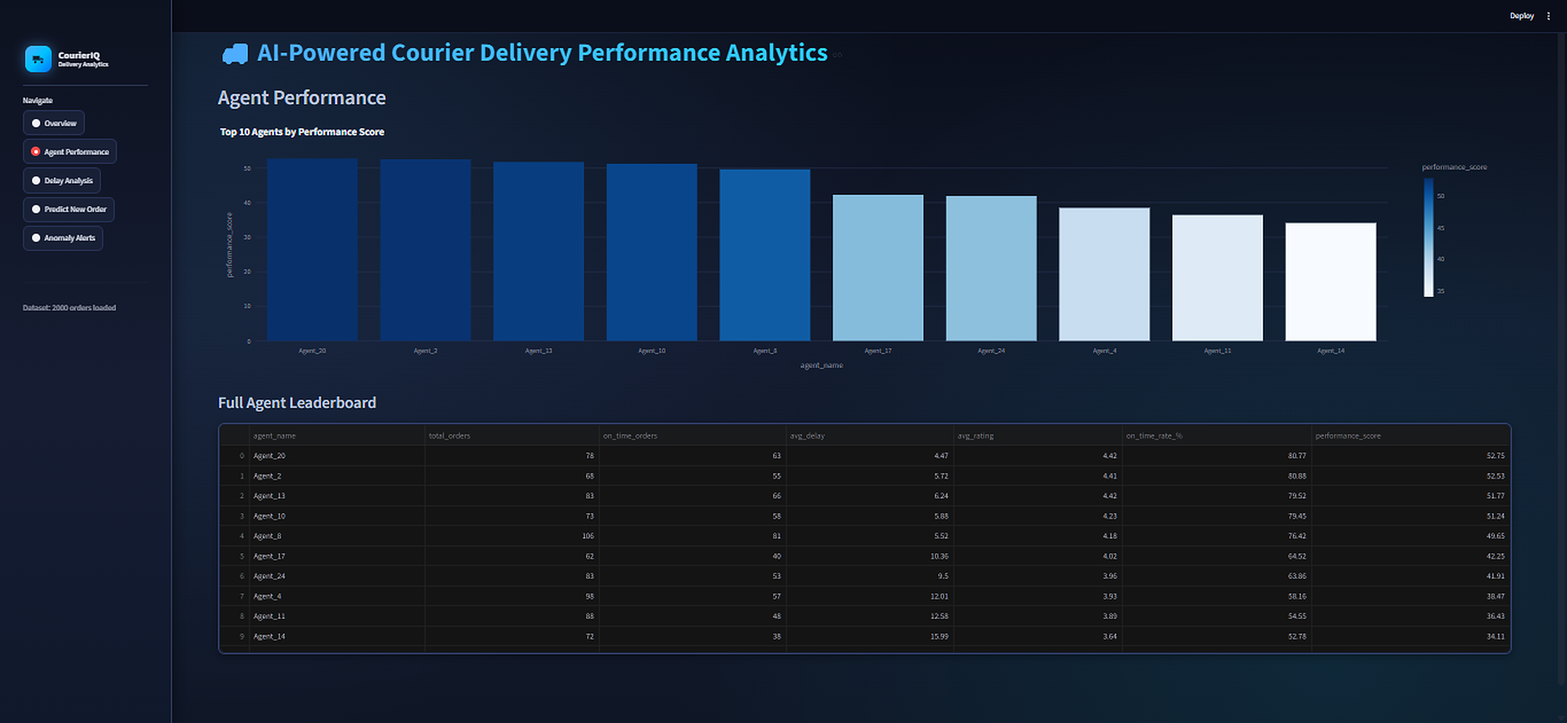
Output 2 – Agent Performance
Top 3 agents
Agent_20
52.75 • 80.8% on-time
Agent_2
52.53 • 80.9% on-time
Agent_13
51.77 • 79.5% on-time
Score ranks all 25 agents in a full leaderboard table.
12
Notes:
Agent_20 top score 52.75, 80.77% on-time. Weak agents low on-time and high delay.

Slide 13
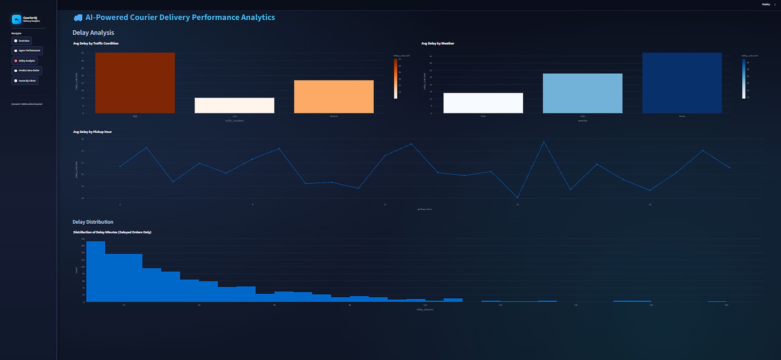
Output 3 – Delay Analysis
40.3 min
Avg delay – High traffic
10.2 min
Avg delay – Low traffic
42.3 min
Avg delay – Storm
Hour of day shows no single dominant peak.
14.2 min
Avg delay – Clear
13
Notes:
Traffic high-na 40 min, low-na 10 min. Storm-la 42 min, clear-la 14 min.

Slide 14
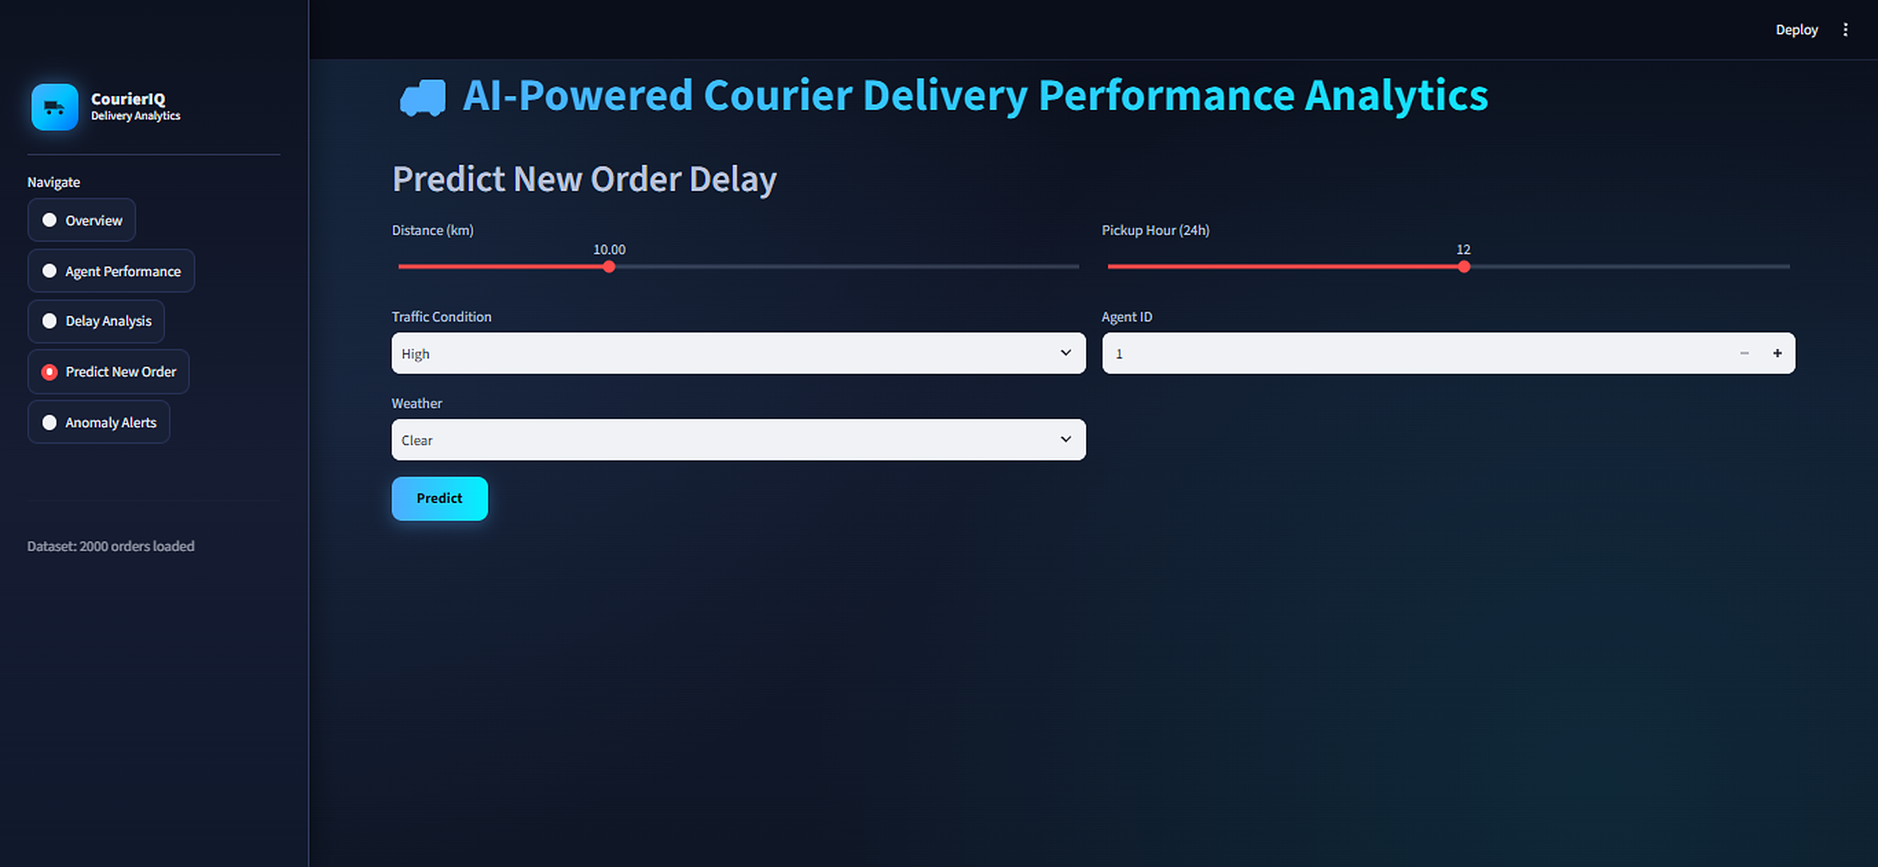
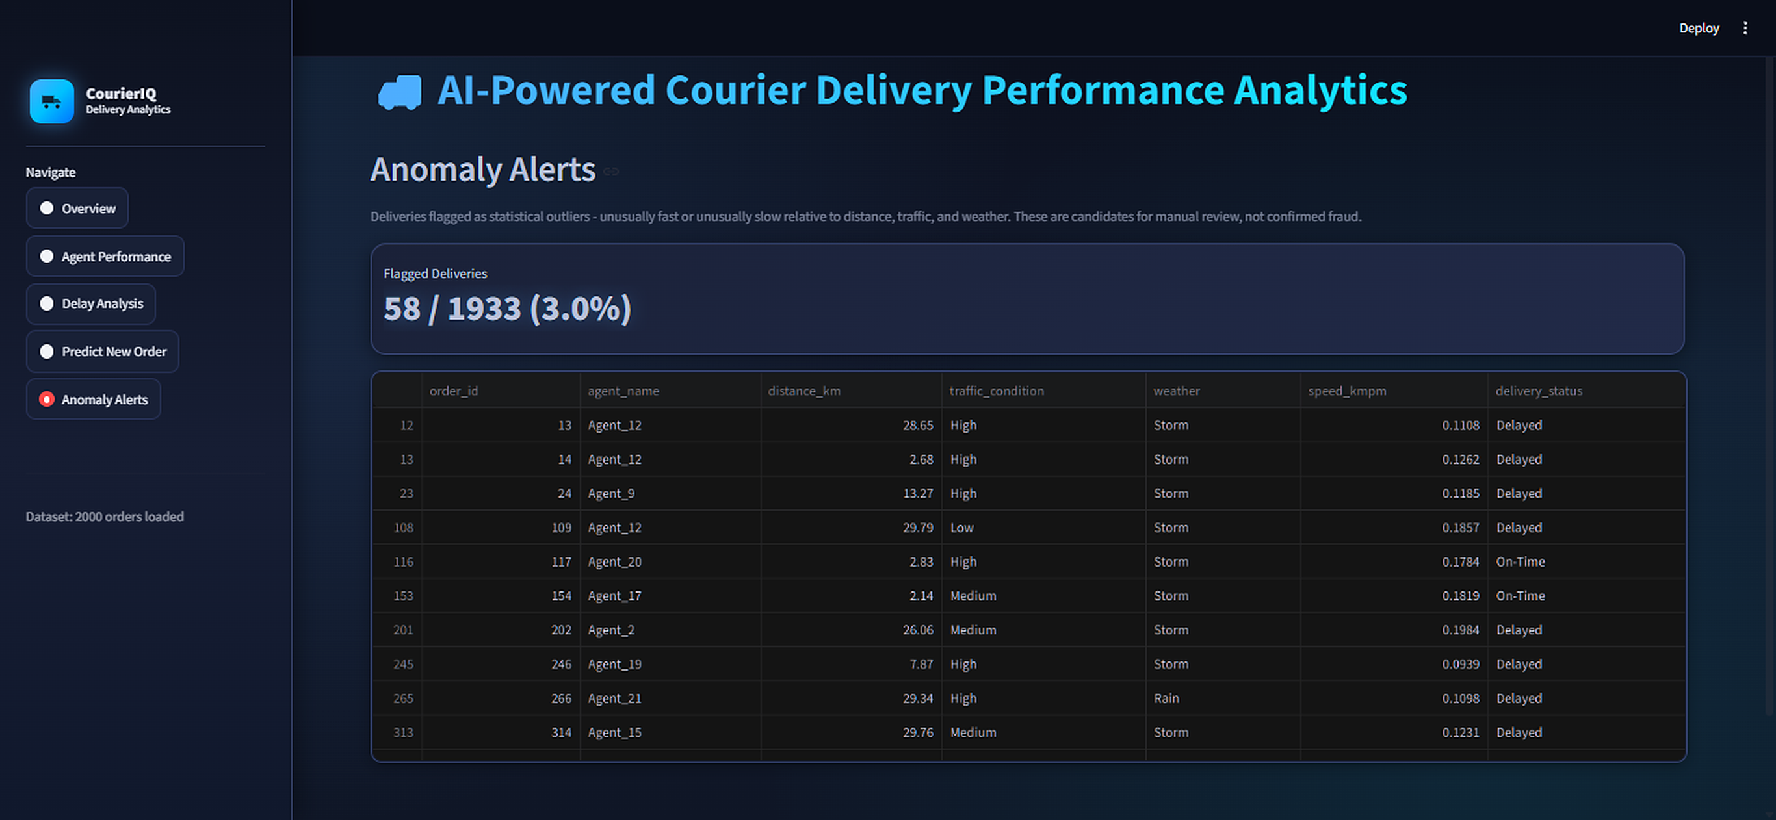
Output 4 – Predict & Anomaly Alerts
Predict New Order: distance, hour, traffic, weather, agent → status, confidence, est. delay
Anomaly Alerts: 58 / 1,933 (3.0%) flagged for manual review, not confirmed fraud
14
Notes:
Left: new order-ku delay predict. Right: 58 of 1,933 deliveries outliers-a flag aagi irukku.

Slide 15
Conclusion & Future Work
Conclusion
Future work
Automated delivery analytics dashboard
Traffic and weather are main delay causes
Fair, objective agent ranking
Predicts delays before dispatch
All 5 modules tested
Live data via APIs / GPS
Database + role-based login
Route optimisation
Real traffic / weather APIs
SMS / e-mail alerts, cloud deploy
Thank you
15
Notes:
Mudivu: manual work-a automate pannum proactive tool. Thank you.

