Slide 1
NATIONAL WEATHER BIG DATA
ANALYTICS PLATFORM
WeatherPulse India — Real-time, verified weather intelligence,
collected, analyzed and visualized at national scale.
Team WeatherPulse
Team Members: Apoorva Nayak (4AL23CS021)
Radhika Raikar (4AL23CS115)

Slide 2
THE PROBLEM
Weather signals are everywhere online — but nowhere trustworthy
!
Fragmented data
Rainfall, flood and storm reports are scattered across social media, government portals and citizen posts, with no single verified view.
x
Unverified & duplicated reports
Fake, exaggerated or duplicate posts spread faster than official alerts, making it hard to separate signal from noise during an emergency.
?
No real-time, geo-tagged intelligence
Existing tools rarely combine live location, event category and a trust score in one place — decisions rely on guesswork.
WeatherPulse India | National Weather Big Data Analytics Platform
2

Slide 3
ABSTRACT
A big data platform for verified, real-time weather intelligence
WeatherPulse India ingests weather-related posts and data tagged with hashtags like #IMD, along with open government datasets, and processes them using big data tools and machine learning. The system automatically removes duplicates, flags fake or misleading reports, and classifies each event — shown on a live, filterable dashboard with an admin panel for verification.
Ingest
ML Verify & Classify
Store
Dashboard & Admin
#IMD posts & open data
Dedup, fake-flag, categorize
PostgreSQL + PostGIS
Live, filterable, verified
WeatherPulse India | National Weather Big Data Analytics Platform
3

Slide 4
OBJECTIVES
Four goals that shaped every design decision
1
Real-time, multi-source collection
Continuously ingest weather signals from social media, open government datasets and citizen reports — not just one source.
2
AI-verified data
Use machine learning to score trust, flag fake reports and remove duplicates before anything is shown.
3
Interactive visualization
Let anyone filter and explore events by date, location and category on a live map and dashboard.
4
Full traceability
Ensure every displayed record links back to a real, verifiable source — no synthetic data, ever.
WeatherPulse India | National Weather Big Data Analytics Platform
4

Slide 5
OUR SOLUTION
One platform: collect, verify, analyze and alert — for the whole country
1
2
3
4
Collect
Verify
Analyze
Alert
Ingest #IMD and weather-tagged posts, citizen reports and open government datasets in real time.
ML models score source trust, flag fake or misleading reports, and remove duplicates automatically.
Auto-categorize into rainfall, flood, storm, heatwave, fog, dust and wind events with location and time.
Surface verified, filterable insights on a live map and dashboard the moment they're confirmed.
WeatherPulse India | National Weather Big Data Analytics Platform
5

Slide 6
FEATURES
Everything a moderator or citizen needs, filtered in real time
Live Map & Alerts
Dynamic Filters
Geo-tagged markers colored by IMD severity (Green / Yellow / Orange / Red), auto-fit to India.
Combine hashtag, date range, state, event category and verification status — all working together.
Verification Queue
Analytics View
Admins review ML-flagged reports with confidence scores, then verify or reject in one click.
Time-series and state-wise breakdowns of events, sourced entirely from stored, traceable records.
Interface designed to meet government accessibility and trust standards — clear contrast, readable typography, verified-source labeling.
WeatherPulse India | National Weather Big Data Analytics Platform
6

Slide 7
BUILT ON REAL, GOVERNMENT-VERIFIED DATA
No synthetic data — every record is traceable to its source
DATA SOURCES
TECH STACK
data.gov.in — Open Government Data Platform
HTML5, Vanilla CSS3
Vanilla Javascript
IMD — India Meteorological Department
PostgreSQL + PostGIS
Spring Boot
NASA POWER — historical & gridded weather
Open-Meteo — live forecast, no key required
Flask
Node.js
React
External APIs
(Open-Meteo, IMD)
WeatherPulse India | National Weather Big Data Analytics Platform
7

Slide 8
IMPACT & WHAT'S NEXT
WHO IT HELPS
WHAT'S NEXT
Disaster management authorities — faster, verified situational awareness
Direct integration with state disaster-management authorities
Citizens — a single trusted view instead of scattered, unverified posts
SMS / IVR alerts for low-connectivity and rural areas
Journalists & researchers — geo-tagged, source-linked event history
Multilingual support across major Indian languages
WeatherPulse India | National Weather Big Data Analytics Platform
8

Slide 9
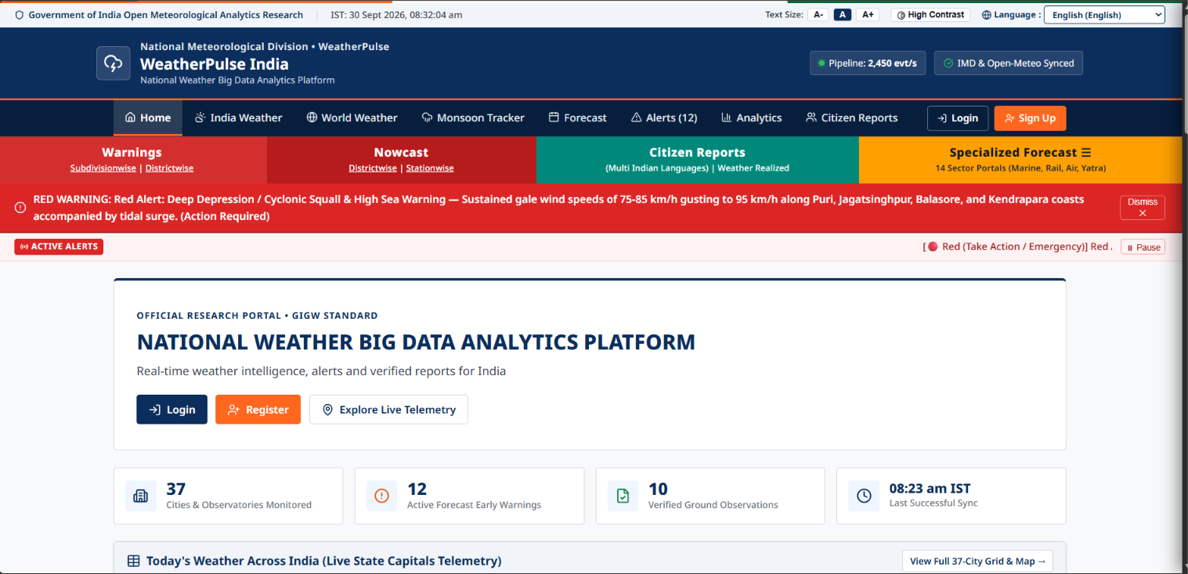

Slide 10
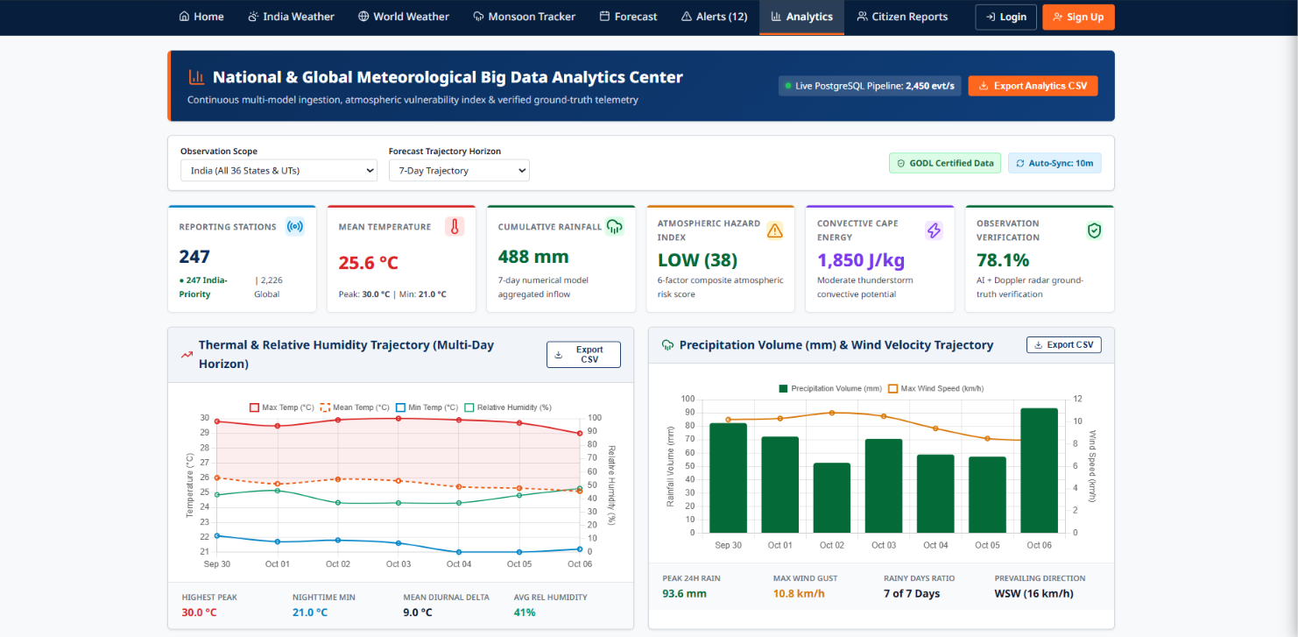

Slide 11
Thank You
Questions & Discussion Welcome
Radhika Raikar • Computer Science, AIET Mangalore
github.com/radhikaraikar

