Slide 1
EXPLORATORY DATA ANALYSIS ON INDUSTRY DATA
Python

Slide 2
Objective
Dataset: INDUSTRY.csv
Rows : 15000, Columns : 13
Missing values: 0 columns affected
Duplicate rows: 0
Major columns: company_name, industry, revenue, profit, customers, rating, region, created_date.
Objective : Summarize key business insights, data quality, and revenue drivers.
Generated from EDA on numeric and categorical business performance metrics.

Slide 3
Data Cleaning & Feature Engineering
Data quality: no duplicate rows
Date conversion applied to created_date.
Derived feature: company_age from founded_year when missing.
Remaining missing values are handled through dropna in analysis plots.

Slide 4
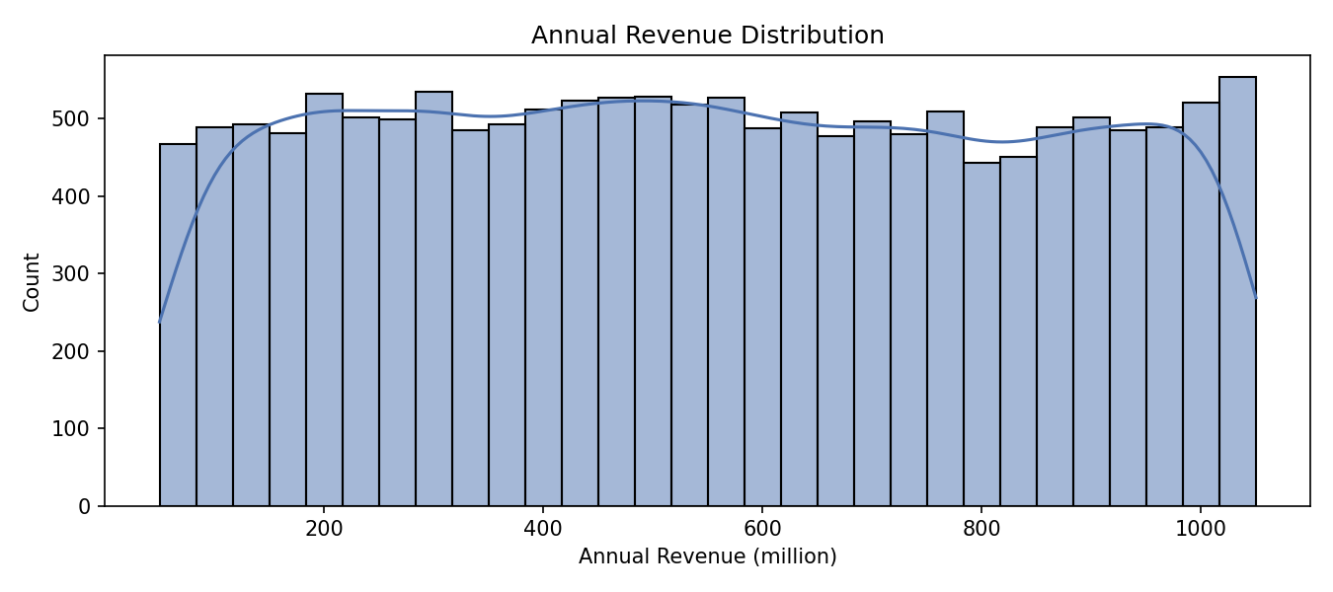
Revenue Distribution
Revenue is approximately symmetric with limited extreme outliers.

Slide 5
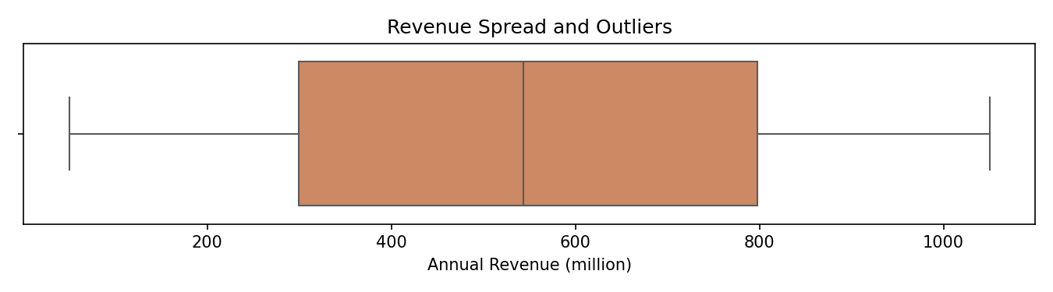
Revenue Spread
The revenue boxplot confirms a compact central range and few extreme values.

Slide 6
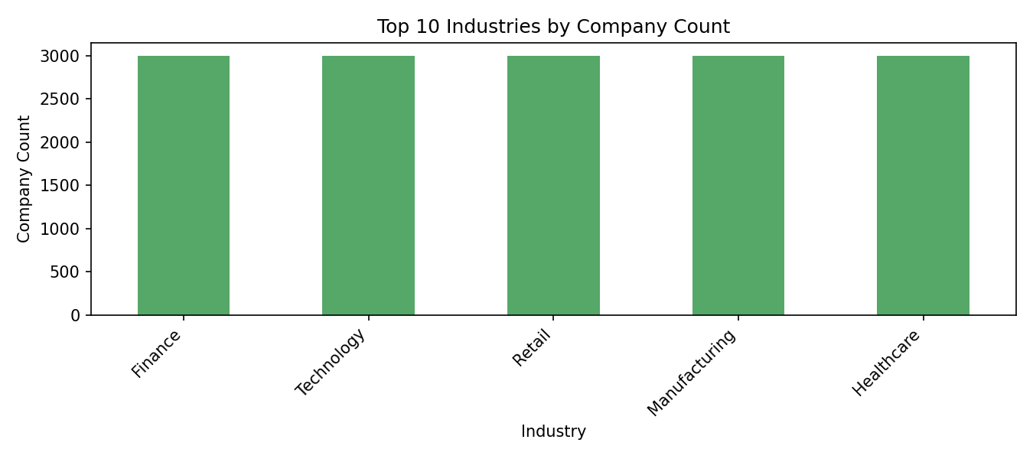
Industry and Region Composition
Industry and region are key categorical drivers. Top industries appear most frequently and
regional revenue share varies by geography.

Slide 7
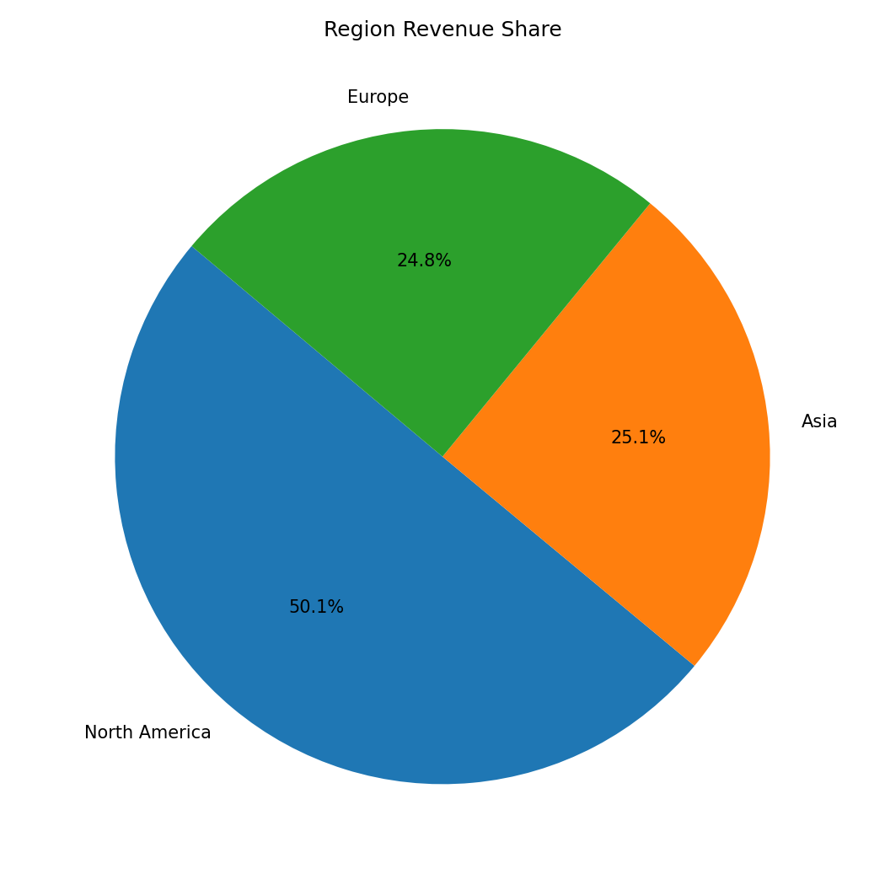
Region Revenue Share
Major regions contribute the majority of total annual revenue.
North America is having more revenue

Slide 8
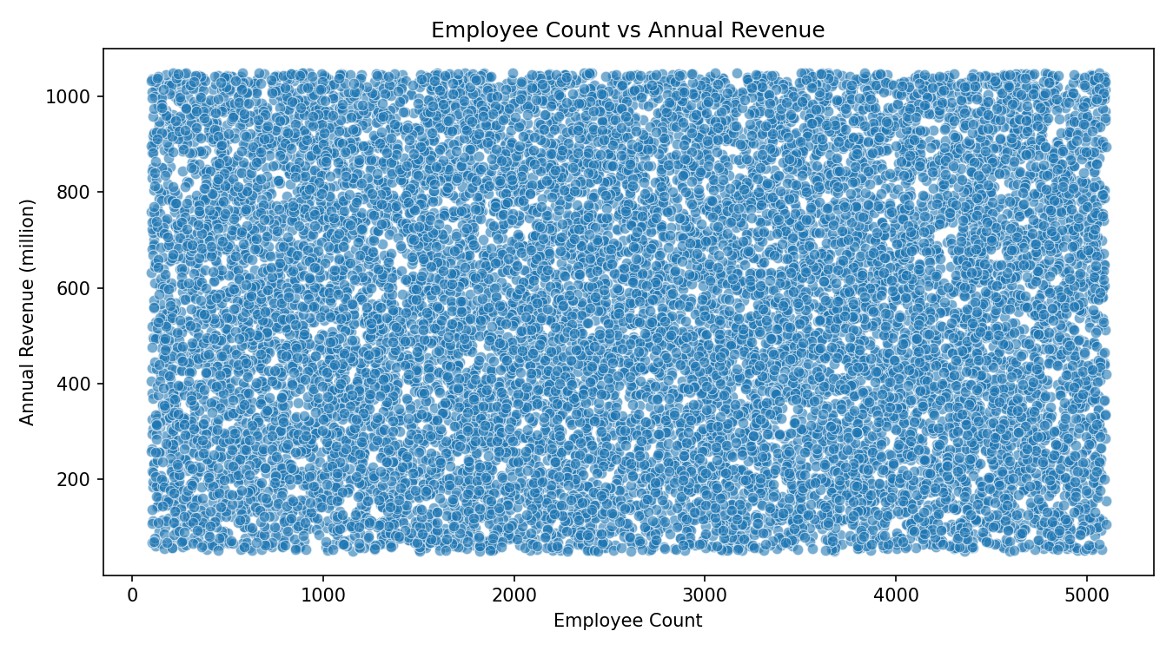
Bivariate Relationship
Employee count shows a broad trend with revenue but no single tight linear pattern.

Slide 9
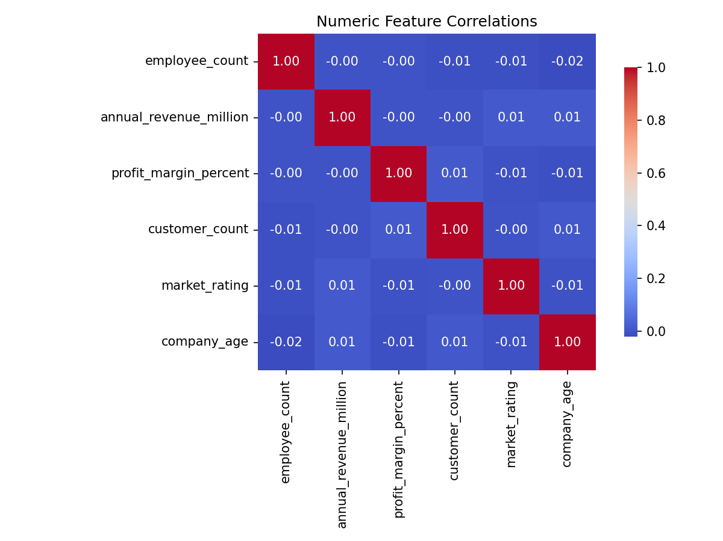
Feature Correlations
Numeric features show weak-to-moderate correlations; revenue links most with
employee_count and profit margin.

Slide 10
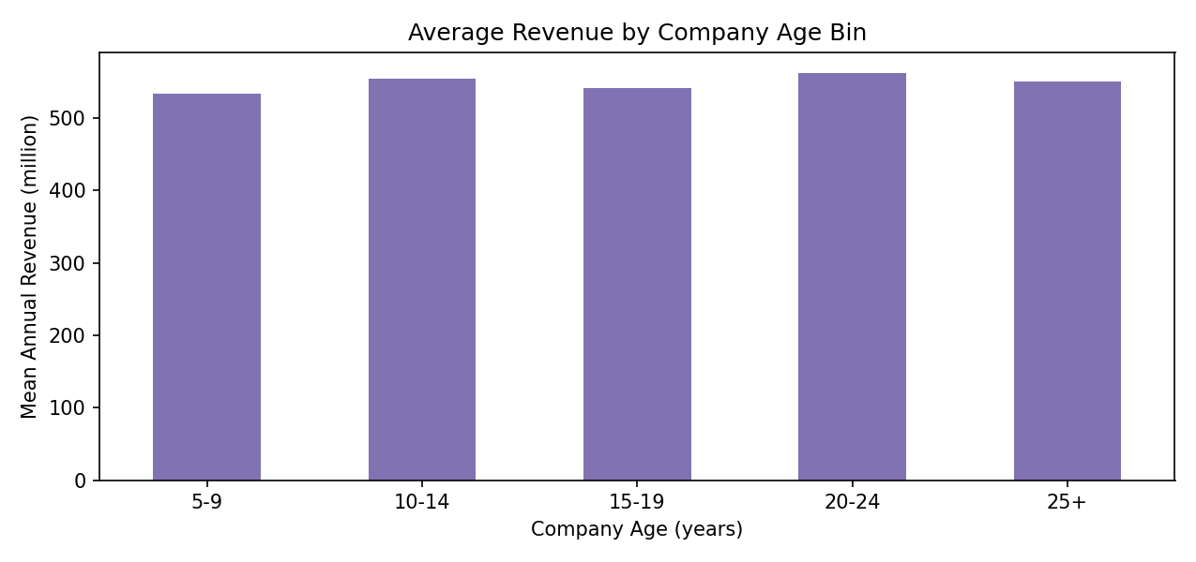
Company Age Insights
Revenue varies across company age groups; mid-aged companies often show higher average revenue.

Slide 11
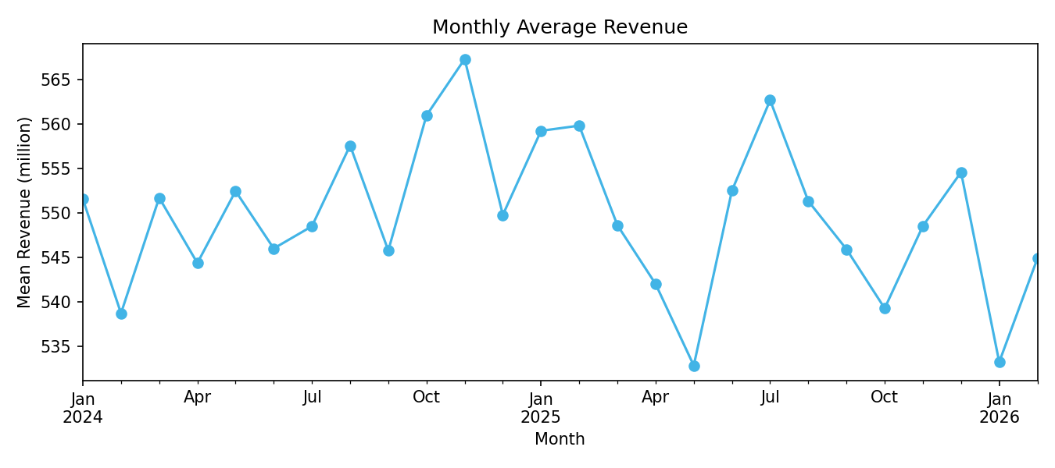
Revenue Trend Analysis
CAGR: -1.14%.

Slide 12
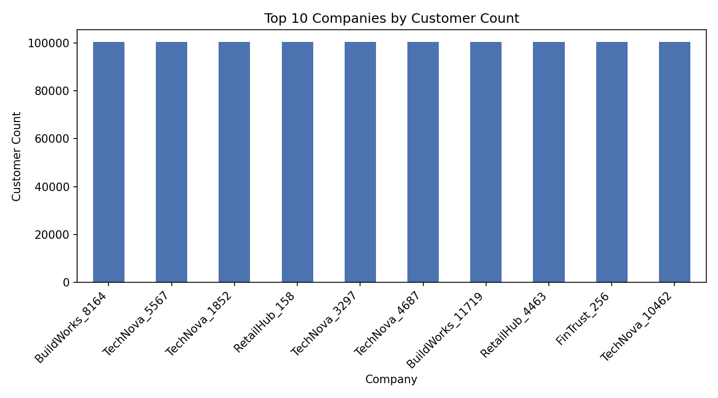
Top Customers & Revenue Leaders
Top customer count firms are also strong revenue contributors.

Slide 13
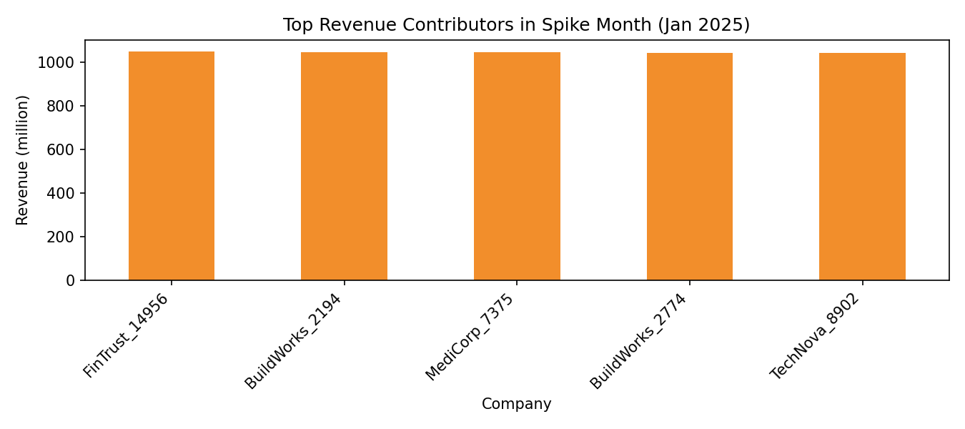
Spike Month Contributors
Spike observed in Jan 2025. Top contributors are shown below.

Slide 14
Insights and future scope
Analytical findings :
Correlation heatmap provides feature dependency context for predictive modeling.
Kruskal-Wallis tests and age-bin summaries can help validate revenue differences by category.
Conclusion :
Revenue distribution is relatively stable with limited extreme outliers.
Top industries and regions are key revenue drivers; customer count and company age add practical segmentation value.
Further analysis should include demand forecasting, churn segmentation, and quarterly profitability modeling.

Slide 15
Thank you!

