Slide 1

Mathlogical (Scientific Calculator)
Radhika Rathod

Slide 2
Introduction
The Mathgical Calculator is a Python-based application built using PyQt5, designed for efficient and user-friendly calculations.
It supports both basic and scientific operations, along with memory functions and calculation history.
The application also features light and dark themes, providing a modern interface and improved user experience.

Slide 3
Why PyQt5?
PyQt5 was chosen because it provides a powerful and flexible framework for building desktop GUI applications with a professional look.
It offers a wide range of ready-to-use widgets, supports event-driven programming, and allows easy implementation of features like layouts, theme switching, and user interactions.
Compared to other libraries, PyQt5 gives better control over UI design and helps create modern, responsive applications efficiently.

Slide 4
Operator & Functions
C | Clears the current input
MC | Clears stored memory
MR | Recalls value from memory
M+ | Adds value to memory
M− | Subtracts value from memory
sin | Calculates sine of an angle
cos | Calculates cosine of an angle
tan | Calculates tangent of an angle
√ | Calculates square root
log | Calculates base-10 logarithm
π | Inserts value of pi
e | Inserts Euler’s number
x² | Squares the number
x³ | Cubes the number
xʸ | Raises number to a power
Operator | Function Description
+ | Adds two numbers
− | Subtracts one number from another
× | Multiplies two numbers
÷ | Divides one number by another
= | Displays the calculated result
. | Adds decimal point for fractional values

Slide 5
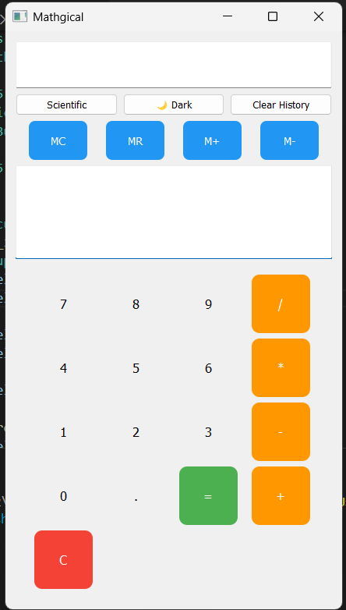
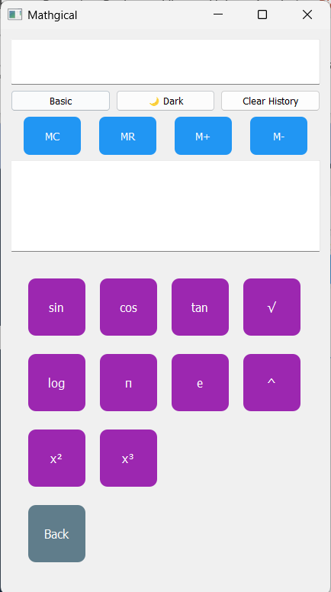
Light Theme
Clean and minimal user interface
Ideal for daytime usage
Light background improves readability
Color-coded actions:
Operators → Orange
Equal → Green
Clear → Red
Simple, intuitive, and easy to navigate
Maintains clarity with a user-friendly layout

Slide 6
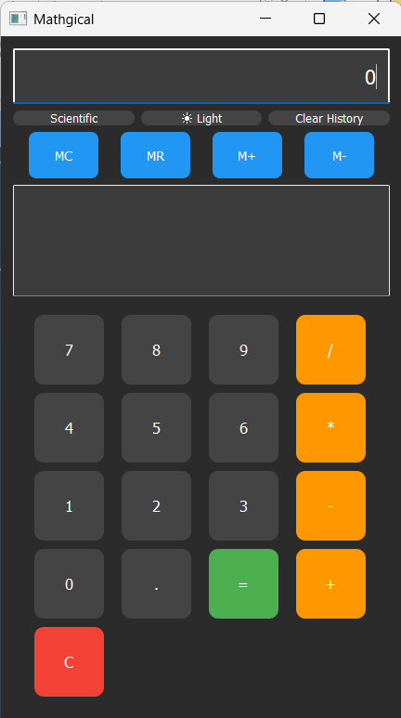
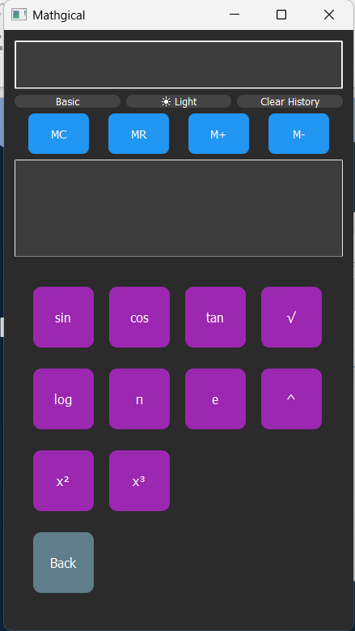
Dark Theme
Modern and visually appealing interface
Suitable for low-light environments
Dark background reduces eye strain
High-contrast text improves visibility
Consistent color coding across themes
Professional look with smooth usability

Slide 7
Challenges
Handling invalid user inputs and calculation errors
Ensuring safe evaluation of expressions using eval()
Implementing scientific functions with correct logic
Managing theme switching (Light/Dark) smoothly
Switching between Basic and Scientific layouts
Implementing memory functions (MC, MR, M+, M-)
Maintaining calculation history efficiently

Slide 8
Future scope
Add advanced mathematical functions (factorial, permutations,
combinations)
Enhance UI with animations and improved styling
Add search/filter option in calculation history
Enable export/save history to file (CSV/PDF)
Implement expression validation before evaluation
Add multi-theme customization (beyond light/dark)
Develop a web or mobile version of the calculator

Slide 9
Conclusion
This project enhanced my understanding of GUI development, problem-solving, and real-time application design, while building a practical and user-centric calculator solution.

Slide 10
Thank you!
10

