Slide 1
Beginning Spring MVC
Spencer Uresk

Slide 2
Notes
This is a training, NOT a presentation
Please ask questions
This is being recorded
https://tech.lds.org/wiki/Java_Stack_Training
Prerequisites
Basic Java
Installed LDSTech IDE (or other equivalent)
Spring, Servlet, and JSP Trainings

Slide 3
A Note About Security
The scope of this training is limited to teaching you how to use Spring MVC
The way we output values in JSPs is insecure – they contain XSS vulnerabilities
We have documented ways to do this properly:
https://tech.lds.org/wiki/Intermediate_JSP#Lab_2_Taglibs
http://code.lds.org/maven-sites/stack/module.html?module=security-web

Slide 4
Objectives
By the end of this training, you should: - Have a general understanding of MVC in general and Spring MVC in particular - Understand how Spring MVC is configured and be able to add it to any project - Know how to create a simple controller - Know how to map an incoming request to a controller

Slide 5
What is MVC?
Well-established architectural pattern for dealing with UI
Model manages the behavior and data of the application
View renders the model into UI elements
Controller processes user inputs and generates a response by operating on model objects

Slide 6
MVC in a Web Application
The model is the data and business/domain logic for your application
The view is typically HTML generated by your application
The controller receives HTTP requests and decides which domain objects to use to carry out specific tasks

Slide 7
Benefits of MVC
Decoupling views and models
Reduces the complexity of your design
Makes code more flexible
Makes code more maintainable

Slide 8
What is Spring MVC?
MVC Web Framework
Developed by the Spring team in response to what they felt were deficiencies in frameworks like Struts
Deeply integrated with Spring
Allows most parts to be customized (ie, you can use pretty much any view technology)
RESTful functionality (URI templates, Content Negotiation)

Slide 9
Spring MVC Features
Clear separation of roles
Simple, powerful annotation-based configuration
Controllers are configured via Spring, which makes them easy to use with other Spring objects and makes them easy to test
Customizable data binding
Flexible view technology
Customizable handler mapping and view resolution

Slide 10
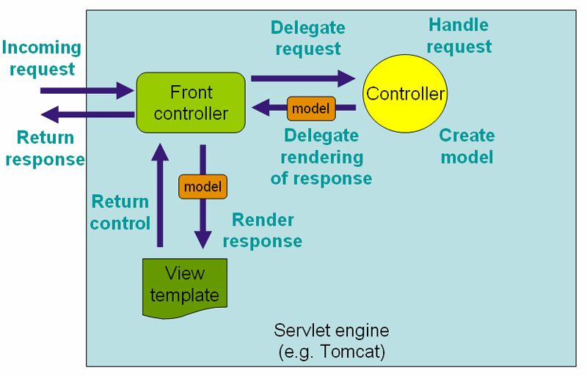
DispatcherServlet
[1] Copyright © 2004-2010 Rod Johnson, Juergen Hoeller, et al. See copyright slide for full copyright information.
Notes:
DispatcherServlet is the Front Controller
It uses request mappings to figure out which controller method (handler) to delegate to.
The controller delegates rendering the response back to the DispatchereServlet, which finds the correct view template and processes it.

Slide 11
Adding Spring MVC to a project
Spring MVC is relatively easy to add to any existing Spring project
When you create a Stack Starter (3.x) project, the default is to include Spring MVC
But we’ll go through the configuration steps so you know what is going on
3 basic steps

Slide 12
Step 1: Add dependencies
First, you need to add the Spring MVC dependency to your web POM
<dependency>
<groupId>org.springframework</groupId>
<artifactId>spring-webmvc</artifactId>
</dependency>

Slide 13
Step 2: Configure web.xml
We need to define the DispatcherServlet , give it a name (yourapp in this case), and map it to a url pattern (/ in this case, which is the default servlet)
<servlet>
<servlet-name>yourapp</servlet-name>
<servlet-class>org.springframework.web.servlet.DispatcherServlet</servlet-class>
<load-on-startup>2</load-on-startup>
</servlet>
<servlet-mapping>
<servlet-name>yourapp</servlet-name>
<url-pattern>/</url-pattern>
</servlet-mapping>

Slide 14
Step 3: Add the configuration file
We need to create a configuration file name [servlet-name]-servlet.xml, where [servlet-name] is the name we gave our servlet in Step 2 (yourapp)
This is a normal Spring configuration file that defines a web context

Slide 15
Step 3, Continued
First, we tell it to look for classes in the org.lds.yourapp namespace, annotated with @Controller
We also need to tell Spring MVC that we are going to configure it via annotations:
<context:component-scan base-package="org.lds.yourapp" use-default-filters="false">
<context:include-filter expression="org.springframework.stereotype.Controller" type="annotation" />
</context:component-scan>
<mvc:annotation-driven />

Slide 16
Step 3, Continued
If you map the DispatcherServlet to the default servlet (we did), you need to add the following:
Finally, we need to configure a ViewResolver to find our JSPs
<mvc:default-servlet-handler />
<bean class="org.springframework.web.servlet.view.InternalResourceViewResolver">
<property name="prefix" value="/WEB-INF/views/"/>
<property name="suffix" value=".jsp"/>
<property name="redirectHttp10Compatible" value="false"/>
</bean>

Slide 17
Hierarchy of Contexts
When we create the [servlet-name]-servlet.xml file, we are creating a new Spring context that is a child of your application context
It can resolve beans from the root context, but other contexts can’t resolve beans from it
You can create as many of these as you need (ie, you might have another one for web services)
You need to make sure you don’t redefine beans, though

Slide 18
Context Hierarchy
a
DefaultWebContext
/
b
GWT Context
/*.gwtrpc
c
Web Services
/ws/
Application Context

Slide 19
Simple request mapping
We can do simple mappings to static content in the xml configuration, which maps /hello to /WEB-INF/views/hello.jsp
<bean id="helloController" class="org.springframework.web.servlet.mvc.ParameterizableViewController">
<property name="viewName" value="hello" />
</bean>
<bean class="org.springframework.web.servlet.handler.SimpleUrlHandlerMapping">
<property name="order" value="1" />
<property name="urlMap">
<map>
<entry key="/hello" value-ref="helloController" />
</map>
</property>
</bean>

Slide 20
Simple request mapping
Thankfully, Spring MVC has a Namespace Handler to make this simpler.
The following does the exact same thing:
<mvc:view-controller path="/hello" view-name=“hello" />

Slide 21
Lab 1: Configure a project
Take a basic project (with no view) created via Stack Starter
Add dependencies, web.xml config, and servlet config
Add a simple request mapping
Verify that it works

Slide 22
Simple Controller
For most cases, you’ll need to create a controller
Create a class and annotate it with @Controller
Then, create a method annotated with a @RequestMapping
package org.lds.yourapp;
@Controller
public class HelloController {
@RequestMapping(value="/")
public String hello() {
return “hello";
}
}

Slide 23
Advanced Request Mapping
RequestMappings are really flexible
You can define a @RequestMapping on a class and all method @RequestMappings will be relative to it.
There are a number of ways to define them:
URI Patterns
HTTP Methods (GET, POST, etc)
Request Parameters
Header values

Slide 24
@RequestMapping – Class level
The url for this (relative to your context root) would be: /portfolio/create
package org.lds.yourapp;
@RequestMapping("/portfolio")
@Controller
public class PortfolioController {
@RequestMapping("/create")
public String create() {
return “create";
}
}

Slide 25
@RequestMapping – HTTP Methods
package org.lds.yourapp;
@RequestMapping("/portfolio")
@Controller
public class PortfolioController {
@RequestMapping(value = "/create“, method = RequestMethod.POST)
public String save() {
return “view";
}
}
Same URL as the previous example, but responds to POSTs

Slide 26
@RequestMapping – Request Params
package org.lds.yourapp;
@RequestMapping("/portfolio")
@Controller
public class PortfolioController {
@RequestMapping(value = "/view“, params=“details=all”)
public String viewAll() {
return “viewAll";
}
}
This will respond to /portfolio/view?details=all

Slide 27
@RequestMapping – URI Templates
package org.lds.yourapp;
@RequestMapping("/portfolio/{id}")
@Controller
public class PortfolioController {
@RequestMapping("/viewProject/{projectId}")
public String viewProject() {
return "viewProject";
}
}
The url for this (relative to your context root) would be: /portfolio/1/viewProject/10
We’ll discuss how to use the values from these placeholders later

Slide 28
Lab 2: Create a controller
Create a simple controller for /hello
Return a jsp
Experiment with some more advanced request mappings

Slide 29
Controller Method Arguments
Sometimes you need access to the request, session, request body, or other items
If you add them as arguments to your controller method, Spring will pass them in
@RequestMapping(value="/")
public String getProject(HttpServletRequest request, HttpSession session, @RequestParam(“projectId”) Long projectId,
@RequestHeader("content-type") String contentType) {
return "index";
}

Slide 30
Supported Method Arguments
Request/Response objects
Session object
Spring’s WebRequest object
java.util.Locale
java.io.Reader (access to request content)
java.io.Writer (access to response content)
java.security.Principal
ModelMap
org.springframework.validation.Errors
org.springframework.validation.BindingResult

Slide 31
Supported Annotations on params
@PathVariable
@RequestParam
@RequestHeader
@RequestBody

Slide 32
Method Arguments (Samples)
This gives you access to the request/response and session
@RequestMapping(value="/")
public String getProject(HttpServletRequest request,
HttpServletResponse response,
HttpSession session) {
return "index";
}

Slide 33
Method Arguments (Samples)
This gives you access to request parameters and headers
@RequestMapping(value="/")
public String getProject(
@RequestParam Long projectId,
@RequestHeader("content-type") String contentType) {
return "index";
}

Slide 34
Method Arguments (Samples)
@PathVariable ties dynamic elements of the URI to method arguments
@RequestMapping(value="/project/{portfolioId}/{projectId}")
public String getProject(
@PathVariable(“projectId”) Long id,
@PathVariable Long portfolioId) {
return "index";
}

Slide 35
The Model
You populate the view with data by via the ModelMap or ModelAndView (which has a ModelMap underneath)
This is basically a Map
All attributes are added to the request so that they can be picked up by JSPs

Slide 36
ModelMap
Add it as a parameter to your controller method
We’d consume it in our JSP like this:
public String doController(ModelMap modelMap){
modelMap.addAttribute(user);
modelMap.addAttribute(“otherUser”, user);
return “index”;
}
User: ${user}<br /><br />
Other User: ${otherUser}

Slide 37
ModelAndView
Combines the model and view into one object
We’d consume it in our JSP like this:
public ModelAndView doController() {
ModelAndView mav = new ModelAndView(“index”);
mav.addObject(user);
mav.addObject(“otherUser”, user);
return mav;
}
User: ${user}<br /><br />
Other User: ${otherUser}

Slide 38
Lab 3: Putting it all together
Add a more complex controller that takes a path param and displays it back to the user
Also, have it echo back a header

Slide 39
Next Steps
Part II of this training in 2 weeks
Spring MVC reference documentation http://static.springsource.org/spring/docs/3.0.x/spring-framework-reference/html/mvc.html

Slide 40
Sources
http://en.wikipedia.org/wiki/Model%E2%80%93view%E2%80%93controller
http://en.wikipedia.org/wiki/Spring_Framework#Model-view-controller_framework
http://static.springsource.org/spring/docs/3.0.x/spring-framework-reference/html/mvc.html

Slide 41
Copyright Notice
1. DispatcherServlet image copyright info:
Copyright © 2004-2010 Rod Johnson, Juergen Hoeller, Keith Donald, Colin Sampaleanu, Rob Harrop, Alef Arendsen, Thomas Risberg, Darren Davison, Dmitriy Kopylenko, Mark Pollack, Thierry Templier, Erwin Vervaet, Portia Tung, Ben Hale, Adrian Colyer, John Lewis, Costin Leau, Mark Fisher, Sam Brannen, Ramnivas Laddad, Arjen Poutsma, Chris Beams, Tareq Abedrabbo, Andy Clement, Dave Syer, Oliver Gierke
Copies of this document may be made for your own use and for distribution to others, provided that you do not charge any fee for such copies and further provided that each copy contains this Copyright Notice, whether distributed in print or electronically.
http://static.springsource.org/spring/docs/3.0.x/spring-framework-reference/html/mvc.html#mvc-servlet

