Slide 1
IDA CUSTOM BOOTCAMP
RADHIKA TIBREWAL

Slide 2
DAY 1

Slide 3
IDA: valuable insight from raw data
Petroleum production how much for next year acc to market and produce accordingly. Manage the demand and the need. Data broadcasting is done for the same.
Every company uses the previous data for employees recruitment, production ,etc. These are called data driven decisions. these would need proper data. But no one has properly structured data. So, extract data refine and store in final destination where the insight can be seen .
Development → Testing → Production
As data engineer development how to develop, deploy
End user start using in production – more of client.
Testing more of python
Data: Factual Information
Types of Data :
Structured : Tables
Semi-structured:
Unstructured: media

Slide 4
Advantage of semi-structured in terms of structured is
More flexible
Schema is not fixed
Not fixed as more fields can be added while tables have fixed no..
E.g.
{ name:
id:}
{
Name:
Id:
Location:
}
Different type of files of company saving in local d
Problems with using data, txt, and other file formats used in the file system.
It doesn’t support large amounts of storage.
It takes a long time to read through the data.
There is high data redundancy.

Slide 5
Keys
Primary key – not null and unique (because without primary key can’t uniquely identify, i.e to maintain integrity and uniqueness)
Foreign key – To create a relation between two tables there has to be a foreign key. foreign key is the primary key in another table. it can have diff name than primary key.
Candidate Key – combination of two keys.
Composite key-A composite key can also be made by the combination of more than one candidate key. A composite key cannot be null.
The difference between composite keys and super keys is that composite keys are minimal super keys. If even 1 column is removed from the set of keys in a composite key, it is no longer unique.
Super Key – single key can connect with all other keys -> employee name can be same but employeeid, employee name can’t be same so these two taken as super key.
Unique key – unique value but can be null. ( e.g. contact no. can be null)
Data Redundancy is removed by normalization.
Normalization: Splitting the table to reduce data redundancy
Denormalization: usually not preferred.

Slide 6
ER DIAGRAM: Entity Relationship
ER Modelling for bookstore.
Book, author, customer, order, publisher - entities
Book – bid, bname, auth_id, edition, pub_id, cost
Author - auth_id, auth_name, phone_num
Customer – cust_id, cust_name, phone_num
Order – order_id, cust_id, book_id, qty, amount
Publisher – pub_id, pub_name, phone_num
First step in working with any requirements
Analyze the requirement
Come up with the ER model
1NF
No multi-valued attributes should be present
2NF
Should be in 1NF
Non-key attributes should not depend on the partial of the primary key
Composite key -> id + course
Age is dependent on the partial of the this composite key: id, name, age are present in the same table
Id and course are present in another table
3NF
Should be in 2NF
Non-key attributes should not have any dependency among them
BCNF
Should be in 3NF
Identify the primary key
Identify the functional dependencies
Check if the columns are non-key attributes
If they are not key attributes, then break the table and put them in another table

Slide 7
Difference between Star and Snowflake Schema
Common Terminologies
Key-value attributes: unique identifier
Non-key attribute: non unique identifiers
Dimension Modelling
Dimension Table:
Contains all the columns
Fact Table
Contains all the columns that are quantitatively measured
Star Schema
Fact table surrounded by a dimension table
Snowflake schema
Fact table is surrounded by a dimension table
Each dimension table is also further surrounded by dimensions table
S.NO | Star Schema | Snowflake Schema
1. | In star schema, The fact tables and the dimension tables are contained. | While in snowflake schema, The fact tables, dimension tables as well as sub dimension tables are contained.
2. | Star schema is a top-down model. | While it is a bottom-up model.
3. | Star schema uses more space. | While it uses less space.
4. | It takes less time for the execution of queries. | While it takes more time than star schema for the execution of queries.
5. | In star schema, Normalization is not used. | While in this, both normalization and denormalization are used.
6. | It’s design is very simple. | While it’s design is complex.
7. | The query complexity of star schema is low. | While the query complexity of snowflake schema is higher than star schema.
8. | Its understanding is very simple. | While it’sunderstanding is difficult.
9. | It has less number of foreign keys. | While it has more number of foreign keys.
10. | It has high data redundancy. | While it has low data redundancy.

Slide 8
Table List
Product
Date
Location
Customer
Salesperson
The above table will use a Star Schema
SLOWLY CHANGING DIMENSION
SCD-1: Just Replace the record e.g location changes from delhi to goa
SCD-2:Add one row . Add three columns – Effective from date, End date (system defined – infinite date), Current flag – Y : Latest City ,N : Not living currently
Here, the previous row will have eff from earlier date , end date as today’s date . Whereas the new row will have eff from date today but end date not defined
SCD-3: Will create one more column and that column will tell whether it is old location or new location. If it’s old write null otherwise new locations name

Slide 9
Customer ID | Customer Name | Contact | Location
1 | A | 64535 | Bengaluru
2 | B | 56747 | Mumbai
3 | C | 87654 | Goa
Change location to new location for C – Goa to Delhi
SCD- 1
Customer ID | Customer Name | Contact | Location
1 | A | 64535 | Bengaluru
2 | B | 56747 | Mumbai
3 | C | 87654 | Delhi
SCD- 2
Customer ID | Customer Name | Contact | Location | Effective from date | End date | Current flag [y: current, n:old]
1 | A | 64535 | Bengaluru | 1.02.22 | null | Y
2 | B | 56747 | Mumbai | 2.03.23 | null | Y
3 | C | 87654 | Goa | 3.03.22 | 29.08.23 | N
3 | C | 87654 | Delhi | 29.08.23 | null | Y

Slide 10
SCD- 3
Customer ID | Customer Name | Contact | Location | New Location
1 | A | 64535 | Bengaluru | Null
2 | B | 56747 | Mumbai | Null
3 | C | 87654 | Goa | Delhi

Slide 11
DAY 2

Slide 12
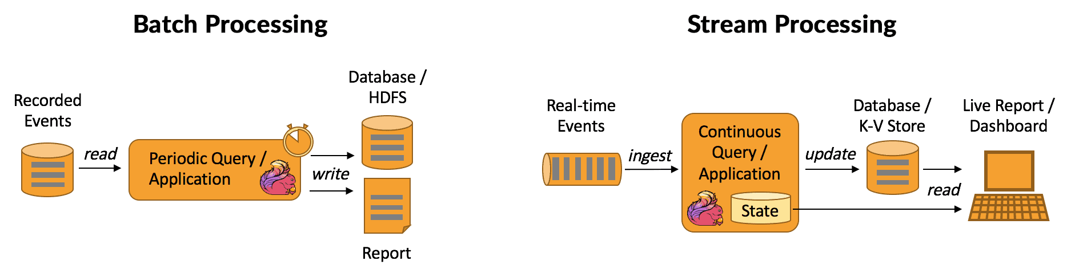
Big Data – huge amount of data
4Vs – Velocity, Volume, Veracity, Variety
Variety – data at many forms
Volume- data at rest
Velocity – data in motion
Veracity – data uncertainity
Batch and Stream Data Processing:
Batch Processing: Batch processing involves collecting a bunch of data, processing it all together, and then getting the results.
Example: Imagine you're running a survey and collecting responses over a week. At the end of the week, you take all the responses, analyze them together, and generate a report showing the overall trends and insights from the entire week's worth of data. This is batch processing.
Stream Processsing: Stream processing involves dealing with data as it arrives, one piece at a time, in real-time.
Example: Think of a social media platform where new posts and comments keep appearing constantly. Instead of waiting for a whole day to see what's been posted, the platform processes each new post or comment as it comes in. So, if someone posts a picture, it shows up in your feed almost instantly. This is stream processing.

Slide 13
Stream analytics help business
360 deg view of the customer
Recommendations
Sentiment analysis : test data train the model
Parallel and distributive processing:
Distributed Processing involves multiple computers working together over a network.
Parallel Processing involves multiple processors or cores within a single machine working together.
Stream Processing involves handling data in real-time as it arrives.
Batch Processing involves processing a set of data all at once, typically done periodically.
Approaches how we are going to deal with data.
Data Warehouse
Save data as object
Structured data
Data modelling
Fixed Schema
ACID properties

Slide 14
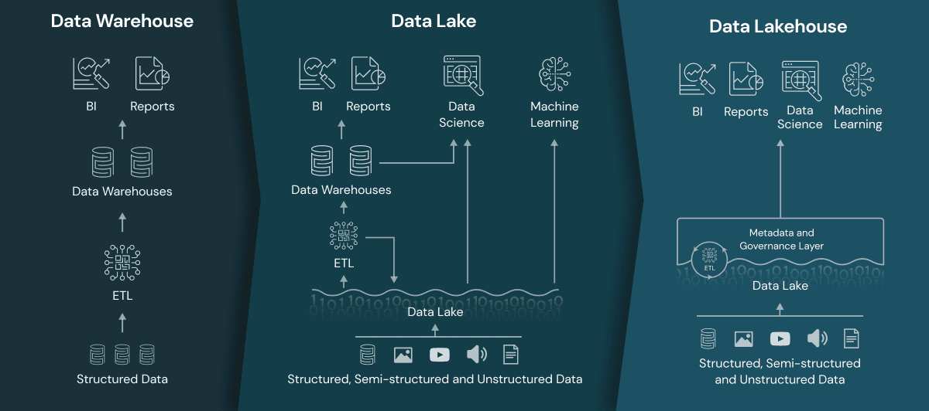
Data Lake / BLOB Storage
[Multiple files how to know what files are imp and what data is to be processed? Every data will have their own data and meta data from where whatever data has to be processed can be found.]
Save data as object
Structured data
Data modelling
Flexi Schema
ACID property
Disadvantage : missing acid properties
Merging Data Warehouse and Data lake is a tedious job , so later it was combined and its called LAKEHOUSE

Slide 15
 | Data Warehouse | Data Lake | Lake House
Definition | A structured, centralized repository that stores integrated, historical data from various sources, optimized for querying and reporting. | A flexible, scalable repository that stores raw and diverse data in its native format, allowing for both structured and unstructured data. | A hybrid architecture that combines the features of a data lake and a data warehouse, offering the benefits of both paradigms.
Storage | Typically uses a relational database management system (RDBMS). | Often relies on distributed file systems like Hadoop HDFS or cloud-based object storage. | Utilizes both data lake storage and structured storage components.
Schema | Enforces a predefined / fixed schema for structured data. | Often relies on distributed file systems like Hadoop HDFS or cloud-based object storage. | Utilizes both data lake storage and structured storage components.
Processing | Suited for structured and pre-aggregated data; optimized for analytical queries. | Often relies on distributed file systems like Hadoop HDFS or cloud-based object storage. | Supports a range of processing tools for different data types.
Use-cases | Business intelligence, reporting, structured analytics. | Data exploration, big data processing, data science. | Integrated analytics, combining raw and structured data, bridging the gap between data lakes and data warehouses.
Example | Traditional relational databases or cloud-based data warehouses like Amazon Redshift. | Hadoop-based systems like Hadoop Distributed File System (HDFS) or cloud-based data lakes like Amazon S3. | Databricks Delta Lake, a unified analytics platform.

Slide 16
Public cloud: amazon and azure cloud platform
Private cloud: company maintain their own data centers and networking.
Hybrid cloud: combination of both public and private
Cloud Benefits:
High Availability
Scalability
Global reach
Agility
Disaster recovery
Fault tolerance
Elasticity
Customer latency capabilities
Predictive cost considerations
Security
Two Models: Capex and Opex
Capital Expenditure: Pay for everything [infrastructure ,resources , everything]
Operational Expenditure: Pay only for the product

Slide 17
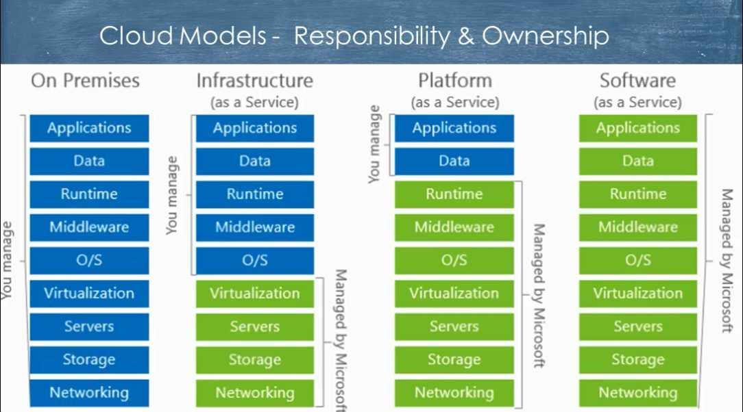
Cloud Service Models:
Iaas:
It only gives infrastructure.
Example: cloud will provide storage, network and computing power
Paas:
It gives operating system and development tools.
Example: It includes server, network data center and operating system and tools
Saas:
It will give all things along with the application.
Example: It includes storage, network, operating system and application
Cloud Computing shared Responsibility Model

Slide 18
Azure Fundamentals
Regions: Nearer region
Region Pairs:
Should have atleast 300 miles of separation between region pairs. The reason is one region goes down /calamity; data is still available at the region pair.
Automatic replication of services
Prioritized region recovery
E.g., Southeast Asia – east Asia
Availability Zone:
provide protection against downtime due to datacenter failure. if one goes down other remains.
Physically separate datacenters within the same region
Each datacenter is equipped separately.
Azure Resources: Components like storage, VMs, networks, SQL database, that are available to build cloud solutions.
Azure Subscriptions: Azure subscription provides with authenticated and authorized access to azure accounts.
Billing boundary
Access control boundary
Azure Resource Manager: ARM provides a management layer that enables all resources. Basically, any service that we are going to get from azure.
Resource Groups: Container that holds all the services/resources we are using. Inside the resource group all the resources will be created
Subscription -> Resource Group -> Resources [Webapp/vm/etc.]

Slide 19
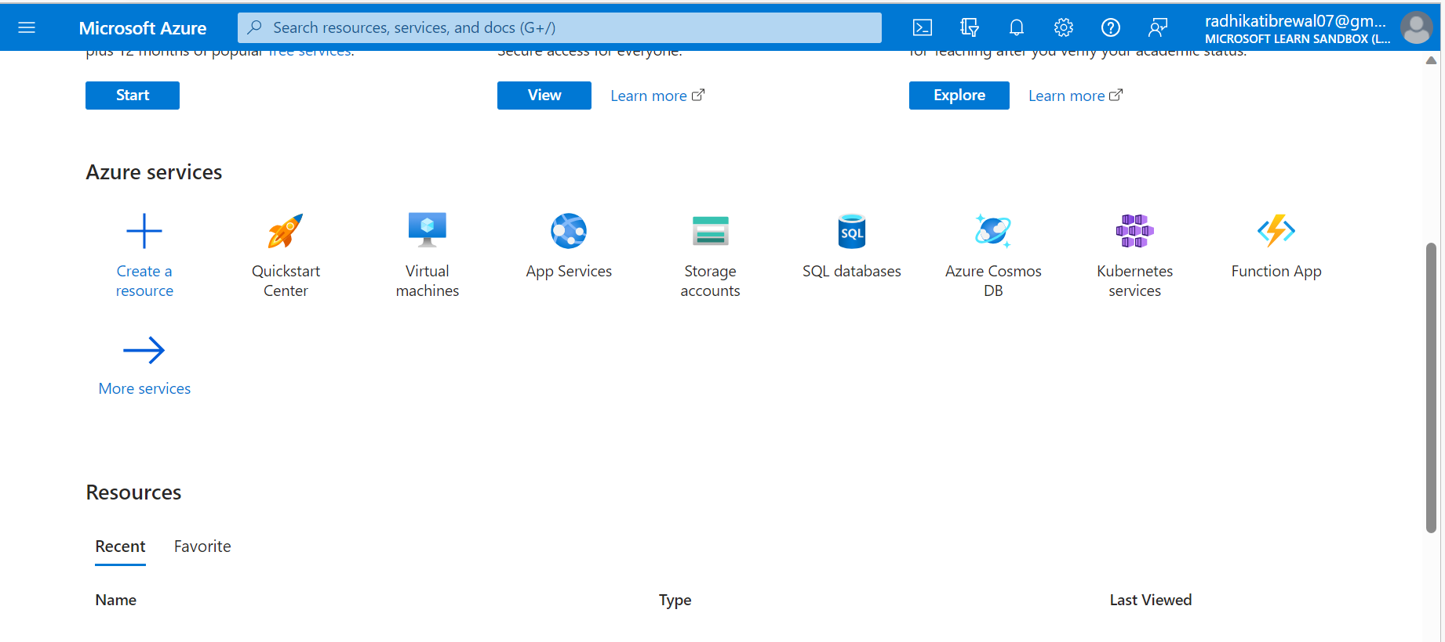
Login to portal.azure.com
Create all services from this site. Subscriptions are provided.
Create either by searching or clicking create a service.
Create a service -> categories ->
Mostly used: analytics -> Data Bricks , Data Factory
Click on Create
Showed example of simple storage account how to create the resource.

Slide 20
DAY 3

Slide 21
Create Azure SQL in particular region: US East
Create Azure SQL -> SQL Databases, SQL managed instances, SQL virtual machines
SQL Databases: when starting from scratch
SQL managed instances manages more services from azure security,
SQL virtual machines: SQL in virtual machine
SQL Databases
Resource Type:
Single Database- separate database for separate things.
Elastic Pool – single resource pool can be used for more services. instead of single combine both . create when one db has less and two db can be used to create pool
Database server- Database is created inside server
User & Group Access
User: Individual access
Group: E.g., New group called IDAShell which has 100 members and give access to the entire group. Maybe only 50/200 tables were required by the IDA team so only that access is provided. If new user comes the person is added to that grp.

Slide 22
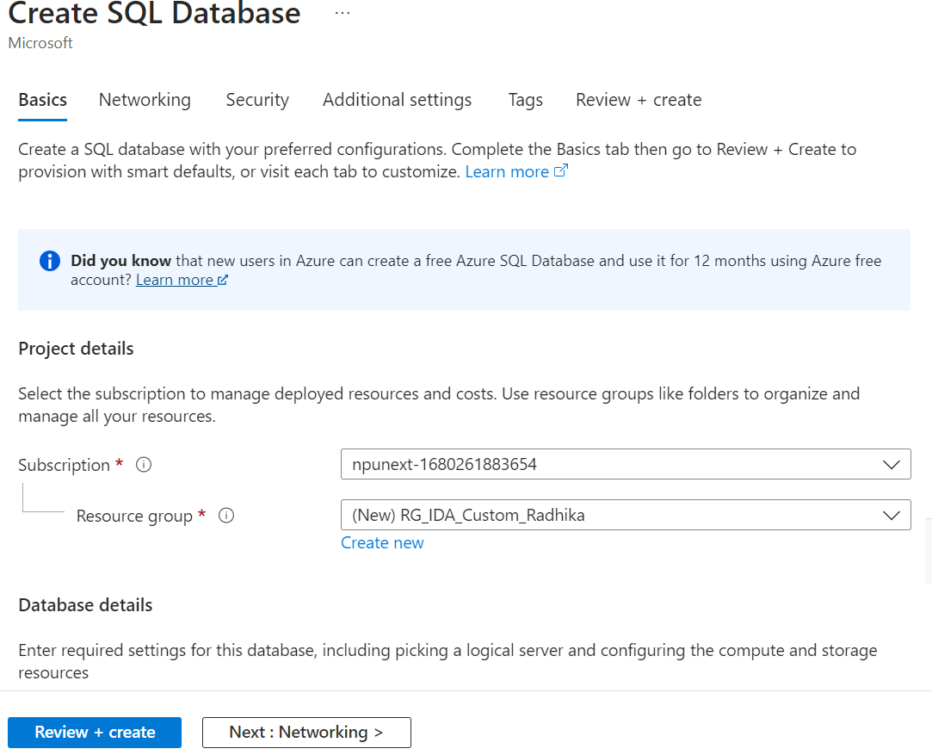
Create SQL Database using Single Db resource:
Basics

Slide 23
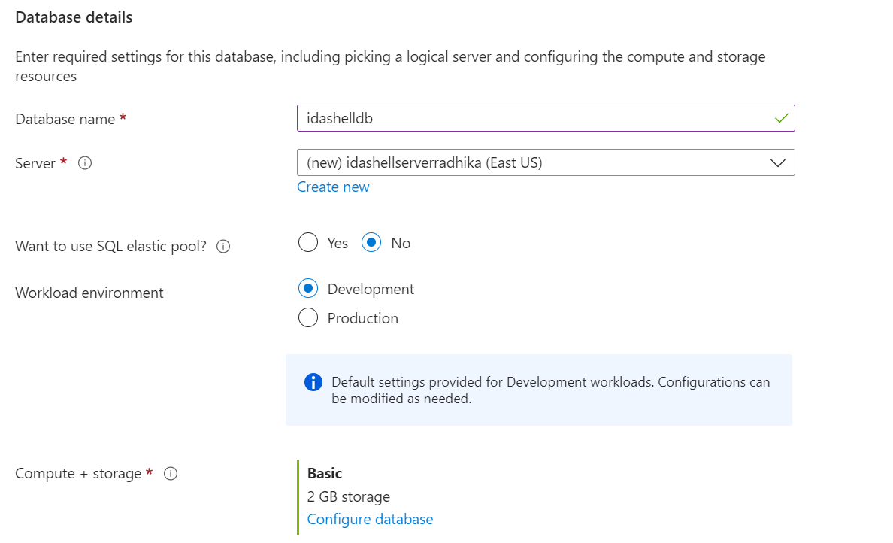
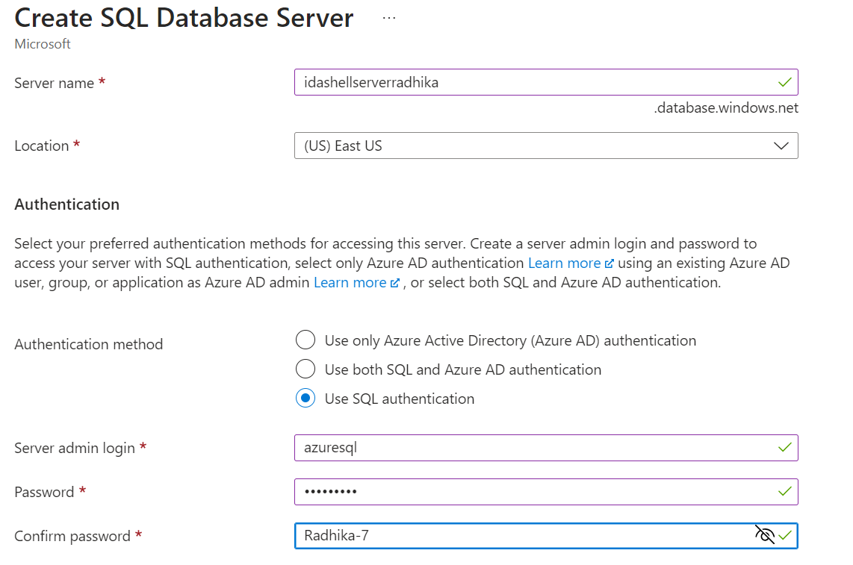
**In computer + storage -> Select Basic 2 GB Storage because that will be cost effective.
**database name (if database server was selected in resource type then the server would have been created at that step) here we will need to create the server as below .
*Authentication Method: AD- Active Directory, SQL, Both AD & SQL
*Active Directory authentication:
* We will go ahead with SQL because everyone has different servers

Slide 24
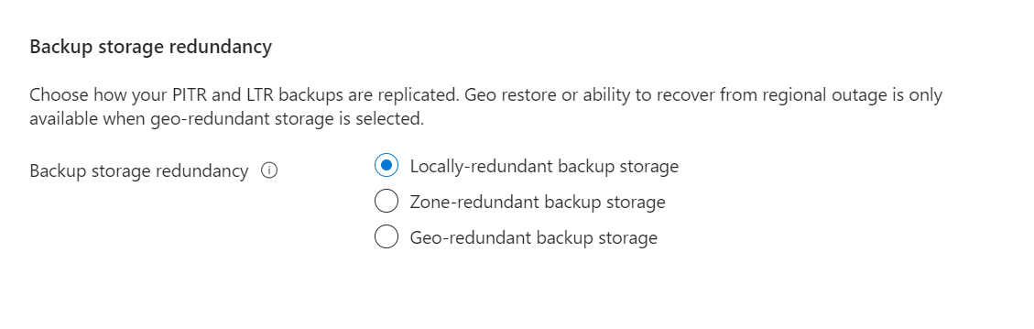
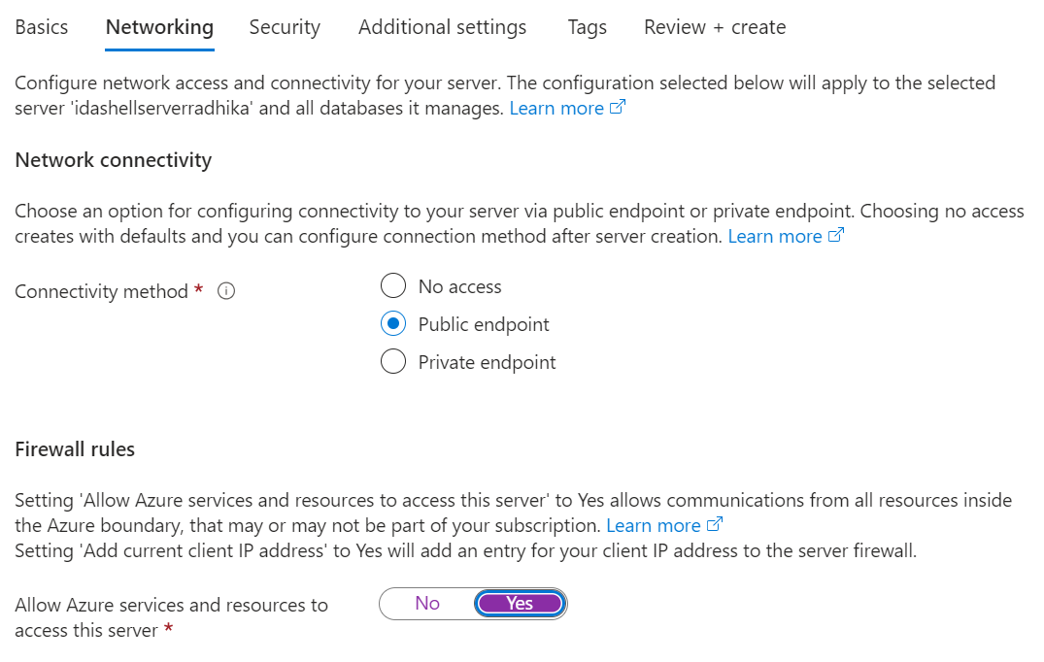
Networking
Locally is selected because it reduces cost .

Slide 25
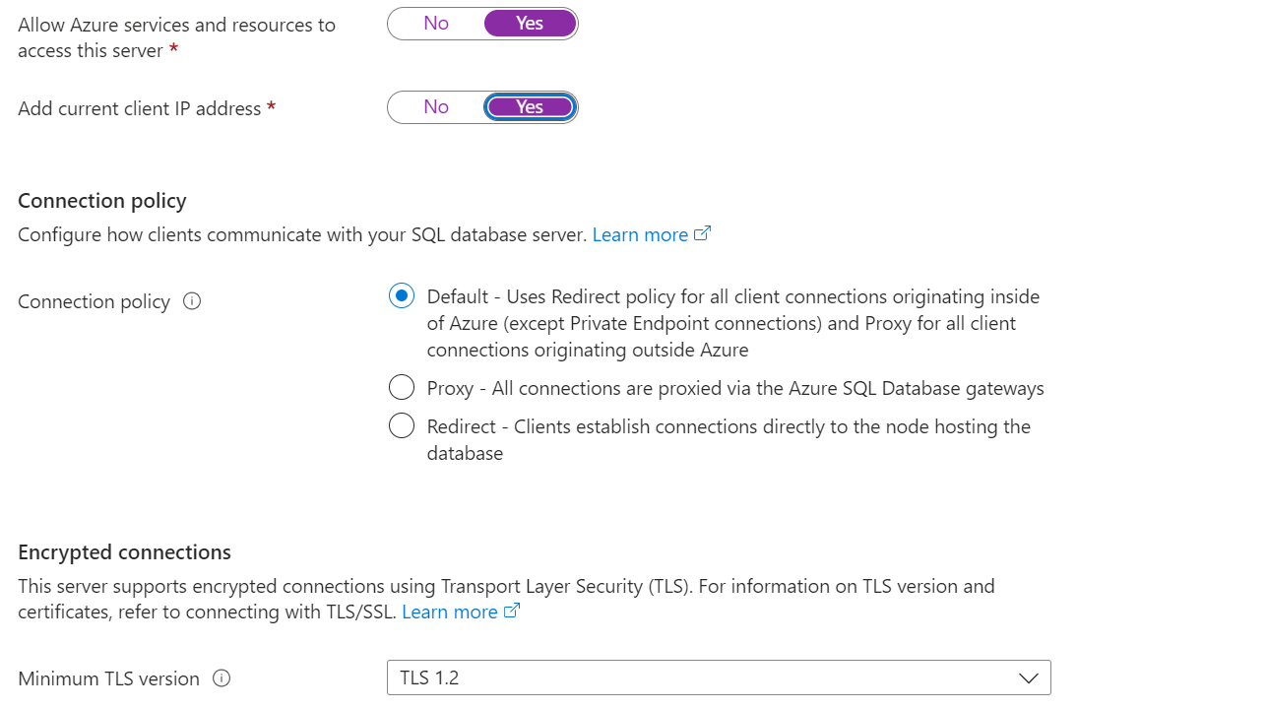
* Connectivity method public endpoint because for private endpoint we will have to create a private endpoint and connect through a virtual network
**Firewall Rules – Allow azure services and resources to access this server: should be Yes otherwise won’t work because no access
**Add current client Ip address – Also Yes Otherwise error.
*Connection Policy:
Default: For the users /client connection inside the azure
Proxy – Database provided through gateways because there is no connection access of the user/client inside azure.
Redirect – In this the client doesn’t have azure connection but it directly establishes connection to the node to access db.
*Transport Layer Security is used whenever the data is being transferred to secure it.
*Minimum TLS Version – Choose the latest.

Slide 26
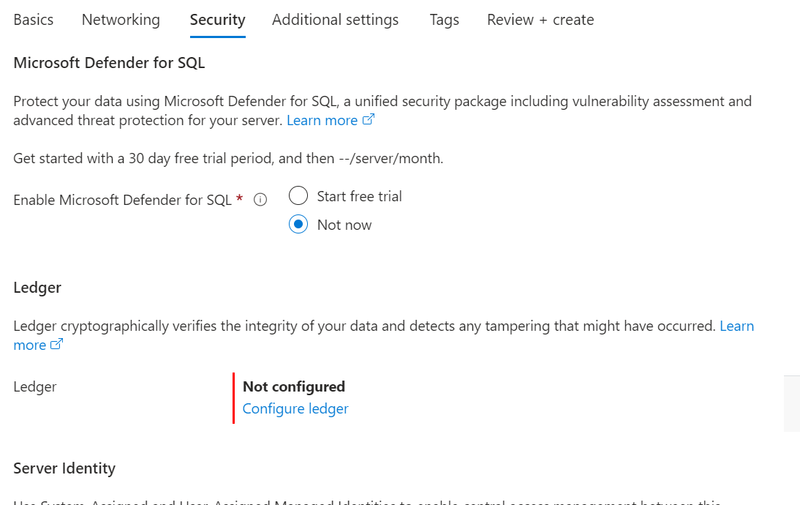
Connection Policy:
Default: For the users /client connection inside the azure
Proxy – Database provided through gateways because there is no connection access of the user/client inside azure.
Redirect – In this the client doesn’t have azure connection but it directly establishes connection to the node to access db.
*Transport Layer Security is used whenever the data is being transferred to secure it.
*Minimum TLS Version – Choose the latest.
Security

Slide 27
DAY 4

Slide 28
View : Limited access of table
CREATE VIEW view_name AS SELECT column1, column2, ... FROM table_name WHERE condition;
DDL : Data definition
DML: Data Manipulation
DCL: Data Control
TCL: Transaction Control
Schema: Logical grouping of table objects
Default Schema: dbo
If we write select without creating schema, if dbo is there it will search for dbo and if not there it will throw error .
If there is any project schema , first find out that
E.g.,
Create schema ven1
Create table ven1.vendor
SYNTAX:
CREATE SCHEMA schemaname
[AUTHORIZATION ownername]
GO
E.g.,
CREATE SCHEMA geeks_sch;GO SELECT *FROM sys.schemas
Difference between Drop table, delete table and truncate tableDrop Table: Entire record and structure will be delete
Delete Table: Selects rows/records will be deleted
Truncate Table: All the records will be deleted but structure will be there.*Only difference between delete and truncate is that where clause can be put in delete that is selected records can be deleted.

Slide 29
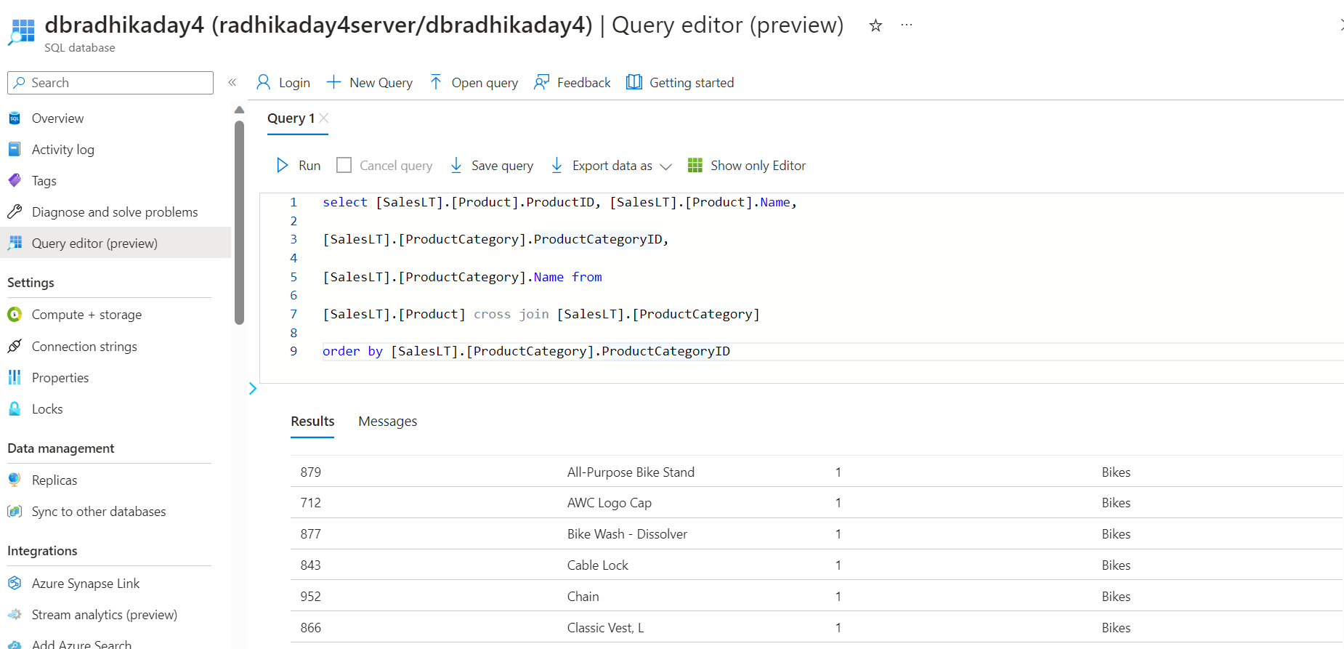
Implementing join using sample data sets
select [SalesLT].[Product].ProductID, [SalesLT].[Product].Name,
[SalesLT].[ProductCategory].ProductCategoryID,
[SalesLT].[ProductCategory].Name from
[SalesLT].[Product] cross join [SalesLT].[ProductCategory]
order by [SalesLT].[ProductCategory].ProductCategoryID

Slide 30
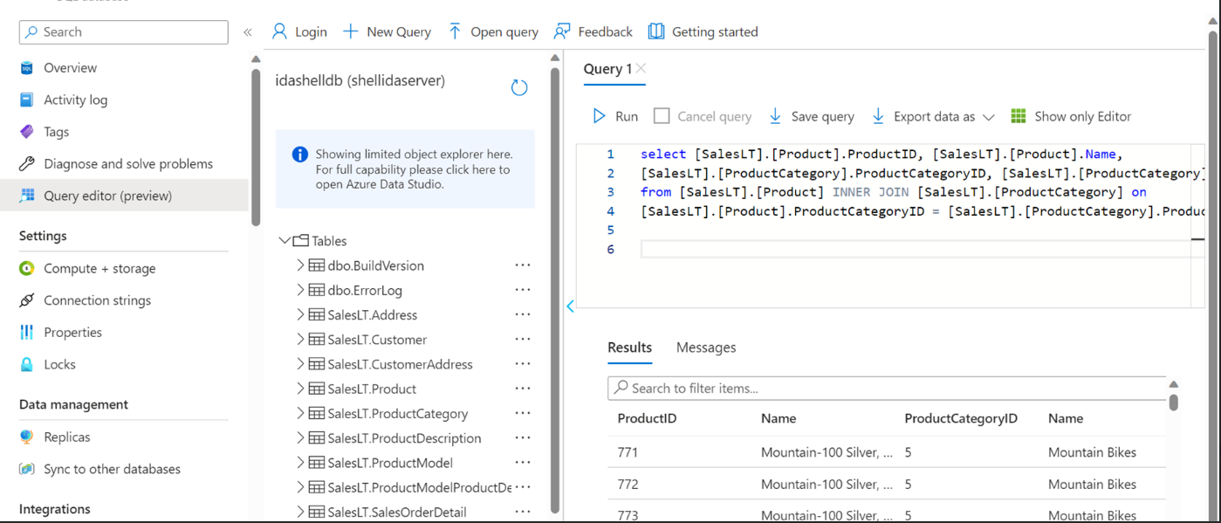

Slide 31
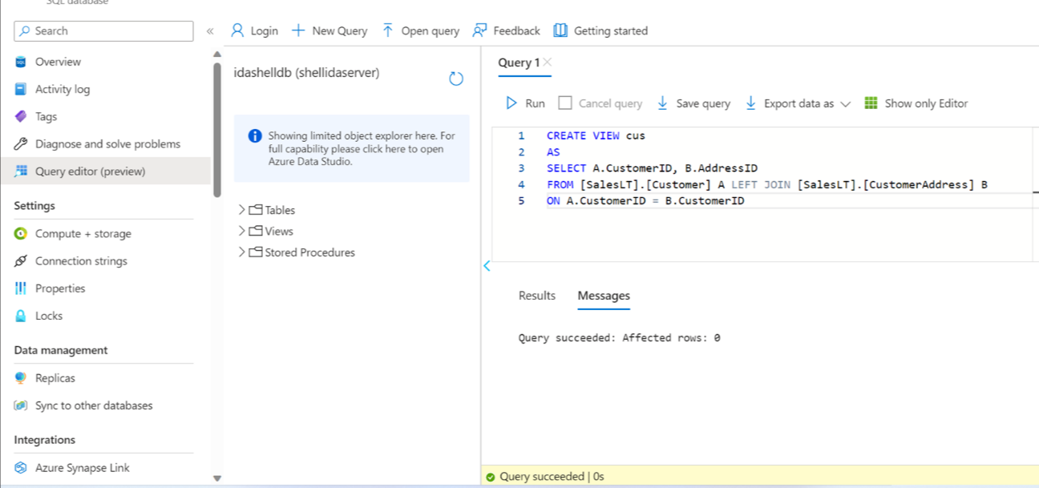

Slide 32
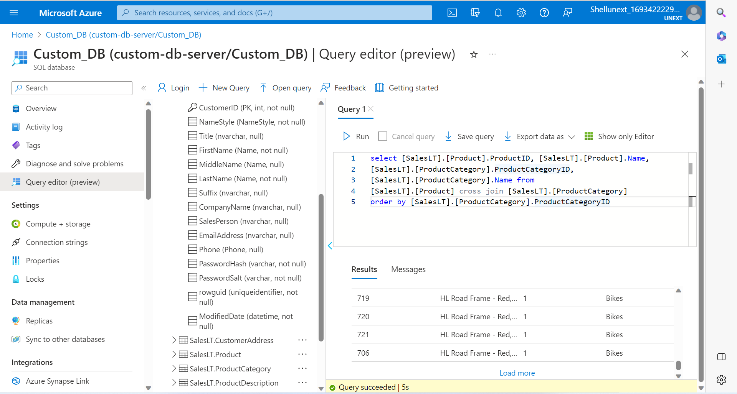

Slide 33
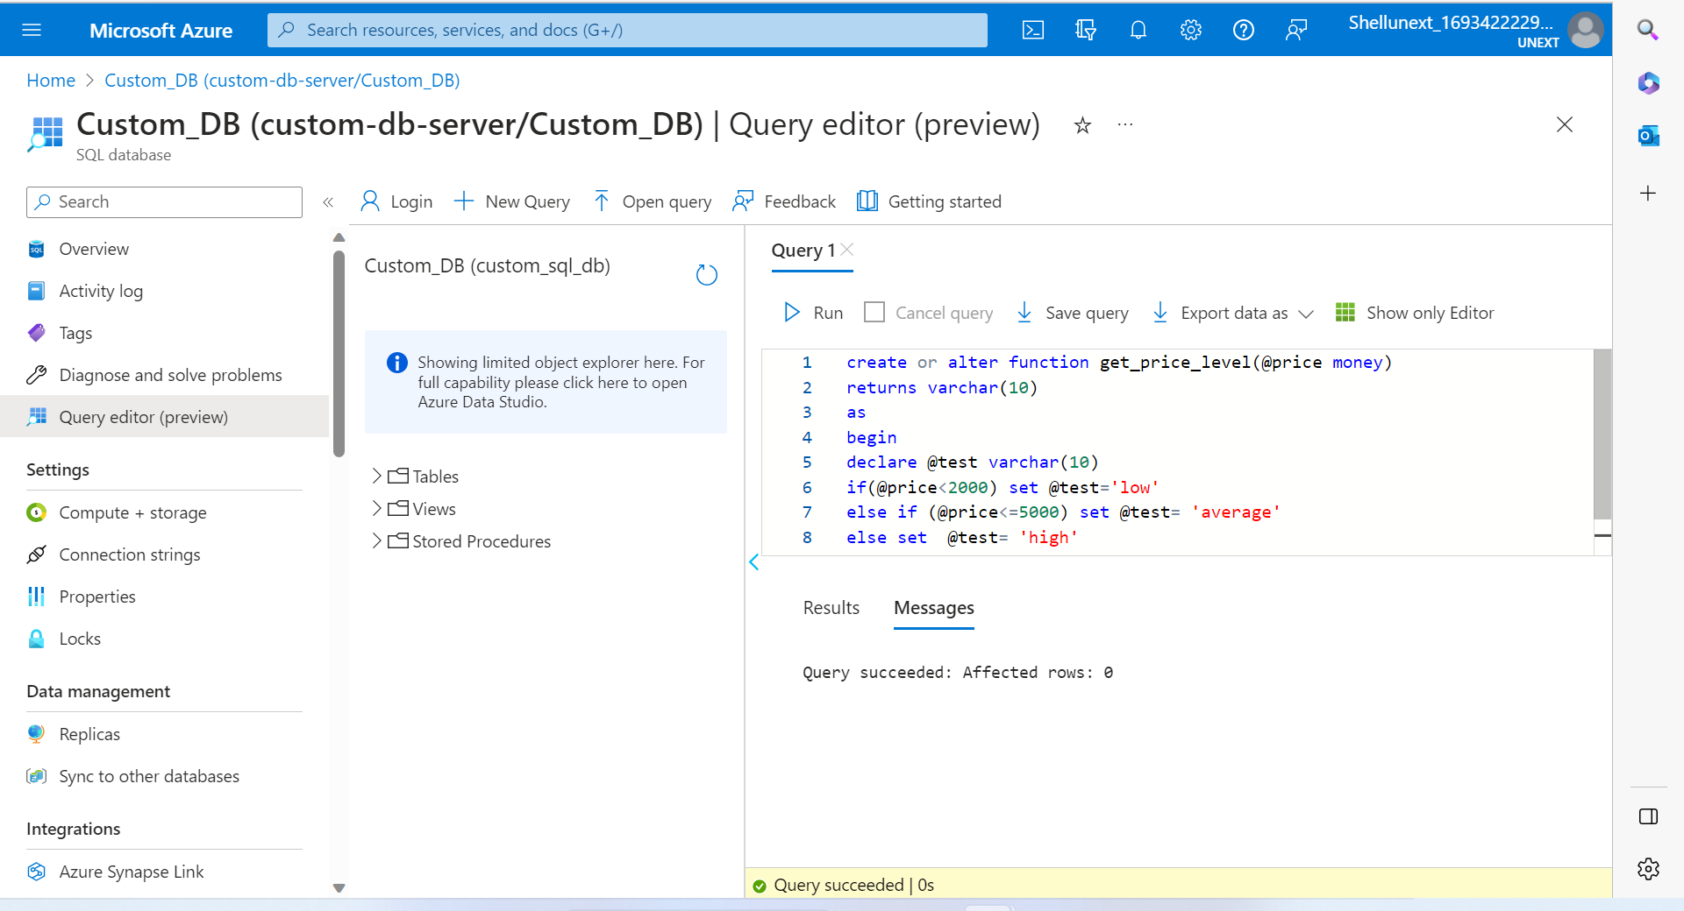

Slide 34
THANK YOU

