Slide 1


Financial analysis of Internal Combustion Engine car, Hybrid car
and Electric vehicle
BY,
VIJAYARAGHAVAN, RADHIKA
Summer 2021

Slide 2
Introduction
Performed a life cycle cost analysis, economic, financial & sensitivity analysis to compare the mutually exclusive alternatives and predict the economical choice.
The mutually exclusive alternatives are S60 (ICE), S60(PHEV), XC40 Pure electric(BEV) by Volvo.
Utilized the data from the past and current and forecasted the future data to compare and identify the best alternative.

Slide 3
Key cost variables - overview
Car | Volvo S60 ICE | Volvo S60 PHEV | Volvo XC40 EV
Total Car Price | $ 42,295.00 | $ 48,919.00 | $ 53,990.00
Tax incentive | $ - | $ 5,419.00 | $ 12,000.00
Sales Tax | $ 3,172.13 | $ 3,668.93 | $ 4,049.25
Total Cash Price | $ 45,467.13 | $ 47,168.93 | $ 46,039.25
Gas mileage(mpg) | 25 | 29.3 | 0
Electric mileage (kWh per mile) | 0 | 0.047 | 0.43
Fuel Prices in current year | $ 4.07 | $ 4.07 | -
 | $ - | $ 0.1331 | $ 0.1331
Interest Rate | 4.16%

Slide 4
Costs overview
Major operating and maintenance costs considered are Fuel prices, Average maintenance and operating costs, License and registration fees, Average insurance fees, depreciation.
Forecasted the fuel(gasoline, electricity) costs using the average inflation rate % of the past decade.
Calculated the capital recovery costs, which served as our basis to calculate the annual equivalent cost of capital
Calculated the interest payments to determine the loan-payment aspect for ownership costs.

Slide 5
Economic analysis
Calculated average inflation rate over the analysis period using the formula F=P(1+f)N to estimate the future fuel prices based on historical data.
Forecasting fuel prices(dollars per gallon)
Initial Value(P) - Year 2010 (period 0) | $ 3.14
Latest Value(F) - Year 2021 (period 11) | $ 4.07
Initial val/Latest Val | $1.29637
Solving LHS of eqn using log fn | $0.01025
Solving RHS of equation | $1.02388
Average fuel inflation rate = 2.4%
Forecasting energy prices(dollars per KWH)
Initial Value(P) - Year 2010 (period 0) | $0.0983
Latest Value(F) - Year 2021 (period 11) | $ 0.1331
Initial val/Latest Val | $1.354
Solving LHS of eqn using log fn | $0.01197
Solving RHS of equation | $1.02793
Average energy inflation rate = 2.8%

Slide 6
Financial Analysis
Calculated the monthly payments using excel fn PMT(0.35%,60,-$41435.33,0,0)
Calculated the total interest payments of each alternative
Calculation for Finance
Total Price | $ 46,039.25
Down Payment | 4603.925
Inputs:
Loan Amount | $41,435.33
APR% / payments per year | 0.0416 / 12
Calculations:
Monthly payment % | $766.09
Interest paid | $4,530.08
Total Amount Paid | $45,965.40
i%(per payment period) | 0.35%
N(periods) | 60
Loan period(years) | 5
Payment No | Payment size | Principal Payment | Interest Payment | Loan Balance

Slide 7
Depreciation
Period | Beginning Value | Depreciation Amount | Ending Value (Salvage Value)
1 | $ 42,295.00 | $ 8,459.00 | $ 33,836.00
2 | $ 33,836.00 | $ 10,827.52 | $ 23,008.48
3 | $ 23,008.48 | $ 4,417.63 | $ 18,590.85
4 | $ 18,590.85 | $ 2,141.67 | $ 16,449.19
5 | $ 16,449.19 | $ 3,289.84 | $ 13,159.35
6 | $ 13,159.35 | $ 5,263.74 | $ 7,895.61
7 | $ 7,895.61 | $ 3,158.24 | $ 4,737.37
8 | $ 4,737.37 | $ 1,894.95 | $ 2,842.42
9 | $ 2,842.42 | $ 1,136.97 | $ 1,705.45
10 | $ 1,705.45 | $ 682.18 | $ 1,023.27
11 | $ 1,023.27 | $ 409.31 | $ 613.96
12 | $ 613.96 | $ 245.59 | $ 368.38
Considered initial cost(I) of the vehicle and below parameters to find the residual value and depreciable amount for each alternative.
Cost basis (I)
Property Class | 5 Year
Depreciation rate | 200% or 2.00(multiplier)
Depreciable life(N) | 5
Salvage Value | -
Declining balance rate(α) | 0.4
(1/N) * 2

Slide 8
Evaluating mutually exclusive alternatives
Analysis period = useful life
Computed the Net Present Worth for each alternative to determine the one with the highest net present worth.
Computed the annual equivalent worth(AEW) for each alternative to determine the lowest cost alternative.
In our analysis considering the annual maintenance/repair costs and salvage values, the optimal replacement time for Volvo S60 ICEV is before year 7, similarly for PHEV and EV it is before year 8.

Slide 9
Comparing alternatives using NPW
Calculated the NPW considering initial cost, tax incentives, O&M cost as inflows and salvage values as outflows.
PV for ICE | PV for HEV | PV for BEV | extra cost of sustainable systems and the saved cost
$ 19,204.67 | $ 28,878.07 | $ 38,884.91 | EV Cost per Mile
$ 6,432.49 | $ 8,836.75 | $ 10,915.03 | EV Cost per Mile
$ 7,884.35 | $ 10,486.21 | $ 12,707.12 | EV Cost per Mile
$ 7,630.27 | $ 10,163.27 | $ 12,323.13 | EV Cost per Mile
$ 3,653.37 | $ 5,535.13 | $ 10,093.04 | EV Cost per Mile
$ (2,211.53) | $ (1,276.01) | $ 5,743.28 | EV Cost per Mile
$ (2,965.25) | $ (2,174.86) | $ (652.90) | EV Cost per Mile
$ (3,352.48) | $ (2,649.17) | $ (1,506.02) | EV Cost per Mile
$ (3,530.11) | $ (2,880.44) | $ (1,960.94) | EV Cost per Mile
$ (3,588.48) | $ (2,973.18) | $ (2,187.83) | EV Cost per Mile
$ (3,579.56) | $ (2,987.51) | $ (2,284.66) | EV Cost per Mile
$ (3,533.26) | $ (2,958.03) | $ (2,307.82) | EV Cost per Mile
interest rate(i%) = 4.16%
NPW of alternatives
Volvo S60 ICEV | -$71,966.08
Volvo S60 Hybrid | - $26,559.80
Volvo XC40 EV | -$26,182.94
First cost (Outflow)
O & M costs (Outflow)
Salvage value (Inflow)
Cash flow(inflow-outflow)
Discounted Cash flow (PV)
Higher NPW

Slide 10
Capital recovery
Capital Recovery Cost (ICEV)
$13,523
$12,892
$10,488
$8,709
$7,837
$7,533
$7,023
$6,491
$6,000
$5,566
$5,190
$4,865
Capital Recovery Cost (PHEV)
$9,996
$12,031
$10,171
$8,574
$7,842
$7,674
$7,215
$6,697
$6,205
$5,764
$5,379
$5,045
Capital Recovery Cost (EV)
$4,762
$10,080
$9,050
$7,798
$6,969
$7,155
$6,873
$6,450
$6,011
$5,602
$5,237
$4,917
Determined the capital recovery cost of each of the alternatives by calculating the net cost of purchase (after any salvage value adjustment) plus the interest rate multiplied by the salvage values.
Initial cost
Salvage value
(P-S)
(P/A, i% ,N)
i*S
Capital Recovery Cost
Inputs for Capital recovery cost calculation

Slide 11
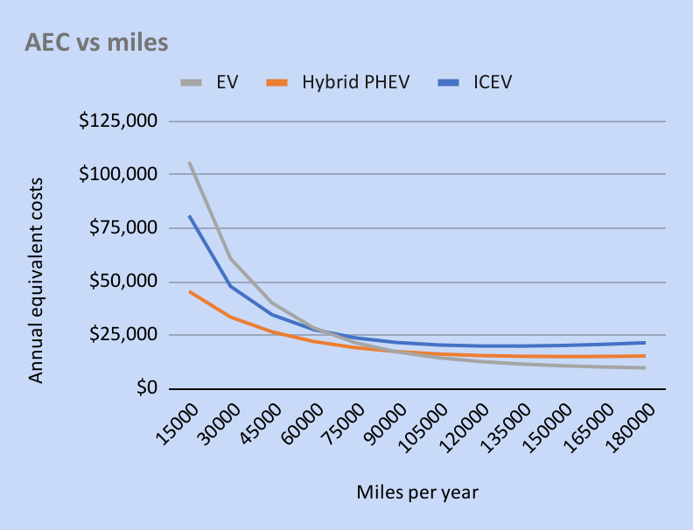
Applying AEW analysis
Considered capital recovery costs(CR), annual equivalent operating costs to calculate the Total Annual Equivalent Costs(AEC)
Miles per year | ICEV | Hybrid PHEV | EV | Minimum Annual equivalent cost
15000 | $27,354.98 | $24,470.75 | $19,451.96 | EV
30000 | $28,921.62 | $28,151.60 | $27,608.27 | EV
45000 | $20,168.66 | $19,208.73 | $18,421.80 | EV
60000 | $16,176.39 | $15,165.83 | $14,290.59 | EV
75000 | $16,517.45 | $15,891.99 | $13,173.18 | EV
90000 | $18,252.87 | $18,109.07 | $18,398.73 | Hybrid PHEV
105000 | $15,704.88 | $15,301.97 | $15,173.23 | EV
120000 | $13,978.38 | $13,401.07 | $12,995.78 | EV
135000 | $12,799.47 | $12,103.93 | $11,516.38 | EV
150000 | $11,983.21 | $11,205.31 | $10,495.97 | EV
165000 | $11,408.27 | $10,570.38 | $9,777.27 | EV
180000 | $10,995.97 | $10,111.75 | $9,258.49 | EV

Slide 12
Applying AEW analysis
Miles per year | ICE Cost per Mile | Hybrid Cost per Mile | EV Cost per Mile | Miles after which alternative becomes more attractive cost wise
15000 | $1.82 | $1.63 | $1.30 | EV Cost per Mile
30000 | $1.93 | $1.88 | $1.84 | EV Cost per Mile
45000 | $1.34 | $1.28 | $1.23 | EV Cost per Mile
60000 | $1.08 | $1.01 | $0.95 | EV Cost per Mile
75000 | $1.10 | $1.06 | $0.88 | EV Cost per Mile
90000 | $1.22 | $1.21 | $1.23 | Hybrid Cost per Mile
105000 | $1.05 | $1.02 | $1.01 | EV Cost per Mile
120000 | $0.93 | $0.89 | $0.87 | EV Cost per Mile
135000 | $0.85 | $0.81 | $0.77 | EV Cost per Mile
150000 | $0.80 | $0.75 | $0.70 | EV Cost per Mile
165000 | $0.76 | $0.70 | $0.65 | EV Cost per Mile
180000 | $0.73 | $0.67 | $0.62 | EV Cost per Mile
Estimated the cost per-mile after each year/ 15000 miles.

Slide 13
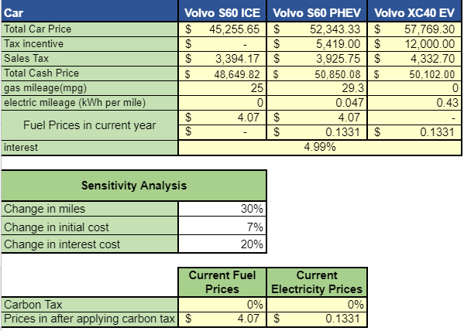
Sensitivity analysis
Change in these parameters changes

Slide 14
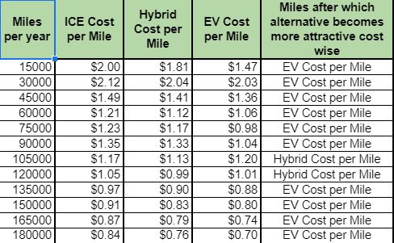
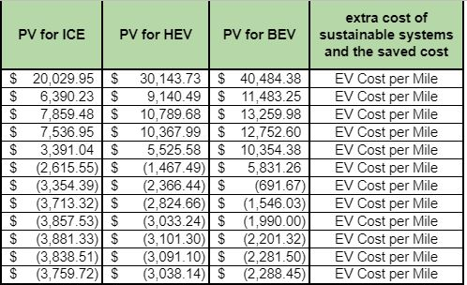
Sensitivity analysis

Slide 15
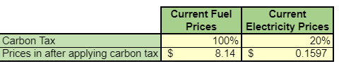

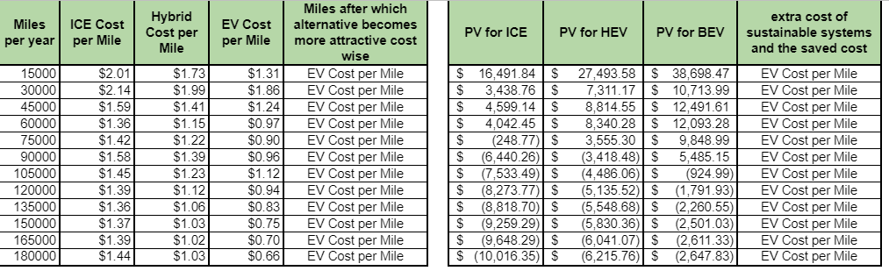
Sensitivity analysis
Increasing the carbon tax on Fuel and electricity

Slide 16
Carbon emissions
After every 15000 miles the adjacent table shows environmental impact of each car
 | Volvo S60 ICEV | Volvo S60 PHEV | Volvo XC40 EV
Carbon emission (in pounds/miles) | 0.88 | 0.14 | 0
Miles | 15000
CO2 emissions (for entered miles) | 13200 | 2100 | 0

Slide 17
Key findings
The Net present worth of EV’s is consistently higher than ICE and HEV.
The AEW analysis show that EV’s have comparatively less costs than HEV and ICE. HEV’s have slightly more cost than EV but less than gasoline.
The purchase costs EV or PHEV appears to be high, but the operating and maintenance costs are low.
The environmental impact of ICE is more than PHEV and EV.
The results of sensitivity analysis and carbon tax show similar analysis.
The savings due to the EV’s lower annual energy and maintenance costs may gradually decline over the lifecycle, depending if insurance prices spike, along with additional replacement costs.

Slide 18
Conclusion
If the tax incentives are not given to EV and PHEV, they won’t be a feasible option to buy.
EV’s are the most economical option over the years. They also have very less environmental impact.
Though EV looks cost-effective, the buyer needs to consider others factors as refill range of the car, availability of refill stations, power of the car required for frequent driving terrain, environmental impact along with the economic analysis to make the right choice.

