Slide 1
ANALYSIS of ACCIDENTS IN BROOKLYN

Slide 2
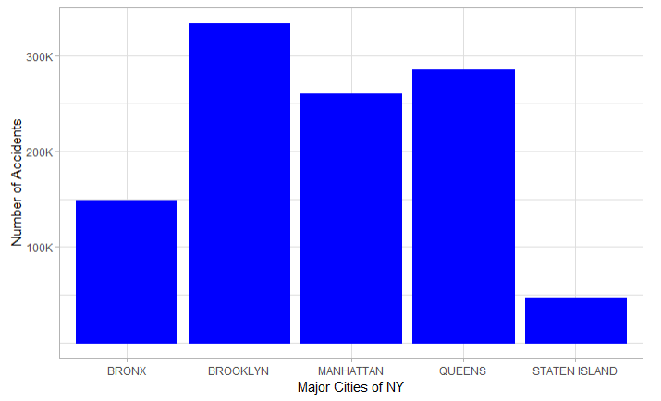
Across major cities of New York, number of Accidents happened in the city of Brooklyn were the most over the last seven year period (July, 2012-July, 2019).
333,528
How to Reduce Accidents in City of Brooklyn?

Slide 3
Analyzing Factors Causing Accidents
Distraction/Inattention:
Driver Distraction
Passenger Distraction
Outside Car Distraction
Eating or Drinking
Cell Phone (hand-Held/Free)
Using On Board Navigation Device
Texting
Other Electronic Device
Listening/Using Headphones
Lost Consciousness
Fell Asleep
Reaction to Other Uninvolved Vehicle
Reaction to Uninvolved Vehicle
Breaking Rules:
Traffic Control Disregarded
Turning Improperly
Unsafe Speed
Alcohol Involvement
Aggressive Driving/Road Rage
Drugs (Illegal)
Vehicle Vandalism
Driving Mistakes:
Failure to Yield Right-of-Way
Backing Unsafely
Following Too Closely
Passing Too Closely
Passing or Lane Usage Improper
Unsafe Lane Changing
Driver Inexperience
Failure to Keep Right
Route Defects:
Pavement Slippery/Defective
View Obstructed/Limited
Glare
Obstruction/Debris
Traffic Control Device Improper/Non-Working
Lane Marking Improper/Inadequate
Shoulders Defective/Improper
Contributing Factors (CF) In an Accident
Vehicle Problems:
Brakes Defective
Steering Failure
Driverless/Runaway Vehicle
Tire Failure/Inadequate
Accelerator Defective
Tow Hitch Defective
Other Lighting Defects
Tinted Windows
Windshield Inadequate
Headlights Defective
Oversized Vehicle
Health:
Fatigued/Drowsy
Prescription Medication
Physical Disability
Illness
Other:
Other Vehicular
Animals Action
Pedestrian/Bicyclist/Other Pedestrian Error/Confusion
*Removed CF types: Unspecified and NA’s

Slide 4
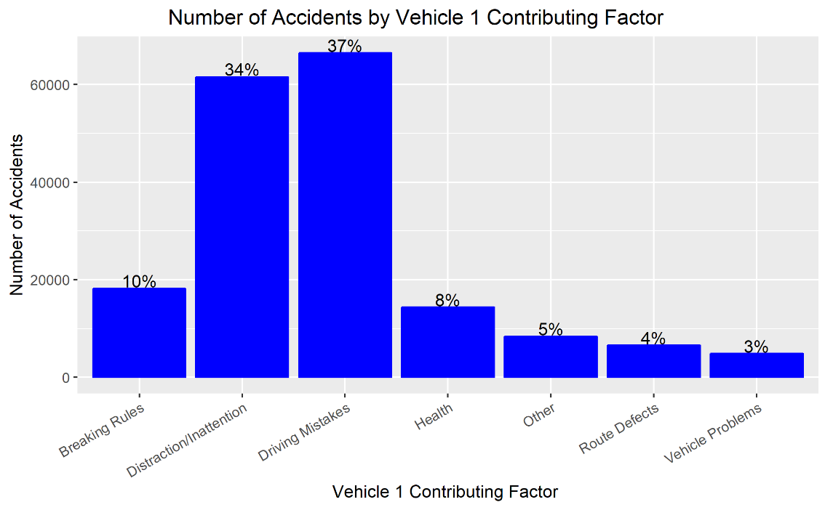
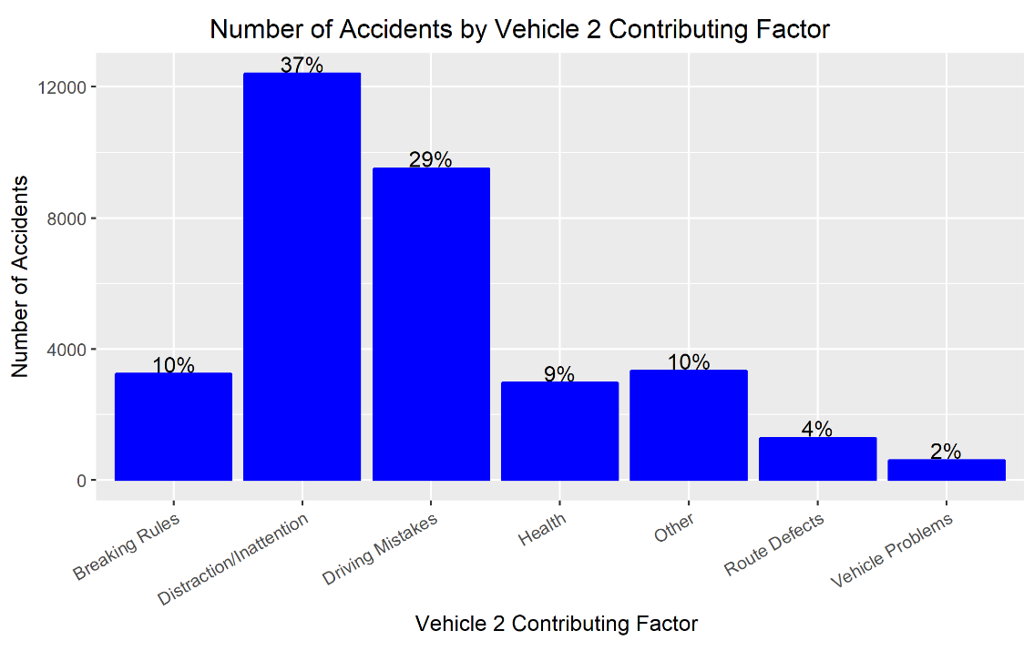
CF for Vehicle 1:
Driving Mistakes (37%)
Distraction/Inattention (34%)
Breaking Rule (10%)
81% of Total Accidents
For both vehicles 1 and 2, Driving Mistakes,
Distraction/Inattention and Breaking Rules are major factors of having an accident.
CF for Vehicle 2:
Driving Mistakes (29%)
Distraction/Inattention (37%)
Breaking Rule (10%)
76% of Total Accidents
*CF: Contributing Factor
*Removed CF types: Unspecified and NA’s

Slide 5
Below Table Shows Relationship between CF for Vehicle 1 vs CF for Vehicle 2:
 | Contributing Factor Vehicle 2
Contributing Factor Vehicle 1 | Breaking Rules | Distraction/Inattention | Driving Mistakes | Health | Other | Route Defects | Vehicle Problems | Total
Breaking Rules | 1425,(46.72%) | 426,(13.96%) | 806,(26.42%) | 224,(7.34%) | 127,(4.16%) | 42,(1.37%) | 36,(1.18%) | 3050
Distraction/Inattention | 545,(4.24%) | 9165,(71.37%) | 1890,(14.71%) | 669,(5.21%) | 452,(3.52%) | 119,(0.92%) | 132,(1.02%) | 12840
Driving Mistakes | 740,(8.73%) | 1496,(17.66%) | 5295,(62.51%) | 298,(3.51%) | 508,(5.99%) | 133,(1.57%) | 143,(1.68%) | 8470
Frequency,(Row%)
*Removed CF types: Unspecified and NA’s
Number of times breaking Rules as CF for Vehicle 1 had an accident with Vehicle 2 having same CF as breaking rules was 1425 (46.72%) times.
Similarly, for Distraction/Inattention and Driving Mistakes it increases to 71.37% and 62.51% respectively.
Key Takeaways:
Number of Accidents can be reduced heavily, if both Vehicle 1 and Vehicle 2 drivers avoid mistakes, stay more alert and don’t break rules.
*CF: Contributing Factor

Slide 6
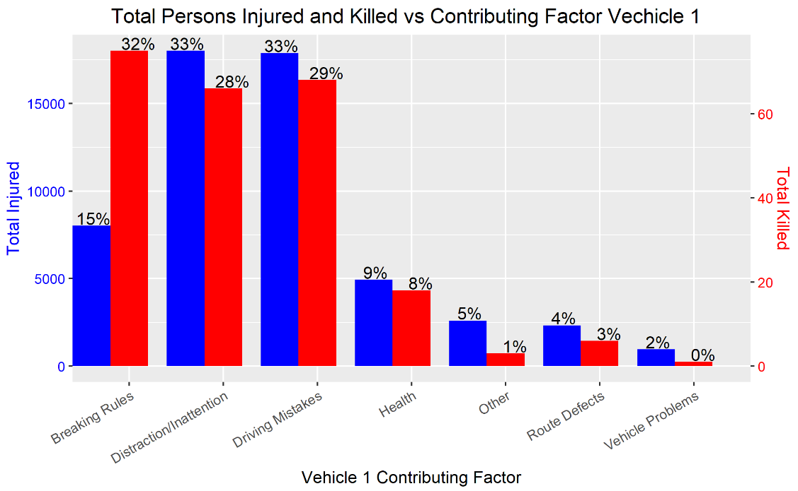
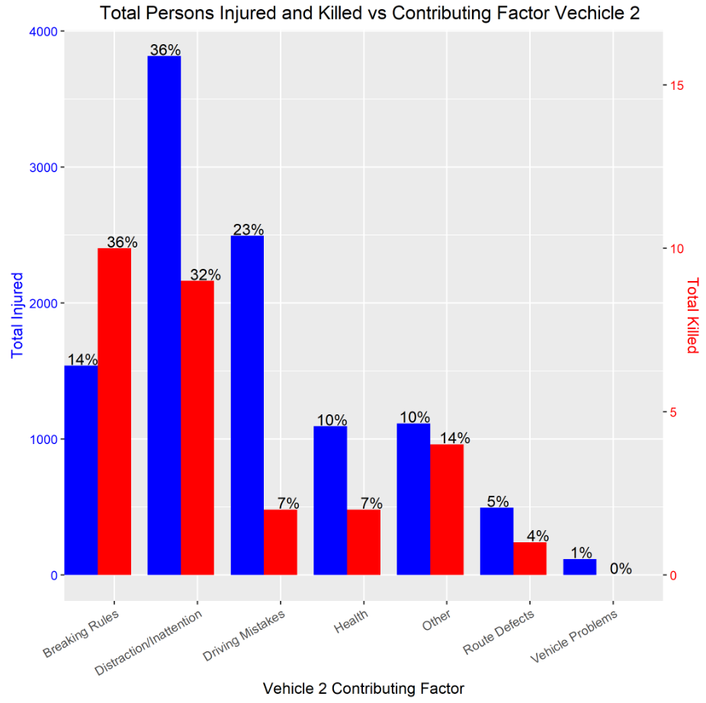
Contributing Factor for Vehicle 1 and 2 vs Total Injured and Total Killed
Max Percentage got Killed is because of Breaking Rules
Percentage of people get killed because of Breaking Rules is highest for both Vehicle 1 and Vehicle 2.
Percentage of people get injured because of Distraction/Inattention is highest for both Vehicle 1 and Vehicle 2.
*Removed CF types: Unspecified and NA’s

Slide 7
Relationship of Top 5 Vehicle 1 Types with Major CF of Vehicle 1’s :
 | Major Contributing Factor Vehicle 1
Top 5 Vehicle 1 Types | Breaking Rules | Distraction/Inattention | Driving Mistakes
PASSENGER VEHICLE | 9024 (55.11%) | 27035 (49.7%) | 28890 (48.64%)
SPORTS CAR/STATION WAGON | 4908 (29.97%) | 18360 (33.75%) | 19702 (33.17%)
SEDAN | 1897 (11.58%) | 6634 (12.2%) | 8424 (14.18%)
PICK-UP TRUCK | 286 (1.75%) | 1184 (2.18%) | 1512 (2.55%)
VAN | 260 (1.59%) | 1180 (2.17%) | 871 (1.47%)
Passenger Vehicle and Sports Car/Station Wagon both have a high percentage of accidents because of major contributing factor.
Frequency,(Column%)
Relationship between Top 5 Vehicle 1 Types with Top 5 Vehicle 2 Types
 | Top 5 Vehicle 1 Types
Top 5 Vehicle 2 Types | SPORTS CAR/STATION WAGON | PASSENGER VEHICLE | SEDAN | PICK-UP TRUCK | VAN
SPORTS CAR/STATION WAGON | 27578 (46.02%) | 22885 (20.94%) | 6619 (39.38%) | 1297 (33.61%) | 1329 (29.52%)
PASSENGER VEHICLE | 22142 (36.95%) | 78644 (71.97%) | 0 | 1761 (45.63%) | 2369 (52.62%)
SEDAN | 6457 (10.78%) | 0 | 10020 (59.61%) | 605 (15.68%) | 130 (2.89%)
BICYCLE | 2270 (3.79%) | 4904 (4.49%) | 0 | 95 (2.46%) | 186 (4.13%)
VAN | 1474 (2.46%) | 2846 (2.6%) | 170 (1.01%) | 101 (2.62%) | 488 (10.84%)
Frequency,(Column%)
Number of times Vehicle 1 Type as “Sports Car/Station Wagon” had an accident with vehicle 2 having same type was 27,578 (46.02%) times.
Similarly, this values increases to 71.97% for Passenger Vehicles.
*Removed CF types: Unspecified and NA’s

Slide 8
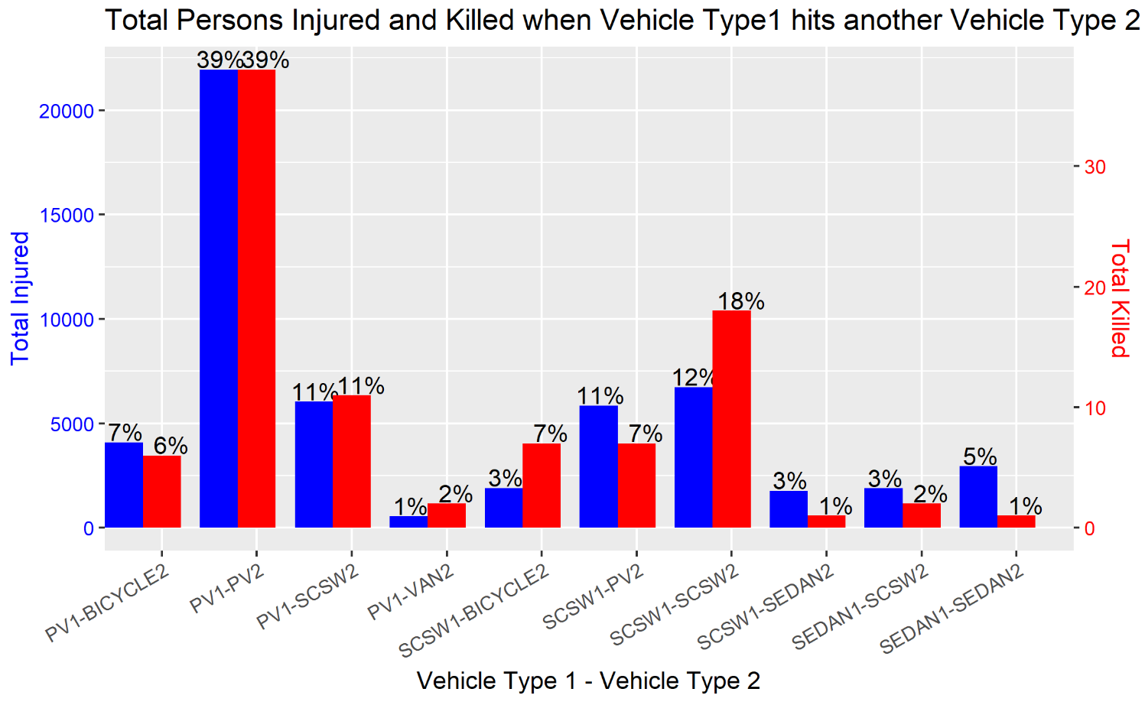
Vehicle Type 1 – Vehicle Type 2 Pairings:
Two “Sports Car/Statin Wagon” having an accident has higher percentage of deaths (18%) as compared to injuries (12%)
Sports Car/Station Wagon accident with Bicycle has more percentage of killed (7%) than passenger vehicle accident with bicycle (6%).
Passenger Vehicle (PV1) having an accident with another Passenger Vehicle (PV2) has highest number of injuries and deaths.
Sports Car/Station Wagon(SCSG1) accidents with SCSW2 has the 2nd highest number of injuries and deaths.
A PV1-Bicycle2 Deaths has lower number as compared to SCSW1-Bicycle2
*PV: Passenger Vehicle, SCSG: Sports Car/Station Wagon

Slide 9
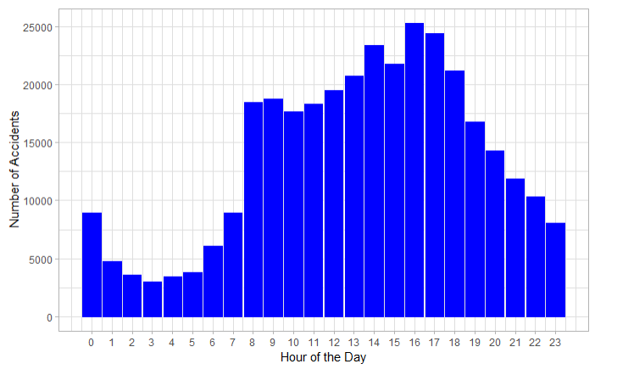
What hour of the day do we have most number of accidents?
More than ~69% Accidents happen
Between 8 am to 6 pm
Total Accident: 229,761
What are the main location where this
Accidents happen?

Slide 10
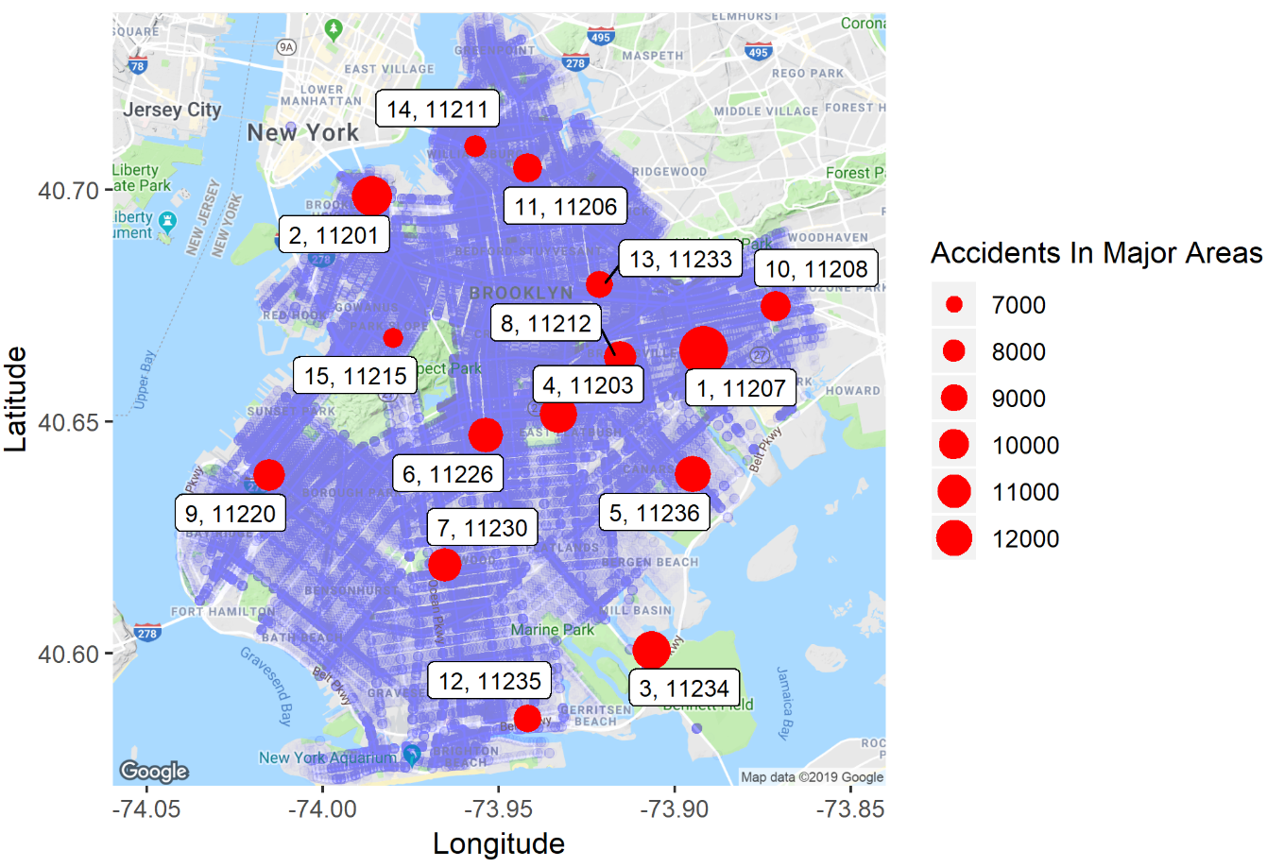
Major Areas Having Accidents During Peak Hours (8 am to 6pm):
Findings:
More than 50% of total peak hour accidents happen in these areas.
This major areas of accidents during peak hour overlap ~94% of the areas across all accidents.
Rank, Zip code
Around this major(danger zone) areas:
Government agencies can make rules more strict.
Increasing the number of patrolling.
This actions can help reduce the number of accidents in this areas.
All Accidents
Total Accidents in Major Areas highlighted by red: 119,933

Slide 11
Recommendations:
The three major contributing factor for an accident were Breaking Rules, Driving Mistakes and Distraction/Inattention.
Driving mistakes can be avoided if city council can re-assess the process in which people gets license to drive.
Increase patrolling in the areas identified where maximum number of accident happen and catch more people who are breaking rules as because of this most people get killed than any other factors.
Increase awareness about the drawbacks of being distracted while driving as because of this most people get injured.
Sports Car/Station Wagon and Passenger Cars has the majority of accidents because of above contributing factors.
Agencies who are issuing licenses to drivers of this cars should make their process more strict.
Patrolling officers should keep an eye on people driving sports car as they are more easier to identify as compared to passenger cars and also a sports car having an accident with another sports car has high percentage.
Around 2% of accidents happened because of “Route Defects” agencies should work on fixing the areas which have route defects.

Slide 12
Thank You

