Slide 1

NASA SPACE APPS CHALLENGE 2017
Project #uRADMonitor
https://github.com/radhoo/NasaSpaceAppsTM.git

Slide 2
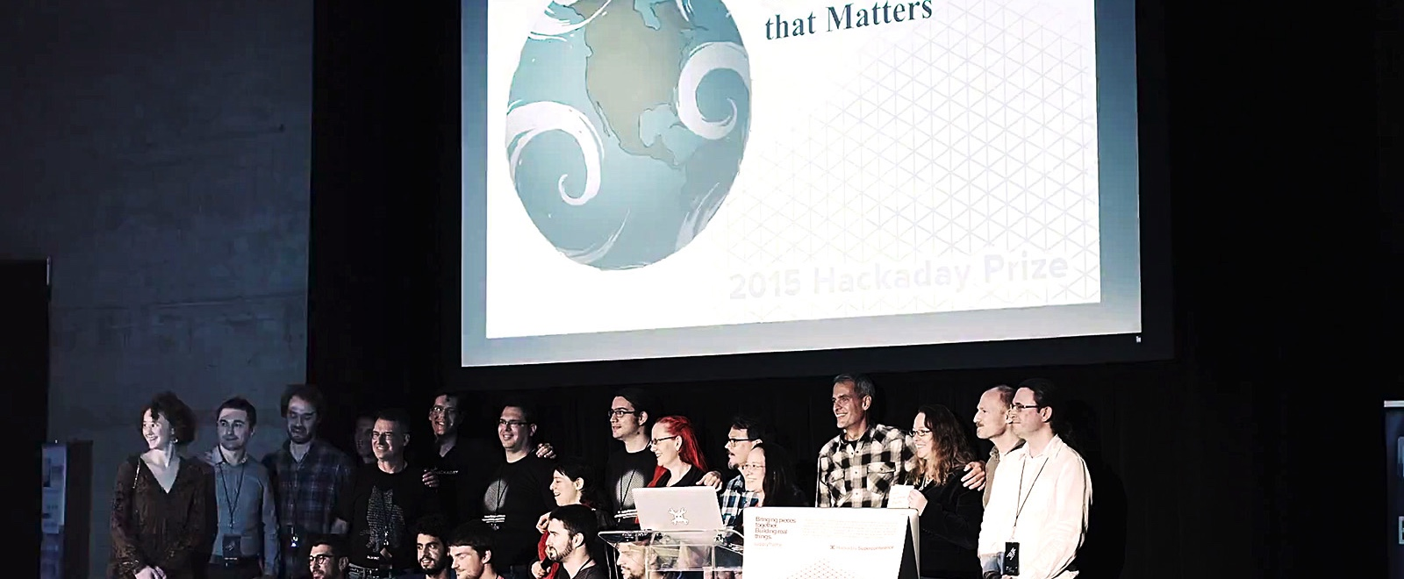
Hackaday Prize 2015 Finalist 1/10 chances for a trip to space
http://www.uradmonitor.com/tag/hackaday-prize-2015/

Slide 3
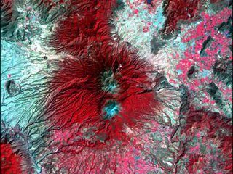
Warning! Danger Ahead!
Challenges in this category will ask you to analyze NASA data to assist in monitoring natural disasters and phenomena associated with health risks, and to assess their impacts on life and property.

Slide 4
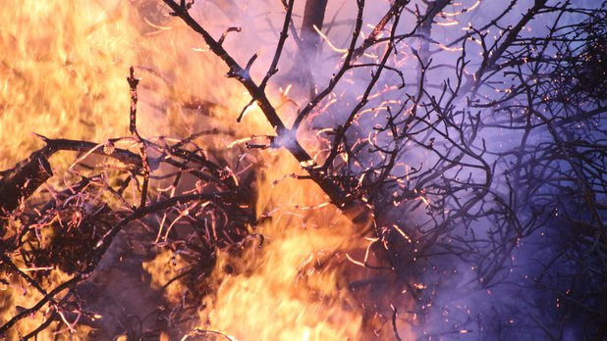
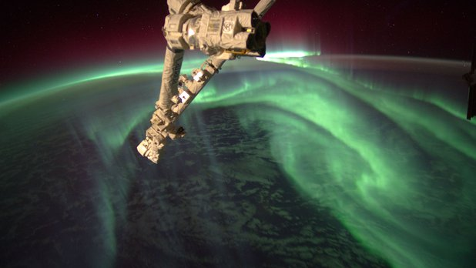
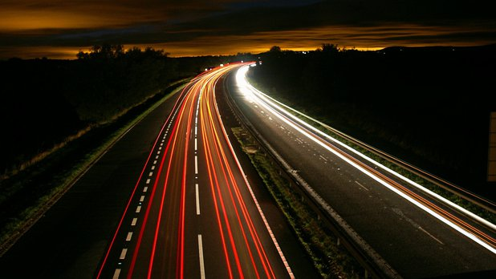
And YOU can Help Fight Fires! Build a fire-monitoring and crowdsourcing tool that will allow local fire managers to respond to wildfires | Mayday, Mayday, Mayday! Calculate and visualize the radiation exposure for an actual or hypothetical polar, or near-polar flight! | Live Smart Evaluate environmental, social, and economic data to design tools and plan blueprints for smart and connected rural and urban settlements.

Slide 5
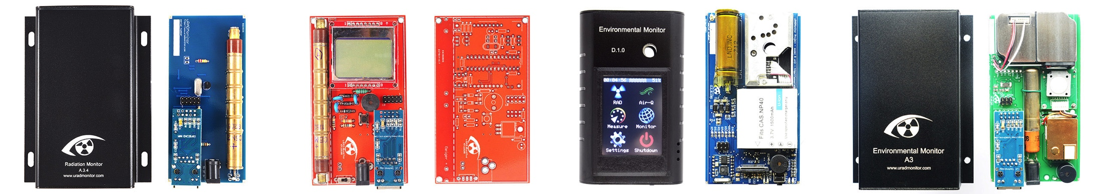
The uRADMonitor network
uRADMonitor is a global network of IOT hardware devices of proprietary design, equipped with advanced sensors to assert the quality of the environment in real time. There +600 units in more than 40 countries.

Slide 6
Solving the challenges
Integrated PM2.5 and CO2 sensors detect fires accurately. The LoraWAN (+15km radio range) based connectivity and low power consumption permits remote deployments.
Integrated Ionising Radiation sensors to map background radiation levels both from Terrestrial and Cosmic sources
Interconnected IOT topology at its core for Smart Cities, Smart homes, a complete Live Smart solution.

Slide 7
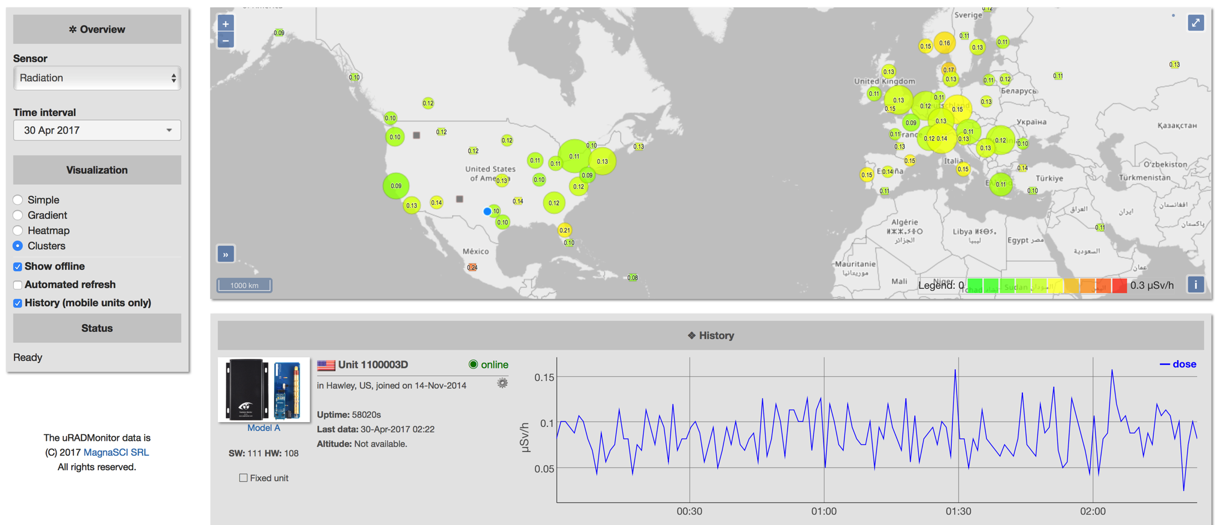
Worldwide Background Radiation map
http://www.uradmonitor.com

Slide 8
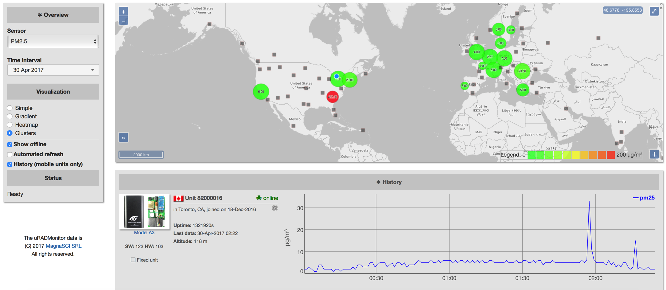
Worldwide PM2.5 map
http://www.uradmonitor.com

Slide 9
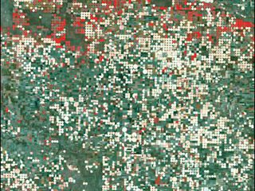
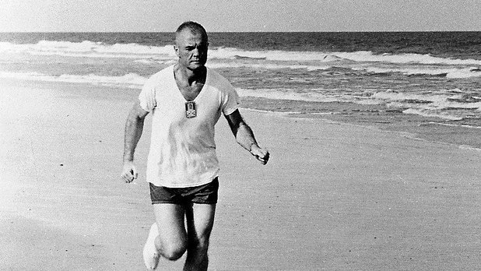
 | The Earth and Us Challenges in this category will ask you to combine NASA Earth Science data with sociological and economic information to generate new understanding and perspectives on human-environment interactions.
 | Let’s go on the Beach Build a tool for beach-goers to monitor for hazards and to alert them of precautionary measures for protection on their swim- and surf-filled adventures!

Slide 10
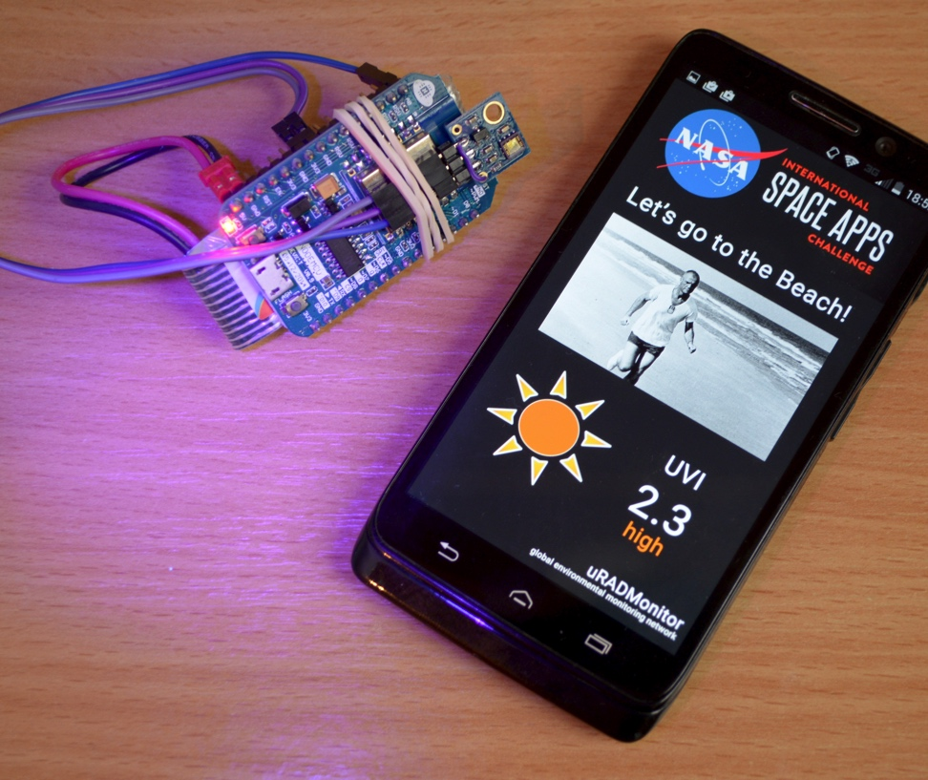
Hackathon Project
Hardware IOT Device based on ESP8266 and ML8511 UV Sensor
ESP8266 firmware
Android App
Backend implementation (uradmonitor.com)

Slide 11
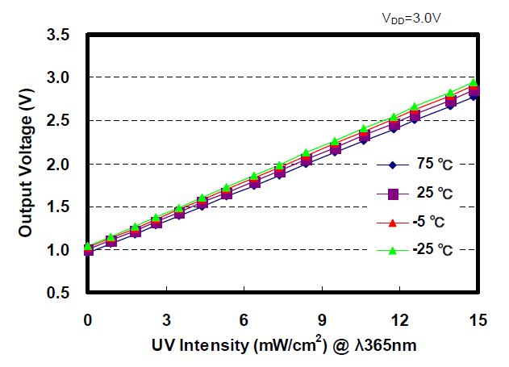
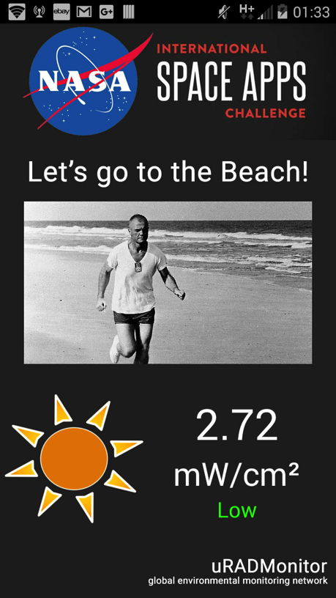
UV Readings

Slide 12
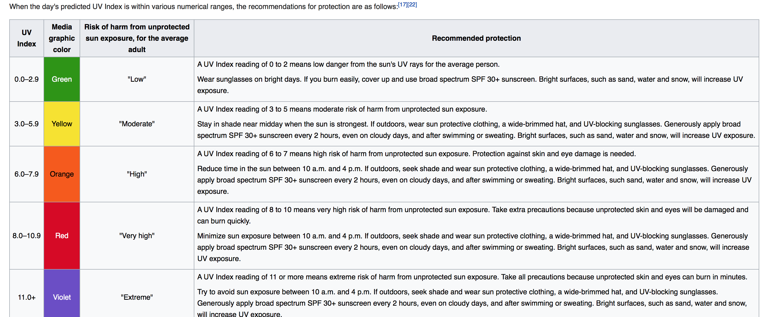
Health impact

Slide 13
Thanks for watching!
Radu Motisan
radu@uradmonitor.com

