Slide 1
An Introduction to Go
Why and how to write good Go code

Slide 2
Radhouen Assakra
DevOps and Full stack engineer

Slide 3
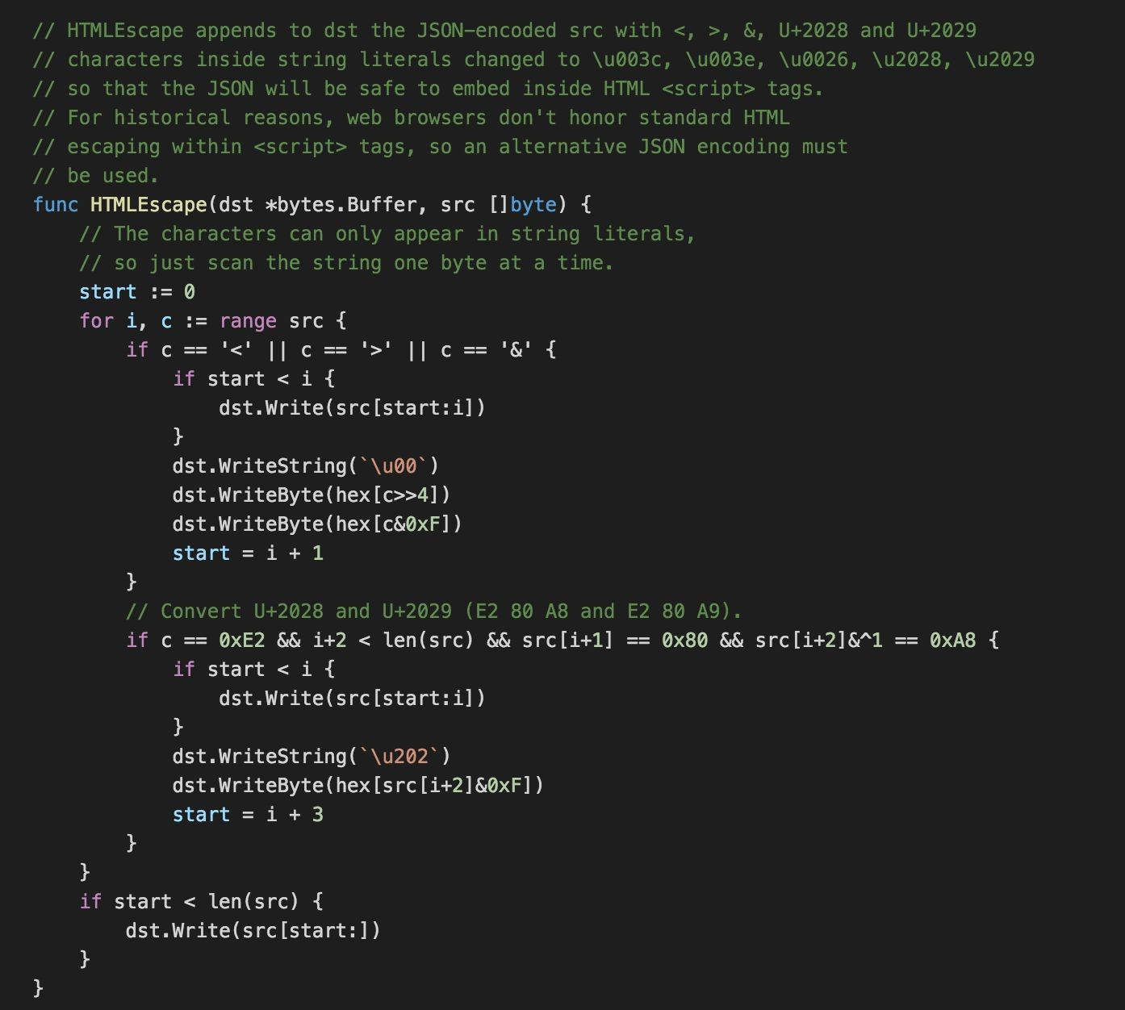
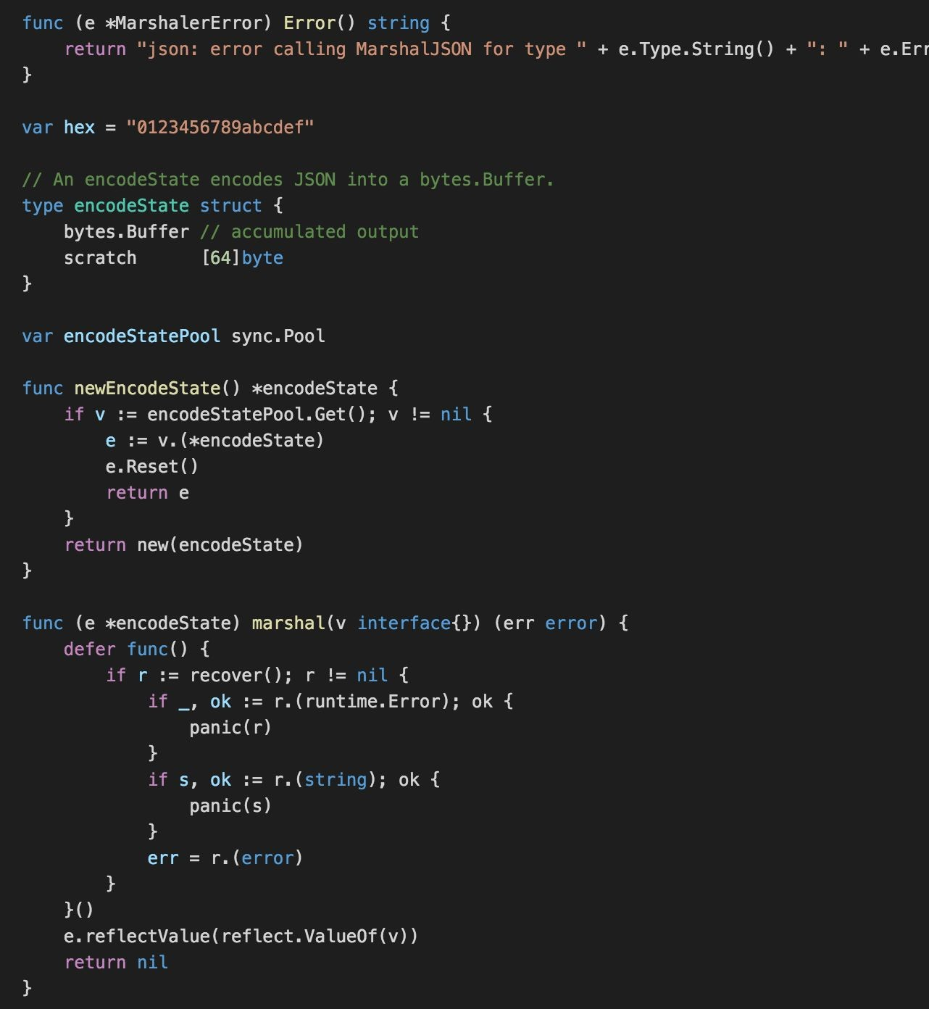
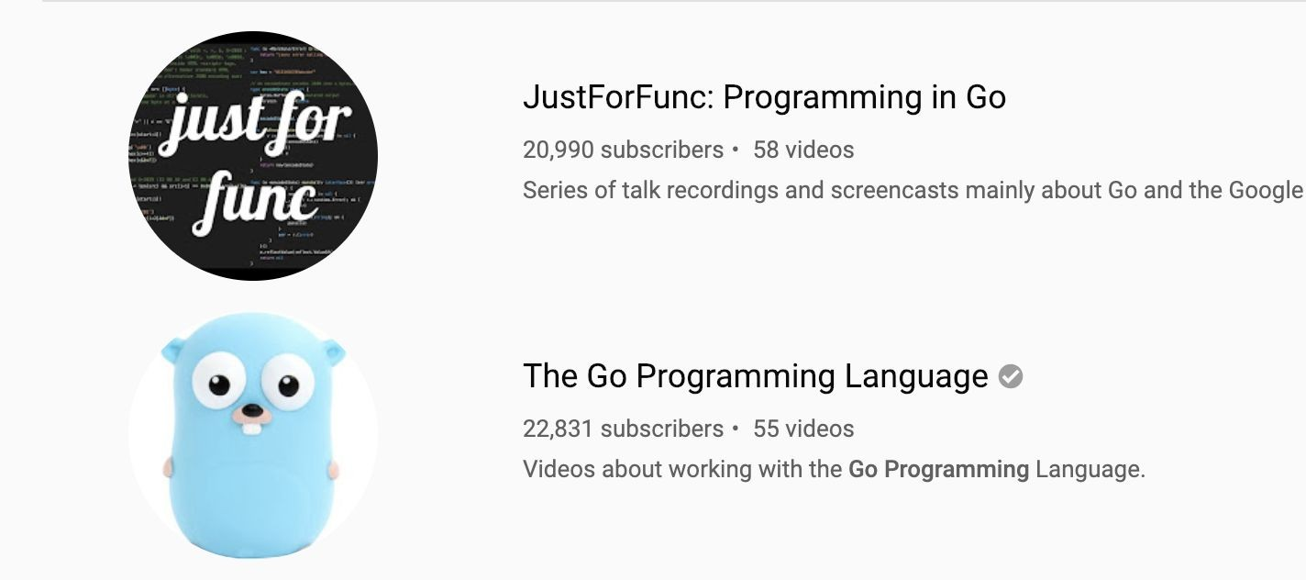
just for

Slide 4
Agenda
15 Hours
15 Hours
20 Hours
Go basics
Type System
- Concurrency
Performance Analysis
Tooling
Advanced Topics
Q&A
- Go for Web Development

Slide 5
Chapter 1
GO
PROGRAMMING–OVERVIEW

Slide 6
Plan
Features of Go Programming
Features Excluded Intentionally
Go Programs
Compiling and Executing Go Programs

Slide 7
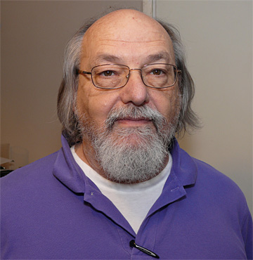


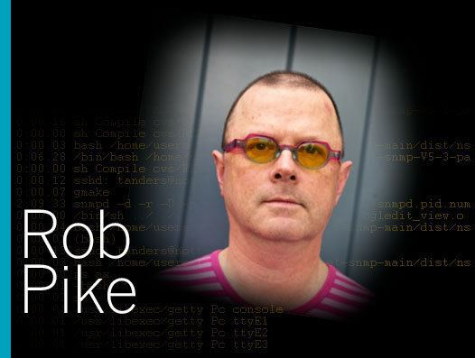
Go Team
Ken Thompson
David Symonds
Robert Griesemer
Rob Pike

Slide 8
What is Go?
An open source (BSD licensed) project:
Language speciﬁcation,
Small runtime (garbage collector, scheduler, etc),
Two compilers (gc and gccgo),
A standard library,
Tools (build, fetch, test, document, proﬁle,format),
Documentation.
Language specs and std library are backwards compatible in Go 1.x.

Slide 9
What is Go?
Go is a compiled programming language. Before you run a program, Go uses a compiler to translate your code into the 1s and 0s that machines speak. It compiles all your code
into a single executable for you to run or distribute. During this process, the Go compiler
can catch typos and mistakes

Slide 10
Why Go?
We wanted a language with the safety and performance of statically compiled languages such as
C++ and Java, but the lightness and fun of dynamically typed interpreted languages such as Python.
** Rob Pike **

Slide 11
Go 1.x
Released in March 2012
A speciﬁcation of the language and libraries supported for years. The guarantee: code written for Go 1.0 will build and run with Go 1.x. Best thing we ever did.

Slide 12
Hello, GoMyCode!
package main
import "fmt" func main() {
fmt.Println("Hello, GoMyCode")
}

Slide 13
Exercice:
True, false question ?
Go is an interpreted programming language ?
Go developed by facebook ?
Go is a statically typed ?

Slide 14
Chapter 2
GO
PROGRAMMING–ENVIRONMENT SETUP

Slide 15
Plan
Try it Option Online
Local Environment Setup
Text Editor
The Go Compiler
Installation on UNIX/Linux/Mac OS X, and FreeBSD
Installation on Windows
Verifying the Installation

Slide 16
Try it Option Online
The quickest way to get started with Go is to navigate to play.golang.org. At the Go Playground (figure 1.2) you can edit, run, and experiment with Go without needing to install anything. When you click the Run button, the playground will compile and execute your code on Google servers and display the result.

Slide 17
Local Environment Setup : editor
To play with Go locally , we need to install two necessary things :
IDE or text editor
Go Compiler
You will require a text editor to type your programs. Examples of
Text editors: include Windows Notepad, OS Edit command, Brief, Epsilon, EMACS, and vim or vi.
IDE: Goland , eclipse , vscode ....

Slide 18
Local Environment Setup : Go compiler
The source code written in source file is the human readable source for your program. It needs to be compiled and turned into machine language so that your CPU can actually execute the program as per the instructions given.
The Go programming language compiler compiles the source code into its final executable program. Go distribution comes as a binary installable for FreeBSD (release 8 and above), Linux, Mac OS X (Snow Leopard and above), and Windows operating systems with 32-bit (386) and 64-bit (amd64) x86 processor architectures

Slide 19
Installation on UNIX/Linux/Mac
To install Go on your laptop that use unix/linux/macos or freebsd system you need :
Download the latest version of Go installable archive file Go Download,
Extract the download archive into the folder /usr/local, creating a Go tree in /usr/local/go. For example:
$ tar -C /usr/local -xzf go1.4.linux-amd64.tar.gz
Add /usr/local/go/bin to the PATH environment variable.

Slide 20
Installation on UNIX/Linux/Mac
OS | Output
Linux | go1.4.linux-amd64.tar.gz
Mac | go1.4.darwin-amd64-osx10.8.pkg
FreeBSD | go1.4.freebsd-amd64.tar.gz

Slide 21
Chapter 3
GO-PROGRAMMING
Introduction

Slide 22
Plan
Syntax
Base types
Function & Variables Declarations
Garbage Collection
Running Go Code

Slide 23
Syntax:Program structure
package main //(1)
import "fmt" //(2)
func main() { //(3)
fmt.Println("Hello, Golang")
}
(1)The main package is the starting point to run the program,
(2)The next line import "fmt" is a preprocessor command which tells the Go compiler to include the files lying in the package fmt.
(3)The next line func main() is the main function where the program execution begins.
the function main will use the package fmt and here function Println to write “Hello, Golang” on the console when we run the program.

Slide 24
Syntax: comment
package main
// import packages (1)
import "fmt"
func main() {
/* here we will create variables, constants, call functions ,,,
*/ (2)
fmt.Println("Hello, Golang")
}
(1)Line comment
(2) Block comment
==> A comment is a line that will be ignored
by the go compiler, Including comments in programs makes code more readable for humans as it provides some information or explanation about what each part of a program is doing.

Slide 25
Syntax: keywords
The following list shows the reserved words in Go. These reserved words may not be used as constant or variable or any other identifier names.
break | default | func | interface | select
case | defer | Go | map | Struct
chan | else | Goto | package | Switch
const | fallthrough | if | range | Type
continue | for | import | return | Var

Slide 26
Data Type
Type | Description
Boolean types | consists of the two predefined constants: true,false
Numeric types | consists of two types:integer,float types
String types | A string is a sequence of one or more characters (letters, numbers, symbols) that can be either a constant or a variable
Derived types | Aggregate Type: Array and structs come under this category. Reference Type: Pointers, slices, maps, functions, and channels come under this category. Interface Type

Slide 27
Data Type: Integer
Go's integer types are: uint8, uint16, uint32, uint64, int8, int16, int32 and int64. 8, 16, 32 and 64 tell us how many bits each of the types use. uint means “unsigned integer” while int means “signed integer”. Unsigned integers only contain positive numbers (or zero). In addition there two alias types: byte which is the same as uint8 and rune which is the same as int32. Bytes are an extremely common unit of measurement used on computers (1 byte = 8 bits, 1024 bytes = 1 kilobyte, 1024 kilobytes = 1 megabyte, …) and therefore Go's byte data type is often used in the definition of other types. There are also 3 machine dependent integer types: uint, int and uintptr. They are machine dependent because their size depends on the type of architecture you are using.
uint8 unsigned 8-bit integers (0 to 255)
uint16 unsigned 16-bit integers (0 to 65535)
uint32 unsigned 32-bit integers (0 to 4294967295)
uint64 unsigned 64-bit integers (0 to 18446744073709551615)
int8 signed 8-bit integers (-128 to 127)
int16 signed 16-bit integers (-32768 to 32767)
int32 signed 32-bit integers (-2147483648 to 2147483647)
int64 signed 64-bit integers (-9223372036854775808 to 9223372036854775807)
Generally if you are working with integers you should just use the int type.

Slide 28
Data Type: Integer(example)
package main
import "fmt"
func main() {
var x int32 = -5
var y int8 = 58960 //constant 58960 overflows int8 (1)
var s uint16 = -1 //constant -1 overflows uint16 (2)
fmt.Println(x)
fmt.Println(y)
fmt.Println(s)
}
(1)constant 58960 overflows int8 , while int8 is 8-bits integers so (-127 to 127)
so this is handle an error overflows,
(2)the second error that -1 overflows uint16
because uint16 is for positive number only,
So we must be careful when we defined a type
of variable (signed/not and the interval(N-bits)).

Slide 29
Data Type: Float and complex
Floating point numbers are numbers that contain a decimal component (real numbers).
Ken Thompson, one of the principal Go authors, wanted complex numbers in Go and so he added them to the Go language specification and implemented complex numbers for the Go gc compilers
Floats and complex numbers also come in varying sizes:
float32 IEEE-754 32-bit floating-point numbers
float64 IEEE-754 64-bit floating-point numbers
complex64 complex numbers with float32 real and imaginary parts
complex128 complex numbers with float64 real and imaginary parts

Slide 30
Data Type: Float,integer Operator
package main
import (
"fmt"
)
func main() {
fmt.Println("float example")
var x float64 = 10
var y float64 = 120
var z float64 = x + y // invalid operation (mismatched type float32 , float64)
//to resolve this error replace float32 by float64
fmt.Println("x + y =",x + y )
fmt.Println("x - y =",x - y )
fmt.Println("x * y =",x * y)
fmt.Println("x / y =",x / y)
fmt.Println("x % y =",x % y) // % is not defined for float64
}
# | Operator
+ | addition
- | subtraction
* | multiplication
/ | division
% | remainder (for integr only)

Slide 31
Data Type: String (example)
package main
import "fmt"
func main() {
// Creating and initializing strings using var keyword
var str1 string
str1 = "Go"
var str2 string
str2 = "-MyCode !!!"
// Concatenating strings Using + operator
fmt.Println( str1+str2)
// Creating and initializing strings Using shorthand declaration
str3 := "Golang"
str4 := "Course"
result := str3 + " " + str4
fmt.Println( result)
}

Slide 32
Variables Declarations
What is a variable ?
Variable is the name given to a memory location to store a value of a specific type. There are various syntaxes to declare variables in go.
Declaring single variable :
var age int // variable declaration
Declaring a variable with initial value :
var age int = 29 // variable declaration with initial value
Type inference :
If a variable has an initial value, Go will automatically be able to infer the type of that variable using that initial value. Hence if a variable has an initial value, the type in the variable declaration can be omitted.
var age = 29 // type will be inferred
Multiple variable declaration :
Multiple variables can be declared in a single statement.
var width, height int = 100, 50 //declaring multiple variables

Slide 33
Variables Declarations
Short hand declaration :
Go also provides another concise way for declaring variables. This is known as short hand declaration and it uses := operator.
name, age := "Radhouen", 27 //short hand declaration
name, age := "Radhouen" //error

Slide 34
Exercice:
Select the right expresion for a comment:
/* ..... */
#
<?--- ?>
2. Choose the rigth variable decalaration:
var case = 1
firstChild := “Radhouen”
var 4G = “4G”
3. Response by True of False for this expression:
var a float64 = 5
var b int8 = 2
var c = a + b
===> c is equal to 7 ?

Slide 35
Exercice:
What are two ways to create a new variable?
What is the value of x after running:
x := 5; x += 1 ?
3. What is scope and how do you determine the
scope of a variable in Go?
4. What is the difference between var and const ?
5. Using the example program as a starting point,write a program that converts from Fahrenheit into Celsius. ( C = (F - 32) * 5/9 )
6. Write another program that converts from feet into meters. ( 1 ft = 0.3048 m )

Slide 36
Function
What is a function?
A function is a block of code that performs a specific task. A function takes a input, performs some calculations on the input and generates a output.
Inputs
Outputs
Function
Function declaration
The general syntax for declaring a function in go is
func functionname(parametername type) returntype {
//function body
}

Slide 37
Function: Simple function
The function declaration starts with a func keyword followed by the functionname. The parameters are specified between ( and ) followed by the returntype of the function. The syntax for specifying a parameter is parameter name followed by the type. Any number of parameters can be specified like (parameter1 type, parameter2 type). Then there is a block of code between { and } which is the body of the function.
The parameters and return type are optional in a function. Hence the following syntax is also a valid function declaration.
Example :
package main
import "fmt"
func add (a int, b int) int {
somme := a + b
return somme
}
func main() {
somme := add(3,5)
fmt.Println("somme =", somme)
}

Slide 38
Function: Multiple return values
package main
import "fmt"
func add (a int, b int) int {
somme := a + b
return somme
}
func rectProps(length, width float64)(float64, float64) {
var area = length * width
var perimeter = (length + width) * 2
return area, perimeter // return two parameters area, perimeter
}
func main() {
somme := add(3,5)
fmt.Println("somme =", somme)
area, perimeter := rectProps(10.8, 5.6)
fmt.Printf("Area %f Perimeter %f", area, perimeter)
}

Slide 39
Function: Named return values
It is possible to return named values from a function. If a return value is named, it can be considered as being declared as a variable in the first line of the function.
The above rectProps can be rewritten using named return values as :
func rectProps(length, width float64)(area, perimeter float64) {
var area = length * width
var perimeter = (length + width) * 2
return // no explicit return value
//area and perimeter are the named return values in the above function.
}

Slide 40
Garbage Collection
It is possible to return named values from a function. If a return value is named, it can be considered as being declared as a variable in the first line of the function.
The above rectProps can be rewritten using named return values as :
func rectProps(length, width float64)(area, perimeter float64) {
var area = length * width
var perimeter = (length + width) * 2
return // no explicit return value
//area and perimeter are the named return values in the above function.
}

Slide 41
Running Go Code
we can run a Go program in different architecture and different operating systems,
Go support multiple a list of GOOS and GOARCH:
A list of valid GOOS values
(Bold = supported by go out of the box, ie. without the help of a C compiler, etc.)
android
darwin
dragonfly
freebsd
linux
nacl
netbsd
openbsd
plan9
solaris
windows
zos

Slide 42
Running Go Code
A list of valid GOARCH values
(Bold = supported by go out of the box, ie. without the help of a C compiler, etc.)
386
amd64
amd64p32
arm
armbe
arm64
arm64be
ppc64
ppc64le
mips
mipsle
mips64
mips64le
mips64p32
mips64p32le
ppc
s390
s390x
sparc
sparc64
for more details visit : list-of-valid-goos-goarch-values

Slide 43
Running Go Code
Run a mian,go example:
$ GOOS=darwin GOARCH=386 go build main.go

Slide 44
Exercice:
1. Create a simple calculator that does this operations List:
Add
Mins
Multiplication
Subtraction
2. A simple Fibonacci sequence function. The Fibonacci sequence is the sequence of numbers where the value(n) = value(n-1) + value (n-2) with the seed values value(0) = 0 and value(1) = 1, Create a program to calculate Fibonacci(25), Fibonacci(5), Fibonacci(11).

Slide 45
Chapter 4
GO-PROGRAMMING
Conditions and Loops

Slide 46
Plan
If statement
Switch case
For Loop

Slide 47
If statement
Child
If Age >20
Adult

Slide 48
If statement
The if statement looks as it does in C or Java, except that the ( ) are gone and the { } are required. Like for, the if statement can start with a short statement to execute before the condition. Variables declared by the statement are only in scope until the end of the if. Variables declared inside an if short statement are also available inside any of the else blocks.
If statement:
if(boolean_expression) { // ---> { is mandatory
/* statement(s) will execute if the boolean expression is true */
}
If..else if .. else statement:
if(boolean_expression 1) {
/* Executes when the boolean expression 1 is true */
} else if( boolean_expression 2) {
/* Executes when the boolean expression 2 is true */
} else if( boolean_expression 3) {
/* Executes when the boolean expression 3 is true */
} else {
/* executes when the none of the above condition is true */
}
Nested if statements :
It is always legal in Go programming to nest if-else statements, which means you can use one if or else if statement inside another if or else if statement(s).

Slide 49
If statement
Nested if statements :
if( boolean_expression 1) {
/* Executes when the boolean expression 1 is true */
if(boolean_expression 2) {
/* Executes when the boolean expression 2 is true */
}
}

Slide 50
Exercice:
1. We have 3 types of operating system (Linux, Unix and Windows), create a program that takes a string and return a message “this a window/Linux/unix distribution “ in case of windows/Linux/Unix...

Slide 51
Switch Case
Expression
Case 1
Code in case 1
Case 2
Code in case 2
case n-1
Code in case n-1
Case n
Code in case n

Slide 52
Switch Case
Switch Case:
score := 7
switch score {
case 0, 1, 3:
fmt.Println("Terrible")
case 4, 5:
fmt.Println("Mediocre")
case 6, 7:
fmt.Println("Not bad")
case 8, 9:
fmt.Println("Almost perfect")
case 10:
fmt.Println("hmm did you cheat?")
default:
fmt.Println(score, " off the chart")
}

Slide 53
Exercice:
Write a programming language that print the level for a developer “You are a junior/senior,,, developer “, we have three degrees by level, for example for junior developer, we have j1 (one year of experience), j2 and j3.
We have multiple levels :
Junior [j1,j2,j3]
Confirmed[c1,c2,c3]
Senior [s1,s2,s3]
Manager [m1,m2,m3]
Director[d1,d2,d3]

Slide 54
For Loop
A for loop is used for iterating over a sequence (that is either a slice, an array, a map, or a string).
As a language related to the C-family, Golang also supports for loop style control structures.
Golang has no while loop because the for loop serves the same purpose when used with a single condition.
Golang - traditional for Statement:
The for loop is used when you know in advance how many times the script should run.
Consider the following example, display the numbers from 1 to 10 in three different ways.
for [condition | ( init; condition; increment ) | Range] {
statement(s);
}

Slide 55
For Loop
package main
import "fmt"
func main() {
k := 1
for ; k <= 10; k++ { // like for in other language
fmt.Println(k)
}
k = 1
for k <= 10 { // look like while in other language
fmt.Println(k)
k++
}
for k := 1; ; k++ { // look like repeat until
fmt.Println(k)
if k == 10 {
break
}
}
}

Slide 56
For Loop: break
The break statement in Go programming language has the following two usages −
When a break statement is encountered inside a loop, the loop is immediately terminated and the program control resumes at the next statement following the loop.
It can be used to terminate a case in a switch statement.
If you are using nested loops, the break statement will stop the execution of the innermost loop and start executing the next line of code after the block.
var a int = 10
/* for loop execution */
for a < 20 {
fmt.Printf("value of a: %d\n", a);
a++;
if a > 15 {
/* terminate the loop using break statement */
break;
}
}

Slide 57
For Loop: Continue
The continue statement in Go programming language works somewhat like a break statement. Instead of forcing termination, a continue statement forces the next iteration of the loop to take place, skipping any code in between.
In case of the for loop, continue statement causes the conditional test and increment portions of the loop to execute.
/* do loop execution */
for a < 20 {
if a == 15 {
/* skip the iteration */
a = a + 1;
continue;
}
fmt.Printf("value of a: %d\n", a);
a++;
}

Slide 58
Exercice:
We need to get the primary number between 1 and N(N>1) , A prime number is a positive number greater than 1 that divided only by 1 and itself.
write a Go program to resolve this issue .
2. Write a go program that prints the number between 2 and N (N >2) multiple to (2 and 5) after (2,3 and 5).
==> code compile ( add function main and a function name without impliment the code to be complited by the candidate,)
micro-project (about 10 function == 150 line end of super-skill )

Slide 59
workshop:
uses case about chapter , that mixt hard and soft skills ( real case ).
if we have a database table called Person (Name, UserName, Email, Age) and we want to display all Persons so we need to get all data from the table using SQL query and after
we use a for loop to display it in front end page .
Name | UserName | Email | Age
Radhouen | Assakra | rassakra@gmail,com | 27
John | Spada | jspada@gmail,com | 32
Sami | Salhi | ssalhi@gmail.com | 42

Slide 60
workshop:
so if we have a persons list so we can use for like this to display data in the console :
type Person struct {
name string
userName string
email string
age age
}
var Persons = []Person {
{name : 'Radhouen', userName : "Assakra", email : 'rassakra@gmail.com', age : 26,},
{name : 'John', userName : "Spada", email : 'jspada@gmail.com', age : 23,},
{name : 'Sami', userName : "Salhi", email : 'ssalhi@gmail.com', age : 42,},
}
for _, person:= range Persons {
fmt.Println("person name :", person.name )
fmt.Println("person userName :", person.userName )
fmt.Println("person email :", person.email )
}

Slide 61
one to one meeting:
Create at mins 10 questions/response about this chapter:
Q1.Documentation
1. Go’s documentation can be read with the godoc program, which is included the
Go distribution.
godoc hash gives information about the hash package:
% godoc hash
PACKAGE
package hash
...
...
...
SUBDIRECTORIES
adler32
crc32
crc64
fnv
With which godoc command can you read the documentation of fnv contained in
hash?

Slide 62
one to one meeting:
Q1.String
1. Create a Go program that prints the following (up to 100 characters):
A
AA
AAA
AAAA
AAAAA
AAAAAA
AAAAAAA
...
2. Create a program that counts the number of characters in this string:
asSASA ddd dsjkdsjs dk
In addition, make it output the number of bytes in that string. Hint: Check out the
utf8 package.
3. Extend/change the program from the previous question to replace the three runes
at position 4 with ’abc’.
4. Write a Go program that reverses a string, so “foobar” is printed as “raboof”. Hint:
You will need to know about conversion; skip ahead to section “Conversions” on
page 54.

Slide 63
one to one meeting:
Create at mins 10 questions/response about this chapter:
For...loop
1. Create a simple loop with the for construct. Make it loop 10 times and print out
the loop counter with the fmt package.
2. Rewrite the loop from 1. to use goto . The keyword for may not be used.
3. Rewrite the loop again so that it fills an array and then prints that array to the
screen.
4.Write a program that prints the numbers from 1 to 100. But for multiples
of three print “Fizz” instead of the number and for the multiples of five
print “Buzz”. For numbers which are multiples of both three and five print
“FizzBuzz”.
Average
1. Write code to calculate the average of a float64 slice. In a later exercise (Q6 you
will make it into a function.

Slide 64
Chapter 5
GO-PROGRAMMING
Data Structures

Slide 65
Plan
Array
Map
Struct
Interfaces
Collection functions

Slide 66
Array
Go programming language provides a data structure called the array, which can store a fixed-size sequential collection of elements of the same type. An array is used to store a collection of data, but it is often more useful to think of an array as a collection of variables of the same type.
All arrays consist of contiguous memory locations. The lowest address corresponds to the first element and the highest address to the last element.
First element
Last element
Tab[0] | Tab[1] | Tab[2] | Tab[3] | Tab[4] | .... | Tab[n]

Slide 67
Array
Declaring Arrays:
The type [n]T is an array of n values of type T. (n is an integer greater than 0)
Example : var tab[20] int ==> we declared an array called tab with 20 items of integer.
Initializing Arrays:
var tab = [5] string { "Go" , "Course", "GoMyCode", "Labs" , "Session1"}
Accessing Array Elements:
fmt.Println("array =", tab[0]) // will display GO
Two-Dimensional Arrays:
var Mat [Size1][Size2] type
Example : var Mat[5][5] string // will define a Mat with 5 columns and 5 rows of string.
Initializing Two-Dimensional Arrays :
var Mat = [2][4] string { {"Go" , "course", "GoMyCode", "Babs"},{"Go" , "course", "GoMyCode", "Babs"}}

Slide 68
Exercice:
We Have an array of integer with a length N (N>10) , write a go program that can calculate the some of the array fields, after write anothor function that return the average of this array using the function some .
We have 15 employers, we need to calculate the salary of our company per month and per year, also we have other benefits like 10d for lunch per day and we work 20 days per month, also the salary is net, to calculate the Brut salary we applied this equation (Brut = 1,3 * net).
1500 | 1200 | 2000 | 1800 | 2630 | 1590 | 1600 | 1550 | 1850 | 1400 | 1350 | 1250 | 1250 | 2400 | 1900

Slide 69
Map
Maps are somewhat similar to what other languages call “dictionaries” or “hashes”.
A map maps keys to values. Here we are mapping string keys (actor names) to an integer value (age).
The generic way to define a map is with:
map[<from type>]<to type>
Example:
monthdays := map[string]int{
"Jan": 31, "Feb": 28,"Mar":31,
"Apr": 30, "May": 31,"Jun":30,
"Jul": 31, "Aug": 31,"Sep":30,
"Oct": 31, "Nov": 30,"Dec":31,
}

Slide 70
Map
Note to use make when only declaring a map : monthdays := make(map[string]int)
For indexing (searching) in the map, we use square brackets. For example, suppose we
want to print the number of days in December: fmt.Printf("%d\n", monthdays["Dec
"])
If you are looping over an array, slice, string, or map a range clause will help you again,
which returns the key and corresponding value with each invocation.
year := 0
for _, days := range monthdays {
← key unused, hence _, days
year += days
}

Slide 71
Map: Example
package main
import "fmt"
func main() {
monthdays := map[string]int{
"Jan": 31, "Feb": 28,"Mar":31,
"Apr": 30, "May": 31,"Jun":30,
"Jul": 31, "Aug": 31,"Sep":30,
"Oct": 31, "Nov": 30,"Dec":31,
}
fmt.Println(monthdays)
fmt.Println("January", monthdays["Jan"])
year := 0
for _, days := range monthdays {
year += days
}
fmt.Println("year days = ", year)
}

Slide 72
Slice
Declare a Slice:
An array has a fixed size. A slice, on the other hand, is a dynamically-sized, flexible view into the elements of an array. In practice, slices are much more common than arrays.
The type []T is a slice with elements of type T.
Subslicing
A slice is formed by specifying two indices, a low and high bound, separated by a colon:
a[low : high], This selects a half-open range which includes the first element, but excludes the last one.
The following expression creates a slice which includes elements 1 through 3 of a:
a[1:4]

Slide 73
Struct
Go arrays allow you to define variables that can hold several data items of the same kind. Structure is another user-defined data type available in Go programming, which allows you to combine data items of different kinds.
The declaration starts with the keyword type, then a name for the new struct, and finally the keyword struct. Within the curly brackets, a series of data fields are specified with a name and a type.
type identifier struct{
field1 data_type
field2 data_type
field3 data_type
}
Example:
type Student struct {
firstName string
lastName string
age int
}

Slide 74
Struct
package main
import "fmt"
type Student struct { // create new student with three fields
firstName string
lastName string
age int
}
func main() {
var S1 Student// All the struct fields are initialized with their zero value
// Initialize a struct by supplying the value of all the struct fields.
S1.firstName = "Radhouen"
S1.lastName = "Assakra"
S1.age = 27
// we can use this to init a struct
// var S1 = Student {"Radhouen","Assakra",27}
//pS1 := new(Student ) // pS1 is a pointer to an instance of Student ,
fmt.Println("Student Number 1=", S1)
}

Slide 75
Struct: Pointer
package main
import (
"fmt"
"reflect"
)
type Student struct {
firstName string
lastName string
age int
}
func main() {
pStudent := new(Student)
pStudent.firstName = "Radhouen"
pStudent.lastName = "Assakra"
fmt.Println("pointer to student", pStudent)
anotherStudent := &Student{"GoMyCode" , "Go course", 12}
fmt.Println("another pointer", anotherStudent)
fmt.Println(reflect.TypeOf(anotherStudent))// check the underlying type of a struct.
}

Slide 76
Interfaces
Interfaces are types that define a contract but not an implementation.
/* define an interface */
type interface_name interface {
method_name1 [return_type]
...
method_namen [return_type]
}
/* define a struct */
type struct_name struct {
/* variables */
}
/* implement interface methods*/
func (struct_name_variable struct_name) method_name1() [return_type] {
/* method implementation */
}
...
func (struct_name_variable struct_name) method_namen() [return_type] {
/* method implementation */
}

Slide 77
Interfaces: Example
package main
import "fmt"
//define the interface
type Logger interface {
Log() string
}
//define two struct
type MySqlConnection struct {
dataBaseName string
dataBaseUrl string
dataBaseUserName string
dataBasePassword string
}
type SShConnection struct {
userName string
url string
password string
}

Slide 78
Interfaces: Example
// Impliment the interface log() functionfor MySqlConnection
func (Connection MySqlConnection) Log() string {
if Connection.dataBaseName == "" || Connection.dataBaseUrl=="" || Connection.dataBaseUserName=="" || Connection.dataBasePassword=="" {
return fmt.Sprintln("Please to create a secure connection , verify that the MySqlConnection data is not empty ")
} else {
return fmt.Sprintln("we can launch a secure connection, congratulation", Connection)
}
}
// Impliment the interface log() function for SShConnection
func (Connection SShConnection) Log() string {
if Connection.userName == "" || Connection.url=="" || Connection.password=="" {
return fmt.Sprintln("Please to create a secure connection , verify that the SShConnection data is not empty ")
} else {
return fmt.Sprintln("we can launch a secure connection, congratulation", Connection)
}
}

Slide 79
Interfaces: Example
func main() {
Connection := MySqlConnection{
"gomycode",
"https://www.127.168.10.10",
"gomycode",
"123654789/*-+",
}
sshConn := SShConnection{
userName: "Radhouen",
url: "192.168.10.126",
password: "gomycode123654/*-+",
}
fmt.Println(Connection.Log())
fmt.Println(sshConn.Log())
}

Slide 80
Collection functions
We often need our programs to perform operations on collections of data, like selecting all items that satisfy a given predicate or mapping all items to a new collection with a custom function.
In some languages it’s idiomatic to use generic data structures and algorithms. Go does not support generics; in Go it’s common to provide collection functions if and when they are specifically needed for your program and data types.
for example iterating an array of string and change all items to UpperCase we have this:
func Map(vs []string, f func(string) string) []string {
vsm := make([]string, len(vs))
for i, v := range vs {
vsm[i] = f(v)
}
return vsm
}
and then call it like so :
fmt.Println(Map(strs, strings.ToUpper))

Slide 81
workshop:
This section is very important because all projects needs this objects(slices,arrays,struct,
map...) to represent data and organize our project .
Example : if we want to develop a web application for our university we need to create multiple struct like student, teachers, course, class, chapter .... .
if we have a list of classes so we need to define a slice of students if we don't know by default the size of the list , if else we can define an array .

Slide 82
one to one meeting:
Q1.Average
1. Write a function that calculates the average of a float64 slice.
Q2.Integer ordering
1. Write a function that returns its (two) parameters in the right, numerical (ascend-
ing) order:
f(7,2) → 2,7
f(2,7) → 2,7
Q3.What is wrong with the following program?
package main
import "fmt"
func main() {
for i := 0; i < 10; i++ {
fmt.Printf("%v\n", i)
}
fmt.Printf("%v\n", i)
}

Slide 83
one to one meeting:
Q4.Var args
Write a function that takes a variable number of ints and prints each integer on a
separate line.
Q5.Fibonacci
The Fibonacci sequence starts as follows: 1, 1, 2, 3, 5, 8, 13, . . . Or in mathematical
terms: x 1 = 1; x 2 = 1; x n = x n−1 + x n−2 ∀n > 2.
Write a function that takes an int value and gives that many terms of the Fibonacci
sequence.
Q6.Minimum and maximum
1. Write a function that finds the maximum value in an int slice ( []int ).
2. Write a function that finds the minimum value in an int slice ( []int ).

Slide 84
Chapter 6
GO-PROGRAMMING
Packages and Imports

Slide 85
Plan
Custom Packages
Third-Party Packages : Go’s Commands, Go Standard Library, Archive and Compression Packages, Bytes and String-Related Packages . . Collection Packages
File, Operating System, and Related Packages
File Format-Related Packages
Graphics-Related Packages
Networking Packages
The Reflect Package

Slide 86
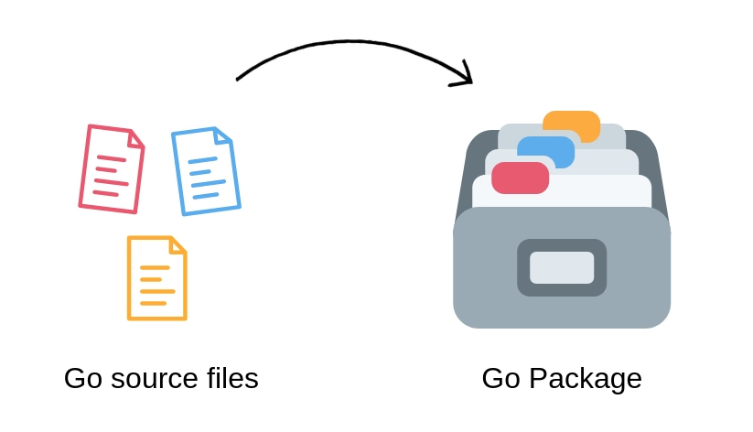
Go Package : Overview
In the most basic terms, A package is nothing but a directory inside your Go workspace containing one or more Go source files, or other Go packages.
workspaces:
A workspace is a directory hierarchy with two directories at its root:
src contains Go source files, and
bin contains executable commands.

Slide 87
Go Package: benifits and main Package
Packaging functionalities in this way has the following benefits :
It reduces naming conflicts. You can have the same function names in different packages. This keeps our function names short and concise.
It organizes related code together so that it is easier to find the code you want to reuse.
It speeds up the compilation process by only requiring recompilation of smaller parts of the program that has actually changed. Although we use the fmt package, we don’t need to recompile it every time we change our program.
The main package and main() function
Go programs start running in the main package. It is a special package that is used with programs that are meant to be executable.
By convention, Executable programs (the ones with the main package) are called Commands. Others are called simply Packages.
The main() function is a special function that is the entry point of an executable program.

Slide 88
Go Package: Import Package
Go's convention is that - the package name is the same as the last element of import path.
For example: the name of the package imported as math/rand is rand. It is imported with path math/rand because It is nested inside the math package as a subdirectory.
package main
import (
"fmt" // here we import the package fmt
"math/rand" // here we import the package math/rand
)
func main() {
fmt.Println(rand.Intn(30)) // here we can use the function defined inside rand package
fmt.Println(rand.Intn(30))
fmt.Println(rand.Intn(30))
fmt.Println(rand.Intn(30))
fmt.Println(rand.Intn(30))
}

Slide 89
Go Package: Custom Package
Let's create under src folder a new repository with a file_name.go :
$ mkdir /lab1/src/github.com/reverse-string/reverse.go
package reverse_string
func Reverse(s string) string {
b := []rune(s)
for i :=0 ; i < len(b)/2 ; i++ {
j := len(b)-i-1
b[i],b[j] = b[j], b[i]
}
return string(b)
}
$ GOBIN=$GOPATH/bin go install
this command will create a new binary package under $GOPATH/bin/github.com/reverse-string.a

Slide 90
Go Package: Custom Package
Using this package:
package main
import "fmt"
import "lab1/src/reverse-string" // import custom package
func main() {
fmt.Println(reverse_string.Reverse("GOLANG Course"))
}

Slide 91
Go Commands
Go is a tool for managing Go source code.
$ go <<commands>> <<arguments>>
The commands are:
bug start a bug report
build compile packages and dependencies
clean remove object files and cached files
doc show documentation for package or symbol
env print Go environment information
fix update packages to use new APIs
fmt gofmt (reformat) package sources
generate generate Go files by processing source
get add dependencies to current module and install them
install compile and install packages and dependencies
list list packages or modules
mod module maintenance
run compile and run Go program
test test packages
tool run specified go tool
version print Go version
vet report likely mistakes in packages

Slide 92
Go Standard Library
Go is a tool for managing Go source code.
$ go <<commands>> <<arguments>>
The commands are:
bug start a bug report
build compile packages and dependencies
clean remove object files and cached files
doc show documentation for package or symbol
env print Go environment information
fix update packages to use new APIs
fmt gofmt (reformat) package sources
generate generate Go files by processing source
get add dependencies to current module and install them
install compile and install packages and dependencies
list list packages or modules
mod module maintenance
run compile and run Go program
test test packages
tool run specified go tool
version print Go version
vet report likely mistakes in packages

Slide 93
Go Standard Library: Archive
Go is a tool for managing Go source code.

Slide 94
Go Standard Library: Compression
Go is a tool for managing Go source code.

Slide 95
Go Standard Library: Collection
Go is a tool for managing Go source code.

Slide 96
Go Standard Library: File
Go is a tool for managing Go source code.

Slide 97
Go Standard Library: OS
Go is a tool for managing Go source code.

Slide 98
Go Standard Library: File Format
Go is a tool for managing Go source code.

Slide 99
Go Standard Library: Graphics-Related
Go is a tool for managing Go source code.

Slide 100
Go Standard Library: Networking
Go is a tool for managing Go source code.

Slide 101
Go Standard Library: Reflect
Go is a tool for managing Go source code.

Slide 102
Chapter 7
GO-PROGRAMMING
Templates

Slide 103
Plan
Understanding templates
Templating with concatenation
Understanding package text/template: parsing & executing templates
Passing data into templates
Variables in templates
Passing composite Data structures into templates
Functions & pipelines in templates
Predefined global functions in templates
Nesting templates - modularizing your code

Slide 104
Understanding templates
Go templates are a powerful method to customize output however you want, whether you’re creating a web page, sending an e-mail, working with Buffalo, Go-Hugo.
There’re two packages operating with templates — text/template and html/template. Both provide the same interface, however the html/template package is used to generate HTML output safe against code injection.
Notice : Almost every programming language has a library implementing templating. In epoch of server side MVC dominance, templating was so important that it could determine language success or failure. Nowadays, however, when single page applications get momentum, templates are used only occasionally.

Slide 105
Understanding templates
Before we learn how to implement it, let’s take a look at template’s syntax. Templates are provided to the appropriate functions either as string or as “raw string”. Actions represents the data evaluations, functions or control loops. They’re delimited by {{ }}. Other, non delimited parts are left untouched.
Data evaluations
Usually, when using templates, you’ll bind them to some data structure (e.g. struct) from which you’ll obtain data. To obtain data from a struct, you can use the {{ .FieldName }} action, which will replace it with FieldName value of given struct, on parse time. The struct is given to the Execute function, which we’ll cover later.
There’s also the {{.}} action that you can use to refer to a value of non-struct types.
Conditions
You can also use if loops in templates. For example, you can check if FieldName non-empty, and if it is, print its value: {{if .FieldName}} Value of FieldName is {{ .FieldName }} {{end}}.
else and else if are also supported: {{if .FieldName}} // action {{ else }} // action 2 {{ end }}.

Slide 106
Passing data into templates
Loops
Using the range action you can loop through a slice. A range actions is defined using the {{range .Member}} ... {{end}} template.
If your slice is a non-struct type, you can refer to the value using the {{ . }} action. In case of structs, you can refer to the value using the {{ .Member }} action, as already explained.

Slide 107
Functions & pipelines in templates
Functions, Pipelines and Variables
Actions have several built-in functions that’re used along with pipelines to additionally parse output. Pipelines are annotated with | and default behavior is sending data from left side to the function on right side.
Functions are used to escape the action’s result. There’re several functions available by default such as, html which returns HTML escaped output, safe against code injection or js which returns JavaScript escaped output.
Using the with action, you can define variables that’re available in that with block: {{ with $x := <^>result-of-some-action<^> }} {{ $x }} {{ end }}.
Throughput the article, we’re going to cover more complex actions, such as reading from an array instead of struct.

Slide 108
Templating with concatenation
Go is a tool for managing Go source code.

Slide 109
parsing & executing templates
Parsing Templates:
The three most important and most frequently used functions are:
New — allocates new, undefined template,
Parse — parses given template string and return parsed template,
Execute — applies parsed template to the data structure and writes result to the given writer.
Verifying Templates:
template packages provide the Must functions, used to verify that a template is valid during parsing. The Must function provides the same result as if we manually checked for the error, like in the previous example.
This approach saves you typing, but if you encounter an error, your application will panic. For advanced error handling, it’s easier to use above solution instead of Must function.
The Must function takes a template and error as arguments. It’s common to provide New function as an argument to it:

Slide 110
Variables in templates
Go is a tool for managing Go source code.

Slide 111
Passing composite Data structures into templates
Go is a tool for managing Go source code.

Slide 112
Functions & pipelines in templates
Go is a tool for managing Go source code.

Slide 113
Predefined global functions in templates
Go is a tool for managing Go source code.

Slide 114
Nesting templates - modularizing your code
Go is a tool for managing Go source code.

Slide 115
Chapter 8
GO-PROGRAMMING
Introduction to Web Dev

Slide 116
Plan
Understanding servers
TCP server - Connection
TCP server - Code a client
TCP server - rot13 & in-memory database
TCP server - HTTP request, method & multiplexer
Net/Http package
Understanding & using ListenAndServe
Foundation of net/http: Handler, ListenAndServe, Request, ResponseWriter
Retrieving form values - exploring *http.Request
Retrieving other request values - exploring *http.Request
Exploring http.ResponseWriter - writing headers to the response

Slide 117
Understanding servers
A web server is server software, or hardware dedicated to running said software, that can satisfy World Wide Web client requests. A web server can, in general, contain one or more websites. A web server processes incoming network requests over HTTP and several other related protocols.
An HTTP server serves data to clients using the HTTP protocol. It is also known as a web server.
The first http server was called CERN HTTPD, and it was written in 1990 by Tim Berners-Lee for the NeXTSTEP platform. Four years later, Berners-Lee initiated the creation of the World Wide Web Consortium (W3C) to regulate the development of HTTP, HTML, and other technologies related to the World Wide Web.

Slide 118
TCP server - Connection
The TCP server in Go that is concurrent in nature. This will enable this server to handle more than one connection. This server will also know if a client disconnects without asking the server to close the connection.
what we need to create a TCP server Connection:
CONN_HOST
CONN_Port
CONN_type
Create a connection :
conn,err := net.Listen(CONN_TYPE, CONN_HOST+”:”+CONN_PORT)

Slide 119
TCP server - Connection
package main
import (
"fmt"
"net"
"os"
)
const (
CONN_HOST = "localhost"
CONN_PORT = "3333"
CONN_TYPE = "tcp"
)
func createConnection() {
con,err := net.Listen(CONN_TYPE,CONN_HOST+":"+CONN_PORT)
if err != nil {
fmt.Println("Error listening:", err.Error())
os.Exit(1)
}
defer con.Close() // Close the listener when the application closes.
fmt.Println("Listening on " + CONN_HOST + ":" + CONN_PORT)
for {
req,err := con.Accept() // accept a connection
if err != nil {
}
go handleRequest(req) // handle the connection will be concurrent
}
}

Slide 120
TCP server - Connection : handel request
// Handles incoming requests.
func handleRequest(conn net.Conn) {
// Make a buffer to hold incoming data.
buf := make([]byte, 1024)
// Read the incoming connection into the buffer.
reqLen, err := conn.Read(buf)
if err != nil {
fmt.Println("Error reading:", err.Error())
}
// Send a response back to person contacting us.
fmt.Println("reqlenght", reqLen)
conn.Write([]byte("Message received."))
// Close the connection when you're done with it.
conn.Close()
}
If you build this and run it, you'll have a simple TCP server running on port 3333.
To test your server, send some raw data to that port:
echo -n "test out the server" | nc localhost 3333
Response: message received

Slide 121
TCP server - Code a client
import "net"
import "fmt"
import "bufio" // Package bufio implements buffered I/O
import "os"
func main() {
// connect to this socket
conn, _ := net.Dial("tcp", "127.0.0.1:8081") // CONN_TYPE , CONN_HOST , CONN_PORT
for {
// read in input from stdin
reader := bufio.NewReader(os.Stdin)
fmt.Print("Text to send: ")
text, _ := reader.ReadString('\n')
// send to socket
fmt.Fprintf(conn, text + "\n")
// listen for reply
message, _ := bufio.NewReader(conn).ReadString('\n')
fmt.Print("Message from server: "+message)
}
}

Slide 122
TCP server - rot13 & in-memory database
Go is a tool for managing Go source code.

Slide 123
TCP server - HTTP request, method & multiplexer
Go is a tool for managing Go source code.

Slide 124
Net/Http package
Controller
Notify
Update
Model
View
Update
User Action

Slide 125
Net/Http package
A web server, also known as an HTTP server, uses the HTTP protocol to communicate with clients. All web browsers can be considered clients.
We can divide the web's working principles into the following steps:
Client uses TCP/IP protocol to connect to server.
Client sends HTTP request packages to server.
Server returns HTTP response packages to client. If the requested resources include dynamic scripts, server calls script engine first.
Client disconnects from server, starts rendering HTML.
This is a simple work flow of HTTP affairs-notice that the server closes its connections after it sends data to the clients, then waits for the next request.

Slide 126
Understanding & using Listen And Serve
ListenAndServe starts an HTTP server with a given address and handler. The handler is usually nil, which means to use DefaultServeMux. Handle and HandleFunc add handlers to DefaultServeMux:
If we run the project no thing happen because it miss a handler , the handler look like a call from the client or an action handled by the client to to something
package main
import (
"fmt"
"net/http"
)
func main() {
http.ListenAndServe("localhost:2600", nil)
}

Slide 127
Foundation of net/http:Request, ResponseWriter
Here we will create a new mux , a mux is like a router that give the direction or the way to acces to some fonctionality, after create a mux we will create a handelFunc that neet two parameters the first is a http.ResponseWriter and the second is a reference of http.Request,
package main
import (
"fmt"
"net/http"
)
func main() {
mux := http.NewServeMux()
mux.HandleFunc("/", func(w http.ResponseWriter , r *http.Request) {
w.Write([]byte("Hello world"))
fmt.Println("request method", r.Method)
})
http.ListenAndServe("localhost:2600", mux)
}

Slide 128
Retrieving form values - exploring *http.Request
first of all we need to define a HTML form , don't forget we need an action to get the endpoint/path to call the back end function also the method “POST”.
After we need to add a name”username,password” to our inputs to use these keys in the go program, and of course an input with submit type to send the form .
<html>
<head>
<title></title>
</head>
<body>
<form action="/login" method="post">
Username:<input type="text" name="username">
Password:<input type="password" name="password">
<input type="submit" value="Login">
</form>
</body>
</html>

Slide 129
Retrieving form values - exploring *http.Request
Now what we need is to create a function with two parameters “ResponseWriter” to display the login form if the HTTP method is “GET” and the second parameters “ Http.Request” to get the data from the form.
we have two methods to get input value :
r.FormValue(“INPUT_NAME”)
r.ParseForm() and r.Form[“INPUT_NAME”]
func login(w http.ResponseWriter, r *http.Request) {
fmt.Println("method:", r.Method) //get request method
if r.Method == "GET" {
t, _ := template.ParseFiles("login.gtpl")
t.Execute(w, nil)
} else {
// use FormValue (1)
fmt.Println("username", r.FormValue("username"))
fmt.Println("password:", r.FormValue("password"))
// logic part of login (2)
r.ParseForm()
fmt.Println("username:", r.Form["username"])
fmt.Println("password:", r.Form["password"])
}
}

Slide 130
Retrieving other request values - exploring *http.Request
There are anothor method for http.Request :
Method
Header
Body
ContentLength
Url
Close
PostForm
RemoteAddr
RequestURI
Cancel
Response
https://golang.org/src/net/http/request.go

Slide 131
Retrieving other request values - exploring *http.Request
Http Status code 100 & 200:
StatusContinue = 100 // RFC 7231, 6.2.1
StatusSwitchingProtocols = 101 // RFC 7231, 6.2.2
StatusProcessing = 102 // RFC 2518, 10.1
StatusEarlyHints = 103 // RFC 8297
StatusOK = 200 // RFC 7231, 6.3.1
StatusCreated = 201 // RFC 7231, 6.3.2
StatusAccepted = 202 // RFC 7231, 6.3.3
StatusNonAuthoritativeInfo = 203 // RFC 7231, 6.3.4
StatusNoContent = 204 // RFC 7231, 6.3.5
StatusResetContent = 205 // RFC 7231, 6.3.6
StatusPartialContent = 206 // RFC 7233, 4.1
StatusMultiStatus = 207 // RFC 4918, 11.1
StatusAlreadyReported = 208 // RFC 5842, 7.1
StatusIMUsed = 226 // RFC 3229, 10.4.1

Slide 132
Retrieving other request values - exploring *http.Request
Http Status code 300 (redirect):
StatusMultipleChoices = 300 // RFC 7231, 6.4.1
StatusMovedPermanently = 301 // RFC 7231, 6.4.2
StatusFound = 302 // RFC 7231, 6.4.3
StatusSeeOther = 303 // RFC 7231, 6.4.4
StatusNotModified = 304 // RFC 7232, 4.1
StatusUseProxy = 305 // RFC 7231, 6.4.5
_ = 306 // RFC 7231, 6.4.6 (Unused)
StatusTemporaryRedirect = 307 // RFC 7231, 6.4.7
StatusPermanentRedirect = 308 // RFC 7538, 3

Slide 133
Retrieving other request values - exploring *http.Request
Http Status code (400 code client):
StatusBadRequest = 400 // RFC 7231, 6.5.1
StatusUnauthorized = 401 // RFC 7235, 3.1
StatusPaymentRequired = 402 // RFC 7231, 6.5.2
StatusForbidden = 403 // RFC 7231, 6.5.3
StatusNotFound = 404 // RFC 7231, 6.5.4
StatusMethodNotAllowed = 405 // RFC 7231, 6.5.5
StatusNotAcceptable = 406 // RFC 7231, 6.5.6
StatusProxyAuthRequired = 407 // RFC 7235, 3.2
StatusRequestTimeout = 408 // RFC 7231, 6.5.7
StatusConflict = 409 // RFC 7231, 6.5.8
StatusGone = 410 // RFC 7231, 6.5.9
StatusLengthRequired = 411 // RFC 7231, 6.5.10
StatusPreconditionFailed = 412 // RFC 7232, 4.2
StatusRequestEntityTooLarge = 413 // RFC 7231, 6.5.11
StatusRequestURITooLong = 414 // RFC 7231, 6.5.12
StatusUnsupportedMediaType = 415 // RFC 7231, 6.5.13
StatusRequestedRangeNotSatisfiable = 416 // RFC 7233, 4.4
StatusExpectationFailed = 417 // RFC 7231, 6.5.14
StatusTeapot = 418 // RFC 7168, 2.3.3
StatusMisdirectedRequest = 421 // RFC 7540, 9.1.2
StatusUnprocessableEntity = 422 // RFC 4918, 11.2
StatusLocked = 423 // RFC 4918, 11.3
StatusFailedDependency = 424 // RFC 4918, 11.4
StatusTooEarly = 425 // RFC 8470, 5.2.
StatusUpgradeRequired = 426 // RFC 7231, 6.5.15
StatusPreconditionRequired = 428 // RFC 6585, 3
StatusTooManyRequests = 429 // RFC 6585, 4
StatusRequestHeaderFieldsTooLarge = 431 // RFC 6585, 5
StatusUnavailableForLegalReasons = 451 // RFC 7725, 3

Slide 134
Retrieving other request values - exploring *http.Request
Http Status code (500 server error) :
StatusInternalServerError = 500 // RFC 7231, 6.6.1
StatusNotImplemented = 501 // RFC 7231, 6.6.2
StatusBadGateway = 502 // RFC 7231, 6.6.3
StatusServiceUnavailable = 503 // RFC 7231, 6.6.4
StatusGatewayTimeout = 504 // RFC 7231, 6.6.5
StatusHTTPVersionNotSupported = 505 // RFC 7231, 6.6.6
StatusVariantAlsoNegotiates = 506 // RFC 2295, 8.1
StatusInsufficientStorage = 507 // RFC 4918, 11.5
StatusLoopDetected = 508 // RFC 5842, 7.2
StatusNotExtended = 510 // RFC 2774, 7
StatusNetworkAuthenticationRequired = 511 // RFC 6585, 6

Slide 135
Exploring http.ResponseWriter - writing headers to the response
A Header represents the key-value pairs in an HTTP header.
type Header map[string][]string
func saveHandler(w http.ResponseWriter, r *http.Request) {
// allow cross domain AJAX requests
w.Header().Set("Access-Control-Allow-Origin", "*")
//
if origin := req.Header.Get("Origin"); origin != "" {
rw.Header().Set("Access-Control-Allow-Origin", origin)
rw.Header().Set("Access-Control-Allow-Methods", "POST, GET, OPTIONS, PUT, DELETE")
rw.Header().Set("Access-Control-Allow-Headers",
"Accept, Content-Type, Content-Length, Accept-Encoding, X-CSRF-Token, Authorization")
}
}

Slide 136
Chapter 9
GO-PROGRAMMING
Routing and serving files

Slide 137
Plan
Understanding ServeMux
Disambiguation: func(ResponseWriter, *Request) vs. HandlerFunc
Third-party servemux
understanding files
Serving & Creating a file
log.Fatal & http.Error
The http.NotFoundHandler

Slide 138
Chapter 10
GO-PROGRAMMING
States and sessions

Slide 139
Plan
State overview
Passing values
Uploading a file, reading the file, creating a file on the server
Encrypt
Redirects
Cookies
Sessions Overview
Universally unique identifier - UUID
Sign-up / Encrypt password
Login / Logout
Permissions
Expire session

Slide 140
State overview
An important topic in web development is providing a good user experience, but the fact that HTTP is a stateless protocol seems contrary to this spirit. How can we control the whole process of viewing websites for users? The classic solutions are using cookies and sessions, where cookies serve as the client side mechanism and sessions are saved on the server side with a unique identifier for every single user. Note that sessions can be passed in URLs or cookies, or even in your database (which is much more secure, but may hamper your application performance).
Cookies and Sessions are used to store information. Cookies are only stored on the client-side machine, while sessions get stored on the client as well as a server.
Session
A session creates a file in a temporary directory on the server where registered session variables and their values are stored. This data will be available to all pages on the site during that visit.
A session ends when the user closes the browser or after leaving the site, the server will terminate the session after a predetermined period of time, commonly 30 minutes duration.

Slide 141
State overview
Cookies and Sessions are used to store information. Cookies are only stored on the client-side machine, while sessions get stored on the client as well as a server.
Session
A session creates a file in a temporary directory on the server where registered session variables and their values are stored. This data will be available to all pages on the site during that visit.
A session ends when the user closes the browser or after leaving the site, the server will terminate the session after a predetermined period of time, commonly 30 minutes duration.
Cookies
Cookies are text files stored on the client computer and they are kept of use tracking purpose. Server script sends a set of cookies to the browser. For example name, age, or identification number etc. The browser stores this information on a local machine for future use.
When next time browser sends any request to web server then it sends those cookies information to the server and server uses that information to identify the user.

Slide 142
Passing values
Passing values:

Slide 143



Uploading a file, reading the file, creating a file on the
server
Within this tutorial, we are going to look at how you can effectively read and write to files within your filesystem using the go programming language.
The method we are going to use to read and write to these files will be file format-agnostic. What this means is that you’ll be able to use the techniques we’ll be covering in order to read and write, .txt, .csv, .xls and so on, the only thing that differs for these files is the structure of the data that you write to each of these file types.
Reading files :
In order to read from files on your local filesystem, you’ll have to use the io/ioutil module.
You’ll first have to pull of the contents of a file into memory by calling ioutil.ReadFile("/path/to/my/file.ext") which will take in the path to the file you wish to read in as it’s only parameter. This will return either the data of the file, or an err which can be handled as you normally handle errors in go.
Data
Read file
Error

Slide 144
Reading file:
Create two files main.go and localfile.txt
package main
// import the 2 modules we need
import (
"fmt"
"io/ioutil"
)
func main() {
// read in the contents of the localfile.data
data, err := ioutil.ReadFile("localfile.txt")
// if our program was unable to read the file
// print out the reason why it can't
if err != nil {
fmt.Println(err)
}
// if it was successful in reading the file then
// print out the contents as a string
fmt.Print(string(data))
}

Slide 145
Reading file:
localfile.txt
$ go run main.go
Hello world !!
Second line
third line
.....
Hello world !!
Second line
third line
.....

Slide 146
Encrypt
Definition:
Encryption is the process through which data is encoded so that it remains hidden from or inaccessible to unauthorized users. It helps protect private information, sensitive data, and can enhance the security of communication between client apps and servers. In essence, when your data is encrypted, even if an unauthorized person or entity gains access to it, they will not be able to read it.
Algorithms:
An algorithm is basically a procedure or a formula for solving a data snooping problem. An encryption algorithm is a set of mathematical procedure for performing encryption on data. Through the use of such an algorithm, information is made in the cipher text and requires the use of a key to transforming the data into its original form. This brings us to the concept of cryptography that has long been used in information security in communication systems.

Slide 147
Encrypt : Algorithm
Algorithm
Data to encrypt
Data encrypted

Slide 148
Encrypt
Cryptography
Cryptography is a method of using advanced mathematical principles in storing and transmitting data in a particular form so that only those whom it is intended can read and process it. Encryption is a key concept in cryptography – It is a process whereby a message is encoded in a format that cannot be read or understood by an eavesdropper. The technique is old and was first used by Caesar to encrypt his messages using Caesar cipher. A plain text from a user can be encrypted to a ciphertext, then send through a communication channel and no eavesdropper can interfere with the plain text. When it reaches the receiver end, the ciphertext is decrypted to the original plain text.

Slide 149
Encrypt
Cryptography Terms:
Encryption: It is the process of locking up information using cryptography. Information that has been locked this way is encrypted.
Decryption: The process of unlocking the encrypted information using cryptographic techniques.
Key: A secret like a password used to encrypt and decrypt information. There are a few different types of keys used in cryptography.
Steganography: It is actually the science of hiding information from people who would snoop on you. The difference between steganography and encryption is that the would-be snoopers may not be able to tell there’s any hidden information in the first place.

Slide 150
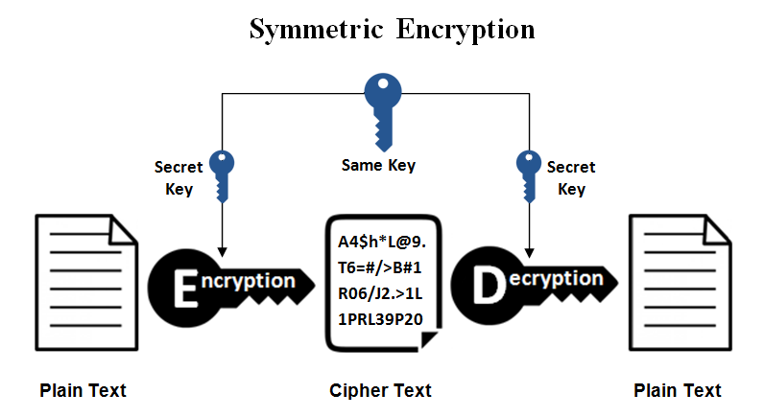
Encrypt : Symmetrical Encryption
Symmetrical Encryption:

Slide 151
Encrypt : Symmetrical Encryption
Symmetrical Encryption:
This is the simplest kind of encryption that involves only one secret key to cipher and decipher information. Symmetrical encryption is an old and best-known technique. It uses a secret key that can either be a number, a word or a string of random letters. It is a blended with the plain text of a message to change the content in a particular way. The sender and the recipient should know the secret key that is used to encrypt and decrypt all the messages.
Blowfish, AES, RC4, DES, RC5, and RC6 are examples of symmetric encryption. The most widely used symmetric algorithm is AES-128, AES-192, and AES-256.
The main disadvantage of the symmetric key encryption is that all parties involved have to exchange the key used to encrypt the data before they can decrypt it.

Slide 152
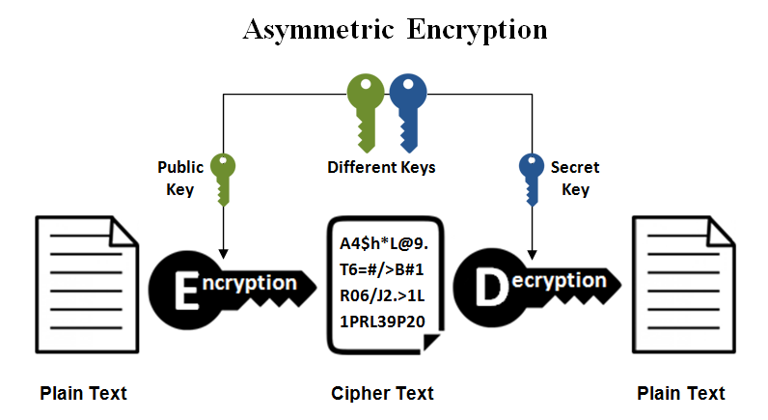
Encrypt : Asymmetrical Encryption
Asymmetrical Encryption:

Slide 153
Encrypt : Asymmetrical Encryption
Asymmetrical Encryption:
Asymmetrical encryption is also known as public key cryptography, which is a relatively new method, compared to symmetric encryption. Asymmetric encryption uses two keys to encrypt a plain text. Secret keys are exchanged over the Internet or a large network. It ensures that malicious persons do not misuse the keys. It is important to note that anyone with a secret key can decrypt the message and this is why asymmetrical encryption uses two related keys to boosting security. A public key is made freely available to anyone who might want to send you a message. The second private key is kept a secret so that you can only know.
A message that is encrypted using a public key can only be decrypted using a private key, while also, a message encrypted using a private key can be decrypted using a public key.
Security of the public key is not required because it is publicly available and can be passed over the internet. Asymmetric key has a far better power in ensuring the security of information transmitted during communication.
Asymmetric encryption is mostly used in day-to-day communication channels, especially over the Internet. Popular asymmetric key encryption algorithm includes EIGamal, RSA, DSA, Elliptic curve techniques, PKCS.

Slide 154
Encrypt : GO Implementation
Go Implementation:
The Go language supports symmetric encryption algorithms in its crypto package. Do not use anything except AES in GCM mode if you don't know what you're doing!
crypto/aes package: AES (Advanced Encryption Standard), also known as Rijndael encryption method, is used by the U.S. federal government as a block encryption standard.
In the following example we demonstrate how to encrypt data using AES in GCM mode:
Define text and key :
text := []byte("My name is Assakra Radhouen")
key := []byte("the-key-has-to-be-32-bytes-long!")
Use encrypt function to encrypt text:
ciphertext, err := encrypt(text, key)// we need to impliment these function
Decrypt text using decrypt function:
plaintext, err := decrypt(ciphertext, key)// we need to impliment these function
Use algorithm to impliment encrypt and decrypt:
AES for symetric encryption : import “crypto/aes”
RSA for asymetric encryption : import "crypto/rsa"

Slide 155
Encrypt : GO AES
func encrypt(plaintext []byte, key []byte) ([]byte, error) {
c, err := aes.NewCipher(key)
/*NewCipher creates and returns a new cipher.Block. The key argument should be the AES key, either 16, 24, or 32 bytes to select AES-128, AES-192, or AES-256.*/
if err != nil {
return nil, err
}
gcm, err := cipher.NewGCM(c)
if err != nil {
return nil, err
}
nonce := make([]byte, gcm.NonceSize())
if _, err = io.ReadFull(rand.Reader, nonce); err != nil {
return nil, err
}
return gcm.Seal(nonce, nonce, plaintext, nil), nil
}

Slide 156
Encrypt : GO AES
func decrypt(ciphertext []byte, key []byte) ([]byte, error) {
c, err := aes.NewCipher(key)
if err != nil {
return nil, err
}
gcm, err := cipher.NewGCM(c)
if err != nil {
return nil, err
}
nonceSize := gcm.NonceSize()
if len(ciphertext) < nonceSize {
return nil, errors.New("ciphertext too short")
}
nonce, ciphertext := ciphertext[:nonceSize], ciphertext[nonceSize:]
return gcm.Open(nil, nonce, ciphertext, nil)
}

Slide 157
Encrypt : GO RSA

Slide 158
Redirects
Redirect replies to the request with a redirect to url, which may be a path relative to the request path.
The provided code should be in the 3xx range and is usually StatusMovedPermanently, StatusFound or StatusSeeOther.
If the Content-Type header has not been set, Redirect sets it to "text/html; charset=utf-8" and writes a small HTML body. Setting the Content-Type header to any value, including nil, disables that behavior.
func Redirect(w ResponseWriter, r *Request, url string, code int)

Slide 159
Cookies
Set A cookies:
Go uses the SetCookie function in the net/http package to set cookies:
http.SetCookie(w ResponseWriter, cookie *Cookie)
w is the response of the request and cookie is a struct. Let's see what it looks like:
type Cookie struct {
Name string
Value string
Path string // optional
Domain string // optional
Expires time.Time // optional
RawExpires string // for reading cookies only
// MaxAge=0 means no 'Max-Age' attribute specified.
// MaxAge<0 means delete cookie now, equivalently 'Max-Age: 0'
// MaxAge>0 means Max-Age attribute present and given in seconds
MaxAge int
Secure bool
HttpOnly bool
Raw string
Unparsed []string // Raw text of unparsed attribute-value pairs
}

Slide 160
Cookies
Set A cookies:
Here is an example of setting a cookie:
expiration := time.Now().Add(365 * 24 * time.Hour)
cookie := http.Cookie{Name: "username", Value: "astaxie", Expires: expiration}
http.SetCookie(w, &cookie)

Slide 161
Cookies
Fetch cookies in Go:
The above example shows how to set a cookie. Now let's see how to get a cookie that has been set:
Here is another way to get a cookie:
cookie, _ := r.Cookie("username")
fmt.Fprint(w, cookie)
for _, cookie := range r.Cookies() {
fmt.Fprint(w, cookie.Name)
}

Slide 162
Sessions Overview
Creating sessions
The basic principle behind sessions is that a server maintains information for every single client, and clients rely on unique session id's to access this information. When users visit the web application, the server will create a new session with the following three steps, as needed:
Create a unique session id
Open up a data storage space: normally we save sessions in memory, but you will lose all session data if the system is accidentally interrupted. This can be a very serious issue if web application deals with sensitive data, like in electronic commerce for instance. In order to solve this problem, you can instead save your session data in a database or file system. This makes data persistence more reliable and easy to share with other applications, although the tradeoff is that more server-side IO is needed to read and write these sessions.
Send the unique session id to the client.

Slide 163
Universally unique identifier - UUID
Universally unique identifier - UUID:
The uuid package generates and inspects UUIDs based on RFC 4122 and DCE 1.1: Authentication and Security Services.
This package is based on the github.com/pborman/uuid package (previously named code.google.com/p/go-uuid). It differs from these earlier packages in that a UUID is a 16 byte array rather than a byte slice. One loss due to this change is the ability to represent an invalid UUID (vs a NIL UUID).
Install:
go get github.com/google/uuid
Supported versions:
Version 1, based on timestamp and MAC address (RFC 4122)
Version 2, based on timestamp, MAC address and POSIX UID/GID (DCE 1.1)
Version 3, based on MD5 hashing (RFC 4122)
Version 4, based on random numbers (RFC 4122)
Version 5, based on SHA-1 hashing (RFC 4122)

Slide 164
Universally unique identifier - UUID
package main
import (
"fmt"
"github.com/satori/go.uuid"
)
func main() {
// Creating UUID Version 4
// panic on error
u1 := uuid.Must(uuid.NewV4())
fmt.Printf("UUIDv4: %s\n", u1)
// or error handling
u2, err := uuid.NewV4()
if err != nil {
fmt.Printf("Something went wrong: %s", err)
return
}
fmt.Printf("UUIDv4: %s\n", u2)
// Parsing UUID from string input
u2, err = uuid.FromString("6ba7b810-9dad-11d1-80b4-00c04fd430c8")
if err != nil {
fmt.Printf("Something went wrong: %s", err)
return
}
fmt.Printf("Successfully parsed: %s", u2)
}

Slide 165
Universally unique identifier - UUID
Do you really need a UUID ?
There are several reasons using a UUID as a PK would be great compared to auto-incrementing integers:
At scale, when you have multiple databases containing a segment (shard) of your data, for example a set of customers, using a UUID means that one ID is unique across all databases, not just the one you’re in now. This makes moving data across databases safe. Or in my case where all of our database shards are merged onto our Hadoop cluster as one, no key conflicts.
You can know your PK before insertion, which avoids a round trip DB hit, and simplifies transactional logic in which you need to know the PK before inserting child records using that key as its foreign key (FK)
UUIDs do not reveal information about your data, so would be safer to use in a URL, for example. If I am customer 12345678, it’s easy to guess that there are customers 12345677 and 1234569, and this makes for an attack vector. (But see below for a better alternative).

Slide 166
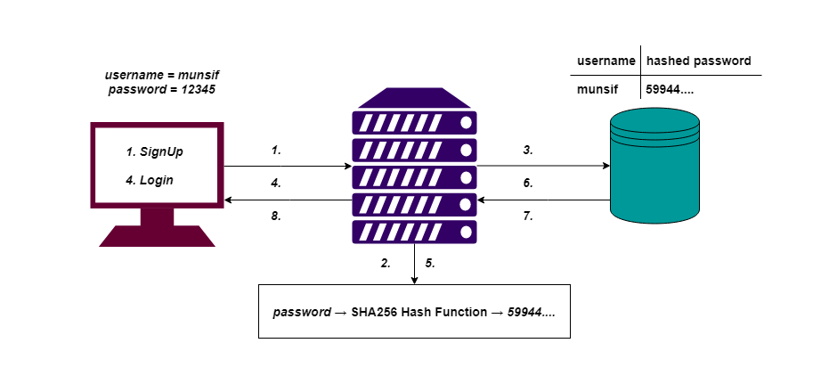
Sign-up / Encrypt password
Sign-up / Encrypt password:

Slide 167
Sign-up / Encrypt password
Password Hashing (bcrypt)
This example will show how to hash passwords using bcrypt. For this we have to go get the golang bcrypt library like so:
$ go get golang.org/x/crypto/bcrypt
From now on, every application we write will be able to make use of this library.

Slide 168
Sign-up / Encrypt password
// passwords.go
package main
import (
"fmt"
"golang.org/x/crypto/bcrypt"
)
func HashPassword(password string) (string, error) {
bytes, err := bcrypt.GenerateFromPassword([]byte(password), 14)
return string(bytes), err
}
func CheckPasswordHash(password, hash string) bool {
err := bcrypt.CompareHashAndPassword([]byte(hash), []byte(password))
return err == nil
}
func main() {
password := "secret"
hash, _ := HashPassword(password) // ignore error for the sake of simplicity
fmt.Println("Password:", password)
fmt.Println("Hash: ", hash)
match := CheckPasswordHash(password, hash)
fmt.Println("Match: ", match)
}

Slide 169
Login / Logout
Login / Logout:

Slide 170
Permissions
Permissions:

Slide 171
Expire session
Expire session:

Slide 172
Chapter 11
GO
PROGRAMMING–Database

Slide 173
Plan
MYSQL Databases
Connect
Insert
Update
Diplay
Delete

Slide 174
MySql DataBase
MYSQL:
The LAMP stack has been very popular on the internet in recent years, and the M in LAMP stand for MySQL. MySQL is famous because it's open source and easy to use. As such, it has become the de-facto database in the back-ends of many websites.
MySQL drivers:
There are a couple of drivers that support MySQL in Go. Some of them implement the database/sql interface, and others use their own interface standards.
https://github.com/go-sql-driver/mysql supports database/sql, written in pure Go.
https://github.com/ziutek/mymysql supports database/sql and user defined interfaces, written in pure Go.
I'll use the first driver in the following examples and I also recommend that you use it for the following reasons:
It's a new database driver and supports more features.
It fully supports database/sql interface standards.
Supports keep-alive, long connections with thread-safety.

Slide 175
Connect to a MySql DataBase
To connect to a data base we need 5 attributes : the database HOST, PORT, USER, PASSWORD and NAME.
type MySqlConnection struct {
dataBaseName string // example test
dataBasePort string // example 3306
dataBaseUrl string // example 127.0.0.1
dataBaseUserName string // example root
dataBasePassword string // example password1
}
Connection := MySqlConnection{
"gomycode",
"https://www.127.168.10.10",
"3306",
"gomycode",
"123654789/*-+",
}
sql.Open("mysql", Connection.dataBaseUserName+”:”+Connection.dataBasePassword+” @tcp(“+Connection.dataBaseUrl+”:”+Connection.dataBasePort+”)/”+Connection.dataBaseName")
Example: sql.Open("mysql", "root:password1@tcp(127.0.0.1:3306)/test")

Slide 176
Insert into an array Mysql
// insert
stmt, err := db.Prepare("INSERT userinfo SET username=?,departname=?,created=?")
checkErr(err)
res, err := stmt.Exec("radhouen", "EL khadhra city", "2020-01-09")
checkErr(err)
id, err := res.LastInsertId()
checkErr(err)
fmt.Println(id)

Slide 177
Update an item
fun deleteElement() {
stmt, err = db.Prepare("update userinfo set username=? where uid=?")
checkErr(err)
res, err = stmt.Exec("astaxieupdate", id)
checkErr(err)
affect, err := res.RowsAffected()
checkErr(err)
fmt.Println(affect)
}

Slide 178
Display
// query
rows, err := db.Query("SELECT * FROM userinfo")
checkErr(err)
for rows.Next() {
var uid int
var username string
var department string
var created string
err = rows.Scan(&uid, &username, &department, &created)
checkErr(err)
fmt.Println(uid)
fmt.Println(username)
fmt.Println(department)
fmt.Println(created)
}

Slide 179
Delete
// delete
stmt, err = db.Prepare("delete from userinfo where uid=?")
checkErr(err)
res, err = stmt.Exec(id)
checkErr(err)
affect, err = res.RowsAffected()
checkErr(err)
fmt.Println(affect)
db.Close()

Slide 180
Chapter 12
GO
PROGRAMMING–Database

Slide 181
Plan
NoSQL Databases
Go & MongoDB
Aggregation
JSON

