Slide 1

Otázky kvality služby vo VoIP sieťach, časť 1
Ing. Peter Palúch, PhD.
Katedra informačných sietí
FRI ŽU

Slide 2
Otázky kvality služby v konvergovanej sieti
Nedostatok prenosovej kapacity
  Mnohé toky súperia o obmedzené množstvo prenosovej kapacity prepínačov, smerovačov a rozhraní medzi nimi
Celkové oneskorenie (pevná aj variabilná zložka)
  Pakety musia prejsť cez početné sieťové zariadenia a prepoje, z ktorých každé vnáša svoju časť oneskorenia
Kolísanie oneskorenia (jitter)
  Tok inej prevádzky popri hlasovej prevádzke vnáša náhodné kolísania v oneskorení
Straty paketov
  Pri zahltení rozhrania sa pakety môžu zahadzovať
Notes:
With inadequate network configuration, voice transmission is irregular or unintelligible. Gaps in speech where pieces of speech are interspersed with silence are particularly troublesome.
Delay causes poor caller interactivity. Poor caller interactivity can cause echo and talker overlap. Echo is the effect of the signal reflecting the speaker voice from the far-end telephone equipment back into the speaker ear. Talker overlap is caused when one-way delay becomes greater than 250 ms. When this long delay occurs; one talker steps in on the speech of the other talker.
The worst-case result of delay is a disconnected call. If there are long gaps in speech, the parties will hang up. If there are signaling problems, calls are disconnected. Such events are unacceptable in voice communications, yet are quite common for an inadequately prepared data network that is attempting to carry voice.
The four major issues that face converged enterprise networks:
Lack of Bandwidth capacity: Large graphics files, multimedia uses, and increasing use of voice and video cause bandwidth capacity problems over data networks.
End-to-end delay (both fixed and variable): Delay is the time it takes for a packet to reach the receiving endpoint after being transmitted from the sending endpoint. This period of time is called the “end-to-end delay” and consists of two components:
Fixed network delay: Two types of fixed network delay are serialization and propagation delays. Serialization is the process of placing bits on the circuit. The higher the circuit speed, the less time it takes to place the bits on the circuit. Therefore, the higher the speed of the link, the less serialization delay is incurred. Propagation delay is the time it takes frames to transit the physical media.
Variable network delay: Processing delay is a type of variable delay and is the time required by a networking device to look up the route, change the header, and complete other switching tasks. In some cases, the packet must also be manipulated, as, for example, when the encapsulation type or the hop count must be changed. Each of these steps can contribute to processing delay.
Variation of delay (also called jitter): Jitter is the delta, or difference, in the total end-to-end delay values of two voice packets in the voice flow.
Packet loss: WAN congestion is the usual cause for packet loss and results in speech dropouts or a stutter effect if the play out side tries to accommodate for the loss by retransmitting previously sent packets.

Slide 3
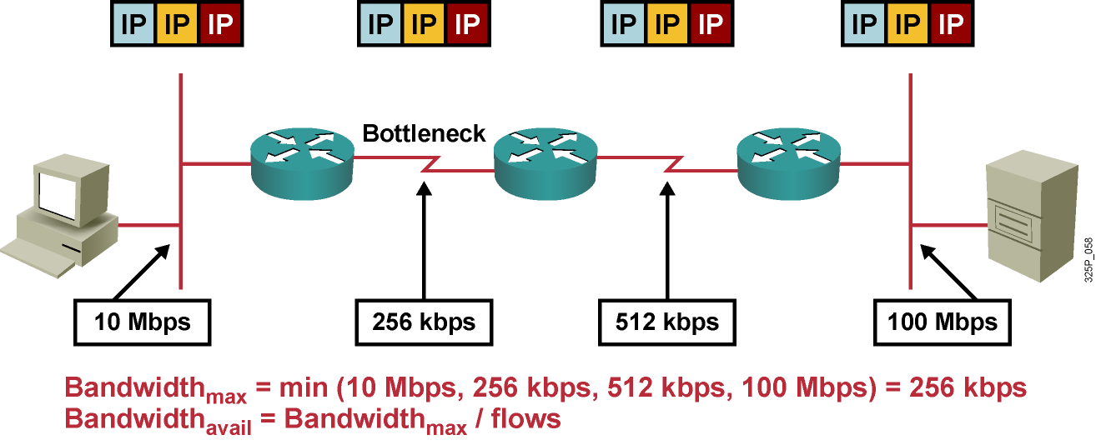
Disponibilná prenosová kapacita
Maximálna dostupná prenosová kapacita je kapacita najpomalšej linky
O túto prenosovú kapacitu sa uchádzajú mnohé toky, čím môžu znížiť jej dostupnosť pre ktorúkoľvek individuálnu aplikáciu
Prirodzene, nedostatok prenosovej kapacity má negatívny vplyv na aplikácie
Notes:
This example shows a network with four hops between a server and a client. Each hop uses different media with different bandwidths. The maximum available bandwidth is equal to the bandwidth of the slowest link.
The calculation of the available bandwidth, however, is much more complex in cases where multiple flows are traversing the network. In such cases, you must calculate average bandwidth available per flow.
Inadequate bandwidth can have performance impacts on network applications, especially those that are time-sensitive (such as voice) or consume a lot of bandwidth (such as videoconferencing). These performance impacts result in poor voice and video quality. In addition, interactive network services, such as terminal services and remote desktops, may also suffer from lower bandwidth, which results in slow application responses.

Slide 4
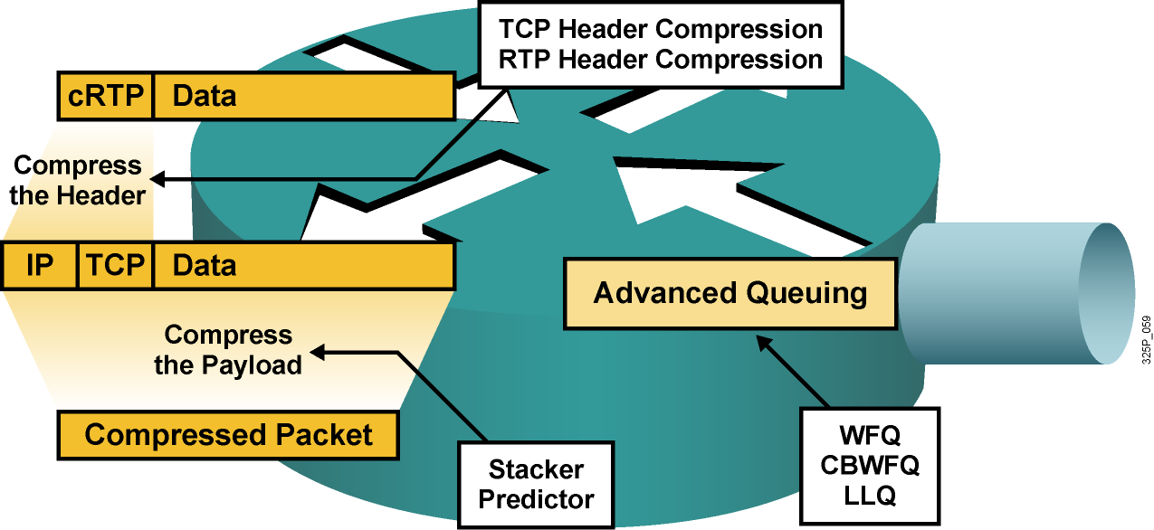
Ako získať disponibilnú prenosovú kapacitu
Zrýchliť linku (najlepšie, ale aj najdrahšie riešenie)
Využiť QoS prostriedky a dať prioritu dôležitým paketom (na úkor iných tokov)
Komprimovať obsah rámcov (to však trvá istý čas)
Komprimovať IP hlavičky (detto)
Notes:
Bandwidth is one of the key factors that affects QoS in a network; the more bandwidth there is, the better the QoS will be.
The best way to increase bandwidth is to increase the link capacity of the network to accommodate all applications and users, allowing extra, spare bandwidth. Although this solution sounds simple, increasing bandwidth is expensive and takes time to implement. There are often technological limitations in upgrading to a higher bandwidth.
The better option is to classify traffic into QoS classes and prioritize each class according to its relative importance. The basic queuing mechanism is First In First Out (FIFO). Other queuing mechanisms provide additional granularity to serve voice and business-critical traffic. Such traffic types should receive sufficient bandwidth to support their application requirements. Voice traffic should receive prioritized forwarding, and the least important traffic should receive the unallocated bandwidth that remains after prioritized traffic is accommodated.
Cisco IOS QoS software provides a variety of mechanisms to assign bandwidth priority to specific classes of traffic:
Priority queuing (PQ) or custom queuing (CQ)
Modified deficit round robin (MDRR) (on Cisco 12000 Series Routers)
Distributed type of service (ToS)-based and QoS group-based weighted fair queuing (WFQ) (on Cisco 7x00 Series Routers)
Class-based weighted fair queuing (CBWFQ)
Low-latency queuing (LLQ)
A way to increase the available link bandwidth is to optimize link usage by compressing the payload of frames (virtually). Compression, however, also increases delay because of the complexity of compression algorithms. Using hardware compression can accelerate packet payload compressions. Stacker and Predictor are two compression algorithms that are available in Cisco IOS software.
Another mechanism that is used for link bandwidth efficiency is header compression. Header compression is especially effective in networks where most packets carry small amounts of data (that is, where the payload-to-header ratio is small). Typical examples of header compression are TCP header compression and Real-Time Transport Protocol (RTP) header compression.

Slide 5
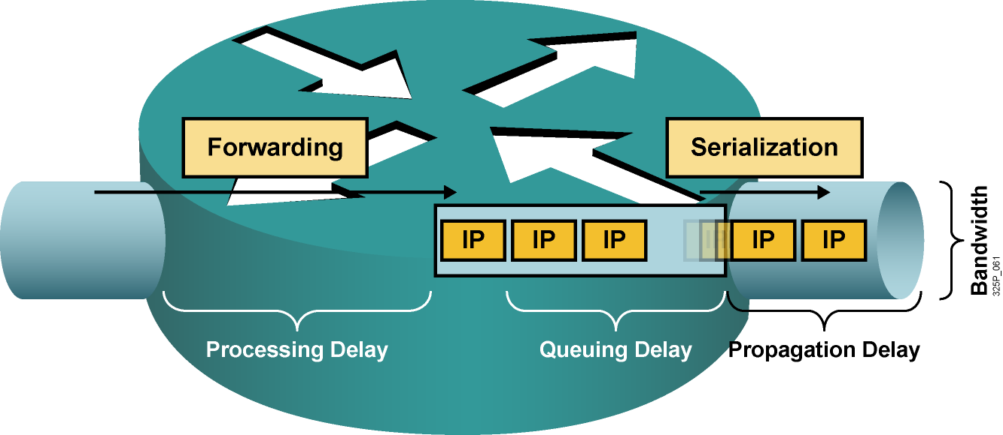
Druhy oneskorenia
Processing delay (oneskorenie pri spracovaní): Čas od prevzatia paketu zo vstupného rozhrania, jeho analýzy, cez smerovacie rozhodnutie až po jeho uloženie do výstupného frontu na výstupnom rozhraní
Queuing delay (oneskorenie vo fronte): Čas, ktorý paket strávi vo výstupnom fronte rozhrania
Serialization delay (serializačné oneskorenie): Čas, ktorý je potrebný na odoslanie paketu rozhraním danej prenosovej rýchlosti
Propagation delay (oneskorenie pri šírení): Čas, ktorý je potrebný na prechod signálu po danom fyzickom médiu
Notes:
Four types of delay:
Processing delay: Processing delay is the time that it takes for a router (or Layer 3 switch) to take the packet from an input interface and put the packet into the output queue of the output interface. The processing delay depends on various factors:
CPU speed
CPU use
IP switching mode
Router architecture
Configured features on both the input and output interfaces
Queuing delay: Queuing delay is the time that a packet resides in the output queue of a router. Queuing delay depends on the number of packets that are already in the queue and packet sizes. Queuing delay also depends on the bandwidth of the interface and the queuing mechanism.
Serialization delay: Serialization delay is the time that it takes to place a frame on the physical medium for transport. This delay is typically inversely proportional to the link bandwidth.
Propagation delay: Propagation delay is the time that it takes for the packet to cross the link from one end to the other. This time usually depends on the type of media that is being transmitted, be it data, voice or video. For example, satellite links produce the longest propagation delay because of the high altitudes of communications satellites.

Slide 6
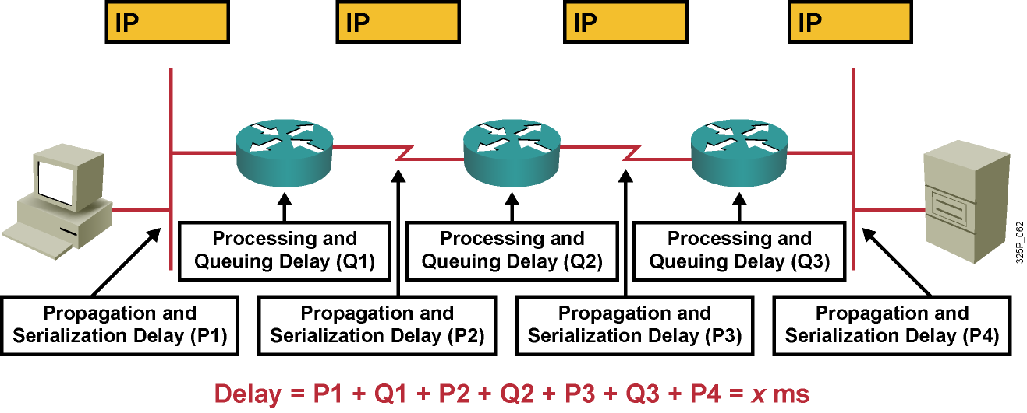
Dopad oneskorenia a jeho kolísania na kvalitu
Celkové oneskorenie: Súčet všetkých propagačných, procesných, serializačných a frontových oneskorení pozdĺž prenosovej trasy
V best-effort networks sú propagačné a serializačné oneskorenia pevné, zatiaľčo procesné a frontové oneskorenia sú náhodné
Notes:
End-to-end delay and jitter have a severe quality impact on the network:
End-to-end delay is the sum of all types of delays.
Each hop in the network has its own set of variable processing and queuing delays, which can result in jitter.
Internet Control Message Protocol (ICMP) echo (ping) is one way to measure the round-trip time of IP packets in a network.

Slide 7
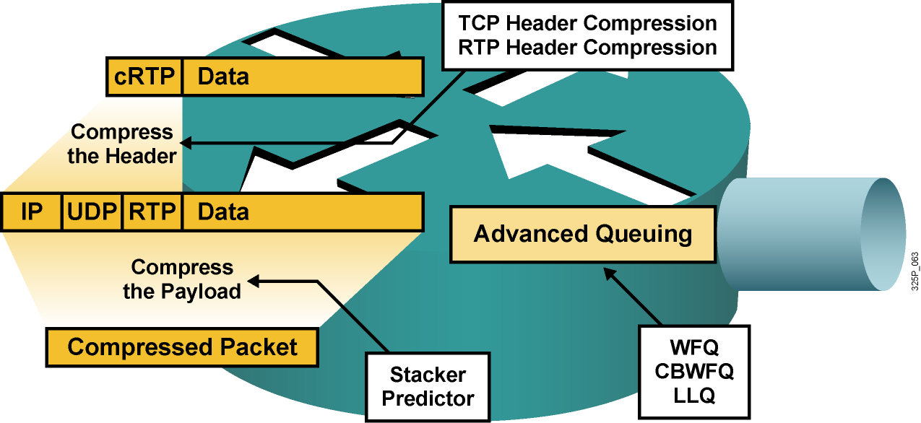
Ako znížiť oneskorenie
Zrýchliť linku (najlepšie, ale aj najdrahšie riešenie)
Dať prioritu dôležitým paketom
Umožniť úpravu prioritu dôležitých paketov
Komprimovať obsah rámcov (to však trvá istý čas)
Komprimovať IP hlavičky (detto)
Notes:
When considering solutions to the delay problem, there are two things to note:
Processing and queuing delays are related to devices and are bound to the behavior of the operating system.
Propagation and serialization delays are related to the media.
There are many ways to reduce the delay at a router. Assuming that the router has enough power to make forwarding decisions rapidly, these factors influence most queuing and serialization delays:
Average length of the queue
Average length of packets in the queue
Link bandwidth
Network administrators can accelerate the packet dispatching for delay-sensitive flows:
Increase link capacity: Sufficient bandwidth causes queues to shrink so that packets do not wait long before transmittal. Increasing bandwidth reduces serialization time. This approach can be unrealistic because of the costs that are associated with the upgrade.
Prioritize delay-sensitive packets: This approach can be more cost-effective than increasing link capacity. WFQ, CBWFQ, and LLQ can each serve certain queues first (this is a pre-emptive way of servicing queues).
Reprioritize packets: In some cases, important packets need to be reprioritized when they are entering or exiting a device. For example, when packets leave a private network to transit an Internet service provider (ISP) network, the ISP may require that the packets be reprioritized.
Compress payload: Payload compression reduces the size of packets, which virtually increases link bandwidth. Compressed packets are smaller and take less time to transmit. Compression uses complex algorithms that add delay. If you are using payload compression to reduce delay, make sure that the time that is needed to compress the payload does not negate the benefits of having less data to transfer over the link.
Use header compression: Header compression is not as CPU-intensive as payload compression. Header compression reduces delay when used with other mechanisms. Header compression is especially useful for voice packets that have a bad payload-to-header ratio (relative large header in comparison to the payload), which is improved by reducing the header of the packet (RTP header compression).
By minimizing delay, network administrators can also reduce jitter (delay is more predictable than jitter and easier to reduce).

Slide 8
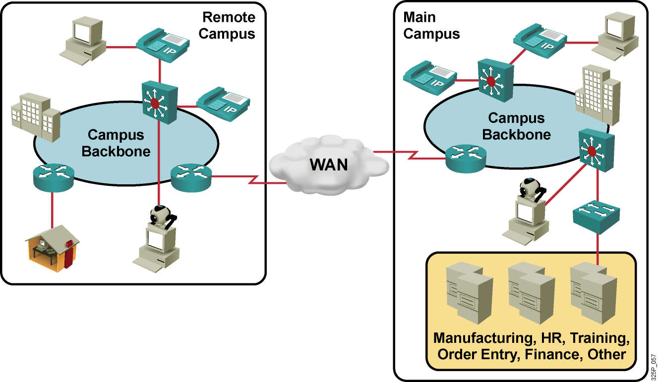
Dôsledky strát paketov
Telefonát: “Nedá sa rozumieť, hlas vypadáva.”
Telekonferencia: “Obraz je trhaný a nesynchronizovaný so zvukom.”
Vydavateľstvo: “Ten súbor je poškodený.”
Call centrum: “Prosím, počkajte, kým sa mi znovu zobrazí Vaša obrazovka.”
Notes:
After delay, the next most serious concern for networks is packet loss. Usually, packet loss occurs when routers run out of buffer space for a particular interface (output queue).
This graphic shows examples of the results of packet loss in a converged network.

Slide 9
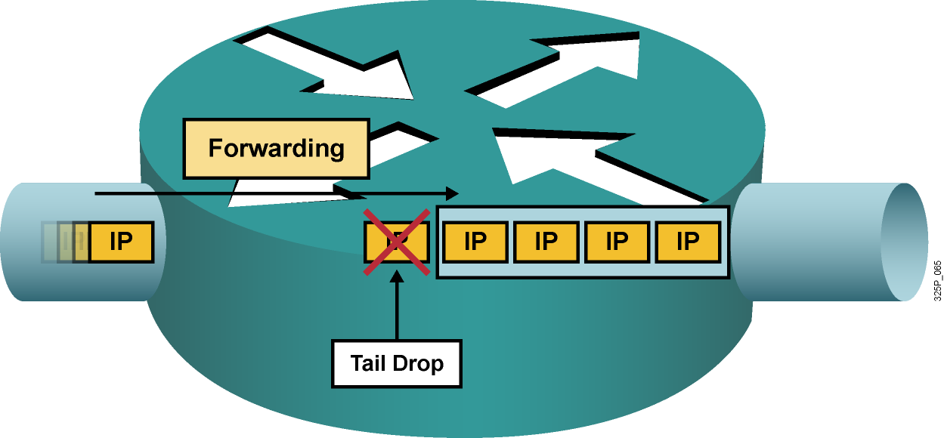
Druhy strát paketov
Straty typu „tail drop“ nastávajú, keď je výstupný front plný. Tieto straty sú bežné a nastávajú pri zahltení výstupného rozhrania
Iné druhy strát sú obvykle spôsobené zahltením na vstupnom rozhraní, pomalým procesorom či chybami pri prenose. Tieto chyby sa často dajú odstrániť upgradom hardvéru
Notes:
This graphic illustrates a full interface output queue, which causes newly arriving packets to be dropped. The term that is used for such drops is “output drop” or “tail drop” (packets are dropped at the tail of the queue).
Routers might also drop packets for other less common reasons:
Input queue drop: The main CPU is busy and cannot process packets (the input queue is full).
Ignore: The router runs out of buffer space.
Overrun: The CPU is busy and cannot assign a free buffer to the new packet.
Frame errors: The hardware detects an error in a frame; for example, cyclic redundancy checks (CRCs), runt, and giant.

Slide 10
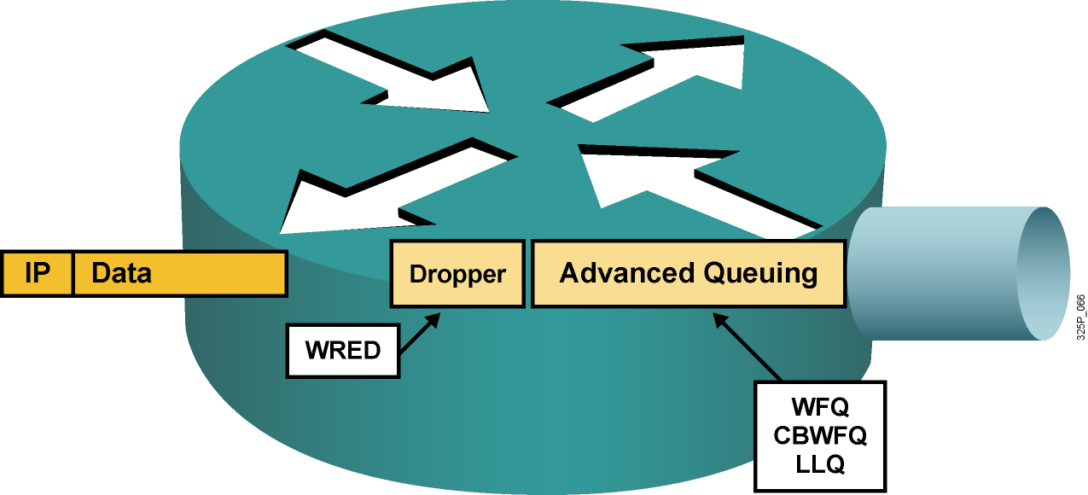
Predchádzanie stratám
Zrýchliť linku (najlepšie, ale aj najdrahšie riešenie)
Garantovať dostatočné pásmo pre citlivé pakety
Predchádzať zahlteniu náhodným zahadzovaním menej dôležitých paketov ešte skôr, než dôjde k zahlteniu
Notes:
Packet loss is usually the result of congestion on an interface. Most applications that use TCP experience slowdown because TCP automatically adjusts to network congestion. Dropped TCP segments cause TCP sessions to reduce their window sizes. Some applications do not use TCP and cannot handle drops (fragile flows).
These approaches prevent drops in sensitive applications:
Increase link capacity to ease or prevent congestion.
Guarantee enough bandwidth and increase buffer space to accommodate bursts of traffic from fragile flows. There are several mechanisms available in Cisco IOS QoS software that can guarantee bandwidth and provide prioritized forwarding to drop-sensitive applications.
Prevent congestion by dropping lower-priority packets before congestion occurs. Cisco IOS QoS provides queuing mechanisms that start dropping lower-priority packets before congestion occurs.

Slide 11
Modely poskytovania kvality služby
Model | Popis
Best effort | Bez riadenia kvality služby. Vhodné, ak nie je dôležité, kedy alebo v akom poradí budú pakety doručené.
Integrated Services (IntServ) | Aplikácie oznamujú sieti, aké QoS parametre požadujú pre ich správnu činnosť.
Differentiated Services (DiffServ) | Sieť rozoznáva triedy prevádzky, ktoré vyžadujú osobitné QoS parametre.
Notes:
IP without QoS provides best effort service:
All packets are treated equally
Bandwidth is unpredictable
Delay and jitter are unpredictable
Cisco IOS Software supports two fundamental Quality of Service architectures: Differentiated Services (DiffServ) and Integrated Services (IntServ).
In the DiffServ model a packet's "class" can be marked directly in the packet, which contrasts with the IntServ model where a signaling protocol is required to tell the routers which flows of packets requires special QoS treatment. DiffServ achieves better QoS scalability, while IntServ provides a tighter QoS mechanism for real-time traffic. These approaches can be complimentary and are not mutually exclusive.

Slide 12
Model Best-Effort
Model best-effort je pôvodným modelom, na ktorom bol Internet založený
Medzi tokmi dát nie je nijaká diferenciácia
  Doručovanie sa podobá obyčajnej poštovej zásielke
  Paket „príde vtedy, keď príde“
Výhody:
  Vynikajúca škálovateľnosť
  Nie je potrebný nijaký osobitný mechanizmus
Nevýhody:
  Neposkytuje garancie služby
  Nediferencuje medzi službami
Notes:
The basic design of the Internet provides for best-effort packet delivery and provides no guarantees. This approach is still predominant on the Internet today and remains appropriate for most purposes. The best-effort model treats all network packets in the same way, so an emergency voice message is treated the same way a digital photograph attached to an e-mail is treated. Without QoS, the network cannot tell the difference between packets and, as a result, cannot treat packets preferentially.
When you mail a letter using standard postal mail, you are using a best-effort model. Your letter is treated exactly the same as every other letter. With the best-effort model, the letter may never arrive, and, unless you have a separate notification arrangement with the letter recipient, you may never know that the letter did not arrive.
Benefits:
The model has nearly unlimited scalability. The only way to reach scalability limits is to reach bandwidth limits, in which case all traffic is equally affected.
You do not need to employ special QoS mechanisms to use the best-effort model. Best-effort is the easiest and quickest model to deploy.
Drawbacks:
There are no guarantees of delivery. Packets will arrive whenever they can and in any order possible, if they arrive at all.
No packets have preferential treatment. Critical data is treated the same as casual e‑mail is treated.

Slide 13
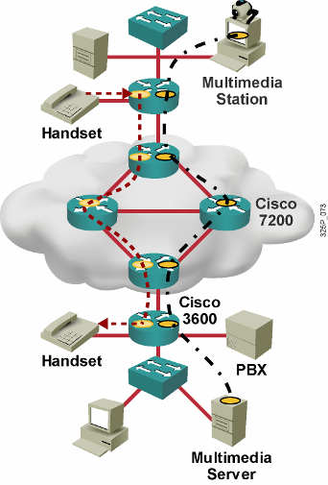
Model Integrated Services (IntServ)
Poskytuje garantované doručenie a predikovateľné správanie sa siete voči aplikáciám
Poskytuje viaceré úrovne služieb
Kľúčovým podporným protokolom je RSVP na signalizáciu QoS požiadaviek pre jednotlivé toky
QoS parametre sa vzťahujú na jednotlivé toky medzi jednotlivými uzlami a aplikáciami
Ak sieť nie je schopná splniť požiadavku aplikácie na QoS parametre, bude o tom aplikáciu informovať
Potrebné sú inteligentné frontové mechanizmy na poskytovanie rezervácie zdrojov
Notes:
Integrated Services (IntServ) provides a way to deliver the end-to-end QoS that real-time applications require by explicitly managing network resources to provide QoS to specific user packet streams, sometimes called microflows. IntServ uses resource reservation and admission-control mechanisms as key building blocks to establish and maintain QoS. This practice is similar to a concept known as “hard QoS.” Hard QoS guarantees traffic characteristics, such as bandwidth, delay, and packet-loss rates, from end to end. Hard QoS ensures both predictable and guaranteed service levels for mission-critical applications.
IntServ uses Resource Reservation Protocol (RSVP) explicitly to signal the QoS needs of an application’s traffic to devices along the end-to-end path through the network. If network devices along the path can reserve the necessary bandwidth, the originating application can begin transmitting. If the requested reservation fails along the path, the originating application does not send any data.
In the IntServ model, the application requests a specific kind of service from the network before sending data. The application informs the network of its traffic profile and requests a particular kind of service that can encompass its bandwidth and delay requirements. The application sends data only after it receives confirmation for bandwidth and delay requirements from the network.
The network performs admission control based on information from the application and available network resources. The network commits to meeting the QoS requirements of the application as long as the traffic remains within the profile specifications. The network fulfills its commitment by maintaining the per-flow state and then performing packet classification, policing, and intelligent queuing based on that state.

Slide 14
Procesy a architektúra smerovača v IntServ
Control Plane
Routing Selection
Admission Control
Reservation Setup
Reservation Table
Data Plane
Flow Identification
Packet Scheduler
Notes:
As a means of illustrating the function of the IntServ model, this graphic shows the control and data planes. In addition to end-to-end signaling, IntServ requires several functions in order to be available on routers and switches along the network path. These functions include the following:
Admission control: Admission control determines whether a new flow requested by users or systems can be granted the requested QoS without affecting existing reservations in order to guarantee end-to-end QoS. Admission control ensures that resources are available before allowing a reservation.
Classification: Entails using a traffic descriptor to categorize a packet within a specific group to define that packet and make it accessible for QoS handling on the network. Classification is pivotal for policy techniques that select packets for different types of QoS service.
Policing: Takes action, including possibly dropping packets, when traffic does not conform to its specified characteristics. Policing is defined by rate and burst parameters, as well as by actions for in-profile and out-of-profile traffic.
Queuing: Queuing accommodates temporary congestion on an interface of a network device by storing excess packets in buffers until access to the bandwidth becomes available.
Scheduling: A QoS component, the QoS scheduler, negotiates simultaneous requests for network access and determines which queue receives priority. IntServ uses round robin scheduling. Round robin scheduling is a time-sharing approach in which the scheduler gives a short time slice to each job before moving on to the next job, polling each task round and round. This way, all the tasks advance, little by little, on a controlled basis. Packet scheduling enforces the reservations by queuing and scheduling packets for transmission.

Slide 15




Resource Reservation Protocol (RSVP)
Prenáša sa v IP – protokol 46
Môže využiť aj TCP/UDP port 3455
Jedná sa o signalizačný protokol
a spolupracuje so smerovacími protokolmi
Slúži na rezerváciu QoS prostriedkov na všetkých zariadeniach medzi
odosielateľom a príjemcom
Sending Host
RSVP Tunnel
RSVP Receivers
Zabezpečuje prostriedky pre rôznorodé multimediálne aplikácie
  Premávka citlivá na prenosové pásmo
  Premávka citlivá na oneskorenie
Notes:
Resource Reservation Protocol (RSVP) is used to implement IntServ models.
The Resource Reservation Protocol (RSVP) is a network-control protocol that enables Internet applications to obtain differing qualities of service (QoS) for their data flows. Such a capability recognizes that different applications have different network performance requirements. Some applications, including the more traditional interactive and batch applications, require reliable delivery of data but do not impose any stringent requirements for the timeliness of delivery. Newer application types, including videoconferencing, IP telephony, and other forms of multimedia communications require almost the exact opposite: Data delivery must be timely but not necessarily reliable. Thus, RSVP was intended to provide IP networks with the capability to support the divergent performance requirements of differing application types.
It is important to note that RSVP is not a routing protocol. RSVP works in conjunction with routing protocols and installs the equivalent of dynamic access lists along the routes that routing protocols calculate. Thus, implementing RSVP in an existing network does not require migration to a new routing protocol.
If resources are available, RSVP accepts a reservation and installs a traffic classifier to assign a temporary QoS class for that traffic flow in the QoS forwarding path. The traffic classifier tells the QoS forwarding path how to classify packets from a particular flow and what forwarding treatment to provide.
RSVP is an IP protocol that uses IP protocol ID 46 and TCP and UDP port 3455.
In RSVP, a data flow is a sequence of datagrams that have the same source, destination (regardless of whether that destination is one or more physical machines), and QoS requirements. QoS requirements are communicated through a network via a flow specification. A flow specification describes the level of service that is required for that data flow.
RSVP focuses on the following two main traffic types:
Rate-sensitive traffic: Traffic that requires a guaranteed and constant (or nearly constant) transmission rate from its source to its destination. An example of such an application is H.323 videoconferencing. RSVP enables constant-bit-rate service in packet-switched networks via its rate-sensitive level of service. This service is sometimes referred to as guaranteed-bit-rate service.
Delay-sensitive traffic: Traffic that requires timeliness of delivery and that varies its rate accordingly. MPEG-II video, for example, averages about 3 to 7 Mbps, depending on the rate at which the picture is changing. RSVP services supporting delay-sensitive traffic are referred to as controlled-delay service (non-real-time service) and predictive service (real-time service).

Slide 16
RSVP Daemon
Policy
Control
Admission
Control
RSVP
Daemon
Reservation
Routing
Data
Packet
Classifier
Packet
Scheduler
Notes:
Each node that uses RSVP has two local decision modules:
Admission control: Admission control keeps track of the system resources and determines whether the node has sufficient resources to supply the requested QoS. The RSVP daemon monitors both of these checking actions. If either check fails, the RSVP program returns an error message to the application that originated the request. If both checks succeed, the RSVP daemon sets parameters in the packet classifier and packet scheduler to obtain the requested QoS.
Policy control: Policy control determines whether the user has administrative permission to make the reservation.
If both Admission control and Policy control succeed, the daemon then sets parameters in two entities, packet classifier and packet scheduler.
Packet classifier: The RSVP packet classifier determines the route and QoS class for each packet.
Packet scheduler: The RSVP packet scheduler orders packet transmission to achieve the promised QoS for each stream. The scheduler allocates resources for transmission on the particular data link layer medium used by each interface.
Routing Process—The RSVP daemon also communicates with the routing process to determine the path to send its reservation requests and to handle changing memberships and routes. Each router participating in resource reservation passes incoming data packets to a packet classifier and then queues the packets as necessary in a packet scheduler.
Once the packet classifier determines the route and QoS class for each packet, and the scheduler allocates resources for transmission, RSVP passes the request to all the nodes (routers and hosts) along the reverse data paths to the data sources. At each node, the RSVP program applies a local decision procedure called admission control to determine whether that node can supply the requested QoS. If admission control succeeds in providing the required QoS, the RSVP program sets the parameters of the packet classifier and scheduler to obtain the desired QoS. If admission control fails at any node, the RSVP program returns an error indication to the application that originated the request. Routers along the reverse data stream path repeat this reservation until the reservation merges with another reservation for the same source stream.

Slide 17
Výhody a nevýhody modelu IntServ
Výhody:
  Explicitné riadenie prístupu k zdrojom (end to end)
  Veľmi vysoká granularita prideľovania QoS prostriedkov
  Riadenie prístupu k prostriedkom na každú žiadosť individuálne
  Signalizácia dynamických čísel portov (napr pre H.323)
Nevýhody:
  Potreba trvalej signalizácie vzhľadom na stavovú architektúru
  Tokovo orientovaný prístup nie je škálovateľné na siete veľkého rozsahu, ako napr. Internet
Notes:
Benefits:
IntServ supports admission control that allows a network to reject or downgrade new RSVP sessions if one of the interfaces in the path has reached the limit (that is, if all bandwidth that can be reserved is booked).
RSVP signals QoS requests for each individual flow. In the request, the authorized user (authorization object) and needed traffic policy (policy object) are sent. The network can then provide guarantees to these individual flows.
RSVP informs network devices of flow parameters (IP addresses and port numbers). Some applications use dynamic port numbers, such as H.323-based applications, which can be difficult for network devices to recognize. Network-Based Application Recognition (NBAR) is a mechanism that complements RSVP for applications that use dynamic port numbers but do not use RSVP.
Drawbacks:
There is continuous signaling because of the stateful RSVP architecture that adds to the bandwidth overhead. RSVP continues signaling for the entire duration of the flow. If the network changes, or links fail and routing convergence occurs, the network may no longer be able to support the reservation.
The flow-based approach is not scalable to large implementations, such as the public Internet, because RSVP has to track each individual flow. This circumstance makes end-to-end signaling difficult. A possible solution is to combine IntServ with elements from the DiffServ model to provide the needed scalability.

Slide 18


Model Differentiated Services
Za cenu istých kompromisov rieši mnohé obmedzenia modelov Best-Effort a IntServ
Na rozdiel od signalizovaných tvrdých požiadaviek na QoS využíva dopredu pripravené QoS prostriedky a politiky
Toky triedi do tzv. agregátov (tried) a poskytuje QoS prostriedky celým triedam
Minimalizuje signalizáciu (žiadna) a stavovú informáciu (minimálna) na sieťových uzloch
QoS parametre charakterizuje popisom tzv. Per-Hop Behavior (PHB)
Úroveň služby sa stanovuje na triedu prevádzky, nie na individuálne toky
Edge
End Station
Edge
Interior
Edge
DiffServ Domain
End Station
Notes:
The differentiated services (DiffServ) architecture specifies a simple, scalable, and coarse-grained mechanism for classifying and managing network traffic and providing QoS guarantees. For example, DiffServ can provide low-latency guaranteed service (GS) to critical network traffic such as voice or video while providing simple best-effort traffic guarantees to non-critical services such as web traffic or file transfers.
The DiffServ design overcomes the limitations of both the best-effort and IntServ models. DiffServ can provide an “almost guaranteed” QoS while still being cost-effective and scalable.
The concept of soft QoS is the basis of the DiffServ model. You will recall that IntServ (hard QoS) uses signaling in which the end-hosts signal their QoS needs to the network. DiffServ does not use signaling but works on the provisioned-QoS model, where network elements are set up to service multiple classes of traffic each with varying QoS requirements. By classifying flows into aggregates (classes), and providing appropriate QoS for the aggregates, DiffServ can avoid significant complexity, cost, and scalability issues.
For example, DiffServ groups all TCP flows as a single class, and allocates bandwidth for that class, rather than for the individual flows as hard QoS (DiffServ) would do. In addition to classifying traffic, DiffServ minimizes signaling and state maintenance requirements on each network node.
DiffServ divides network traffic into classes based on business requirements. Each of the classes can then be assigned a different level of service. As the packets traverse a network, each of the network devices identifies the packet class and services the packet according to that class.
The hard QoS model (IntServ) provides for a rich end-to-end QoS solution, using end-to-end signaling, state-maintenance and admission control. This approach consumes significant overhead, thus restricting its scalability. On the other hand, DiffServ cannot enforce end-to-end guarantees, but is a more scalable approach to implementing QoS. DiffServ maps many applications into small sets of classes. DiffServ assigns each class with similar sets of QoS behaviors and enforces and applies QoS mechanisms on a hop-by-hop basis, uniformly applying global meaning to each traffic class to provide both flexibility and scalability.
DiffServ works like a packet delivery service. You request (and pay for) a level of service when you send your package. Throughout the package network, the level of service is recognized and your package is given either preferential or normal service, depending on what you requested.
Benefits:
Highly scalable
Many levels of quality possible
Drawbacks:
No absolute service guarantee
Requires a set of complex mechanisms to work in concert throughout the network

Slide 19
Model Differentiated Services (DiffServ)
Model DiffServ sa zaoberá poskytovaním QoS nad triedami prevádzky, nie nad jednotlivými tokmi
Komplexná klasifikácia, značkovanie a vstupné úpravy prevádzky sa realizujú na okraji siete
  Vo vnútri siete sa QoS pravidlá riadia už iba pridelenými značkami
Vo vnútri siete sa neudržiavajú informácie o jednotlivých tokoch, udržiavajú sa len informácie o spôsobe obsluhy jednotlivých tried prevádzky
Cieľom DiffServ je
  Škálovateľnosť
  Spolupráca s uzlami, ktoré ešte nepodporujú DiffServ
  Možnosť postupného nasadzovania
Notes:
In contrast to integrated service (IntServ), which is a fine-grained, flow-based mechanism, differentiated service (DiffServ) is a coarse-grained, class-based mechanism for traffic management. DiffServ architecture is based on a simple model in which data packets are placed into a limited number of traffic classes, rather than differentiating network traffic based on the requirements of an individual flow.
Each traffic class can be managed differently, insuring preferential treatment for higher-priority traffic on the network.
One of the primary principles of DiffServ is that you should mark packets as close to the edge of the network as possible. It is often a difficult and time-consuming task to determine which traffic class a data packet belongs to. You want to classify the data as few times as possible. By marking the traffic at the network edge, core network devices and other devices along the forwarding path will be able to quickly determine the proper CoS to apply to a given traffic flow.
A key benefit of DiffServ is ease of scalability in comparison to IntServ.

Slide 20
Klasifikačné nástroje
IP Precedence a DiffServ Code Point
Version
Length
ToS
Byte
Len
ID
Offset
TTL
Proto
FCS
IP SA
IP DA
Data
IPv4 Paket
7
6
5
4
3
2
1
0
Štandard IPv4
IP Precedence
Unused
DiffServ Code Point (DSCP)
IP ECN
Rozšírenie DiffServ
IPv4: tri najvyššie bity ToS bajtu sa nazývajú IP Precedence (IPP). Ostatné bity boli niekoľkokrát predefinované (Delay, Throughput, Reliability, Monetary cost)
DiffServ: šesť najvyšších bitov ToS bajtu sa nazývajú DiffServ Code Point (DSCP). Zvyšné dva bity sa využívajú na explicitnú informáciu o zahltení (ECN). Hodnota DSCP poľa sa nazýva codepoint
Hodnoty DSCP sú spätne kompatibilné s hodnotami IP Precedence
Konkrétna hodnota DSCP má dohodnutý význam a spôsob obsluhy
Notes:
• IP Type of Service Byte—As Layer 2 media often changes as packets traverse from source to destination, a more ubiquitous classification would occur at Layer 3. The second byte in an IPv4 packet is the Type of Service (ToS) byte. The first three bits of the ToS byte alone are referred to as the IP Precedence (IPP) bits. These same three bits, in conjunction with the next three bits, are known collectively as the DSCP bits.
The IP Precedence bits, like 802.1p CoS bits, allow for only 8 values of marking (0-7).
IPP values 6 and 7 are generally reserved for network control traffic (such as routing).
IPP value 5 is recommended for voice.
IPP value 4 is shared by video conferencing and streaming video.
IPP value 3 is for voice-control.
IPP values 1 and 2 can be used for data applications.
IPP value 0 is the default marking value.
Many enterprises find IPP marking to be overly restrictive and limiting, favoring instead the 6-Bit/64-value DSCP marking model.

Slide 21
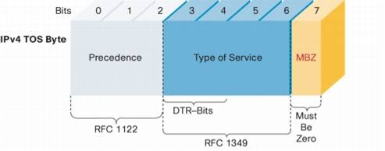
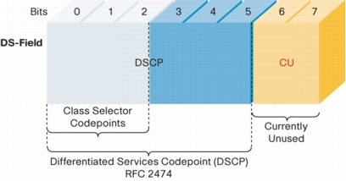
IP ToS a DS pole v IP hlavičke
Notes:
To support DiffServ, the IPv4 Type of Service (ToS) octet has been redefined from the 3-bit IP-precedence to a 6-bit DSCP field.
Prior to DiffServ, IP networks could use the Precedence field in the Type of Service (TOS) byte of the IP header to mark priority traffic.
As the TOS byte and IP precedence was not widely used, the IETF agreed to reuse the TOS byte as the DS field for DiffServ networks. In order to maintain backward compatibility with network devices that still use the Precedence field, DiffServ defines the Class Selector PHB.
The Class Selector codepoints are of the form 'xxx000'. The first three bits are the IP precedence bits. Each IP precedence value can be mapped into a DiffServ class. If a packet is received from a non-DiffServ aware router that used IP precedence markings, the DiffServ router can still understand the encoding as a Class Selector codepoint.

Slide 22
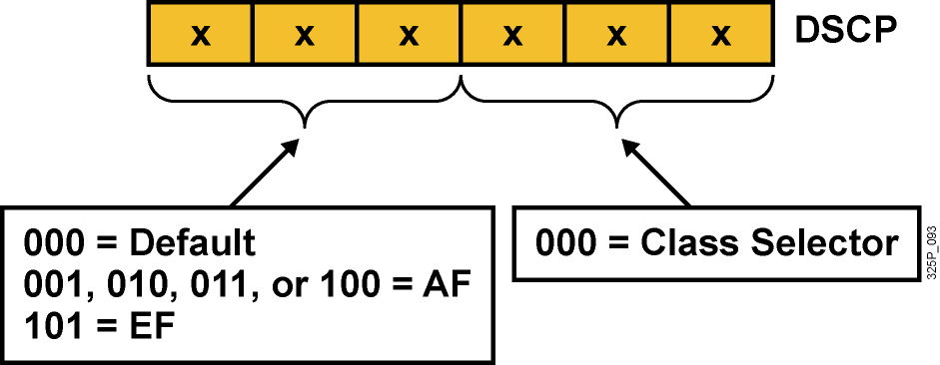
Per-Hop Behavior – PHB
PHB je spôsob obsluhy konkrétnej triedy prevádzky na danom uzle
DSCP vlastne vyberá PHB pozdĺž siete
  Default PHB (FIFO, tail drop)
  Class-selector PHB (IP precedence)
  EF PHB (Expedited Forwarding)
  AF PHB (Assured Forwarding)
Notes:
Now that packets can be marked using the DSCP, how do we provide meaningful CoS, and provide the QoS that is needed?
First, the collection of packets that have the same DSCP value (also called a codepoint) in them, and crossing in a particular direction is called a Behavior Aggregate (BA)…more about this later. Packets from multiple applications/sources could belong to the same BA.
Formally, RFC-2475 defines a Per Hop Behavior (PHB) as the externally observable forwarding behavior applied at a DS-compliant node to a DS BA. In more concrete terms, a PHB refers to the packet scheduling, queuing, policing, or shaping behavior of a node on any given packet belonging to a BA, and as configured by a Service Level Agreement (SLA) or policy.
To date, four standard PHBs are available to construct a DiffServ-enabled network and achieve coarse-grained, end-to-end CoS and QoS: Default, EF, AF and Class-selector.
PHBs are defined in terms of behavior characteristics relevant to service provisioning policies, and not in terms of particular implementation mechanisms. In general, a variety of implementation mechanisms may be suitable for implementing a particular PHB group.
The DiffServ architecture defines the DiffServ (DS) field to make per-hop behavior (PHB) decisions about packet classification and traffic conditioning functions, such as metering, marking, shaping, and policing.
The Default PHB (Defined in RFC-2474)
The default PHB specifies that a packet marked with a DSCP value (recommended) of `000000' gets the traditional best effort service from a DS-compliant node (a network node that complies to all the core DiffServ requirements). Also, if a packet arrives at a DS-compliant node and its DSCP value is not mapped to any of the other PHBs, it will get mapped to the default PHB.
Class-Selector PHBs (Defined in RFC-2474)
To preserve backward compatibility with the IP-precedence scheme, DSCP values of the form `xxx000,' where x is either 0 or 1, are defined. These codepoints are called class-selector codepoints. The PHB associated with a class-selector codepoint is a class-selector PHB. These PHBs retain almost the same forwarding behavior as nodes that implement IP-precedence based classification and forwarding. For example, packets with a DSCP value of `110000' (IP-precedence 110) have a preferential forwarding treatment (scheduling, queuing, etc.) as compared to packets with a DSCP value of `100000' (IP-precedence 100). These PHBs ensure that DS-compliant nodes can co-exist with IP-precedence aware nodes, with the exception of the DTS bits.
EF PHB (described in following slides)
AF PHB (described in following slides)

Slide 23
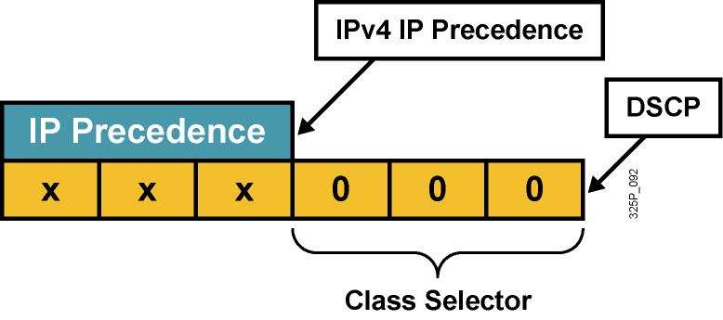
Kompatibilita IP Precedence a DSCP
Pre zachovanie kompatibility s IP Precedence (RFC 1812) boli zavedené tzv. Class Selector codepoints v tvare xyz000 s názvom CS0 až CS7
Odlišuje pravdepodobnosť včasného vybavenia paketu:
  (xyz000) >= (abc000), ak xyz >= abc
Napríklad, ak má paket DSCP codepoint 011000 (CS3), má väčšiu pravdepodobnosť včasného odoslania než paket s DSCP 001000 (CS1)
Notes:
RFC 2474 replaced the ToS field with the DiffServ field, in which a range of eight values (class selector) is used for backward compatibility with IP precedence. There is no compatibility with other bits used by the ToS field.
The class selector Per Hop Behavior (PHB) was defined to provide backward compatibility for DSCP with ToS-based IP precedence.
RFC 1812 simply prioritizes packets according to the precedence value. In this sense, the PHB is defined as the probability of timely forwarding.
For example, consider a service provider offering so-called “Olympic” service classes (Gold, Silver, and Bonze) so that packets in the gold class experience lighter load, and thus have greater probability for timely forwarding, than packets assigned to the silver class. Packets with higher IP precedence should be (on average) forwarded in less time than packets with lower IP precedence.
The last 3 bits of the DSCP (bits 2 to 4) set to 0 identify a class-selector PHB.

Slide 24
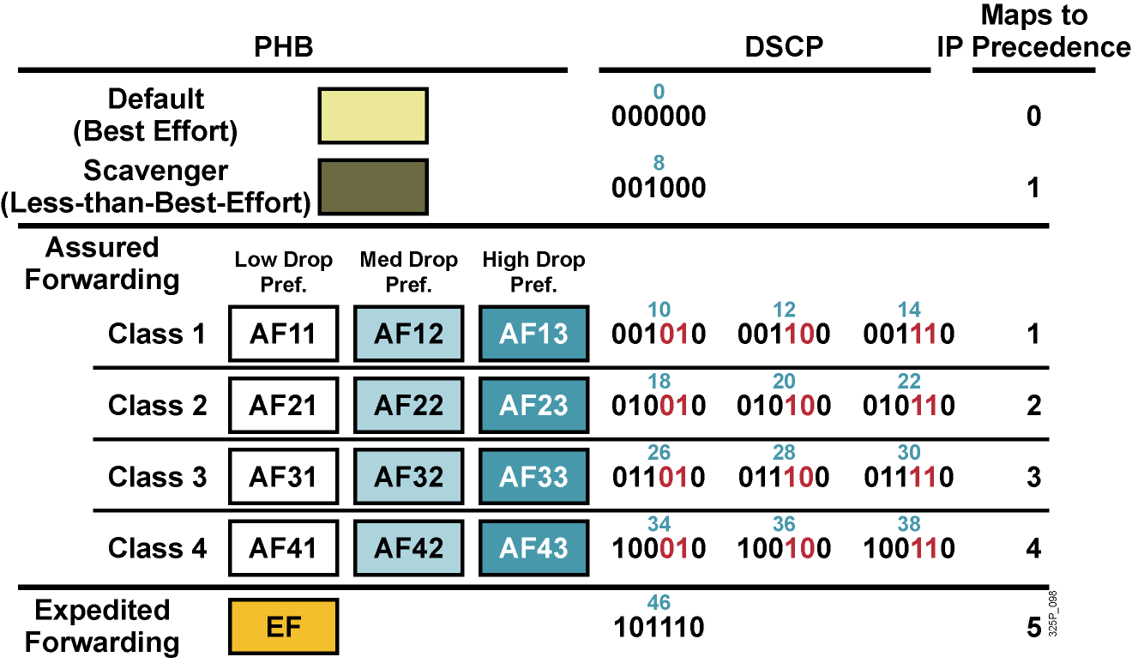
Štandardné PHB skupiny
Notes:
Standard PHBs are available to construct a DiffServ-enabled network and achieve coarse-grained, end-to-end CoS and QoS.
Default PHB (as defined in RFC 2474)
AF PHB (as defined in RFC 2597)
EF PHB (as defined in RFC 2598) class-selector PHB (as defined in RFC 2474)

Slide 25
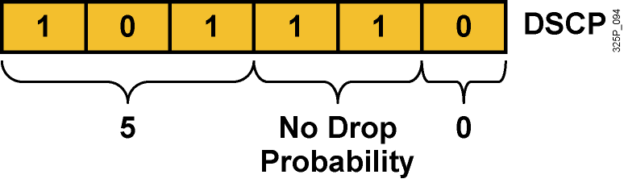
Expedited Forwarding (EF) PHB
EF PHB:
  Garantuje tzv. minimum departure rate – právo prednostného odoslania
  Garantuje prenosové pásmo vyhradené pre triedu prevádzky s EF
  Limituje pásmo pomocou policingu – trieda s EF nemôže prekročiť garantované pridelené pásmo
DSCP codepoint 101110 (46): Pre zariadenia podporujúce len IPP je to precedencia 5:
  Bity 5 až 7: 101 = 5 (rovnaké 3 bity použité pre IP Precedence)
  Bity 3 a 4: 11 = Bez strát (low delay, high throughput)
  Bit 2: Nastavený na 0
Notes:
The Expedited Forwarding (EF) PHB is the key ingredient in DiffServ for providing a low-loss, low-latency, low-jitter, and assured bandwidth service. Applications such as VoIP, video, and online trading programs require a robust network-treatment. EF can be implemented using priority queuing, along with rate limiting on the class (formally, a BA).
Although EF PHB when implemented in a DiffServ network provides a premium service, it should be specifically targeted toward the most critical applications, because if congestion exists, it is not possible to treat all or most traffic as high priority. EF PHB is especially suitable for applications (like VoIP) that require very low packet loss, guaranteed bandwidth, low delay and low jitter.
Packets requiring EF should be marked with DSCP binary value 101110 (46 or 0x2E).
Non-DiffServ-compliant devices regard EF DSCP value 101110 as IP precedence 5 (101). This precedence is the highest user-definable IP precedence and is typically used for delay-sensitive traffic (such as VoIP). Bits 5 to 7 of the EF DSCP value are 101, which matches IP precedence 5 and allows backward compatibility.

Slide 26
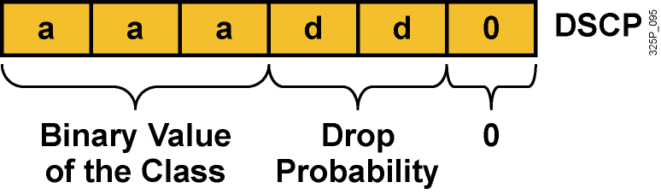
Assured Forwarding (AF) PHB
AF PHB:
  Garantuje isté minimálne prenosové pásmo
  Umožňuje využiť aj väčie pásmo, ak je momentálne
  k dispozícii
Štyri základné kategórie: AF1, AF2, AF3 a AF4
DSCP codepoint má tvar aaadd0:
  aaa je binárne číslo triedy (1, 2, 3 alebo 4)
  dd je pravdepodobnosť zahodenia
Notes:
The AF PHB is identified based on the following:
The AF PHB guarantees a certain amount of bandwidth to an AF class.
The AF PHB allows access to extra bandwidth, if available.
Packets requiring AF PHB should be marked with DSCP value aaadd0, where aaa is the number of the class and dd is the drop probability.
There are four standard AF classes defined: AF1, AF2, AF3, and AF4. Each class should be treated independently and should have allocated bandwidth that is based on the QoS policy.
AF PHB defines a method by which BAs can be given different forwarding assurances. For example, traffic can be divided into gold, silver, and bronze classes, with gold being allocated 50 percent of the available link bandwidth, silver 30 percent, and bronze 20 percent.

Slide 27
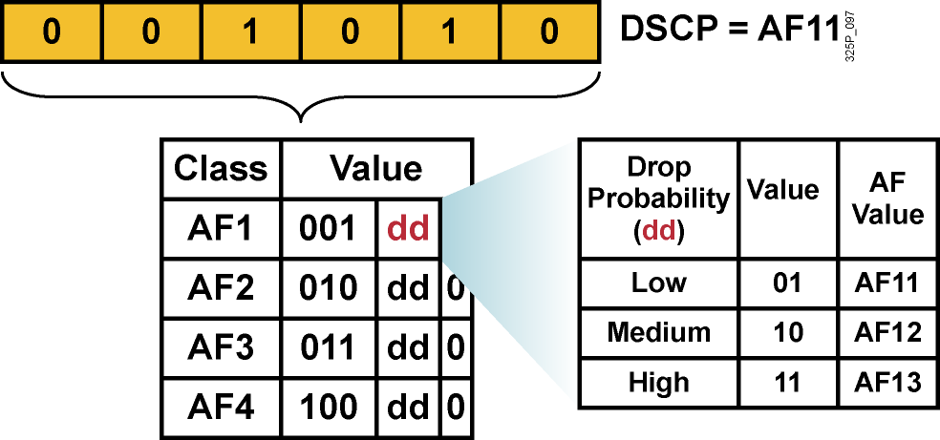
Hodnoty AF PHB
Každá AF trieda využíva 3 DSCP hodnoty
Každá AF trieda sa preposiela nezávisle od ostatných so svojou garantovanou šírkou pásma
Aby sa predišlo zahlteniu, v každej triede sa používajú techniky predchádzania zahlteniu – Weighted RED (WRED)
Ak je daná trieda AFxy, dekadickú hodnotu DSCP vypočítame ako 8x+2y
Notes:
Within each AFx class, it is possible to specify 3 drop precedence values. If there is congestion in a DS-node on a specific link, and packets of a particular AF class (for example AF1) need to be dropped, packets will be dropped such that the probability of drop creates a relationship where AFx1 <= AFx2 <= AFx3.
In other words, packets in AF13 will get dropped before packets in AF12, before packets in AF11. This concept of drop precedence is useful, for example, to penalize flows within a BA that exceed the assigned bandwidth. Packets of these flows could be re-marked by a policer to a higher drop precedence.

Slide 28
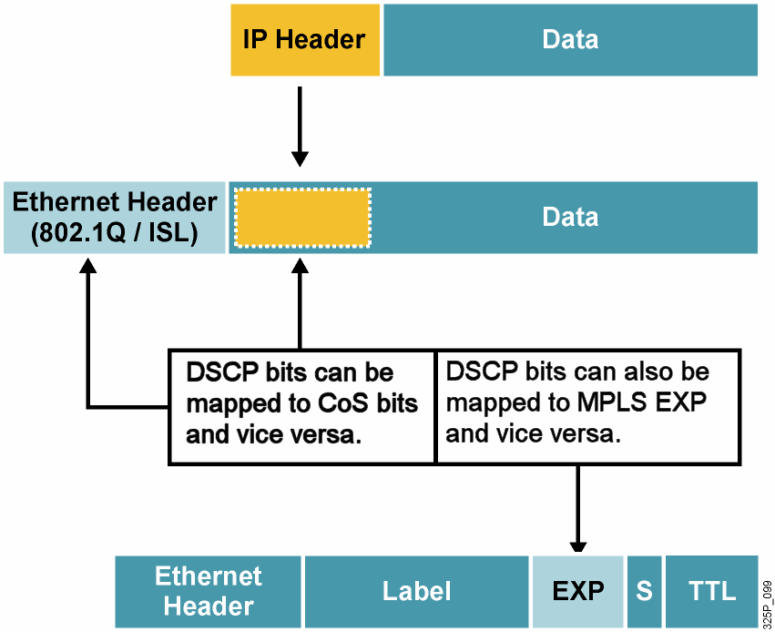
Mapovanie medzi DSCP a CoS
Notes:
Providing end-to-end QoS through an enterprise requires that CoS markings that are set at the LAN edge are mapped into QoS markings (such as IP precedence or DSCP) for transit through Campus or WAN routers. Campus and WAN routers can also map the QoS markings to new data-link headers for transit across the LAN. With the mapping, QoS can be preserved and uniformly applied across the enterprise.
Compatibility between an MPLS transport layer and network layer QoS is also achieved by mapping between MPLS EXP bits and the IP precedence or DSCP bits. A service provider can map the customer network layer QoS marking as is or change it to fit an agreed-upon SLA. The information in the MPLS EXP bits can be carried end to end in the MPLS network,

Slide 29
Vytváranie obslužných tried
Obslužné triedy sú typy prevádzky, ktoré budú vybavované rovnakým spôsobom (dostanú rovnakú QoS obsluhu)
Nie je vhodné vytvárať priveľa tried. Pre dátovú prevádzku obvykle stačí najviac 4-5 tried:
  Hlasové aplikácie: VoIP
  Mission-critical aplikácie: Oracle, SAP, SNA
  Interaktívne aplikácie: Telnet, TN3270
  Veľkoobjemové aplikácie: FTP, TFTP
  Best-effort aplikácie: E-mail, web
  Ostatné „smeti“: Kazaa, Yahoo, RapidShare
Do mission-critical a transakčných tried nezaraďovať viac ako tri aplikácie
Uprednostniť proaktívne pravidlá (WRED) pred reaktívnymi (policing)
Notes:
One key element of defining QoS service classes is to understand the basic quality needs of network applications. It is essential that applications be given QoS treatment in line with their needs. For example, improperly specifying voice traffic into a service class with guaranteed bandwidth but without a guaranteed low latency (delay) would not meet the needs of the voice traffic.
While it is important to fully understand network application requirements, it is equally important not to overprovision or overdesign the administrative policy. An administrative policy should be proactive in nature and require as few service classes as necessary. One good rule is to limit the number of service classes to no more than four or five.
The QoS requirements of these applications can be met with a few well-designed service classes. The more service classes implemented in support of an administrative QoS policy, the more complex the QoS implementation will be. This complexity also extends to support and troubleshooting.
It is also important that the highest-priority classes be reserved for a select few applications. Marking 90 percent of network traffic as high priority will render most administrative QoS policies useless.

Slide 30
Koľko tried treba?
4/5 Class Model
8 Class Model
11 Class Model
Realtime
Voice
Voice
Interactive-Video
Video
Streaming Video
Call Signaling
Call Signaling
Call Signaling
Critical Data
Network Control
IP Routing
Network Management
Critical Data
Mission-Critical Data
Transactional Data
Bulk Data
Bulk Data
Best Effort
Best Effort
Best Effort
Scavenger
Scavenger
Scavenger
Čas
Notes:
Many enterprises aren’t ready to deploy a complex 11-Class Model, or may never have the need for 11 classes of service.
5-Classes is the recommended model for provisioning QoS for Voice, Video and Data.
Some of these classes can be gradually split into more granular classes, as shown in the diagram, as needed by the network.

Slide 31
Nástroje QoS
Medzi nástroje na zabezpečenie QoS patrí
  Klasifikácia
  Značkovanie
  Frontové režimy
  Riadenie zahltenia
  Predchádzanie zahlteniu
  Tvarovanie a obmedzovanie prevádzky
  Linkové mechanizmy pre efektivitu

Slide 32
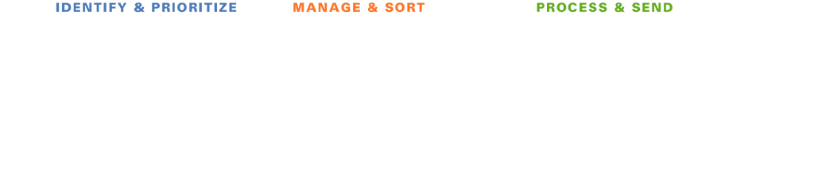







Ako QoS nástroje pracujú?
Klasifikácia
a značkovanie
Ukladanie do frontov
(Selektívne) zahadzovanie
Činnosti po uložení do frontu
Notes:
In this illustration, the packages on the conveyer belt represent data packets moving through the network.
As packets move through each phase, they are identified and prioritized, then managed and sorted, and finally processed and sent.
As the packets are identified, they are sorted into separate queues. Notice how some packets receive priority (more of these packets are processed over time), and some packets are selectively dropped.
In the next lessons, we will examine in detail the mechanisms used to support these processes.

Slide 33
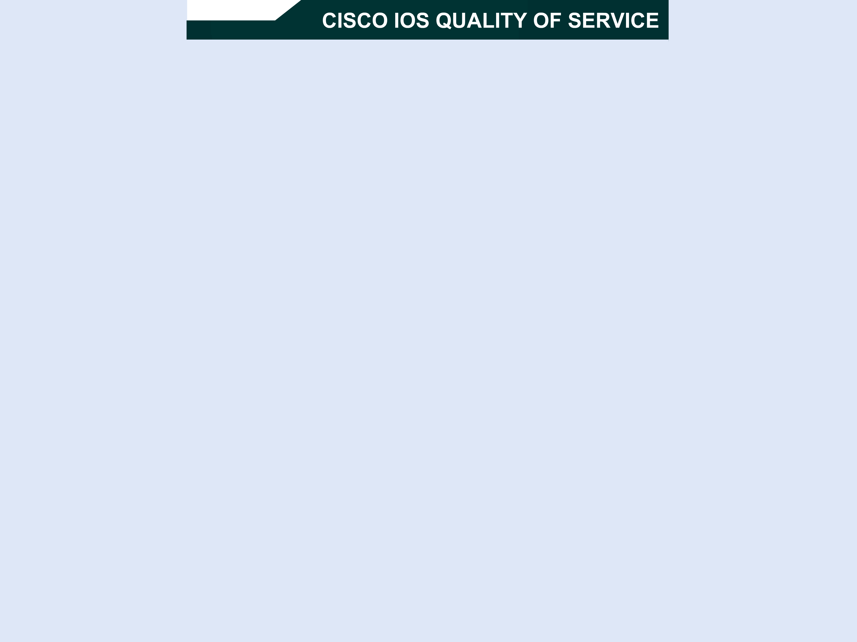
Notes:
A communications network forms the backbone of any successful organization. These networks transport a multitude of applications and data, including high-quality video and delay-sensitive data such as real-time voice. The bandwidth-intensive applications stretch network capabilities and resources, but also complement, add value, and enhance every business process. Networks must provide secure, predictable, measurable, and sometimes guaranteed services. Achieving the required Quality of Service (QoS) by managing the delay, delay variation (jitter), bandwidth, and packet loss parameters on a network becomes the secret to a successful end-to-end business solution. Thus, QoS is the set of techniques to manage network resources.

Slide 34
Klasifikácia
Klasifikácia je proces indentifikácie a rozdelenia prevádzky do tried, spravidla na základe:
  Vstupného rozhrania
  Hodnoty IP precedencie
  Hodnoty DSCP
  Zdrojovej alebo cieľovej adresy
  Aplikácie
Bez klasifikácie sa voči paketom chováme rovnako
Klasifikácia sa má realizovať čo najbližšie
k zdroju dát
Notes:
Classification is the process of identifying traffic and categorizing that traffic into classes. Classification uses a traffic descriptor to categorize a packet within a specific group to define that packet. After the packet has been classified or identified, the packet is then accessible for QoS handling on the network.
Traffic descriptors that are typically used include:
Incoming interface
IP precedence
Differentiated services code point (DSCP)
Source or destination address
Application
Using classification, network administrators can partition network traffic into multiple classes of service (CoS). When traffic descriptors are used to classify traffic, the source implicitly agrees to adhere to the contracted terms and the network promises QoS. Various QoS mechanisms, such as traffic policing, traffic shaping, and queuing techniques, use the traffic descriptor of the packet (that is, the classification of the packet) to ensure adherence to that agreement.
Classification should take place at the network edge, typically in the wiring closet, within IP phones, or at network endpoints.
Cisco recommends that classification occur as close to the source of the traffic as possible.
NOTE: The term classification is interchangeable with the term packet classification.

Slide 35
Značkovanie
Značkovanie je súčasť QoS nástrojov, ktorý pridelí paketu (rámcu) istú „farbu“, ktorá ho odlišuje od iných paketov (rámcov) pre účely QoS obsluhy
Typicky použité značkovanie:
  Linková vrstva:
    CoS (ISL, 802.1p)
    MPLS EXP (podľa RFC 5462 sa premenúva na „Traffic Class“)
    Frame Relay DE (len zahadzovanie)
    ATM CLP (len zahadzovanie)
  Sieťová vrstva:
    DSCP
    IP precedencia
Notes:
Marking is related to classification. QoS classification tools categorize packets by examining the contents of the frame, cell, and packet headers; whereas marking tools allow the QoS tool to change the packet headers for easier classification.
Marking involves placing a value into one of the small number of well-defined frame, packet, or cell header fields specifically designed for QoS marking. By marking a packet, other QoS functions can perform classification based on the marked field inside a header. Marking simplifies the network's QoS design, it simplifies configuration of other QoS tools, and it reduces the overhead required by each of the other QoS tools to classify the packets.
Marking a packet or frame with its classification allows subsequent network devices to easily distinguish the marked packet or frame as belonging to a specific class. After the packets or frames are identified as belonging to a specific class, QoS mechanisms can be uniformly applied to ensure compliance with administrative QoS policies.
This slide identifies some commonly used markers at the link layer and network layers.

Slide 36
Čo sú to frontové disciplíny (Queuing)?
Frontové disciplíny (režimy, mechanizmy) sú mechanizmy na riadenie (zvládnutie) zahltenia na rozhraniach
Frontové disciplíny sú navrhnuté tak, aby obslúžili prechodné zahltenie rozhrania odložením nadbytočných paketov do vyrovnávacích pamätí (frontov), pokým nebude rozhranie opäť dostupné
Existujúce frontové disciplíny:
  First-in, first-out (FIFO)
  Priority queuing (PQ)
  Round robin (RR)
  Weighted round robin (WRR), Custom queueing (CQ)
  Weighted Fair Queueing (WFQ), Class-Based WFQ (CBWFQ)
  Low Latency Queueing = PQ+CBWQF
Notes:
Queuing is a congestion-management mechanism that allows you to control congestion by determining the order in which identified packets leave an interface based on priorities assigned to those packets. Congestion management entails creating queues, assigning packets to those queues based on the classification of the packet, and scheduling the packets in a queue for transmission.
The default mechanism on most interfaces is the very simplistic first-in, first-out (FIFO) queue. Some traffic types, such as voice and video, have very demanding delay and jitter requirements, so more sophisticated queuing mechanisms must be configured on interfaces used by voice and video traffic.
Cisco IOS routers support several queuing methods to meet the varying bandwidth, jitter, and delay requirements of different applications.

Slide 37
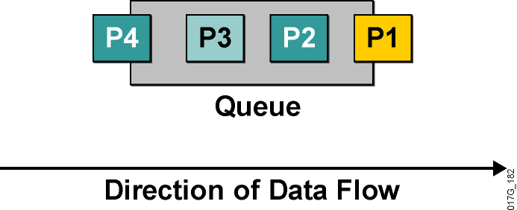
Frontový režim FIFO
Pakety sa odosielajú v poradí, v ktorom prišli
Definitívne najjednoduchší
Využíva jeden front
V iných mechanizmoch sa využíva niekoľko frontov, každý z nich je sám osebe FIFO
  FIFO preto tvorí veľmi dôležitý základ všetkých ďalších mechanizmov
Notes:
In its simplest form, FIFO queuing—also known as first-come, first-served queuing—involves storing packets when the network is congested and forwarding them in order of arrival when the network is no longer congested.
FIFO embodies no concept of priority or classes of traffic and consequently makes no decision about packet priority. There is only one queue, and all packets are treated equally. Packets are placed into a single queue and transmitted in the order in which they arrive. Higher-priority packets are not transmitted faster than lower-priority packets.
When no other queuing strategies are configured, all interfaces except serial interfaces at E1 (2.048 Mbps) and below use FIFO by default. FIFO, which is the fastest method of queuing, is effective for links that have little delay and minimal congestion. If your link has very little congestion, FIFO queuing may be the only queuing you need to use.
All individual queues are, in fact, FIFO queues. Other queuing methods rely on FIFO as the underlying queuing mechanism for the discrete queues within more complex queuing strategies that support advanced functions such as prioritization.

Slide 38
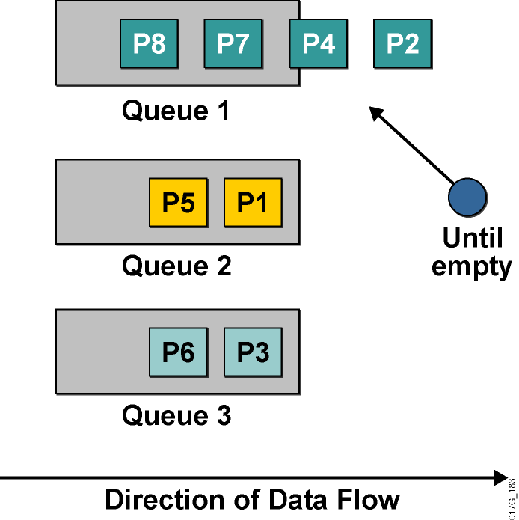
Frontový režim Priority Queuing
Používa viaceré fronty
Umožňuje stanoviť absolútne priority
Plánovač vždy vyberá pakety
z frontu s najvyššou prioritou,
v ktorom sa ešte nachádzajú čakajúce pakety
Front s najvyššou prioritou má garantovanú obsluhu
Hrozí riziko starvácie menej prioritných frontov
Je veľmi ťažké garantovať oneskorenie v menej prioritných frontoch
Notes:
Priority Queuing (PQ) allows network administrators to prioritize traffic in the network. A series of filters based on packet characteristics can be defined to cause the router to place traffic into a queue. The queue with the highest priority is serviced first until it is empty, then the lower queues are serviced in sequence.
During transmission, PQ gives priority queues absolute preferential treatment over low-priority queues; important traffic, given the highest priority, will always take precedence over less important traffic.
A priority list is a set of rules that describe how packets should be assigned to priority queues. A priority list might also describe a default priority or the queue size limits of the various priority queues.
Packets can be classified by the following:
Protocol type
Incoming interface
Packet size
Fragments
Access control list (ACL)
Keepalives sourced by the network server are always assigned to the high-priority queue; all other management traffic (such as Enhanced Interior Gateway Routing Protocol [EIGRP] updates) must be configured.
Although you can enable priority output queuing for any interface, it is best suited to low-bandwidth, congested serial interfaces.
When you choose to use PQ, consider that, because lower-priority traffic is often denied bandwidth in favor of higher-priority traffic, the use of PQ could, in the worst case, result in lower-priority traffic never being transmitted (the lower-priority traffic class is “starved”). To avoid this problem, you can use traffic shaping to rate-limit the higher-priority traffic.
PQ introduces extra overhead that is acceptable for slow interfaces but that may not be acceptable for higher-speed interfaces such as Ethernet. With PQ enabled, the system takes longer to switch packets because the packets are classified by the processed switch path. Furthermore, PQ uses a static configuration that does not adapt readily to changing network conditions.

Slide 39
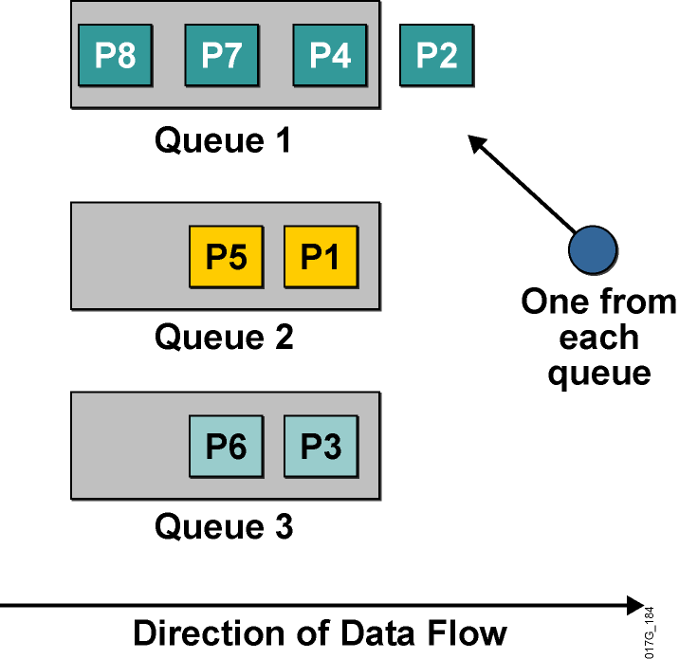
Frontový režim Round Robin Queuing
Využíva viaceré fronty
Nepodporuje priority
Plánovač v nekonečnom cykle prechádza frontami v pevnom poradí a z každého pri jednom prechode vyberie jeden paket na odoslanie
Každý front má garantované, že plánovač z neho do istého času odoberie paket
Podiel prenosového pásma pripadajúci na jeden front sa však nedá garantovať
Notes:
Round robin refers to an arrangement that involves choosing all elements in a group equally in some rational order, usually starting from the top to the bottom of a list and then starting again at the top of the list and so on. A simple way to think of round robin is that it is about “taking turns.” In round-robin queuing, one packet is taken from each queue and then the process repeats.
If all packets are the same size, all queues share the bandwidth equally. If packets being put into one queue are larger, that queue will receive a larger share of bandwidth.
No queue will “starve” with round-robin queuing because all queues receive an opportunity to dispatch a packet every round.
A limitation of round-robin queuing is the inability to prioritize traffic.

Slide 40
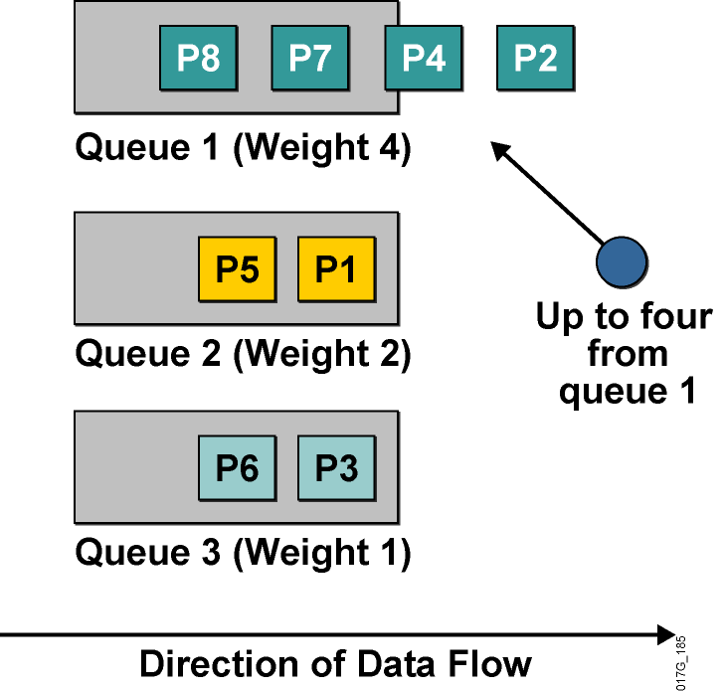
Frontový režim Weighted Round Robin Queuing
Vylepšenie obyčajného RRQ
Podporuje priority
Každému frontu prideľuje váhu
Fronty obsluhuje cyklicky ako RRQ, avšak z každého frontu vyberie počet paketov úmerný váhe frontu
Existujú implementácie, kde namiesto počtu paketov je definovaný objem dát, ktorý sa má z frontu odoslať
  Táto implementácia sa volá Custom Queueing (CQ)
Notes:
The weighted round robin (WRR) algorithm provides prioritization capabilities for round-robin queuing as shown here.
In WRR, packets are accessed round-robin style, but queues can be given priorities called “weights.” For example, in a single round, four packets from a high-priority class might be dispatched, followed by two from a middle-priority class, and then one from a low-priority class.
Some implementations of the WRR algorithm provide prioritization by dispatching a configurable number of bytes each round rather than a number of packets. The Cisco custom queuing (CQ) mechanism is an example of this implementation.

Slide 41
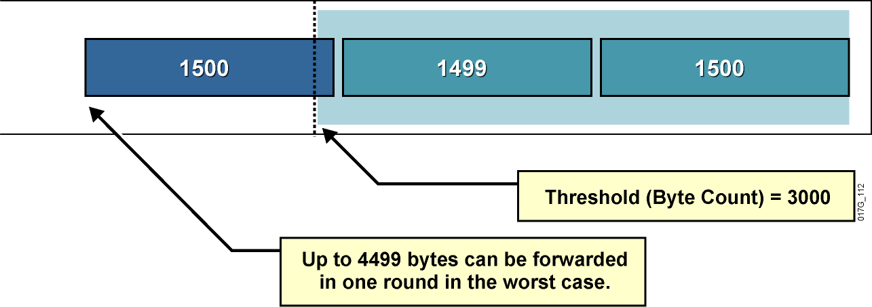
Problémy s Weighted Round Robin Queuing
Vo WRR (CQ) môže dochádzať k vychýleniu skutočných váh frontov
  CQ dovoľuje v jednom prechode plánovača odoslať z frontu istý počet bajtov tým, že sa odošle hneď niekoľko paketov
  Plánovač však môže odoslať paket aj vtedy, ak celkový počet odoslaných bajtov je väčší než povolená váha frontu
Notes:
This slide illustrates the worst-case scenario of the WRR algorithm, which uses the following parameters to implement WRR queuing on an interface:
The maximum transmission unit (MTU) of the interface is 1500 bytes.
The byte count to be sent for the queue in each round is 3000 bytes (twice the MTU).
The example shows that the router first sent two packets with a total size of 2999 bytes. Because this size is within the limit (3000), the router can send the next packet (which is MTU-sized, 1500 bytes). The result is that the queue received almost 50 percent more bandwidth in this round than it should have received.
This example shows one of the drawbacks of WRR queuing—it does not allocate bandwidth accurately.
The limit or weight of the queue is configured in bytes. The accuracy of WRR queuing depends on the weight (byte count) and the MTU. If the ratio between the byte count and the MTU is too small, WRR queuing will not allocate bandwidth accurately.
If the ratio between the byte count and the MTU is too large, WRR queuing will cause long delays.

Slide 42
Frontový režim Weighted Fair Queuing
Frontový režim, ktorý realizuje „férovú“ politiku, by sa mal správať podľa týchto kritérií:
  Každý tok dostane rovnaký podiel na kapacite rozhrania
  Znižovať dobu odozvy pre interaktívne toky tým, že ich pri odosielaní uprednostní pred ostatnými
  Zabrániť veľkoobjemovým tokom monopolizáciu rozhrania
Ideálny férový algoritmus by mal cyklicky obsluhovať všetky fronty a z každého vybrať v jednom cykle jeden bit
  Tento prístup je v paketových sieťach nepoužiteľný
  Možno ho však nahradiť približným postupom:
    Pre každý front si viesť evidenciu, koľko dát celkovo bude z neho odoslaných, ak z neho odošleme ďalší paket
    Obsluhovať vždy ten front, z ktorého je vrátane nasledujúceho paketu celkovo odoslaných najmenej dát
Notes:
WFQ is a dynamic scheduling method that provides fair bandwidth allocation to all network traffic. WFQ applies priority, or weights, to identified traffic to classify traffic into conversations and determine how much bandwidth each conversation is allowed relative to other conversations.
WFQ is a flow-based algorithm that simultaneously schedules interactive traffic to the front of a queue to reduce response time and fairly shares the remaining bandwidth among high-bandwidth flows. In other words, WFQ allows you to give low-volume traffic, such as Telnet sessions, priority over high-volume traffic, such as FTP sessions. WFQ gives concurrent file transfers balanced use of link capacity; that is, when multiple file transfers occur, the transfers are given comparable bandwidth.
WFQ solves problems inherent in the following queuing mechanisms:
FIFO queuing causes starvation, delay, and jitter.
Priority queuing (PQ) causes starvation of lower-priority classes and suffers from the FIFO problems within each of the four queues that it uses for prioritization.

Slide 43
Frontový režim WFQ
Front 1, 200-bajtové pakety
Front 2, 150-bajtové pakety
Front 3, 100-bajtové pakety
Krok | Front 1 | Front 2 | Front 3
0 | 200 | 150 | 100
1 | 200 | 150 | 200
2 | 200 | 300 | 200
3 | 400 | 300 | 200
4 | 400 | 300 | 300
5 | 400 | 450 | 300
6 | 400 | 450 | 400
7 | 600 | 450 | 400
8 | 600 | 450 | 500
9 | 600 | 600 | 500
10 | 600 | 600 | 600

Slide 44
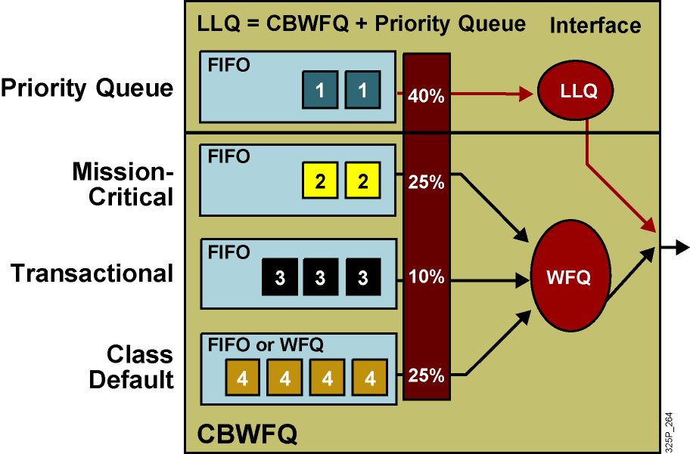
Kombinácia frontových mechanizmov
WFQ sa obvykle realizuje pre jednotlivé toky (flows)
  Toky sa rozdeľujú do tzv. konverzačných frontov
  Využíva sa Src/Dst IP, L4 protokol, porty
WFQ, ktoré namiesto tokov obsluhuje triedy prevádzky, sa nazýva CBWFQ (Class-Based)
Notes:
Neither the basic queuing methods nor the more advanced weighted fair queuing (WFQ) methods completely solve the quality of service (QoS) problems resulting from converged network traffic. The following problems remain:
If only a priority queue is used for a voice-enabled network, voice gets the needed priority. However, data traffic would suffer.
If only custom queuing (CQ) is used for a voice-enabled network, data traffic is assured of some bandwidth. However, voice traffic would suffer delays.
If WFQ is used, voice still experiences delay even when treated “fairly” by WFQ.
In PQ and CQ, all of the classification, marking, and queuing mechanisms are complicated to use and time-consuming when applied on an interface-by-interface basis.
Newer queuing mechanisms combine the best aspects of existing queuing methods. Low latency queuing (LLQ) is a combination of class-based weighted fair queuing (CBWFQ), which assigns weights according to bandwidth, and a priority system based on class that gives voice the priority it requires while ensuring that data is serviced efficiently. This solves the potential starvation problem of the priority queue by including a policing function based on the configured bandwidth of the priority system.

Slide 45
Low Latency Queuing (LLQ)
LLQ je kombinácia prioritného frontu s CBWFQ
Do prioritného frontu sa umiestňujú spravidla real-time dáta
  Hlas, video
Prioritný front má zároveň aplikovaný policing, aby nemohol presiahnuť garantovanú kapacitu
Ostatná prevádzka je rozdelená do tried obsluhovaných pomocou CBWFQ
Notes:
Although WFQ provides a fair share of bandwidth to every flow and provides fair scheduling of its queues, it cannot provide guaranteed bandwidth and low delay to selected applications. For example, voice traffic may still compete with other aggressive flows in the WFQ queuing system because the WFQ system lacks priority scheduling for time-critical traffic classes.
For CBWFQ, the weight for a packet belonging to a specific class is derived from the bandwidth that you assigned to the class when you configured it. Therefore, the bandwidth assigned to the packets of a class determines the order in which packets are sent. All packets are serviced fairly based on this internal weight; no class of packets may be granted strict priority. This scheme poses problems for voice traffic, which is largely intolerant of delay, especially variation in delay. For voice traffic, variations in delay introduce irregularities of transmission heard as jitter in the conversation.
LLQ reduces the jitter in voice conversations. To enqueue real-time traffic to a strict-priority queue, you configure the priority command for the class after you specify the named class within a policy map. (Classes to which the priority command is applied are considered priority classes.) Within a policy map, you can give one or more classes priority status. When multiple classes within a single policy map are configured as priority classes, all traffic from these classes is enqueued to the same, single, strict priority queue.

Slide 46
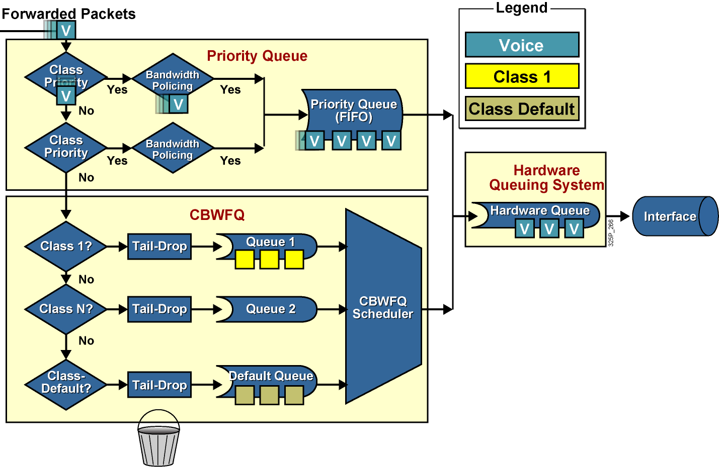
Architektúra LLQ
Notes:
LLQ extends CBWFQ by adding strict-priority queuing.
Strict-priority queuing allows delay-sensitive data such as voice to be dequeued and sent first. Voice packets that enter the LLQ system are sent to the priority queue part of the LLQ system, where they have a fixed bandwidth allocation and where they are served first. Data packets enter the CBWFQ system directly where CBWFQ assigned weights determine how they are treated.
Without LLQ, CBWFQ provides weighted queuing based on defined per-class bandwidth with no strict-priority queue available for real-time traffic. CBWFQ allows you to define traffic classes and then assign characteristics to that class. For example, you can designate the minimum bandwidth delivered to the class during congestion.

Slide 47
Vďaka za pozornosť!
Ing. Peter Palúch, PhD.
Peter.Paluch@fri.uniza.sk
KIS FRI ŽU

