Slide 1

Otázky kvality služby vo VoIP sieťach, časť 2
Ing. Peter Palúch, PhD.
Katedra informačných sietí
FRI ŽU

Slide 2
Resumé faktov
Degradačné faktory v paketových sieťach
  Oneskorenie, jeho kolísanie, straty paketov
Nástrojmi na zabezpečenie QoS môžeme tieto faktory ovplyvniť
  Zvýhodníme isté toky na úkor iných
Modely zabezpečenia kvality služby
  Best effort (bez ohľadu na kvalitu služby)
  Integrované služby (IntServ)
  Diferencované služby (DiffServ)

Slide 3
Resumé faktov (pokr.)
Architektúra DiffServ
  Rozdelenie prevádzky do tried
  Dohodnutý spôsob obsluhy konkrétnej triedy na každom uzle (PHB)
Triedy prevádzky v DiffServ
  Best Effort (BE)
  Assured Forwarding (AFxy, x=1...4, y=1...3)
  Expedited Forwarding (EF)

Slide 4
Resumé faktov (pokr.)
Nástroje QoS
  Klasifikácia (classification)
  Značkovanie (marking)
  Riadenie zahltenia (congestion management)
    Frontové režimy (PQ, RR, CQ/WRR, WFQ, CBWFQ)
  Predchádzanie zahlteniu (congestion avoidance)
    RED, WRED
  Limitovanie a tvarovanie (policing, shaping)
  Mechanizmy efektívnosti linky (link efficiency mechanisms)

Slide 5
Predchádzanie zahlteniu

Slide 6
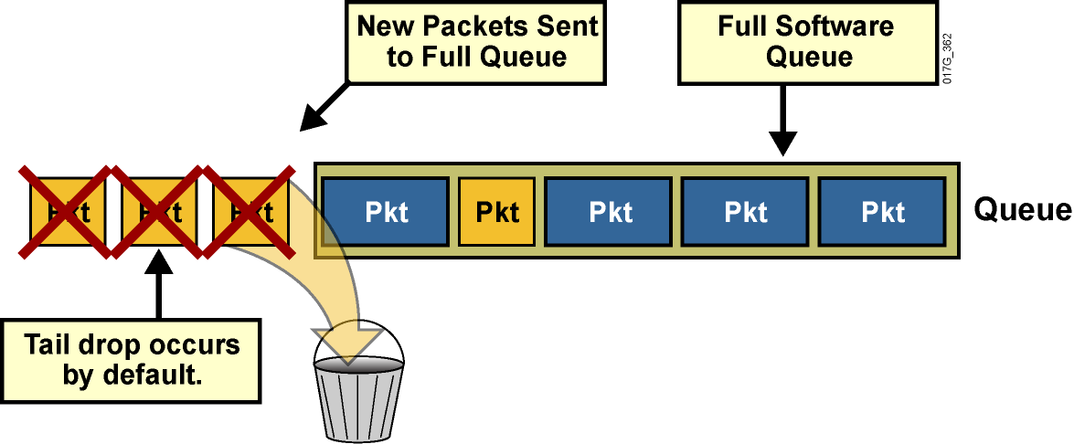
Zahltenie rozhrania a tail drop

Slide 7
Obmedzenia tail drop
Tail drop je jednoduchý, avšak má niektoré negatívne následky
  Môže viesť k tzv. TCP synchronizácii
  Niektoré TCP spojenia sa môžu neúmerne spomaliť
  V zahadzovaní nie je nijaká priorita – dôležité pakety sa zahodia rovnako ako nedôležité
Notes:
The simple tail-drop scheme does not work very well in environments with a large number of TCP flows or in environments in which selective dropping is required. Understanding the network interaction between TCP stack intelligence and dropping is required to implement a more efficient and fair dropping scheme, especially in service provider environments.
Tail drop has the following shortcomings:
Normally, when congestion occurs, dropping affects most of the TCP sessions, which simultaneously back off and then restart again. This process causes inefficient link utilization at the congestion point (TCP global synchronization). To avoid dropping of TCP packets, TCP reduces the window size.
TCP starvation occurs, in which all buffers are temporarily seized by aggressive flows, and normal TCP flows experience buffer starvation.
There is no differentiated drop mechanism, and therefore higher-priority traffic is dropped in the same way as best-effort traffic.

Slide 8
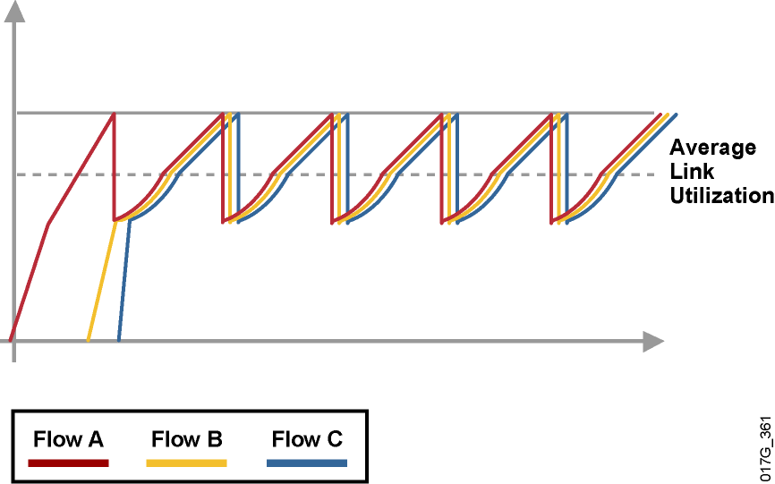
TCP synchronizácia
Predpokladajme viaceré TCP relácie
TCP okná v jednotlivých spojeniach postupne rastú, až objem dát zahltí výstupné rozhranie routera
Tail drop spôsobí stratu paketov vo všetkých spojeniach, ktoré náhle spomalia
Po čase sa okno v týchto spojeniach začne zväčšovať a proces sa opakuje
Notes:
Global synchronization is a TCP-related phenomenon that reduces optimal throughput of network applications. Tail drop contributes to this phenomenon.
A router can handle multiple concurrent TCP sessions. However, bursty network traffic could cause a router to fail if the traffic exceeds the queue limit.
This graphic illustrates the issue of TCP synchronization. If the receiving router drops all traffic that exceeds the queue limit (the default tail drop action), many TCP sessions then simultaneously go into slow start. Traffic temporarily slows down to the extreme, and then all flows go into slow start again. This activity creates a condition called global synchronization.
Global synchronization occurs as waves of congestion crest, only to be followed by troughs during which the transmission link is not fully used. Global synchronization of TCP hosts can occur because packets are dropped all at once. Global synchronization occurs when multiple TCP hosts reduce their transmission rates in response to packet dropping. When congestion is reduced, their transmission rates are increased.
The waves of transmission known as global synchronization result in significant link underutilization.

Slide 9
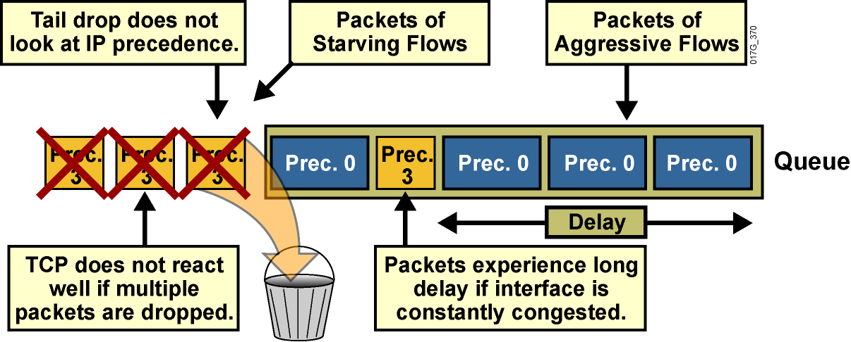
Problémy pri tail drop
Dlhý front vnáša oneskorenie
Premenlivé využitie frontu vnáša jitter
Agresívne toky môžu spôsobiť „starváciu“ subtílnejších tokov
Zahadzovanie nezohľadňuje priority
Notes:
Another TCP-related phenomenon that reduces optimal throughput of network applications is TCP starvation.
When multiple flows are being transmitted through a router, some of these flows may be much more aggressive than other flows. For instance, when the TCP transmit window increases for file-transfer applications, the TCP session can send a number of large packets to its destination. These packets immediately fill the queue on the router, and other, less aggressive flows can be starved because there is no differentiated treatment indicating which packets should be dropped. As a result, less aggressive flows are dropped at the output interface.
Again, tail drop does not address this issue.

Slide 10
Random Early Detection (RED)
Tail drop-u je možné sa vyhnúť, ak sa nepreplní výstupný front rozhrania – idea RED
RED je mechanizmus, ktorý náhodne zahadzuje pakety ešte skôr, ako je front plný
Čím je front plnší, tým s väčšou pravdepodobnosťou sa pakety zahadzujú
Čo sme tým dosiahli?
  TCP spojenia sa spomalia približne na úroveň dostupnej kapacity na výstupe
  Priemerná dĺžka frontu je nižšia
  TCP synchronizácia nenastáva vďaka náhodnému zahadzovaniu
Notes:
Random early detection (RED) is a dropping mechanism that randomly drops packets before a queue is full, thus helping to avoid tail drop.
The basis of the dropping strategy is the average queue length—that is, when the average size of the queue increases, RED is more likely to drop an incoming packet than when the average queue length is shorter.
Because RED drops packets randomly, it has no per-flow intelligence. The rationale is that an aggressive flow will represent most of the arriving traffic, and it is likely that RED will drop a packet of an aggressive session. RED therefore punishes more aggressive sessions with a higher statistical probability and is able to somewhat selectively slow the most significant cause of congestion. Directing one TCP session at a time to slow down allows for full utilization of the bandwidth rather than utilization that manifests itself as crests and troughs of traffic.
As a result of implementing RED, TCP global synchronization is much less likely to occur, and TCP can use link bandwidth more efficiently.
In RED implementations, the average queue size also decreases significantly because the possibility of the queue filling up is reduced. This is because RED is very aggressive in tail dropping when traffic bursts occur and the queue is already quite full.
RED distributes losses over time and normally maintains a low queue depth while absorbing traffic spikes. RED can also utilize IP precedence or differentiated services code point (DSCP) bits in packets to establish different drop profiles for different classes of traffic.
RED is useful only when the bulk of the traffic is TCP traffic. With TCP, dropped packets indicate congestion, so the packet source reduces its transmission rate. With other protocols, packet sources might not respond or might re-send dropped packets at the same rate, and so dropping packets might not decrease congestion.

Slide 11
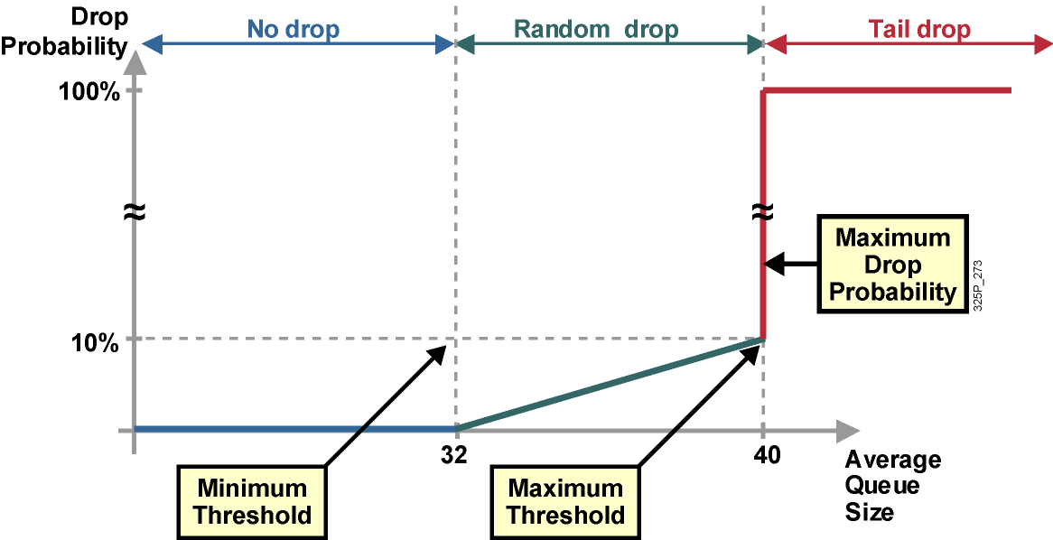
RED profil
Notes:
RED uses a traffic profile to determine the packet-dropping strategy based on the average queue length. The packet drop probability is based on the minimum threshold, maximum threshold, and mark probability denominator. When the average queue depth is above the minimum threshold, RED starts dropping packets. The rate of packet drop increases linearly as the average queue size increases until the average queue size reaches the maximum threshold.
The figure shows that depending on queue length, the profile assigns a no drop, a random drop or full drop probability.
The probability of a packet being dropped is based on three configurable parameters contained within the RED profile:
Minimum threshold: When the average queue length is above the minimum threshold, RED starts dropping packets. The rate of packet drop increases linearly as the average queue size increases, until the average queue size reaches the maximum threshold.
Maximum threshold: When the average queue size is above the maximum threshold, all packets are dropped.
Mark probability denominator: This number is the fraction of packets that are dropped when the average queue depth is at the maximum threshold. For example, if the denominator is 512, one out of every 512 packets is dropped when the average queue is at the maximum threshold. The linear increase of packet drops from the minimum threshold (0 drops) to the maximum threshold is based on this parameter and the queue size between the minimum and maximum thresholds.
The minimum threshold value should be set high enough to maximize link utilization. If the minimum threshold is too low, packets may be dropped unnecessarily, and the transmission link will not be fully used.
The difference between the maximum threshold and the minimum threshold should be large enough to avoid global synchronization. If the difference is too small, many packets may be dropped at once, resulting in global synchronization.

Slide 12
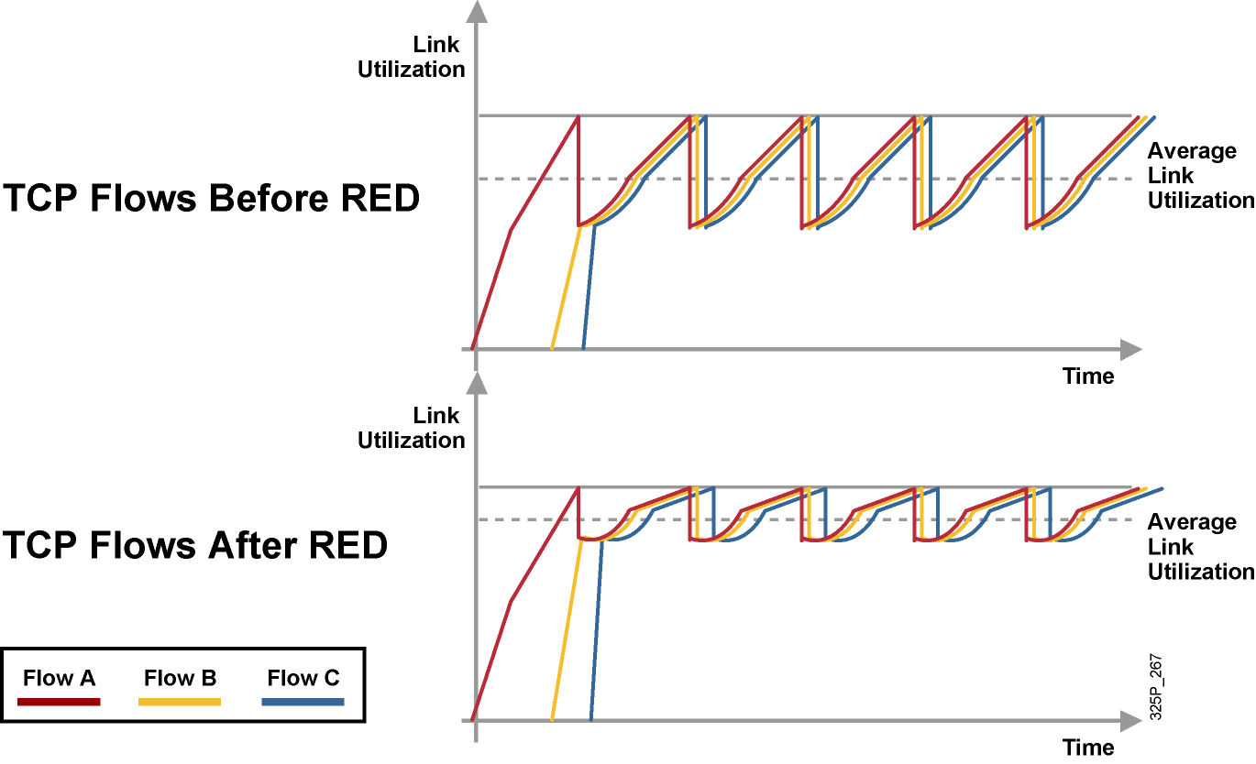
TCP bez RED a s ním
Notes:
These graphics show TCP throughput behavior compared to link bandwidth in a congested network scenario where the tail-drop and RED mechanisms are in use on the link.
Before RED, when all sessions slow down, congestion on the router interface is removed and all TCP sessions restart their transmission at about the same time. Again, the router interface quickly becomes congested, causing tail drop. As a result, all TCP sessions back off again. This behavior cycles constantly, resulting in a link that is generally underutilized.
After RED is applied, RED randomly drops packets, influencing a small number of sessions at a time, before the interface reaches congestion. Overall throughput of sessions is increased, as is average link utilization. Global synchronization is very unlikely to occur because of selective, but random, dropping of adaptive traffic.

Slide 13
Weighted Random Early Detection (WRED)
WRED je rozšírenie RED vytvorením profilov pre viaceré triedy prevádzky
Každý profil je identifikovaný svojou
  Minimálnou prahovou hodnotou (veľkosť frontu)
  Maximálnou prahovou hodnotou (veľkosť frontu)
  Maximálnou pravdepodobnosťou zahadzovania
Výber WRED profilu sa odvodzuje od triedy prevádzky
  IP precedence (8 profilov)
  DSCP (64 profilov)
WRED takto môže dôležité pakety zahadzovať menej agresívne než nedôležité
Notes:
Cisco does not support RED. Instead, Cisco supports weighted random early detection (WRED) which combines RED with IP precedence or DSCP and performs packet dropping based on IP precedence or DSCP markings.
For example, a packet with an IP precedence value of 0 might have a minimum threshold of 20 packets, whereas a packet with an IP precedence of 1 might have a minimum threshold of 25 packets. In this example, packets with an IP precedence of 0 would start to be discarded before packets with an IP precedence of 1.
As with RED, WRED monitors the average queue length in the router and determines when to begin discarding packets based on the length of the interface queue. When the average queue length exceeds the user-specified minimum threshold, WRED begins to randomly drop packets with a certain probability. If the average length of the queue continues to increase so that it becomes larger than the user-specified maximum threshold, WRED reverts to a tail-drop packet-discard strategy, in which all incoming packets are dropped.
The idea behind using WRED is to maintain the queue length at a level somewhere below the maximum threshold and to implement different drop policies for different classes of traffic. WRED can selectively discard lower-priority traffic when the interface becomes congested and can provide differentiated performance characteristics for different classes of service. WRED can also be configured to produce nonweighted RED behavior.
For interfaces configured to use Resource Reservation Protocol (RSVP), WRED chooses packets from other flows to drop rather than the RSVP flows. Also, IP precedence or DSCP helps determine which packets are dropped, because traffic at a lower priority has a higher drop rate than traffic at a higher priority (and, therefore, lower-priority traffic is more likely to be throttled back). In addition, WRED statistically drops more packets from large users than from small users. The traffic sources that generate the most traffic are more likely to be slowed than traffic sources that generate little traffic.
WRED reduces the chances of tail drop by selectively dropping packets when the output interface begins to show signs of congestion. By dropping some packets early rather than waiting until the queue is full, WRED avoids dropping large numbers of packets at once and minimizes the chances of global synchronization. As a result, WRED helps maximize the utilization of transmission lines.
WRED treats non-IP traffic as precedence 0, the lowest precedence. Therefore, non-IP traffic, in general, is more likely to be dropped than IP traffic.
WRED should be used wherever there is a potential congested link (bottleneck), which could very well be an access or edge link; however, WRED is normally used in the core routers of a network rather than at the network edge. Edge routers assign IP precedence or DSCP to packets as they enter the network. WRED uses these assigned values to determine how to treat different types of traffic.
Note that Cisco does not recommend WRED for any voice queue, although you may enable WRED on an interface carrying voice traffic. WRED will not throttle back voice traffic because voice traffic is User Datagram Protocol (UDP)-based.

Slide 14
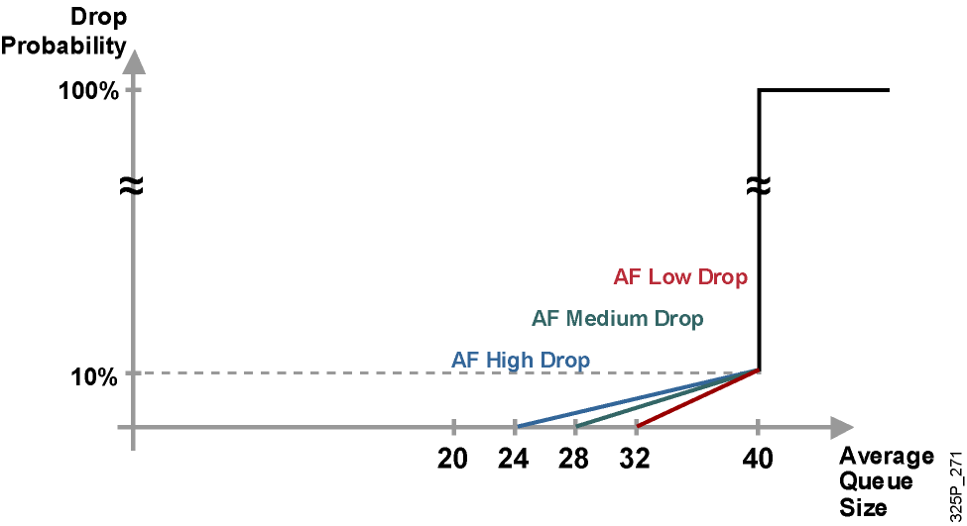
WRED profil pre AF PHB
Notes:
In DSCP, the following parameters identify Assured Forwarding (AF) PHB based on:
Guarantees a certain amount of bandwidth to an AF class.
Allows access to extra bandwidth, if available.
Packets requiring AF PHB should be marked with DSCP value aaadd0, where aaa is the number of the class and dd is the drop probability, or drop preference, of the traffic class.
There are four defined AF classes. Each class should be treated independently and have bandwidth allocated that is based on the QoS policy.
For the AF DiffServ traffic class, WRED configures itself by default for three different profiles, depending on the drop preference DSCP marking bits. Therefore, AF traffic should be classified into the three possible classes, such as AF high drop, AF medium drop, and AF low drop. These three classes are based on the sensitivity to packet drops of the application or applications represented by the class. This would mean that the mission-critical class would have an AF low drop, an AF medium drop, and an AF high drop.

Slide 15
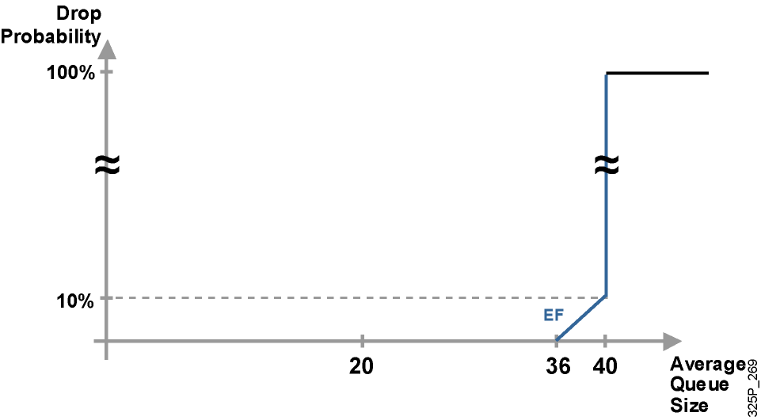
WRED profil pre EF PHB
Notes:
Recall that a per hop behavior (PHB) is the externally observable forwarding behavior applied at a DiffServ-compliant node to a DiffServ behavior aggregate (BA).
Expedited Forwarding (EF) PHB is suggested for applications that require a hard guarantee on the delay and jitter. Typically, mission critical applications would require this service and would be allocated a small percentage of the total network capacity.
In DSCP, the Expedited Forwarding (EF) PHB is identified based on these parameters:
A low departure rate is ensured to provide low delay to delay-sensitive applications.
Bandwidth is guaranteed to prevent starvation of the application if there are multiple applications using EF PHB.
Bandwidth is policed to prevent starvation of other applications or classes that are not using this PHB.
Packets requiring EF should be marked with DSCP binary value 101110 (46).
For the EF DiffServ traffic class, WRED configures itself by default so that the minimum threshold is very high, increasing the probability of no drops being applied to that traffic class. It is expected that EF traffic will be dropped very late, compared to other traffic classes, and the EF traffic is therefore prioritized in the event of congestion.

Slide 16
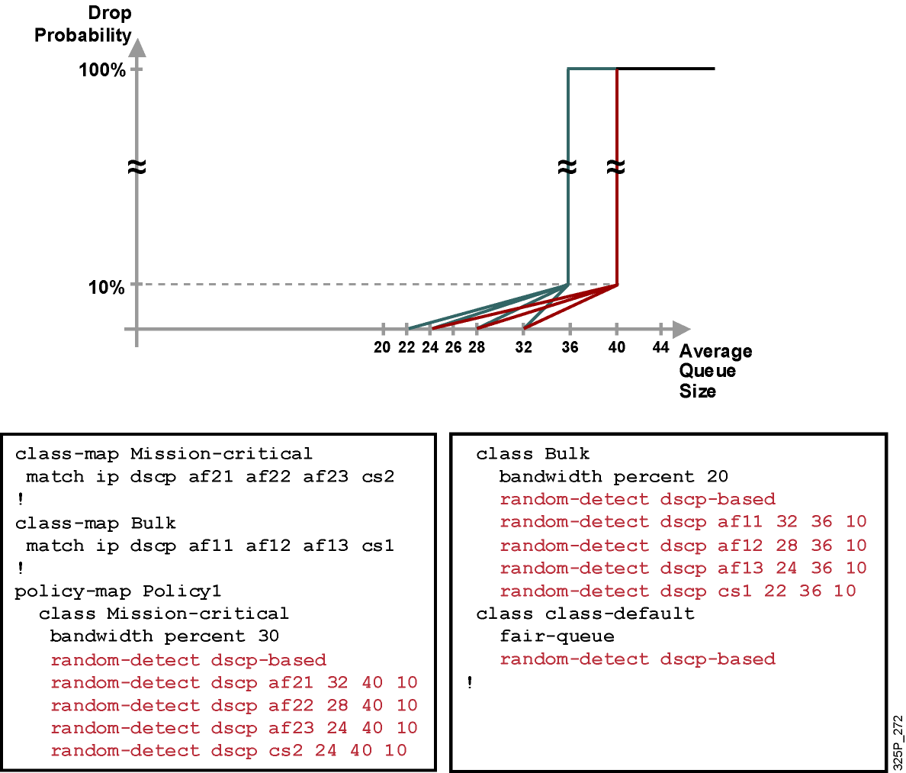
Príklad konfigurácie WRED
Notes:
To enforce this service policy, a router uses CBWFQ to perform bandwidth sharing and uses WRED within service classes to perform differentiated drop. This example shows sample drop profile graphs and outputs.
The configuration example shows how traffic classification is performed using DSCP-based classes, representing the mission-critical class as the AF1 class, and the bulk class as the AF2 class. WRED DSCP-based parameters are set reflecting the class-dependent drop strategy:
The mission-critical class is guaranteed at least 30 percent of bandwidth, with a custom WRED profile that establishes three different drop probabilities for AF class 2. The minimum threshold for DSCP AF21 packets is 32. The minimum threshold for DSCP AF22 packets is 28. The minimum threshold for DSCP AF23 and CS2 packets is 24. The maximum threshold for all Mission-critical traffic is 40 - the default maximum threshold is equal to the default hold queue size (40) on an interface. The (default) mark probability is 10 for the Mission-critical traffic (one out of every 10 packets is dropped when the average queue depth is at the maximum threshold – the average queue size changes with time as a function of the previously calculated average queue size and the current queue size).
The bulk class is guaranteed at least 20 percent of bandwidth, is configured with three different drop probabilities for AF class 1, and has a somewhat lower WRED maximum threshold. As a result, bulk-class traffic is more likely to be dropped than the mission-critical class if interface congestion occurs. The minimum threshold for DSCP AF11 packets is 32. The minimum threshold for DSCP AF12 packets is 28. The minimum threshold for DSCP AF13 packets is 24. The minimum threshold for DSCP CS1 packets is 24. The maximum threshold for all Mission-critical traffic is 36. The (default) mark probability is 10 for the Bulk traffic.
All other traffic is part of the default class and is fair-queued, with default WRED parameters.

Slide 17
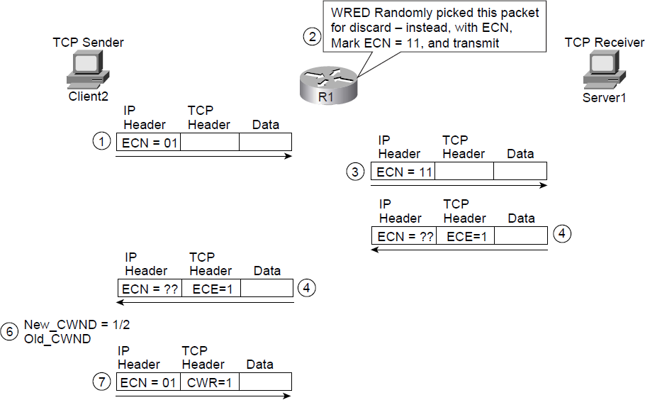
Explicit Congestion Notification a ((CB)W)RED

Slide 18
Policing, shaping

Slide 19
Úprava prevádzky
Policing
  Limituje šírku pásma zahadzovaním nadbytočnej prevádzky
  Nadbytočná prevádzka môže byť aj preznačkovaná
  Vhodné najmä na vysokorýchlostné rozhrania
  Môže byť použitý na vstupnom i výstupnom rozhraní
Shaping
  Limituje šírku pásma bufferovaním nadbytočnej prevádzky
  Buffering môže viesť k oneskoreniam
  Vhodné pre pomalšie rozhrania
  Nedokáže preznačkovať prevádzku
  Môže byť použitý len na výstupnom rozhraní
Notes:
Traffic conditioners, QoS mechanisms that limit bandwidth, include policing and shaping. Both of these approaches limit bandwidth, but each has different characteristics, as follows:
Policing: Policing typically limits bandwidth by discarding traffic that exceeds a specified rate. However, policing also can re-mark traffic that exceeds the specified rate and attempt to send the traffic anyway. Because of the drop behavior of policing TCP retransmits, policing should be used on higher-speed interfaces. Policing can be applied inbound or outbound on an interface. Traffic policing tools are often configured on interfaces at the edge of a network to limit the rate of traffic entering or leaving the network. In the most common traffic-policing configurations, traffic that conforms is transmitted and traffic that exceeds is sent with a decreased priority or is dropped. Such priorities can be based on IP precedence or DSCP.
Shaping: Shaping limits excess traffic, not by dropping it but by buffering it. This buffering of excess traffic can lead to delay. Because of this delay, shaping is recommended for slower-speed interfaces. Unlike policing, shaping cannot re-mark traffic. As a final contrast, shaping can be applied only in the outbound direction on an interface. Traffic shaping can be used to account for speed mismatches, which are common in nonbroadcast multiaccess (NBMA) networks such as Frame Relay and ATM.

Slide 20
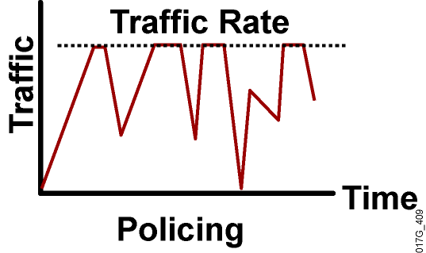
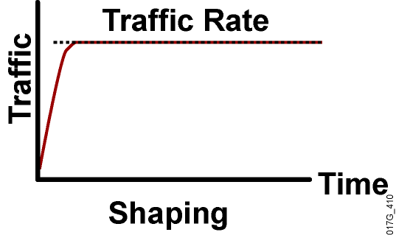
Policing vs. Shaping
Použiteľný na vstupe i výstupe
Nadpočetné pakety sú zahodené
V spoľahlivých protokoloch zahodenie spôsobí retransmisie
Je možné (pre)značkovávať pakety ako súčasť činnosti
Použiteľný iba na výstupe
Nadpočetné pakety sa bufferujú
Buffering znižuje počet TCP retransmisií
Preznačkovanie nie je podporované
Notes:
Policing can be applied to either the inbound or outbound direction, while shaping can be applied only in the outbound direction. Policing drops nonconforming traffic instead of queuing the traffic like shaping. Policing also supports marking of traffic. Traffic policing is more efficient in terms of memory utilization than traffic shaping because no additional queuing of packets is needed.
Both traffic policing and shaping ensure that traffic does not exceed a bandwidth limit, but each mechanism has different impacts on the traffic:
Policing drops packets more often, generally causing more retransmissions of connection-oriented protocols, such as TCP.
Shaping adds variable delay to traffic, possibly causing jitter. Shaping queues excess traffic by holding packets in a shaping queue. Traffic shaping is used to shape the outbound traffic flow when the outbound traffic rate is higher than a configured rate. Traffic shaping smoothes traffic by storing traffic above the configured rate in a shaping queue. Therefore, shaping increases buffer utilization on a router and causes unpredictable packet delays. Traffic shaping can also interact with a Frame Relay network, adapting to indications of Layer 2 congestion in the WAN. For example, if the backward-explicit congestion notification (BECN) bit is received, the router can lower the rate limit to help reduce congestion in the Frame Relay network.

Slide 21
Kedy policing a kedy shaping?
Policing
Shaping
Obmedzenie prístupu, ak je prístupová technológia rýchlejšia, než na koľko má zákazník nárok
Obmedzenie pásma pre vybrané aplikácie alebo triedy prevádzky
Preznačkovanie nadbytočnej prevádzky na L2 alebo L3
Riešenie zahltenia v ATM, Frame Relay alebo Metro Ethernet sieťach
  FR je typická technológia
  s tzv. oversubscription
Regulovanie výstupnej rýchlosti: prispôsobenie sa dohodnutej rýchlosti
v ATM, Frame Relay alebo Metro Ethernet
Notes:
Why Use Policing?
Limiting the access rate on an interface when high-speed physical infrastructure is used in transport. Rate limiting is typically used by service providers to offer customers subrate access. For example, a customer may have an Optical Carrier-3 (OC-3) connection to the service provider but pay only for a T1 access rate. The service provider can rate-limit the customer traffic to T1 speed.
Engineering bandwidth so that traffic rates of certain applications or classes of traffic follow a specified traffic-rate policy. For example, traffic from file-sharing applications may be rate-limited to 64 kbps maximum.
Re-marking excess traffic with a lower priority at Layer 2 and Layer 3 or both before sending the excess traffic out. Cisco class-based traffic policing can be configured to mark packets at both Layer 2 and Layer 3. For example, excess traffic can be re-marked to a lower differentiated services code point (DSCP) value and also have the Frame Relay discard eligible (DE) bit set before the packet is sent out.
Why Use Shaping?
Traffic shaping is typically used to prevent and manage congestion in ATM, Frame Relay, or Metro Ethernet networks, where asymmetric bandwidths are used along the traffic path. If shaping is not used, then buffering can occur at the slow (usually the remote) end, which can lead to queuing and cause delays, and overflow, which can cause packet drops.
Traffic shaping is an attempt to control traffic in ATM, Frame Relay, or Metro Ethernet networks to optimize or guarantee performance, low latency, or bandwidth. Traffic shaping deals with the concepts of classification, queue disciplines, enforcing policies, congestion management, quality of service (QoS), and fairness.
Traffic shaping provides a mechanism to control the volume of traffic being sent into a network (bandwidth throttling) by not allowing the traffic to burst above the subscribed (committed) rate. For this reason, traffic-shaping schemes need to be implemented at the network edges, as with ATM, Frame Relay, or Metro Ethernet, to control the traffic entering the network. It also may be necessary to identify traffic with a granularity that allows the traffic-shaping control mechanism to separate traffic into individual flows and shape them differently.

Slide 22
Token Bucket
Token Bucket (zásobník priepustiek) je matematický model mechanizmu pre policing a shaping
Priepustky predstavujú povolenie odoslať do siete istý objem dát
Priepustky sú pridávané do zásobníka istou dopredu stanovenou konfigurovanou rýchlosťou
Zásobník má obmedzenú veľkosť, nadbytočné priepustky sa nevyužijú
Pri odosielaní paketu sa zo zásobníka odoberie počet priepustiek úmerný veľkosti paketu
Ak v zásobníku niet dosť priepustiek na odoslanie paketu, aktivuje sa pre tento paket daný mechanizmus (policing alebo shaping)
Notes:
The token bucket is a mathematical model used by routers and switches to regulate traffic flow. The model has two basic components:
Tokens: Each token represents permission to send a fixed number of bits into the network. Tokens are put into a token bucket at a certain rate by Cisco IOS software.
Token bucket: A token bucket has the capacity to hold a specified number of tokens. Each incoming packet, if forwarded, takes tokens from the bucket representing the packet size. If the bucket fills to capacity, newly arriving tokens are discarded. Discarded tokens are not available to future packets. If there are not enough tokens in the token bucket to send the packet, the traffic-conditioning mechanisms may take the following actions:
Wait for enough tokens to accumulate in the bucket (traffic shaping)
Discard the packet (traffic policing)
Using a single token bucket model, the measured traffic rate can conform to or exceed the specified traffic rate. The measured traffic rate is conforming if there are enough tokens in the token bucket to transmit the traffic. The measured traffic rate is exceeding if there are not enough tokens in the token bucket to transmit the traffic.

Slide 23
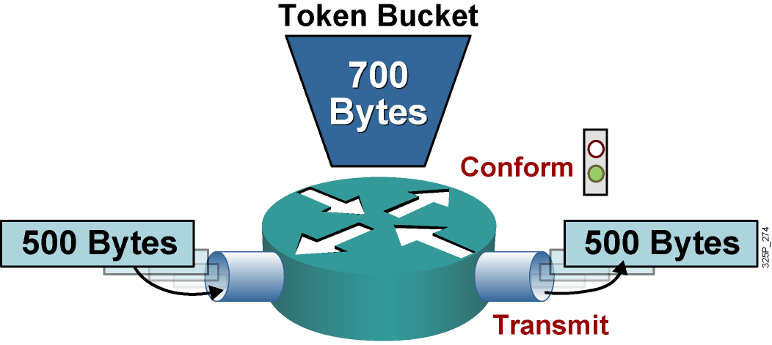
Jednoduchý token bucket
Ak je v zásobníku dosť priepustiek (tzv. conform action):
  Zo zásobníka sa odoberie príslušný počet priepustiek
  Paket bude odoslaný
Notes:
This graphic shows a single token bucket traffic policing implementation.
Starting with a current capacity of 700 bytes worth of tokens accumulated in the token bucket, when a 500-byte packet arrives at the interface, its size is compared to the token bucket capacity (in bytes).
The 500-byte packet conforms to the rate limit (500 bytes is less than 700 bytes), and the packet is forwarded: 500 bytes worth of tokens are taken out of the token bucket, leaving 200 bytes worth of tokens for the next packet.

Slide 24
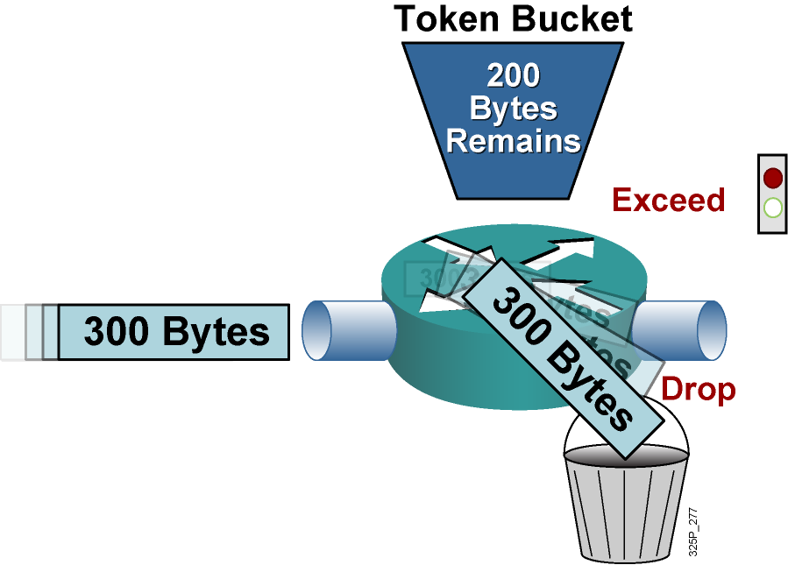
Jednoduchý token bucket (pokr.)
Ak v zásobníku nie je dosť priepustiek (tzv. exceed action):
  Paket sa zahodí alebo preznačkuje (policing), prípadne odloží na neskoršie odoslanie (shaping)
Notes:
Continuing with the single token bucket example from the previous figure, when the next 300-byte packet arrives immediately after the first packet, no new tokens have been added to the bucket (which is done periodically).
This packet exceeds the rate limit. The current packet size (300 bytes) is greater than the current capacity of the token bucket (200 bytes), and the exceed action is performed.
In traffic policing, the exceed action can be to drop or mark the packet.

Slide 25
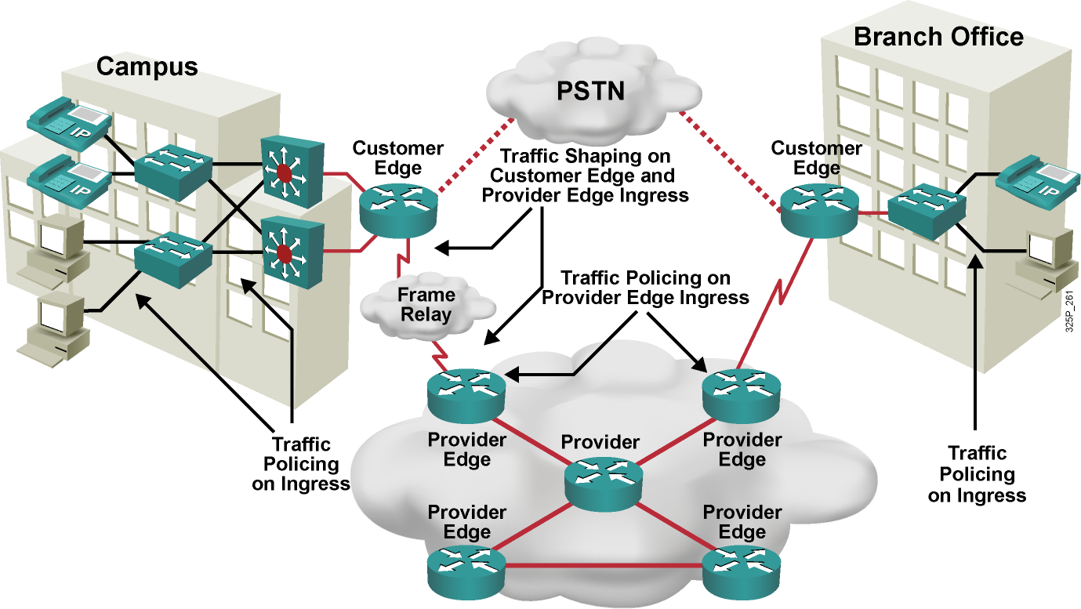
Využitie policingu a shapingu
Notes:
This example shows how traffic policing is often implemented in an enterprise network. Typically, the access or distribution layer employs traffic policing to limit certain traffic classes before that traffic exits the campus onto the WAN. Traffic shaping is often implemented at the WAN edge when there are speed mismatches or oversubscription.
In a typical service provider network, traffic policing is often implemented inbound at the Provider Edge (PE) router to rate-limit incoming traffic from the Customer Edge (CE) router to ensure that the customer traffic rate is not exceeding the contractual rate. Traffic shaping is often implemented outbound at the Provider Edge and at the Customer Edge to limit the traffic rate between the Provider Edge and Customer Edge and to allow for FRF.12 fragmentation on Frame Relay connections between the Customer Edge and Provider Edge.

Slide 26
Mechanizmy efektívnosti linky

Slide 27
Mechanizmy efektívnosti linky
Mechanizmy efektívnosti linky sú často využívané na WAN prepojoch
  Účelom je znížiť oneskorenie, jitter, zvýšiť priepustnosť
  Nie sú obvykle dostupné na ľubovoľnej linkovej technológii, ale obvykle iba na point-to-point prepoji (t.j. PPP, HDLC, Frame Relay)
Medzi tieto mechanizmy patria:
  Kompresia tela L2 rámca
  Kompresia hlavičiek
  Tzv. Link Fragmentation and Interleaving (LFI)
Notes:
WAN links can use bandwidth optimizing link efficiency QoS mechanisms such as payload compression, header compression, and link fragmentation and interleaving (LFI). These features are applicable to low-speed WAN interfaces and are emerging for use on high-speed Ethernet interfaces.
Payload compression: Payload compression does create additional bandwidth, because it squeezes packet payloads, and therefore increases the amount of data that can be sent through a transmission resource in a given time period. Payload compression is mostly performed on Layer 2 frames and, as a result, compresses the entire Layer 3 packet.
Header compression: The basis of header compression, like other compression methods, is the elimination of redundancy. This applies especially to often-repeated protocol headers.
LFI: LFI is a Layer 2 technique in which large frames are broken into small, equal-sized fragments and transmitted over the link in an interleaved fashion. The three primary LFI mechanisms supported by Cisco are as follows:
Multilink PPP (MLP): Used on PPP links
FRF.12: Used on Voice over IP over Frame Relay (VoIPovFR) links
FRF.11 Annex C: Used on Voice over Frame Relay (VoFR) links

Slide 28
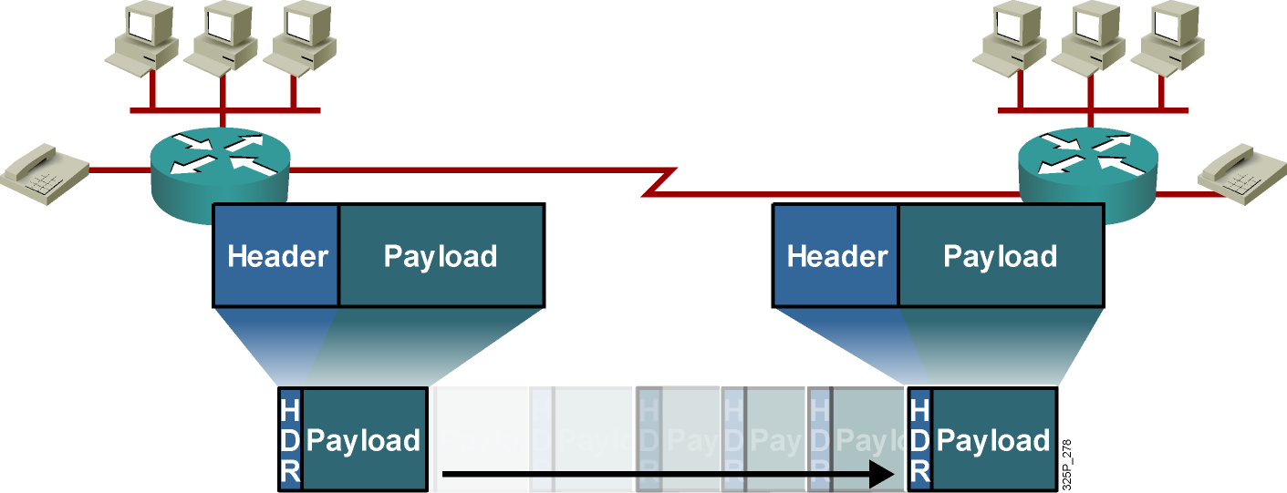
Kompresia tela a hlavičiek
Kompresia tela zmenšuje obsah L2 rámca
  Komprimovaný je teda celý L3 paket aj s hlavičkou, aj s obsahom
  Prirodzene, komprimovaný obsah (MPEG, G.729 atď.) už zmenšiť nemožno
Kompresia hlavičiek zmenšuje objem L3 a vyšších hlavičiek
Dôsledkom je vyššia prenosová rýchlosť a menšie oneskorenie
Notes:
Payload compression squeezes payloads, either the Layer 2 payload or the Layer 3 payload. With Layer 2 payload compression, the Layer 2 header remains intact, but its payload (Layer 3 and above) is compressed. With Layer 3 payload compression, Layer 2 and 3 headers remain intact. Payload compression increases the throughput and decreases the latency in transmission, because smaller packets (with compressed payloads) take less time to transmit than the larger, uncompressed packets. Layer 2 payload compression is performed on a link-by-link basis, whereas Layer 3 payload compression is generally used on a session-by-session basis.
Header compression methods work by not transmitting repeated information in packet headers throughout a session. The two peers on a PPP Layer 2 connection (a dialup link) agree on session indices that index a dictionary of packet headers. The dictionary is built at the start of every session and is used for all subsequent (noninitial) packets. Only changing, or nonconstant, parameters in the headers are actually sent along with the session index.
Header compression cannot be performed across multiple routers because routers need full Layer 3 header information to be able to route packets to the next hop.

Slide 29
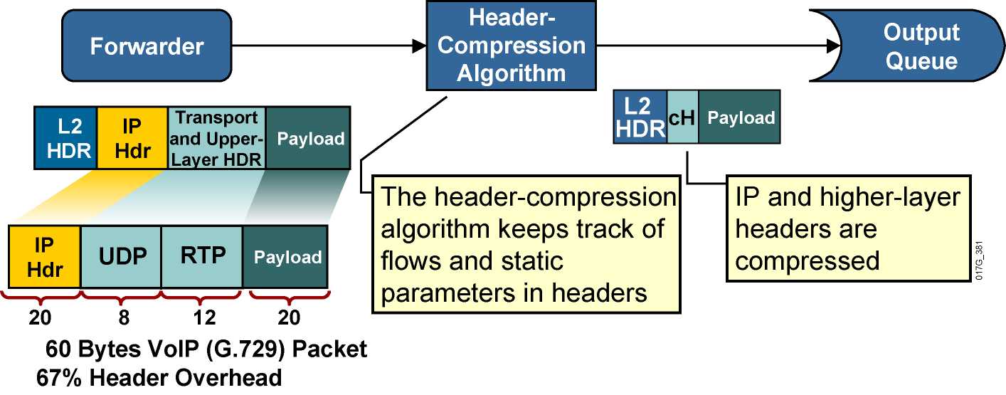
Kompresia hlavičiek
.
.
Notes:
Header compression increases throughput and reduces delay by compressing the protocol headers. Header compression is most useful for applications that generate small payloads because the protocol headers of such applications use a significant percentage of bandwidth on a link relative to their payload.
When header compression is applied on a TCP/IP header, some of the redundant fields in the header of a TCP/IP connection are removed. Header compression keeps a copy of the original header on either side of the link, removes the entirely redundant fields, and differentially codes the remaining fields in order to allow the compression of 40 bytes of header to an average of 5 bytes. This process uses a very specific algorithm designed around the constant structure of the TCP/IP header. It does not touch the payload of the TCP packet in any way.
TCP and RTP header compression applies to all TCP and RTP flows. For example, if TCP compression is enabled on a link, there is no mechanism to restrict its function to specific application types. TCP header compression for bulk data transfer yields little bandwidth savings. Class-based TCP header compression can be performed on specific traffic classes, such as the Telnet traffic class.
Class-based TCP header compression allows configuring RTP or TCP IP header compression on a per-class basis, when a class is configured within a policy map.

Slide 30
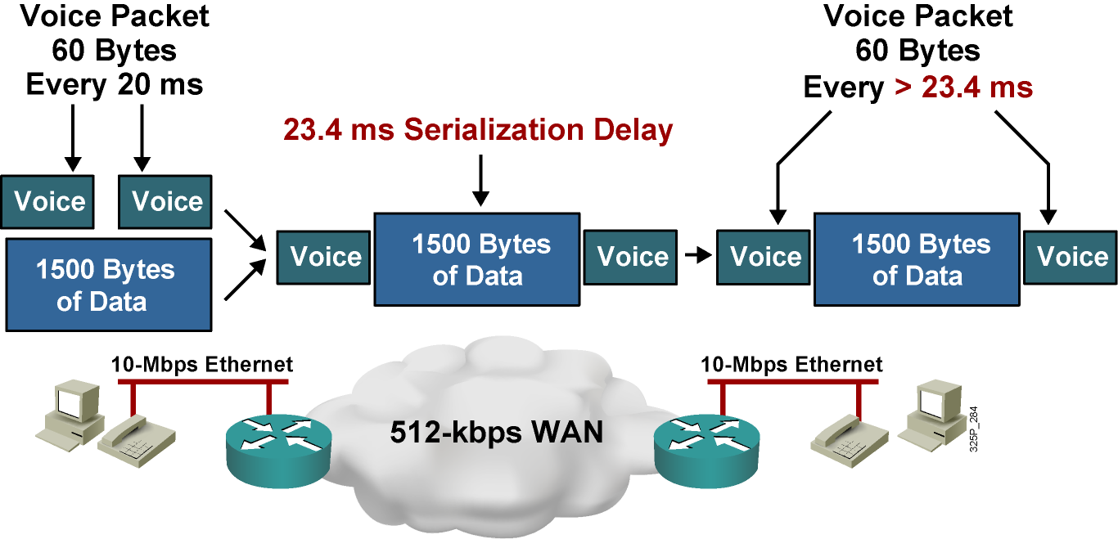
Problém so striedaním paketov
Notes:
In considering delay between two hops in a network, queuing delay in a router must be taken into account because it may be comparable to, or even exceed, serialization and propagation delay on a link. In an empty network, an interactive or voice session experiences low or no queuing delay, because the session does not compete with other applications on an interface output queue. Also, the small delay does not vary enough to produce significant jitter on the receiving side.
In a congested network, interactive data and voice applications compete in the router queue with other applications. Queuing mechanisms may prioritize voice traffic in the software queue, but the hardware queue (TxQ) always uses a FIFO scheduling mechanism. After packets of different applications leave the software queue, the packets will mix with other packets in the hardware queue, even if their software queue processing was expedited. Thus, a voice packet may be immediately sent to the hardware queue where two large FTP packets are waiting for transmission. The voice packet must wait until the FTP packets are transmitted, thus producing an unacceptable delay in the voice path. Because links are used variably, the delay varies with time and may produce unacceptable jitter in jitter-sensitive applications such as voice.
In the example shown here, the serialization delay of a 1500-byte packet over a 512-kbps link will be 24.3 ms. For VoIP traffic, the maximum recommended one-way, end-to-end delay is 150 ms. Therefore, having a 1500-byte packet ahead of a VoIP packet in the hardware queue on a 512-kbps link can cause the end-to-end delay of the voice packet to be over the budget of 24.3 ms.

Slide 31
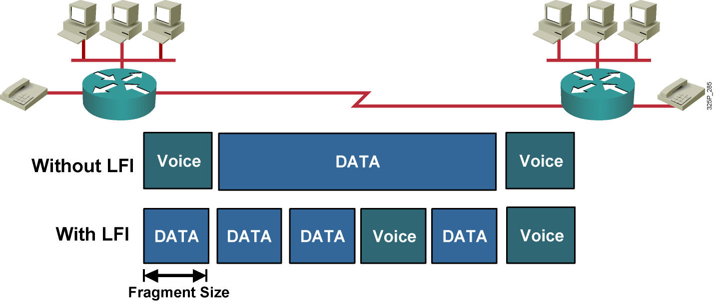
Link Fragmentation and Interleaving (LFI)
Notes:
The use of a hybrid queuing method such as low latency queuing (LLQ) can provide low latency and low jitter for VoIP packets while servicing other data packets in a fair manner. But, even if VoIP packets are always sent to the front of the software queue, there is still the issue of serialization delay. A large packet may be on its way out of the hardware queue, which uses FIFO. When a VoIP packet is sent to the front of the software queue, the serialization of the large packet in the hardware transmit queue can cause the VoIP packet to wait for a long time before it can be transmitted out.
The solution is to fragment the large packets so that they never cause a VoIP packet to wait for more than a predefined amount of time. The VoIP packets must also be allowed to transmit in between the fragments of the larger packets (interleaving), or there will be no point in doing the fragmenting.
When you are configuring the proper fragment size to use on a link, a typical goal is to have a maximum serialization delay of around 10 to 15 ms. Depending on the LFI mechanisms being configured, the fragment size is either configured in bytes or in milliseconds.

Slide 32
Vďaka za pozornosť!
Ing. Peter Palúch, PhD.
Peter.Paluch@fri.uniza.sk
KIS FRI ŽU

