Slide 1
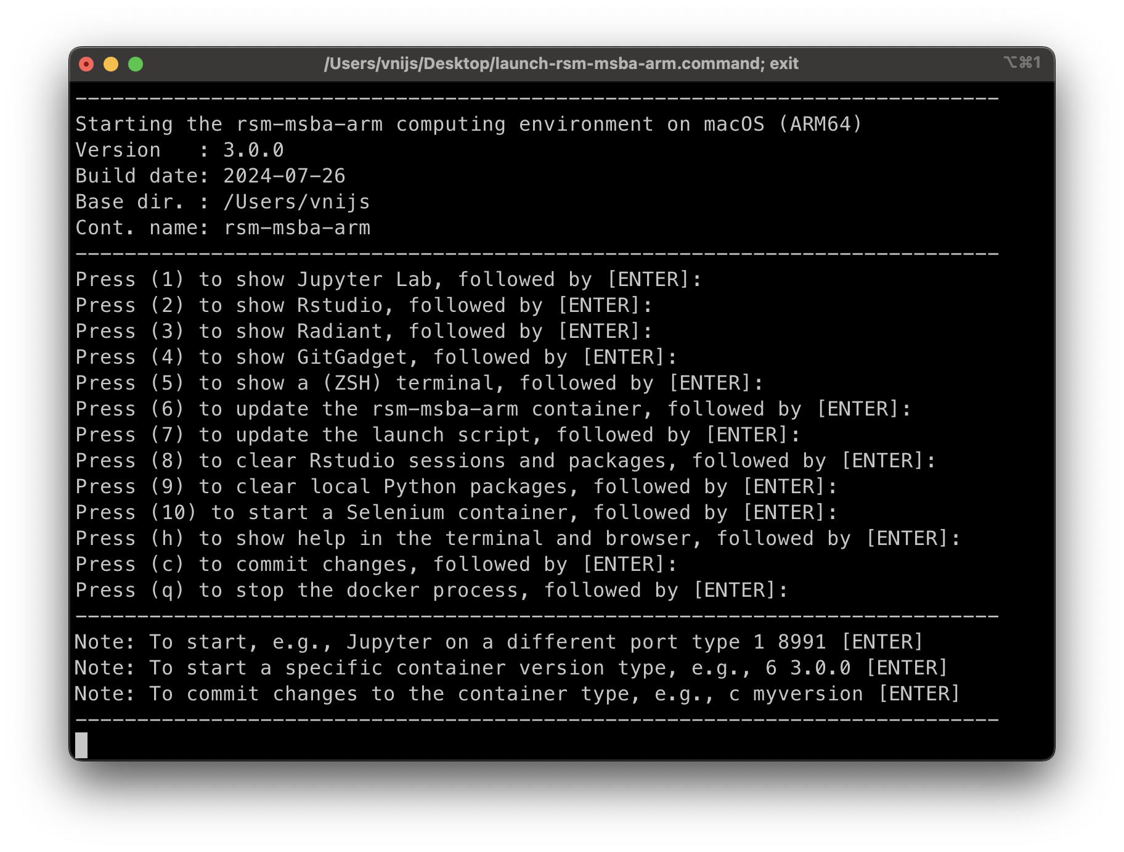
rsm-msba-intel
(Intel)
rsm-msba-intel

Slide 2
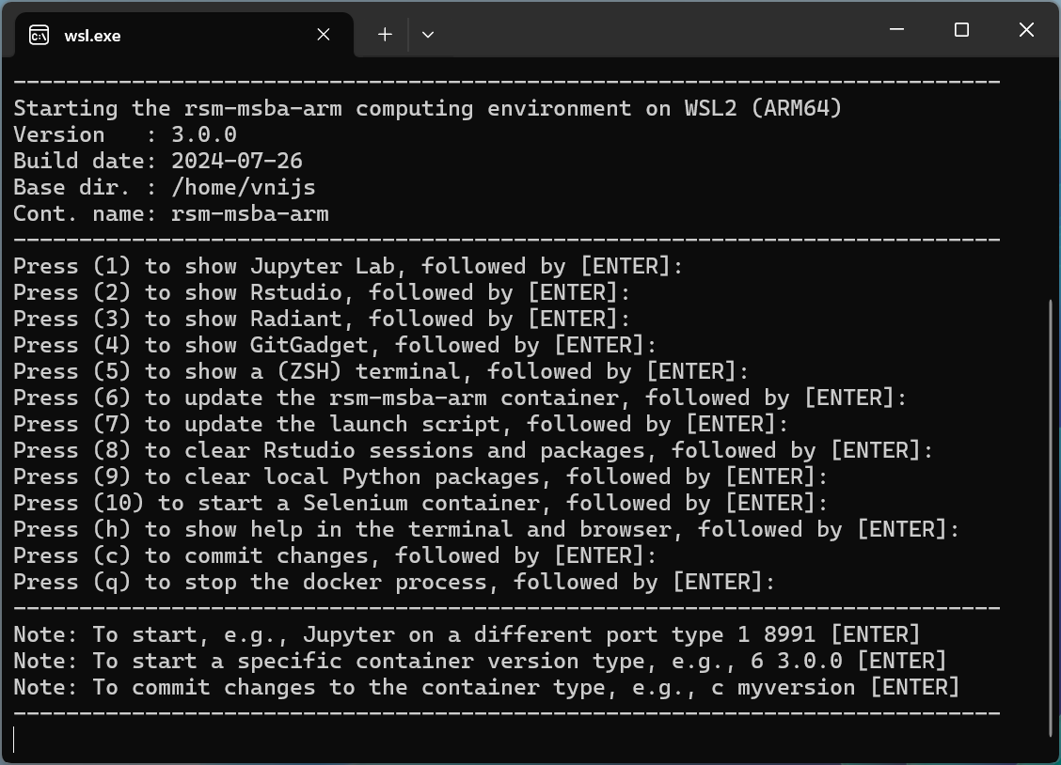
rsm-msba-intel
(Intel)
rsm-msba-intel

