Slide 1
Developing with Sciunit
Raza Ahmad
DePaul University

Slide 2
>> sciunit create my_project >> sciunit exec my_scipt.sh >> sciunit show e1 >> sciunit repeat e1
Behind the Scenes

Slide 3
Sciunit Code
Sciunit interface sciunit2 in python
Program execution and tracing provenance-to-use in C
Deduplication engine vvpkg/sciunit-dedup in C++

Slide 4
Repository Organization https://github.com/radiant-systems-lab/sciunit
Documentation
Environment
Test code
Source code

Slide 5
Documentation
Install instructions
API Docs
Tutorial(s)
Developer Guidelines

Slide 6
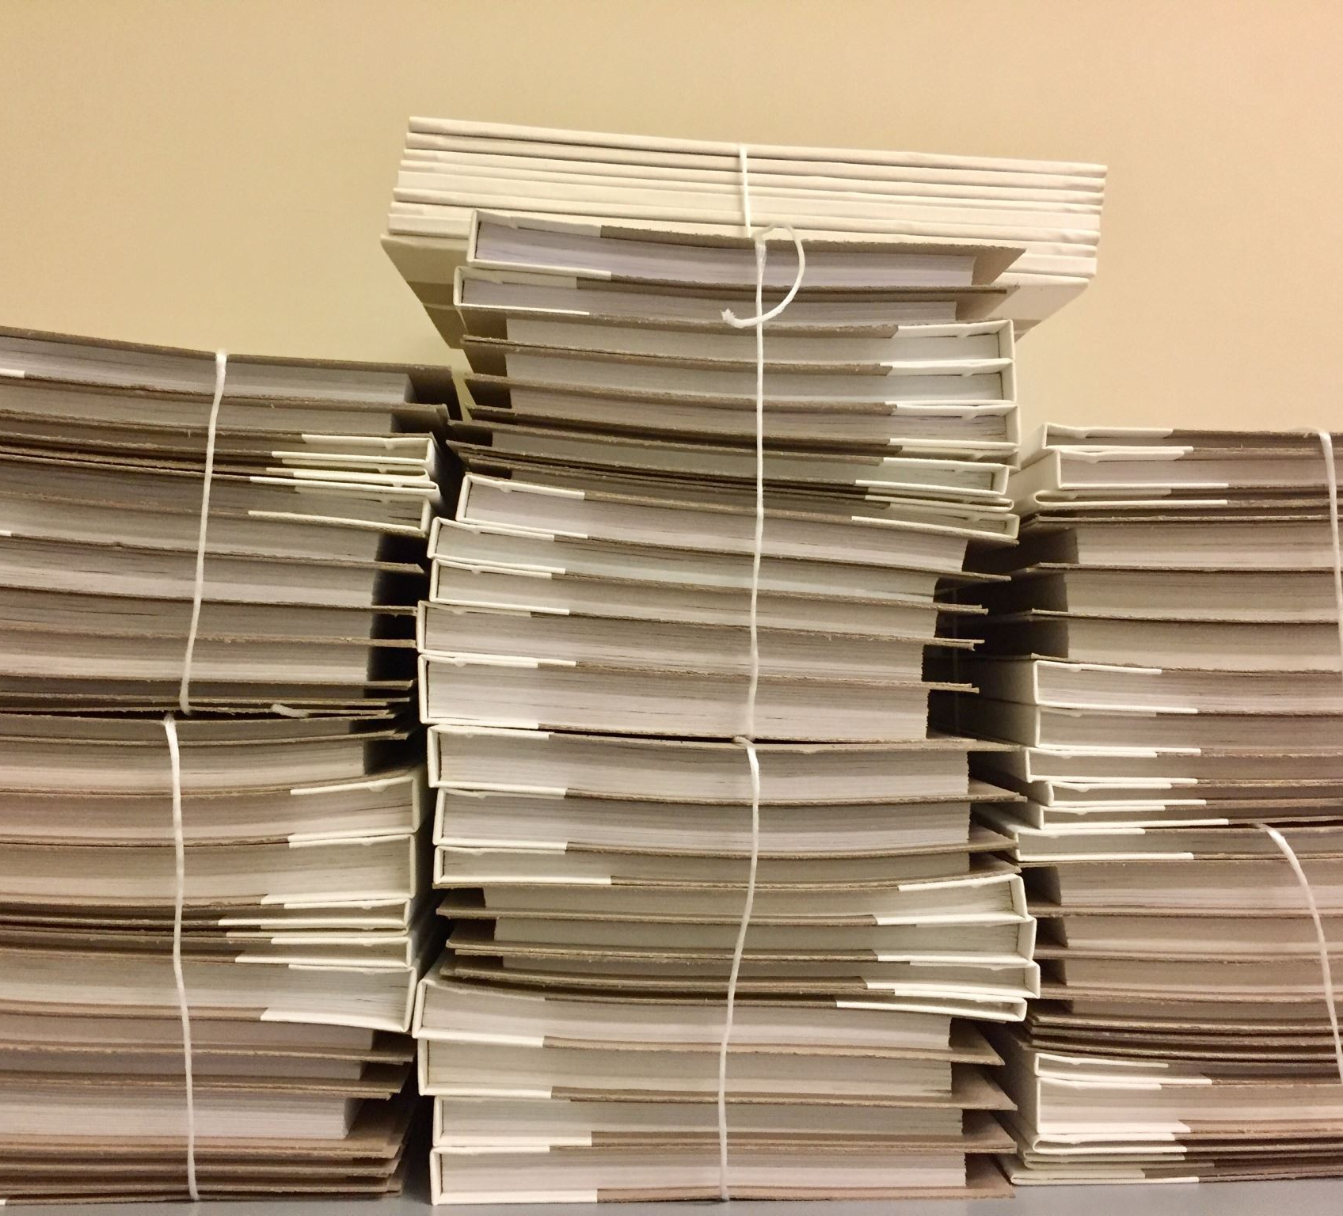
Documentation
Sciunit Wiki https://github.com/radiant-systems-lab/sciunit/wiki
Miscellaneous Files

Slide 7

Environment
Workflows
Requirements
Configurations
Packaging

Slide 8
Test Code
One test file per functionality.
Test all code using unittest, nose and mock.
Tests all branches in the code.
Tox (test automation and management)

Slide 9
Source Code
Infrastructure
Commands

Slide 10
Commands
Currently 13 user commands in sciunit
Create Exec Commit Open Repeat Given List | Show Copy Delete Sort Diff Push

Slide 11
Core Functionality
Storage
Program execution
Execution Management
Interface with user
Utility functions

Slide 12
Best Practices Step-by-Step
Work in an IDE (PyCharm recommended).
Create and make changes in a separate branch. Always!
Write and run test cases for each change.
Arrange code review before merging into master branch.

Slide 13
Best Practices Continued…
Have every change that you make into a separate commit.
Follow commit message convention: <tag>: commit summary
tags: chore, feat, fix, docs, style, refactor, test
Push periodically to GitHub during development.
Push to PyPI after completion of development and testing.

Slide 14
Sciunit Core Functionality
Entry point for sciunit execution is cli.py
All database operations are in records.py. Storage of executions is in sqlite.
Interface with vvpkg/sciunit-dedup is in version_control.py
Programs are executed from cdelog.py and core.py
Details about currently opened Sciunit package is in workspace.py

Slide 15
Questions

