Slide 1
COP290(MINI Business simulator)
CH.Y.N.V. HANUMATH(2022cs11608)
Anand Sasikumar(2022cs11087)

Slide 2
introduction
This is a Business simulator inspired by Monopoly in which we deal with stocks instead of properties.
In This simulator we have multiple stocks present on the board. You can decide which stock to buy strategically so that you can earn maximum profit.
This game can be beneficial for children as they can learn how the stock market works in a simplified manner which can lead to their financial literacy. This can also be a fun game to play among family and friends.

Slide 3
HOW the game works
There is a die in the game which when rolled will determine how many steps you will move forward. Then you might land on a stock. If the stock is not owned by anyone yet then you can choose to buy the stock. Buying the stock has an advantage, Whenever someone else lands on your stock they will have to pay you some amount as a dividend. At the end of the game, the stocks bought by you are sold and you get back the price of the stock.
If you land on a special token like chest, then your fate will depend on your last move that is the number on the dice. This chest can be good for you or may be bad for you.
At the end whoever has the most amount of money wins the game. The game ends when someone has a negative balance or when 250 moves are completed whichever happens first

Slide 4

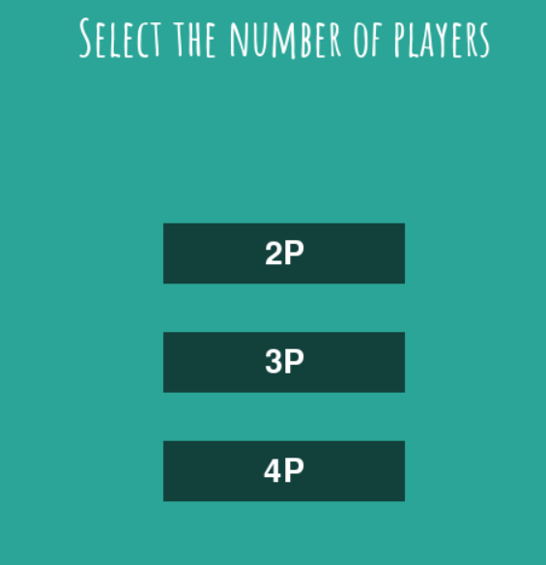
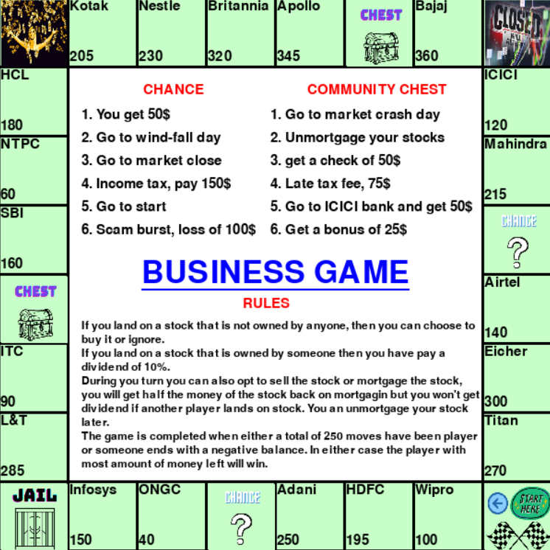
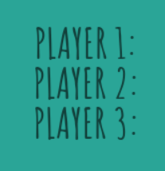
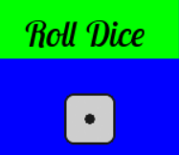
Game UI

Slide 5
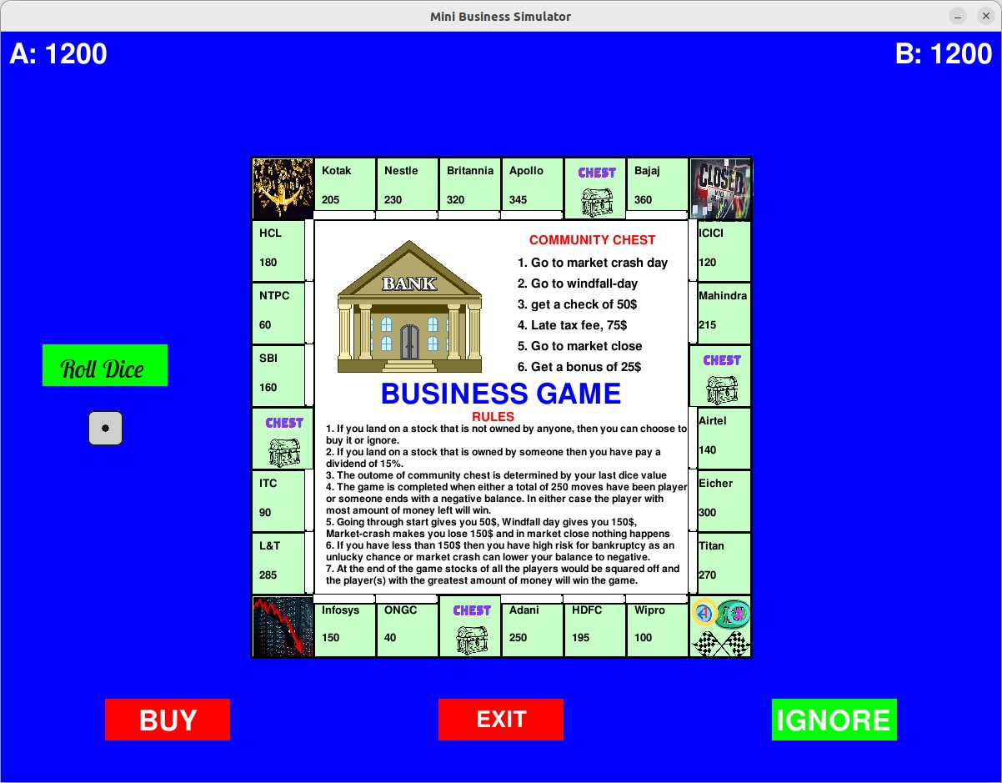
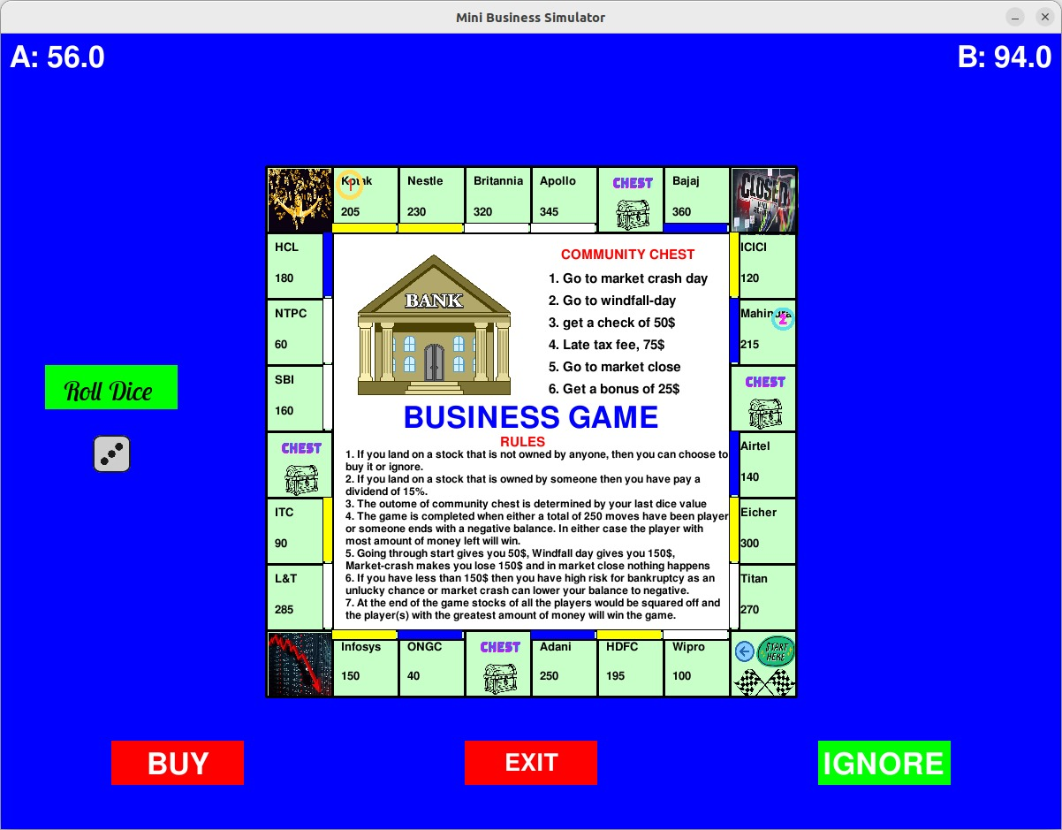

GAMEPLAY

Slide 6
ABOUT ThE game
This game was made using pygame module of python. Some of the sprites for the game were made by us while some of them where taken form the internet.
This is a multiplayer game and allows from 2 to 4 users to play at one time.

Slide 7
Evaluation metrics
Since this game is made for a varying age population so we want this game to be easy to understand with a simplistic user Interface. The rules should be concise but should explain all the mechanisms of the game.
The game should run smoothly without any lags or unexpected behaviors.
The game has a nontrivial evaluation metric in which the final score(amount) is determined by adding the cost of the stocks on top of the remaining amount.

Slide 8
UNIQUE MECHANISMS
Other than the stocks there exists certain special special blocks which you can’t buy or sell but affects how you play the game. These can be:-
Chest – This can give you some random tasks some can be good some can be bad. It all depends on the number on the dicd you rolled.
Windfall day- This gives you lot of money at an instant.
Crash- The market crashes so you incur huge loss.
Close- The market is closed on this day so you can’t do any sort of transaction.
Start-Each time you cross the start you will gain certain amount.

Slide 9
CHALLANGES
The most challenging part was to construct a game that is balanced and can be fun for all ages. The game shouldn’t be too luck dependend, but at the same time should be uncertain.
Implementing some features on the board like buying and selling of stock, declaring ownership of the stock was pretty challenging.
Some features like mortgaging was dropped because of lack of time.

Slide 10
IMPROVEMENTS
The UI can be made more beautiful with some animated elements, the game can have music, etc.
There can be bots in the game so a single person can also enjoy the game.
The game can have an online multiplayer option so that people all around the globe can enjoy the game with strangers. There can also be a leaderboard in place.
There can be more features like mortgaging, trading, variation of stock price with respect to time, taking loan from bank, etc.

Slide 11
CONCLUSION
So this is the implementation of the Business simulator game which can be enjoyed by multiple people at the same time. This game can be used as a strategy game, game to have fun with family and friends or as an educational game.

Slide 12
ThANK YOU

