Slide 1
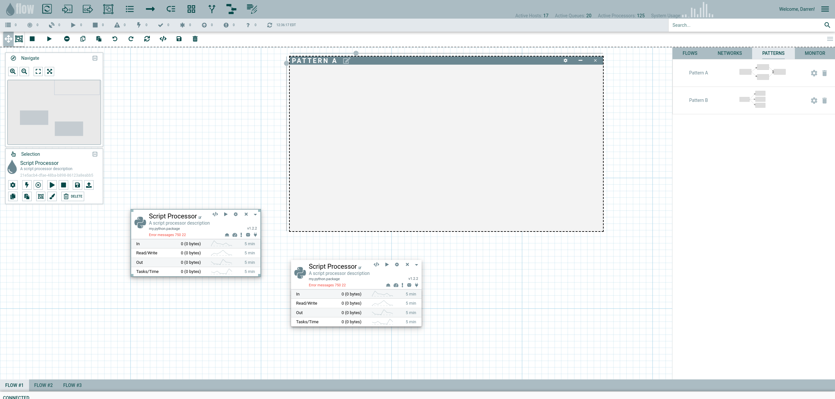
Droppable objects
System status
User
Flow statistics linked to vuex and updated by message listener over socket.io
Search nodes in current flow
Actions on flow
Actions on View
Droppable patterns,
Real-time flow stats/charts,
Network object browser,
Stored flows
Actions on Node
Separate flow tabs
Status bar

