Slide 1
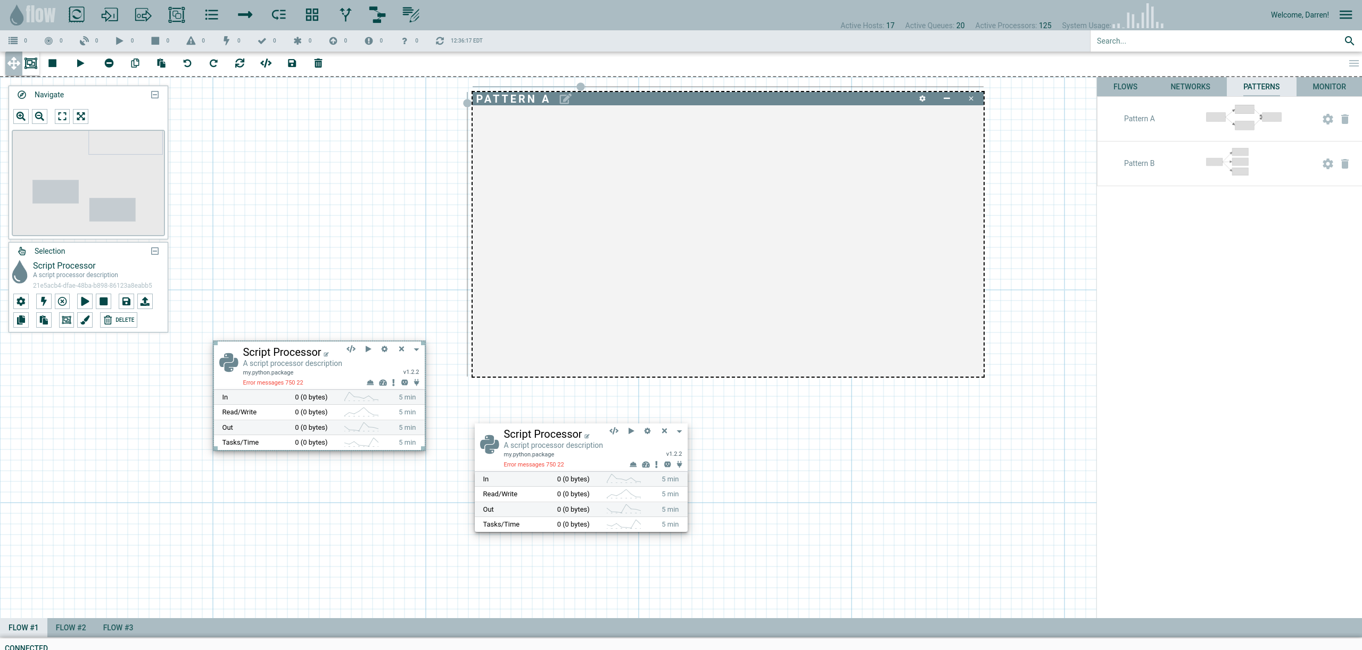
Droppable objects
System status
User
Flow statistics linked to vuex and updated by message listener over socket.io
Search nodes in current flow
Actions on flow
Actions on View
Droppable patterns,
Real-time flow stats/charts,
Network object browser,
Stored flows
Actions on Node
Processors simply “react” to
Changing store state for their uuid
Backend database update
triggers will push to redis for each
object uuid, which will trigger a pub/sub message to get sent and reach the UI
Separate flow tabs
Status bar

