Slide 1
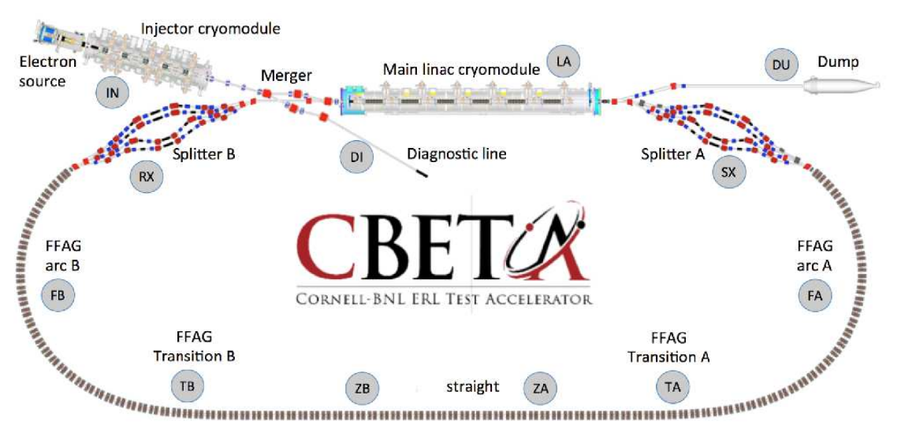
Wednesday’s tutorial
CBETA with field maps
These slides come in complement to the detailed
exercise_1.pdf and exercise_2.pdf.

Slide 2
EXERCISE 1
In this exercise we are interested in computing and plotting, at the four design energies: 42, 78, 114 and 150 MeV,
- the orbits,
- the betatron and dispersion functions,
along the permanent magnet loop.

Slide 3
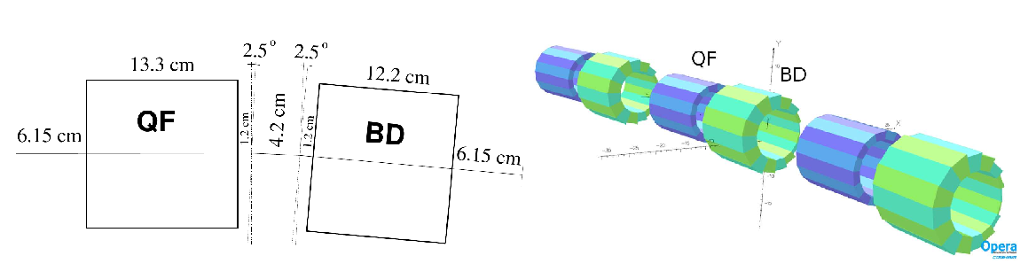
FA and FB arc cell
Exercise 1
This is the cell modeled in zgoubi
- it could use an analytical field model for QF and for BD, for instance ‘MULTIPOL’ since the previous tutorials (PSR, ESRF),
- however today we deal with a simulation based on the use of OPERA field maps, instead, keyword ‘TOSCA’ in zgoubi

Slide 4
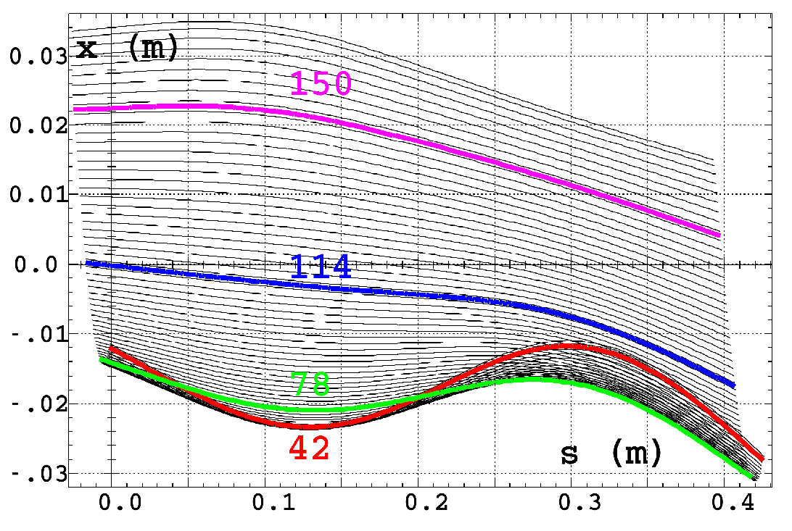
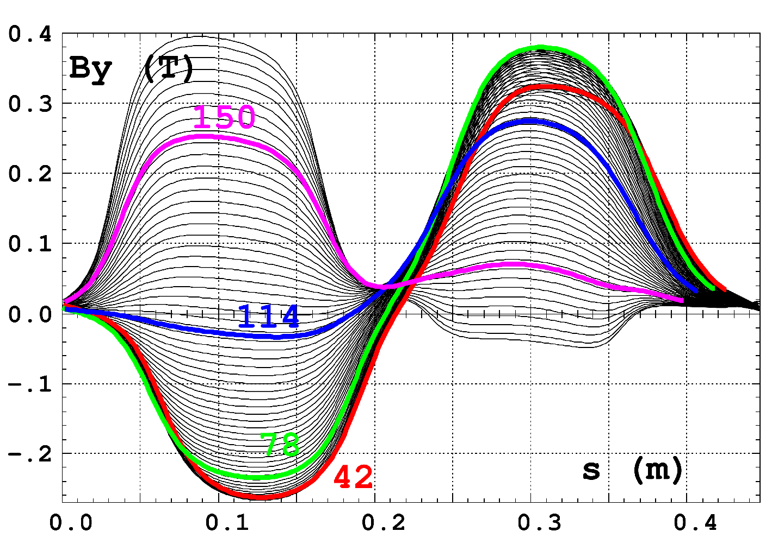
Exercise 1
1/ This is what we want to compute and plot:
periodic orbits and field across an FA cell
The FA (or FB) arc cell sequence,
keywords in blue, field map file name in red
'DRIFT' FA.PIP03\1#1
5.600000000000001
!-----------------------------------------------------------------
'DRIFT'
-33.35 ! = (80cm - 13.3cm)/2
'TOSCA' FA.PIP03\FA.QUA03\1
0 0
-9.76000000E-04 1.00000000E+00 1.00000000E+00 1.00000000E+00
HEADER_8 ZroBXY
801 83 1 15.1 1.
./QF-V6p5_x+-4p1y+-1p3z+-40_stp1mm_integral_2D.table
0 0 0 0
2
.2
2 0.00000000E+00 0.00000000E+00 0.00000000E+00
'DRIFT'
-33.35 ! = (80cm – 13.3cm)/2
!-----------------------------------------------------------------
'DRIFT' FA.PIP03\1#2
1.200000000000000
'CHANGREF' FA.PATCH03\1
ZR -2.49981490
'DRIFT' FA.BLK02\1#1
2.100000000000000
'MARKER' FA.BPM02\1
'DRIFT' FA.BLK02\1#2
2.100000000000000
'CHANGREF' FA.PATCH04\1
ZR -2.49981490
'DRIFT' FA.PIP04\1#1
1.200000000000000
!-----------------------------------------------------------------
'DRIFT'
-33.9 ! = (80cm - 12.2cm)/2
'TOSCA' FA.PIP04\FA.QUA04\1
0 0
-9.76000000E-04 1.00000000E+00 1.00000000E+00 1.00000000E+00
HEADER_8 ZroBXY
801 83 1 15.1 1.0
./BD_v6_x+-4p1_y+-1p3_x+-40_stp1mm_integral_2D.table
0 0 0 0
2
.2
2 0.00000000E+00 -1.90000000E-02 0.00000000E+00
'DRIFT'
-33.9 ! = (80cm – 12.2cm)/2
!-----------------------------------------------------------------
'DRIFT' FA.PIP04\1#2
6.700000000000000

Slide 5
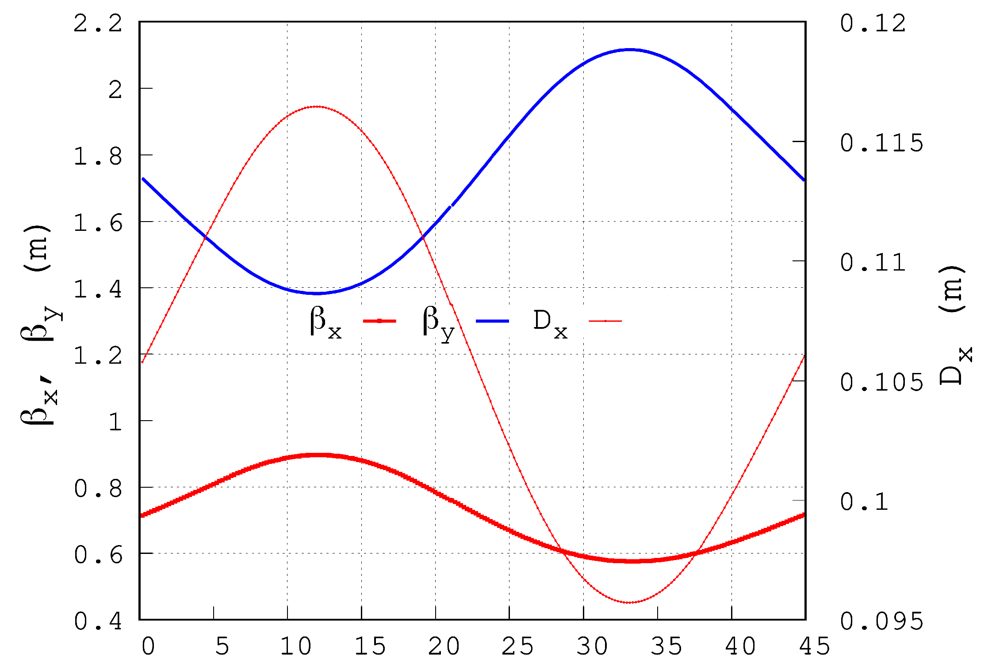
Exercise 1
2/ This is what we want to compute and plot now:
optical functions across an FA cell.
Below is the case of 42 MeV energy:
The FA (or FB) arc cell sequence,
keywords in blue, field map file name in red
'DRIFT' FA.PIP03\1#1
5.600000000000001
!-----------------------------------------------------------------
'DRIFT'
-33.35 ! = (80cm - 13.3cm)/2
'TOSCA' FA.PIP03\FA.QUA03\1
0 0
-9.76000000E-04 1.00000000E+00 1.00000000E+00 1.00000000E+00
HEADER_8 ZroBXY
801 83 1 15.1 1.
./QF-V6p5_x+-4p1y+-1p3z+-40_stp1mm_integral_2D.table
0 0 0 0
2
.2
2 0.00000000E+00 0.00000000E+00 0.00000000E+00
'DRIFT'
-33.35 ! = (80cm – 13.3cm)/2
!-----------------------------------------------------------------
'DRIFT' FA.PIP03\1#2
1.200000000000000
'CHANGREF' FA.PATCH03\1
ZR -2.49981490
'DRIFT' FA.BLK02\1#1
2.100000000000000
'MARKER' FA.BPM02\1
'DRIFT' FA.BLK02\1#2
2.100000000000000
'CHANGREF' FA.PATCH04\1
ZR -2.49981490
'DRIFT' FA.PIP04\1#1
1.200000000000000
!-----------------------------------------------------------------
'DRIFT'
-33.9 ! = (80cm - 12.2cm)/2
'TOSCA' FA.PIP04\FA.QUA04\1
0 0
-9.76000000E-04 1.00000000E+00 1.00000000E+00 1.00000000E+00
HEADER_8 ZroBXY
801 83 1 15.1 1.0
./BD_v6_x+-4p1_y+-1p3_x+-40_stp1mm_integral_2D.table
0 0 0 0
2
.2
2 0.00000000E+00 -1.90000000E-02 0.00000000E+00
'DRIFT'
-33.9 ! = (80cm – 12.2cm)/2
!-----------------------------------------------------------------
'DRIFT' FA.PIP04\1#2
6.7000000000000001#2
6.700000000000000

Slide 6
Exercise 1
3/ - Add the half-BD section
- Add a FIT[2] (vary optical functions at start to get macth at exit)
'FIT2'
8
1 30 0 [-3.,3.] Figure out what these variables
1 31 0 [-200.,200.] and constraints are
1 40 0 9.5
1 41 0 9.5
1 42 0 9.5
1 43 0 9.5
1 46 0 [-1.,1.]
1 47 0 [-1.,1.]
8 1e-10
3 1 2 #End -1.28235115E+00 .2 0 ! These are the orbit values and optical
3 1 3 #End -1.20023364E+02 2. 0 ! functions, at end of periodic FA cell
0 1 1 #End 0.346084 .2 0
0 2 1 #End -2.542387 1. 0
0 3 3 #End 0.322542 .2 0
0 4 3 #End 1.996305 1. 0
0 1 6 #End -0.010223 .01 0
0 2 6 #End 0.076642 .02 0
Followed by the FA cell
'DRIFT' FA.PIP03\1#1
5.600000000000001
!-----------------------------------------------------------------
'DRIFT'
-33.35 ! = (80cm - 13.3cm)/2
'TOSCA' FA.PIP03\FA.QUA03\1
0 0
-9.76000000E-04 1.00000000E+00 1.00000000E+00 1.00000000E+00
HEADER_8 ZroBXY
801 83 1 15.1 1.
./QF-V6p5_x+-4p1y+-1p3z+-40_stp1mm_integral_2D.table
0 0 0 0
2
.2
2 0.00000000E+00 0.00000000E+00 0.00000000E+00
'DRIFT'
-33.35 ! = (80cm – 13.3cm)/2
!-----------------------------------------------------------------
'DRIFT' FA.PIP03\1#2
1.200000000000000
'CHANGREF' FA.PATCH03\1
ZR -2.49981490
'DRIFT' FA.BLK02\1#1
2.100000000000000
'MARKER' FA.BPM02\1
'DRIFT' FA.BLK02\1#2
2.100000000000000
'CHANGREF' FA.PATCH04\1
ZR -2.49981490
'DRIFT' FA.PIP04\1#1
1.200000000000000
!-----------------------------------------------------------------
'DRIFT'
-33.9 ! = (80cm - 12.2cm)/2
'TOSCA' FA.PIP04\FA.QUA04\1
0 0
-9.76000000E-04 1.00000000E+00 1.00000000E+00 1.00000000E+00
HEADER_8 ZroBXY
801 83 1 15.1 1.0
./BD_v6_x+-4p1_y+-1p3_x+-40_stp1mm_integral_2D.table
0 0 0 0
2
.2
2 0.00000000E+00 -1.90000000E-02 0.00000000E+00
'DRIFT'
-33.9 ! = (80cm – 12.2cm)/2
!-----------------------------------------------------------------
'DRIFT' FA.PIP04\1#2
6.700000000000000
'MARKER' FA.MAR.BEG\1
'DRIFT' FA.PIP00A\1#1
1.200000000000000
'DRIFT'
-36.95 ! = (80cm - 6.1cm)/2 (50cm is field map extent)
'TOSCA' FA.PIP00A\FA.QUA00\1
0 0
-9.76000000E-04 1.00000000E+00 1.00000000E+00 1.00000000E+00
HEADER_8 ZroBXY
801 83 1 15.1 1.
./BDH-v6_x+-4p1_y+-1p3_z+-40_stp0p1_integral_2D.table
0 0 0 0
2
.2
2 0.00000000E+00 -1.90000000E-02 0.00000000E+00
'DRIFT'
-36.95 ! = (80cm - 6.1cm)/2 (50cm is field map extent)
'DRIFT' FA.PIP00A\1#2
1.200000000000000
'CHANGREF' FA.PATCH00\1
ZR -1.08747390
'DRIFT' FA.PIP00B\1
3.3000000

Slide 7
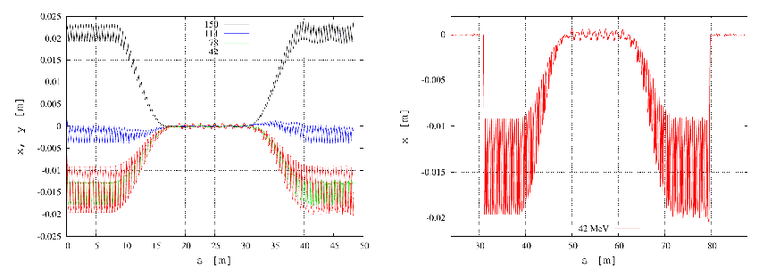
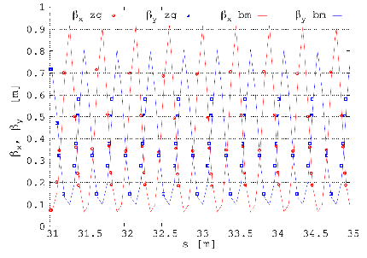
Exercise 1
4/ This is what we want to check, eventually: orbits and optical functions along the complete permanent magnet return loop
42 MeV
150 MeV
orbits
42 MeV
Optical functions
42 MeV
First meters of FA arc

