Slide 1
First Results of the Simulation of the
Nonlinear Magnets Ramping
D. Bruhwiler, Yu. Eidelman, C. Hall, A. Romanov
July 29, 2019

Slide 2
Sources:
synergia2 (Fermilab);
rssynergia (RadiaSoft);
turn_end_action_lattice_edit.py (script of C. Hall)
Script: variabledNLsimulations_v3.py
Repository:
GitHub/radiasoft/rsnibo/experimental/eidelyur
rsnibo means RadiaSoft Nonlinear Integrable Beam Optics

Slide 3
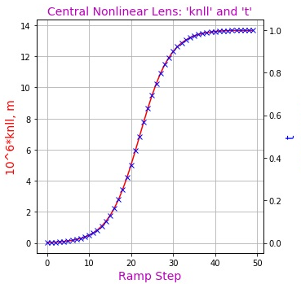
Goal: Change the strengths of nonlinear lenses (t- or equivalent
knll-parameter) in the process of beam circulating in the
IOTA ring (by the steps after definite number of the turns)
One of three possible methods for changing a parameter in time
(“smooth sign-function”):

Slide 4
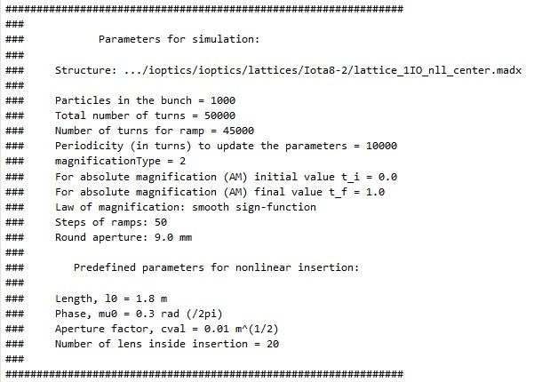
Initial Parameters:

Slide 5
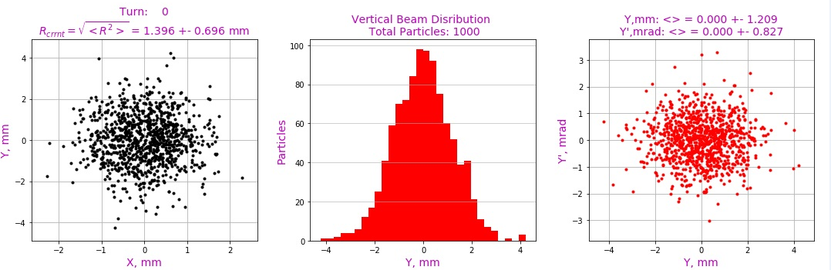
Initial Distributions (didn’t match with lattice):

Slide 6
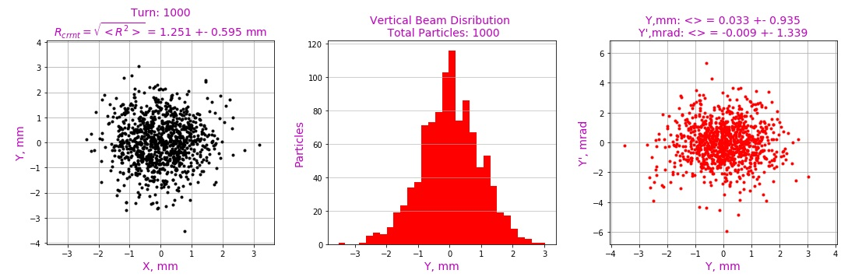
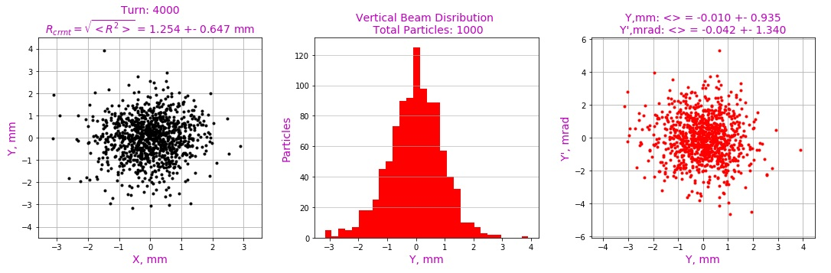

Slide 7
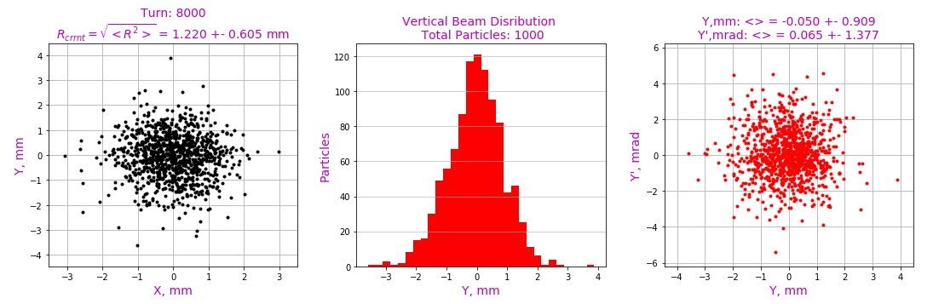
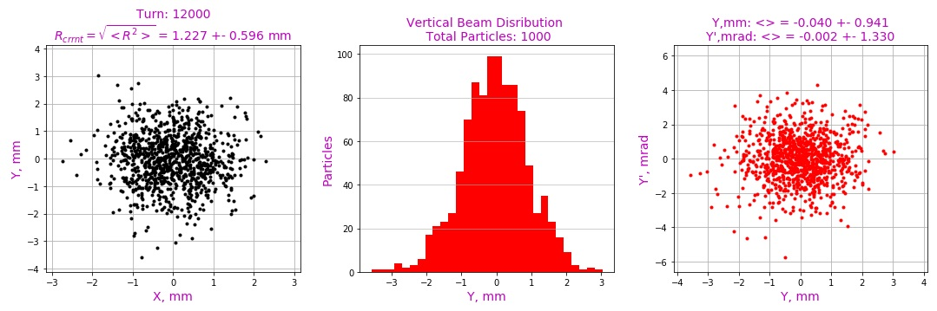

Slide 8
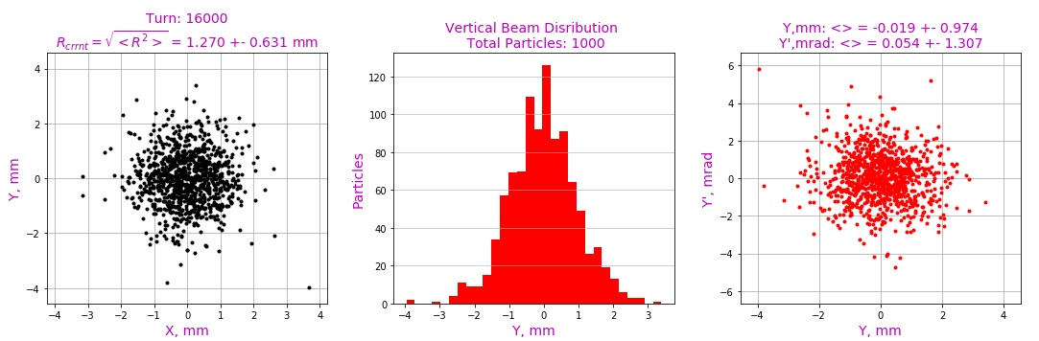
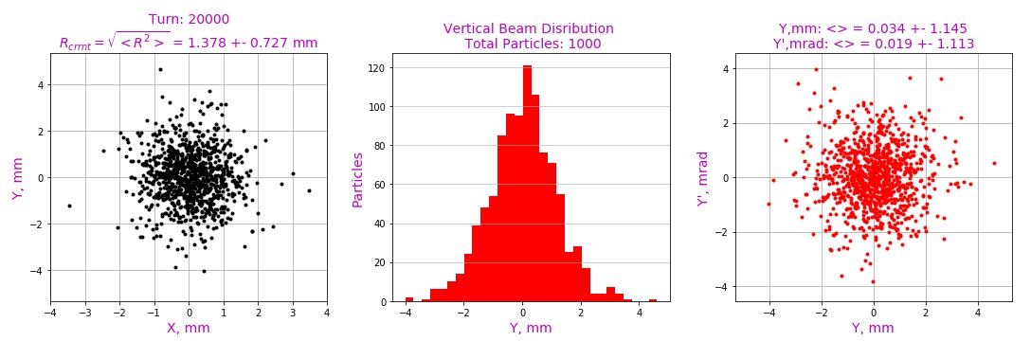

Slide 9
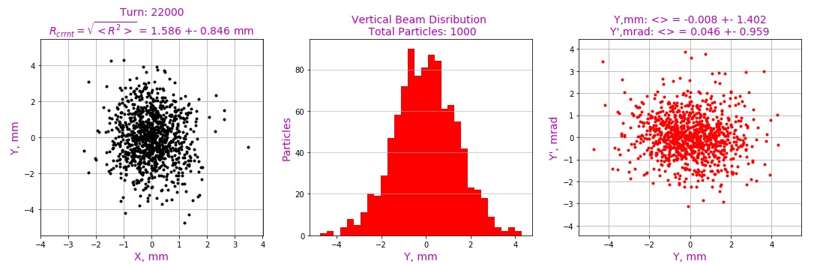
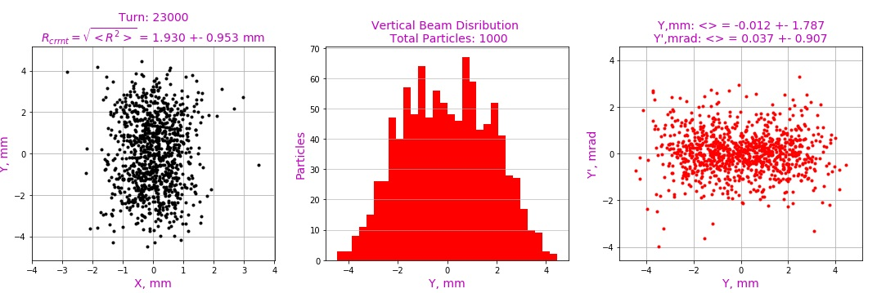

Slide 10
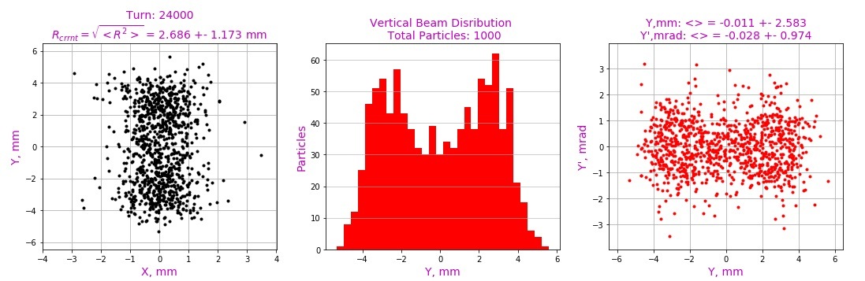
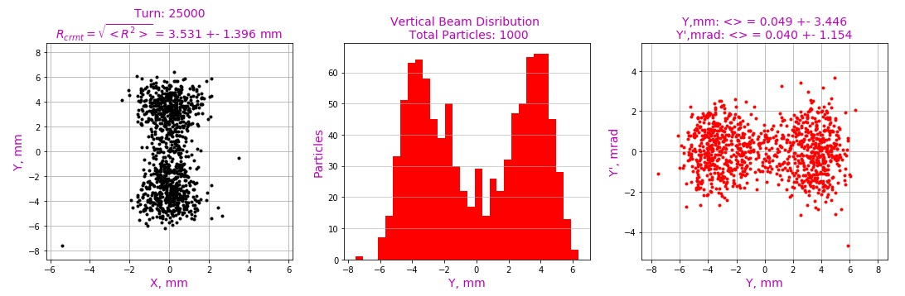

Slide 11
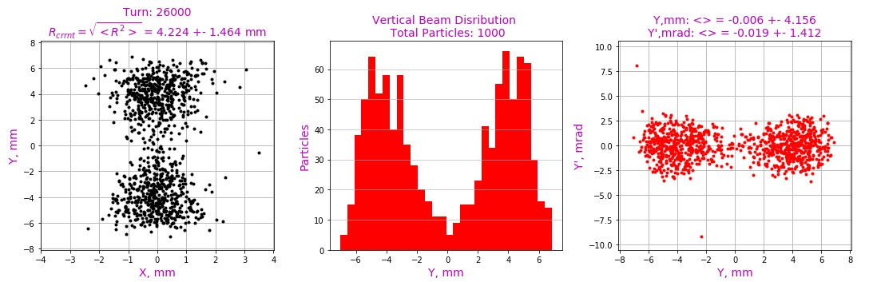
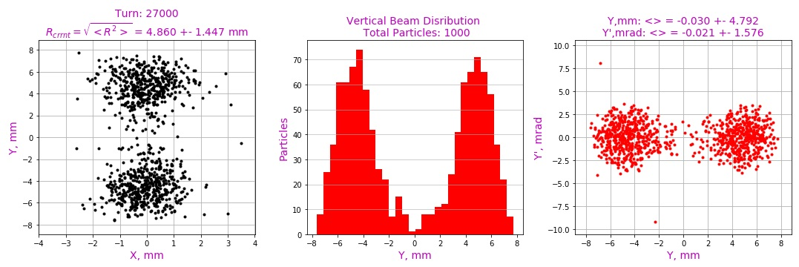

Slide 12
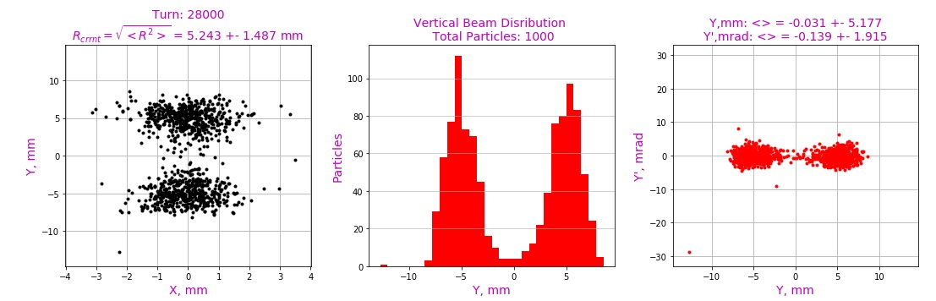
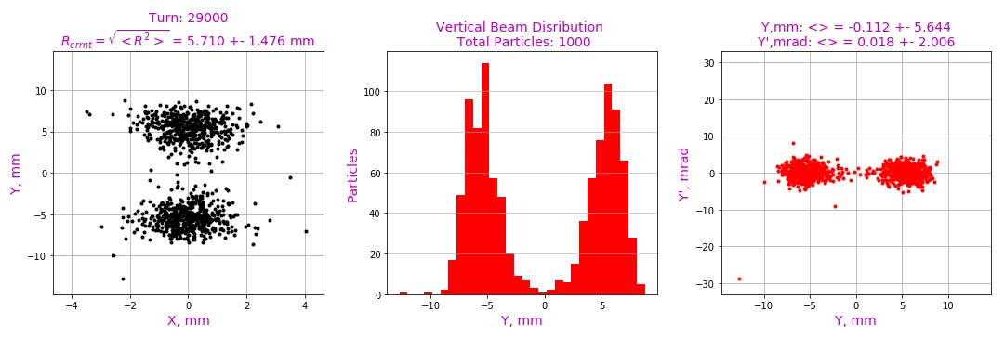

Slide 13
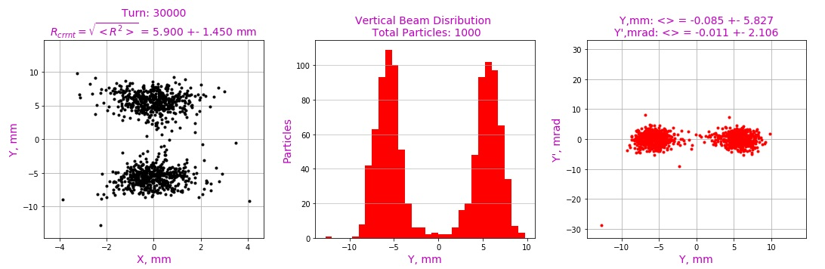
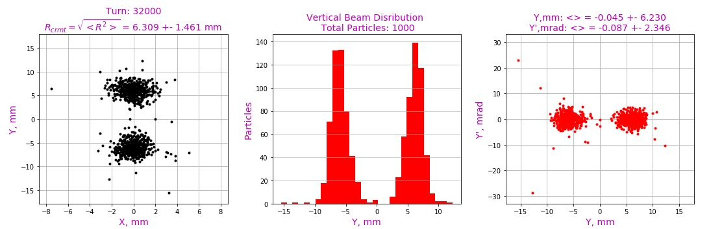

Slide 14
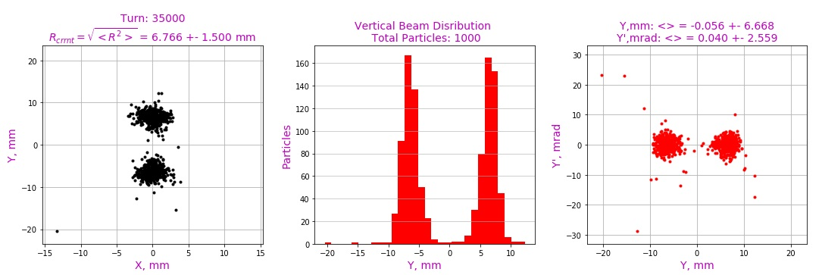
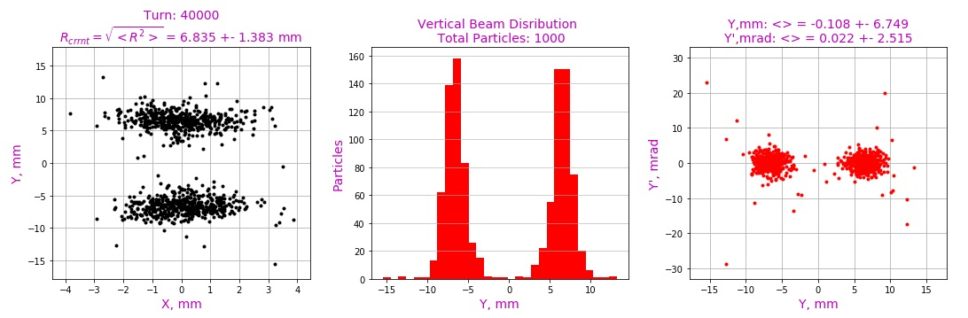

Slide 15
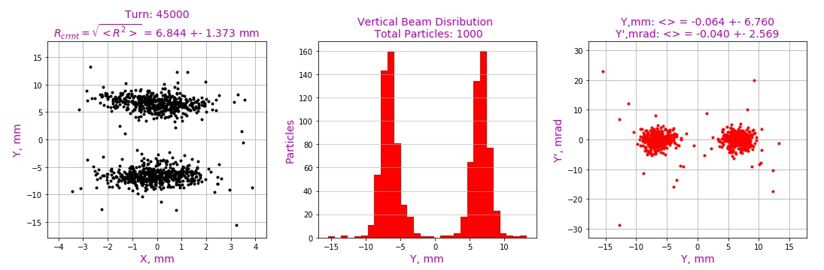
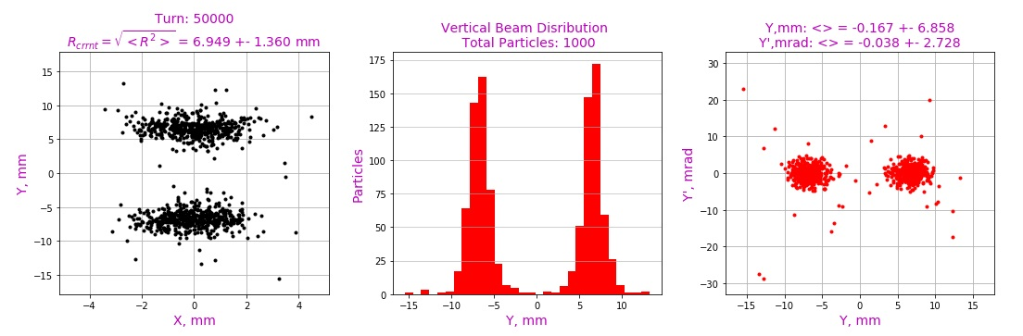
~13 mm

Slide 16
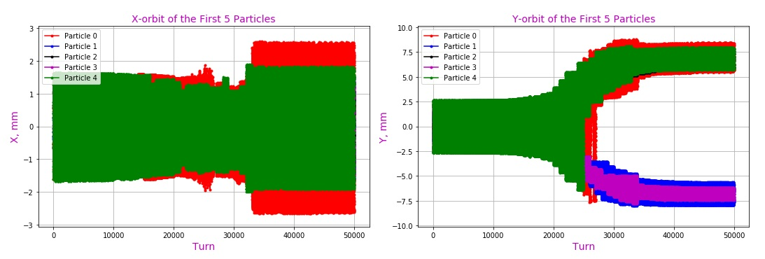
Orbits of First Particles
~13 mm

Slide 17
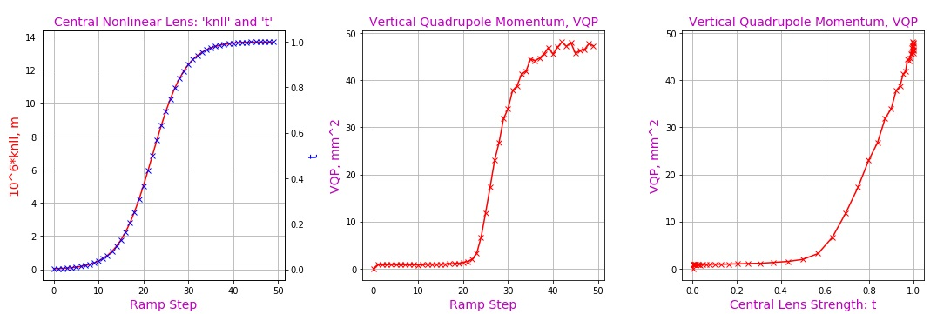
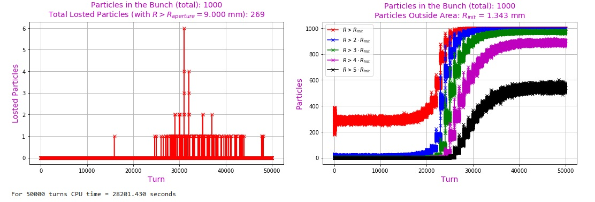
Some
Results
Losses: ~25%

Slide 18
Next desired steps:
Eliminate lost particles after they appear (a decrease in running time and a more accurate calculation of the vertical second moment of the beam);
Use modern lattice of the ring (8-4 model?);
Selection of a correct step size for the propagator (must be less than beta-function in the element);
Overall reduction in running time (a possibility to simulate millions of turns);
???
Thanks for Attention

