Slide 1
CYCLOTRONS
- A BRIEF HISTORY
- BASIC PRINCIPLES
- CYCLOTRONS NOWADAYS

Slide 2
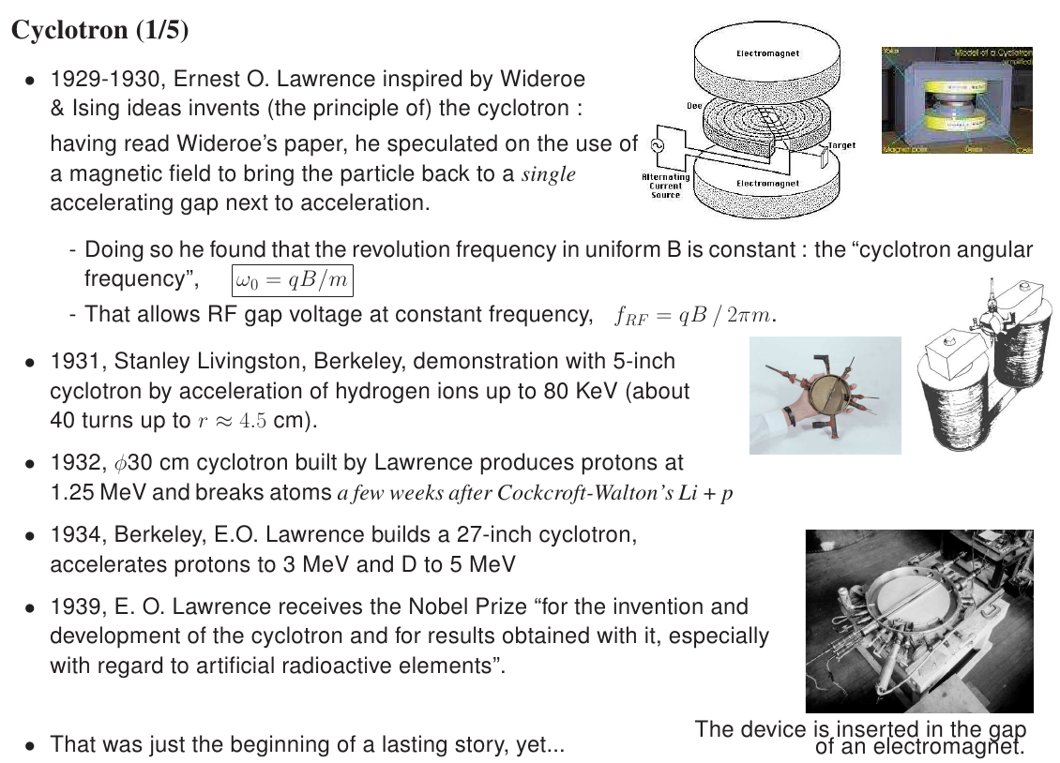

Slide 3
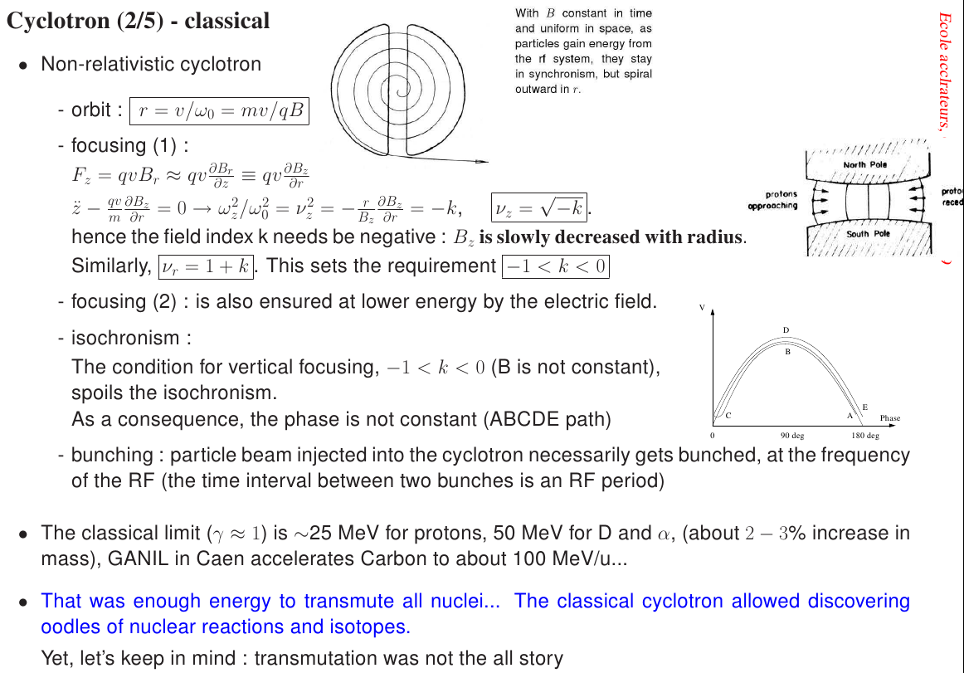

Slide 4
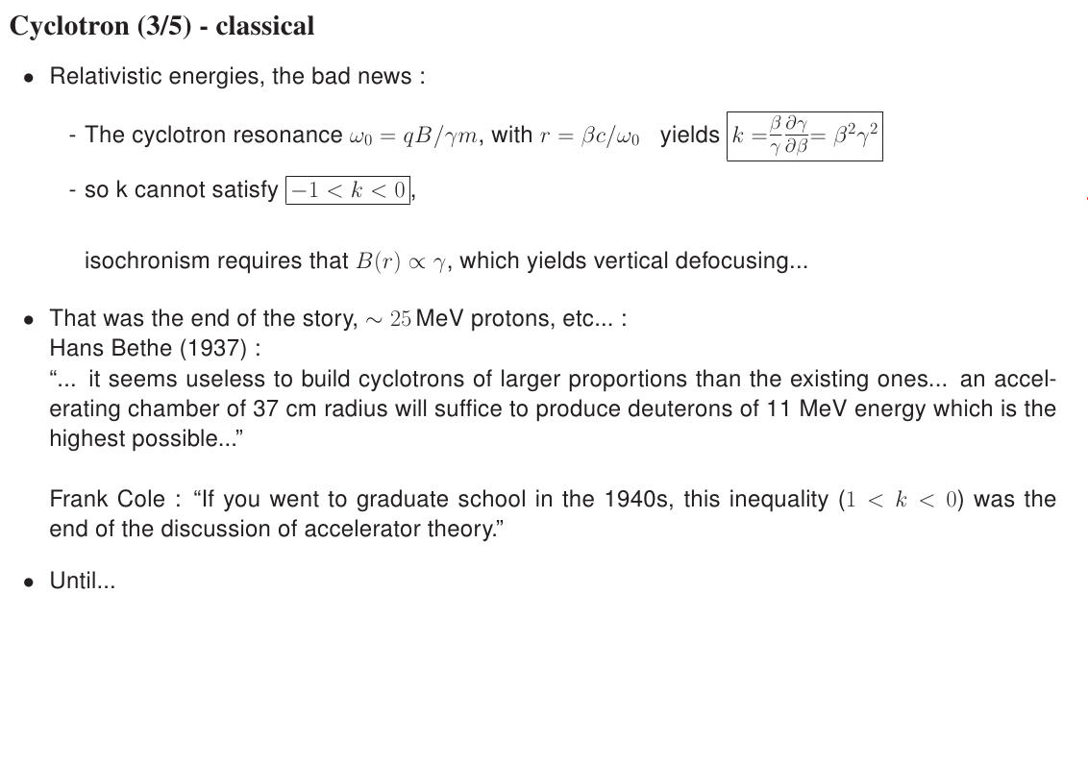

Slide 5
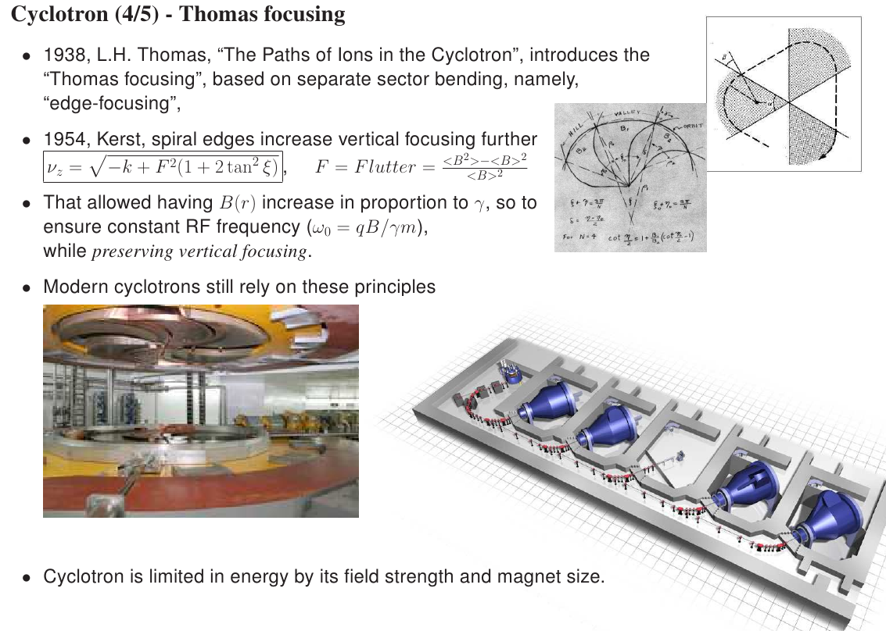
8.13

Slide 6
Some famous cyclotrons.
Popular applications.
PSI highest power, ~SNS linac
TRIUMF
Proton-therapy
Radio-isotope production
Education

