Slide 1
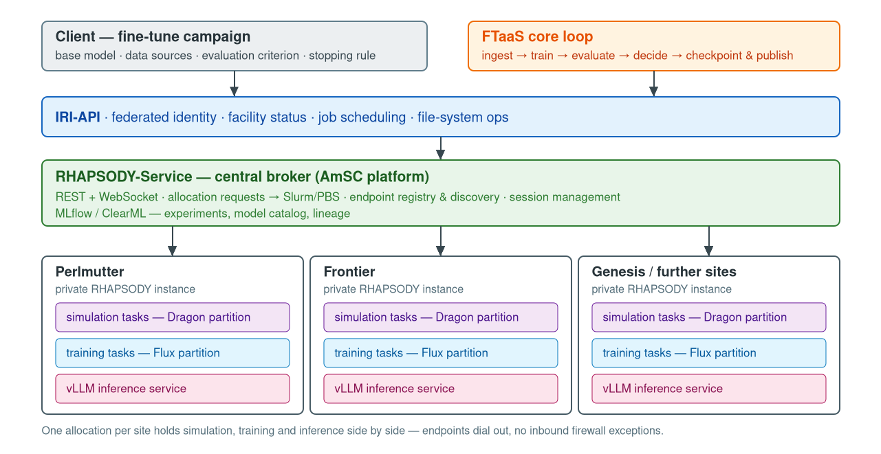
Fine-Tuning as a Service on the AmSC — Design
Notes:
Genesis has produced 12+ scientific foundation models, and every downstream fusion task needs its own fine-tune. Fine-tuning is not a training job: it needs simulation, training and inference running concurrently, steered while it runs, with a workload shape that is not known at submission time.
FTaaS is that campaign submitted as a request. The client names a base model, data sources, an evaluation criterion and a stopping rule. IRI carries identity, facility status and scheduling. RHAPSODY-Service brokers the request out to a private RHAPSODY instance per site, where one allocation holds simulation, training and inference side by side. MLflow / ClearML carry experiments and the model catalog.
Same substrate as ROSE-aaS in Aymen’s slides, and as DTaaS — one platform, three science services.

Slide 2
FTaaS — Current Status
AmSC Demo Runs on Perlmutter
Fine-tuning campaign (MATEY) driven through the IRI / SFAPI path.
Simulation and training side by side in one allocation — concurrent Dragon and Flux partitions, validated against Flux 0.79.
Multiple inference services per allocation, explicit node placement, typed model / hardware / batching configuration.
RHAPSODY at scale (arXiv 2512.20795)
~11k tasks/s sustained peak, near-linear weak scaling, a distinct task on every node.
~50,000 active agents: sustained overlap of AI decision rate and HPC task realization.
100–300 µs per-task overhead, 90–95% GPU utilization; Frontier, Perlmutter, Anvil.
Next Steps:
Evolve demo recipe into a service
Concurrent fine-tunes sharing one allocation
Model catalog, provenance, deployment
Notes:
Honest split: the runtime numbers are measured and published; the Perlmutter path is a working recipe driven by a script. What is missing is the submission surface — a user asking the platform for a fine-tune rather than driving one. Transport, placement and MLOps integration are already deployed across OLCF, ALCF and NERSC.

