Slide 1
DT-as-a-Service on the RADICAL stack
What DT-as-a-Service means for NSTX-U · scoping the first use case · August 2026
RADICAL, Rutgers University
Digital twins as long-running services on DOE HPC. v1 is implemented and measured.

Slide 2
What is a digital twin (here)
A digital twin is a computational counterpart of a physical system: its models keep learning against reality while serving inference.
The DT is a graph of capabilities: typed input → output contracts (e.g. diagnostics → heat flux), each realized by one or more learned models.
Two concurrent loops: learning runs until its objective is met and restarts on new data; inference runs indefinitely and hot-swaps models as they improve.
Event sources drive the DT: sensors, shot data, simulation output, users, timers.
DT-as-a-Service · AmSC · 2026-08-17
2 / 15

Slide 3
What “as a service” adds
The DT control plane runs as a plugin on a persistent ORBIT broker; the DT runs for months, independent of any login session.
Scientists attach from a laptop, steer, and detach; the DT keeps running. Reattach later, from anywhere.
One broker hosts multiple sessions (name spaces); each session holds multiple DTs.
Compute is acquired on demand: inference and training tasks run in HPC allocations through the AmSC/RADICAL stack.
Instrument streams feed the DT continuously; all connections are outbound, the facility opens no inbound ports.
L5 DT framework → L4 ROSE → L3 AsyncFlow → L2.5 ORBIT → L2 Rhapsody → L1 resources
DT-as-a-Service · AmSC · 2026-08-17
3 / 15

Slide 4
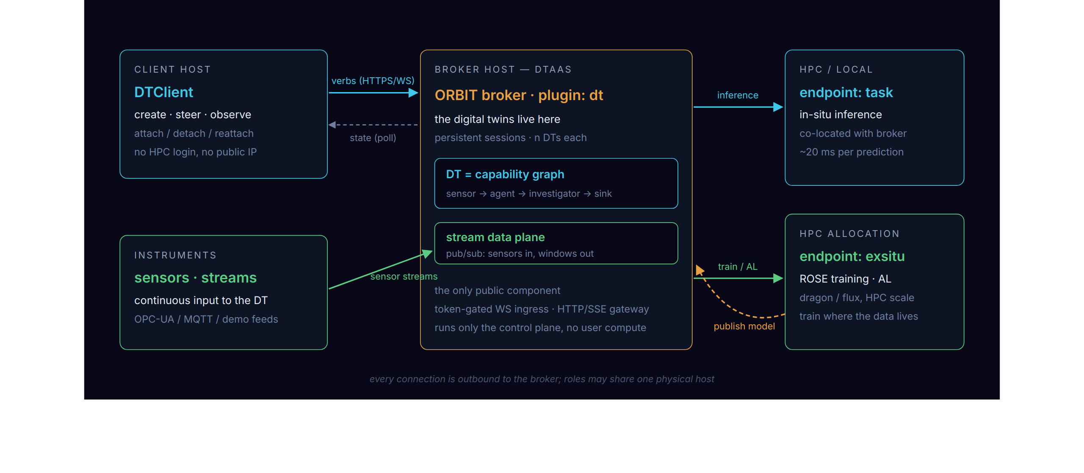
Architecture — roles
Four roles: the client steers, instruments feed, the broker hosts the digital twins, endpoints compute. The broker is the only publicly reachable component.
DT-as-a-Service · AmSC · 2026-08-17
4 / 15

Slide 5
Status
DTaaS v1 is implemented on the RADICAL stack and under review: the ORBIT dt plugin, a streaming learner, and two stream backends.
126 tests, including live-broker integration; demos run end to end and calibration converges.
Latencies are measured: ~20 ms per served prediction, 1–2 ms per stream hop.
A live viz dashboard shows convergence and activity, with live and replay modes.
Architecture, lifecycle, benchmarks, and the requirements map are in the backup slides.
DT-as-a-Service · AmSC · 2026-08-17
5 / 15

Slide 6
What this offers NSTX-U
A surrogate on NSTX-U geometry has been demonstrated on this stack: the heat recipe learns the Eich optical heat flux with active learning on Perlmutter.
No standing service is required: the compute side is spawned on demand into a normal allocation and torn down after the run.
Diagnostics become event sources: any stream feeds the DT, live or from shot archives.
Models learn between shots and serve between and during shots; they improve continuously as data arrives.
Compute runs on DOE HPC; PPPL deploys no services and opens no inbound ports.
Every run is tracked (MLflow); results and models stay inspectable.
DT-as-a-Service · AmSC · 2026-08-17
6 / 15

Slide 7
First use case — a World Model for the NSTX-U DT
Proposal: scope this together, starting from five questions.
Meaning: is the world model one learned model of the machine state which serves many capabilities, or a graph of per-capability surrogates around a shared state estimate?
Signals: which diagnostics come first, and at what rate?
Data: shot archives, live shots, simulation (XGC, M3DC1), or a mix?
Placement and latency: where does learning run; must serving keep up between shots or within a shot?
Success: what does a first demo have to show?
The framework is use-case independent; these choices configure it and do not change it.
DT-as-a-Service · AmSC · 2026-08-17
7 / 15

Slide 8
Discussion · next steps
Agree on the world-model scope and the first capability.
Identify data access: which archives and streams, and who provides them.
Pick a first demo target and date; the service stack is ready to host it.
References: dtaas-v1-plan.md (implementation) · amsc/architecture/dt-framework.md (architecture) · use-cases/heat (NSTX-U heat-flux recipe)
DT-as-a-Service · AmSC · 2026-08-17
8 / 15

Slide 9
Backup
Architecture detail · lifecycle · data plane · implementation · benchmarks · requirements

Slide 10
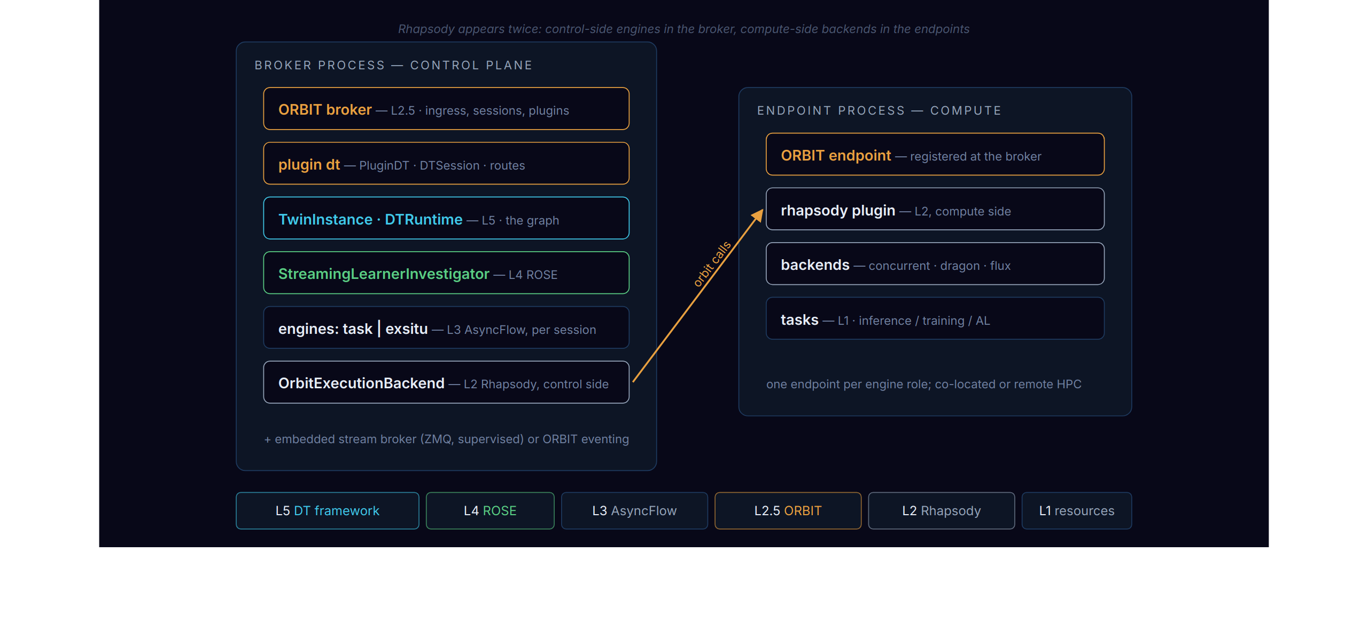
Architecture — software
New v1 code is the dt plugin and the hardened L5 runtime; the layers below are reused unchanged.
DT-as-a-Service · AmSC · 2026-08-17
10 / 15

Slide 11
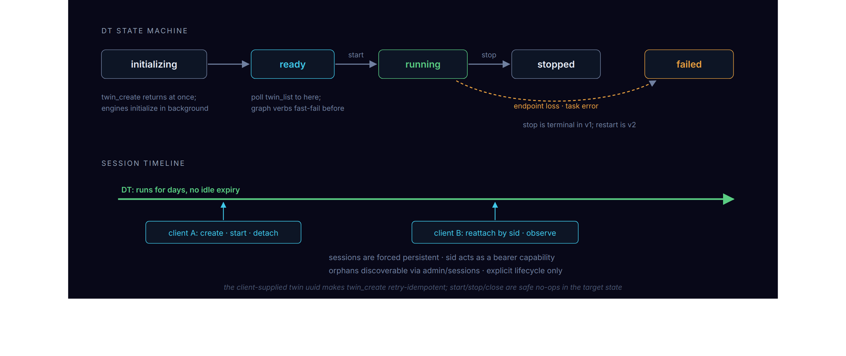
Lifecycle — DT states and sessions
twin_create is the only asynchronous verb; all other verbs are short and synchronous. Clients attach and detach; the digital twin continues to run.
DT-as-a-Service · AmSC · 2026-08-17
11 / 15

Slide 12
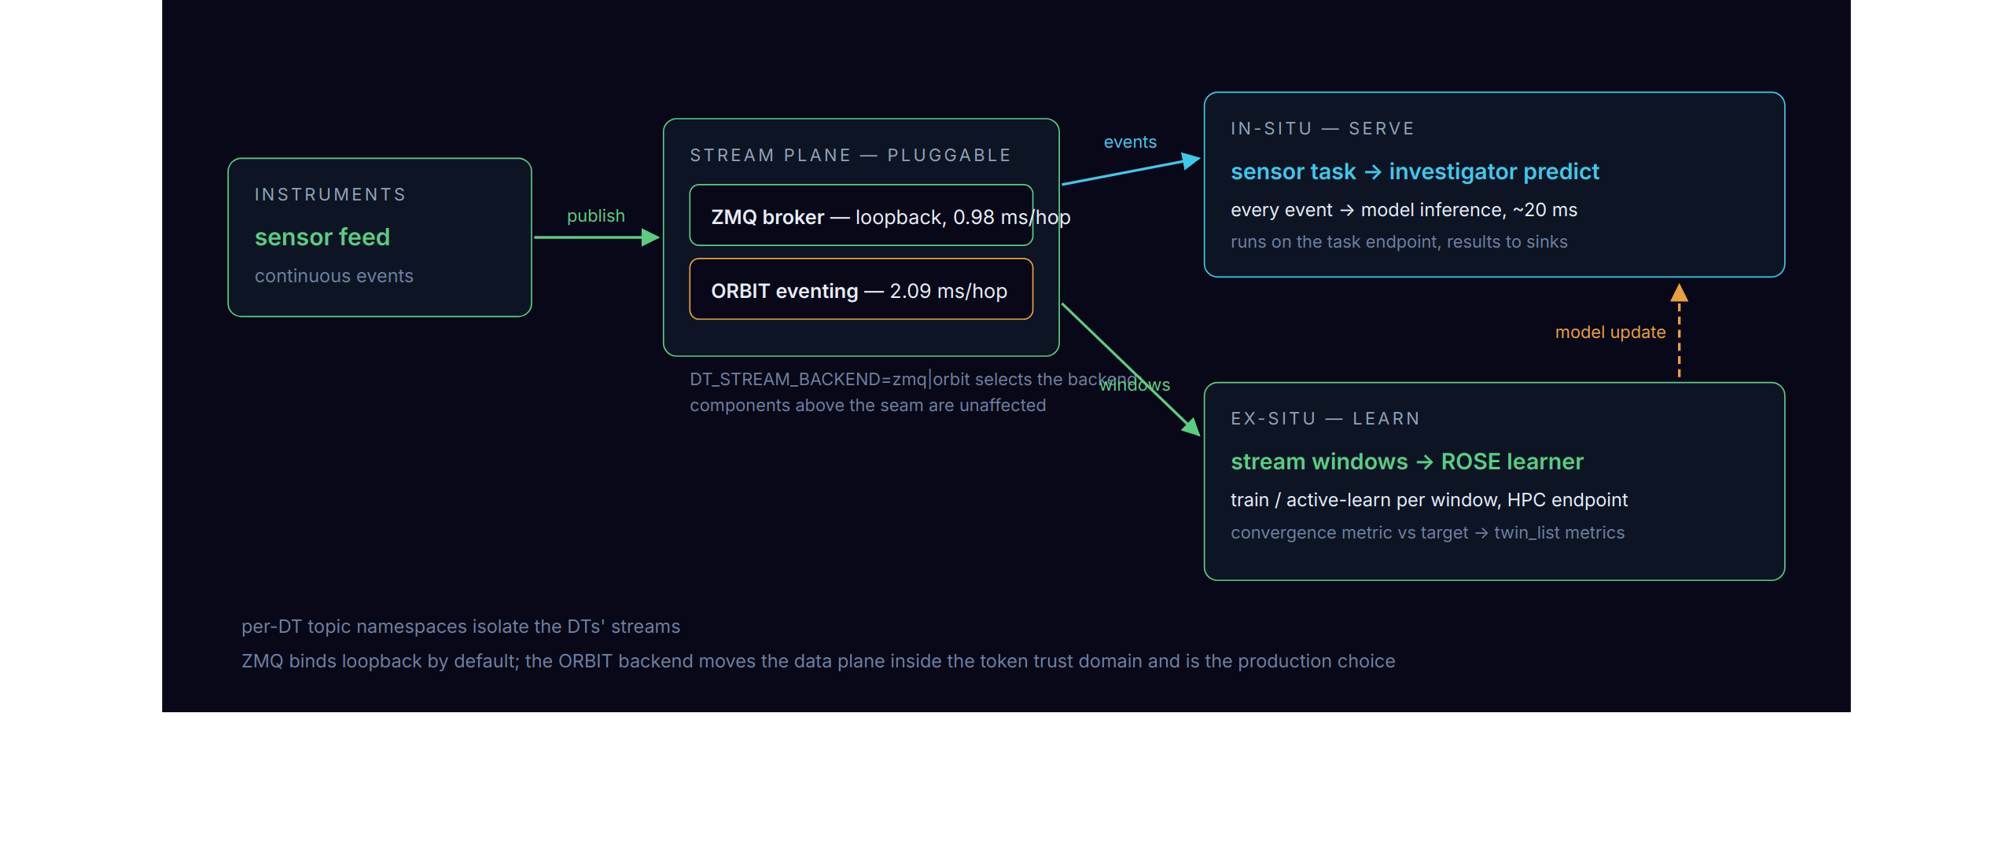
Data plane — streams and learning
One stream feeds two loops: serving runs on every event, learning on every window; the model update closes the learning cycle.
DT-as-a-Service · AmSC · 2026-08-17
12 / 15

Slide 13
Implementation status
MILESTONE | DELIVERS | STATE
M0 hardening | stop/teardown, per-DT topic namespaces, embeddable stream broker, packaging, pytest/tox | PR ready
M1 ORBIT plugin | dt plugin: persistent sessions, sid reattach, async twin_create + short sync verbs, admin listing | PR ready
M2 ROSE ex-situ | StreamingLearnerInvestigator, dual-engine DTs (task | exsitu), endpoint-loss visibility | PR ready
M3 data plane | ORBIT-pubsub backend: stream traffic inside the token domain | PR ready
126 tests, including live-broker integration. Demos verified with both stream backends: service DT and streaming learner; calibration converges.
Upstream: two ORBIT PRs merged; one AsyncFlow fix + one ROSE dependency in review.
Live viz dashboard: convergence bars and activity lanes, in the ORBIT Explorer and standalone, with live and replay modes.
DT-as-a-Service · AmSC · 2026-08-17
13 / 15

Slide 14
Measured performance
MEASUREMENT | RESULT | DECISION IT SETTLED
in-situ prediction | ~20 ms p50 via endpoint vs ~11 ms in-process; endpoint wins under concurrency | all compute goes through Rhapsody, without an in-process pool; a co-located endpoint is the "local" deployment
stream hop | 0.98 ms ZMQ · 2.09 ms ORBIT | the secure ORBIT data plane costs ~1 ms per hop and becomes the production default
sequential latency | 261 ms → 20 ms after fixing the rhapsody notify batcher | fixed upstream as an endpoint configuration knob
Benchmarks live in the repo (perf/) and rerun against the demos.
DT-as-a-Service · AmSC · 2026-08-17
14 / 15

Slide 15
Map to use-case requirements
REQUIREMENT (AMSC · XGFABRIC) | DTAAS V1 ANSWER
DT outlives any login session | persistent sessions; DTs survive clients, reattach by sid
drive from a laptop | outbound-only ORBIT connectivity; no HPC login, no public IP
train where the data lives | exsitu engine → Rhapsody endpoint in the HPC allocation (dragon / flux)
continuous sensor streams | stream plane with per-DT namespaces; ZMQ or ORBIT backend
serve inference continuously | in-situ loop on the task endpoint, ~20 ms per prediction
DOE-site security posture | token-gated ingress; M3 puts stream traffic in the same trust domain
many DTs, many users | n DTs per session, admin listing; per-tenant auth is v2
model selection · capability graphs · recovery | v2: cross-model selector, declarative graph spec, restart across broker loss
DT-as-a-Service · AmSC · 2026-08-17
15 / 15

