Slide 1
Spatially-Adaptive Multi-Scale Optimization for Local Parameter Estimation: Application in Cardiac Electrophysiological Models
Jwala Dhamala
Rochester Institute of Technology
5/27/2016

Slide 2
Overview
Coarse to Fine Hierarchy
Iterative Procedure
Optimization
Coarse to Fine
Adaptive Decision Making
Initialization

Slide 3
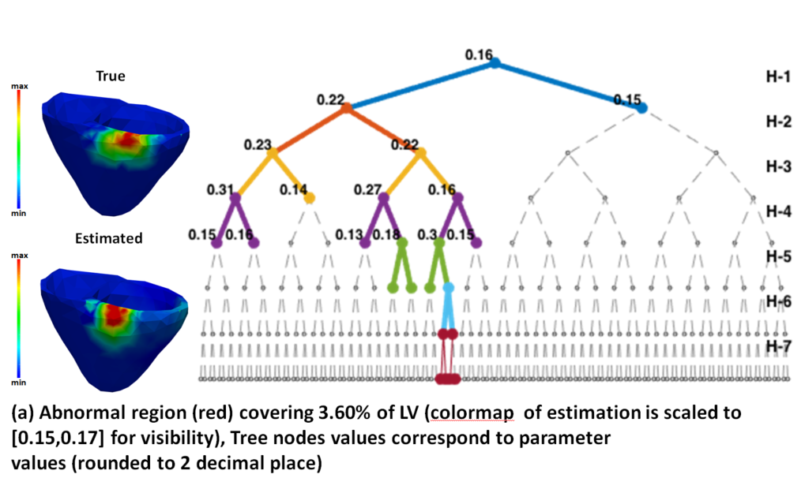
Overview
Coarse to Fine Hierarchy
Iterative Procedure
Optimization
Coarse to Fine
Adaptive Decision Making
Initialization
Red Means Computationally Expensive

Slide 4
Overview
Coarse to Fine Hierarchy
Iterative Procedure
Iterative Procedure
Initialization
Optimization
Coarse to Fine
Coarse to Fine
Adaptive Decision Making
Optimize UCB of GP
Initialization
Update GP by model evaluation
Red Means Computationally Expensive

