Slide 1
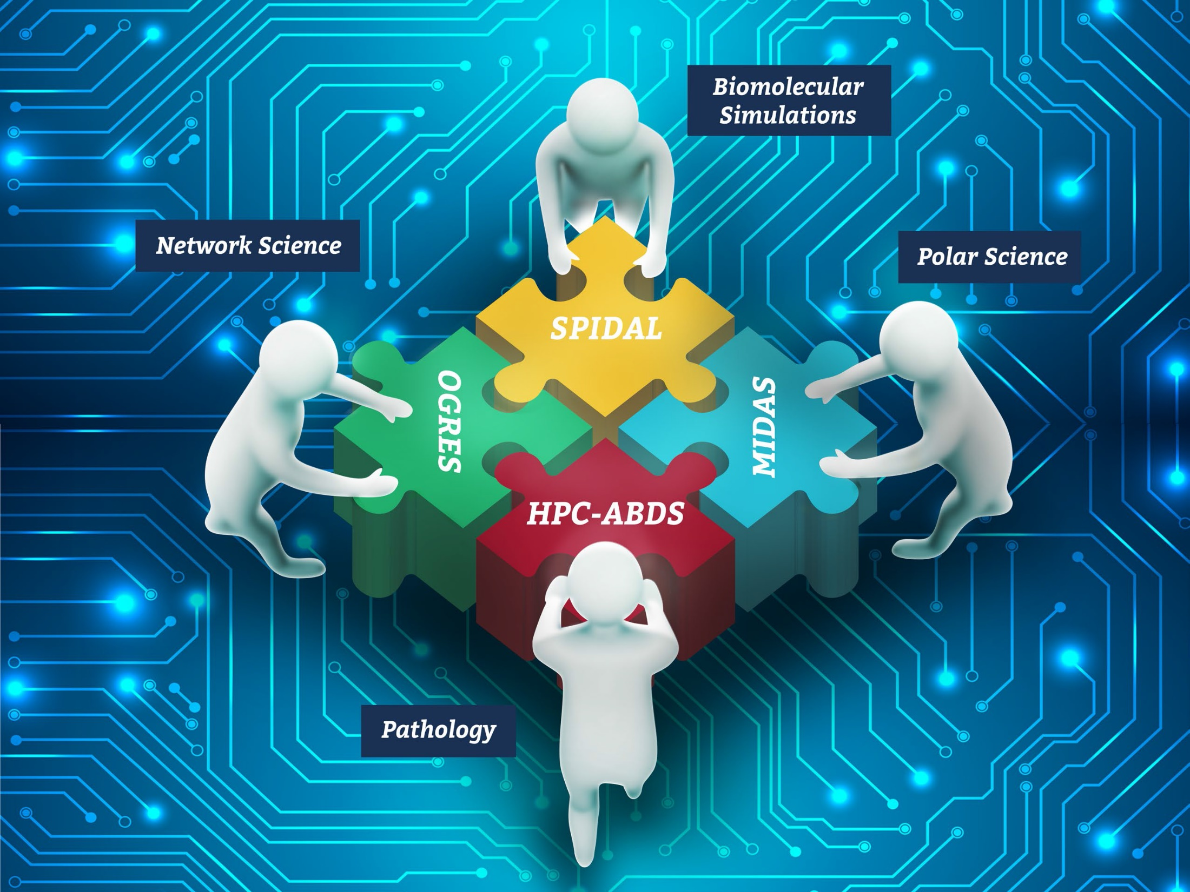




NSF 1443054: CIF21 DIBBs: Middleware and High Performance Analytics Libraries for Scalable Data Science
MIDAS- Molecular Dynamics Analysis Tutorial February 2017
Software: MIDAS HPC-ABDS

Slide 2
MIDAS- Molecular Dynamics Analysis Tutorial
Ioannis Paraskevakos, Andre Luckow, Oliver Beckstein, Shantenu Jha

Slide 3
Agenda
Introduction
Pilot-Abstractions: A Unified Abstraction for Hadoop, Spark and HPC
BioMolecular Dynamics Applications
Performance Analysis
Conclusion and Hands-On

Slide 4
Material
https://becksteinlab.github.io/SPIDAL-MDAnalysis-Midas-tutorial/
https://github.com/radical-cybertools/MIDAS-tutorial
https://github.com/Becksteinlab/SPIDAL-MDAnalysis-Midas-tutorial

Slide 5
1. Introduction

Slide 6
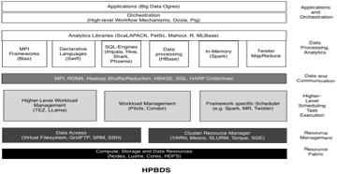
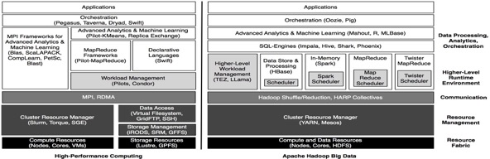
The Convergence of HPC and “Data Intensive” Computing
At multiple levels: Applications, Micro-Architectural (“near data computing” processors), Macro-Architectural (e.g. File Systems), Software Environment (e.g., Analytical Libraries).
Objective: Bring ABDS Capabilities to HPDC
HPC: Simple Functionality, Complex Stack, High Performance ABDS: Advanced Functionality
A Tale of Two Data-Intensive Paradigms: Data Intensive Applications, Abstractions and Architectures In collaboration with Geoffrey Fox (Indiana), ^{http://arxiv.org/abs/1403.1528}

Slide 7
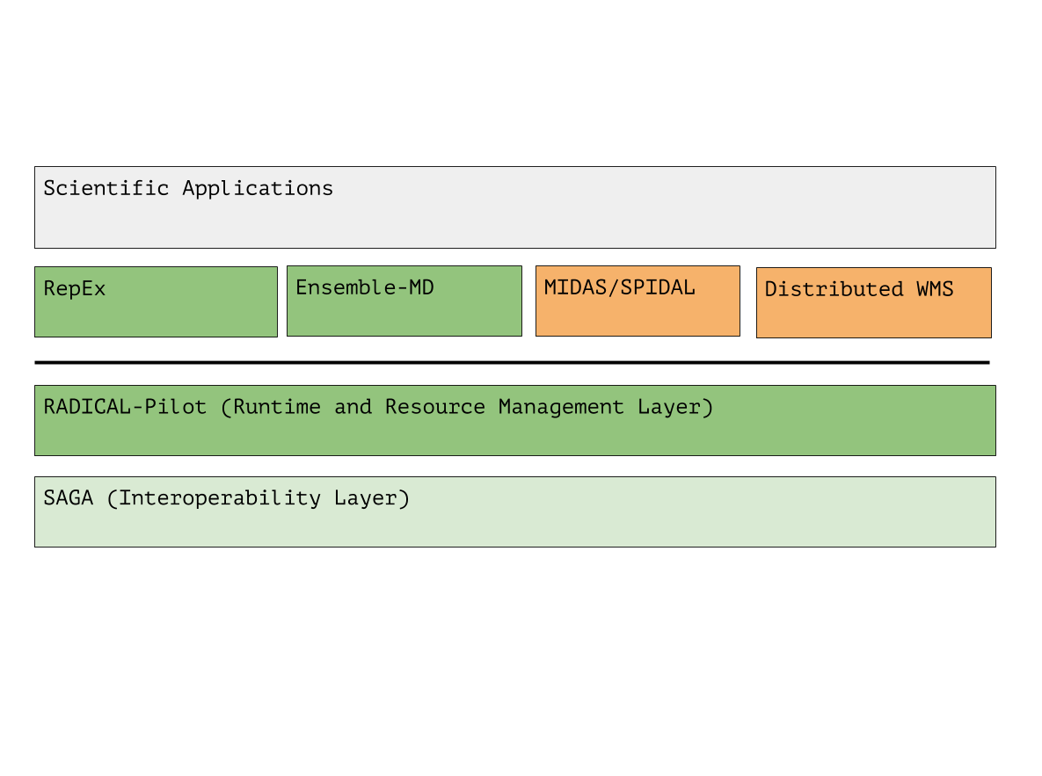
RADICAL-Cybetools: Abstraction based approach to HPC
RADICAL-Cybertools provide:
Flexible execution and resource management
“Static” versus “Dynamic” resource execution
Pilot-Abstraction for “higher-level” resource management
Manage heterogeneity
Middleware variants (syntax)
Infrastructure utilization (semantics)
(some) Architectural features
Serve as building blocks upon which other components can be built
Application/Domain specific Toolkits:Ensemble Toolkit
Data-Intensie Applications Libraries (SPIDAL)
Infrastructural abstractions:
Pilot-Abstraction: General, Scalable HPDC resource management
SAGA: Standardized API
Execution Strategy: Decouple workload from execution management

Slide 8
Objectives
Introduce MIDAS
Introduce how to execute Data-Intensive Molecular Dynamics Analysis applications using RADICAL-Pilot

Slide 9
MIDAS: Pilot-based Middleware for Data-intensive Analysis and Science
Application is integrated deeply with Infrastructure.
Great for performance. But bad for extensibility & flexibility.
Multiple levels of functionality, indirection and abstractions
Performance is often difficult.
Challenge: How to find “Sweet Spot”? “Neck of hour glass” for multiple applications and infrastructure

Slide 10
MIDAS: Pilot-based Middleware for Data-intensive Analysis and Science
MIDAS is the middleware for support analytical libraries, by providing
Resource management. Pilot-Hadoop for managing ABDS frameworks on HPC
Coordination and communication. Pilot-Spark for supporting iterative analytical algorithms
Address heterogeneity at the infrastructure level: File and storage abstractions.
Flexible and multi-level compute-data coupling.
Must have a well-defined API and semantics that can then be used by application and SPIDAL library/layer.

Slide 11
MIDAS: Pilot-based Middleware for Data-intensive Analysis and Science
The Pilot-Abstraction provides a well-defined resource management layer for MIDAS:
Application-level scheduling well suited for fine-grained data parallelism of data-intensive applications
Data-intensive applications more heterogeneous and thus, more demanding with respect to their resource management needs
Application-level scheduling enables the implementation of a data-aware resource manager for analytics applications
Interoperability Layer between Hadoop/ABDS and HPC

Slide 12
Why Hadoop/Spark on HPC?
Data Parallelism/SQL/Machine Learning capabilities often need to be manually implemented on HPC
Code hidden behind executables (written in C/C++) – difficult to re-use and to implement complex data pipelines and applications
Powerful frameworks, such as Spark, provide Implicit parallelism, reusability, flexibility. However, they are difficult to use on HPC

Slide 13
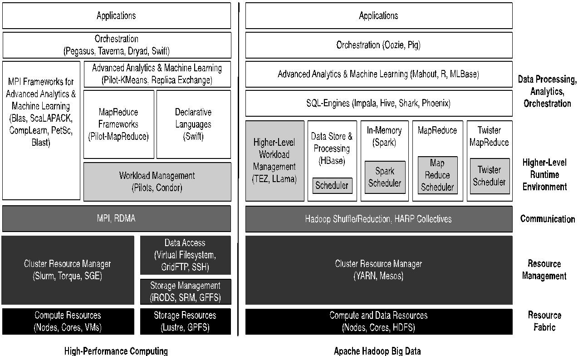
HPC and Hadoop Ecosystem

Slide 14
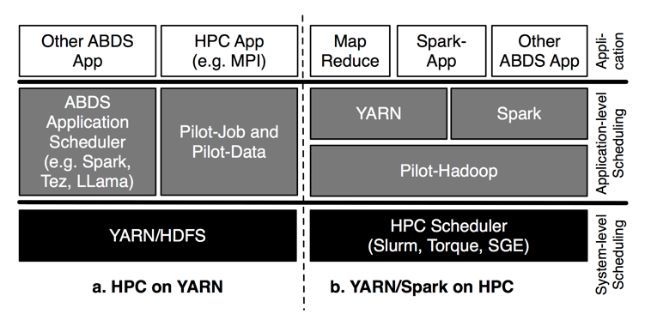
HPC and ABDS Interoperability

Slide 15
https://github.com/radical-cybertools/MIDAS-tutorial/wiki

Slide 16
3. Pilot-Abstraction

Slide 17
Introduction Pilot Abstraction
Working definition: A system that generalizes a placeholder job to provide multi-level scheduling to allow application-level control over the system scheduler via a scheduling overlay.
User Space
User Application
Pilot-Job System
Policies
Pilot-Job
Pilot-Job
Resource Manager
System Space
Resource A
Resource B
Resource C
Resource D
Notes:
The Pilot-Jobs acquire a set of resources. As soon as those Pilot-Jobs are active the User application can start submitting the tasks. The submission can be done either based on which resource has enough resources to satisfy the tasks requirements or based on a more complicated policy that is defined by the user.

Slide 18
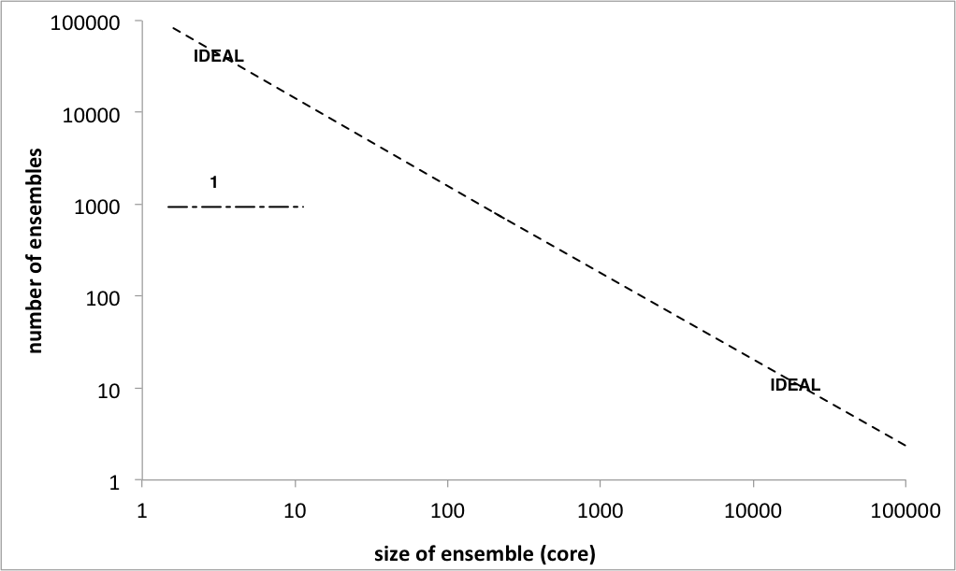
Introduction to Pilot-Abstraction
Advantages of Pilot-Abstractions:
The Perfect Pilot: Decouples workload from resource management
Flexible Resource Management
Enables the fine-grained (ie “slicing and dicing”) of resources
Tighter temporal control and other advantages of application-level Scheduling (avoid limitations of system-level only scheduling)
Build higher-level frameworks without explicit resource management
Notes:
Pilot-jobs as a (A)RM because of limitations of the middleware and infrastructure. Different middleware; differenent limitations. Therefore different pilot jobs semantically and functionally.
Pilots tell you what to do (N x M) but not why or how?

Slide 19
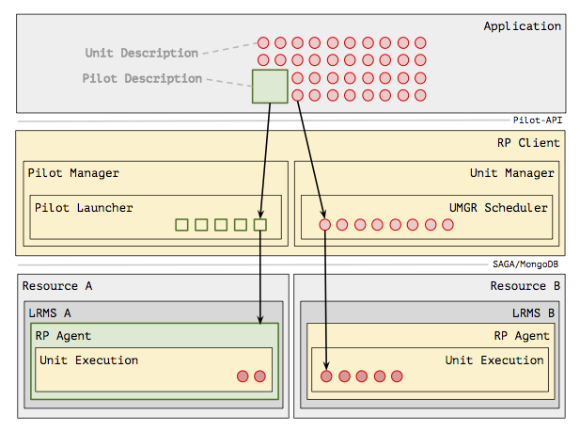
RADICAL-Pilot: Architecture
ApplicaPilot-Description: Describes the resources
tion Level:
Unit-Description: Describes the compute task
RADICAL-Pilot Client:
Pilot Manager & Launcher: Are responsible to launch a Pilot to a resource
Unit Manager & Scheduler : Manage and schedule unit to various pilots
Notes:
A general overview of the RADICAL-Pilot architecture
Pilot Description: Describes the resources (Resource, Nodes, Memory, Wall time) that the pilot will use
Unit Description: Describes the task (Executable, Cores, Environment, etc) that will be executed from the pilot.
Pilot Manager and Pilot Launcher: The Pilot manager manages the communication between the application and the pilots, the pilot launcher launches the pilot to the resource that is defined in the pilot’s description.
Unit Manager and Scheduler: The Unit Manager uses the Unit Manager Scheduler to schedule units in the various pilots.

Slide 20
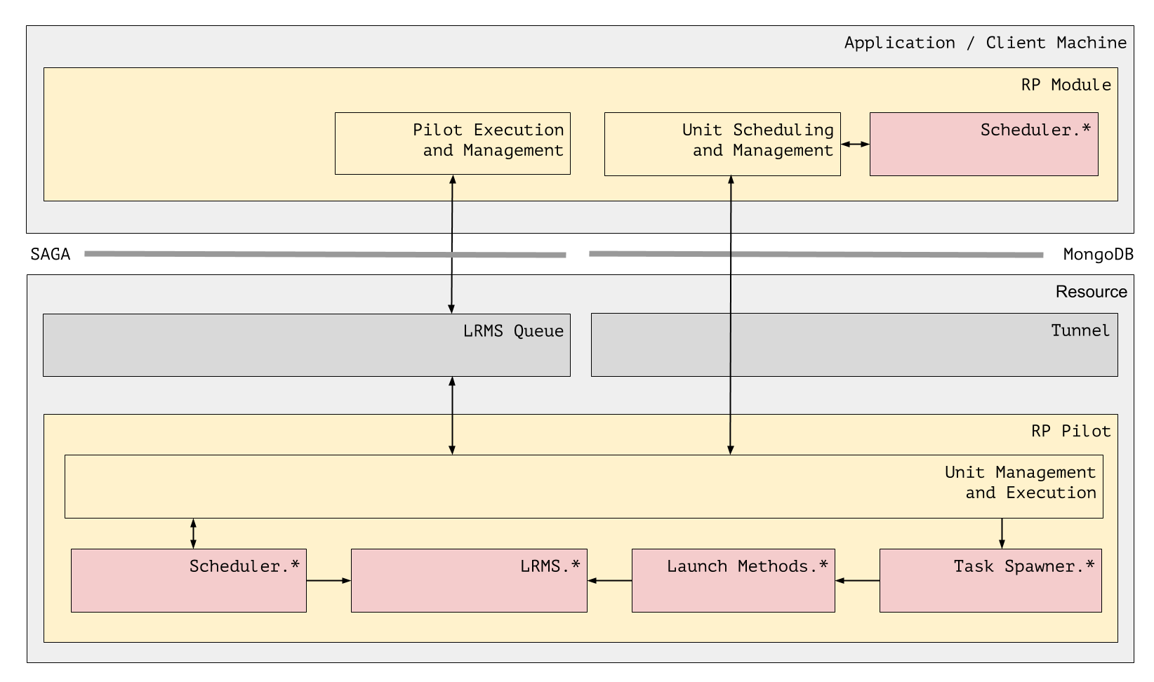
RADICAL-Pilot: Architecture
Under RP Pilot we have:
Task Spawner: It is responsible to start the execution of a task.
The Launch Method recognises the way a task will be executed, e.g. mpirun, ssh, spark-submit
LRMS * : This module recognises the resources that the Pilot has acquired (which exact nodes for example) and informs the Scheduler *
Scheduler *: Knows how many resources are free and how many are being used. It is also responsible to decide where a task will be executed.
Notes:
A more detailed picture of the architecture, that also shows the internal modules of RADICAL-Pilot’s client and agent.
LRMS Queue: Is the queue of the resource that the Pilot is submitted, e.g. the SLURM queue on Stampede. Under RP Pilot we have:
Task Spawner: It is responsible to start the execution of a task.
The Launch Method recognises the way a task will be executed, e.g. mpirun, ssh, spark-submit
LRMS * : This module recognises the resources that the Pilot has acquired (which exact nodes for example) and informs the Scheduler *
Scheduler *: Knows how many resources are free and how many are being used. It is also responsible to decide where a task will be executed.

Slide 21
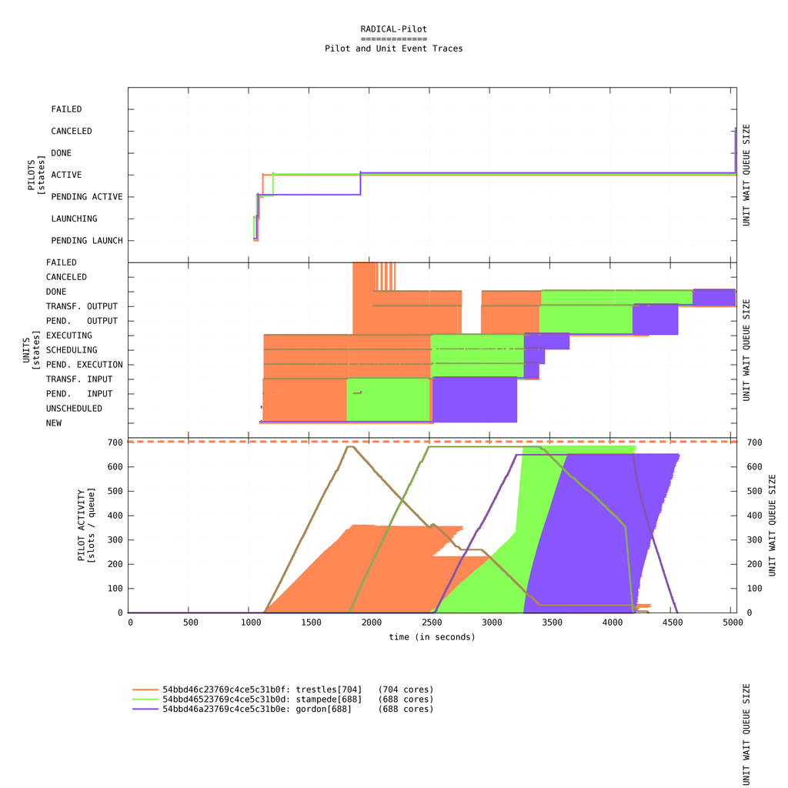
RADICAL-Pilot:
Why RADICAL-Pilot?
Well defined state models (for pilots and units)
Scalability (up and out) and Portability (often contradictory design objectives!)
Supports research whilst supporting production scalable science!
Pluggable schedulers; high degree of introspection, provenance.
Modular Pilot agent adaptable for different architectures
Link: https://github.com/radical-cybertools/MIDAS-tutorial/blob/master/pilot/Radical_Pilot.ipynb
Notes:
RADICAL-PIlot is a python implementation of the Pilot abstraction. RADICAL-Pilot has well defined models for the states of the Pilots and the states of the Unit (Compute Tasks). It allows a user application to scale up and out. It’s implementation allows RADICAL-Pilot to be used virtually to any system, since it is only dependency is Python.
It’s architecture allows it to adapt to new resources by just adding a resource configuration file.

Slide 22
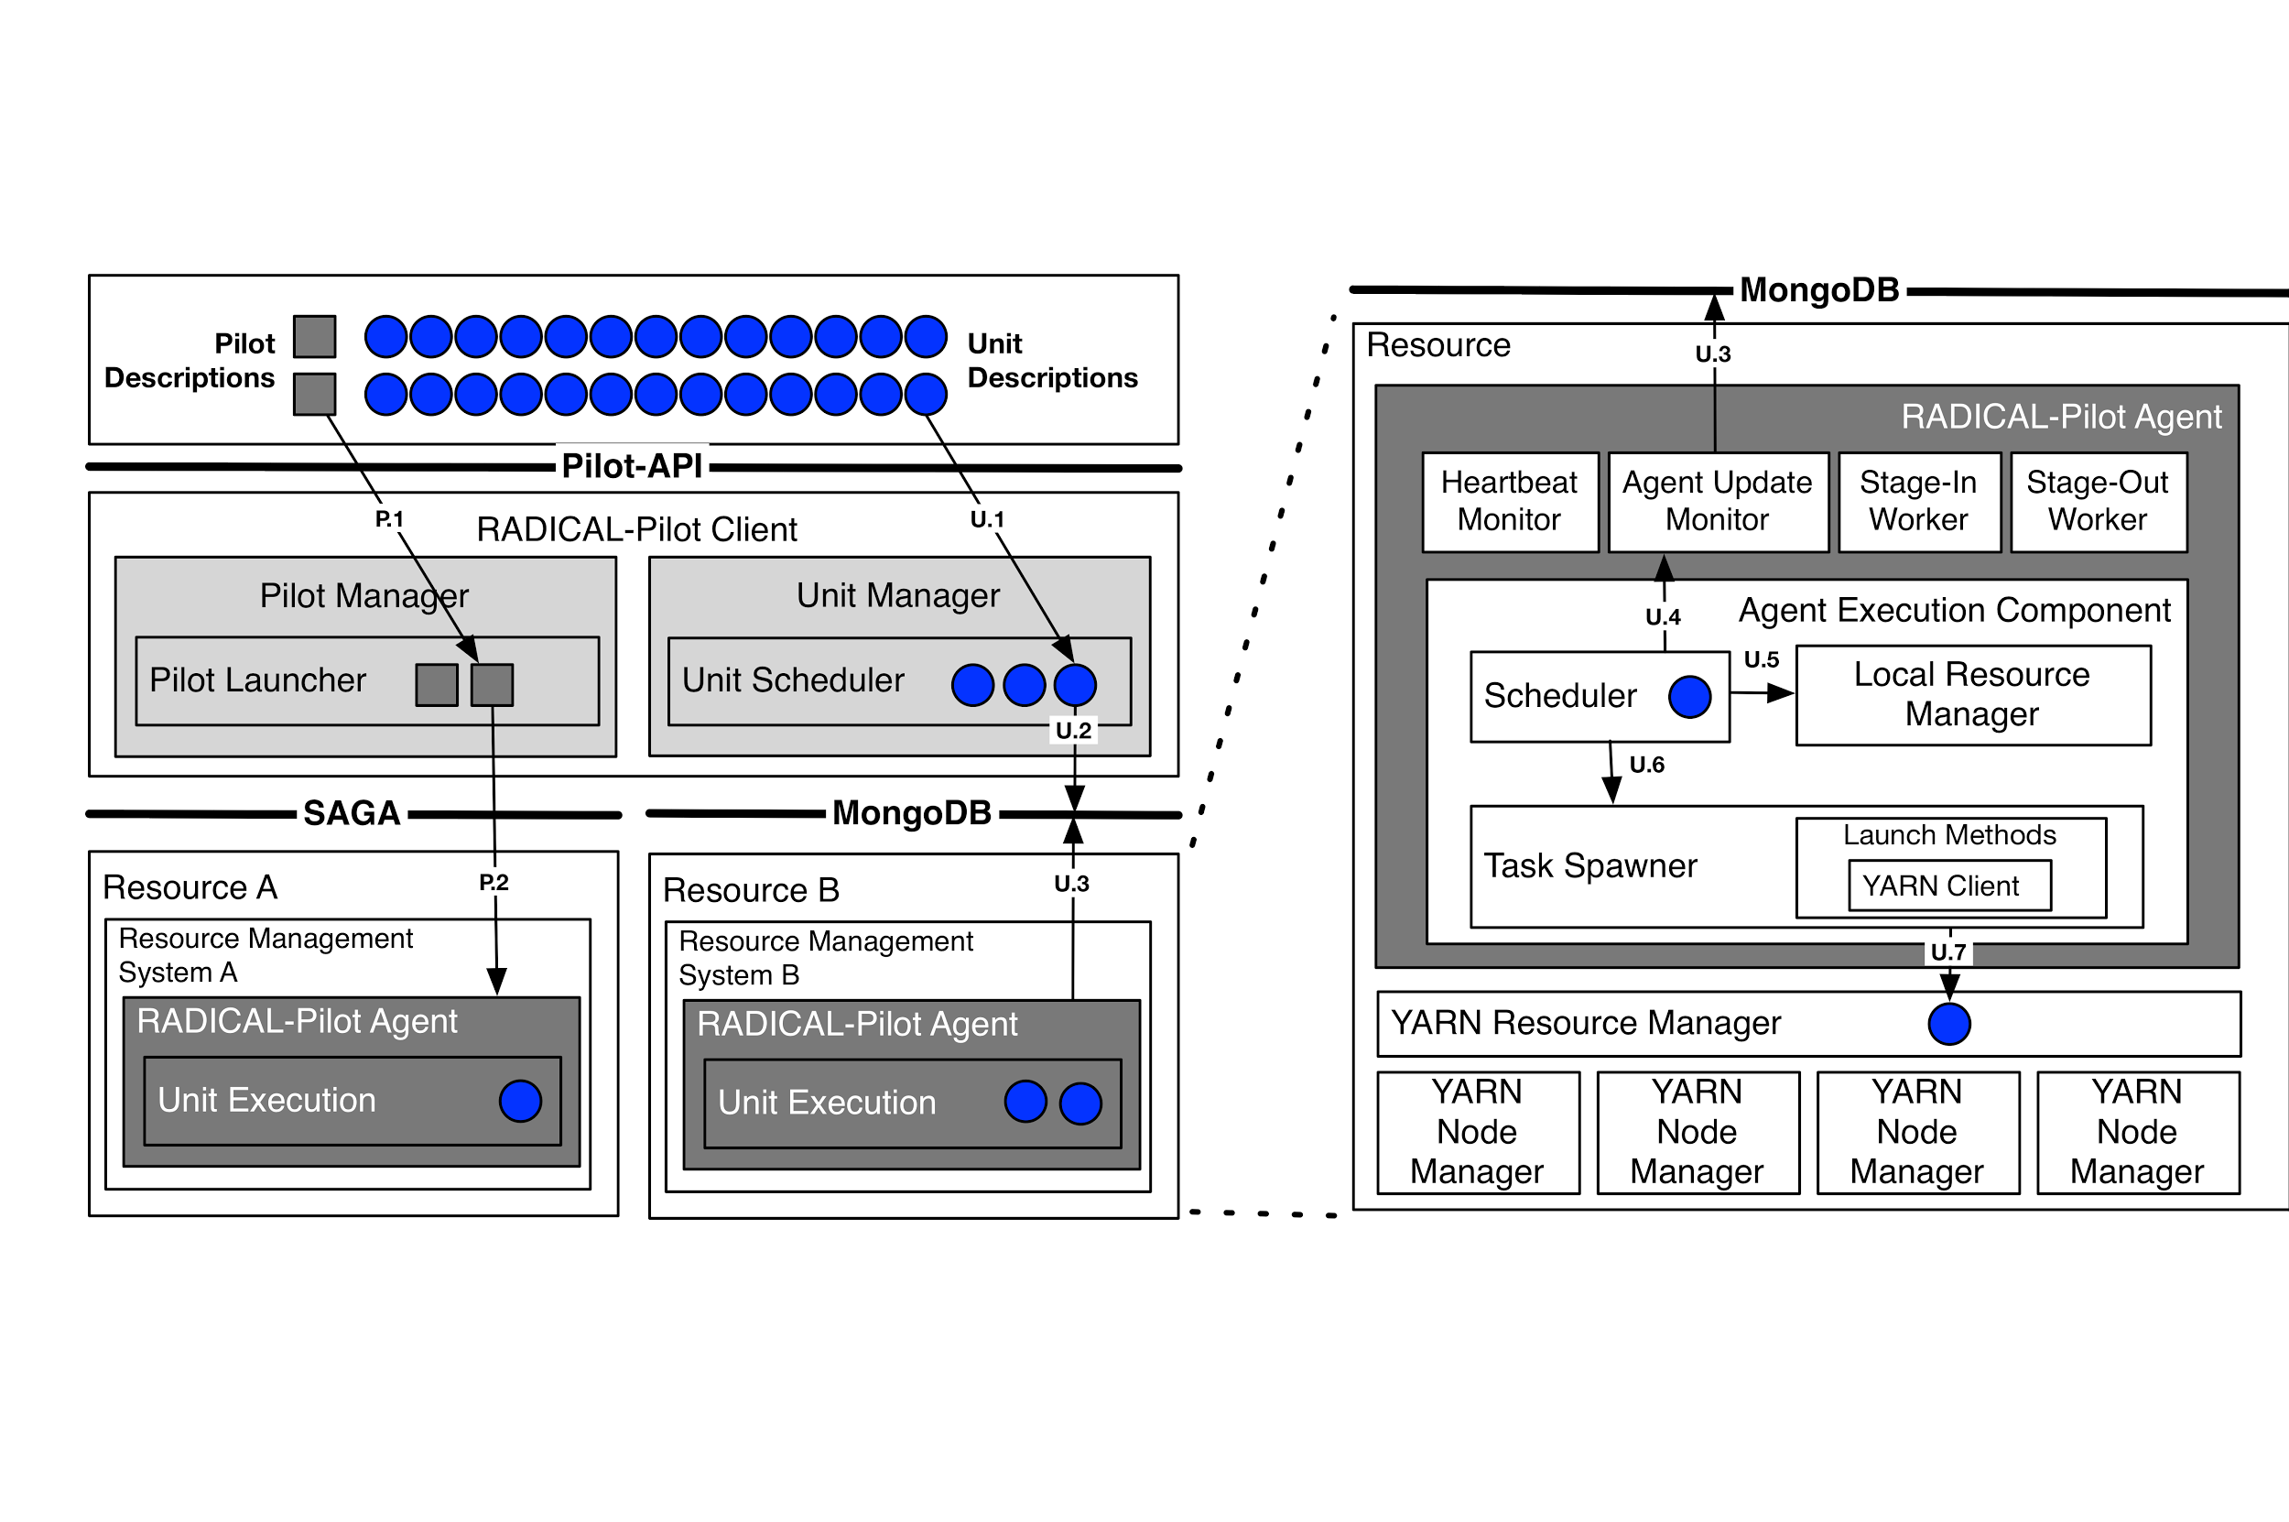
Pilot-Hadoop
Pilot-Hadoop are able to start a Hadoop cluster on an HPC resource
The Pilot’s agent is responsible to manage Hadoop resources
Units are submitted to Hadoop’s RM YARN
Link: https://github.com/radical-cybertools/MIDAS-tutorial/blob/master/pilot/Pilot-Hadoop.ipynb
Notes:
The Pilot is responsible to start a Hadoop or Spark cluster in the resources that have been acquired. Specifically, the Pilot downloads Hadoop/Spark, setups the cluster, starts it and submits applications to it according to the resources it has available at any given time.
During unit submission, the Pilot checks the resource requirements (e.g Cores, Memory) of the unit and if there are enough resources free, it submits the application to Hadoop or Spark through a yarn or spark-submit command.

Slide 23
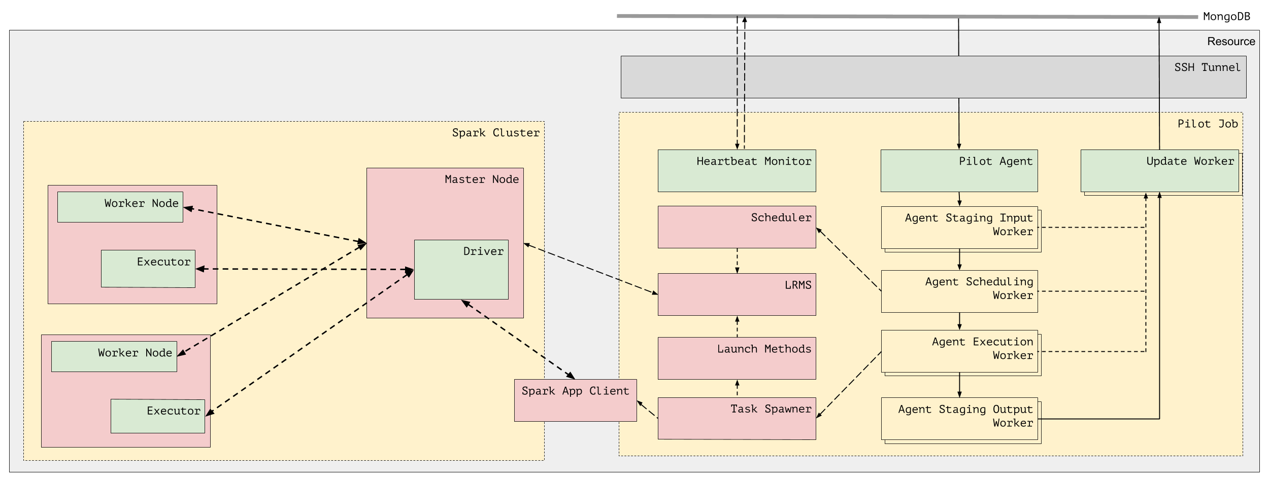
Pilot-Spark
Pilot downloads and configures a Spark cluster
The Master node is with the Pilot’s Agent
When Spark is launched, Spark applications can be submitted.
Link: https://github.com/radical-cybertools/MIDAS-tutorial/blob/master/pilot/Pilot-Spark.ipynb
Notes:
When the Pilot is launched it downloads and configures Spark. The node where the Agent is is selected as the master node of the Spark cluster and the rest of the nodes as its workers. As soon as it is launched, Spark applications can be submitted and executed. The Scheduler communicates with the Master Node to discover the available resources. If there are enough, the Task Spawner executes a spark-submit command. From that point on the execution is handled by the Spark cluster.

