Slide 1
Emulator Metrics

Slide 2
PERFORMANCE COMPARISON

Slide 3
Resources
Resource 1: Edge
m1.tiny (CPU: 1, Mem: 2 GB, Disk: 8 GB)
Resource 2: Fog
m1.quad (CPU: 4, Mem: 10 GB, Disk: 20 GB)
Resource 3: Cloud
m1.xxlarge (CPU: 44, Mem: 120 GB, Disk: 60 GB)
Running K_means: Clustering 4,8,16……...1048576 point into 3 clusters

Slide 4
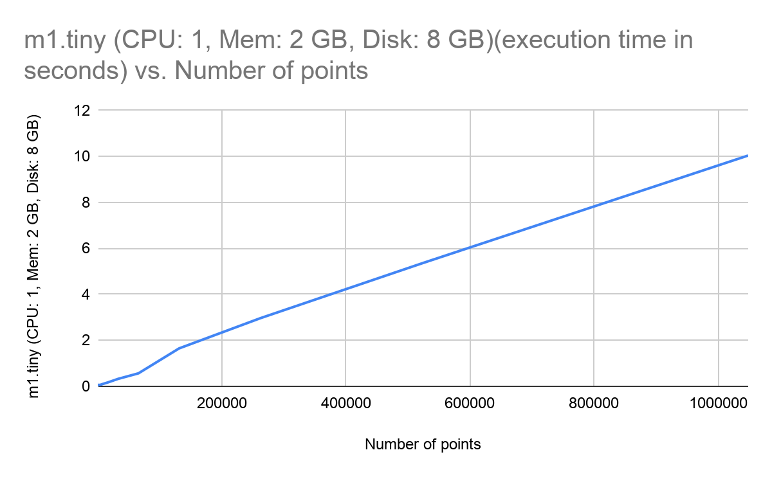
Individual performance: Edge resources

Slide 5
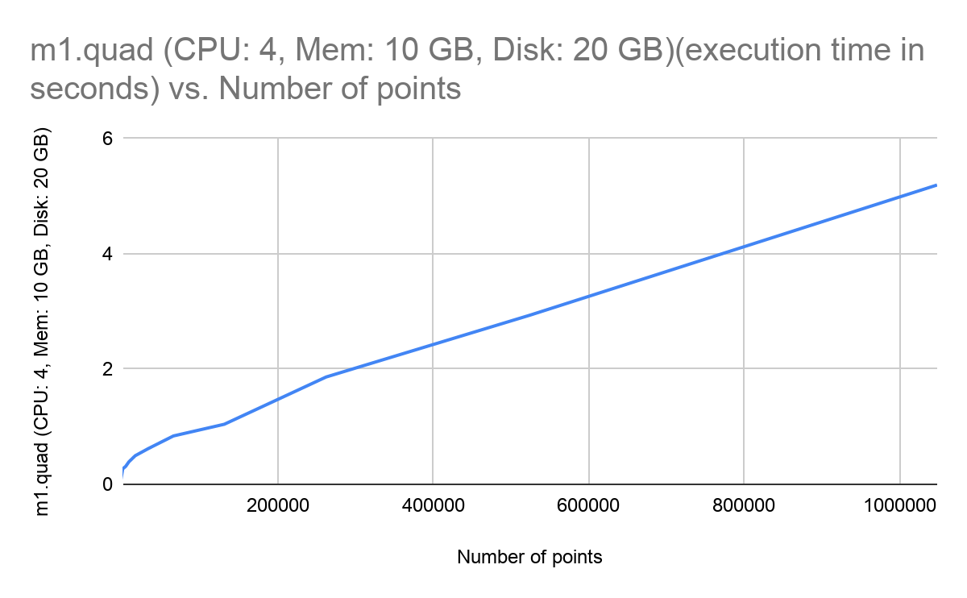
Individual performance: Fog resources

Slide 6
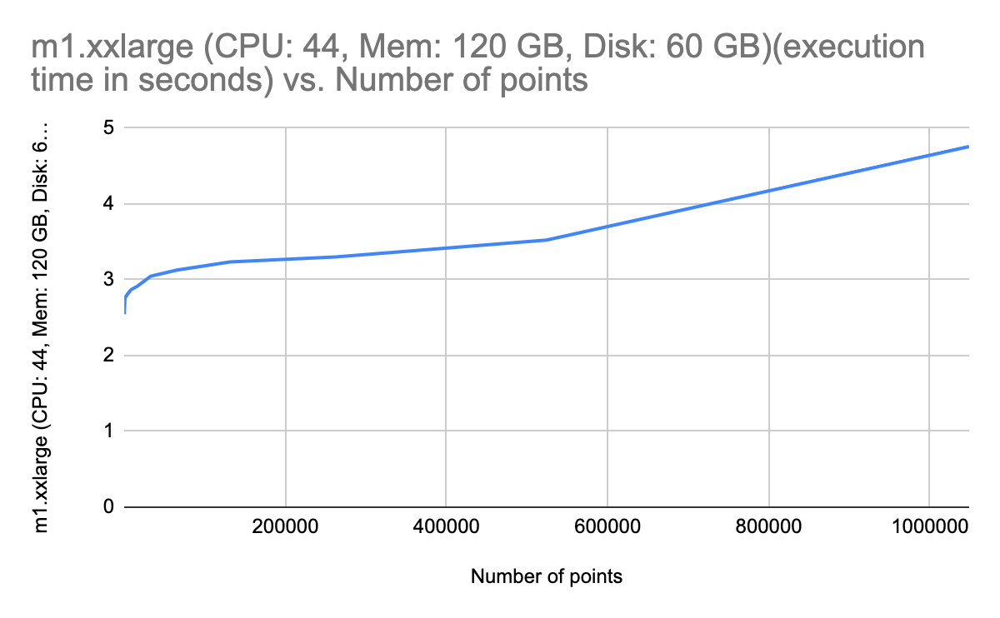
Individual performance: cloud resources

Slide 7
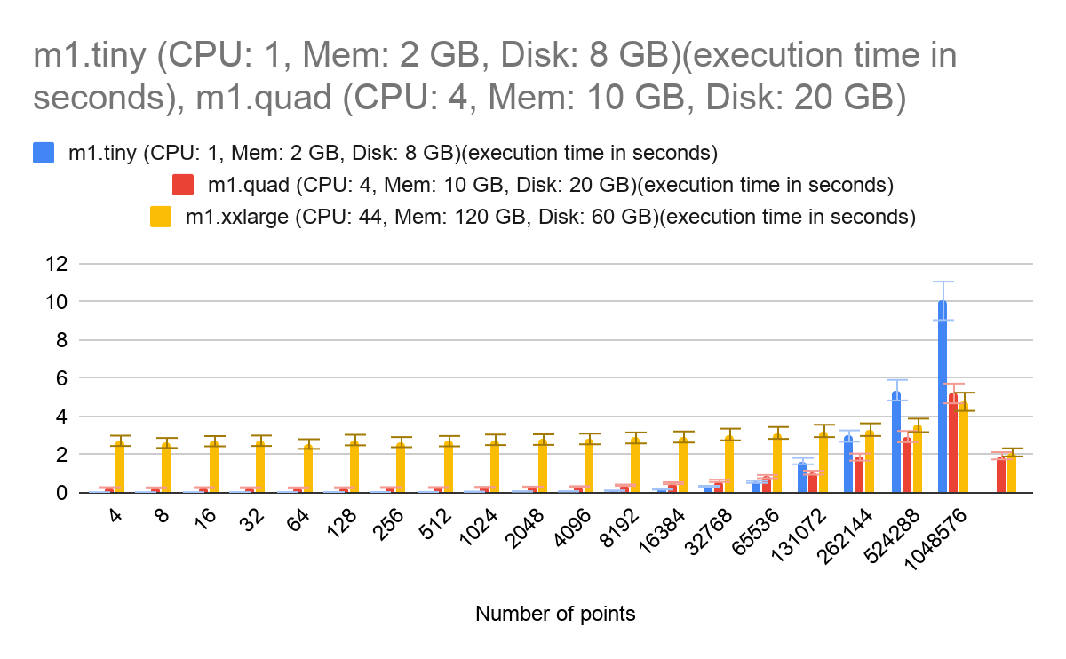
Comparison between resources

Slide 8
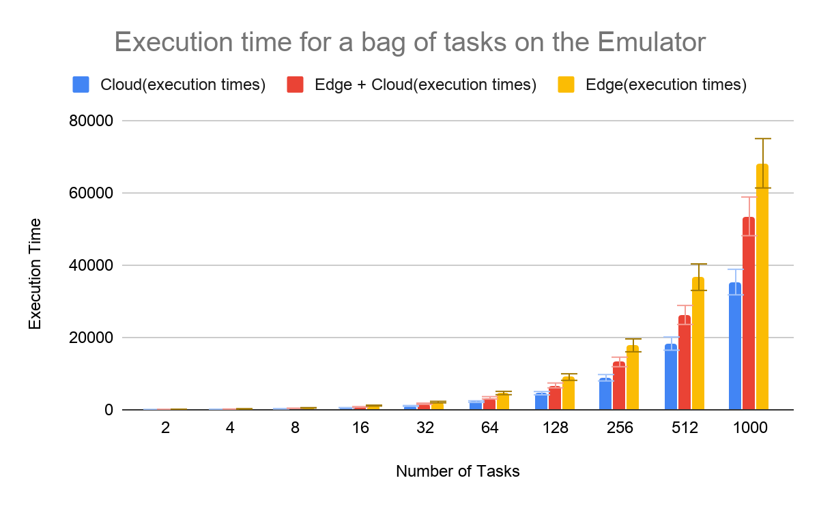
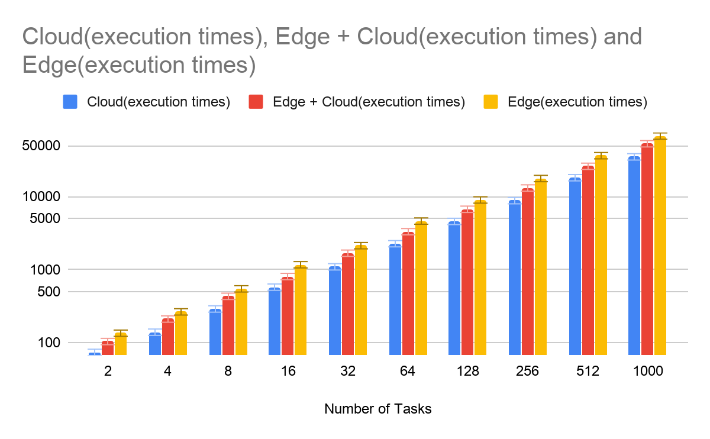
Vivek’s Emulator comparison (Edge, Cloud and Edge-Cloud)
The right graph has the vertical axis in log scale.
Notes:
Rn on 50 percent
Edge on 1%, …….

Slide 9
Total data transfer time and Data rate
Resource 1: m1.small (CPU: 2, Mem: 4 GB, Disk: 20 GB)
PRODUCER
Resource 2: s1.large (CPU: 10, Mem: 30 GB, Disk: 120 GB, Disk: 120 GB root)
CONSUMER
KAFKA BROKER
Where Data rate = Number of Data_points / Total time in seconds to transfer the data
Using confluent_Kafka, I produced random points (2,4,8,16……...524288) and calculated the total time required between generation of first point and receiving the last data point on consumer.

Slide 10
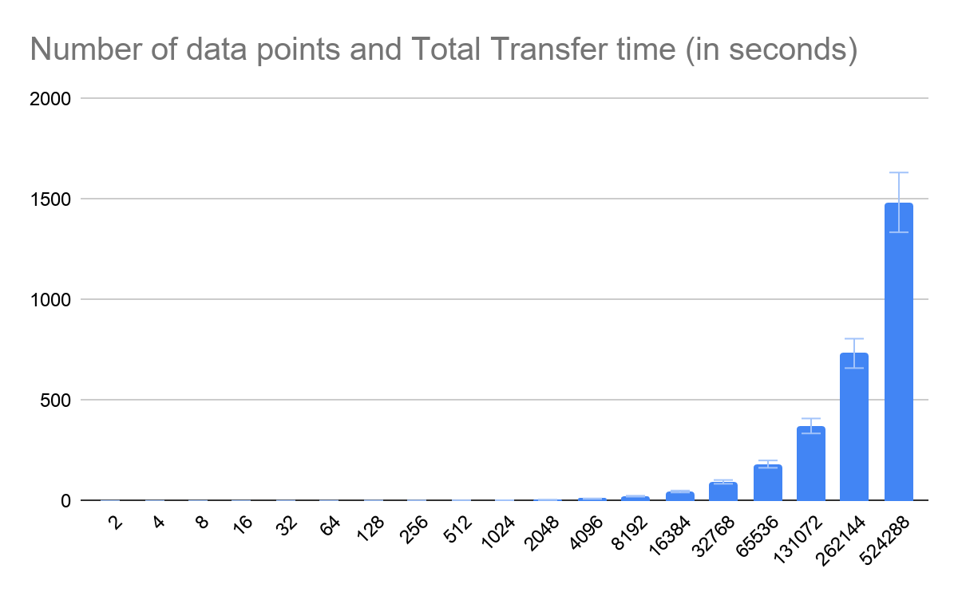
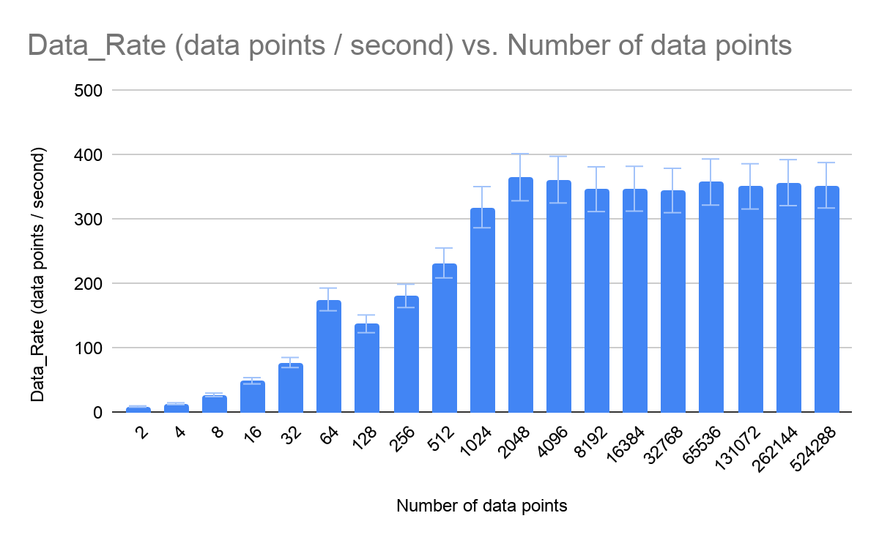
Total data transfer time and Data rate
Notes:
Points from 2 to ~500,000 points
5 minutes or 300 seconds

Slide 11
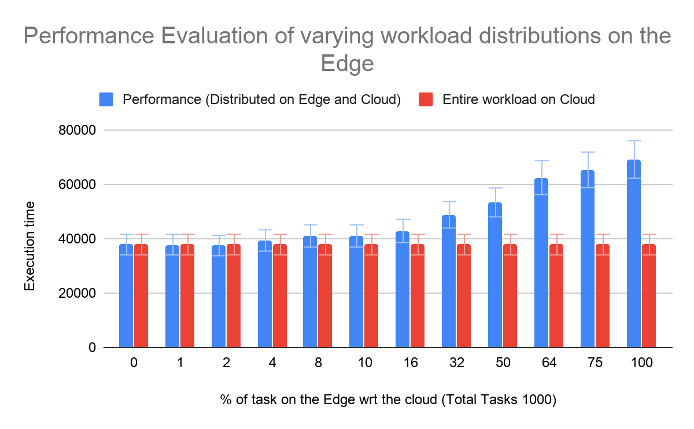
Division of work on Edge and Cloud
How much compute can I run on the edge without degrading my performance?
Notes:
-divided the work on Edge and Cloud
- Now since the best performance is on the cloud, I see the change in performance with respect to work 100 on the cloud

Slide 12
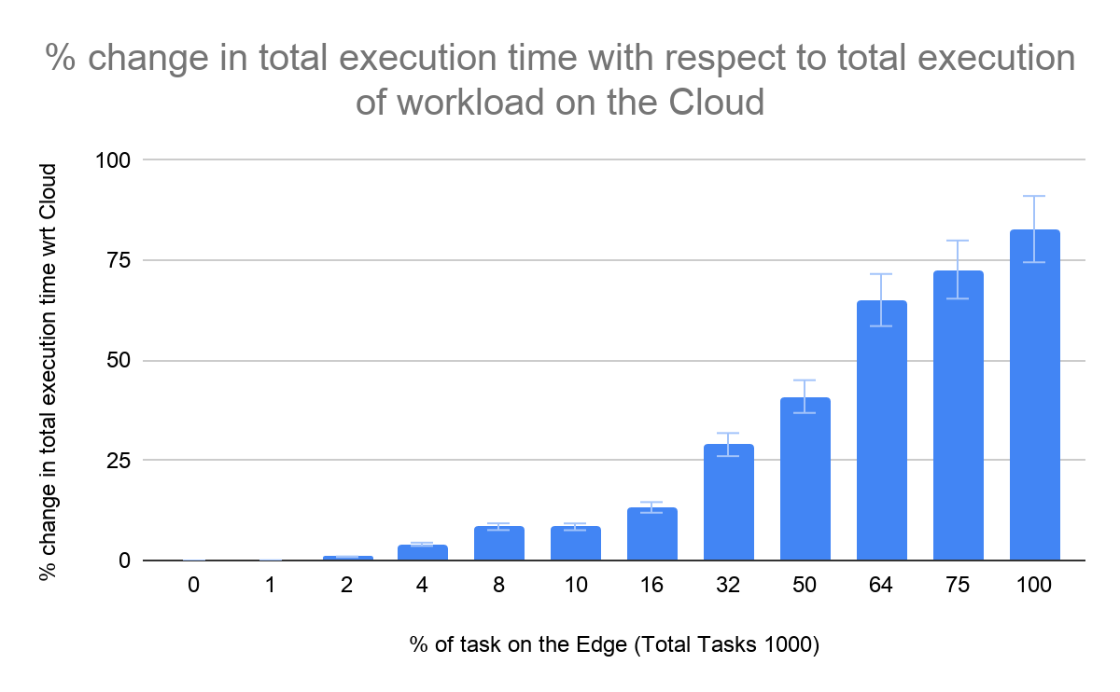
Division of work on Edge and Cloud
How much compute can I run on the edge without degrading my performance?

Slide 13
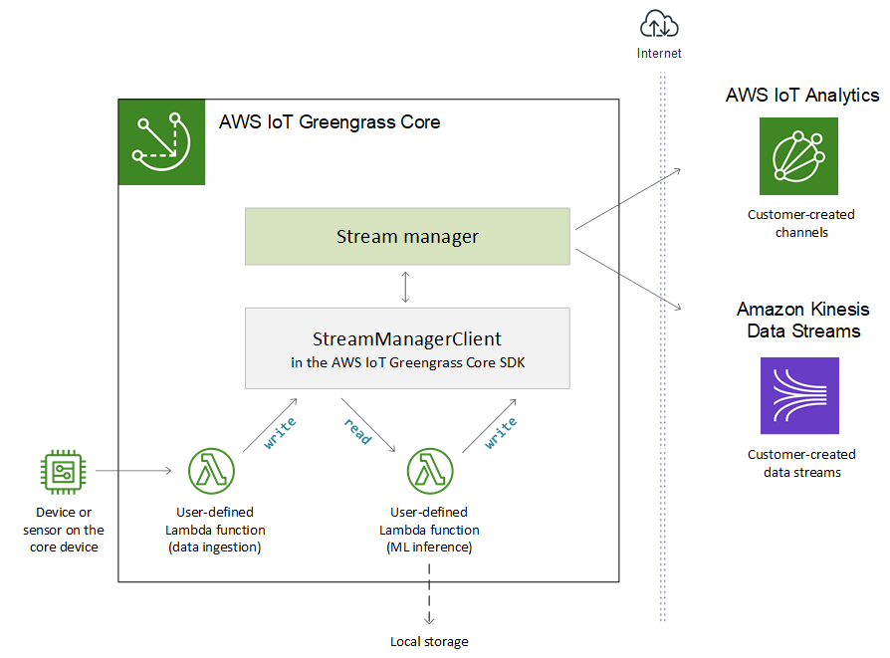

Slide 14
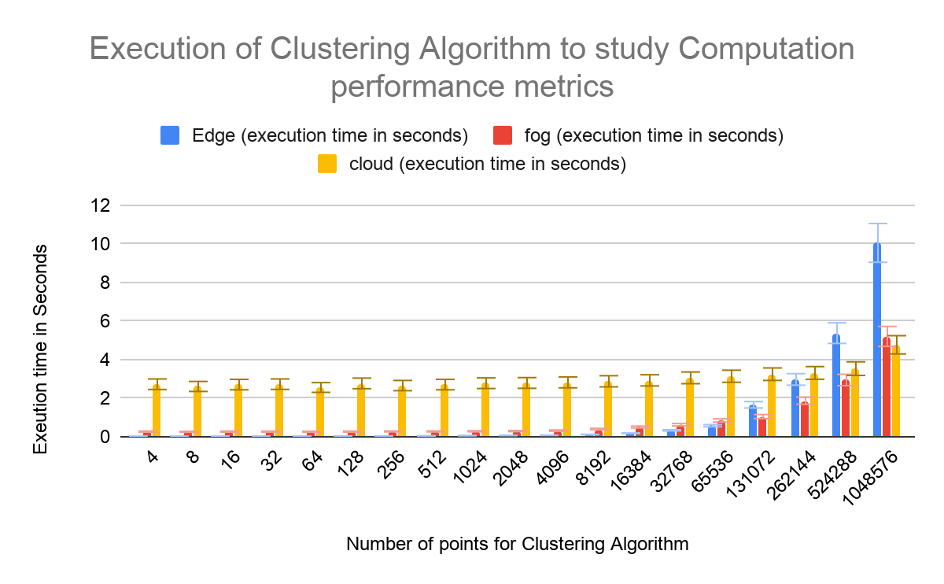
Using K_means provided with Andre

Slide 15
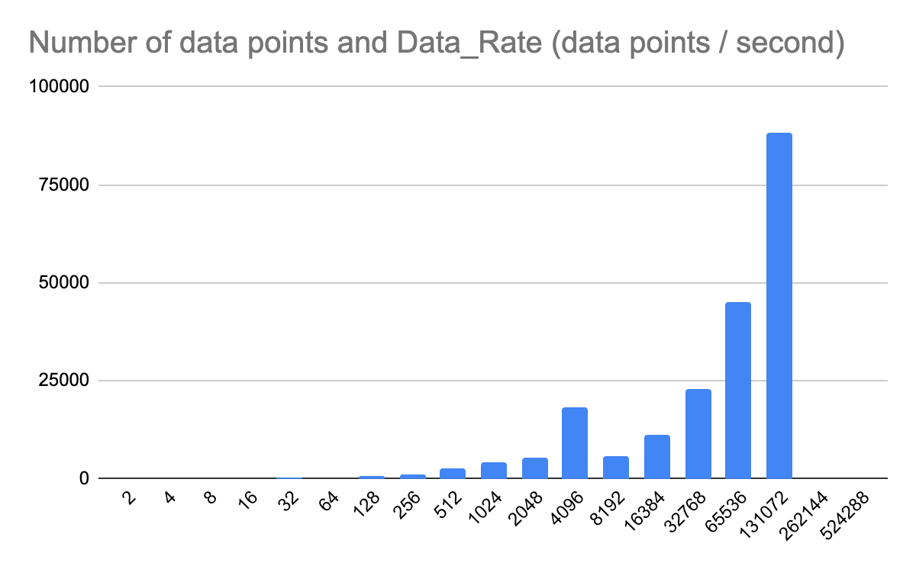
Transfer of data rate as a List: Calculate the data_rate

Slide 16
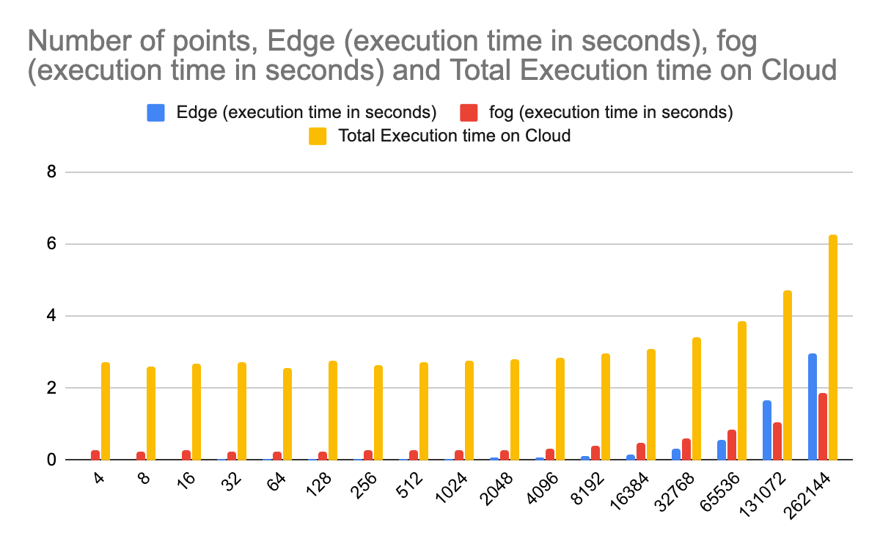
Performance evaluation with data_rate = 88183.81658

Slide 17
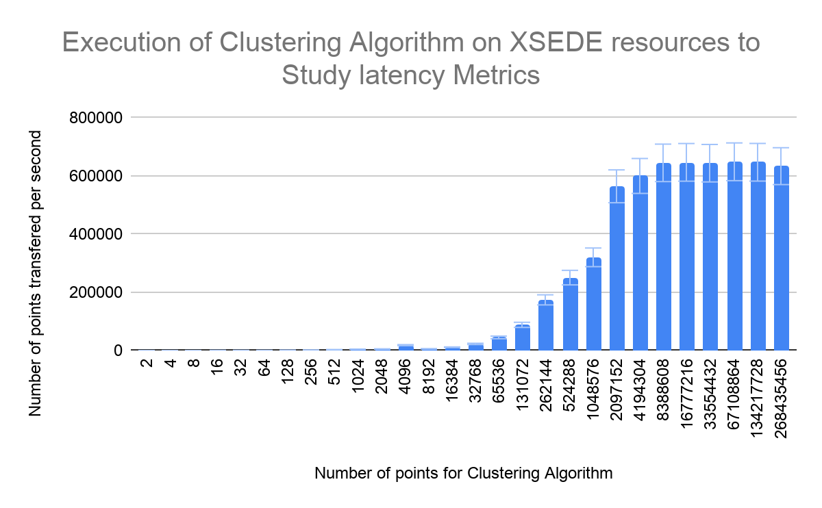
Transfer of data rate as a List: Calculate the data_rate
‘stable data rate for points greater than 131072 to steady the data rate’
Notes:
0.1 million points: Threshold to send data by Kafka Brokers
0.2 billion points
Avg: 643948.2094 ~ 0.6 million points per second

Slide 18
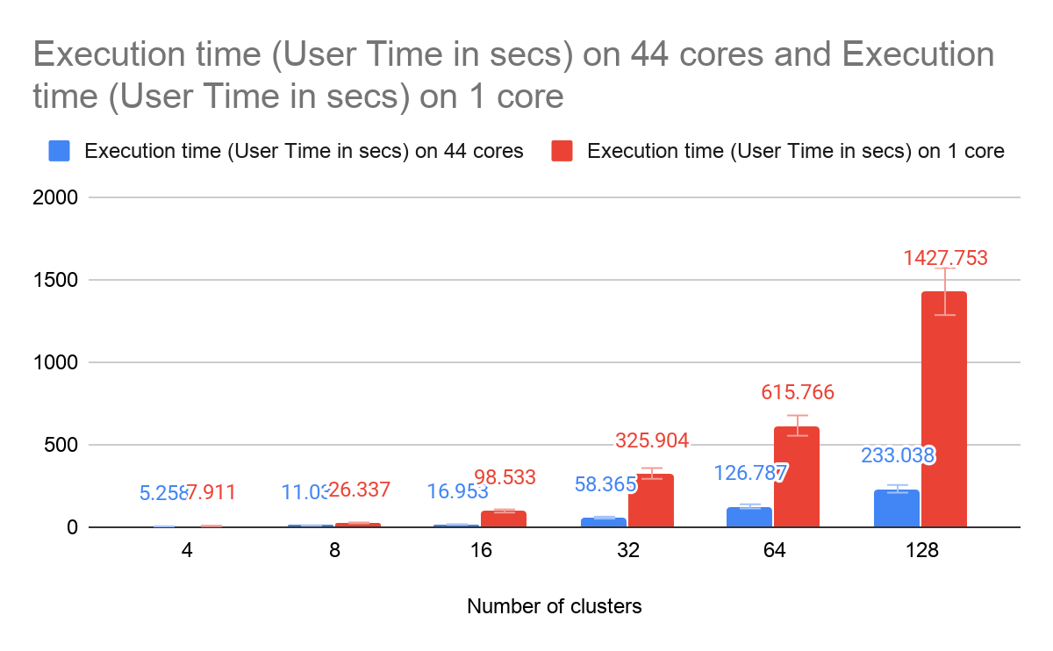
Performance comparison as complexity increases
‘Trade-off between working on Edge and Cloud’

Slide 19
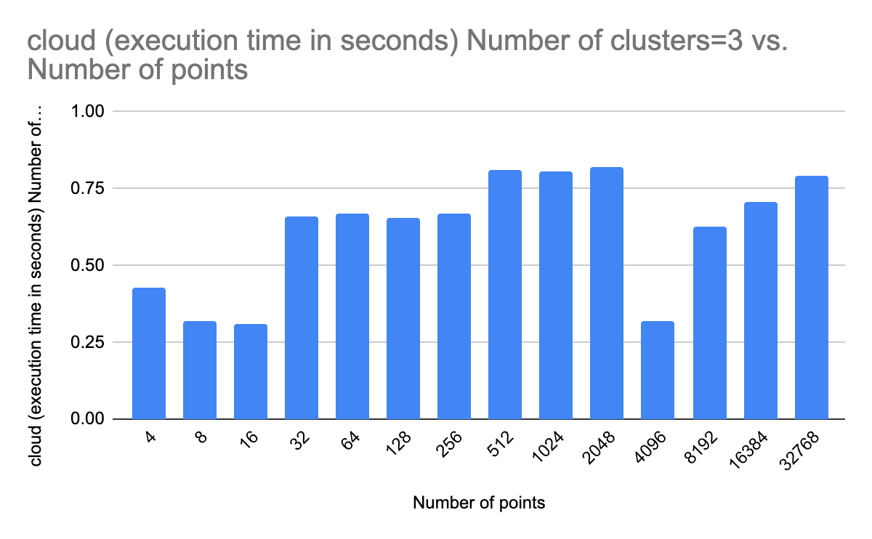
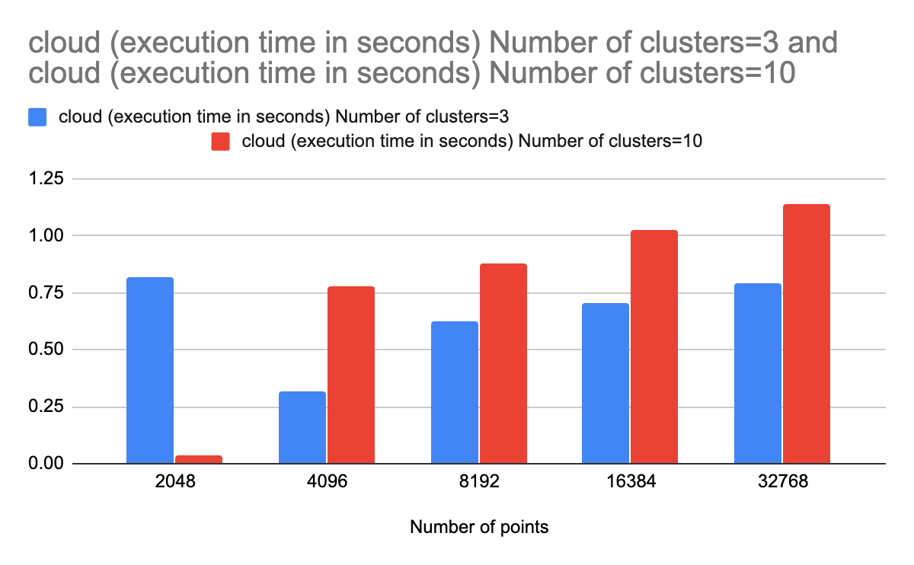
End to end experiment for transfer of data and running K-Means clustering
Notes:
Questions:
1. Time is different on the two machines? (consumer machine shows receiving time less the product time)
2. It shows very fluctuating results. Thus, I run it 5 times first and then take the average of 10 times.
--Points are different

Slide 20
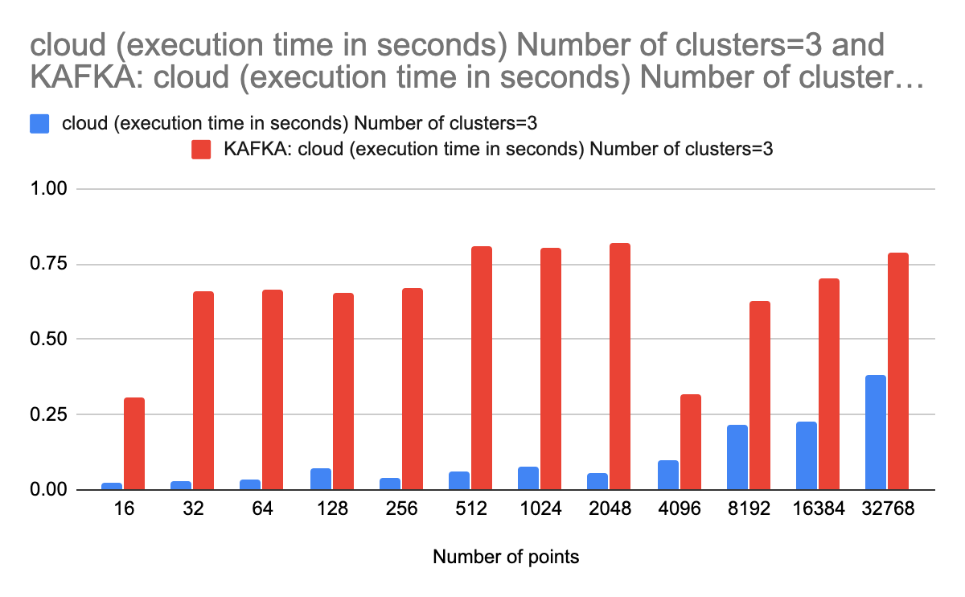
Benchmarking Andre K_Means on large (num cores=10)

Slide 21
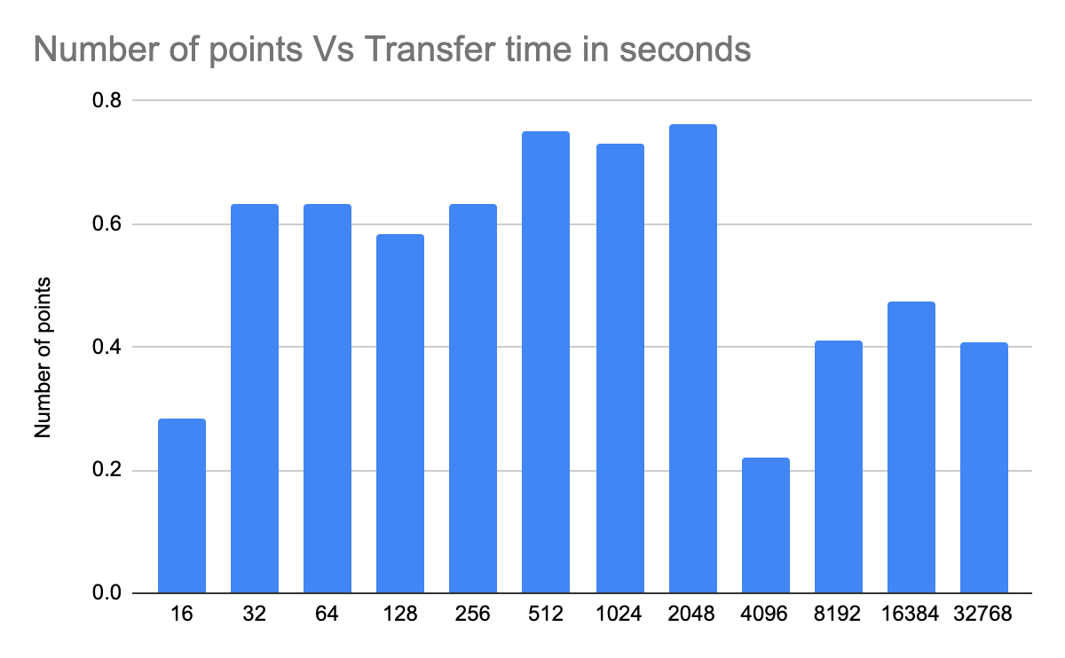
Transfer time (Computation E2E - benchmarking (just K-Means)) ?
Notes:
Number of clusters= 3 Number of cores = 10

Slide 22
NTP-date: synchronize two machine upto milliseconds
Notes:
Ran date command simultaneously to both of my machines.

Slide 23
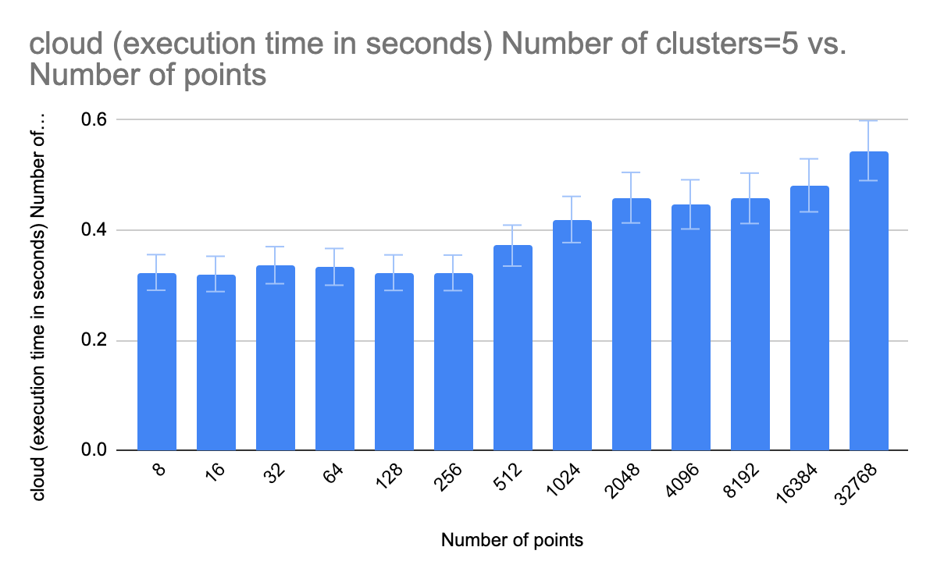
End to end experiment for transfer of data and running K-Means clustering

Slide 24
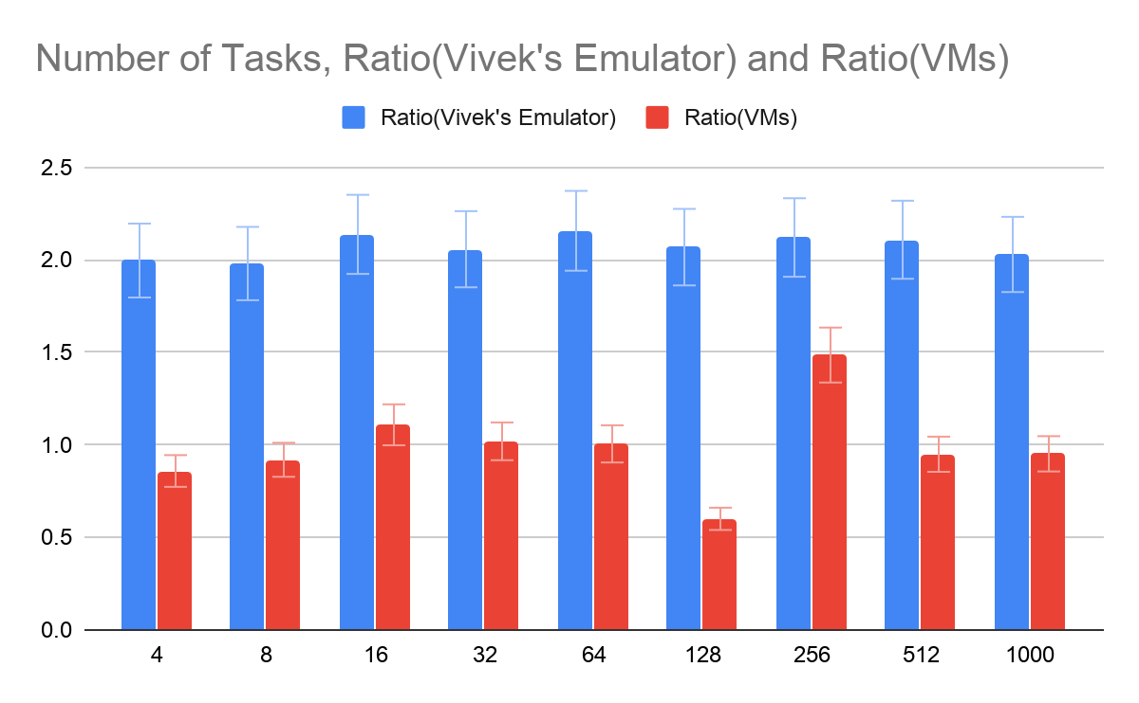
Vivek’s Emulator Reproduction of results
Notes:
Data_rate = 600000 data points per second
Computation power of Edge = 50% of the cloud NOTES: Number of points

Slide 25
Questions
How do I bring the systems (VMs and Vivek’s Emulator) to the same scale?
Computation in emulator is: Ops/execution power (this is not in seconds?)
Computation time in VMs is seconds
There is also some constant time for cloud resources (starting the cores?). How do I include that in the Vivek’s emulator?
Notes:
Bandwidth? The amount of tasks we can compute on the edge with overwhel the edge resources API Vivek’s emulator

Slide 26
Difference between the two systems
Vivek’s Emulator:
1 Task = x operations (x is defined wrt a distribution)
Show data of 50 tasks (define a uniform distribution with mean = 1000), each task consist of 1000 operations
Execution time = Ops/execution power + data_transfer time (Ops / data_rate)
Time for distribution of workload on cores in not benchmarked, significant part of execution in
VMs
Execution time = Transfer time via Kafka brokers + Computation time on VMs is seconds
Also, includes time for distribution of workload on cores: Overheads
Notes:
Model: Emulator works - Working - Extensions done by Kartik Task management overhead? WLMS: sim/emulate and then verify them on the VMS Benchmark the overheads and include in viveks emulator

Slide 27
Other way round: Verify the Emulator on VMs
Resource 1: Edge
m1.tiny (CPU: 1, Mem: 2 GB, Disk: 8 GB)
Resource 2: Cloud
m1.xxlarge (CPU: 44, Mem: 120 GB, Disk: 60 GB)
Should I try to split the K-means to run x% points on Resource 1 and then the total -x % points on Resource 2 to see if similar numbers are generated?
This would be a good approach? Openstack API?

Slide 28
Next Steps
Breakdown execution for edge devices
Maximum data set that can give us good execution times
What is good?
Continue Experimenting with diff Clustering sizes
Why are we doing this?
Applications other than K-Means
Increase the Parameter Space
Diff data rates
Increase the number of VMs in the experiment: Openstack API
Notes:
Optimal throughout as a metric: Quality of model

Slide 29
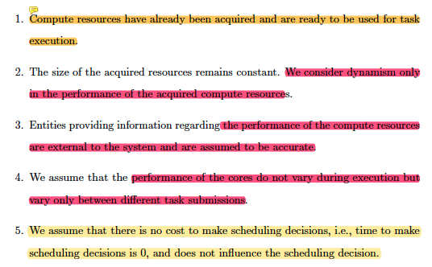
Model: Emulator works - Working
- Extensions done :https://docs.google.com/presentation/d/18sciSqvqgFaK2OLIJhqkJJz99NW8MwlwCDZvodwRgvI/edit#slide=id.g882a99e560_0_135 Task management overhead?

Slide 30
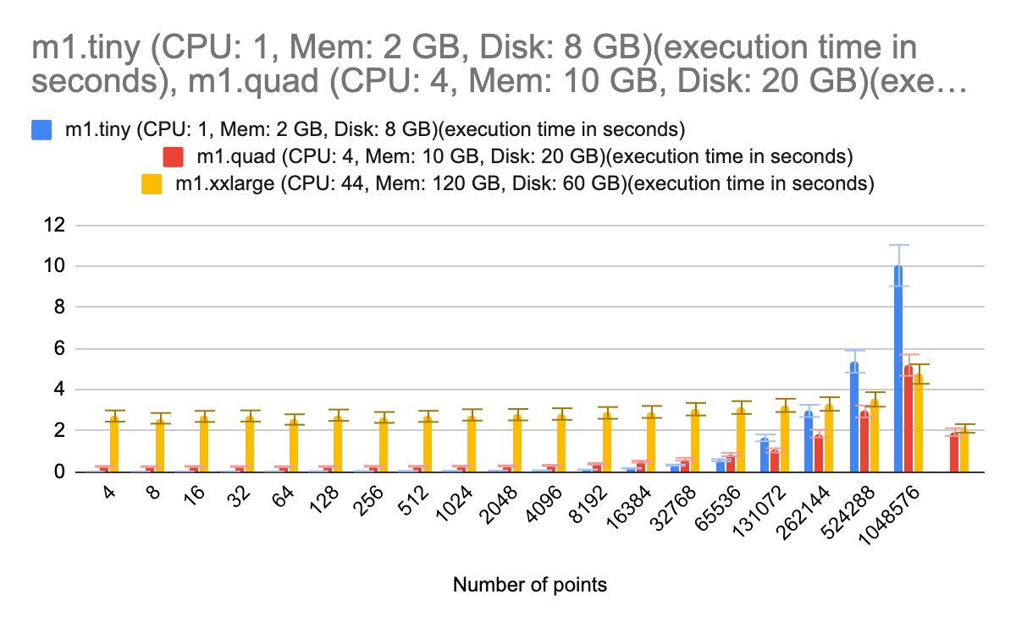
Overhead for Xsede Machines
Number of cores used Start-time(secs) End-time(secs) Total execution time=overhead(secs)
1 1592836927 1592836927 0
2 1592836914 1592836914 0
4 1592836899 1592836899 0
8 1592836716 1592836716 0
16 1592836690 1592836690 0.009999990463
32 1592836660 1592836660 0.01999998093
44 1592836290 1592836290 0.02999997139
Notes:
Code link: https://github.com/krb09/Benchmarking_K_Means/blob/master/start_workers.py

Slide 31
Relate between the Emulator and the VMs experiment
WorkLoad
K-Means Algorithm
N₁ Tasks
N₁ Iterations
N₂ Operations
N₂ Data_points X clusters
Notes:
Questions:
Both utilize parallel processing, but in different sense.

Slide 32
Mathematical deduction?
K- means Clustering:
Each iteration has number of points * number of clusters operations which do not influence the total complexity.
For instance 512 points * number of cluster, Each iterations = 512 X i ~ 512 * number of clusters operations ——————————— (1)
In the scikit K-means script, we have 300 iterations completed = 10.04 seconds (for an edge device)
1 iteration = 10.04 / 300 seconds ⇒ D ——————————————(2) => 1 second = 512 X 1/D operations ?? ——————--from (1) and (2)
Notes:
Analysis for scikit: https://scikit-learn.org/stable/modules/generated/sklearn.cluster.KMeans.html#:~:text=The%20k%2Dmeans%20problem%20is,is%20the%20number%20of%20iteration.&text=In%20practice%2C%20the%20k%2Dmeans,it%20falls%20in%20local%20minima. This brings me to the number of operations per second for a core

Slide 33
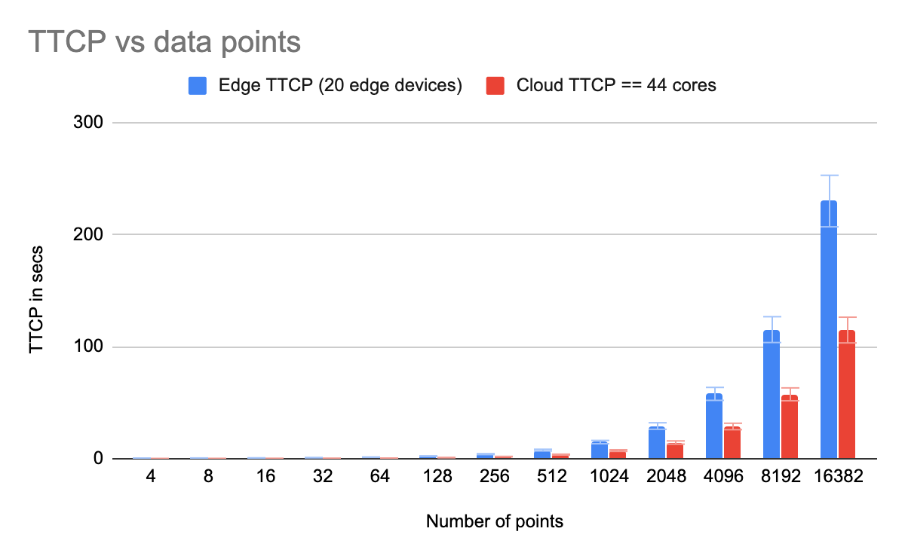
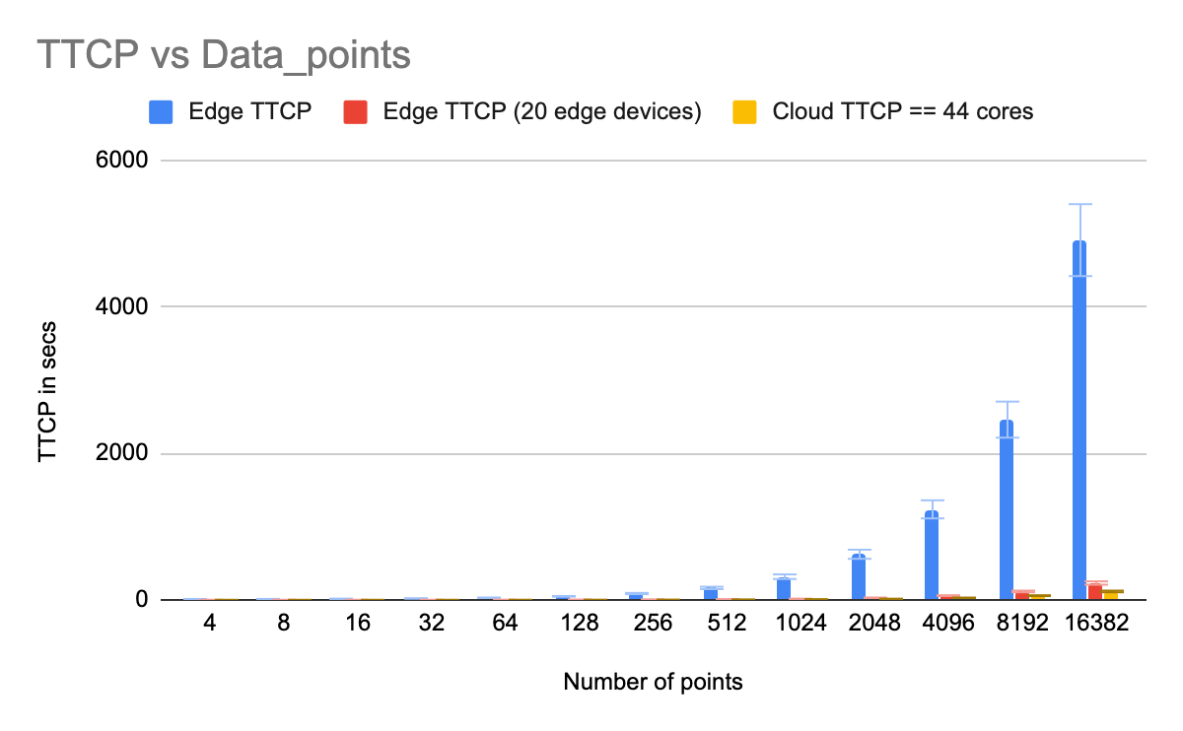
K_means Experiment on Emulator
Notes:
Put the data into the repository
Use case into rough draft
Ratio of data points to TTCP and between two TTCP

Slide 34
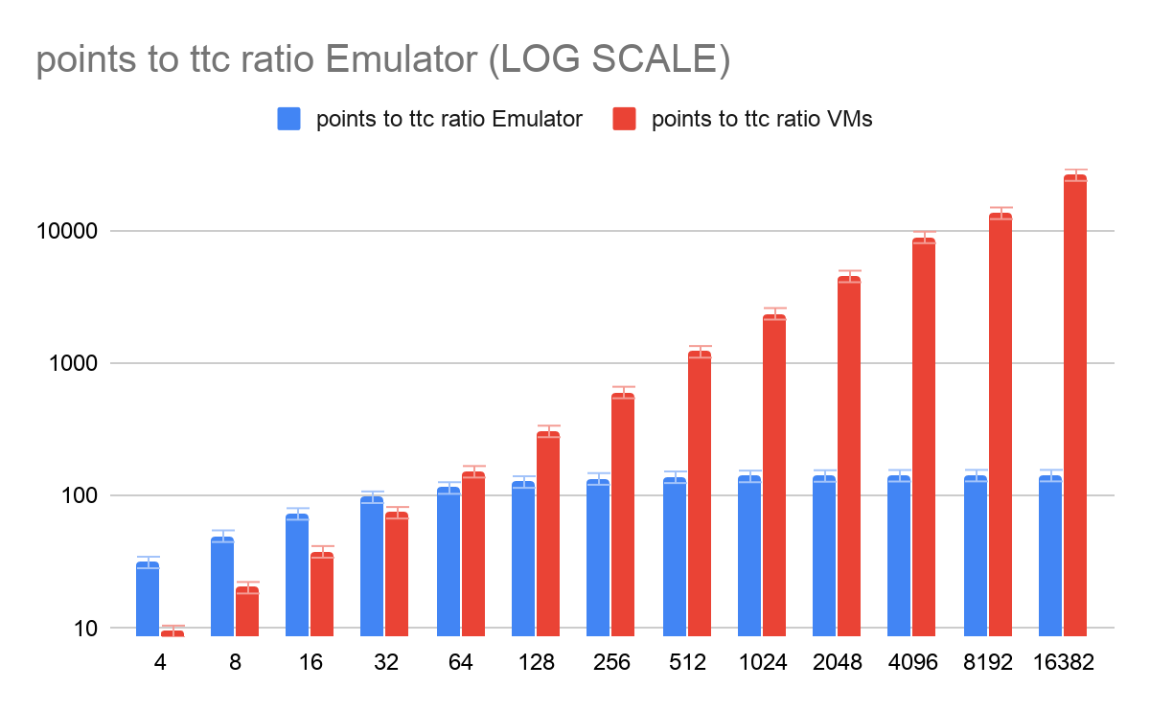
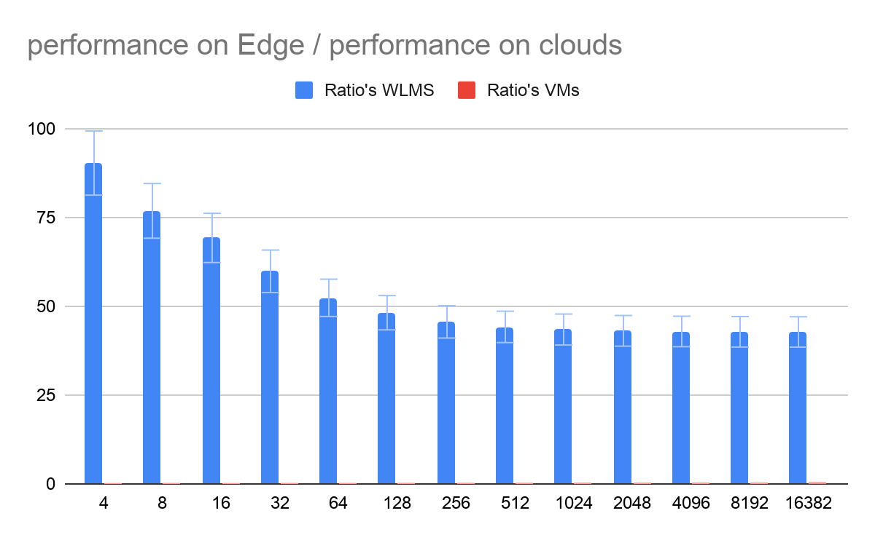
Ratios between data_points, and devices computation times
Notes:
VM :m1.xxlarge (CPU: 44, Mem: 120 GB, Disk: 60 GB)

Slide 35
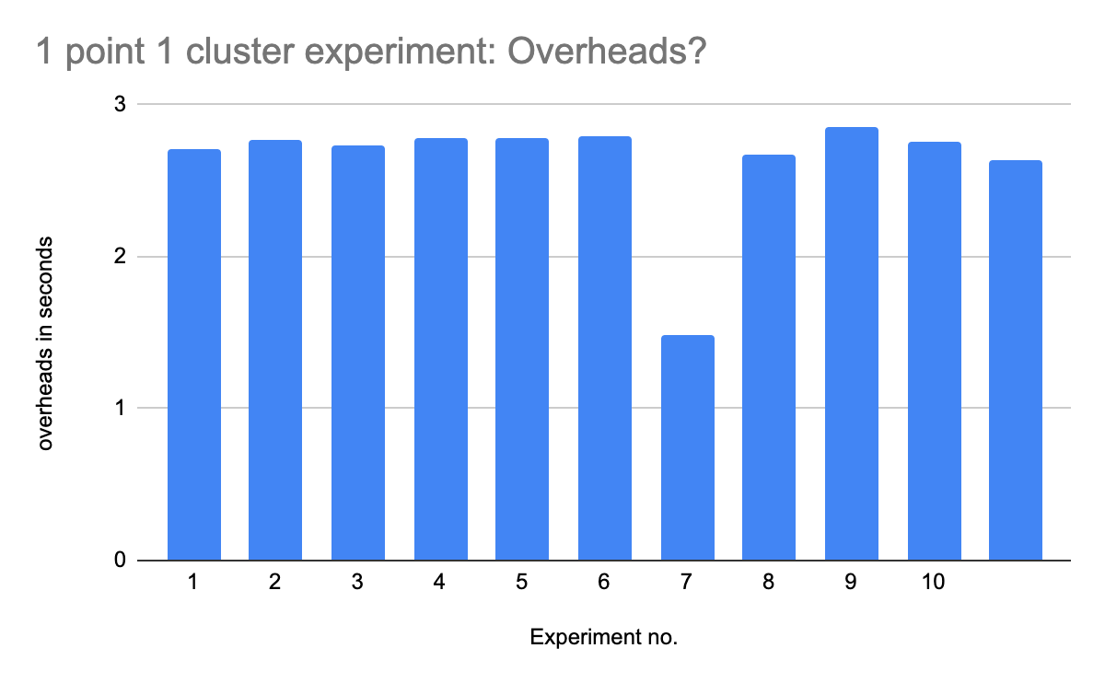
Overheads: one point one cluster K-Means on VMs

Slide 36
Ratios between data_points, and devices computation times
Apples and oranges
I repeated the experiments on the VMS and the emulator for one core (cloud devices).

Slide 37
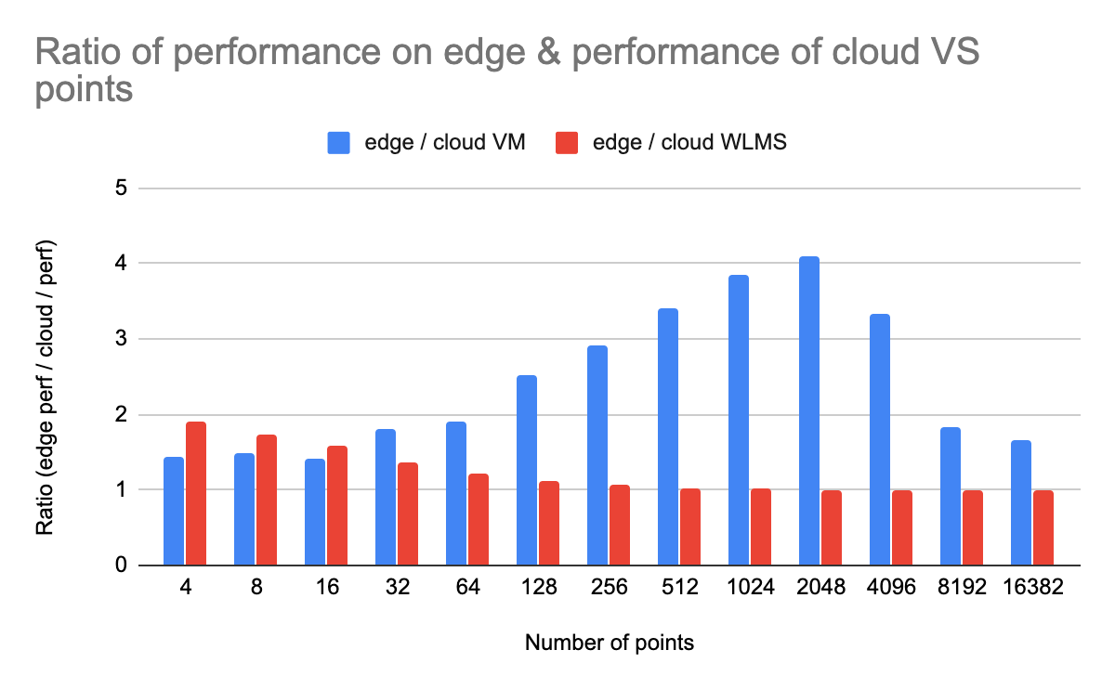
Ratios between data_points, and devices computation times ( 1 CORE)
Notes:
Parameters to fine tune Compute time on edge data movement and cloud compute time

Slide 38
Relate between the Emulator and the VMs experiment
WorkLoad
K-Means Algorithm
N₁ Tasks
N₁ Iterations
N₂ Operations
N₂ Data_points X clusters
VMs have 1 core per resource, therefore no concurrent execution of K-means. That is each iteration happens on 1 core and then we move on to the next iteration sequentially. For the emulator, the same thing happens. Each task (== each iteration) happens sequentially.
Notes:
1 core per resource

Slide 39
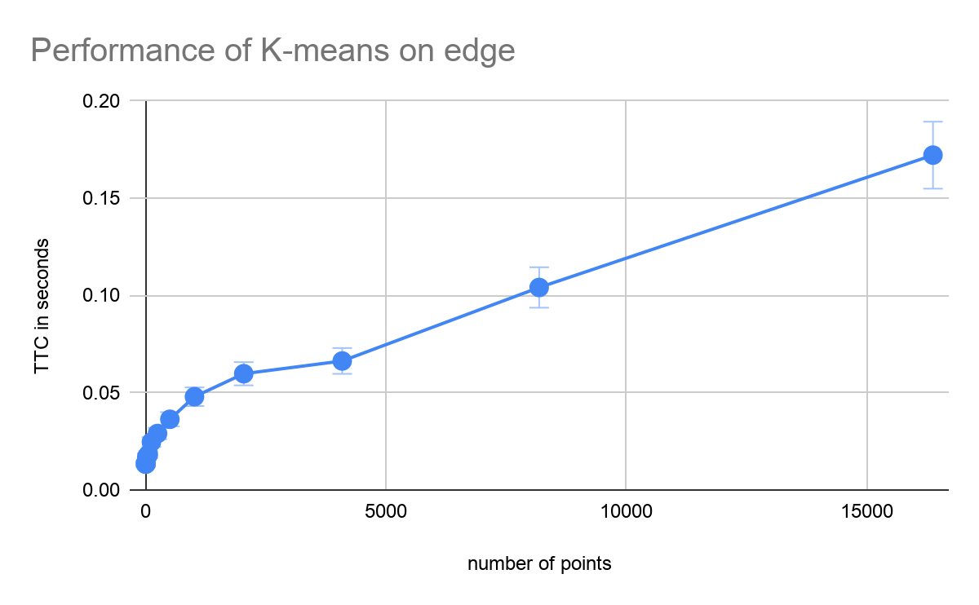
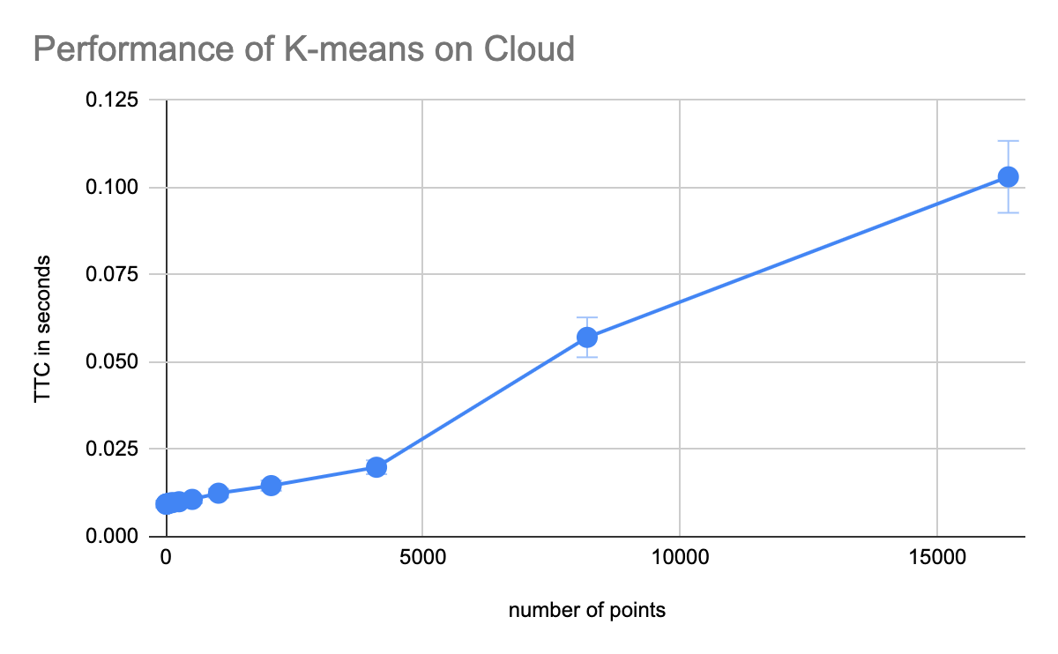
Ops per second to calculate Total time to execution
In the emulator: total time to execution = total ops in a task / performance of core
*performance of core = ops per second.
Tried to mimic the performance of these resources from the VM on jetstream
Notes:
Edge = m1.tiny (CPU: 1, Mem: 2 GB, Disk: 8 GB)(execution time in seconds)
Cloud = m1.xxlarge (CPU: 44, Mem: 120 GB, Disk: 60 GB)(execution time in seconds)

Slide 40
Ops per second to calculate Total time to execution
K-means clustering for D points in 3 cluster (300 iterations) = T secs
⇒ T secs = D x 3 x 300 ops
⇒ 1 sec = ( D x 3 x 300 ) / T ⇒ ops per second
Feeding this into the Emulator:
⇒ TTC = number of ops (D x3) / [ (D x 3 x 300) / T] ⇒ T / 300 ⇒ constant for the size of data points.
T differs for each of the data-size. So do I need to enter each time. But the number of ops per sec on a resource should be constant?
P1
C1
C3
C2
Notes:
Universal scalability law: reference
Vivek thesis, Giannis and Aydin for mimic workload

Slide 41
How do I calculate the ops per second for Emulator
I can figure out the ratio of performance between the two resources. BUT How do I calculate the number of ops done per second by the resource?
Till now I have been calculating the number of ops done to complete the K-means algorithm. How do I calculate the general performance?

