Slide 1
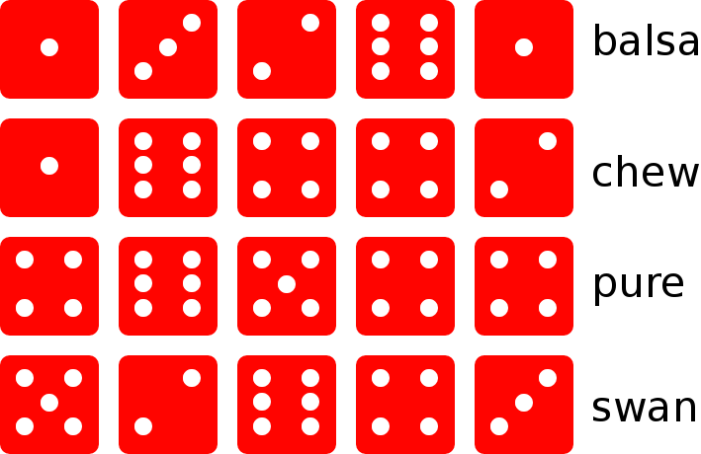
Probabilistic
Passphrase Cracking
Luc Gommans
Radically Open Security

Slide 2
Contents
Introduction
Prior Work
Research Question
Methods
Results
Conclusions
Future work

Slide 3
What are passphrases?
balsa chew pure swan
I have got a nice bike

Slide 4
Prior Work
2012 Labrande
Hybrid dictionary attack
2016 Sparell and Simovits
Markov chains
2017 Gaastra, Gijtenbeek and Gommans
Using lyrics and famous quotes

Slide 5
Research Question
How can software efficiently generate likely passphrases, to be used in passphrase cracking?
Efficient:
  Computational power
  RAM
  Storage
Likely:
  Results

Slide 6


Contribution
Implement a new method
Compare different methods
  Make previous work directly comparable

Slide 7
Hybrid dictionary attack
Reproduced Labrande‘s work
  Training dataset
  Effectiveness comparison
Dictionary of phrases + sets of rules
  Lowercase all, remove spaces, etc.

Slide 8
Probabilistic Method Selection
Markov chains
done by Sparell and Simovits
Probabilistic Context-Free Grammar
applied to passwords successfully
N-grams
popular in text prediction

Slide 9
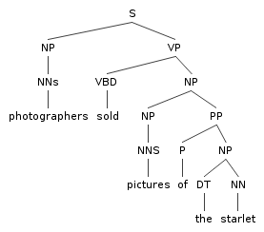
Context-Free Grammar
S → NP VP
NP → Det N | W
VP → V NP
W → I | he | she | Joe
Det → a | the | my | his
N → elephant | cat | jeans | suit
V → kicked | followed | shot
I followed Joe
a cat shot my elephant

Slide 10
Probabilistic
Context-Free Grammar
NP → 0.7(Det N) | 0.3(W)
Generate probabilities and rules based on texts
  Word classification database

Slide 11
N-grams
„have we lost or have we won“ n=2
  2 have we
  1 we lost
  1 lost or
  1 or have
  1 we won
→ have we won

Slide 12
N-grams
Generated weighted statistics from:
  Wikipedia articles
  Previously cracked passphrases
Cracking by taking the most frequently occurring
n-gram and finding continuations

Slide 13
Results
Effectiveness
Hybrid dictionary (Labrande)
  4.2M phrases of Korelogic (200k of ≥16 characters)
Hybrid dictionary (ours)
  2.3M phrases of Korelogic (147k of ≥16 characters)
  1.3M phrases of LinkedIn (13k of ≥16 characters)
Markov chains
  25k phrases of LinkedIn (384 of ≥16 characters)
N-grams
  835k phrases of Korelogic (33k of ≥16 characters)
  482k phrases of LinkedIn (4k of ≥16 characters)

Slide 14
Results
Efficiency
Hybrid dictionary
  Speed: >10 000 000 pps (phrases per second)
  Storage: medium (690MiB)
Markov chains
  Speed: 2 500–22 500 pps
  Storage: unknown
N-grams
  Speed: 3 300 000 pps
  Storage: low-medium (47-464MiB)

Slide 15
Conclusions
Hybrid dictionary is efficient and effective
N-grams most effective when length of phrase ≤n

Slide 16
Future work
Better language modeling using n-grams
Probabilistic Context-Free Grammar
Neural Networks

Slide 17
Thank you
Thanks to Radically Open Security
See our git repository for GPLv3 licensed:
  N-gram phrase generator & models (n=2 and n=3)
  Phrase dictionary & rules
  Slides and preview of the paper
github.com/radicallyopensecurity/passphrase-cracking
Questions?

