Slide 1
Password Cracking
Developed by:
September 5th, 2016 – (c) CC BY-SA 4.0
info@radicallyopensecurity.com

Slide 2
Agenda
Password Basics
  Definition and Terminology
  Password Policy Scenario
  Worst password
  Passphrase vs Password
  Strong password policy
How people manage passwords
How to manage passwords
Password Managment Tools

Slide 3
Password Basics
(Definition and Terminology)

Slide 4
Password
A secret word/string of characters used to authenticate a user into a system
Courtesy:https://en.wikipedia.org/wiki/Password

Slide 5
Hash
Use of cryptographic/mathematical algorithm to convert password into fix length string of character.

Slide 6
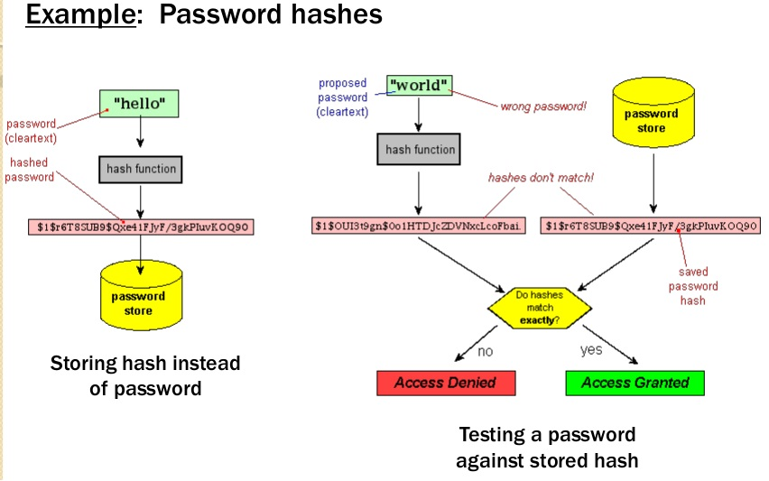
Password hash
Courtesy:http://www.differencebetween.info/difference-between-hashing-and-encryption

Slide 7
Password Cracking Techniques/Methods

Slide 8
Two types of password cracking
Online
  Trying different passwords to log in
  Can be slow and noisy
  You may only be allowed a few guesses
Offline
  You grabbed the password file (hash)
  You now are only limited by how fast your computer is

Slide 9
Attack Vector
Attack vectors enable hackers to exploit system vulnerabilities, including the human element.
Courtesy:http://searchsecurity.techtarget.com/

Slide 10
Worst password of 2015
Top 15: 123456, password, 12345678, qwerty, 12345, 123456789, football, 1234, 1234567, baseball, welcome, 1234567890, abc123, 111111
Internet of Things devices with default or no passwords
Automated tests for passwords
2)

Slide 11

Worst Passwords (Cont.)
All 11,000,000 passwords of Ashley Madison were hacked
'123456' and 'password' were most popular
Psyomjesus
2)

Slide 12
How People Manage passwords?

Slide 13
Password Management by Humans
Writing them down on sticky notes
Not changing default password
Keeping it simple i.e. “password”
Maintain a text file with user credentials
Using same credentials at multiple places*
*Specially the insecure ones ... (leaks)

Slide 14
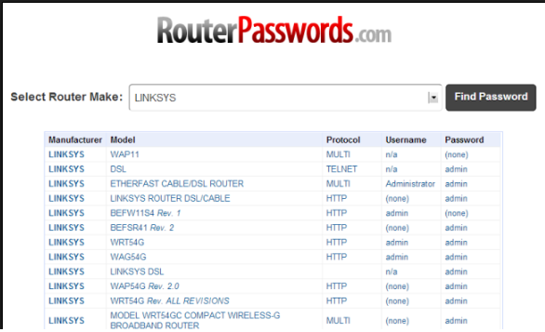
Online list of default password
Courtesy:http://www.howtogeek.com/131338/how-to-access-your-router-if-you-forget-the-password/

Slide 15
Hands-On
Tools and Techniques to crack password

Slide 16
Online - Dictionary attack
Hydra
rcrack
John the ripper
Hashcat

Slide 17
Password Cracking Tools

Slide 18
Tools
Jhon the Ripper
Cain and Abel
THC Hydra
Hashcat, WhitePixel
RainbowCrack
Aircrack-ng

Slide 19
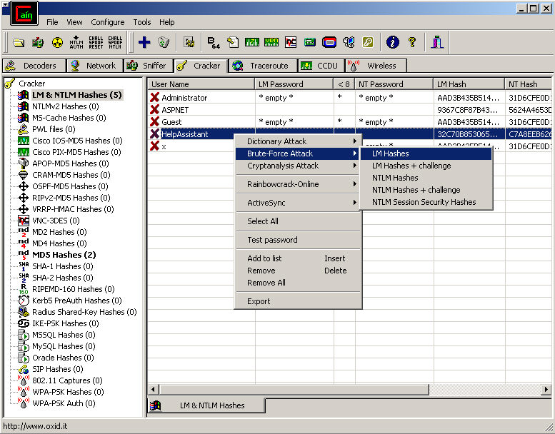
Cain and Abel
Courtesy:http://sectools.org/tool/cain/l

Slide 20
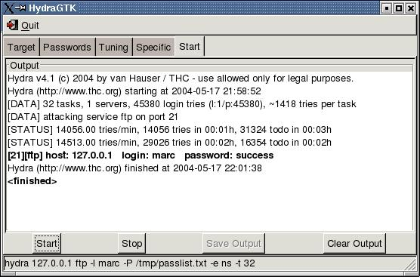
THC Hydra
Courtesy:http://sectools.org/tool/hydra/

Slide 21
Salt
A salt is random data that is used as an additional input to a one-way function that "hashes" a password or passphrase. Salts are closely related to the concept of nonce.
Courtesy:https://en.wikipedia.org/wiki/Salt_(cryptography)

Slide 22

Password Salt
Courtesy:http://sladigitalforensics.blogspot.in/2013/12/salted-hash-future-for-passwords.html

Slide 23
How to manage passwords

Slide 24
What help
Different passwords everywhere
  Twitter, Facebook, Google
  Government logins
  Banks
Better, stronger passwords
  Use password vaults
  Use longer texts
Protect your access with additional controls. i.e. 2FA

Slide 25
Password Management Tools

Slide 26
Password Management Tools
LastPass
  Free utility
  Just one “master password” to remember
  Can automatically log you on the websites
  https://lastpass.com/features_free.php

Slide 27
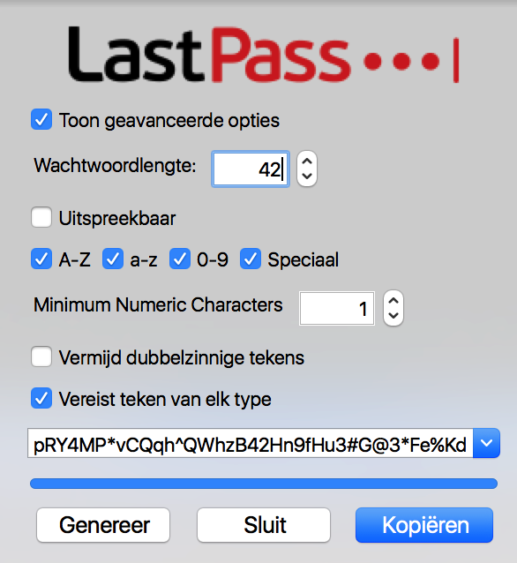
Password Management Tools

Slide 28
Password Management Tools
KeePass
  Free and opensource utility
  Supports the Advanced Encryption Standard (AES, Rijndael) and the Twofish algorithm to encrypt its databases
  Full database encryption including: user names, notes, etc.
  In-Memory Passwords Protection for master password
  Master password is hashed using SHA-256

Slide 29

Kee-Pass
Courtesy:http://keepass.info/

Slide 30
Passphrase vs password
Password composed of 10-12 letters and symbols (Special characters)
Passphrase is long sentence which contains spaces. Can also contain symbols
Passphrase are easier to remember
Passwords are relatively easy to guess or crack
Passphrase satisfies complex rules easily

Slide 31
Passpharase vs password
Major OS and applications supports passphrase : Up-to 127 characters long
Passphrases are hard to crack using standard attack vector like brutefoce/dictionary etc.
Example :
  “Friends don’t let friends reuse passwords”
  “!It’s fun to try the impossible!”
Courtesy:http://www.passworddragon.com/password-vs-passphrase

Slide 32
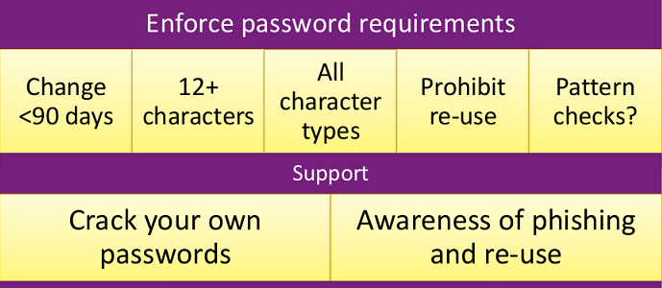
Strong password policy
Courtesy: https://www.rsaconference.com/writable/presentations/file_upload/pdac-w05_the_state_of_modern_password_cracking_final.ppt.pdf

Slide 33
Password Storage

Slide 34
Password Storage
In plain-text file
  .htpasswd, /etc/ppp/chap-secrets, browser/application cache file
In database
  Mysql, MS-SQL, sqlite
In memory
  Temporary storage

Slide 35
Password Storage
Windows
  SAM database, Active Directory
Linux
  /etc/shadow, OpenLDAP
Application Server
  Database and files

Slide 36
MITM – Password Sniffing using sslsniff

Slide 37
Password Sniffing
How is SSL used?
  Mostly people do not types https:// or http://
  People generally encounter SSL through HTTP code 302 (redirect)
  Which means that people only encounter SSL through HTTP
Courtesy:https://moxie.org/

Slide 38
In browser/application cache, local file and database

Slide 39
Chrome local database
Chrome stores all the sign-on details in file called 'Login Data' in the current user profile folder.
This database file is in SQLite format contains number of tables
The logins table mainly contains the information about sign-on secrets such as website URL, username, password fields etc. All this information is stored in the clear text except passwords which are in encrypted format.

Slide 40

Chrome Password Decryptor
Courtesy: http://securityxploded.com/chromepassworddecryptor.php

Slide 41
Password cracking time using various methods and hardware

Slide 42
Questions

