Slide 1
Password Cracking
Developed by:
September 5th, 2016 – (c) CC BY-SA 4.0
info@radicallyopensecurity.com

Slide 2
Agenda
Introduction
  Authentication Types
  Password policies
  Passphrase vs complex password
What you need to know about password
  How and where are they stored?
  How they are used?
  How they can be attack?
Password cracking tools
Password management tools
Q&A

Slide 3
Authtenticaiton Types
Something you know
  Password
Something you have
  Badge, token, digital certificate
Something you are (biometric)
  Fingerprint, retina

Slide 4
Password Policies Scenario
Which one is better?
  8 character password with only mix-alpha-numeric (26 lower case, 26 uppercase, 10 ditigit)
  6 character password with mix-alpha-numeric-special-character (26 lower case, 26 uppercase, 10 ditigit, 33 sepcial character)
  7 character password with mix-alpha-numeric-special-character (26 lower case, 26 uppercase, 10 ditigit, 33 sepcial character)

Slide 5
Password Policies Scenario
Scenario 1
  62^8
  Combinations of pass 218,340,105,584,896
Scenario 2
  95^6
  Combinations of pass 735,091,890,625
Scenario 3
  95^7
  Combinations of pass 69,833,729,609,375

Slide 6
Password Calculator
http://calc.opensecurityresearch.com/
http://projects.lambry.com/elpassword/

Slide 7
Passphrase vs password
Password composed of 10-12 letters and symbols (Special characters)
Passphrase is long sentence with contains spaces. Can also contain symbols
Passphrase are easier to remember
Passwords are relatively easy to guess or crack
Passphrase satisfies complex rules easily

Slide 8
Passpharase vs password
Major OS and applications supports passphrase : Up-to 127 characters long
Passphrases are hard to crack using standard attack vectore like brutefoce/dictionary etc.
Example :
  “Friends don’t let friends reuse passwords”
  “!It’s fun to try the impossible!”

Slide 9
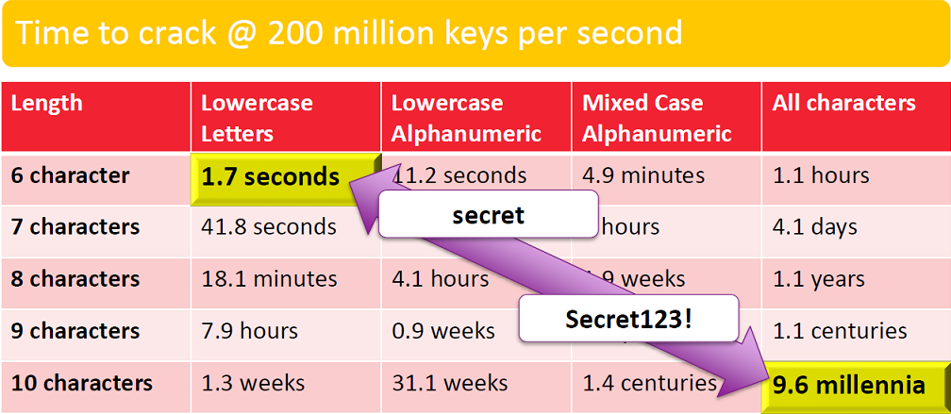
Interesting facts (Brute force)

Slide 10
What you need to know about passwords
How are they stored?
  Password storage
How are they used?
  Application authentication
  Network based authentication protocols
How they can be attack?
  Password cracking methods
  Password cracking tools

Slide 11
Password Storage
How they store
  Plain text
  Encrypted
    DES, 3DES, AES, blowfish etc.
  Hash
    MD5, SHA1/2, SHA258, SHA512, NT Hash, LM Hash (MD4) etc.

Slide 12
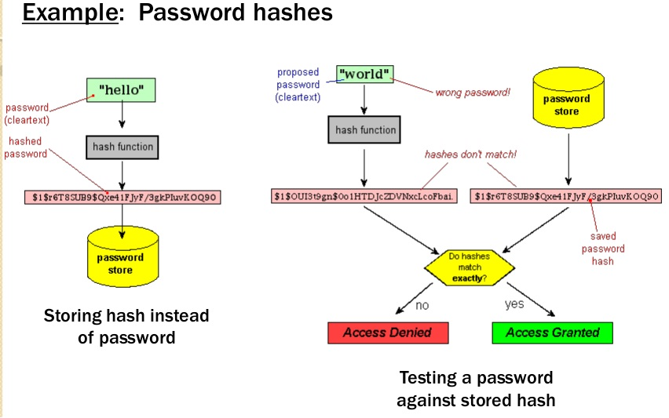
Password hash

Slide 13
Hashing Vs Encryption
 | Hashing | Encryption
Definition | Hashing involves the conversion of plaintext into a hash or digest. A digest cannot be reversed into the original message. | Encryption is the process of converting plain text into cypher by using an algorithm. The encrypted message can only be read by knowing the encryption key.
Protection of | Integrity | Confidentiality
Unlocking | No key can be used for unlocking | Requires key for unlocking

Slide 14
Hashing Vs Encryptino
 | Hashing | Encryption
Channel | One Way | Two Way
Action | Relatively Light | Relatively heavier
Example | Password hash storage, to check integrity of downloaded file | File transfer,encrypte instant messing

Slide 15
Salt
A salt is random data that is used as an additional input to a one-way function that "hashes" a password or passphrase. Salts are closely related to the concept of nonce. The primary function of salts is to defend against dictionary attacks or against its hashed equivalent, a pre-computed rainbow table attack.

Slide 16

Password Salt

Slide 17
Password Storage
Where they stored
  In file
    .htpasswd, /etc/ppp/chap-secrets,
  In database
    Mysql, MsSql, sqlite
  In memory

Slide 18
How are password stored
LM Hash
  Old method, mostly obsolete
NT Hash
  Still supported on windows environment but not preferable
  Replaced by Kerberos

Slide 19
LM Hash generation
Padded with NULL to 14 characters
Converted to upper case
Separated into two 7 characters strings

Slide 20
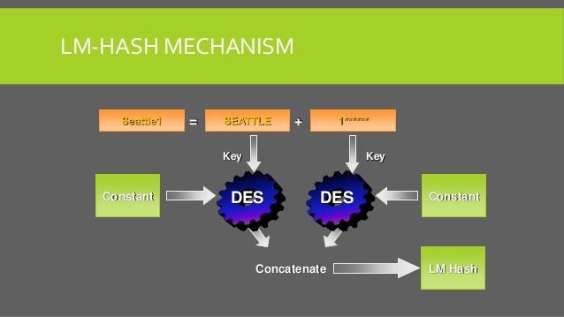
LM Hash
Courtesy: download.microsoft.com

Slide 21
NT Hash
Hash the password
Store it
MD4
unicode
Pwd
Seattle1

Slide 22
Password Storage
SAM database
LDAP/Active Directory
/etc/shadow
Database

Slide 23
Where NT Stored Password
Windows use SAM to store password
  The SAM Registry Keys
    HKEY_LOCAL_MACHINE->SAM
    Only accessible to built-in system account
  SAM on Storage Subsystems
    %systemroot%system32\config
    Lsass.exe lock the file for exclusive use
    \repair directory

Slide 24
Where NT Stored Password
  Password Hash in Memory
    NT cache the logon credentials for past 10 users
  SAM on the network
    Server Message Block(SMB) Protocol
    Sniffing SMB based password hashes (L0phtCrack’s)

Slide 25
How they are used?

Slide 26
Application Authentication
HTTP authentication
HTTP form based authentication
FTP authentication
SMTP authentication
IMAP/POP3 authentication

Slide 27
Authentication Protocols (FYI)
Key authentication protocols
  PAP (Password authentication protocol)
  CHAP (Challenge-handshake authentication protocol)
  MS-CHAP and MS-CHAPv2
  EAP (Extensible authentication protocol)
  NTLM
  Kerberos
  AD/LDAP
  RADIUS
  TACACS and TACACS+

Slide 28
Authentication on network layers
Application
HTTP, FTP, SMTP
Application
Transport
SSL, SSH
Transport
Network
IPSEC
Network
Link
PAP, CHAP, WEP
Link
Physical
Physical

Slide 29
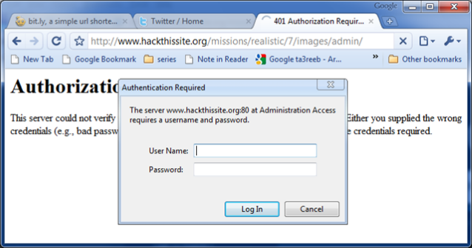
HTTP Authentication

Slide 30
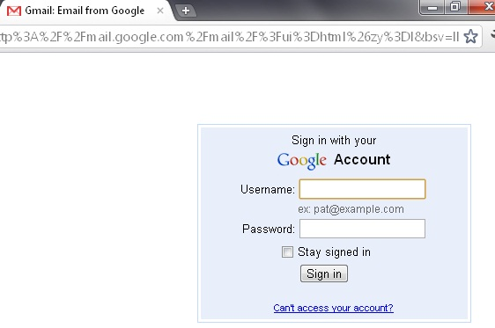
HTTP Form based Authentication

Slide 31
Difference between http auth and http form base auth
HTTP uses in build HTTP authentication mechanism called basic auth
  Server sends 401 Response status code to client
  Browser pop up authentication window
  Password stored in .htpass file
  Password generated throguh htpasswd command
HTTP form based authentication uses database (mostly) to store user credentials
  Authentication performed through SQL query
  Storage of password is depends on application developer

Slide 32
How they can be attack?

Slide 33
Two types of password cracking
Online
  Trying different passwords to log in
  Can be slow and noisy
  You may only be allowed a few guesses
Offline
  You grabbed the password file (hash)
  You now are only limited by how fast your computer is

Slide 34
Attack Vector
Dictionary/Brute foce attack
Offline and Rainbow table attack
Password sniffing (MITM) attack sslstrip/sslsniff
In browser/application cache
Authentication through password hash
Pass the hash attack
In memory

Slide 35
Attack Vector
Shoulder surfing
Guess
Spidering
Access of authentication database/server
Password Hardcoded in thick client

Slide 36
Attack Vector
Dictionary Attack
  A dictionary attack is a method of breaking into a password-protected computer or server by systematically entering every word in a dictionary(wordlist) as a password.
Brute force attack
  Brute force (also known as brute force cracking) is a trial and error method used by application programs to decode encrypted data such as passwords or Data Encryption Standard (DES) keys, through exhaustive effort (using brute force) rather than employing intellectual strategies.

Slide 37
Hands-On

Slide 38
Dictionary attack
HTTP Basic auth
  hydra -l "admin" -P /usr/share/wordlists/rockyou.txt localhost http-get /basic
HTTP form
  hydra -l "admin" -P /usr/share/wordlists/rockyou.txt localhost http-form-post "/form/index.php:username=^USER^&password=^PASS^:Login failed"

Slide 39
Brute Force Attack
HTTP Basic auth
  hydra -l "admin" -x 6:8:a1 localhost http-get /basic

Slide 40
Hands-On Done

Slide 41
Attack Vector
Offline Attack
  Needed access to password hash(es)
  Hash(es) dump through compromised host
  No Lockout
Rainbow table attack
  One form of offline attack
  A rainbow table is a list of pre-computed hashes
  Compormised hash get compair against the pre-computed hash

Slide 42
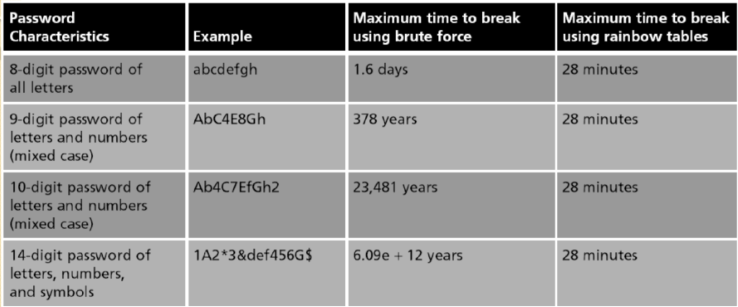
Brute force vs Rainbow table

Slide 43
Hands-On

Slide 44
Offline cracking hands-on
John the ripper
  Bechmark (number of hashes per second)
    john –test
  Brute force attack on md5crypt
    john --format=md5crypt --incremental=alpha hashes.txt
  Show the current status of crack hashes
    john --show myhashfile.txt

Slide 45
Offline cracking with hashcat
Hashcat
  Benchmark (number of hashes per second)
    hashcat -b
  Brute force attack on md5crypt
    ashcat -m 500 hashes.txt wordlist.txt
  To display cracked hashes
    hashcat -m 3000 --show My_LM_hash.txt

Slide 46
Offlien Cracking tool hashcat
brute force command where we look for passwords 1-8 characters long, starting with 4 lowercase letters, followed by 4 numbers.
  hashcat -m 500 -a 3 hashes.txt ?l?l?l?l?d?d?d?d --increment

Slide 47
Rainbowcrack
rcrack /usr/share/rainbowtables/lm_alpha-numeric#1-7_1_3800x33554432_0.rt -l /root/password-cracking/rainbow/hashes_lm.txt
-l option to specify a list of hashes contained in a file

Slide 48
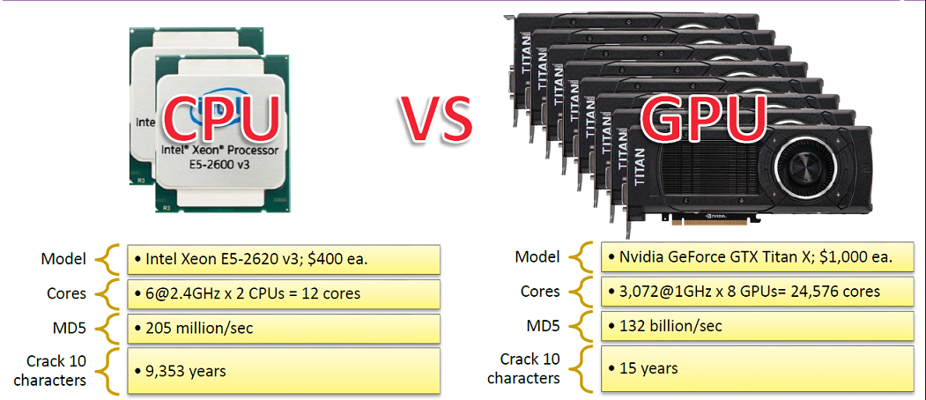
CPU Vs GPU

Slide 49
Attack Vector
Password sniffing
  MITM using sslsniff/sslstrip

Slide 50
How is SSL used?
  Mostly people do not types https:// or http://
  People generally encouter SSL throuh HTTP code 302 (redirect)
  Which means that people only encounter SSL through HTTP

Slide 51
Scenario
Victim IP
  192.168.2.2
Attacker IP
  192.168.2.3
Gateway
  192.168.2.1
Interface
  eth0

Slide 52



Network Diagram
Victim
Switch
192.168.2.2/24
0.0.0.0/0
Attacker
192.168.2.1/24
eth0
Gateway
192.168.2.3/24

Slide 53
Attacker Machine
Step 1
  echo "1" > /proc/sys/net/ipv4/ip_forward
Step 2
  ./sslstrip.py -l 8090 -p
Step 3
  iptables -t nat -A PREROUTING -p tcp --destination-port 80 -j REDIRECT --to-port 8090
Step 4
  arpspoof –i eth0 –t 192.168.2.2 192.168.2.1

Slide 54
Veictime Machine
Step 6
  Go to victim machine and type yahoo.com or facebook.com or twitter.com
  You will see now login page of yahoo.com as http: instead of https://yahoo.com
  Enter the user name and password on the page and click on login

Slide 55
Attacker Machine
Step 6
  Check the log file in “sslstrip.log” in sslstrip directory in local directory.
  Open “sslstrip.log” file and look for POST method
  You can see entered username and password

Slide 56
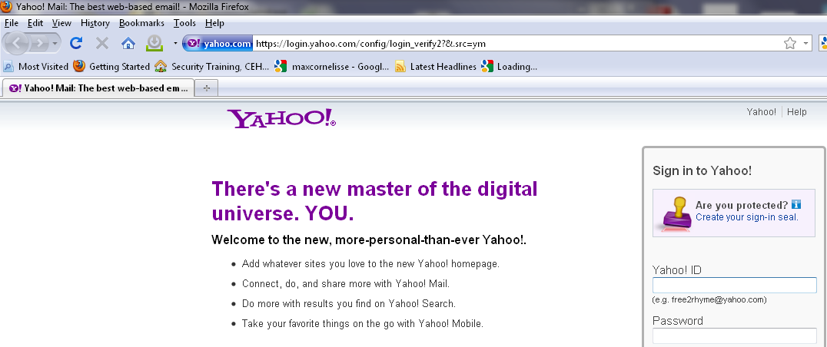
Secure Site

Slide 57
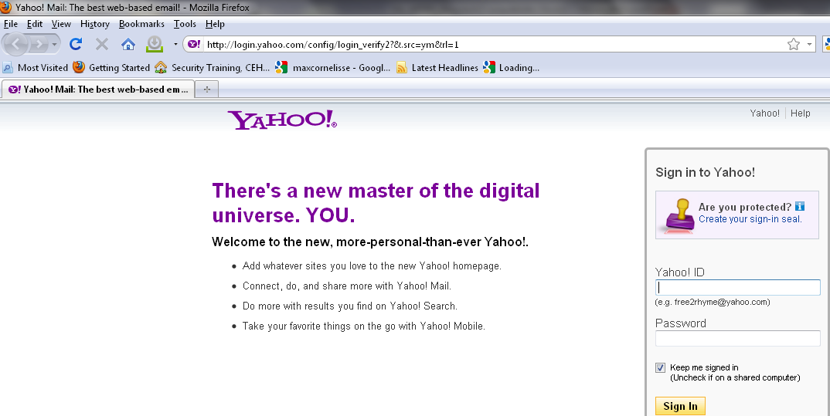
Insecure Site

Slide 58
Attack Vector
In browser/application cache
Google Password Decryptor
  http://securityxploded.com/googlepassworddecryptor.php
  http://securityxploded.com/googlepasswordsecrets.php
Facebook Password Decryptor
  http://securityxploded.com/facebookpassworddecryptor.php
Browser Password Decryptor
  http://securityxploded.com/browser-password-decryptor.php

Slide 59
Attack Vector
Download any of the password recovery tool from below link
  http://securityxploded.com/password-recovery-tools.php
Install on windows machine from which you want to restore saved password
Click on Start Recovery
You can save all recovered password list to HTML/XML/Text/CSV file

Slide 60

Chrome Password Decryptor

Slide 61
Attack Vector
Authentication through password hash
Pass the hash attack
  A pass the hash attack is an expoit in which an attacker steals a hashed user credential and, without cracking it, reuses it to trick an authentication system into creating a new authenticated session on the same network.

Slide 62
Attack Vector
Steps
  Attacker obtains the hashes from the traget system
  Attacker uses tools to send hash
  Authentication system believe that the attacker's endpoint is the legitimate user.

Slide 63
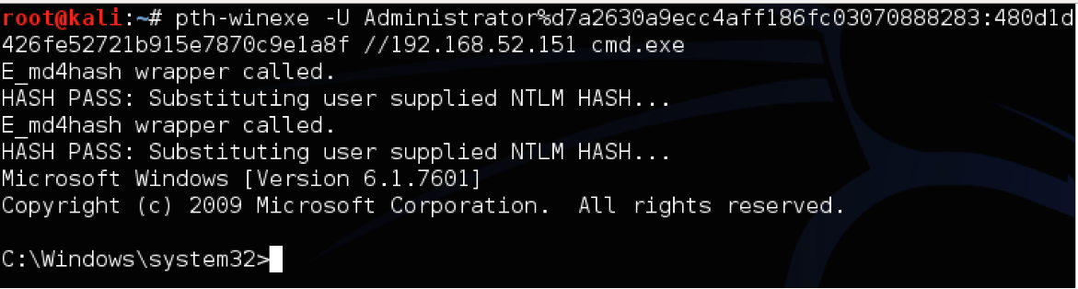
Pass the hash attack

Slide 64
Hands-On

Slide 65
Attack Vector
Forget password
  Interesting case study
  Anatomy Of The Twitter Attack
  https://techcrunch.com/2009/07/19/the-anatomy-of-the-twitter-attack/

Slide 66
Attack Vector
Security Questions
  Google Study: Most Security Questions Easy To Hack
    https://techcrunch.com/2015/05/21/google-study-shows-security-questions-arent-all-that-secure/
  Facebook security question vulnerability
    http://www.hacker9.com/facebooks-security-question-vulnerability-bypassing-security-question.html

Slide 67
Attack Vector
Security Question (Not recommanded)
  What is your favorite food?
  What is your favorite color?

Slide 68
Attack Vector
Phishing
  Phishing is the attempt to obtain sensitive information such as usernames, passwords, and credit card details (and sometimes, indirectly, money), often for malicious reasons, by masquerading as a trustworthy entity in an electronic communication

Slide 69
Attack Vector
Social Engineering
  Social engineering, in the context of information security, refers to psychological manipulation of people into performing actions or divulging confidential information. A type of confidence trick for the purpose of information gathering, fraud, or system access, it differs from a traditional "con" in that it is often one of many steps in a more complex fraud scheme.

Slide 70
Attack Vector
Malware (Man in the browser)
  Man-in-the-browser (MITB, MitB, MIB, MiB), a form of Internet threat related to man-in-the-middle (MITM), is a proxy Trojan horse that infects a web browser by taking advantage of vulnerabilities in browser security to modify web pages, steal user credentials, modify transaction content or insert additional transactions, all in a completely covert fashion invisible to both the user and host web application.

Slide 71
Attack Vector
Shoulder surfing
  In computer security, shoulder surfing refers to using direct observation techniques, such as looking over someone's shoulder, to get information. It is commonly used to obtain passwords, PINs, security codes, and similar data.

Slide 72
Attack Vector
Guess
  Crack password through predictability and knowledge about the user
  Always change default password for application/products
Spidering
  Studying coporate literature, website sales materials and competitors and build custom word list

Slide 73
Attack Vector
Password Hardcoding
  The software contains a hard-coded password, which it uses for its own inbound authentication or for outbound communication to external components.

Slide 74
Attack Vector
Access of authentication database/server
  Attacker compromises database server using web vulnerabilities like SQL injection, file upload/inclusion or application server/software exploitable vulnerabilities.

Slide 75
Tools
Jhon the Ripper
Cain and Abel
THC Hydra
ophcrack and L0phtcrack
Aircrack-ng
hashdump
hashcat
RainbowCrack

Slide 76
Tools
John the ripper
  Offline cracking tool
  Command line tool for linux and Mac OS X
  Built-in default password cracking strategy
  Accept file format username:hash
  John-jumbo for large cracking jobs, uses GPU and cluster computin
  Perform session managment

Slide 77
Tools
Johb the ripper
  Support mutiple hash format like i.e. crypt, des, md5, krb4/5 (Kerberos ), mssql, mysql, oracle 11g, sha1/2-512 etc.
  http://pentestmonkey.net/cheat-sheet/john-the-ripper-hash-formats

Slide 78
Tools
Cain and Abel
  Offline Cracking tool
  For windows only
  Support cracking of NTLM, NTLMv2, MD5, wireless, Oracle, MySQL, SQL Server, SHA1, SHA2, Cisco, VoIP etc.
  Uses Dictionary attack, rainbow attack, and brute force
  Can also pefrom MITM using ARP Poisoning and can perform sniffing

Slide 79
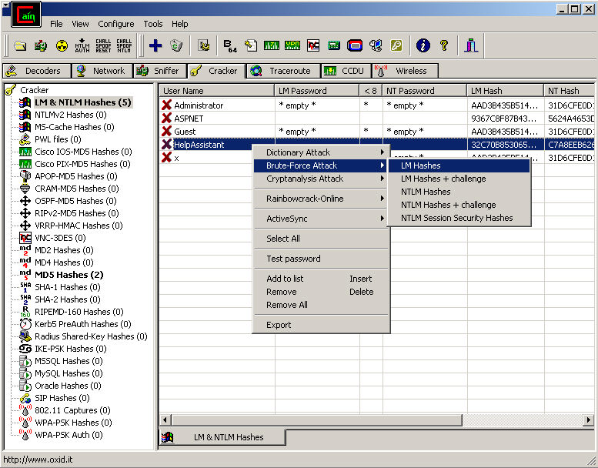
Cain and Abel

Slide 80
THC-Hydra
  Available on windoes, linux and Mac OS
  Online password cracking tool
  Perform dictionary attack
  Support more then 50+ authentication protocols i.e. telnet, ftp, http, https, smb, several databases etc.
  https://www.thc.org/thc-hydra/network_password_cracker_comparison.html

Slide 81
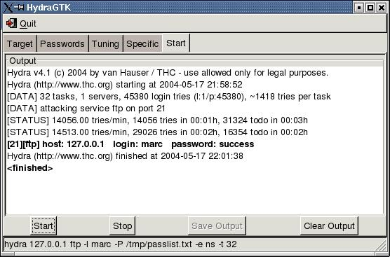
THC Hydra

Slide 82
Tools
L0phtcrack
  Crack windows password from hashes.
  Pre-computed dictionary support
  Provide executive level reporting

Slide 83
Tools
Hashcat
  Offline cracking tool
  Uses available GPU
  Support session managment
  Better optimize algorithm

Slide 84
Tools
RainbowCrack
  Full time-memory tradeoff tool suites
  Support rainbow table of any hash algorithm and any charset
  Run on windows and linux both
  GPU acceleration with multiple GPUs
  Command line and Graphics user interface

Slide 85
Tools
Aircrack-ng
  Wi-fi hacking tool
  Capable of cracking WEP and WPA2
  Only available for Linux
  Require compatible wireless card
  Require bit of learning curve

Slide 86
References
http://sectools.org/tag/pass-audit/
http://securityxploded.com/password-recovery-tools.php
http://pentestmonkey.net/cheat-sheet/john-the-ripper-hash-formats

Slide 87
Password Managment Tools

Slide 88
Tools
LastPass
  Free utility
  Just one “master password” to remember
  Can automatically log you on the websites
  https://lastpass.com/features_free.php

Slide 89
Tools
KeePass
  Free and opensource utitlity
  Supports the Advanced Encryption Standard (AES, Rijndael) and the Twofish algorithm to encrypt its databases
  Full database encryption including
  user names, notes, etc.
  In-Memory Passwords Protection for master password
  Master password is hashed using sha-256

Slide 90

Kee-Pass

Slide 91
Courtesy
http://searchsecurity.techtarget.com/
http://null-byte.wonderhowto.com/how-to/password-cracking/
http://www.differencebetween.info/difference-between-hashing-and-encryption
http://www.unixwiz.net/techtips/iguide-crypto-hashes.html
http://sladigitalforensics.blogspot.in/2013/12/salted-hash-future-for-passwords.html

Slide 92
Courtesy
http://www.passworddragon.com/password-vs-passphrase

Slide 93
Questions?

