Slide 1
Password Management and Cracking Training
Developed by: Melanie Rieback, Rais Mense,
Nathan Stern, Murtuja Bharmal,
Fernando Quintero
September 28th, 2016 – (c) CC BY-SA 4.0
info@radicallyopensecurity.com

Slide 2
Agenda
Part I – Password Creation
  Intro: what are Passwords? Hashes?
  Weak passwords (guessability, recon, default Pws)
  Attacks against passwords (brute force, dictionary attacks)
  DEMO: PW cracking (Online vs. Offline, Rainbow Tables)
  Solutions (salt, passphrases, PW policies)
Part II – Password Usage
  Passwords on the Wire
  DEMO: password sniffing with WiFi Pineapple (http, ssl-strip)
  Worst Password Management techniques
Part III – Password Storage
  Intro to PW Storage (text files, DBs, memory, Linux)
  Password caching, pros vs. cons
  DEMO: retrieving passwords from memory w/ Volatility
  Solutions (PW vaults, encryption in DBs/filesystems)

Slide 3
Part I - Password Creation

Slide 4
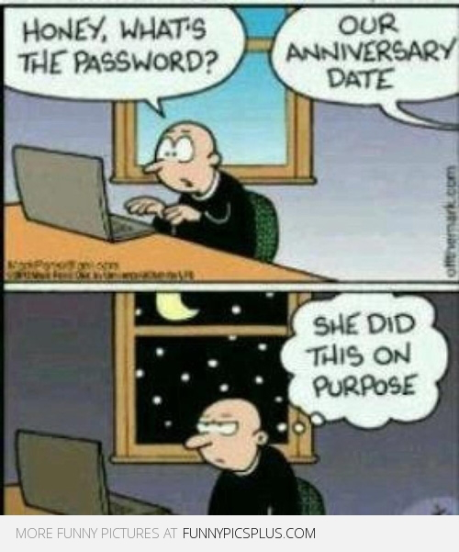
What is a Password?
A secret word/string of characters used to authenticate a user into a system
Authentication trilogy
  What you have
  Who you are
  What you know

Slide 5
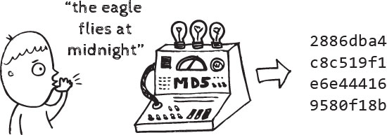
Hash Functions
Cryptographic one-way functions, that convert a string into fixed number of character.
Example algorithms: NT Hash, LM Hash, MD4, MD5, SHA1, SHA2, SHA256, SHA512

Slide 6
Hashing Vs Encryption
 | Hashing | Encryption
Definition | Hashing involves the conversion of plaintext into a hash or digest. A digest cannot be reversed into the original message. | Encryption is the process of converting plain text into cipher by using an algorithm. The encrypted message can only be read by knowing the encryption key.
Protection of | Integrity | Confidentiality
Unlocking | No key can be used for unlocking | Requires key for unlocking
Courtesy:http://www.differencebetween.info/difference-between-hashing-and-encryption

Slide 7
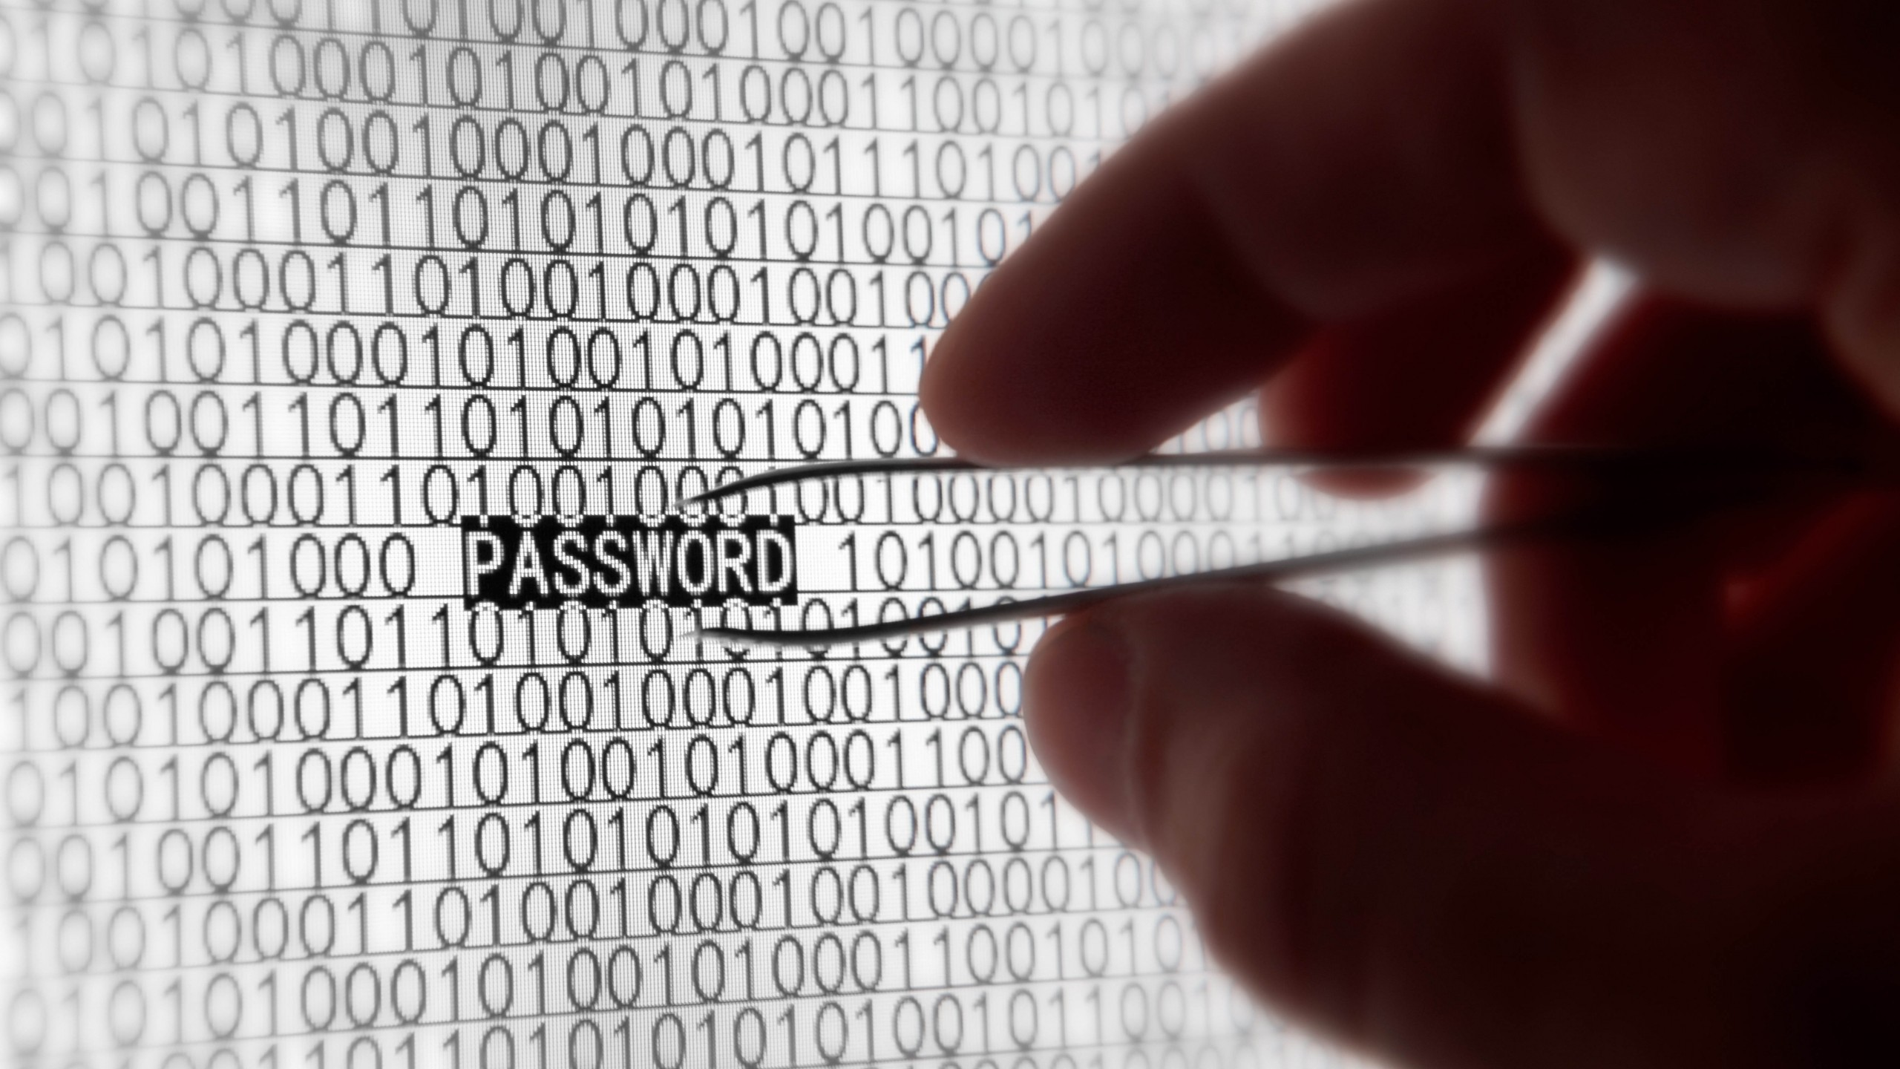
Worst Passwords of 2015
Top 15: 123456, password, 12345678, qwerty, 12345, 123456789, football, 1234, 1234567, baseball, welcome, 1234567890, abc123, 111111
All 11,000,000 passwords of Ashley Madison were hacked
2)

Slide 8
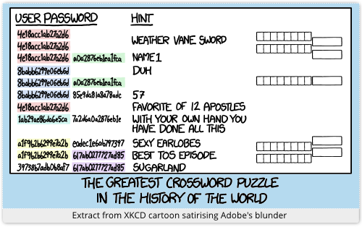
What makes passwords weak?
Guessability
  Predictability and low entropy
Relevance
  Studying corporate literature, website sales materials and competitors, build custom word list

Slide 9
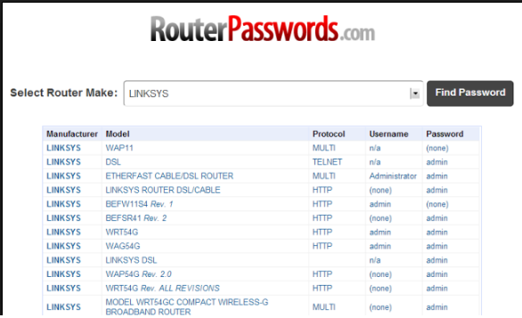
Default Passwords
Courtesy:http://www.howtogeek.com/131338/how-to-access-your-router-if-you-forget-the-password/

Slide 10
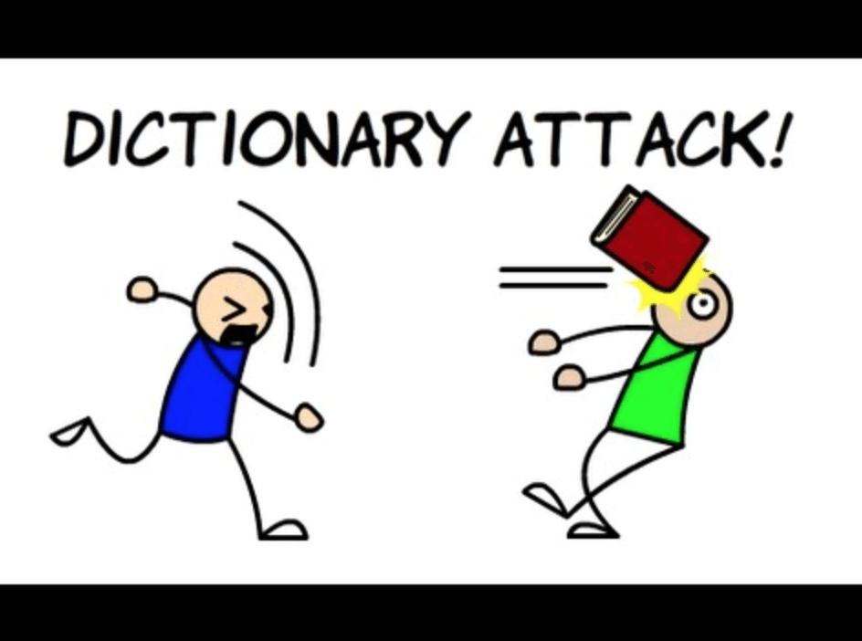
Attacks Against Passwords
Dictionary Attack
  Systematically entering every word in a dictionary(wordlist) as a password
Brute force attack
  Decoding encrypted/hashed data through exhaustive effort (using brute force) rather than employing intellectual strategies.
Courtesy:http://searchsecurity.techtarget.com/

Slide 11

Types of Password Cracking
Online
  Trying different passwords interactively
  Usually slow and noisy
  You might be allowed only a few guesses
Offline
  Processing password files/hashes locally
  Limited by computing speed

Slide 12

Rainbow Tables
Rainbow Tables
  A rainbow table is a list of pre-computed hashes
  The hash to test gets compare against the other pre-computed hashes
  Space/time tradeoff

Slide 13

DEMO TIME!!!
Estimator
Generator
Offline cracking
Rainbow tables

Slide 14
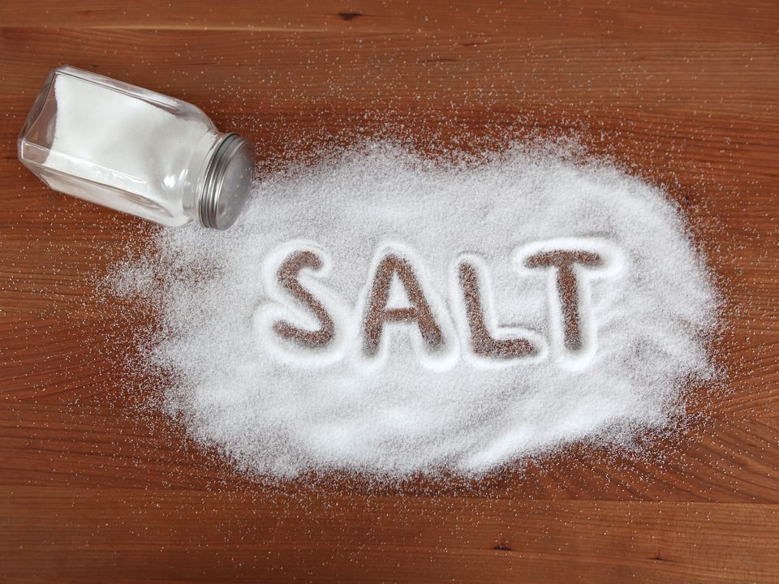
Solutions: Salt
Random data used as additional input to a one-way hash function.
Salt can defend against dictionary attacks or pre-computed rainbow table attacks

Slide 15

Example: Password Salt
Courtesy:http://sladigitalforensics.blogspot.in/2013/12/salted-hash-future-for-passwords.html

Slide 16
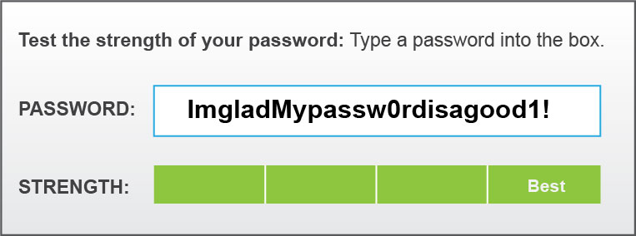
Passphrases vs Passwords
Passwords usually 10-12 letters / numbers / symbols
Passphrase is long sentence which contains spaces. Can also contain symbols.
Passphrases have more entropy

Slide 17
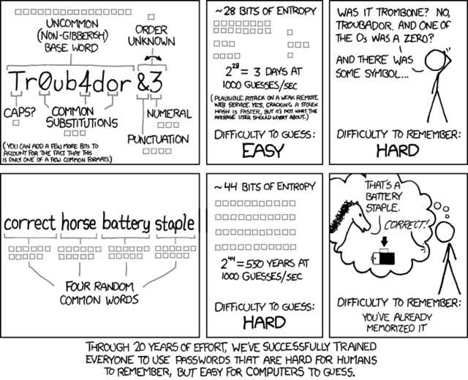
xkcd on Passphrases <3

Slide 18
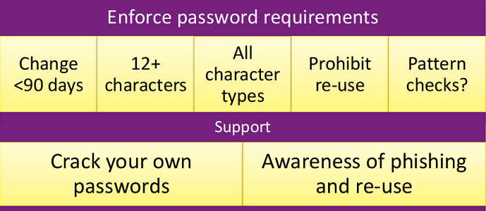
Password Policy
Courtesy: https://www.rsaconference.com/writable/presentations/file_upload/pdac-w05_the_state_of_modern_password_cracking_final.ppt.pdf

Slide 19
Part II - Password Usage

Slide 20
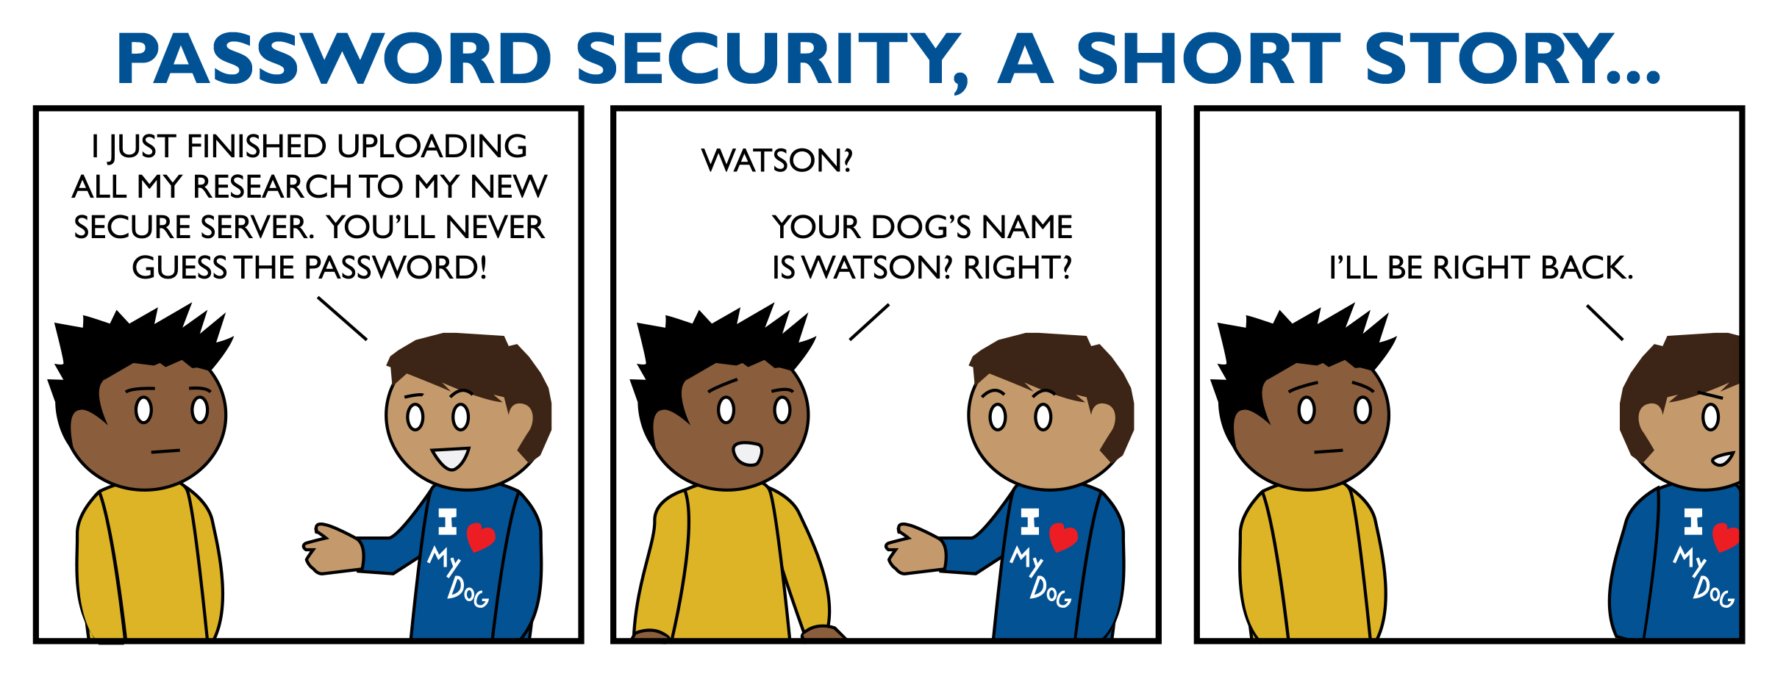
Password Pitfalls
Writing them down on sticky notes
Maintain a text file with user credentials
Using same credentials at multiple places*
*Specially the insecure ones ... (leaks)

Slide 21

Data on the Wire
Password sniffing
  Sniffing with tcpdump, tshark, Wireshark
  i.e. HSRP passwords in Cisco routers, VoIP passwords
  MITM using sslsniff/sslstrip/bettercap

Slide 22

DEMO TIME!!!
Password Sniffing with the WiFi Pineapple!
  HTTP
  ssl-strip

Slide 23
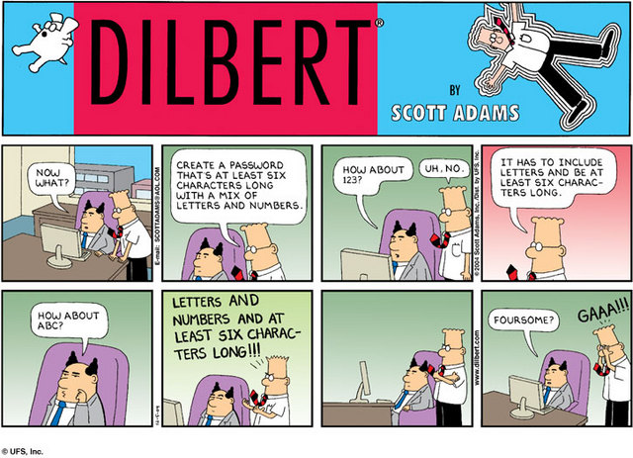
Stuff That Can Help
Different passwords everywhere
  Twitter, Facebook, Google
  Government logins
  Banks
Protect your access with additional controls. i.e. 2FA

Slide 24
Part III - Password Storage

Slide 25

Where Do Passwords Live?
In plain-text files
  .htpasswd, /etc/ppp/chap-secrets, browser/application cache file
In databases
  Mysql, MS-SQL, sqlite
In memory
  Temporary storage

Slide 26
Where Do Passwords Live?
Windows
  SAM database, Active Directory
Linux
  /etc/shadow, OpenLDAP
Application Servers
  Files and DBs

Slide 27
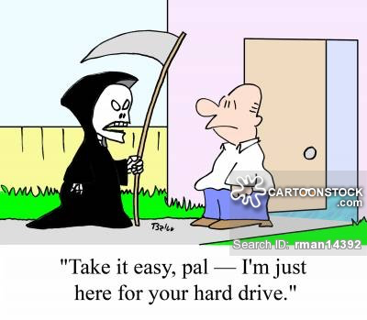
Saving Passwords on the HD
Password Hardcoding
  Software (and filesystems) sometimes contain cleartext passwords, which are used for inbound authentication or outbound communication
  This is useful for users / sysadmins.. and for attackers!

Slide 28
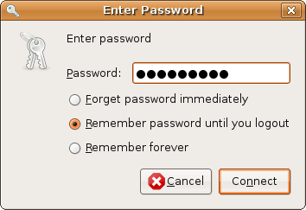
Saving Passwords in Caches
Browser/application caches are handy!
  Login credentials stored locally for later use.
  Web browsers, applications, etc..
  Password recovery tools/malware can recover and decrypt stored passwords

Slide 29

Chrome Password Decryptor
Courtesy: http://securityxploded.com/chromepassworddecryptor.php

Slide 30
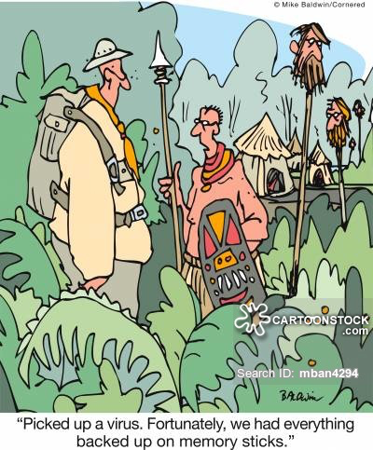
Retrieving Password from Memory
Passwords are sometimes stored cleartext in memory
  Attacker compromises a desktop or server + dumps the RAM memory
  Plain-text or hashed passwords can be extracted from the memory dump
  i.e. Process Memory Dumper, Volatility, Mimikatz

Slide 31

DEMO TIME!!!
Retrieving passwords from memory
  Volatility
  DumpIt

Slide 32
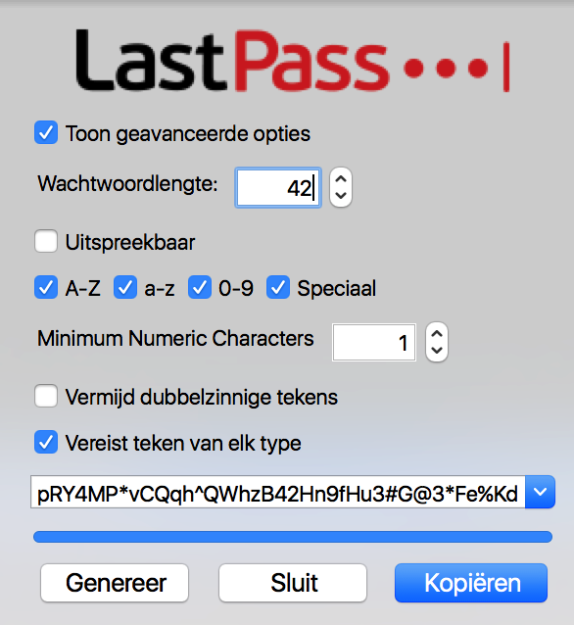
Solution: Password Vaults

Slide 33

Solution: Password Vaults
Courtesy:http://keepass.info/

Slide 34
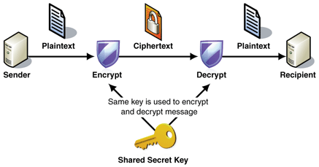
Solution: Encrypt Data at Rest
Courtesy:
http://www.kadix.ca/

Slide 35
Questions?

