Slide 1
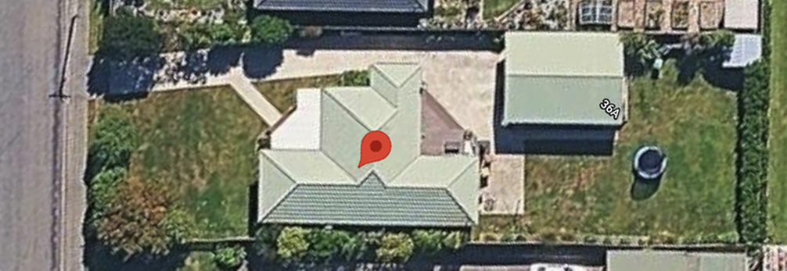
Dining
Room
Lounge
Kitchen
Hallway
Entrance
Master
Bedroom
Laundry
Office
Bathroom
Bedroom 2
Toilet

