Slide 1
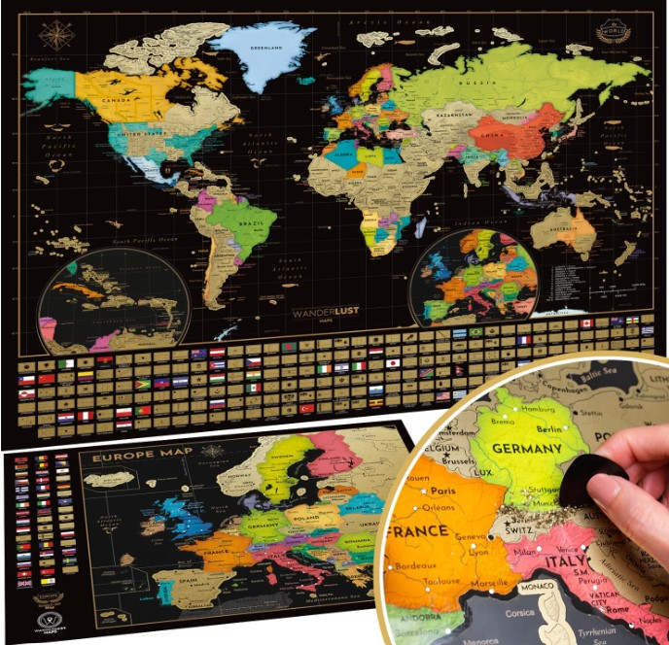
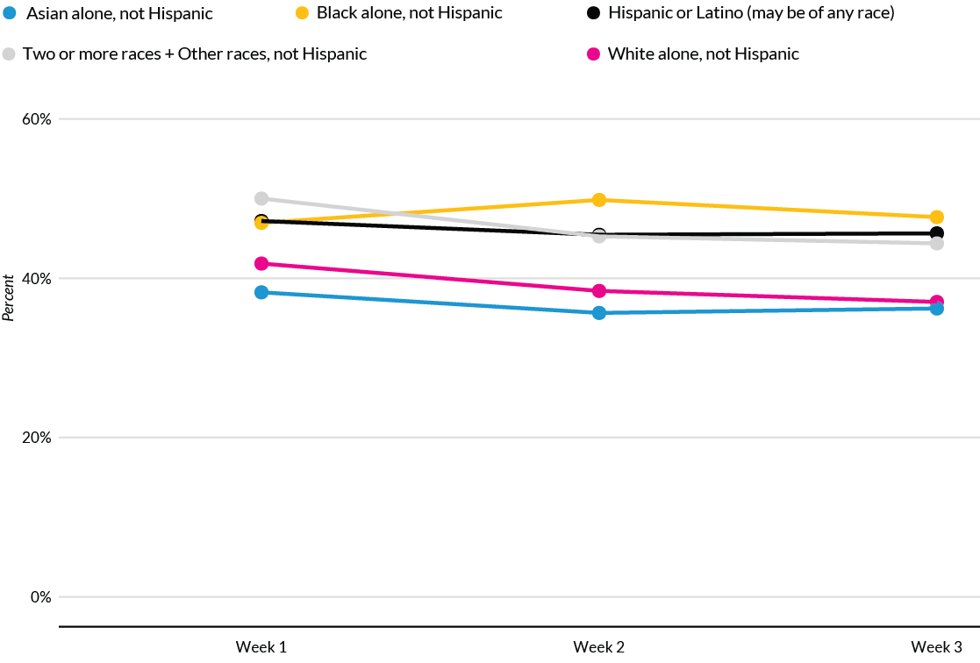
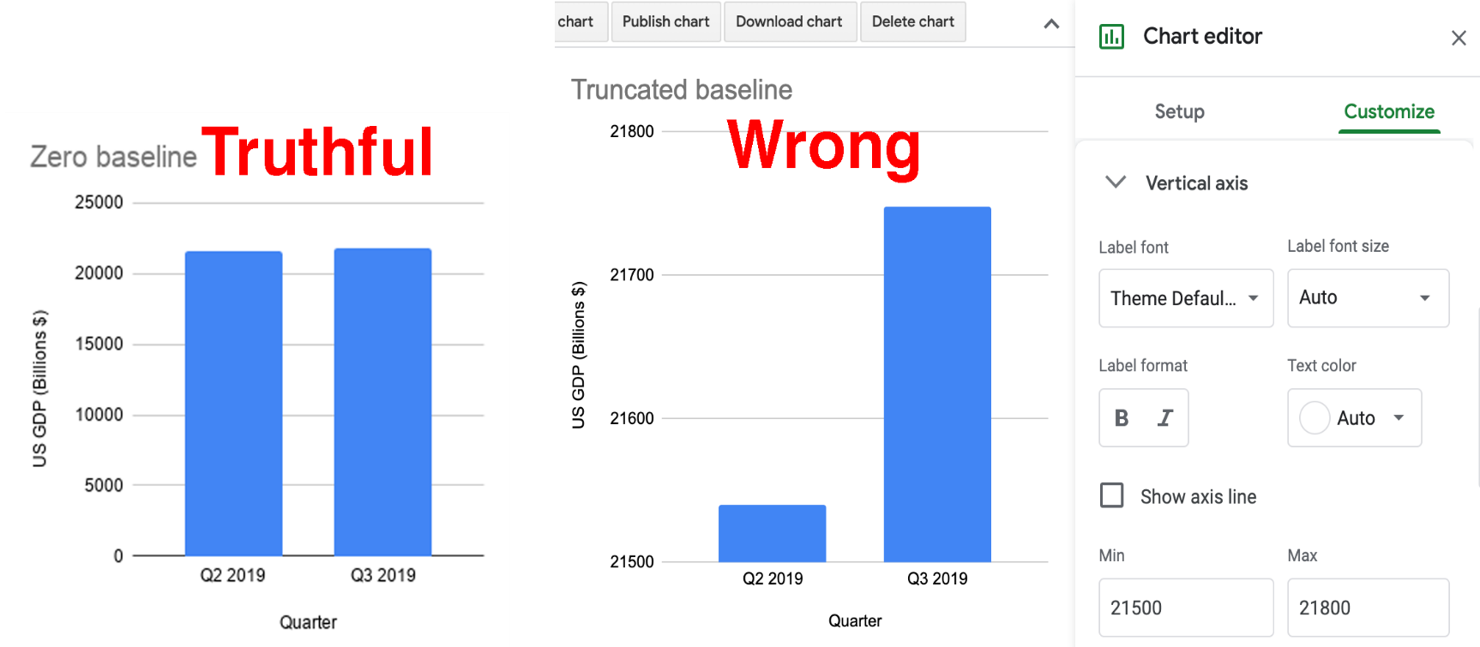
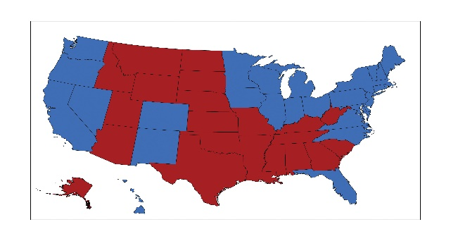
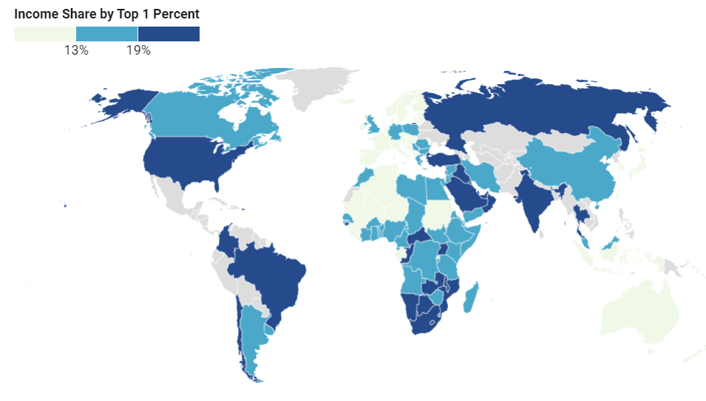

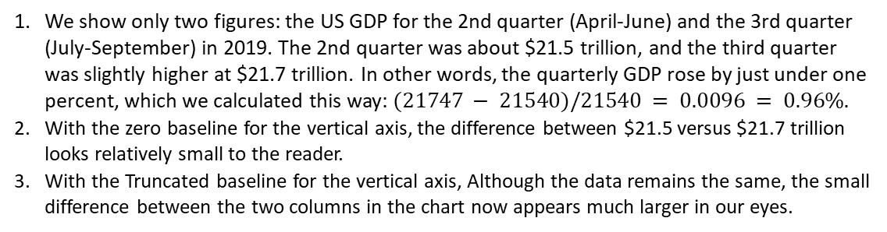
Cartography – (mis)representation and perception of geospatial information
Rajendra Didel^{1,1};
¹MSc in Data Engineering Student of Jacobs University.
Introduction
How to lie to Charts & Maps
Recognize and Reduce Data & Spatial Bias
Maps have long been seen as Objective, neutral products of science. Map are never fully formed, and their work is never complete. Cartography is the process by which geospatial information has been typically visualized. That means the surface of the earth is represented as faithfully as possible. The purpose of this study is to explain Cartography 1) Representation and Perception 2) how to lie to maps 3) Recognize and reduce Data & Spatial Bias
We will learn how to avoid being fooled by misleading charts. Our goal is to understand the truth and to think more carefully about the ethics of designing your data stories.
We define bias as unfairly favoring one view over another. When working with data and designing visualizations.
Correctly identify the bias: sampling biases, cognitive biases, algorithmic biases, and intergroup biases.
We show only two figures: the US GDP for the 2nd quarter (April-June) and the 3rd quarter (July-September) in 2019. The 2nd quarter was about $21.5 trillion, and the third quarter was slightly higher at $21.7 trillion. In other words, the quarterly GDP rose by just under one percent, which we calculated this way: $(21747 − 21540)/21540 = 0.0096 = 0.96\%.$
With the zero baseline for the vertical axis, the difference between $21.5 versus $21.7 trillion looks relatively small to the reader.
With the Truncated baseline for the vertical axis, Although the data remains the same, the small difference between the two columns in the chart now appears much larger in our eyes.
To avoid a deficit-based perspective, Schwabish and Feng argue against combining
racial and ethnic data on the same chart
Image 5: Foreclosure Area
Discussion
These two models are extremely similar to each other, where only change in greenness and overall greenness are switched as dependent and independent variables. Generally extreme greenness and brownness becomes less so in relation to each other indicated by inverse relationship.
The discrepancy of median age, construction year, and lawn size all not being significant in both models, only overall greenness indicates that these factors are not important in defining change, particularly because construction and lawn size are structural variables and are more important long term greenness of a household overall than change.
GWR models better for overall greenness than change in greenness as expected. Areas of best model fit areas and range indicate some variables may be missing especially for change in greenness model
Areas where foreclosure was important in explaining greenness change occurred where actual rates of greenness change were negative, indicating foreclosure may have some effect on tract-level browning.
Properties of Visual System
A high-quality map is composed of many different elements, color is one of the first components noticed by end-users.
Map perception is based on the process of visual perception involving the eye and part of the nervous system that transmits information to the brain centers controlling the phenomena of attention and memory. In terms of the visual display, a color scheme need to be devised. Similarly, there are technical solution such as RGB, HLS, or HVC models, In other cases the color ramp is chosen by the cartographer.
In this map, red counties are those that voted for the Republican Party in the 2004 presidential election, while blue counties voted Democrat. These colors are typically used to designate the Democratic and Republican Parties.
How should we make decisions when designing maps?
First and foremost, always look for better ways to use map color ranges to show true and meaningful differences in the data, rather than hiding them out of sight.
Finding a compromise between honesty and usefulness.
Tell the truth when displaying evidence and use design choices to emphasize an interpretation that calls our attention to what’s most important in the data story.
Income inequality map: A linear interpolation works best to emphasize extreme lows and highs,
while quantiles or other non-linear groupings reveal more geographic diversity in the middle ranges.
Conclusions
These results highlight the spatial variability of foreclosure importance to an urban system. The drastic increase in foreclosures in a short amount of time is a unique shock to a large system in a unique desert landscape, and understanding how these changes manifest could have a variety of benefits.
Most importantly they provide specific locational information where policy may make differences in recovery from large scale events. Social systems such as homeowners associations, or town policy initiatives, will be drastically different across the Phoenix Metro area. Therefore spatial context is vital to the foreclosure, and greenness generally even in a single urban area.
Map perception relies on the process of visual perception. Therefore, the knowledge of its inner workings in the map environment enables cartographers to construct cartographic symbols in agreement with the properties of the visual system. The properties operate independently from the consciousness of the beholder and significantly affect the nature of images perceived by the map user. They include optical resolution, visual adaptation, reactions of inhibition and strengthening, the reaction to the image characteristics as well as the phenomena of contrast, grouping and spatial arrangement.
Contact
Rajendra Didel
Department of MSc Data Engineering
Jacobs University Bremen, Germany Radidel@Jacobs-University.de
References
1. Minn, M., Cutts, B. B., Greenberg, J. A., Pavlovic, N., Fraterrigo, J. M., & Kelly Turner, V. (2015). Detection of foreclosure-related landscape management changes using Landsat. Applied Geography, 62, 217–224. https://doi.org/10.1016/j.apgeog.2015.04.023
Acknowledgements: DR. Prof. Vikram Unnithan; DR. Prof Kettemann, Stefan for comments and suggestions

