Slide 1




Market Research for Technologies
A how-to-guide
Team TOPAS - Praxis Summer Camp 2023

Slide 2
Objective
Project goal, key term definition, and our approach to achieve
Notes:
Change this make it work :)

Slide 3

Objectives
Project goal: produce a market research how-to-guide for technology
What is Market Research?
Market Research aims to offer deep insights into industries, base customers, and competitors.
Source: G2
Notes:
Delete the picture, data sources related

Slide 4

Objectives
What is a Market Research Guide
A market research guide offers step-by-step instructions, methodologies, data sources, and insights.
The guide guides users through the process of gathering, analyzing, and interpreting data about a specific market, industry, or target audience.
Source: Unsplash

Slide 5
Objective
What we have done to produce a market research guide:
Survey
Secondary data research
Focusing on data sources of all kind for professional use
Audio, video, print media, newsletter, etc.
Search engine
Wikipedia
Business websites
Workshops
Notes:
Merge with previous

Slide 6
How to use our guide
The key aspects of market research, process, and data resources recommendation.
Notes:
Change this make it work :)

Slide 7



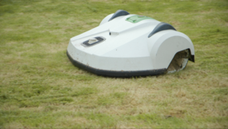
Example
REAL ROBOTICS
Goal : 100% autonomous field Robots.
Objective :
Marketing & Branding key elements -
Efficiency Meets Innovation
Discover Ultimate Convenience
Competitor Analysis
Market segmentation
Source: topas.tech
Notes:
Objecitve: Marketing related

Slide 8
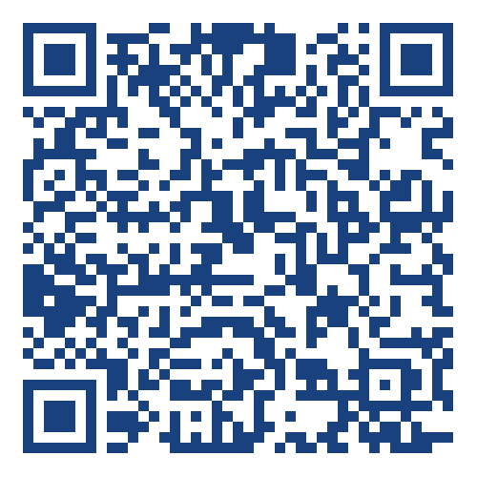
Website
“A comprehensive framework to navigate through the outcomes of our market research efforts, providing clear insights for strategic decision-making."
Where you can access our guide:
With the link: https://pscmarketresearch17.github.io/marketresearch17.github.io/
With the QR code ->
Notes:
Marketing & Branding
Competitor analysis
Presenting your guide

Slide 9








Recommendation
A comprehensive summary of survey result, including various data resource for professional use.
Online learning platforms
Video/audio platforms

Slide 10
Conclusion, limitation, and feedback
What we have done, where we have limitation, and how to improve.

Slide 11
Conclusion
This is a guide for future student for market research tasks. As you start your research journey, remember these three important things:
Knowledge Helps: Knowing your audience, trends, and competition.
Change is Okay: The market changes a lot. Be ready to change your plans
Use Data Smartly: Pay attention to data.

Slide 12
Limitation
Limited range of survey distribution
Sampling Bias
Limited IT resources for website development
Time Constraints
Limited Content
Lack of Visual Richness

Slide 13
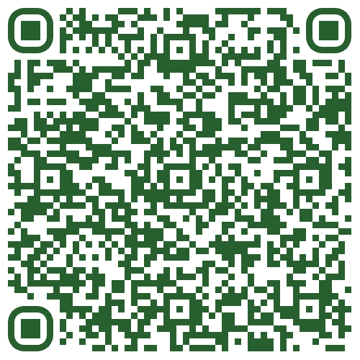
Feedback
If you have any suggestions, thoughts, and feedback, please use the following link to tell us what you think.
Notes:
Change to survey link

Slide 14
Reference
https://en.wikipedia.org/wiki/Market_research
https://topas.tech/referenzen/referenz/echte-robotik/
https://www.hubspot.com/
https://www.askattest.com/blog/guides/market-research-for-branding
https://onstrategyhq.com/resources/internal-and-external-analysis/

Slide 15
Thank you for your attention!
Do you have any questions or feedback?

