Slide 1
Reactive Programming Spring Webflux

Slide 2
Reactive Programming
Asynchronous
Non-blocking
Push-Pull based Data Streams Model
Event/Message driven Stream
Functional Programming Style
Backpressure on Data Streams

Slide 3
Reactive Streams
Publisher
Subscriber
Subscription

Slide 4
Reactive Streams - Publisher
Publisher is the Data Source – DB, External Service
public interface Publisher<T> { public void subscribe(Subscriber<? super T> s); }

Slide 5
Reactive Streams - Subscriber
Represents the application that needs the data resource
public interface Subscriber<T> { public void onSubscribe(Subscription s); public void onNext(T t); public void onError(Throwable t); public void onComplete(); }

Slide 6
Reactive Streams - Subscription
Makes the connection between the Data Source and the Application
public interface Subscription { public void request(long n); public void cancel(); }

Slide 7
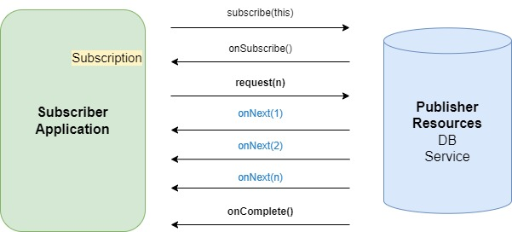
Reactive Programming

Slide 8
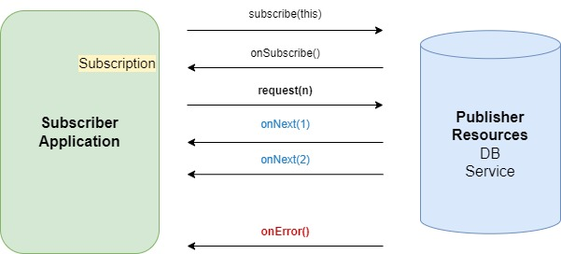
Reactive Programming

Slide 9
Spring Webflux
Used to build reactive REST APIs
Uses Project Reactor
Project Reactor Uses two Reactor Types
Mono
Flux

Slide 10
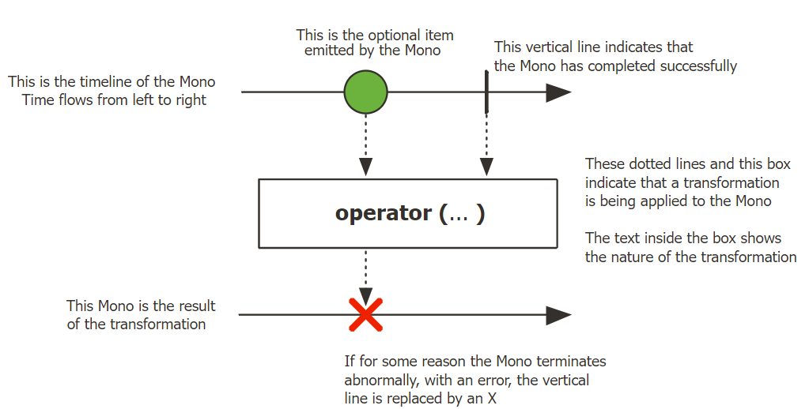
Project Reactor Mono
https://projectreactor.io/docs/core/release/api/reactor/core/publisher/Mono.html

Slide 11
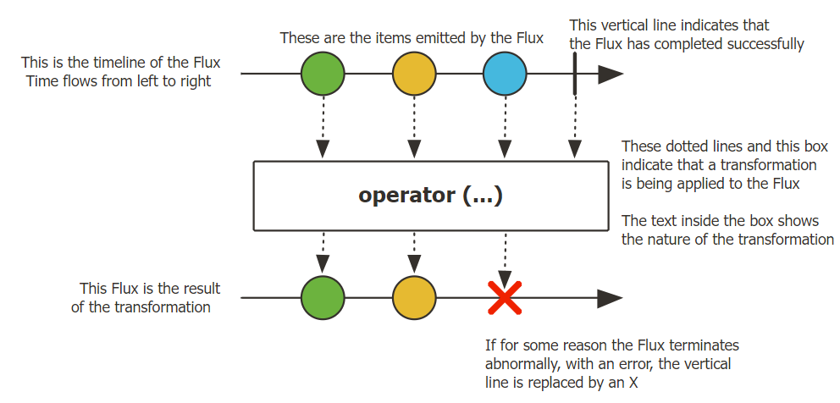
Project Reactor Flux
https://projectreactor.io/docs/core/release/api/reactor/core/publisher/Flux.html

Slide 12
Transform Data
filter()
map()
flatMap()
concatMap()
transform()
concat() and concatWith()
merge() and mergeWith()
zip() and zipWith()
defaultIfEmpty() and switchIfEmpty()

Slide 13
WebClient
Reactive Non-blocking REST Client
Functional Style
Exception Handling

Slide 14
THANKS!
Any questions?
You can find me at:
hkostadinova@gmail.com

