Slide 1
A Generative Chatbot with Natural Language Processing
David Liebman

Slide 2
Overview
Word Vectors
Describe GRU
Describe Transformer
Describe GPT2
Installations on Small Single Board Computers
Other Installations
Observations
Further Reading

Slide 3
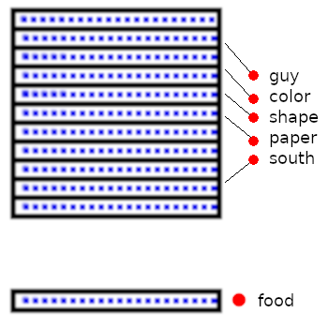
Word Vectors
Dictionary of Vocabulary Words
Table of Floating Point Numbers
Word number is key to
Table – Returns a vector.
A vector is just a 1D string of
Floating Point Numbers.

Slide 4
Word Vectors
All vectors are the same size in a given application.
Word Vectors are used in place of words in many Natural Language Tasks.

Slide 5
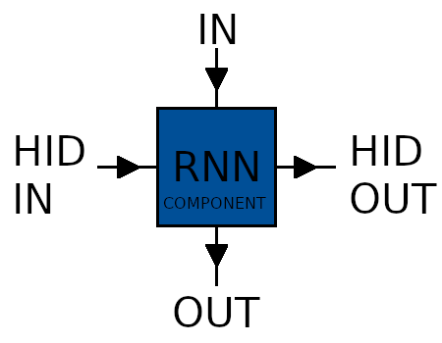
RNN – Recurrent Neural Network
Re-usable Network Component
Two Inputs – Two Outputs
Detects Patterns
Regular Input,
Hidden Input,
Regular Output,
Hidden Output ...

Slide 6
RNN – Recurrent Neural Network
Hidden Values are used as ‘Memory’ by the Network
Regular Input would be a Word Vector
Regular Output would be a Word Vector

Slide 7
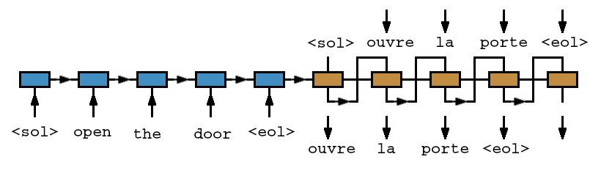
RNN – Recurrent Neural Network
Pattern For Neural Machine Translation
English to French
Each Rectangle is an RNN Component

Slide 8
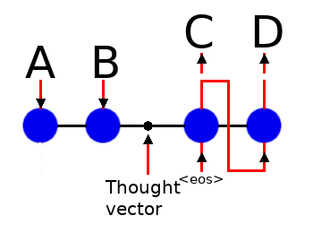
RNN – Recurrent Neural Network
RNN Closeup
A+B – Encoder Input
C+D – Decoder Output
Special Spot Between ‘In’ and ‘Out’

Slide 9
RNN – Recurrent Neural Network
Diagram Comparison
Each blue circle is a complete RNN Component

Slide 10
RNN – Recurrent Neural Network
Typical Types of RNN Component
Gated Recurrent Unit – GRU
Long Short Term Memory - LSTM

Slide 11
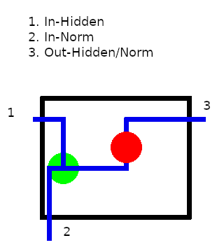
RNN – Recurrent Neural Network
RNN - simplified
Two inputs
One output for both
GREEN – concatenate
RED – tanh activation

Slide 12
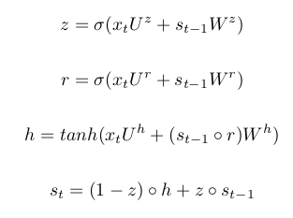
RNN – Recurrent Neural Network
GRU – Gated Recurrent Unit
r = reset (how much from prev)
z = update (how much new)
h = used internally
st = regular out/hidden out
xt = hidden in
St-1 = regular in

Slide 13
RNN – Recurrent Neural Network
Translation

Slide 14
RNN – Recurrent Neural Network
Translation:
Two Dictionaries
Two Embedding Tables
RNNs – Shared Weights:
One For Encoder
One For Decoder
Reason for term ‘Recurrent’

Slide 15
RNN – Recurrent Neural Network
Encoder
Take in words one at a time and decide what to remember about each.
Pass this info on to hidden input for next word.

Slide 16
RNN – Recurrent Neural Network
Decoder:
Take in hidden state and generate first token
Generate next token from previous token and previous hidden state

Slide 17
RNN – Recurrent Neural Network
Problems:
Batches need to be processed separately. Words in the first cardinal position must all be processed together, etc.
Exploding and vanishing gradients make RNNs unstable.
Solution:
Smaller sentence length.
Attention mechanism.

Slide 18
RNN – Recurrent Neural Network
CORPUS:
If you were training a translator for English/French, the corpus must have English and French sentences with the same meaning.
The English sentences would be in a table and the associated French would be in a second table.

Slide 19

RNN – Recurrent Neural Network
Attention:
Along with the thought vector, pass a copy of all the encoder outputs to each decoder position.
Figure out which one is important. Consider which is important when you decide on your decoder output.

Slide 20
RNN – Recurrent Neural Network
Neural Conversational Model:
Train using one language.
Train with Question/Answer pairs (movie subtitles).
Same problems as Translation model.

Slide 21
Scaled Dot Product Attention
Start with vectors like RNN.

Slide 22
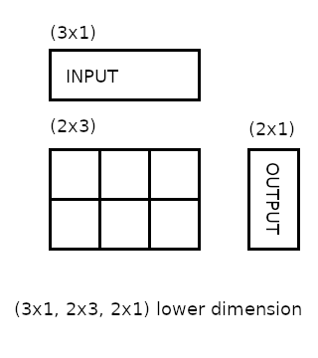
Scaled Dot Product Attention
Every vector is converted to three smaller vectors.
Using simple matrix multiplication.
Weights are not shared.
Named K, Q, and V.

Slide 23
Scaled Dot Product Attention
Vector Names:
Query
Key
Value
Dot Product the Key and Query, then softmax that result, then you get single float for all values… between 0 and 1.
Multiply this to get specific Value!

Slide 24

Scaled Dot Product Attention
Formula actually uses denominator in (Query * Key) to scale down results for softmax.
Also note the Key is transposed.

Slide 25
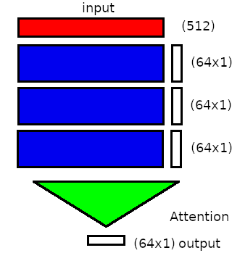
Scaled Dot Product Attention
Remember:
Vectors all have smaller size.
Result of attention is also smaller size.
Desire original size.

Slide 26
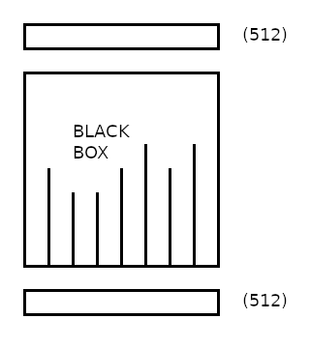
Scaled Dot Product Attention
Solution:
Perform Attention 8 times with 8 heads.
Group output together with concatenation.

Slide 27
Transformer
Three attention mechanisms at each layer.
Encoder attention is serial.
Decoder attention is serial and also parallel.
Layer count can be larger.
Input vector size can be larger.

Slide 28
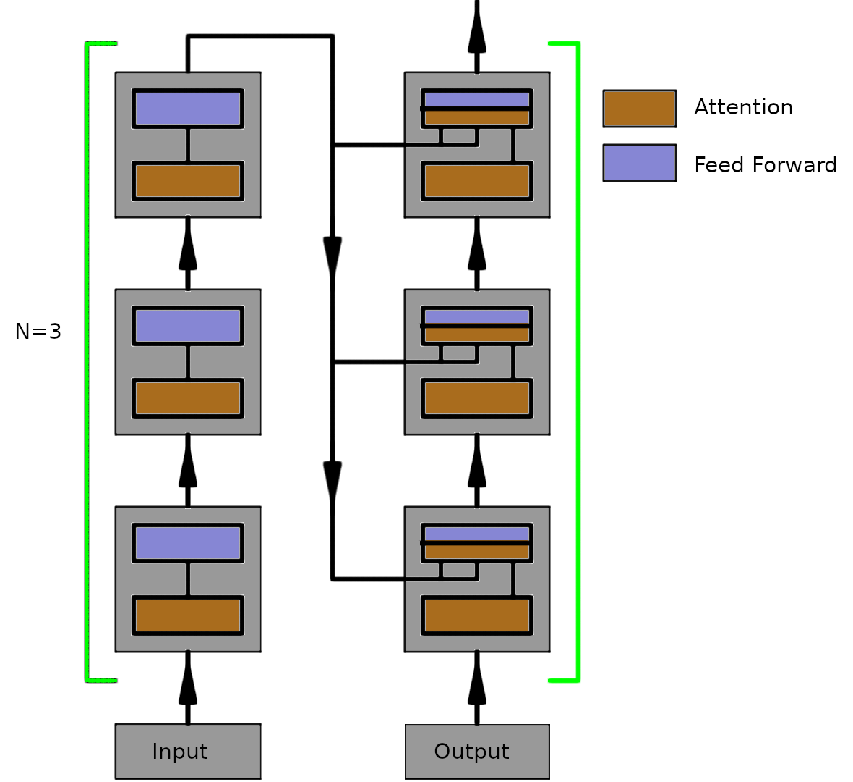
Transformer
Flow Diagram for
three layers.

Slide 29
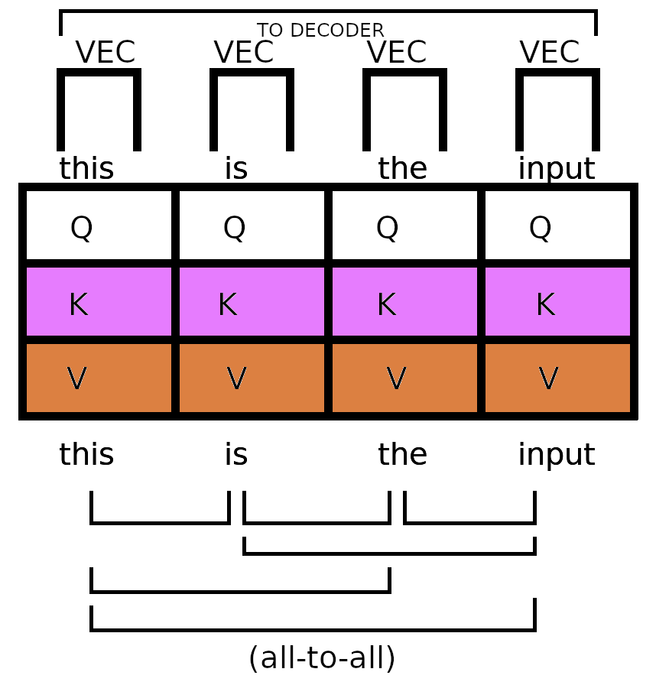
Transformer
Encoder portion:
All-To-All
arrangement.
Sentence-length
output.
Basis for models
like BERT

Slide 30
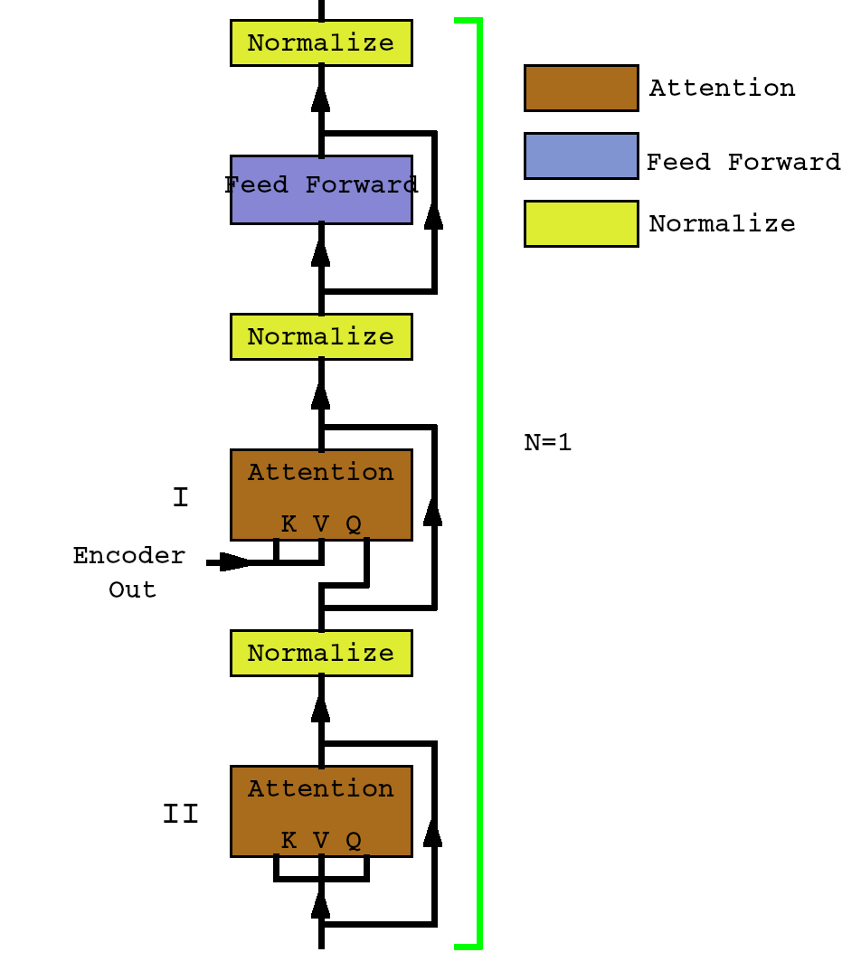
Transformer
Decoder:
Two ATTN mechanisms
at each layer.
Serial and Parallel.
Output of one token at
a time.
One-to-many
arrangement.
Similar to GPT2

Slide 31
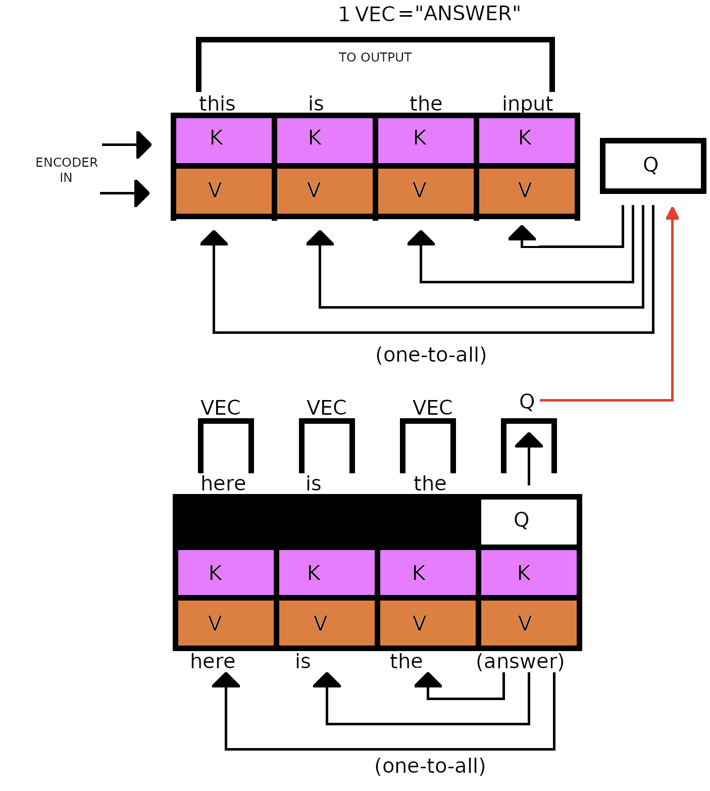
Transformer
Decoder Portion:
Takes input from
Encoder and Decoder
Output.
Two attention stages.
One-to-many
arrangement.
Many time steps for
complete output.

Slide 32
Transformer
Input
Positional Encoding – sine and cosine patterns added to each input. Allow for before/after comparisons.
Output
Normalization and a large feed-forward network to pick out an output word from the dictionary.

Slide 33
Generative Pre-Training 2
Modified version of Transformer decoder.
One attention mechanism at each layer.
Many layers.
Pre-trained.
Uses Scaled Dot
Product Attention.

Slide 34
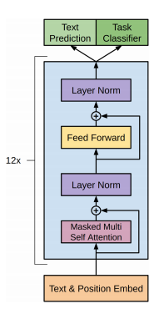
Generative Pre-Training 2
Layer Flowchart.

Slide 35
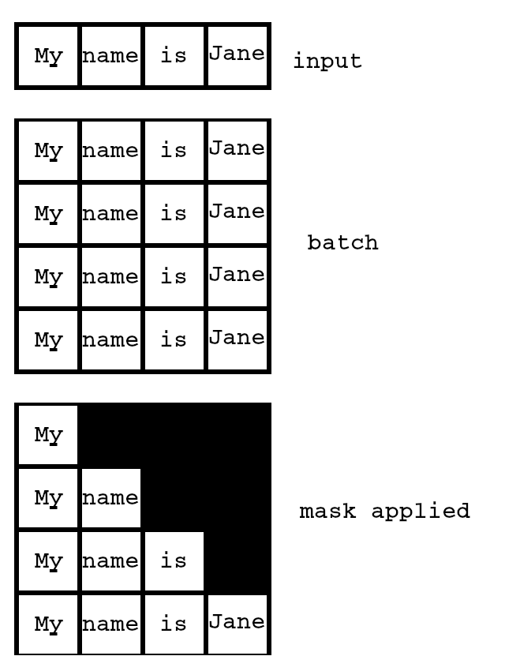
Generative Pre-Training 2
Training:
Large Corpus
Reddit Text
Predict One Word
At A Time
Like Transformer, Masks
Decoder During Training.

Slide 36
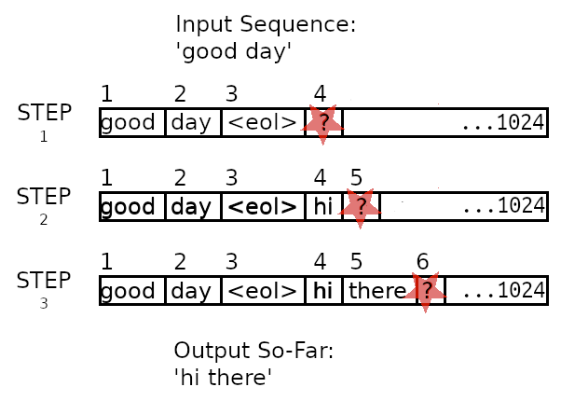
Generative Pre-Training 2
Generating Output:
Multi-step process.
Input and output
words share the
same context area.
Context size is
1024.

