Slide 1
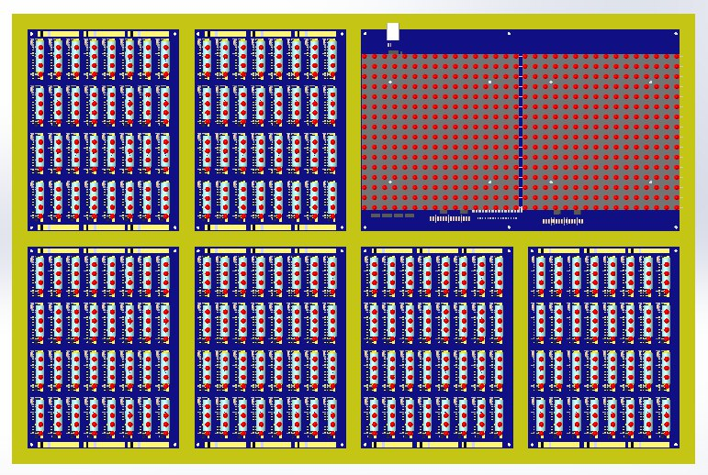
16-bit
FULL ADDER with CARRY
IP REG
AP REG
(16bit)
RAM, CIN, COUT
MCU loader, LED display,
Wi-Fi& USB Connection
TMP REG
(16bit)
CMD REG
(12+4bit)
SEQUENCER,
CMD SELECTOR
and some other logic
±

Slide 2
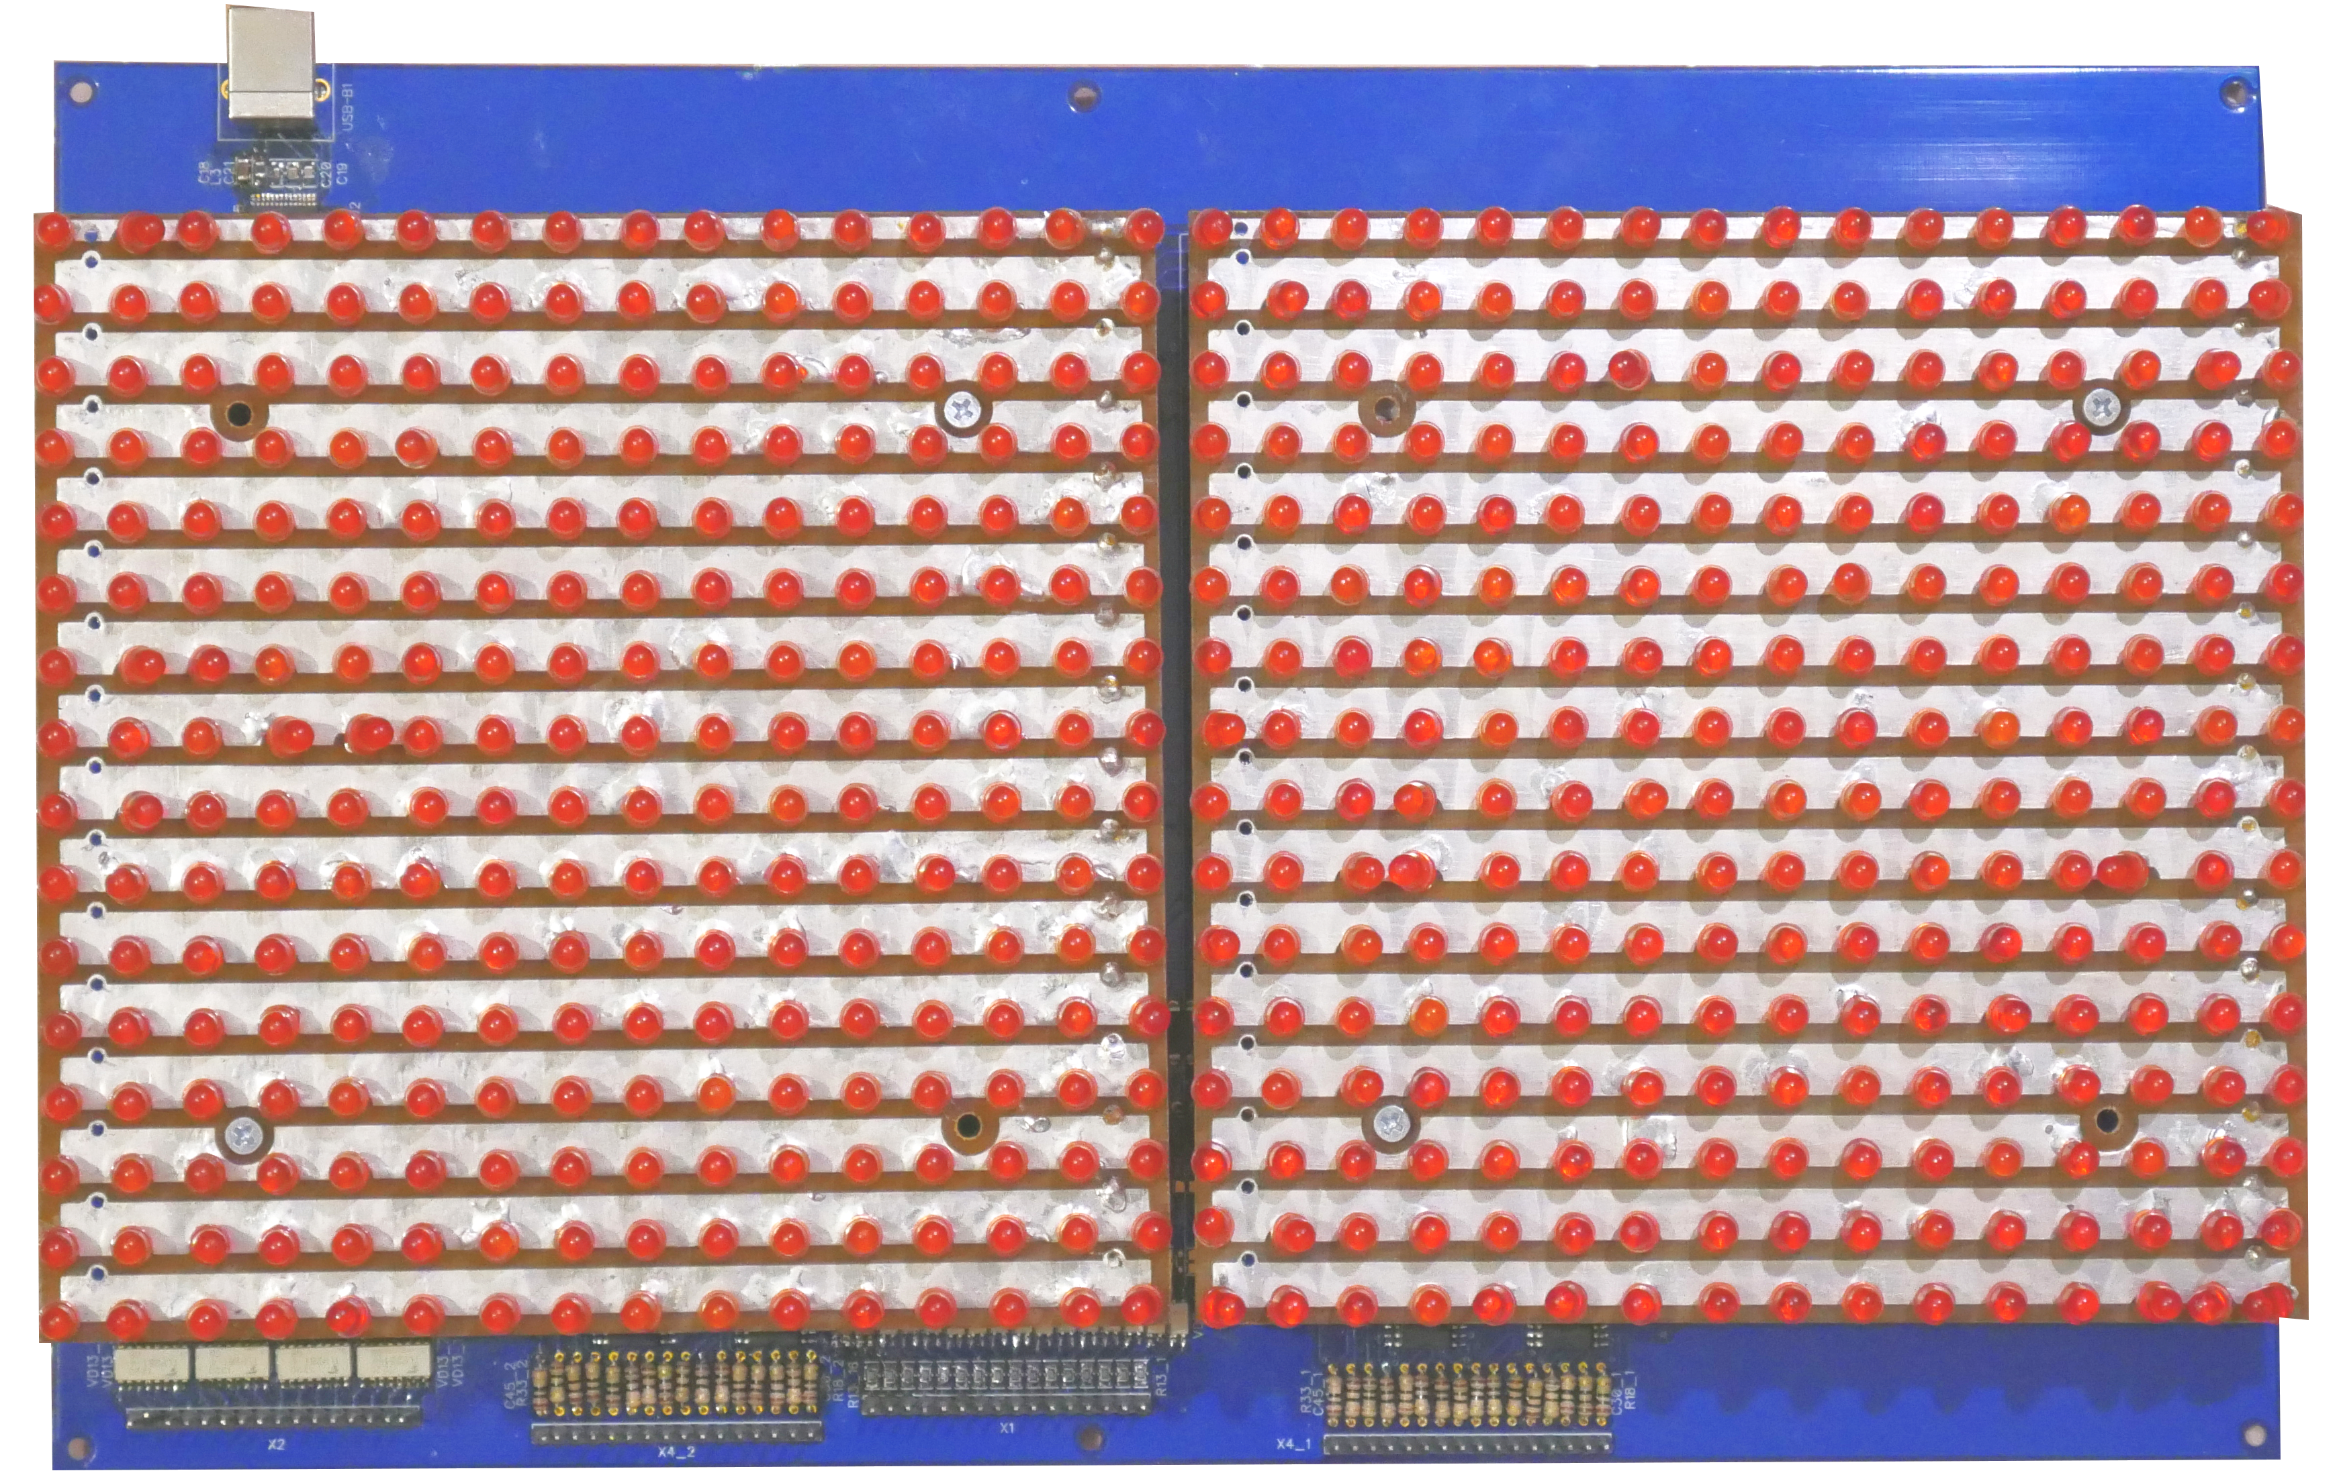
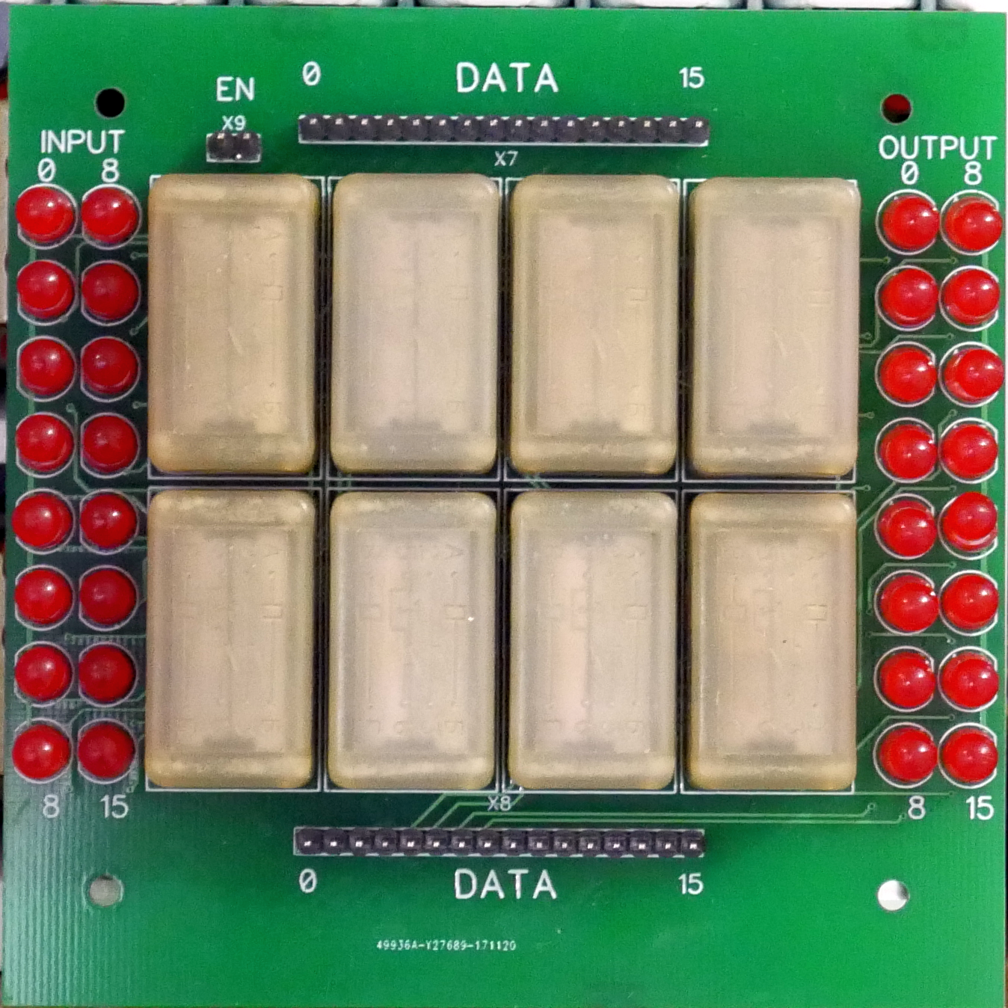
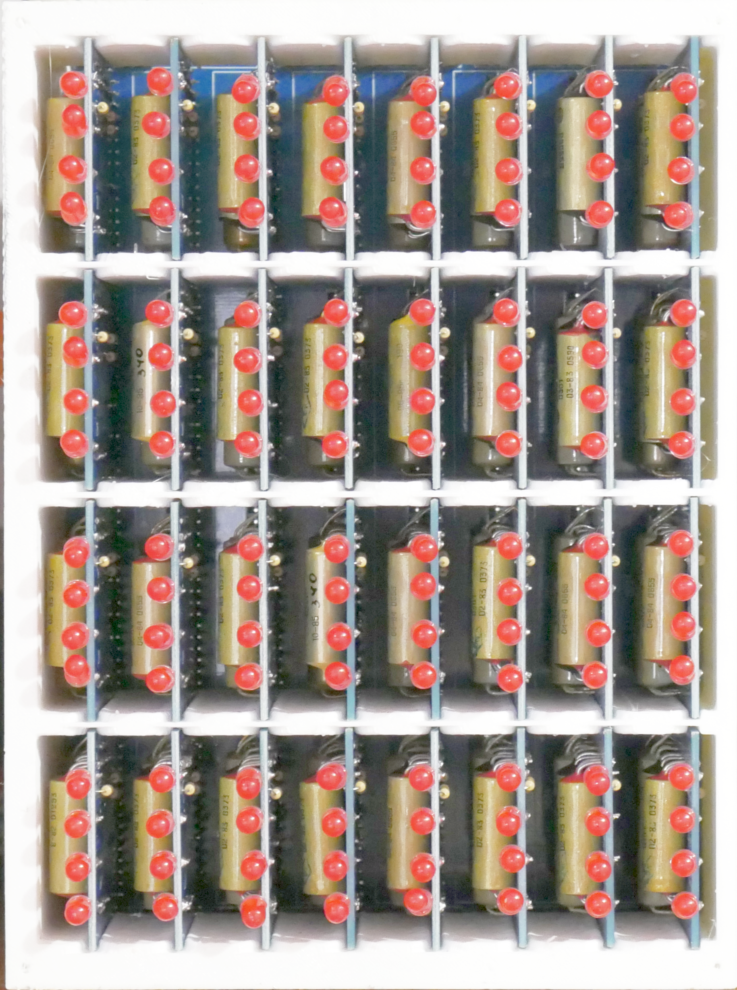
Memory Board
LED Board
Console In/Out
SW
SW
SW
SW
16 bit
Switches
TMP&CMD
16 bit REG
IP&AP
16 bit REG
16 bit
Switches
SW
SW
SW
SW

Slide 3
ADDRESS BUS
TMP
REG
16bit
IP
REG
16bit
RAM
64K
x16bit
ADDER
+
CARRY
AP
REG
16bit
COUT
CMD
REG
12bit
CIN
4bit
LOGIC
DATA BUS

Slide 4
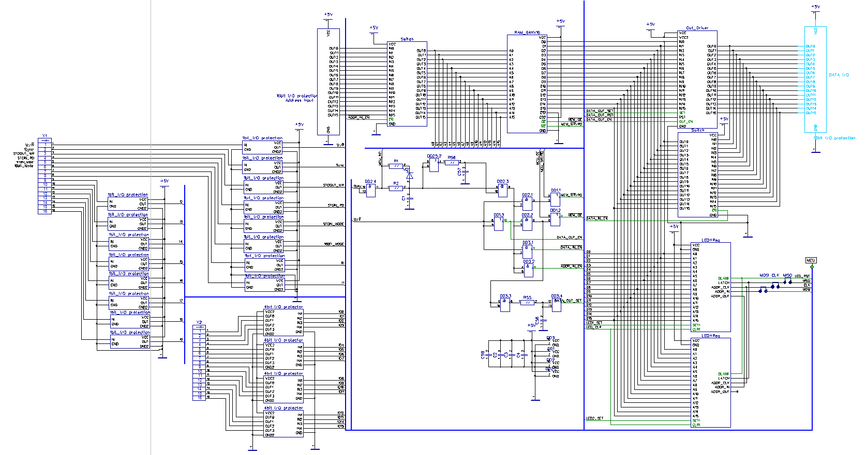
RAM Main Flow
Address input buffer

Slide 5
