Slide 1

Ceng 585 Paper Presentation
  D*-Lite
  Path Finding Algorithm and its Variations
  Can Eroğul
  erogul@ceng.metu.edu.tr

Slide 2
Outline
Motivation
Environment Properties
A* (1968), D* (1994)‏
D* Lite (2002 & 2005)‏
Field D* (2005)‏
Multi-resolution Field D* (2006)‏

Slide 3
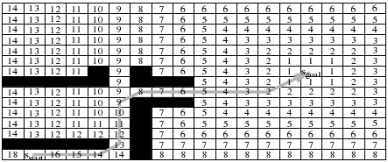
Problem Definition:
Path Finding

Slide 4
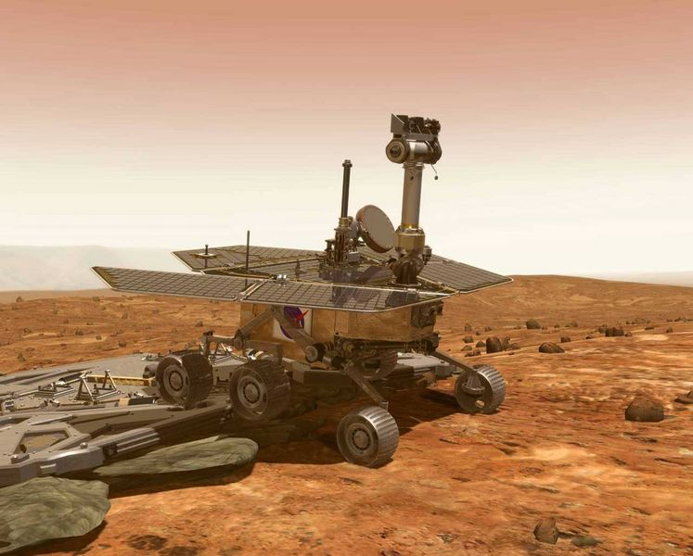
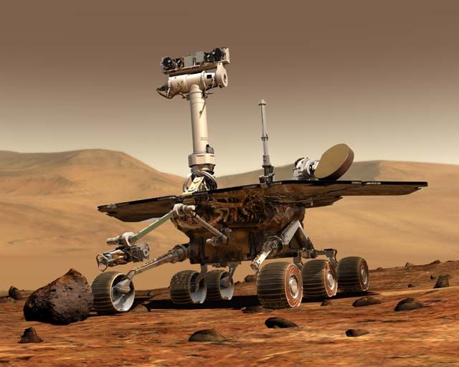
Motivation
Only A* in lectures
D* is more useful for robotic domain.
Used in various robots including Mars rovers "Spirit" and "Opportunity"

Slide 5
Environment Properties
Static vs Dynamic
Complete vs Incomplete (Accesible vs Inaccesible)‏
Discrete vs Continuous
Deterministic vs Non-deterministic
Stationary Target vs Moving Target
  We assume discrete & deterministic environment with stationary target.
  Note: All continuous domains can be discretized.

Slide 6
Why Discretize?
Robotic domain is continuous, why discretize? Discretization is a mathematical method.
Easier calculation: Making data more suitable for
  numerical computation
  implementation on digital computers

Slide 7
Problems of Grid Based Path Planning
Path Quality (Limited rotation values (0,π/4,π/2) 4 or 8 neighborhood)‏
Memory & computational power requirements

Slide 8
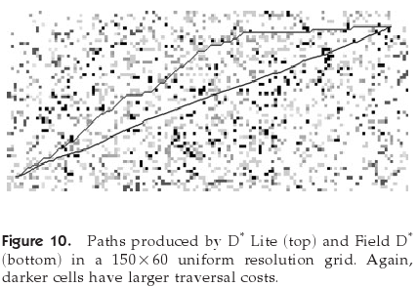
Lack of Smooth Paths

Slide 9
Other Environment Properties
Stationary Target vs Moving Target (MTS)‏
One agent vs Multi-agents
Fuel constraint? (PHA*)‏
Time constraint? (Anytime algorithms)‏
Real-Time? (RTA* & LRTA*)‏
Shortest path needed?
Agility or Fatigue?

Slide 10
A* Environment Assumptions
Static world
Complete knowledge of the map
Freespace Assumption: The robot assumes that the terrain is clear unless it knows otherwise.
& also deterministic and discrete with stationary target.

Slide 11
A*
Covered in 585 lectures.
Breif reminder: Breadth first search using a heuristic function.
Forward A*: Search starts from the start to goal
Backward A*: Search starts from the goal to starting point.

Slide 12
A* Details
f(x) = g(x) + h(x)‏
g(x) = Path cost from start to node x
h(x) = ”Heuristic estimate” of the distance to the goal from node x.
h(x) should be admisibble (kabul edilebilir). It must never overestimate the distance to the goal, so that A* guarantees to find the shortest path.
Implemented with a priority queue.

Slide 13
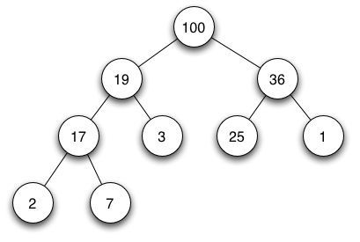
Priority Queue
Priority Queue is an abstract data type
Heap is a data structure.
Priority Queue can be implemented with heap structure.

Slide 14
Dynamic A*
Capable of planning paths in unknown, partially known and changing environments efficiently.
When the map changes or an unknown obstacle cuts the way, the algorithm replans another path efficiently.

Slide 15
How D* Lite works?
First run is the same as A*. D* finds the same path with A*.
When a node changes, D* just recomputes the values of the inconsistent nodes, which are necessary to compute, while A* recomputes all of the path.
D* makes backward search. (Starts searching from the goal node)‏

Slide 16
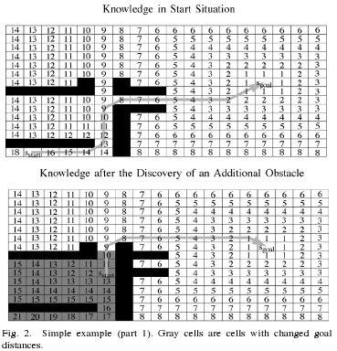
Inconsistent Nodes

Slide 17
Inconsistent Nodes
Consistency = (g(x) == rhs(x))‏
If a node is inconsistent update all of it's neighbors and itself again. (Updating nodes will try to make them consistent)
Continue updating while the robots node is inconsistent or there are inconsistent nodes that are closer to the target, which may open a shorter path to the robot.

Slide 18
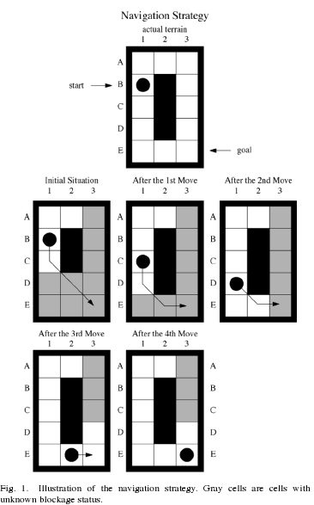
How D* Lite works?
  Example run of D*

Slide 19
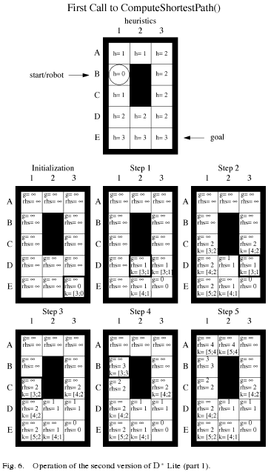
How D* Lite works?
  First run of D*

Slide 20
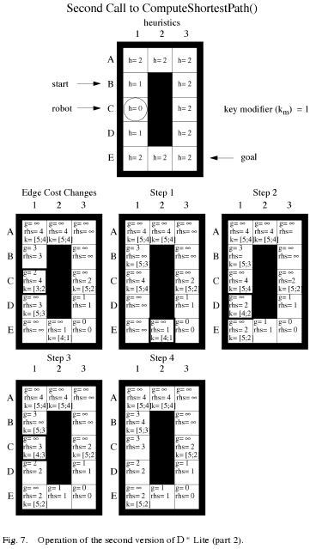
How D* Lite works?
  Second run of D*

Slide 21
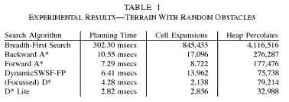
Comparison

Slide 22
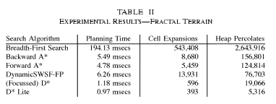
Comparison

Slide 23
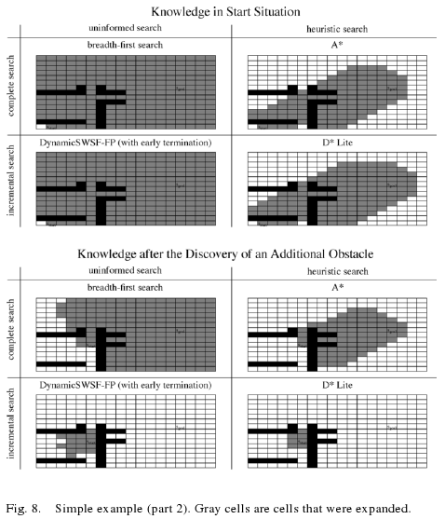
A* - D* Comparison

Slide 24
2 D*-Lite Versions
D* Lite has 2 versions, which just have different implementations, and D* is also another algorithm. They all find the same path. Second D* Lite algorithm is the fastest.

Slide 25
Problems of Grid Based Path Planning
Path Quality (Limited rotation values (0,π/4,π/2)) Solved by Field D*
Memory & computational power requirements

Slide 26
Field D*
Operates on continuous domain. After D* computes the path, a post processing function, shortens the path based on interpolation.

Slide 27
Field D*

Slide 28
Problems of Grid Based Path Planning
Path Quality (Limited rotation values (0,π/4,π/2)) Solved by Field D*
Memory & computational power requirements Solved by Multi-resolution Field D*

Slide 29
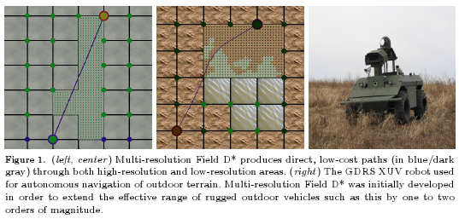
Multi-resolution Field D*
Computes nearly the same path with Field D* in shorter time with less memory usage.

Slide 30
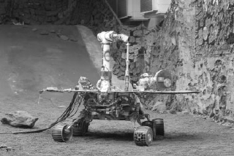

D* on MARS!
Joseph Carsten and Art Rankin from NASA's Jet Propulsion Laboratory installed a version of Field D* using elements of D*-Lite on the Mars rovers "Spirit" and "Opportunity" and first let it control a rover on Mars in February 2007 after testing it on a rover on Mars in November 2006.

Slide 31
Related Papers
Optimal and Efficient Path Planning for Partially-Known Environments, Anthony Stenz, ICRA, 94
Fast Replanning for Navigation in Unknown Terrain 2002 & 2005, Sven Koenig & Maxim Likhachev
Multi-resolution Field D* IAS 2006 Dave Ferguson, Anthony Stenz

Slide 32
Questions?
  Thanks for listening

