Slide 1
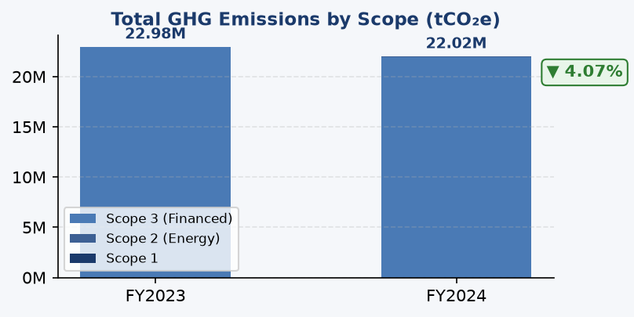
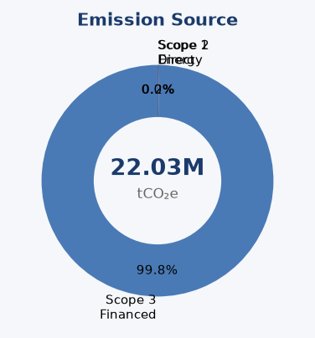
ESG Performance Dashboard
Multi-Framework Sustainability Report — FY2024
▼ 4.07%
▼ 11.3%
▲ 0.12
Stable
239.4
3.36
100%
22.03M
tCO₂e
tCO₂e/IDR Bn
score (1-5)
portfolio
Total GHG Emissions
Revenue Intensity
PCAF Data Quality
Coverage
ESG Scorecard
🟡 Environmental
Stable, peers declining faster
🟢 Social
Female 42.3%, training 35.2 hrs
🔴 Governance
No SBTi, no ESG committee
⚡ Board Actions Required
1. Approve SBTi commitment letter (Q3 2025)
2. Allocate IDR 15B solar+battery program
3. Mandate top-20 borrower engagement
AI-Generated | GRI 305 • IFRS S2 • CSRD/ESRS E1 • OJK PSPK | DRAFT | 2026-06-12

Slide 2
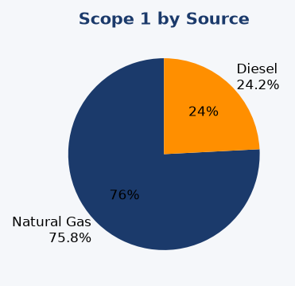
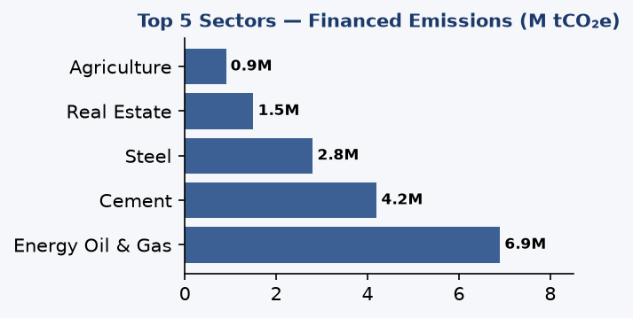
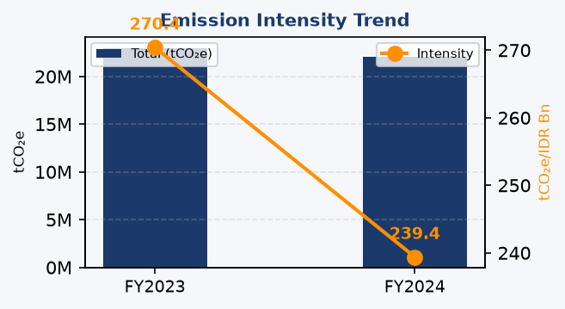
Environmental Performance
GHG Emissions Analysis — Scope 1, 2, 3
47
Facilities
2.1/4
Data Quality
-4.07%
YoY Change
⚠️ KEY INSIGHT
99.78% of emissions from financed portfolio. Operational reduction alone cannot achieve material impact.
📊 Diesel dependency (64.7% of Scope 1) is the primary operational lever. Solar+battery at top 5 sites = -881 tCO₂e/yr.
🏦 Peers: BRI -3.2%, DBS -12% (2023 vs 2022)

Slide 3
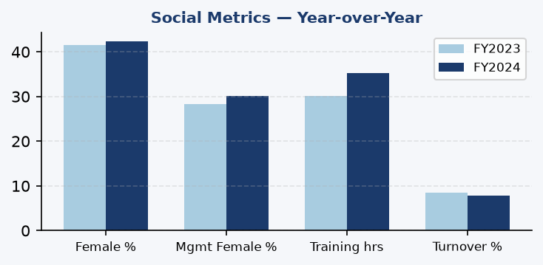
Social & Governance
Workforce Metrics + ESG Governance Maturity
E | Environmental
S | Social
G | Governance
Scope 1: 3,403 tCO₂e (+2.4%)
Scope 2: 44,614 tCO₂e (stable)
Scope 3: 21.98M tCO₂e (-4.2%)
Intensity: 239.4 tCO₂e/IDR Bn
FTE: 12,847 (+3.1%)
Female: 42.3%
Training: 35.2 hrs/FTE
Turnover: 7.8% (down)
❌ No ESG Committee
❌ No SBTi Commitment
⚠️ No Transition Plan
✅ PCAF Adopted
🔴 Governance Gaps — Framework Compliance
• IFRS S2 Para 5-9: Board climate oversight — NOT ESTABLISHED
• ESRS 2 GOV-1: Sustainability governance body — NOT ESTABLISHED
• OJK POJK 51: ESG committee + climate policy — PARTIAL (policy only)
• SBTi: Science-based targets — NOT COMMITTED (peers BRI/BCA committed)

Slide 4
Strategic Roadmap
Priority Actions & Implementation Timeline
Q3 2025
Q4 2025
Q1 2026
Q2 2026
Q3 2026
ENVIRON.
Solar+Battery Top 5 Sites (-881 tCO₂e)
Borrower Engagement Program (Top 20 Emitters)
SOCIAL
Diversity Target Setting
Training Program Expansion (40hrs target)
GOVERN.
SBTi Commitment Letter
ESG Committee Formation
Transition Plan Development
DATA
PCAF Score → 2.5 (Data Improvement)
Automated Scope 3 Data Collection

