Slide 1
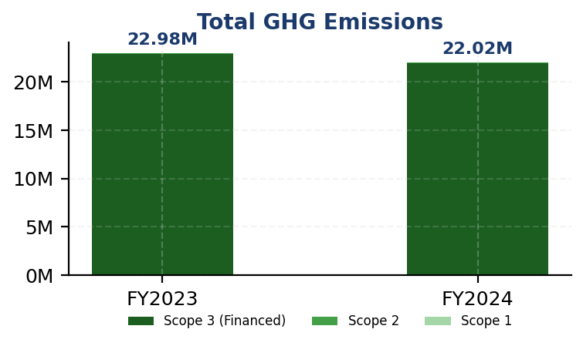
IFRS S2: Climate Performance Summary
GENERIC_FI_001 | FY2024
22024814.173
tCO₂e
Total GHG Emissions (Scope 1+2+3)
239.400139
tCO₂e/IDR Bn
Revenue Intensity
3.36
score (1-5)
PCAF Data Quality Score
100.0
%
Financed Emissions Coverage
⚡ Key Insight
Scope 1 naik 2.36% sementara peers turun 8-12% — diesel over-reliance adalah gap driver utama

Slide 2
Priority Actions & Compliance
IFRS S2: Climate | FY2024
⚡ Priority Actions
1. Establish sector-specific decarbonization targets for Energy - Oil & G
2. Implement PCAF data quality improvement program targeting portfolio-we
3. Conduct climate scenario analysis per IFRS S2 para 22 covering 1.5°C (
4. Develop transition finance product suite (green loans, sustainability-
5. Establish climate competency development program to restore training h
IFRS S2: Climate Compliance
✅ Scope 1 & 2 Disclosed
✅ Scope 3 PCAF Disclosed
✅ Intensity Metrics
⚠️ Reduction Targets (Partial)
❌ Transition Plan
❌ Scenario Analysis

