Slide 1
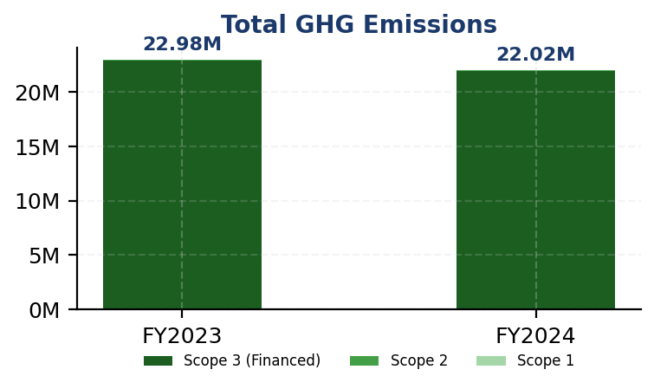
IFRS S2: Climate Performance Summary
GENERIC_FI_001 | FY2024
22024814.173
tCO₂e
Total GHG Emissions (Scope 1+2+3)
239.400139
tCO₂e/IDR Bn
Revenue Intensity
3.36
score (1-5)
PCAF Data Quality Score
100.0
%
Financed Emissions Coverage
⚡ Key Insight
Scope 1 naik 2.36% sementara peers turun 8–12% — diesel over-reliance (64.7%) adalah gap driver utama

Slide 2
Priority Actions & Compliance
IFRS S2: Climate | FY2024
⚡ Priority Actions
1. Establish science-based sector decarbonization targets for Energy - Oi
2. Launch borrower engagement program targeting top 50 clients in high-ca
3. Conduct IFRS S2-compliant scenario analysis using NGFS 1.5°C and 2°C p
4. Develop transition finance product suite for cement and steel sectors
5. Implement gender diversity action plan to reverse declining female rep
IFRS S2: Climate Compliance
✅ Scope 1 & 2 Disclosed
✅ Scope 3 PCAF Disclosed
✅ Intensity Metrics
⚠️ Reduction Targets (Partial)
❌ Transition Plan
❌ Scenario Analysis

