Slide 1
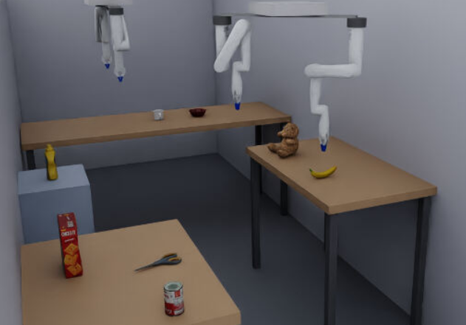

Energy-Aware Arm and Base Selection for a Dual-Gantry Quad-Arm Ceiling Robot Using a GNG Capability Map
Raditya Artha Rochmanto
Achmad Fahrul Aji, Anhar Risnumawan, Teuku Zikri Fatahillah, Alfin Junaedy, Naoyuki Kubota
Graduate School of Systems Design, Tokyo Metropolitan University
SCIS&ISIS 2026 | Paper 282
Energy-aware pick in Isaac Sim (replace this frame with the demo video)
≈4×
93.3%
−5.1%
workspace
plan success
mean energy
rail treated as a DOF
vs 63–65% single arm
vs nearest-arm policy
Notes:
(1:05)
[Video starts automatically.]
Hello, everyone. My name is Raditya Artha Rochmanto, from Tokyo Metropolitan University. Today I will present energy-aware arm and base selection for a dual-gantry, quad-arm ceiling robot.
Let me start with the result. In this video, four robot arms hang from two rails on the ceiling. We ask the robot to fetch an object. The robot decides two things at once. Which arm should move, and where should its rail go? It makes this choice to use the least energy. This is a simulation in Isaac Sim, shown at five times speed.
[Point to the three boxes.]
Here are the three key numbers. Using the rail as a degree of freedom gives a workspace about four times larger. Using all four arms raises planning success from sixty-three to ninety-three percent. And our energy-aware choice uses five percent less energy than choosing the nearest arm.

Slide 2
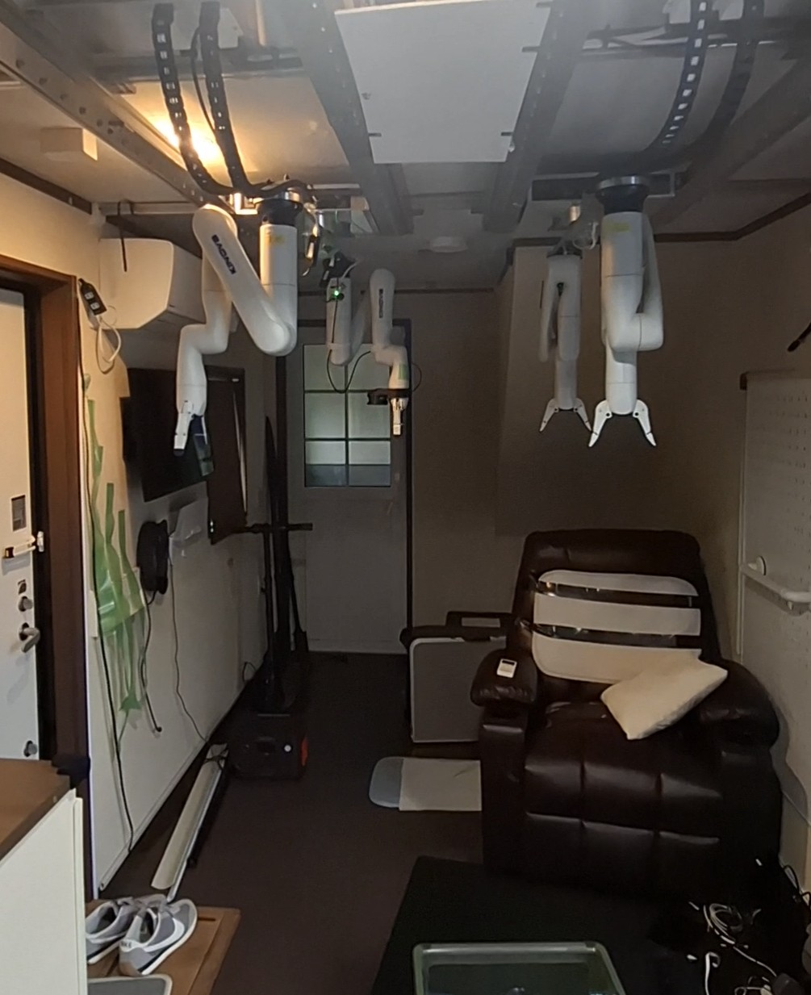
Why a Ceiling-Mounted Robot at Home?
1
Aging society creates demand for in-home assistive robots (fetch, tidy, deliver objects).
2
Homes are small and cluttered. A floor robot shares the floor with residents, who must keep avoiding it.
3
A ceiling-mounted robot keeps the floor free and still serves the whole room from above.
Our testbed: Trailer Living Laboratory (TMU) with a dual-gantry, quad-arm ceiling robot already installed.
Physical platform in the trailer living lab
Notes:
(0:50)
Why put a robot on the ceiling? There are three reasons.
First, our society is aging. So we need robots that can help at home, for example to fetch or tidy objects.
Second, homes are small and full of furniture. A mobile robot on the floor shares this space with the residents, and they must always avoid it.
Third, if we mount the robot on the ceiling, the floor stays free. And the robot can still reach the whole room from above.
[Point to the photo.]
This photo shows our real platform, in the Trailer Living Laboratory at our university.

Slide 3
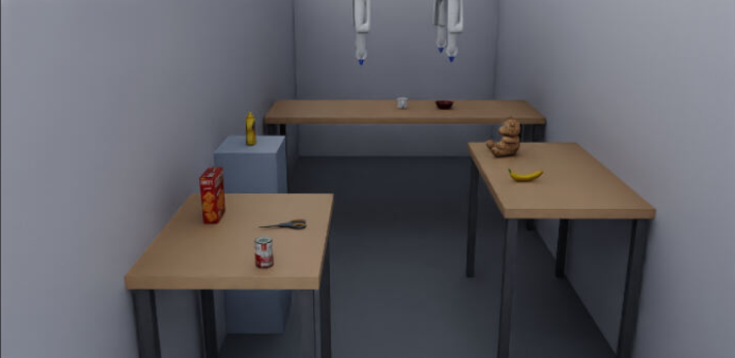
Platform: Real Robot and Its Digital Twin
All experiments are in simulation.
The twin is built from the same URDF as the real robot, so kinematics and joint limits match the hardware.
(a) Real platform
(b) Isaac Sim digital twin (same URDF)
Gantries | 2 ceiling rails, base height 2.05 m | Arms | 4 × Kinova Gen3 Lite (6-DOF, ~0.76 m reach)
Rail DOF | linear 0–2.0 m + rotation ±180° | Gripper | 2-finger, one per arm
DOF per arm | 8 = rail (d, θ) + 6 arm joints | Carriage load | ≈ 18.8 kg (2 arms + mounts)
Sensors | 2 × RGB-D (1280×720), ceiling corners | Room | 2.4 m wide, 3 work tables
Notes:
(1:05)
Here is the platform in more detail. On the left is the real robot. In the middle is its digital twin in Isaac Sim.
[Point to the boxed text.]
I want to be clear. All experiments in this paper are in simulation. The twin uses the same robot model as the real hardware, so the kinematics and joint limits are the same.
[Point to the table.]
The robot has two rails on the ceiling, at a height of two point zero five meters. Each rail slides two meters and also rotates. Each rail carries two Kinova Gen3 Lite arms. Each arm has six joints and about seventy-six centimeters of reach. So every arm has eight degrees of freedom, two from the rail and six from the arm.
Note that the two arms on one rail share the same carriage. The carriage carries about nineteen kilograms, including both arms. For sensing, we use only two RGB-D cameras in the ceiling corners.

Slide 4
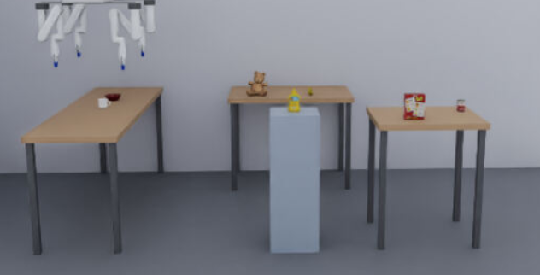
Problem: Which Arm Acts, and Where Should Its Base Go?
Limit of the standard rule (nearest arm)
The nearest arm ignores the cost of moving its base.
Example target (1.12, −0.60, 1.15) m:
Nearest picks arm_4
rail travel 1.15 m → 72.5 J
Four arms on two rails: most objects are reachable by several arms
Repositioning the heavy base is a dominant cost of the motion. A single fixed arm reaches only 63–65% of targets.
Q1 Which arm?
Q2 Where is its base?
4 candidates on 2 independent rails
rail travel d and rotation θ, shared by 2 arms
Goal: choose arm + base placement for minimum energy
Notes:
(1:05)
Now, the problem. Most objects can be reached by several arms, from several rail positions. So for every pick, the robot must answer two questions together. Question one: which arm? Question two: where should its base go?
The standard answer is to use the nearest arm. But the nearest arm ignores the cost of moving the base.
[Point to the grey box.]
Look at this example. For this target, the nearest rule chooses arm four. Its rail must travel one point one five meters, and the motion costs seventy-two joules. Moving the heavy base is a dominant cost. Also, if we use only one fixed arm, we can reach only sixty-three to sixty-five percent of the targets.
So our goal is to choose the arm and the base position together, for minimum energy.

Slide 5
Related Work and Gap
Method | Chooses among several arms | Rail / base motion in the model | Per-node configuration + quality | Energy-scored
Capability map, Zacharias et al. 2007 | – | – | △ | –
Reuleaux base placement, 2018 | – | ✓ | – | –
MoMa-Pos, 2024 | – | ✓ | – | –
BaSeNet (base pose sequence), 2024 | – | ✓ | – | –
RoboPARA (task-level allocation), 2026 | ✓ | – | – | –
Ours | ✓ | ✓ | ✓ | ✓
△ = reach orientation only, no IK-ready configuration
Gap: prior work places one arm well from a fixed-base, binary map. None chooses among arms and scores arm + base by energy.
Notes:
(0:50)
How does previous work handle this? Capability maps, like the work of Zacharias, describe where one arm can reach. Base placement methods, like Reuleaux, MoMa-Pos and BaSeNet, find a good position for one mobile base. RoboPARA assigns tasks to several arms, but at the task level, without energy.
[Point to the boxed row.]
As you can see in the table, previous work places one arm well. It usually uses a map with a fixed base, and only a yes-or-no value per cell. No method chooses among several arms and scores the arm and the base by energy. This is the gap we address.

Slide 6
Proposed System: Three Subsystems
1
3
2 RGB-D cameras
+ text query
Perception
YOLOE → object pose
Energy-aware selection
rank by cost J
Arm +
base
MoveIt 2
plan + execute
2
Base-aware GNG
capability map (offline, per arm)
Contributions
C1 Energy-aware selection cost J that picks the arm and the full 8-DOF configuration (rail travel included).
C2 Base-aware GNG capability map: rail as an active DOF, every node stores a configuration + manipulability; boundary seeding.
C3 Isaac Sim evaluation against nearest, fixed and random baselines.
Notes:
(0:50)
Our system has three subsystems.
[Point to block 1, then 2, then 3.]
Subsystem one is perception. It finds the object position from the cameras. Subsystem two is the base-aware capability map, built with Growing Neural Gas. We build it offline, one map per arm. Subsystem three is energy-aware selection. It uses the maps to rank the candidates by an energy cost, J. The winner gives us the arm and its rail position. Then MoveIt 2 plans and executes the motion.
This gives our three contributions. The energy cost J, the base-aware GNG map, and an evaluation in Isaac Sim against three baselines.

Slide 7
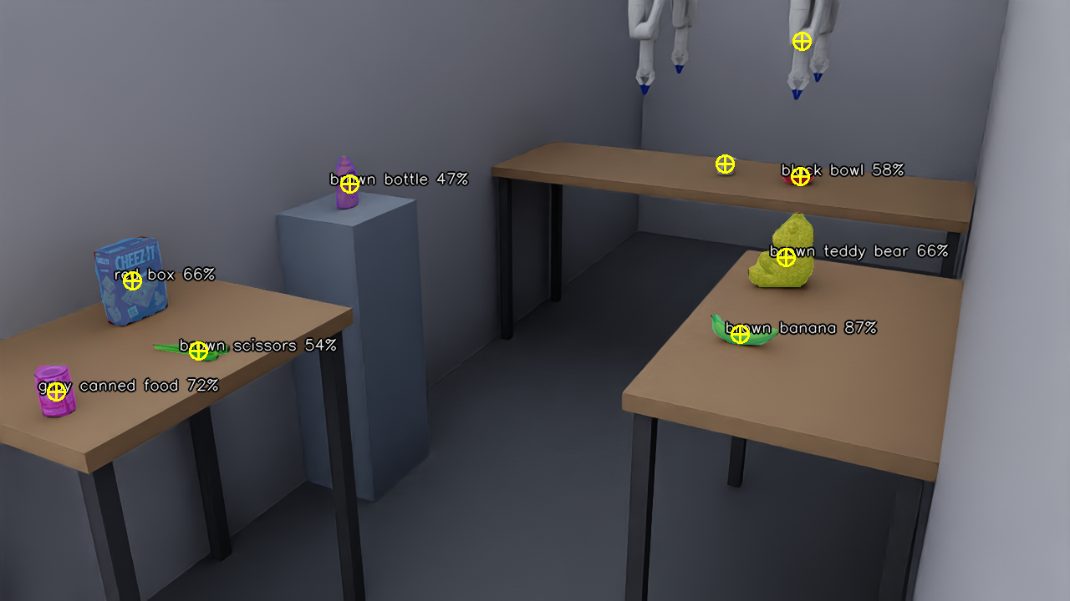
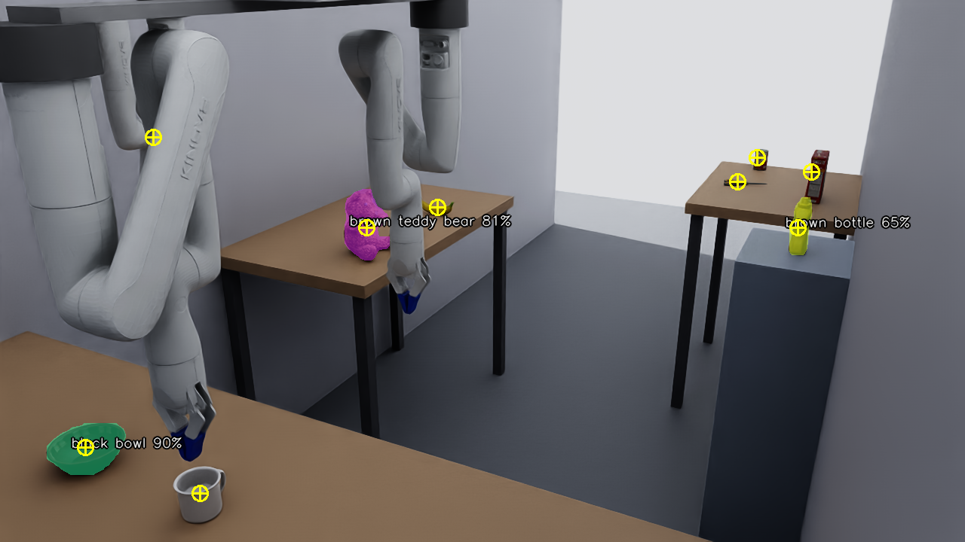
Subsystem 1: Open-Vocabulary Perception
(a) camera 1
(b) camera 2 (diagonally opposite corner)
YOLOE mask
from text query
Depth → world
3D points
Median
centroid
Fuse 2 cameras
(0.10 m radius)
Track +
label vote
YOLOE check (3864 detections): 100% detection, 0.023 m mean localization error, 0% false positives
Notes:
(0:45)
First, perception. We use two RGB-D cameras in opposite ceiling corners. So an object hidden from one camera is usually visible from the other.
YOLOE finds each object from a text query. We project the depth pixels into 3D, take the median point as the object center, and merge the two cameras. A simple tracker keeps the labels stable.
In our check over almost four thousand detections, detection was one hundred percent, with about two centimeters of error. The same depth images also build the octomap, a voxel grid map, which we use for collision avoidance.
[10-min version, say only this:] Perception uses two ceiling cameras and YOLOE to find the 3D position of each object. The same depth images build the collision map.

Slide 8
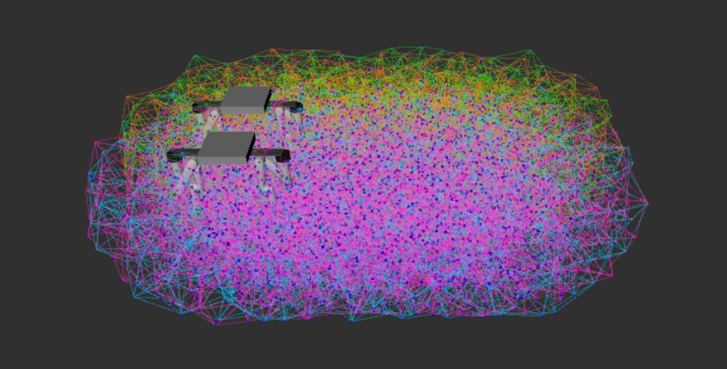
Subsystem 2: Base-Aware GNG Capability Map
1
Sample configurations
80,000 random 8-DOF configs q = [d, θ, q1…q6]. Forward kinematics (Pinocchio) + manipulability w = √det(JJᵀ).
2
Grow the GNG
Each node stores [ x | q ]: a reachable point AND a representative 8-DOF config, rail placement included.
GNG capability map of one arm (RViz)
3
Boundary seeding
Pin 600 nodes on the measured reach surface first, so the map does not shrink inward at the edge.
2915
0.090 m
~14,500
8
nodes
median spacing
edges
DOF per node
BMU search uses position x only; adaptation updates the whole vector [x | q].
Notes:
(1:10)
Subsystem two is the core of our method, the base-aware GNG capability map. We build it in three steps.
[Point to step 1.] Step one. We sample eighty thousand random configurations of all eight joints, including the rail. For each one, we compute the hand position and the manipulability. Manipulability tells us how freely the arm can move at that point.
[Point to step 2.] Step two. We train a Growing Neural Gas on these samples. Each node stores two things. A reachable position, and a full eight-joint configuration that reaches it, including the rail position. So one node already tells us both the arm posture and the base position.
[Point to step 3.] Step three is boundary seeding. Without it, the nodes move inward, and the map becomes smaller than the true workspace. So we first fix six hundred nodes on the real boundary, and then we grow the inside.
The final map for each arm has two thousand nine hundred fifteen nodes, about nine centimeters apart.

Slide 9
Map Result: Rail as DOF and Boundary Seeding
≈ 4×
1.92 → 7.90 m³ reachable volume when the rail is a DOF
0.8 cm
edge error, down from 22.1 cm (about 28× smaller)
Notes:
(0:40)
Here is what the map gives us.
[Point to the left chart.] If we treat the rail as part of the arm, the reachable volume grows from one point nine to seven point nine cubic meters. That is about four times larger.
[Point to the right chart.] Boundary seeding reduces the error at the edge of the workspace from twenty-two centimeters to less than one centimeter. So we can trust the map, even near the boundary.

Slide 10
Subsystem 3: Energy-Aware Selection Cost J
Δlin, Δrot: rail linear / rotation travel
Δarm: summed arm-joint travel
e: tool-to-object distance
m: manipulability (subtracted, so dexterity is cheaper)
ρ: median of each term, makes terms unitless
Term | Weight w | Ref. ρ
Rail linear travel | 27.16 | 1.18 m
Tool-to-object distance | 12.78 | 1.45 m
Rail rotation travel | 3.08 | 1.24 rad
Manipulability (−) | 2.95 | 0.105
Arm joint travel | 0.09 | 7.18 rad
Weights are learned, not hand-set: OLS regression of measured mechanical energy on the 5 terms (168 picks).
Rail friction model (assumed, sliding guide μ = 0.15): 27.6 N linear, 2.03 N·m rotation.
Fit quality R² 0.055 → 0.857, Spearman 0.31 → 0.909 (frictionless → friction model).
Notes:
(1:15)
Subsystem three is the energy cost, J.
[Point to the equation.]
For each candidate, J adds up the rail linear travel, the rail rotation, the arm joint travel, and the remaining distance from the hand to the object. It subtracts manipulability, so a more dexterous posture is cheaper. Each term is divided by its median value, so all terms have a similar scale.
We do not set the weights by hand. We learn them by least-squares regression, on the measured energy of one hundred sixty-eight picks.
[Point to the box at the bottom.]
At first, the fit was very poor. R squared was only zero point zero five five. The reason is that in simulation, a horizontal rail costs no energy without friction. So we added a rail friction model, with an assumed friction coefficient of zero point one five, which is typical for a sliding guide. With friction, R squared rose to zero point eight five seven. And rail linear travel became the largest weight. This matches our idea that moving the base is the main cost.

Slide 11
Selection Procedure and Experiment Setup
Selection (per target)
Experiment setup
1
Pool map nodes near the target from all 4 arms
Targets | 60-position grid (6×5×2) over both rails
Policies | energy (ours), nearest, random, fixed (each arm)
Run | planned against live MoveIt 2 (Isaac Sim)
Metrics | plan success, rail and arm travel, measured mechanical energy
Energy | Pinocchio inverse dynamics + rail friction
Plan time | ≈ 0.08 s per pick for every policy
2
Score every candidate with J, sort ascending
3
Try in order, interleaved across arms: IK to pre-grasp + MoveIt plan-only
4
First valid plan = selected arm + rail placement, then execute
Notes:
(0:45)
For each target, selection works like this. We collect the map nodes near the target from all four arms. We score each one with J and sort them. Then we try them in order, switching between arms, with inverse kinematics and a collision-free plan. The first valid plan is our decision, the arm and its rail position.
To test this, we used sixty target positions on a grid over both rails. We compared four policies. Our energy-aware method, the nearest arm, a random arm, and a single fixed arm. Planning took about zero point zero eight seconds per pick for every policy.
[10-min version, say only this:] We tested on sixty grid targets, against nearest, random and fixed-arm policies.

Slide 12
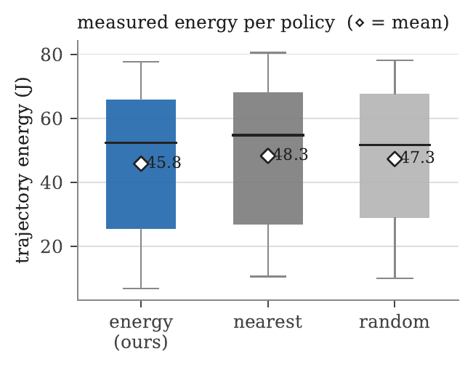
Result: Success Rate and Measured Energy
Policy | Success | Rail lin. (m) | Arm (rad) | Mean E (J) | Median E (J)
energy (ours) | 93.3% | 0.97 | 8.66 | 45.84 | 52.34
nearest | 93.3% | 1.19 | 7.94 | 48.28 | 54.79
random | 93.3% | 1.17 | 8.10 | 47.31 | 51.72
fixed (best arm)* | 65.0% | 1.14 | 7.47 | 49.79 | 55.78
fixed (worst arm)* | 63.3% | 1.13 | 8.05 | 45.43 | 43.12
* fixed-arm energy is over that arm's own, smaller reachable set
Using all 4 arms: 93.3% vs 63–65% plan success.
Energy-aware: lowest mean energy, −5.1% vs nearest, −3.1% vs random; same-target wins 57% / 61%.
Measured trajectory energy per policy (◇ = mean)
Same target as before: ours picks arm_3, rail 0.64 m, 42.4 J vs nearest arm_4, rail 1.15 m, 72.5 J → −30.1 J
Notes:
(1:15)
Here are the main results.
[Point to the Success column.]
First, success rate. All three multi-arm policies reach ninety-three point three percent. A single fixed arm reaches only sixty-three to sixty-five percent. So using four arms is the big gain in reachability.
[Point to the boxed row.]
Second, energy. Among the multi-arm policies, our method has the lowest mean energy, forty-five point eight joules. That is five point one percent lower than nearest, and three point one percent lower than random. It also has the shortest rail travel. In same-target comparisons, our method wins fifty-seven to sixty-one percent of the time. This is a real majority, but not every time.
[Point to the grey box.]
Remember the example from the problem slide. For that target, our method chose arm three instead of arm four. The rail moved about half a meter less, and we saved thirty joules.

Slide 13
Sensitivity to the Assumed Rail Friction
Saving grows with friction: 5.1% at μ = 0.15 → 12.4% at 3× (μ = 0.45) vs nearest; pairwise wins 84–86%.
Same planned trajectories re-scored with friction 0–3× nominal; selections kept fixed.
Ours stays lowest for μ > ~0.11.
At μ = 0.10 the policies are within ~1%; below that rail travel is cheap and the ranking reverses.
Key next step: measure the real rail friction on the hardware.
Notes:
(0:55)
Our friction coefficient is an assumption, so we checked how sensitive the result is. We kept the same trajectories, and changed the friction from zero to three times the nominal value.
[Point to the dark line.]
The graph shows the energy saving of our method. The saving grows with friction. At the nominal value it is five percent, and at three times the friction it reaches twelve percent. Our method stays the best for any friction above about zero point one one.
[Point to the left end of the line.]
However, if the rail has almost no friction, moving the base is cheap, and the advantage disappears. So the next important step is to measure the real friction of our rail.

Slide 14
End-to-End Pick and Reachability Classification
35/35
picks succeeded
7 objects × 5 trials, 0 failures
time-to-pick mean 39.6 s, median 28.1 s
8/8
reachability correctly classified
by GNG nearest-node test (r ≥ 0.12 m), 0 false positives
3 arms
used by energy mode
arm_2/3/4 = 10/13/12 picks (arm_1 wins 12 of 60 grid targets)
arm_2 approaching the banana (Isaac Sim physics)
Object poses from Isaac ground truth; YOLOE-driven end-to-end picking is future work.
Notes:
(0:45)
Finally, we tested the full pipeline in Isaac Sim with physics, from perception to execution. Seven objects, five trials each. All thirty-five picks succeeded, with no failures.
The same GNG map can also tell whether an object is reachable. One object, a soup can, is placed out of reach on purpose. The map classified all eight objects correctly, with no false positives.
Please note that these picks used ground-truth object positions from the simulator. Using YOLOE from end to end is future work.

Slide 15
Conclusion and Future Work
C1
Energy-aware selection chooses arm + full 8-DOF config: lowest mean energy of the multi-arm policies, and the gain grows with rail friction.
C2
Base-aware GNG map: ≈4× reachable workspace, edge error 0.8 cm, 100% reachability classification.
C3
Isaac Sim evaluation: 93.3% vs 63–65% plan success, 35/35 end-to-end picks.
Future work
Validate on the physical ceiling robot (trailer lab)
Measure real rail friction; sim-to-real gap of the weights of J
YOLOE-driven end-to-end picking
Thank you
rochmanto-artha@ed.tmu.ac.jp
Notes:
(0:40)
To conclude. First, our energy-aware selection chooses the arm and its full eight-joint configuration. It gives the lowest mean energy among the multi-arm policies. Second, our base-aware GNG map makes the workspace about four times larger, with less than one centimeter of error at the edge. Third, in Isaac Sim, we reached ninety-three percent planning success, and thirty-five out of thirty-five picks.
In the future, we will test the method on the real ceiling robot, measure the real rail friction, and use YOLOE in the full pipeline.
Thank you very much. I am happy to take your questions.

Slide 16
Backup: Why We Report the Mean (Energies Are Bimodal)
About 1/3 of targets need little rail travel (< 40 J); the rest need a long rail move.
The median falls in the gap between the two clusters, so medians are fragile (ours: 48.5 vs 56.2 J middle values).
Paired median still favours ours: −0.37 J vs nearest, −0.34 J vs random.
26/56 near-ties; the mean gain comes from large savings: 5 targets save > 20 J, only 2 lose > 20 J.
Notes:
[Only if someone asks why the median is not clearly better.]
Thank you, that is a good question. The energies are bimodal. About one third of the targets need little rail travel, and the rest need a long rail move. The median falls in the gap between these two groups, so it is fragile.
The paired comparison is more informative. Its median still favors our method, by about zero point three joules. Twenty-six of fifty-six targets are near ties. The mean gain comes from a few large savings. Five targets save more than twenty joules, and only two lose that much.

