Slide 1
Group 3: Radka, Revathi, Natalia
Answer business questions:
Is Magist a good fit for high-end tech products?
Are orders delivered on time?
WBS coding school 21.11.2022

Slide 2
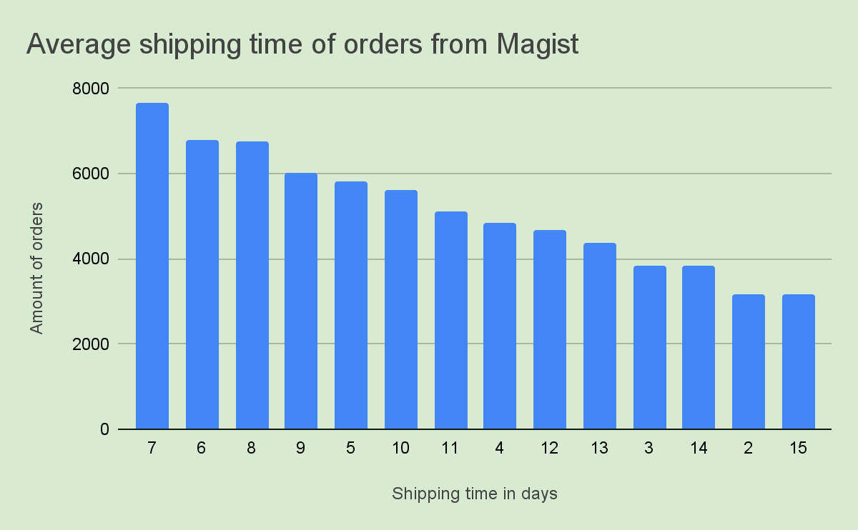
As of May 2020, an online order in Brazil would take, on average, 16 days to be delivered to the shopper. (Source: statista.com)

Slide 3
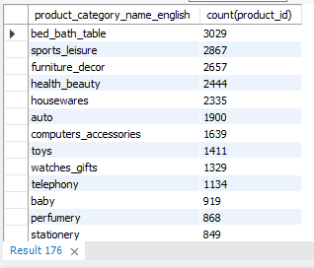
Categories with a most products
This slide is better to delite in final version. We will not show it. Otherwise it will be too many slides.
~5%
Products: 32951

Slide 4
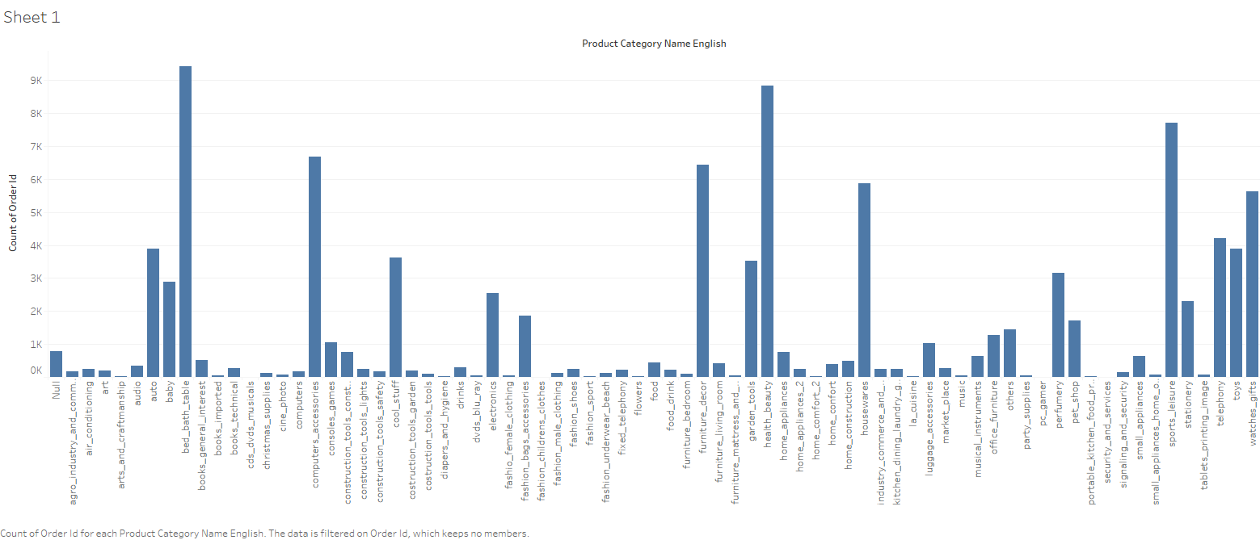
Is Magist a good fit for high-end tech products?
Total orders: 98666
Orders: computer_accessories: 6689 (~ 7 %)

Slide 5
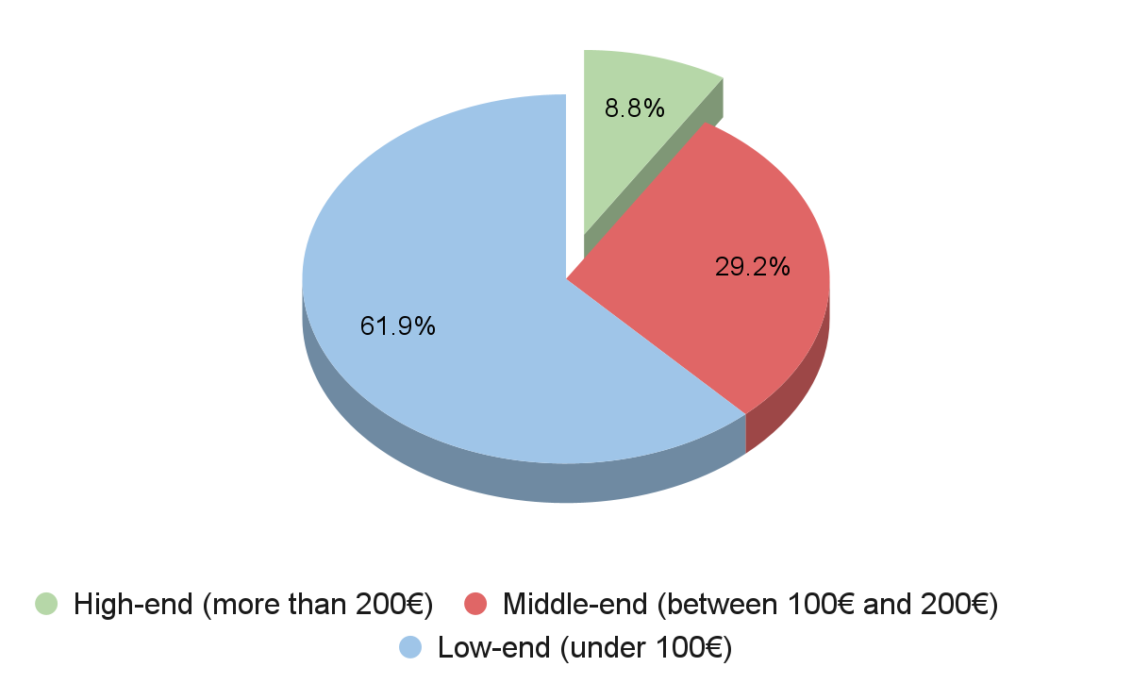

Slide 6
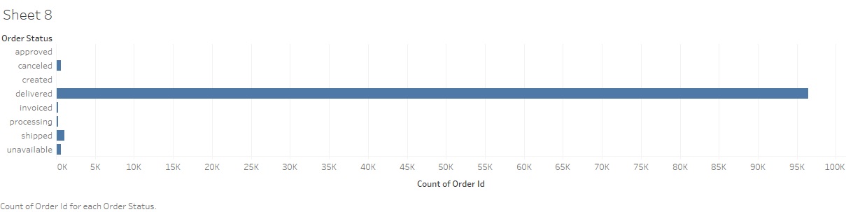
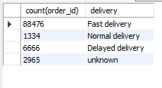
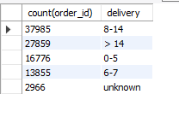
Total orders: 99441
Orders delivered: 96478 (97%)
Are orders delivered on time?
89 %
38 %
1,3 %
28 %
6,7 %
17 %
< 2%
Fast: order_estimated_delivery_date > order_delivered_customer_date
Total 99441
order_delivered_customer_date - order_purchase_timestamp

