Slide 1
Spotify Category Prediction
By: Radha Katkamwar

Slide 2
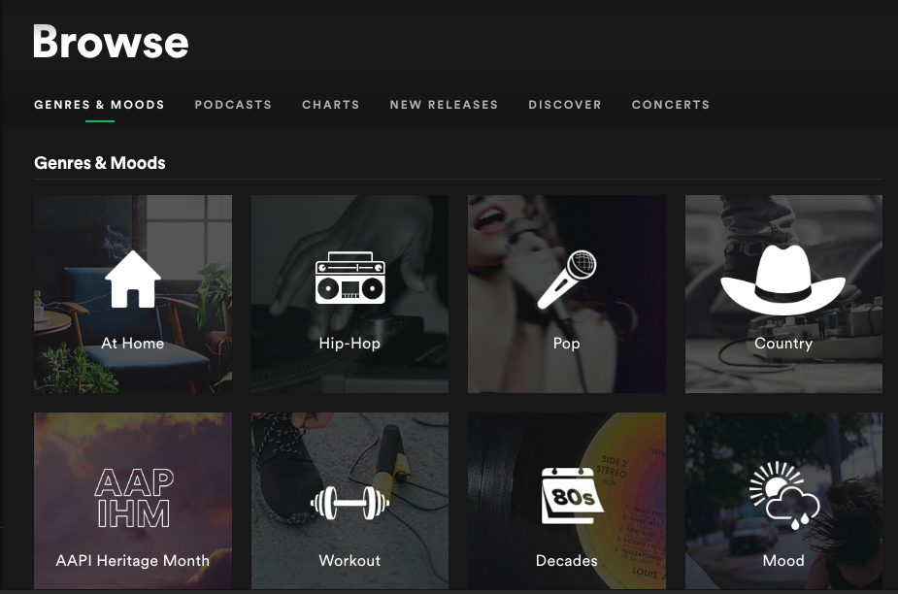
Background
Spotify has a browse feature that is filled with different categories of music
Ex: At home, hip-hop, workout, latin, mood, chill, etc.
I wanted to see if I can predict what category a track belongs

Slide 3
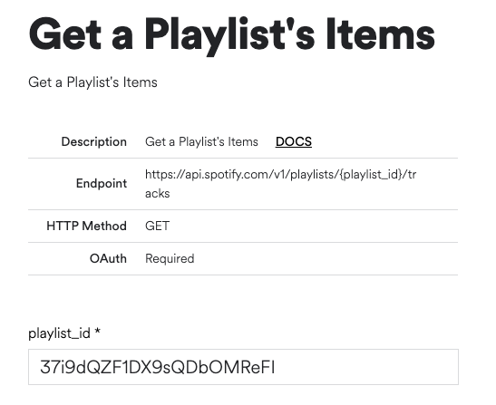
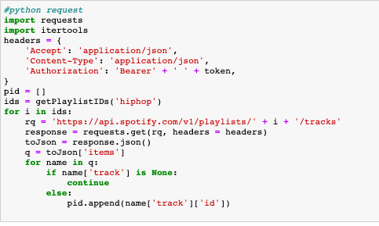
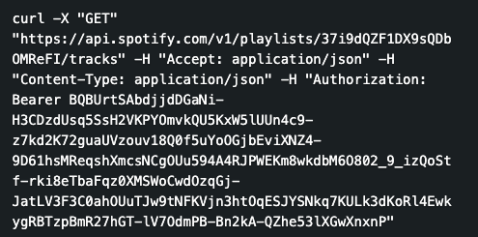
Collecting data
Spotify’s API allows you to access audio analysis of a track, playlist, or album
On the Spotify website, they have an interactive web API so you can make requests which would return a JSON file
I copied the CURL request and then converted it into a python request so I can use it in the Jupyter notebook
From these JSON files, I extracted playlist ids, track ids and audio analyses of tracks
I was getting the most up to date playlists and tracks of categories because I was directly accessing the categories through their API each time I ran the notebook

Slide 4
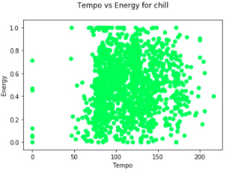
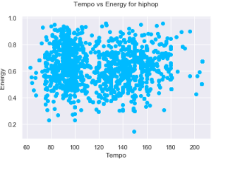
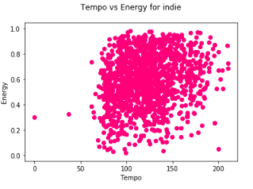
Tempo vs Energy Analysis
I focused primarily on five categories: Chill, hip-hop, indie_alt, latin, and mood but will show analysis of just chill, hip-hop and indie for simplicity
In these scatter plots, we can see how hiphop’s distribution for the tracks have two different clusters
and the other two only
1. We can also see that chill tends to have more data points for low energy compared to indie and hiphop

Slide 5
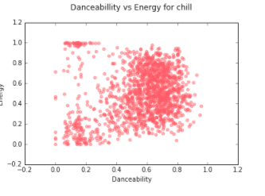
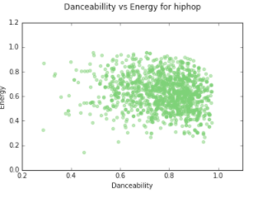
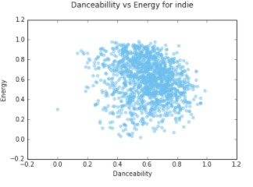
Danceability vs Energy Analysis
‘Chill’ category has two cluster whereas hip-hop and indie only have 1. However hip-hop and indie’s
distribution is still different. Hiphop has wider range for danceability and lower range for energy which is
the opposite from indie

Slide 6
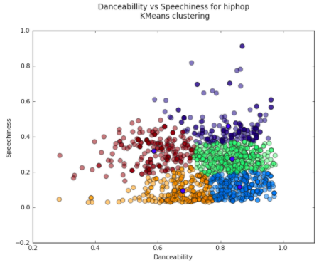
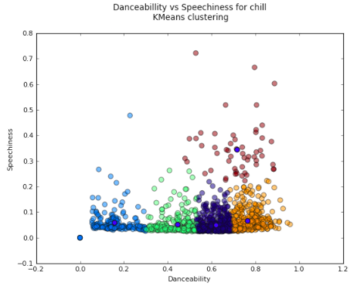
K-Means clustering danceability vs speechiness
From the hip-hop kmeans, we can tell that if something is in the red cluster the probability of the track belonging to the chill category is extremely low

Slide 7
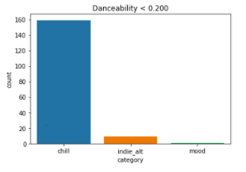
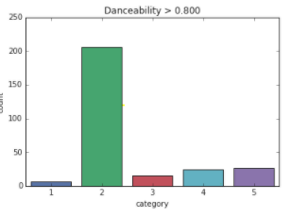
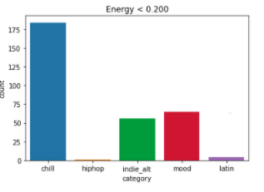
Value counts for categories
Danceability and Energy was something that differed a lot under a certain range. For this reason, I added features based on these graphs to incorporate into my ML algorithms

Slide 8

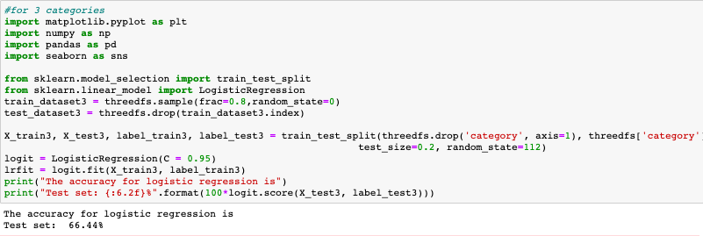
Logistic Regression
Multi-class logistic regression to predict what category a track belonged to
Additional features ex:
Results: The accuracy for logistic regression is 66.44%

Slide 9
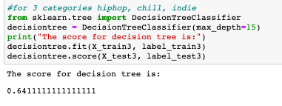
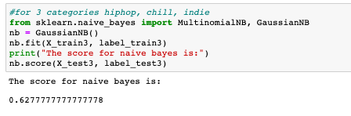
Decision Trees vs Naïve Bayes

Slide 10
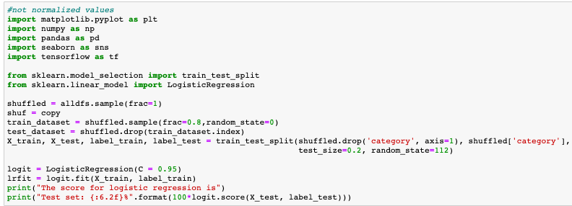

Logistic Regression from using 5 categories(Chill, hiphop, indie, mood, latin) )

