Slide 1
Analytics Project Symposium - Fall 2016
Analytics Project:
Predicting Redddit Post Popularity
Team:
Prasanna, Radhakrishnan, Varun
Abstract:
In this analytic, we aim to identify patterns and trends from Reddit and Hackernews datasets that would benefit online marketing. The goal is to predict popularity of a post/comment given it's content, sentiment and timing

Slide 2
Predicting Redddit Post Popularity
Motivation
Who are the users of this analytic?
Advertisers who aim to reach a target audience using discussion forums
Who will benefit from this analytic?
Media companies and Advertising agencies
Why is this analytic important?
Revenues for media companies and advertising agencies depend on the content they publish. They need insights about the advertising platforms and their user engagements. This analytic aims to answer a few of those questions.

Slide 3
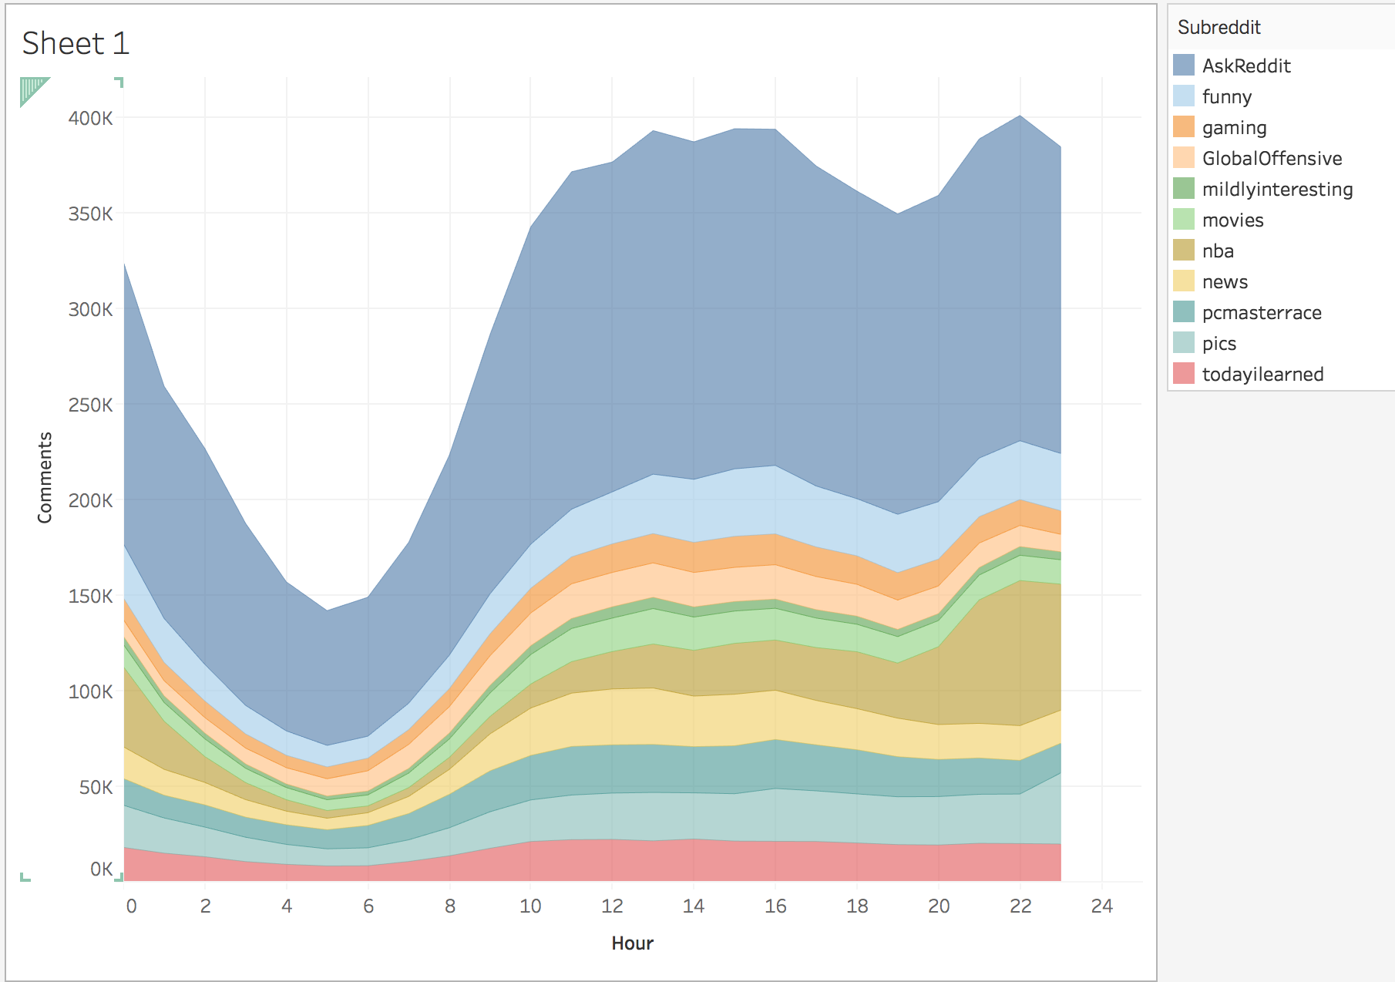
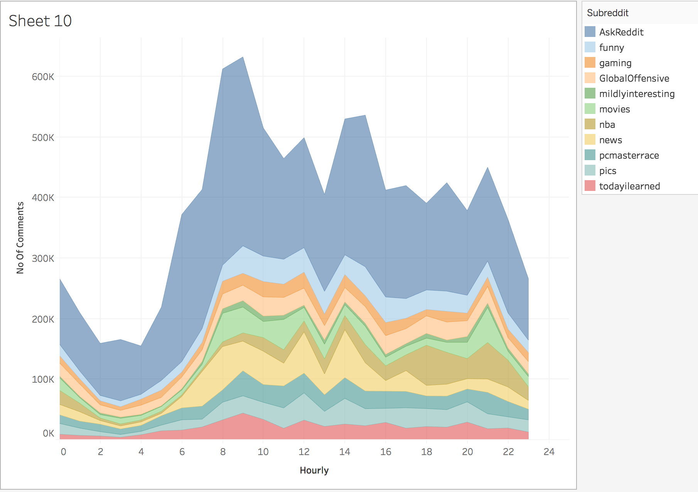
Predicting Redddit Post Popularity
Goodness
What steps were taken to assess the ‘goodness’ of the analytic?
We used the results of our analytic from reddit comments dataset and cross-verfied similar trends in reddit posts dataset.
Comments timeline from Comments data set
Comments timeline from
Posts data set

Slide 4
Predicting Redddit Post Popularity
Data Sources
Name: Reddit Comments May-2015
Description: Conatins all comments and its associated information like author, score and time etc
Size of data: 16GB
Name: Reddit Posts Dec 2015
Description: Conatins all posts and its assciated information like author, score, time, number of comments etc
Size of data: 8GB
Name: Hacker News Posts Jan-Sep 2016
Description: Contains all posts from hacker news and its associated information like author, score, time etc for each post
Size of data: 200 mb

Slide 5
Predicting Redddit Post Popularity
Design Diagram
Platform(s) on which the analytic ran:
NYU Dumbo, Google BigQuery

Slide 6
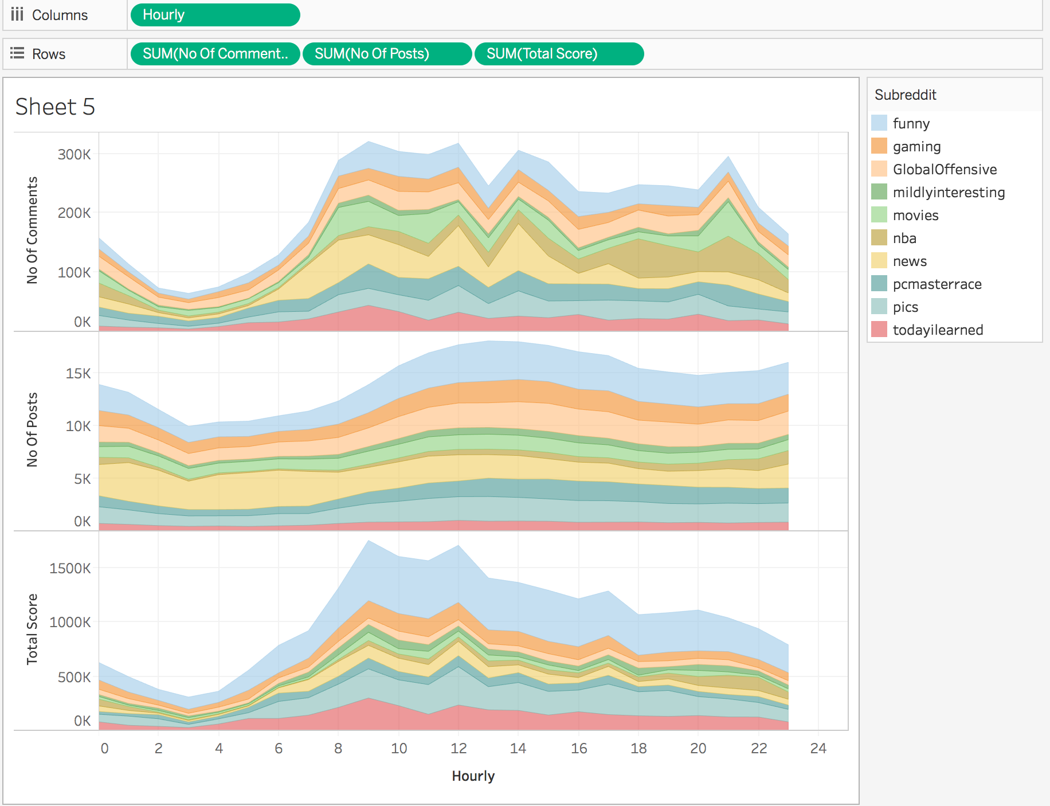
Predicting Redddit Post Popularity
Result 1
A timeline showing engagements for each of the top subreddits

Slide 7
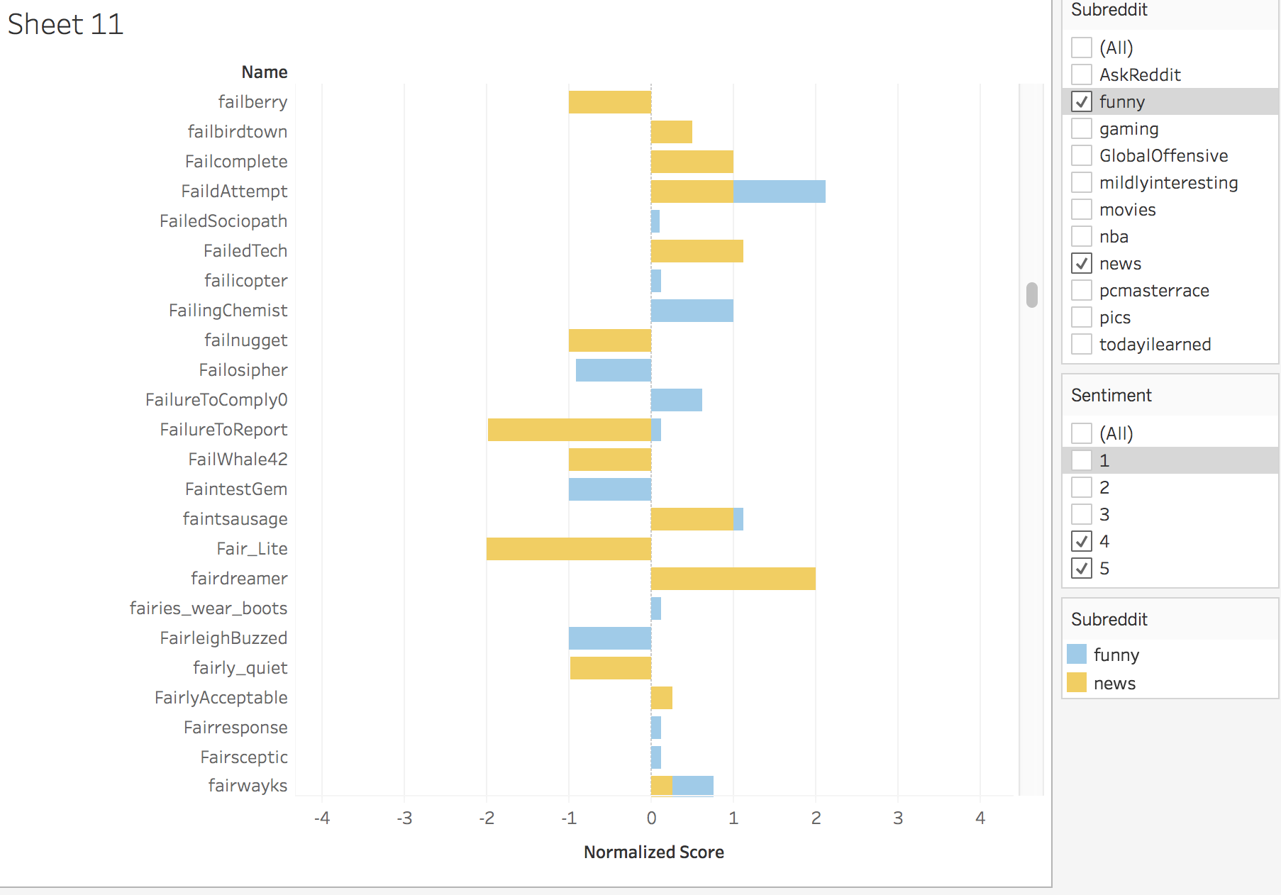
Predicting Redddit Post Popularity
Result 2
Normalized score for individual authors posting moderately negative or highly negative comments under subreddits news and funny

Slide 8
Predicting Redddit Post Popularity
Result 3
subreddit : todayilearned
timstamp : 1433004219
author : xvvvvx score : 10 comment : “I literally wanted to be dead rather than feel the pain when it happened”.
sentiment_class : 5
prediction author :
subreddit:todayilearned
author:xvvvvx
sentiment: 5
Normalized score: 0.125
prediction timeline :
subreddit:todayilearned
Time Bucket:12
Setiment_class: 5
Normalized score: 0.0307895875033
prediction N Grams
(literally wanted) : 1,1
(literally wanted dead) :1,1
(feel pain):14,274
(pain happened): 1,1
Median Score : 1.0

Slide 9
Predicting Redddit Post Popularity
Obstacles
Stanford NLP java api was compatible only in java 1.8, whereas, hadoop currently runs only on java 1.7, and so we had to move to python with hadoop streaming that supports NLTK
We were unable to get the reddit post data set from May 2015. Instead we had to use posts from Dec 2015.

Slide 10
Predicting Redddit Post Popularity
Summary
We’ve identified 3 different features that conform to consistent patterns and influence the popularity of the posts and comments. Although this analytic gives predicitions of the popularity of a post to a desirable extent, some of the posts do not become popular unless they are posted multiple times.
Acknowledgements
We thank HPC’s support staff for their quick responses.
We thank Kaggle and Googlee BigQuery for providing us with their data
We thank tableu for saving time!

Slide 11
Predicting Redddit Post Popularity
References
PREDICTING REDDIT POST POPULARITY by Jordan Segall and Alex Zamoshchin A. Gates. Programming Pig. O’Reilly Media Inc.,Sebastopol, CA, October 2011.
PREDICTING REDDIT POST POPULARITY by Alex Bragdon, Ben McMorran, Himanshu Sahay, Lambert Wang.Text Analytics: the convergence of Big Data and Artificial Intelligence by Antonio Moreno1 , Teófilo Redondo2 https://dialnet.unirioja.es/descarga/articulo/5573981.pdf
Reddit Recommendation System by Daniel Poon, Yu Wu, David (Qifan) Zhang CS229, Stanford University December 11th, 2011Multidisciplinary Instruction with the Natural Language Toolkit by Steven Bird, Ewan Klein, Edward Loper, Jason Baldridge
PREDICTING REDDIT POST POPULARITY VIA INITIAL COMMENTARY by Andrei Terentiev and Alanna Tempest
Telegraph (2013). ., [http://www.telegraph.co.uk/technology/twitter/9945505/Twitter-in-numbers.html]
Facebook statistics (2013)[https://newsroom.fb.com/News]
YouTube Statistics (2013). [http://www.youtube.com/yt/press/statistics.html[10]
Widespread Underprovision on Reddit by Eric Gilbert

Slide 12
Predicting Redddit Post Popularity
Thank you!

