Slide 1
From reactive to proactive: the metamorphosis of antiviruses
Radosław Kumorek
SFI 2024

Slide 2
anegdota

Slide 3
Statisctics
Every day, 560,000 new pieces of malware are detected.
There are now over 1 billion malware programs in existence.

Slide 4
History
Every day, 560,000 new pieces of malware are detected.
There are now over 1 billion malware programs in existence.

Slide 5
Malware
Trojan
Ransomware
MALWARE (MALICIOUS SOFTWARE)
Spyware
Adware
Rootkit
Keylogger
Bots

Slide 6

Black hat
Blackhat – computer hacker who violates laws

Slide 7
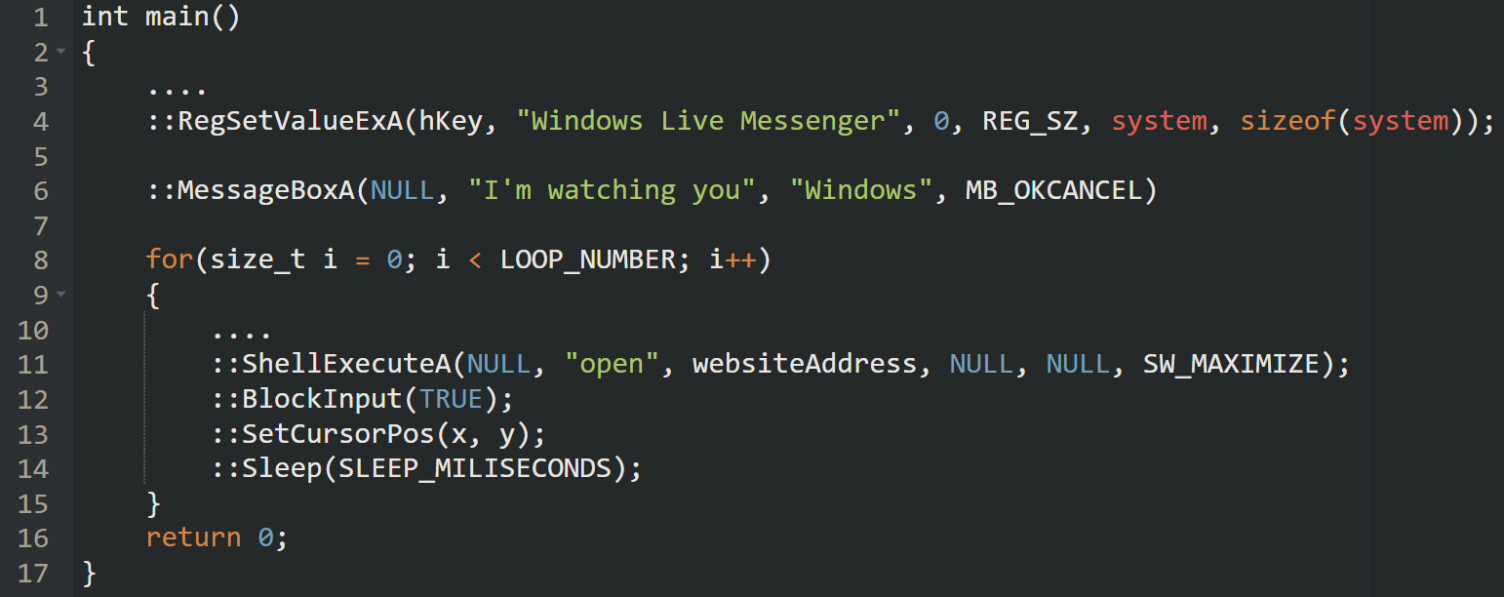
Wacatac

Slide 8
Wacatac
Filmik z nagraniem działania wacatac

Slide 9


STATIC ANALYSIS
Types of detection/analysis
Static analysis in cybersecurity
Static analysis in car mechanics
scanning a file before launch
Checking the car before starting the engine

Slide 10

STATIC ANALYSIS
Simplest detection
Malwares database
File
Is the file in the database?

Slide 11
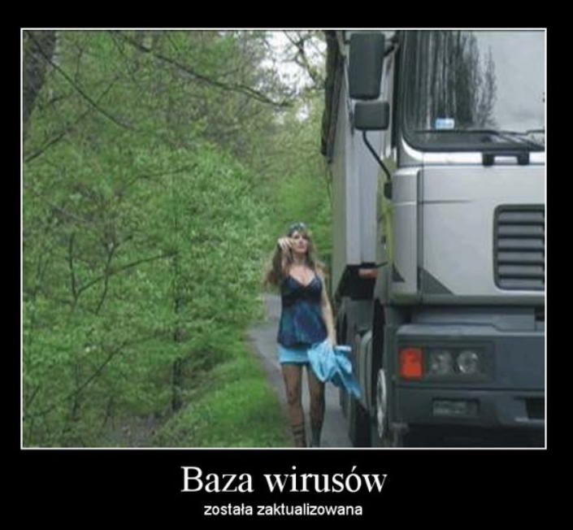
STATIC ANALYSIS
Simplest detection

Slide 12

STATIC ANALYSIS
Comparing files
Compare files byte by byte? low efficiency
Compare sizes? not deterministic

Slide 13
STATIC ANALYSIS
Hash function
FILE
SHA256
CHECKSUM

Slide 14
STATIC ANALYSIS
Hash function
notepad.exe
SHA256
87F53BC444C05230CE439DBB127C03F2E374067D6FB08E91C834371FD9ECF661

Slide 15
STATIC ANALYSIS
Simplest detection
Malwares SHA database
File
SHA256
Is SHA in the database?
Checksum

Slide 16
STATIC ANALYSIS
Algorithm

Slide 17
STATIC ANALYSIS
Signature

Slide 18
STATIC ANALYSIS
Example

Slide 19
STATIC ANALYSIS
Evading

Slide 20
DYNAMIC ANALYSIS
Types of detection/analysis
Dynamic analysis in cybersecurity
Dynamic analysis in car mechanics
run file in „safe” environment
Start engine remotely on desert

Slide 21
DYNAMIC ANALYSIS
Obfuscation
Encrypted strings
Lazy loading of libraries
run file in „safe” environment
Start engine remotely on desert

Slide 22
DYNAMIC ANALYSIS
Wacatac
Encrypted strings
Lazy loading of libraries
run file in „safe” environment
Start engine remotely on desert

Slide 23

DYNAMIC ANALYSIS
Sandbox
ISOLATED ENVIRONMENT
FAKENET
filestytes
VIRTUALIZATION

Slide 24

DYNAMIC ANALYSIS
Quasi-Sandbox
NORMAL
HOOKED
API CALL
API CALL
MY FUNCTION
API FUNCTION
API FUNCTION

Slide 25
DYNAMIC ANALYSIS
Algorithm

Slide 26
DYNAMIC ANALYSIS
Signature

Slide 27
DYNAMIC ANALYSIS
Example

Slide 28
DYNAMIC ANALYSIS
Antyvirtualization Tricks

Slide 29
Thanks
Source: https://github.com/radkum

