Slide 1
From thermal results to a FEMAP point cloud
How two scripts turn a 2-D transient thermal solution into a 3-D, vertex-centered point cloud you can map and visualize on a circular mirror.
npz_to_3D.py (Python) + show_point_cloud.bas (FEMAP API)

Slide 2
The Pipeline At A Glance
show_point_
cloud.bas
FEMAP points
2D Thermal model outputs
Result in FEMAP: geometry Points overlaid on the mirror model for a spatial sanity check.
Thermal model
model1_results.npz
npz_to_3D.py
map T -> nodes, build
vertex-centered circle
x, y, z, T
point-cloud table
Node map
model1_node_map.csv
Output flavors: a dense analysis cloud (~37k pts) and a fast viz skeleton (~600 pts).
Temperature Load Set
→FEMAP data surface
→ Loads, temperature on nodes
Result in FEMAP: Interpolated nodal data applied to model as a load set

Slide 3
npz_to_3D.py — build the point cloud
SCRIPT 1

Slide 4
What npz_to_3D.py does
Reads 2D transient thermal result and a node map, then writes a 3-D point cloud for one mirror at one time step.
INPUTS
OUTPUTS
Node map (.csv)
Dense analysis cloud
Cell centroids per plate: x_m, z_m, dx_m, dz_m
11 plates x 50 nodes (5 wide x 10 deep)
Regular grid, clipped to the disk
<Mirror>_MirrorCloud3D_<t>s.csv (~37k pts)
Thermal results (.npz)
Viz skeleton
T[timestep, node] = 773 x 550
t (time) and node_names arrays
Rim ring + a few rows/cols
<Mirror>_VizSkeleton_<t>s.csv (~600 pts)
Columns are always x, y, z, T — the table FEMAP reads as an arbitrary 3-D scalar map.

Slide 5
The data it reads
Node map — geometry
Results (.npz) — temperatures
Each row = a cell centroid with its size.
x = in-plane (uniform spacing dx).
z = through-thickness (fine near the surface).
Grouped by plate (mirror) name.
773
550
time steps
nodes
T = [timestep, node] scalar field.
A chosen time snaps to the nearest step.
T is mapped onto the matching node name.
node_name links each row to its temperature column by NAME — robust even if ordering changes.

Slide 6
The core idea: map the strip onto a centered disk
1. Rescale x to the true diameter
The mesh describes the shape of the field; x is scaled to the mirror's physical diameter L.
2. Center on the vertex
x_c = (x_m / X_mesh) * L - R, so the origin sits at the mirror vertex (0,0). R = L / 2.
3. Sweep y, clip to the circle
T is uniform in y, so keep points where x^2 + y^2 <= R^2; each takes T from its x.
y
vertex (0,0,0)
x
T varies across x, uniform in y

Slide 7
Two clouds from one model
Same geometry and temperatures — different sampling for different jobs.
Dense analysis cloud (if needed)
Viz skeleton
~37k
~600
points (M1 @ 0.25 in)
points (rim + rows/cols)
Regular grid, clipped to the disk.
For the real scalar map in FEMAP.
Outer rim + a few rows and columns.
Plots instantly for the geometry check.
Spacing | Point count
0.25 | 37,500
0.50 | 9,324
0.75 | 4,188
1.00 | 2,316

Slide 8
Built to fail loud — never a bad file
Every check runs before anything is written. On any failure: a clear message and no CSV.
1
Mirror only
2
Names resolve
3
Uniform dx
M1-M7 accepted; others rejected by name
every node maps to a T column
the rescale assumption is verified
4
No NaN / inf
5
Inside the disk
6
Centered + deduped
temperatures and coordinates are finite
x^2 + y^2 <= R^2 for every point
origin on the vertex; no coincident points

Slide 9
Running npz_to_3D.py
1
Pick the node map .csv
You get
2
Pick the results .npz
A 4-column CSV
x, y, z, T in inches
+ a summary
diameter, radius, point count, bounding box, T range, and any mesh-vs-CAD mismatch.
3
Choose output: dense / skeleton / both
4
Enter the time (seconds)
5
Type the mirror (e.g. M1)
6
Choose the output folder

Slide 10
show_point_cloud.bas — see it in FEMAP
SCRIPT 2

Slide 11
What show_point_cloud.bas does
A FEMAP API macro that drops the cloud in as geometry Points — a placement check, one color.
1
Reads x,y,z,T
any delimiter; header and bad lines skipped; the T column is ignored
2
Places Points
one per row, single color, on their own layer (toggle in Visibility)
3
No re-mapping
the cloud is already centered and circular from Python
4
Safe by default
NextEmptyID never overwrites existing geometry; AppLock keeps it fast

Slide 12
Landing the cloud on the real mirror
The CSV is in the mirror-LOCAL frame
Origin at the vertex, +Z along the optical axis — exactly how Python built it.
You enter the mirror's CSys
The macro transforms each local x,y,z to global with feCoordTransform, so the cloud sits on the right mirror in the right orientation.
Must be rectangular
Checked before anything is created; 0 = global.
feCoordTransform
global
model
mirror-local CSys

Slide 13
Running it in FEMAP
1
File > Programming > API (Ctrl+F11), paste, Run
Settings to tweak
2
Enter the path to the x,y,z,T file
PT_COLOR
palette index for the points
LAYER_ID
which layer to draw on
STRIDE
thin a dense file on the fly
3
Enter the mirror's CSys ID (0 = global)
4
Points appear on layer 9100

Slide 14
Create Mapped Temps in FEMAP (manual method)
Backup

Slide 15
Create temperature loads in FEMAP from npz_to_3D.py output CSV
In FEMAP
  Tools > Data Surface Editor > Create Load/ Date Surface > Arbitrary 3D data surface
    Data Options > Options
      Csys > Select your vertex rectangular coordinate system
      Arbitrary 3D Interpolation Options
        % Locations to include = 0 (When this option is set to % Locations to Include, the value can vary from “0” to “100”. If it is set to “100”, Femap will use the “weighted contribution” from all of the Data Surface 3-D Variation Locations, while if it is set to “0” Femap will use the number set in Min Locations to Include)
        Min Locations to Include = 1 ( This will force the interpolation algorithm to use nearest neighbor. The value for Min Locations to Include must be higher than one and simply tells Femap the minimum number of variation locations that will be used at each interpolation point)
    Data Options > Select scalar radio button
    Variation Options
      Define Multiple
      Open the CSV created by the python script and copy the xyzT data and click Paste
    Press OK
    In the Data Surface editor click save and close the window
  Model Info window
    Right click Loads > New
    Right click load definitions > Nodal > select mirror nodes
    Create Loads on Nodes Dialog
      Set definition and equation csys to your vertex
      Select Temperature for type
      Method > Data Surface > Select your data surface under the data surface drop down
      Set temperature value = 1 (allows the data surface value to be multiplied through to each node
      Press OK

Slide 16
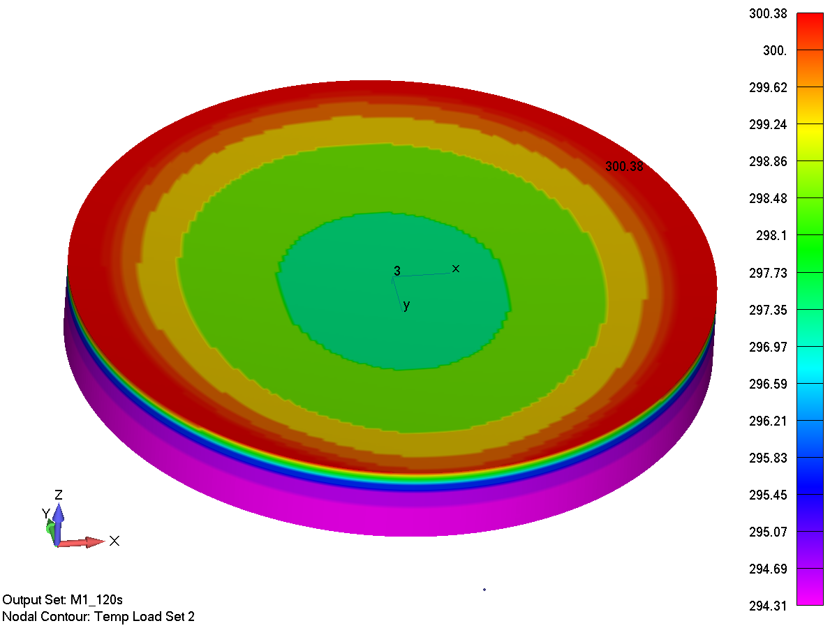
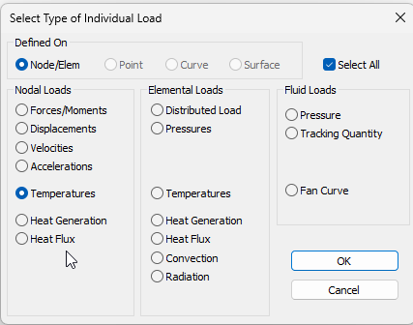
Visualize mapped data before running
Model > Output > From Load…
Temperatures
Press OK
Allows visualization prior to running Nastran

