Slide 1
Session 2

Slide 2
Agenda
Session 2
Homework discussion
Filtering and Sorting data
Workshop
Combining sets (UNION, UNION ALL, INTERSECT)
Workshop
Table constraints (Default, Check, Unique)
Workshop
Referential integrity (Foreign Keys)
Workshop
Join Types (Left, Right, Inner, Cross Join)
Workshop
Knowledge check (Quiz, Discussion, Homework)

Slide 3
Homework discussion

Slide 4
Homework - solution
New database: SedcHOME
Provide create script (homework folder)

Slide 5
Filtering and Sorting data

Slide 6
Fill database with example data
Let’s populate the tables with example data
Execute script: Session 2 – 01 Insert example data in SEDC database.sql
NOTE: Do not go into details with this script – JUST RUN IT

Slide 7
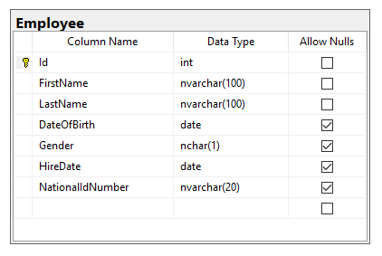
Filtering data
Filtering expressions are used to reduce number of rows returned based on some criteria
WHERE statement
Example:
SELECT *
FROM [TableName]
WHERE [ColumnName] = Value
SELECT *
FROM Employee
WHERE FirstName = 'Aleksandar'

Slide 8
Filtering data using Like
There are two wildcards used with Like operator
The percent sign (%) – zero, one or multiple characters
The underscore sign (_) – one single character
LIKE
Example:
SELECT *
FROM [TableName]
WHERE [ColumnName] LIKE pattern
SELECT *
FROM Employee
WHERE FirstName LIKE ‘Alek%'

Slide 9
Filtering data using NOT Like
Filtering expressions are used to reduce number of rows returned based on some criteria
LIKE
Example:
SELECT *
FROM [TableName]
WHERE [ColumnName] NOT LIKE pattern
SELECT *
FROM Employee
WHERE FirstName NOT LIKE 'Aleks%'
More info https://www.w3schools.com/sql/sql_like.asp

Slide 10
Filtering data - Workshop
Find all Employees with FirstName = Goran
Find all Employees with LastName starting With ‘S’
Find all Employees with DateOfBirth greater than ‘01.01.1988’
Find all Male employees
Find all employees hired in January/1998
Find all Employees with LastName starting With ‘A’ hired in January/2019

Slide 11
Sorting data
Ordering the results based on specific order
ORDER BY statement
Example:
SELECT *
FROM [TableName]
ORDER BY [ColumnName] ASC\DESC
SELECT *
FROM Employee
ORDER BY FirstName ASC

Slide 12
Sorting data - Workshop
Find all Employees with FirstName = Aleksandar ordered by Last Name
List all Employees ordered by FirstName
Find all Male employees ordered by HireDate, starting from the last hired

Slide 13
Combining sets
Union, Union ALL, Intersect

Slide 14
Combining sets - UNION
UNION set operator unifies the results of the two input queries. As a set operator, UNION has an implied DISTINCT property, meaning that it does not return duplicate rows.
Duplicates are eliminated
Pre-requisites
All sets should have same number and order of columns
Columns should be of same or compatible data type
Example:
Set1
Set2
SELECT FirstName,LastName
FROM Employee
UNION
SELECT FirstName,LastName
FROM Employee

Slide 15
Combining sets – UNION ALL
UNION ALL operator unifies the results of the two input queries. As a set operator, UNION ALL doesn’t has an implied DISTINCT property, meaning that it can return duplicate rows.
Duplicates remain
Pre-requisites
All sets should have same number of columns
Columns should be of same or compatible data type
Example:
Set1
Set2
SELECT FirstName,LastName
FROM Employee
UNION ALL
SELECT FirstName,LastName
FROM Employee

Slide 16
Combining sets – INTERSECT
INTERSECT operator returns only distinct rows that are common to both sets. In other words, if a row appears at least once in the first set and at least once in the second set, it will appear once in the result of the INTERSECT operator.
Pre-requisites
All sets should have same number of columns
Columns should be of same or compatible data type
Example:
Set1
Set2
SELECT FirstName,LastName
FROM Employee
WHERE FirstName = 'Aleksandar'
INTERSECT
SELECT FirstName,LastName
FROM Employee
WHERE LastName = 'Nikolovski'

Slide 17
Combining sets - Workshop
List all BusinessEntity Names and Customer Names in single result set with duplicates
List all regions where some BusinessEntity is based, or some Customer is based. Remove duplicates
List all regions where we have BusinessEntities and Customers in the same time

Slide 18
Table Constraints
Default, Check, Unique

Slide 19
Table Constraints - Default
The least constraining of all the T-SQL table constraints is the default constraint. In fact, you could say default constraints don't really constrain anything at all; they just supply a default value during an INSERT if no other value is supplied
Can be defined during the table creation
Table can be edited later on to support default constraint
Syntax with CREATE TABLE:
CREATE TABLE TableName (
Column1Name ColumnType NULL/NOT NULL,
Column2Name ColumnType NULL/NOT NULL,
...
ColumnNName ColumnType NULL/NOT NULL DEFAULT (Value)
);
CREATE TABLE Students (
ID int NOT NULL,
LastName nvarchar (255) NOT NULL,
FirstName nvarchar (255),
Age int Default 20
);

Slide 20
Table Constraints – Default 2
Syntax with ALTER TABLE:
Example:
ALTER TABLE TableName
ADD CONSTRAINT df_name DEFAULT VALUE FOR ColumnName
ALTER TABLE Students
ADD CONSTRAINT df_City DEFAULT 20 FOR Age;

Slide 21
Table Constraints - Check
With a check constraint, you declare that the values of a column are constrained in some fashion.
The values are already constrained by the data type, so a check constraint adds some additional constraints on the ranges, or set of allowable values.
Syntax with CREATE TABLE:
CREATE TABLE TableName (
Column1Name ColumnType NULL/NOT NULL,
Column2Name ColumnType NULL/NOT NULL,
...
ColumnNName ColumnType NULL/NOT NULL CHECK (Condition)
);
CREATE TABLE Regions (
ID int NOT NULL,
Country nvarchar(255) NOT NULL,
City nvarchar(100) NOT NULL,
TotalPopulation int NOT NULL check (TotalPopulation >= 100000)
);

Slide 22
Table Constraints – Check 2
Syntax with ALTER TABLE:
ALTER TABLE TableName WITH CHECK
ADD CONSTRAINT CHK_Name CHECK (Condition);
ALTER TABLE Regions WITH CHECK
ADD CONSTRAINT CHK_Population CHECK (TotalPopulation >= 100000);

Slide 23
Table Constraints - UNIQUE
Unique constraints guarantee that no more then one row can have the same value for specific column(s) in the table.
In the real world this constraints are used to prevent storing duplicate data for the same object (e.g. Table used to store the product can not have the same product inserted twice)
Syntax with CREATE TABLE:
CREATE TABLE TableName (
Column1Name ColumnType NULL/NOT NULL,
Column2Name ColumnType NULL/NOT NULL,
...
ColumnNName ColumnType NULL/NOT NULL,
CONSTRAINT UC_ColumnName UNIQUE (ColumnName)
);
CREATE TABLE Persons (
ID int NOT NULL,
LastName nvarchar (255) NOT NULL,
FirstName nvarchar (255),
Age int,
CONSTRAINT UC_Person UNIQUE (FirstName)
);

Slide 24
Table Constraints – UNIQUE 2
Syntax with ALTER TABLE:
Example:
ALTER TABLE TableName
ADD CONSTRAINT UniqueName UNIQUE (ColumnName)
ALTER TABLE Persons
ADD CONSTRAINT Unique_FirstName UNIQUE (FirstName)

Slide 25
Table constraints - Workshop
Change Products table always to insert value 1 in price column if no price is provided on insert
Change Products table to prevent inserting Price that will more than 2x bigger then the cost price
Change Products table to guarantee unique codes across the products

Slide 26
Referential integrity
Foreign keys

Slide 27
Foreign key
A foreign key is a column or combination of columns in one table that serve as a link to look up data in another table.
In the second table, often called a lookup table, the corresponding column or combination of columns have a primary key or unique constraint applied to them, or a unique index.
So a value in the first table may be duplicated, but in the second table where you look up the corresponding value, it must be unique
Syntax with CREATE TABLE:
CREATE TABLE Orders (
OrderID int NOT NULL,
OrderNumber int NOT NULL,
PersonID int,
CONSTRAINT PK_ID PRIMARY KEY (OrderID),
CONSTRAINT FK_PersonOrder FOREIGN KEY (PersonID) REFERENCES Persons(PersonID)
);
CREATE TABLE TableName1 (
Column1Name ColumnType NULL/NOT NULL,
Column2Name ColumnType NULL/NOT NULL,
...
ColumnNName ColumnType NULL/NOT NULL,
CONSTRAINT FK_ColumnName FOREIGN KEY (ColumnName) REFERENCES TableName2([ColumnName])
);

Slide 28
Foreign key
Syntax with ALTER TABLE
Example:
ALTER TABLE TableName1 WITH CHECK
ADD CONSTRAINT [FK_Column] FOREIGN KEY([ColumnName])
REFERENCES TableName2 ([ColumnName])
GO
ALTER TABLE [dbo].[Order] WITH CHECK
ADD CONSTRAINT [FK_Order_BusinessEntity] FOREIGN KEY([BusinessEntityId])
REFERENCES [dbo].[BusinessEntity] ([Id])
GO

Slide 29
Foreign key - Workshop
How it works without keys
Add foreign key between BusinessEntity and Order with script
How it works with keys

Slide 30
Types of relations
Types of relations between tables
One-to-Many Relationship (1:M) – Most common
A one-to-many relationship is the most common type of relationship. In this type of relationship, a row in table A can have many matching rows in table B, but a row in table B can have only one matching row in table A. For example, one Customer can have many Orders, but one order is only for 1 Customer.
Many-to-Many Relationships (M:M)
In a many-to-many relationship, a row in table A can have many matching rows in table B, and vice versa. You create such a relationship by defining a third table - C, called a junction table, whose primary key consists of the foreign keys from both tables A and table B.
For example the BusinessEntity table and the Customer table both have 1:M relation with Orders table which makes the M:M relation.
One-to-One Relationships (1:1)
In a one-to-one relationship, a row in table A can have no more than one matching row in table B, and vice versa. Example is the Customer table we have PhoneNumber column which can be placed in different table - CustomerPhone.
Relations are also known as Foreign Key (FK) relations.

Slide 31
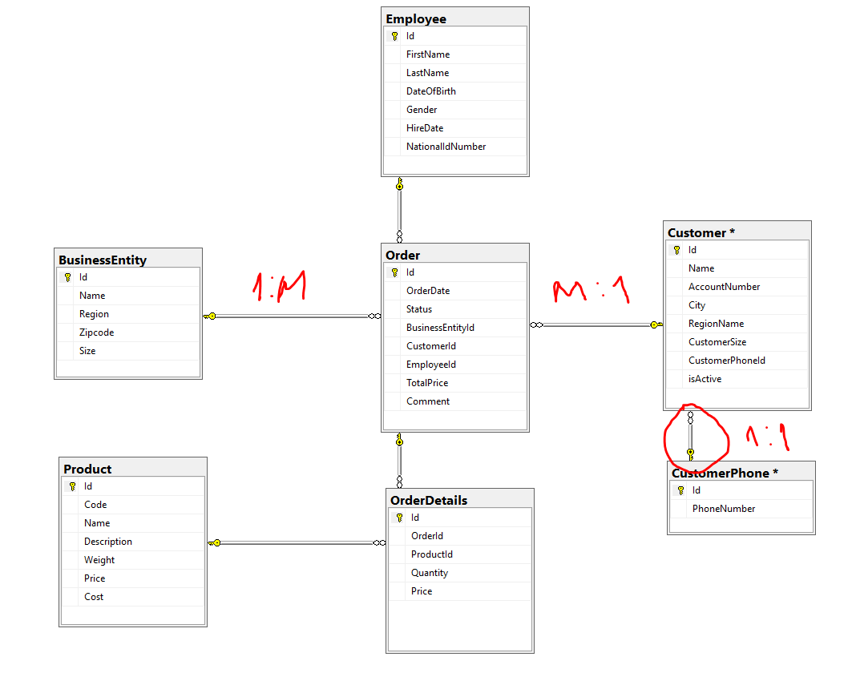
Types of relations - explained

Slide 32
Join types
Inner, Left, Right, Cross

Slide 33
Join types
Often, data that you need to query is spread across multiple tables. The more normalized the environment is, the more tables you usually have.
The tables are usually related through keys, such as a foreign key in one side and a primary key in the other. Then you can use joins to query the data from the different tables and match the rows that need to be related.
This lesson covers the different types of joins that T-SQL supports:
Cross
Inner
Outer (Left, Right)

Slide 34
Join types – Cross join
A cross join is the simplest type of join, though not the most commonly used one. This join performs what’s known as a Cartesian product of the two input tables. In other words, it performs a multiplication between the tables, yielding a row for each combination of rows from both sides.
Table A
Table B
M x N rows
M rows
N rows

Slide 35
Join types – Inner join
With an inner join, you can match rows from two tables based on a predicate—usually one that compares a primary key value in one side to a foreign key value in another side.
Inner join returns only matching rows - rows that exists in both tables
Table A
Table B
M rows
N rows

Slide 36
Join types – Outer join
With outer joins, you can request to preserve all rows from one or both sides of the join, never mind if there are matching rows in the other side based on the ON predicate.
Types:
LEFT (OUTER) JOIN RIGHT (OUTER) JOIN FULL (OUTER) JOIN
Table A
Table B
Table A
Table B
Table A
Table B

Slide 37
Join types - Demo
Create two tables (TableA, TableB)
Insert 2 records in each with values (1,2) ,(2,3)
Show all join types on this example
Demo: Session 2 – 05 Join types.sql

Slide 38
Join types - Workshop
List all possible combinations of Customer names and Product names that can be ordered from specific customer
List all Business Entities that has any order
List all Entities without orders
List all Customers without orders (using Right Join and using Left join)

Slide 39
Knowledge check
Quiz, Discussion, Homework

Slide 40
Quiz
Which SQL statement filters the resultset with additional conditions?
a. ORDER
b. FILTER
c. WHERE
d. REMOVE
Which SQL statement defines how records are ordered in sort operations?
a. HIGHEST \ LOWEST
b. TOP \ BOTTOM
c. ASC \ DESC
d. FIRST \ LAST

Slide 41
Quiz
How to combine two result sets in order to have result containing all data from both tables without duplicates?
a. INTERSECT
b. UNION
c. EXCEPT
d. UNION ALL
Which type of constraint should be used in order to prevent having two or more same values in specific table column? Default, Check, Unique
a. DEFAULT
b. CHECK
c. UNIQUE
d. DISTINCT
Which of the join types returns only records that exist in both tables?
a. CROSS JOIN
b. INNER JOIN
c. LEFT JOIN
d. FULL JOIN

Slide 42
Quiz
What is the purpose of Foreign keys?
Provide example from real world where CROSS JOIN type can be used?

Slide 43
Homework 2

Slide 44
Homework – pre-requisite
Provide script for inserting dummy data in already created SEDCHome database
Session 2 - 06 Insert example data in SEDCHome database - data.sql

Slide 45
Homework requirement 1/6
Find all Students with FirstName = Antonio
Find all Students with DateOfBirth greater than ‘01.01.1999’
Find all Male students
Find all Students with LastName starting With ‘T’
Find all Students Enrolled in January/1998
Find all Students with LastName starting With ‘J’ enrolled in January/1998

Slide 46
Homework requirement 2/6
Find all Students with FirstName = Antonio ordered by Last Name
List all Students ordered by FirstName
Find all Male students ordered by EnrolledDate, starting from the last enrolled

Slide 47
Homework requirement 3/6
List all Teacher First Names and Student First Names in single result set with duplicates
List all Teacher Last Names and Student Last Names in single result set. Remove duplicates
List all common First Names for Teachers and Students

Slide 48
Homework requirement 4/6
Change GradeDetails table always to insert value 100 in AchievementMaxPoints column if no value is provided on insert
Change GradeDetails table to prevent inserting AchievementPoints that will more than AchievementMaxPoints
Change AchievementType table to guarantee unique names across the Achievement types

Slide 49
Homework requirement 5/6
Create Foreign key constraints from diagram or with script

Slide 50
Homework requirement 6/6
List all possible combinations of Courses names and AchievementType names that can be passed by student
List all Teachers that has any exam Grade
List all Teachers without exam Grade
List all Students without exam Grade (using Right Join)

